Slide 1
CS276: Information Retrieval and Web Search
Basic inverted index construction

Slide 2
Index construction
Ch. 4
How do we construct an index?
What strategies can we use with limited main memory?

Slide 3
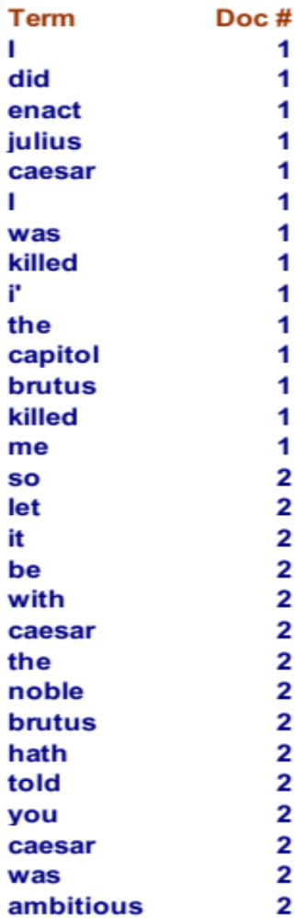
Recall index construction
Sec. 4.2
Documents are parsed to extract words and these are saved with the Document ID.
Doc 1
Doc 2
I did enact Julius
Caesar I was killed
i' the Capitol;
Brutus killed me.
So let it be with
Caesar. The noble
Brutus hath told you
Caesar was ambitious

Slide 4
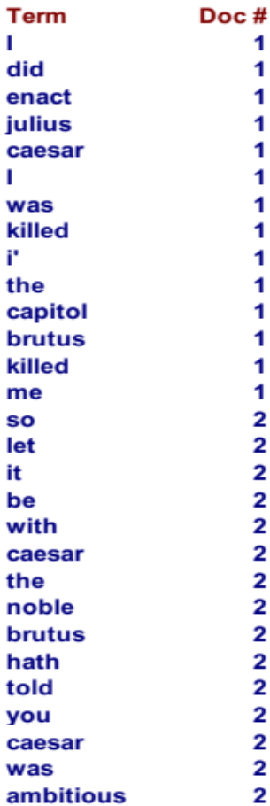
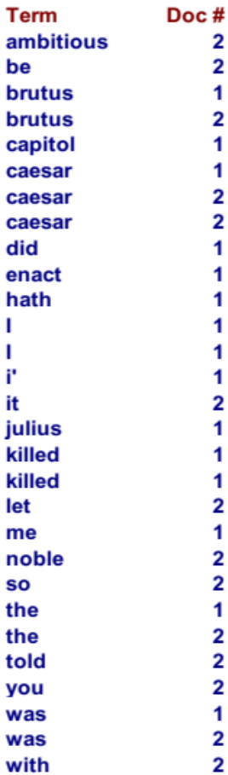
Key step
Sec. 4.2
After all documents have been parsed, the inverted file is sorted by terms.
We focus on this sort step.

Slide 5
RCV1: Our collection for this lecture
Sec. 4.2
As an example for applying scalable index construction algorithms, we will use the Reuters RCV1 collection.
  This is one year of Reuters newswire (part of 1995 and 1996)
The collection isn’t really large enough, but it’s publicly available and is a plausible example.

Slide 6

A Reuters RCV1 document
Sec. 4.2

Slide 7
Reuters RCV1 statistics
Sec. 4.2
symbol statistic value
N documents 800,000
L avg. # tokens per doc 200
M terms (= word types) 400,000
avg. # bytes per token 6
  (incl. spaces/punct.)
avg. # bytes per token 4.5
    (without spaces/punct.)
avg. # bytes per term 7.5
non-positional postings 100,000,000
4.5 bytes per word token vs. 7.5 bytes per word type: why?

Slide 8
Sort-based index construction
Sec. 4.2
As we build the index, we parse docs one at a time.
  The final postings for any term are incomplete until the end.
At 8 bytes per (termID, docID), demands a lot of space for large collections.
T = 100,000,000 in the case of RCV1
  So … we can do this in memory today, but typical collections are much larger. E.g., the New York Times provides an index of >150 years of newswire
Thus: We need to store intermediate results on disk.

Slide 9
Scaling index construction
Sec. 4.2
In-memory index construction does not scale
  Can’t stuff entire collection into memory, sort, then write back
How can we construct an index for very large collections?
Taking into account hardware constraints. . .
  Memory, disk, speed, etc.
Let’s review some hardware basics

Slide 10
Hardware basics
Sec. 4.1
Servers used in IR systems now typically have several GB of main memory, sometimes tens of GB.
Available disk space is several (2–3) orders of magnitude larger.
Fault tolerance is very expensive: It’s much cheaper to use many regular machines rather than one fault tolerant machine.

Slide 11
Hardware basics
Sec. 4.1
Access to data in memory is much faster than access to data on disk.
Disk seeks: No data is transferred from disk while the disk head is being positioned.
Therefore: Transferring one large chunk of data from disk to memory is faster than transferring many small chunks.
Disk I/O is block-based: Reading and writing of entire blocks (as opposed to smaller chunks).
Block sizes: 8KB to 256 KB.

Slide 12
Hardware assumptions (circa 2007)
Sec. 4.1
symbol statistic value
s average seek time 5 ms = 5 x 10⁻³ s
b transfer time per byte 0.02 μs = 2 x 10⁻⁸ s
processor’s clock rate 10⁹ s⁻¹
p low-level operation 0.01 μs = 10⁻⁸ s
  (e.g., compare & swap a word)
size of main memory several GB
size of disk space 1 TB or more
Notes:
Access to main memory is a few clock cycles (say 5 ns), which is much faster than accessing from disk
CPU is generally available during I/O. So we can store compressed data and decompress as the data is being read in.

Slide 13
Sort using disk as “memory”?
Sec. 4.2
Can we use the same index construction algorithm for larger collections, but by using disk instead of memory?
No: Sorting T = 100,000,000 records on disk is too slow – too many disk seeks.
We need an external sorting algorithm.

Slide 14
CS276: Information Retrieval and Web Search
External memory indexing

Slide 15
BSBI: Blocked sort-based Indexing (Sorting with fewer disk seeks)
Sec. 4.2
8-byte records (termID, docID)
These are generated as we parse docs
Must now sort 100M such 8-byte records by termID
Define a Block ~ 10M such records
  Can easily fit a couple into memory
  Will have 10 such blocks to start with
Basic idea of algorithm:
  Accumulate postings for each block, sort, write to disk
  Then merge the blocks into one long sorted order

Slide 16
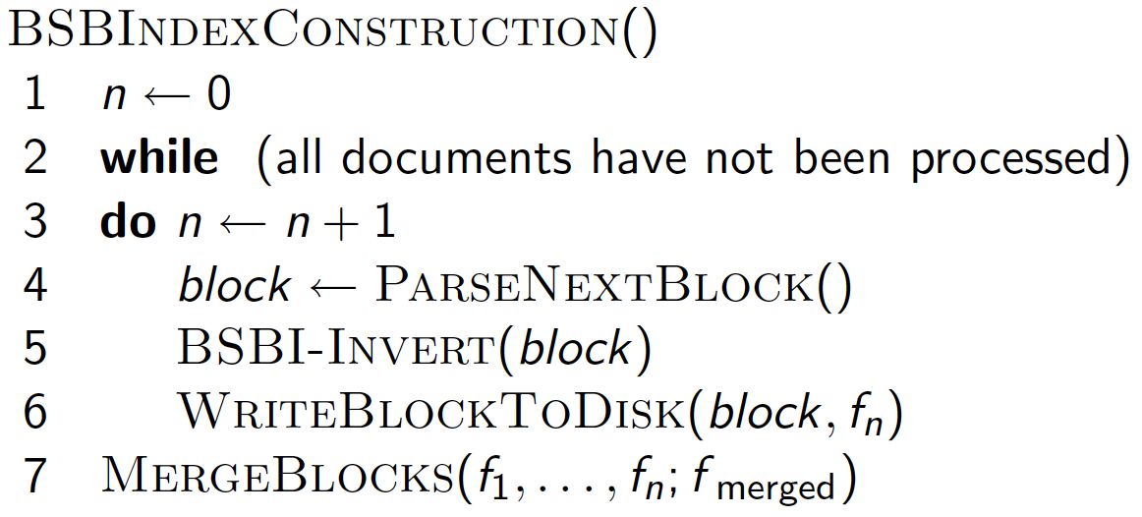
Sec. 4.2

Slide 17
Sorting 10 blocks of 10M records
Sec. 4.2
First, read each block and sort within:
  Quicksort takes O(N ln N) expected steps
  In our case N=10M
10 times this estimate – gives us 10 sorted runs of 10M records each.
Done straightforwardly, need 2 copies of data on disk
  But can optimize this

Slide 18
How to merge the sorted runs?
Sec. 4.2
Can do binary merges, with a merge tree of log₂10 = 4 layers.
During each layer, read into memory runs in blocks of 10M, merge, write back.
brutus
caesar
julius
killed
noble
with
d1,d3,d6,d7
d1,d2,d4,d8,d9
d10
d8
d5
d1,d2,d3,d5
brutus
caesar
noble
with
d1,d3
d1,d2,d4
d5
d1,d2,d3,d5
brutus
caesar
julius
killed
d6,d7
d8,d9
d10
d8
Postings lists
to be merged
Merged
postings list
Disk

Slide 19
How to merge the sorted runs?
Sec. 4.2
But it is more efficient to do a multi-way merge, where you are reading from all blocks simultaneously
  Open all block files simultaneously and maintain a read buffer for each one and a write buffer for the output file
  In each iteration, pick the lowest termID that hasn’t been processed using a priority queue
  Merge all postings lists for that termID and write it out
Providing you read decent-sized chunks of each block into memory and then write out a decent-sized output chunk, then you’re not killed by disk seeks
Notes:
What is the overall complexity of

Slide 20
Remaining problem with sort-based algorithm
Sec. 4.3
Our assumption was: we can keep the dictionary in memory.
We need the dictionary (which grows dynamically) in order to implement a term to termID mapping.

Slide 21
SPIMI:
Single-pass in-memory indexing
Sec. 4.3
Key idea 1: Generate separate dictionaries for each block – no need to maintain term-termID mapping across blocks.
Key idea 2: Don’t sort. Accumulate postings in postings lists as they occur.
With these two ideas we can generate a complete inverted index for each block.
These separate indexes can then be merged into one big index.

Slide 22
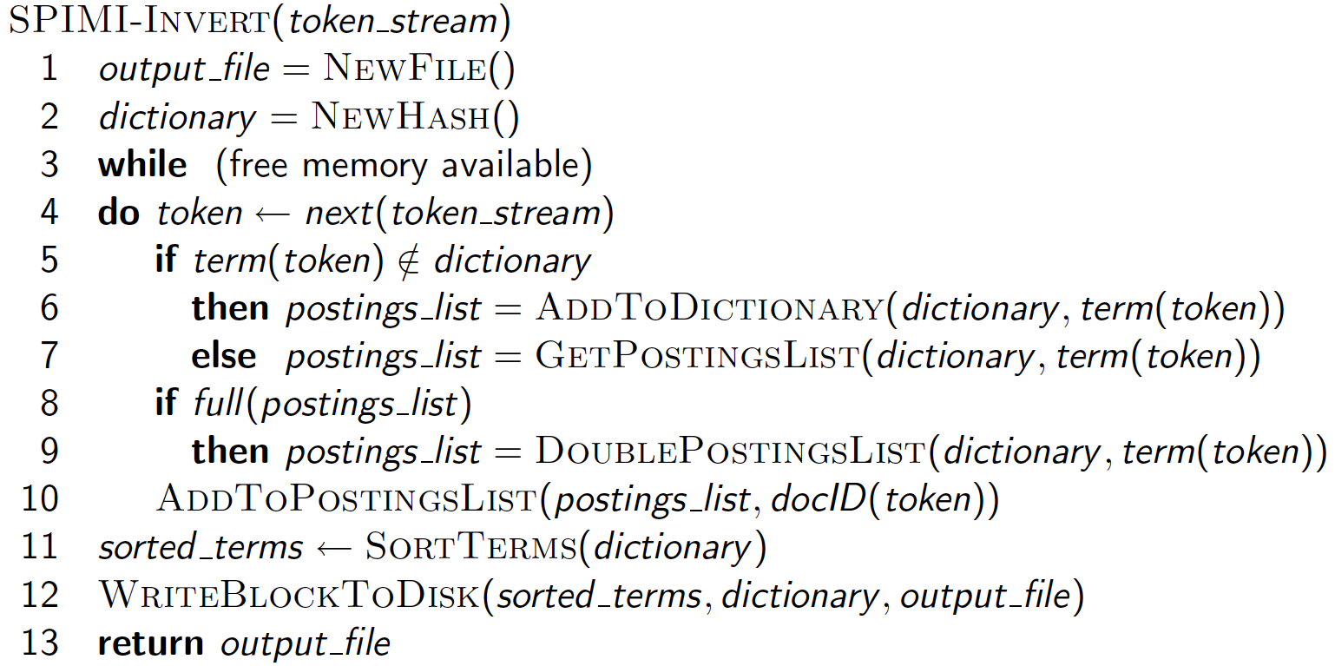
SPIMI-Invert
Sec. 4.3
Merging of blocks is analogous to BSBI.

Slide 23
SPIMI in action
Sorted
dictionary
Input token
Dictionary
Caesar d1
brutus d1
d3
brutus d1
d3
with d1
caesar d1
d2
d4
Brutus d1
with d1
d2
d3
d5
noble d5
Caesar d2
noble d5
with d1
d2
d3
d5
with d2
Brutus d3
caesar d1
d2
d4
with d3
Caesar d4
noble d5
with d5

Slide 24
SPIMI: Compression
Sec. 4.3
Compression makes SPIMI even more efficient.
  Compression of terms
  Compression of postings
More on this later …
Original publication on SPIMI: Heinz and Zobel (2003)

Slide 25
CS276: Information Retrieval and Web Search
Distributed indexing

Slide 26
Distributed indexing
Sec. 4.4
For web-scale indexing (don’t try this at home!):
  must use a distributed computing cluster
Individual machines are fault-prone
  Can unpredictably slow down or fail
How do we exploit such a pool of machines?

Slide 27
Web search engine data centers
Sec. 4.4
Web search data centers (Google, Bing, Baidu) mainly contain commodity machines.
Data centers are distributed around the world.
Estimate: Google ~1 million servers, 3 million processors/cores (Gartner 2007)

Slide 28
Massive data centers
Sec. 4.4
If in a non-fault-tolerant system with 1000 nodes, each node has 99.9% uptime, what is the uptime of the entire system?
Answer: 37% - meaning, 63% of the time one or more servers is down.
Exercise: Calculate the number of servers failing per minute for an installation of 1 million servers.

Slide 29
Distributed indexing
Sec. 4.4
Maintain a master machine directing the indexing job – considered “safe”.
Break up indexing into sets of (parallel) tasks.
Master machine assigns each task to an idle machine from a pool.

Slide 30
Parallel tasks
Sec. 4.4
We will use two sets of parallel tasks
  Parsers
  Inverters
Break the input document collection into splits
Each split is a subset of documents (corresponding to blocks in BSBI/SPIMI)

Slide 31
Data flow
Sec. 4.4
assign
Master
assign
Postings
Parser
a-f
g-p
q-z
Inverter
a-f
Parser
a-f
g-p
q-z
Inverter
g-p
splits
Inverter
q-z
Parser
a-f
g-p
q-z
Map
phase
Reduce
phase
Segment files

Slide 32
Parsers
Sec. 4.4
Master assigns a split to an idle parser machine
Parser reads a document at a time and emits
(term, doc) pairs
Parser writes pairs into j partitions
Example: Each partition is for a range of terms’ first letters
  (e.g., a-f, g-p, q-z) – here j = 3.
Now to complete the index inversion

Slide 33
Inverters
Sec. 4.4
An inverter collects all (term,doc) pairs (= postings) for one term-partition.
Sorts and writes to postings lists

Slide 34
Example for index construction
Map:
d1 : C came, C c’ed.
d2 : C died.
→
<C,d1>, <came,d1>, <C,d1>, <c’ed, d1>, <C, d2>, <died,d2>
Reduce:
(<C,(d1,d1,d2)>, <died,(d2)>, <came,(d1)>, <c’ed,(d1)>)
→
(<C,(d1:2,d2:1)><died,(d2:1)>, <came,(d1:1)>,<c’ed,(d1:1)>)
Caesar
conquered

Slide 35
Index construction
Sec. 4.4
Index construction was just one phase.
Another phase: transforming a term-partitioned index into a document-partitioned index.
  Term-partitioned: one machine handles a subrange of terms
  Document-partitioned: one machine handles a subrange of documents
As we’ll discuss in the web part of the course, most search engines use a document-partitioned index … better load balancing, etc.

Slide 36
MapReduce
Sec. 4.4
The index construction algorithm we just described is an instance of MapReduce.
MapReduce (Dean and Ghemawat 2004) is a robust and conceptually simple framework for distributed computing …
… without having to write code for the distribution part.
They describe the Google indexing system (ca. 2002) as consisting of a number of phases, each implemented in MapReduce.

Slide 37
Schema for index construction in MapReduce
Sec. 4.4
Schema of map and reduce functions
map: input → list(k, v) reduce: (k,list(v)) → output
Instantiation of the schema for index construction
map: collection → list(termID, docID)
reduce: (<termID1, list(docID)>, <termID2, list(docID)>, …) → (postings list1, postings list2, …)

Slide 38
CS276: Information Retrieval and Web Search
Dynamic indexing

Slide 39
Dynamic indexing
Sec. 4.5
Up to now, we have assumed that collections are static.
They rarely are:
  Documents come in over time and need to be inserted.
  Documents are deleted and modified.
This means that the dictionary and postings lists have to be modified:
  Postings updates for terms already in dictionary
  New terms added to dictionary

Slide 40
Simplest approach
Sec. 4.5
Maintain “big” main index
New docs go into “small” auxiliary index
Search across both, merge results
Deletions
  Invalidation bit-vector for deleted docs
  Filter docs output on a search result by this invalidation bit-vector
Periodically, re-index into one main index

Slide 41
Issues with main and auxiliary indexes
Sec. 4.5
Problem of frequent merges – you touch stuff a lot
Poor performance during merge
Actually:
  Merging of the auxiliary index into the main index is efficient if we keep a separate file for each postings list.
  Merge is the same as a simple append.
  But then we would need a lot of files – inefficient for OS.
Assumption for the rest of the lecture: The index is one big file.
In reality: Use a scheme somewhere in between (e.g., split very large postings lists, collect postings lists of length 1 in one file etc.)

Slide 42
Logarithmic merge
Sec. 4.5
Maintain a series of indexes, each twice as large as the previous one
  At any time, some of these powers of 2 are instantiated
Keep smallest (Z₀) in memory
Larger ones (I₀, I₁, …) on disk
If Z₀ gets too big (> n), write to disk as I₀
or merge with I₀ (if I₀ already exists) as Z₁
Either write merge Z₁ to disk as I₁ (if no I₁)
Or merge with I₁ to form Z₂

Slide 43
Logarithmic merge in action
≤n
n
2n
4n
8n
16n
Z₀
I₀
Z₀
I₀
I₁
Z₀
I₁
I₀
I₁
Z₀
I₀
I₁
I₂

Slide 44
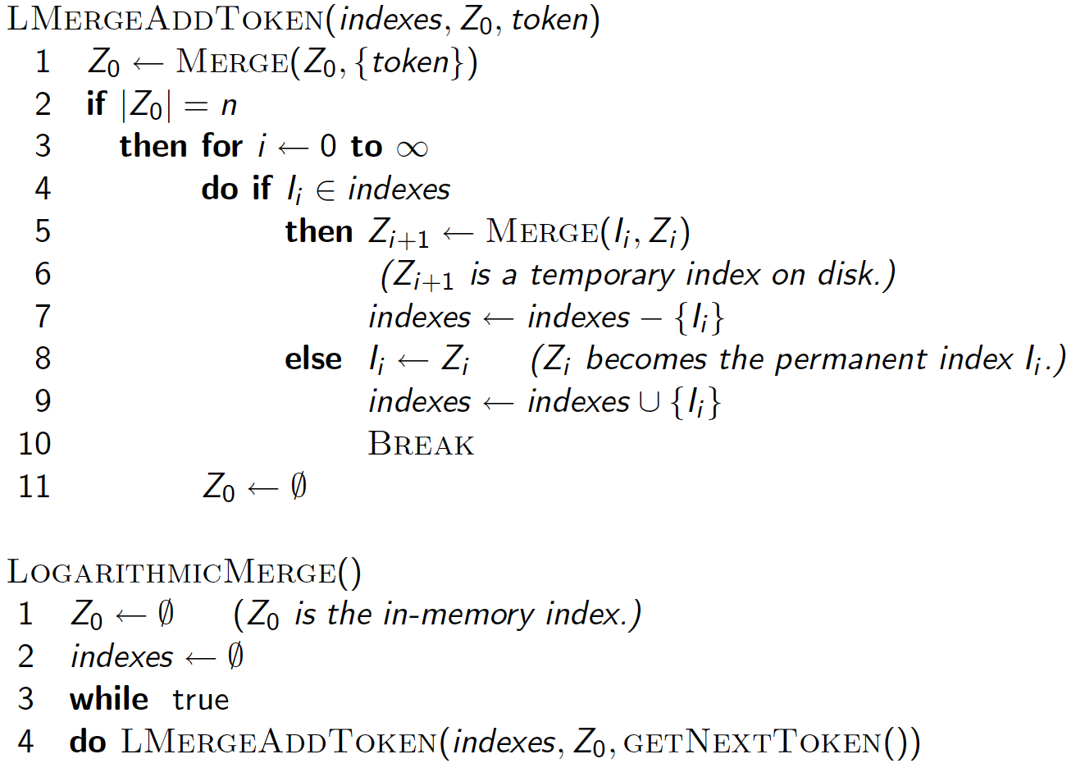
Sec. 4.5

Slide 45
Logarithmic merge
Sec. 4.5
Auxiliary and main index:
  T/n merges where T is # of postings and n is size of auxiliary
  Index construction time is O(T²/n) as in the worst case a posting is touched T/n times
Logarithmic merge: Each posting is merged at most O(log (T/n)) times, so complexity is O(T log (T/n))
So logarithmic merge is much more efficient for index construction
But query processing now requires the merging of O(log (T/n)) indexes
  Whereas it is O(1) if you just have a main and auxiliary index

Slide 46
Further issues with multiple indexes
Sec. 4.5
Collection-wide statistics are hard to maintain
E.g., when we speak of spell-correction: which of several corrected alternatives do we present to the user?
  We may want to pick the one with the most hits
  How do we maintain the top ones with multiple indexes and invalidation bit vectors?
  One possibility: ignore everything but the main index for such ordering
Will see more such statistics used in results ranking

Slide 47
Dynamic indexing at search engines
Sec. 4.5
All the large search engines now do dynamic indexing
Their indices have frequent incremental changes
  News items, blogs, new topical web pages
But (sometimes/typically) they also periodically reconstruct the index from scratch
  Query processing is then switched to the new index, and the old index is deleted

Slide 48
Earlybird: Real-time search at Twitter
Requirements for real-time search
  Low latency, high throughput query evaluation
  High ingestion rate and immediate data availability
  Concurrent reads and writes of the index
  Dominance of temporal signal

Slide 49
Earlybird: Index organization
Earlybird consists of multiple index segments
  Each segment is relatively small, holding up to 2²³ tweets
  Each posting in a segment is a 32 bit word: 24 bits for the tweet id and 8 bits for the position in the tweet
Only one segment can be written to at any given time
  Small enough to be in memory
  New postings are simply appended to the postings list
  But the postings list is traversed backwards to prioritize newer tweets
The remaining segments are optimized for read-only
  Postings sorted in reverse chronological order (newest first)

Slide 50
Other sorts of indexes
Sec. 4.5
Positional indexes
  Same sort of sorting problem … just larger
Building character n-gram indexes:
  As text is parsed, enumerate n-grams.
  For each n-gram, need pointers to all dictionary terms containing it – the “postings”
Why?

Slide 51
Resources for today’s lecture
Ch. 4
Chapter 4 of IIR
MG Chapter 5
Original publication on MapReduce: Dean and Ghemawat (2004)
Original publication on SPIMI: Heinz and Zobel (2003)
Earlybird: Busch et al, ICDE 2012

