Slide 1
Performance Evaluation of Information Retrieval Systems
Many slides in this section are adapted from Prof. Joydeep Ghosh (UT ECE) who in turn adapted them from Prof. Dik Lee (Univ. of Science and Tech, Hong Kong)

Slide 2
Why System Evaluation?
There are many retrieval models/ algorithms/ systems, which one is the best?
What is the best component for:
  Ranking function (dot-product, cosine, …)
  Term selection (stopword removal, stemming…)
  Term weighting (TF, TF-IDF,…)
How far down the ranked list will a user need to look to find some/all relevant documents?

Slide 3
Difficulties in Evaluating IR Systems
Effectiveness is related to the relevancy of retrieved items.
Relevancy is not typically binary but continuous.
Even if relevancy is binary, it can be a difficult judgment to make.
Relevancy, from a human standpoint, is:
  Subjective: Depends upon a specific user’s judgment.
  Situational: Relates to user’s current needs.
  Cognitive: Depends on human perception and behavior.
  Dynamic: Changes over time.

Slide 4
Human Labeled Corpora
(Gold Standard)
Start with a corpus of documents.
Collect a set of queries for this corpus.
Have one or more human experts exhaustively label the relevant documents for each query.
Typically assumes binary relevance judgments.
Requires considerable human effort for large document/query corpora.

Slide 5
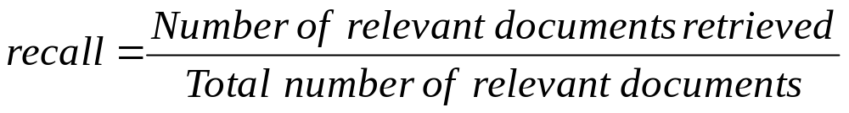
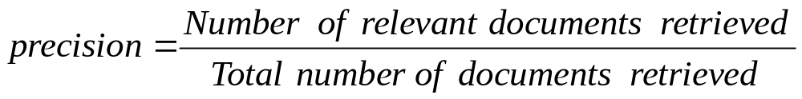
Precision and Recall
retrieved & irrelevant
Not retrieved & irrelevant
Entire document collection
irrelevant
Relevant documents
Retrieved documents
retrieved & relevant
not retrieved but relevant
relevant
retrieved
not retrieved

Slide 6
Precision and Recall
Precision
  The ability to retrieve top-ranked documents that are mostly relevant.
Recall
  The ability of the search to find all of the relevant items in the corpus.

Slide 7
Determining Recall is Difficult
Total number of relevant items is sometimes not available:
  Sample across the database and perform relevance judgment on these items.
  Apply different retrieval algorithms to the same database for the same query. The aggregate of relevant items is taken as the total relevant set.

Slide 8
Trade-off between Recall and Precision
Returns relevant documents but
misses many useful ones too
The ideal
1
Precision
0
1
Recall
Returns most relevant
documents but includes
lots of junk

Slide 9
Computing Recall/Precision Points
For a given query, produce the ranked list of retrievals.
Adjusting a threshold on this ranked list produces different sets of retrieved documents, and therefore different recall/precision measures.
Mark each document in the ranked list that is relevant according to the gold standard.
Compute a recall/precision pair for each position in the ranked list that contains a relevant document.

Slide 10
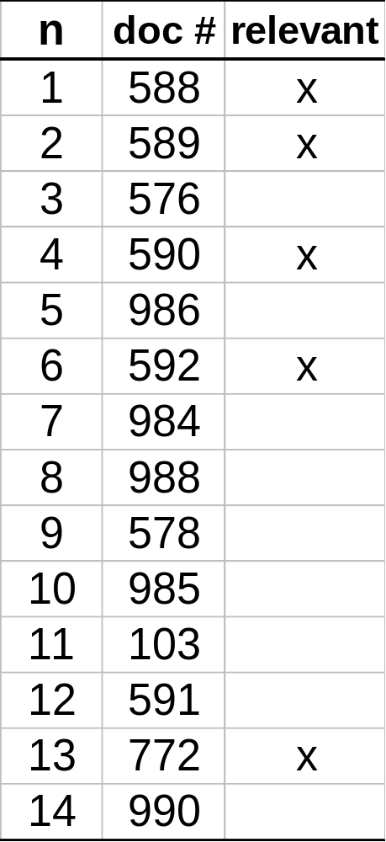
Computing Recall/Precision Points:
Example 1
Let total # of relevant docs = 6
Check each new recall point:
R=1/6=0.167; P=1/1=1
R=2/6=0.333; P=2/2=1
R=3/6=0.5; P=3/4=0.75
R=4/6=0.667; P=4/6=0.667
Missing one
relevant document.
Never reach
100% recall
R=5/6=0.833; p=5/13=0.38

Slide 11
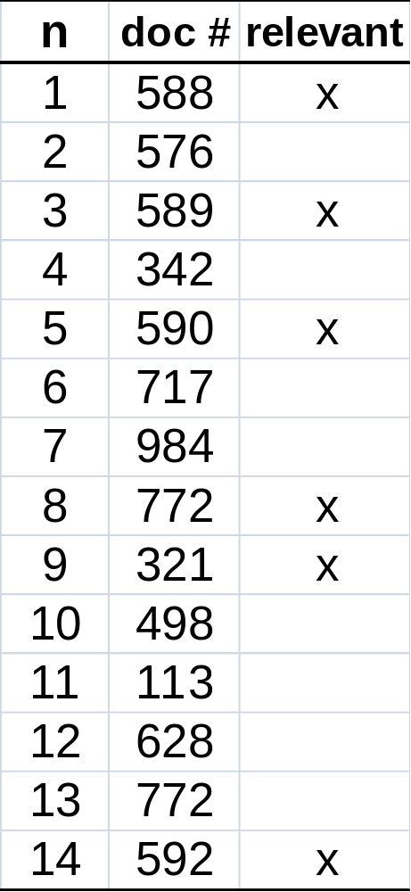
Computing Recall/Precision Points:
Example 2
Let total # of relevant docs = 6
Check each new recall point:
R=1/6=0.167; P=1/1=1
R=2/6=0.333; P=2/3=0.667
R=3/6=0.5; P=3/5=0.6
R=4/6=0.667; P=4/8=0.5
R=5/6=0.833; P=5/9=0.556
R=6/6=1.0; p=6/14=0.429

Slide 12
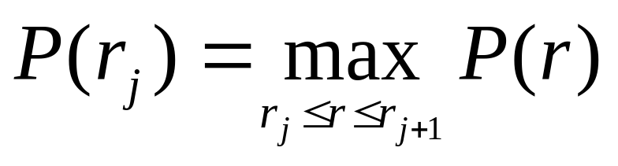
Interpolating a Recall/Precision Curve
Interpolate a precision value for each standard recall level:
  r_{j} ∈{0.0, 0.1, 0.2, 0.3, 0.4, 0.5, 0.6, 0.7, 0.8, 0.9, 1.0}
  r₀ = 0.0, r₁ = 0.1, …, r₁₀=1.0
The interpolated precision at the j-th standard recall level is the maximum known precision at any recall level between the j-th and (j + 1)-th level:

Slide 13
Interpolating a Recall/Precision Curve: Example 1
Precision
1.0
0.8
0.6
0.4
0.2
0.2
0.4
0.6
0.8
1.0
Recall

Slide 14
Interpolating a Recall/Precision Curve:
Example 2
Precision
1.0
0.8
0.6
0.4
0.2
0.2
0.4
0.6
0.8
1.0
Recall

Slide 15
Average Recall/Precision Curve
Typically average performance over a large set of queries.
Compute average precision at each standard recall level across all queries.
Plot average precision/recall curves to evaluate overall system performance on a document/query corpus.

Slide 16
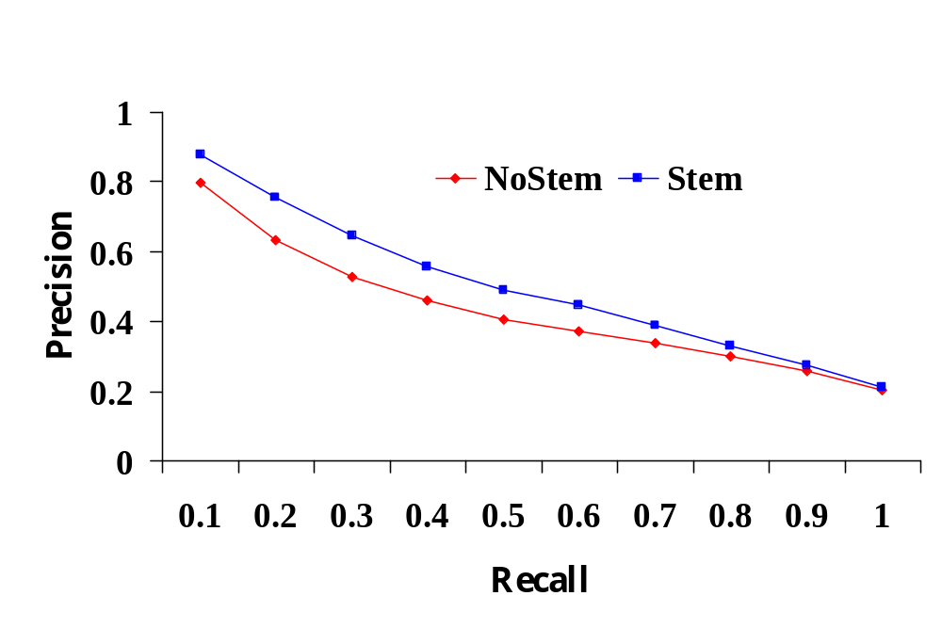
Compare Two or More Systems
The curve closest to the upper right-hand corner of the graph indicates the best performance

Slide 17
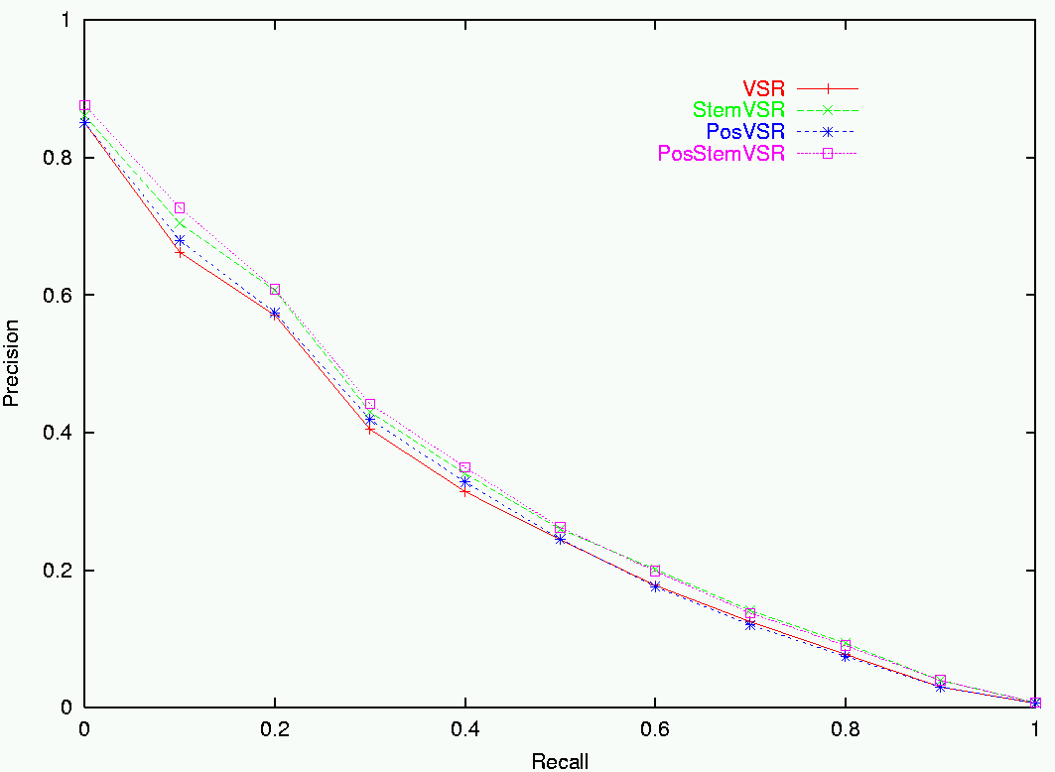
Sample RP Curve for CF Corpus

Slide 18
R- Precision
Precision at the R-th position in the ranking of results for a query that has R relevant documents.
R = # of relevant docs = 6
R-Precision = 4/6 = 0.67

Slide 19
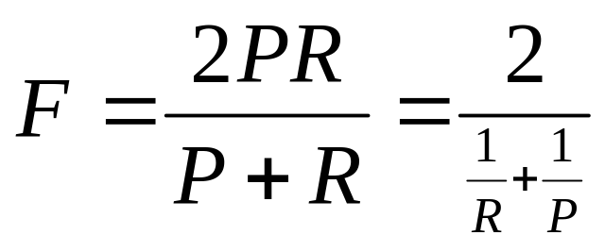
F-Measure
One measure of performance that takes into account both recall and precision.
Harmonic mean of recall and precision:
Compared to arithmetic mean, both need to be high for harmonic mean to be high.

Slide 20
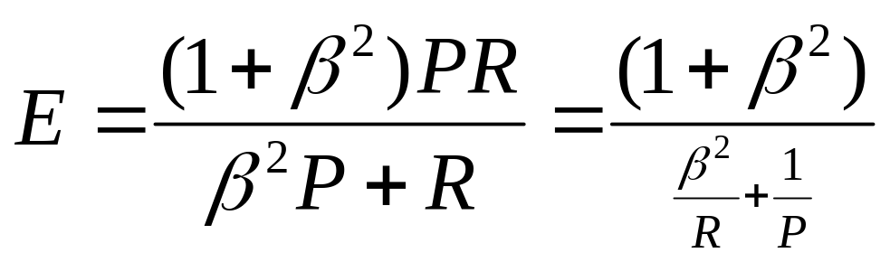
E Measure (parameterized F Measure)
A variant of F measure that allows weighting emphasis on precision over recall:
Value of β controls trade-off:
  β = 1: Equally weight precision and recall (E=F).
  β > 1: Weight recall more.
  β < 1: Weight precision more.

Slide 21
Mean Average Precision
(MAP)
Average Precision: Average of the precision values at the points at which each relevant document is retrieved.
  Ex1: (1 + 1 + 0.75 + 0.667 + 0.38 + 0)/6 = 0.633
  Ex2: (1 + 0.667 + 0.6 + 0.5 + 0.556 + 0.429)/6 = 0.625
Mean Average Precision: Average of the average precision value for a set of queries.

Slide 22
Non-Binary Relevance
Documents are rarely entirely relevant or non-relevant to a query
Many sources of graded relevance judgments
  Relevance judgments on a 5-point scale
  Multiple judges
  Click distribution and deviation from expected levels (but click-through != relevance judgments)

Slide 23
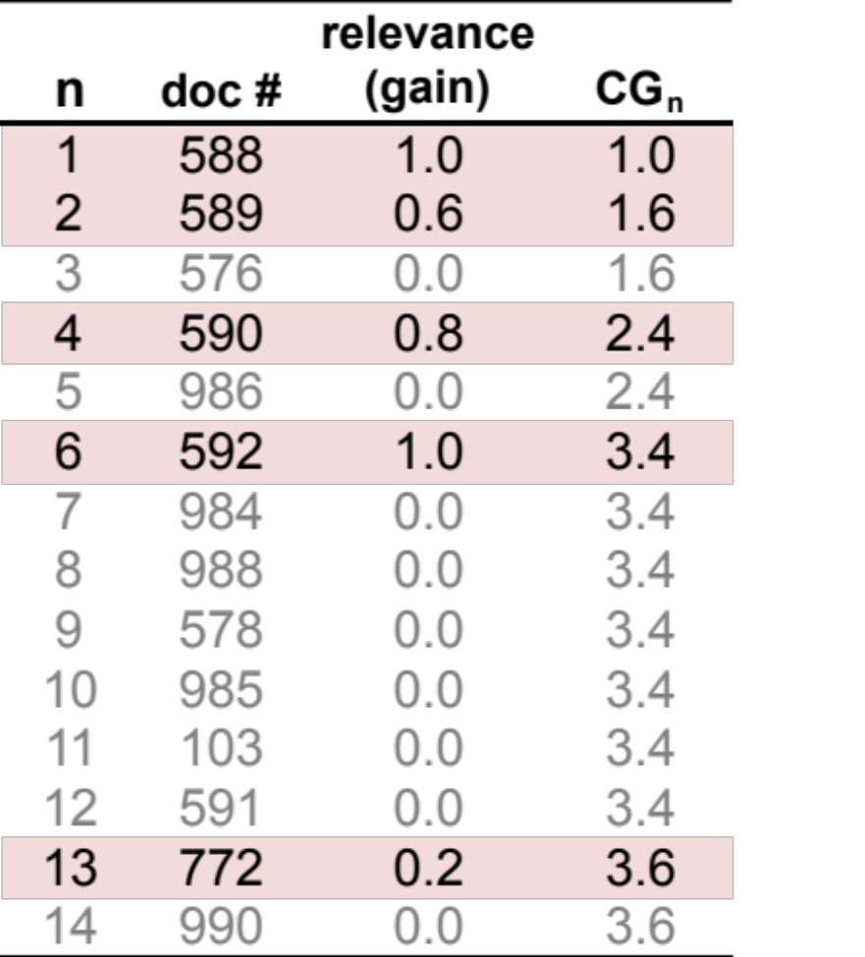
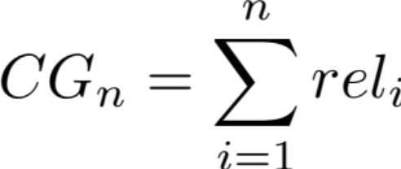
Cumulative Gain
With graded relevance judgments, we can compute the gain at each rank.
Cumulative Gain at rank n:
  (Where rel_{i} is the graded relevance of the document at position i)

Slide 24
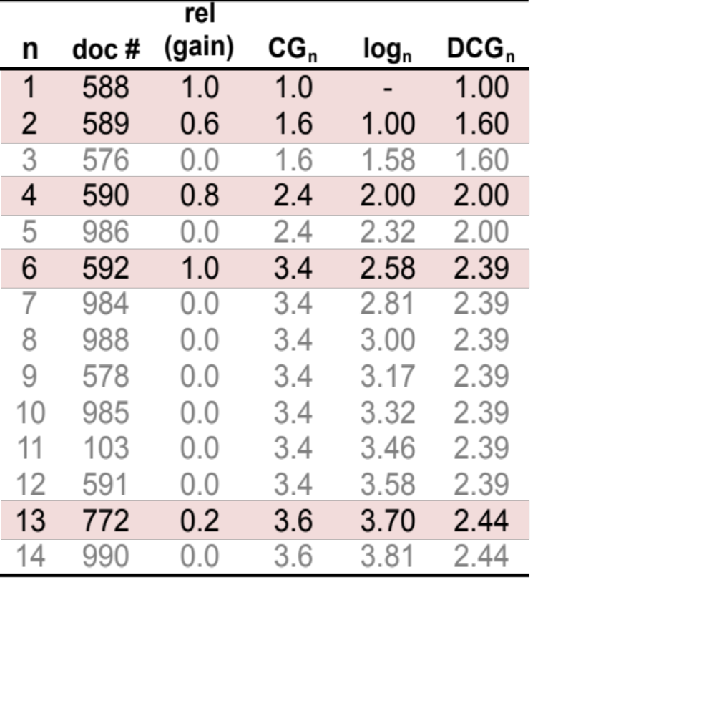
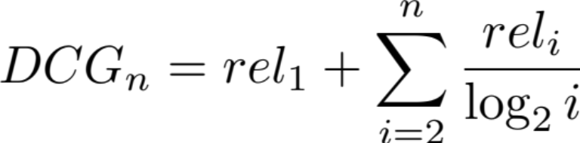
Discounting Based on Position
Users care more about high-ranked documents, so we discount results by 1/log₂(rank)
Discounted Cumulative Gain:

Slide 25
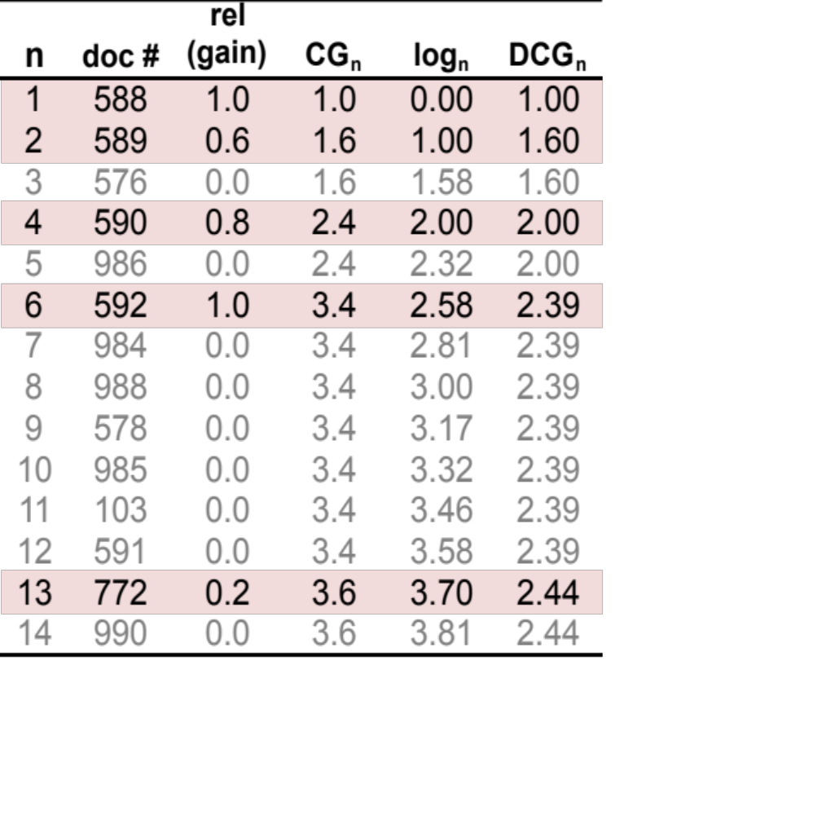
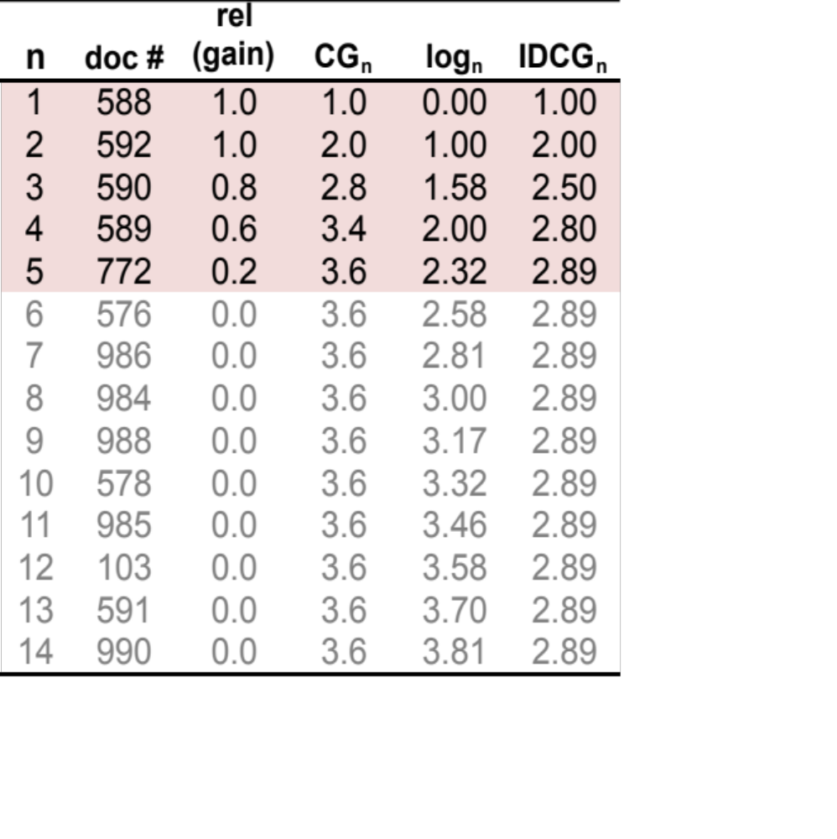
Normalized Discounted
Cumulative Gain (NDCG)
To compare DCGs, normalize values so that a ideal ranking would have a Normalized DCG of 1.0
Ideal ranking:

Slide 26
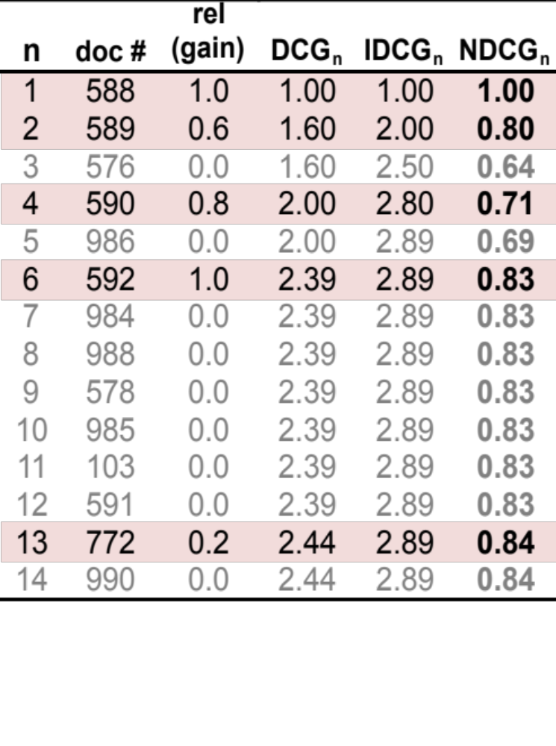
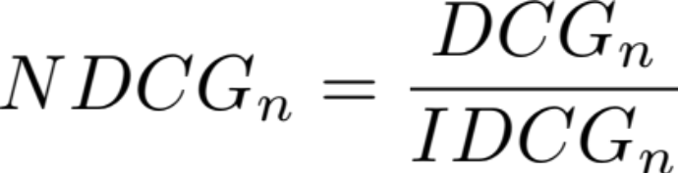
Normalized Discounted
Cumulative Gain (NDCG)
Normalize by DCG of the ideal ranking:
NDCG ≤ 1 at all ranks
NDCG is comparable across different queries

Slide 27
Issues with Relevance
Marginal Relevance: Do later documents in the ranking add new information beyond what is already given in higher documents.
  Choice of retrieved set should encourage diversity and novelty.
Coverage Ratio: The proportion of relevant items retrieved out of the total relevant documents known to a user prior to the search.
  Relevant when the user wants to locate documents which they have seen before (e.g., the budget report for Year 2000).

Slide 28
Other Factors to Consider
User effort: Work required from the user in formulating queries, conducting the search, and screening the output.
Response time: Time interval between receipt of a user query and the presentation of system responses.
Form of presentation: Influence of search output format on the user’s ability to utilize the retrieved materials.
Collection coverage: Extent to which any/all relevant items are included in the document corpus.

Slide 29
A/B Testing in a Deployed System
Can exploit an existing user base to provide useful feedback.
Randomly send a small fraction (1−10%) of incoming users to a variant of the system that includes a single change.
Judge effectiveness by measuring change in clickthrough: The percentage of users that click on the top result (or any result on the first page).

Slide 30
Experimental Setup for Benchmarking
Analytical performance evaluation is difficult for document retrieval systems because many characteristics such as relevance, distribution of words, etc., are difficult to describe with mathematical precision.
Performance is measured by benchmarking. That is, the retrieval effectiveness of a system is evaluated on a given set of documents, queries, and relevance judgments.
Performance data is valid only for the environment under which the system is evaluated.

Slide 31
Benchmarks
A benchmark collection contains:
  A set of standard documents and queries/topics.
  A list of relevant documents for each query.
Standard collections for traditional IR:
  Smart collection: ftp://ftp.cs.cornell.edu/pub/smart
  TREC: http://trec.nist.gov/
Retrieved result
Precision and recall
Standard document collection
Algorithm under test
Evaluation
Standard queries
Standard result

Slide 32
Benchmarking − The Problems
Performance data is valid only for a particular benchmark.
Building a benchmark corpus is a difficult task.
Benchmark web corpora are just starting to be developed.
Benchmark foreign-language corpora are just starting to be developed.

Slide 33
Early Test Collections
Previous experiments were based on the SMART collection which is fairly small. (ftp://ftp.cs.cornell.edu/pub/smart)
Collection Number Of Number Of Raw Size
Name Documents Queries (Mbytes)
CACM 3,204 64 1.5
CISI 1,460 112 1.3
CRAN 1,400 225 1.6
MED 1,033 30 1.1
TIME 425 83 1.5
Different researchers used different test collections and evaluation techniques.

Slide 34
The TREC Benchmark
TREC: Text REtrieval Conference (http://trec.nist.gov/)
Originated from the TIPSTER program sponsored by
Defense Advanced Research Projects Agency (DARPA).
Became an annual conference in 1992, co-sponsored by the
National Institute of Standards and Technology (NIST) and
DARPA.
Participants submit the P/R values for the final document
and query corpus and present their results at the conference.

Slide 35
TREC Tasks
Ad hoc: New questions are being asked on a static set of data.
Routing: Same questions are being asked, but new information is being searched. (news clipping, library profiling).
New tasks added after TREC 5 - Interactive, multilingual, natural language, multiple database merging, filtering, very large corpus (20 GB, 7.5 million documents), question answering.

Slide 36
Characteristics of the TREC Collection
Both long and short documents (from a few hundred to over one thousand unique terms in a document).
Test documents consist of:
WSJ Wall Street Journal articles (1986-1992) 550 M
AP Associate Press Newswire (1989) 514 M
ZIFF Computer Select Disks (Ziff-Davis Publishing) 493 M
FR Federal Register 469 M
DOE Abstracts from Department of Energy reports 190 M

Slide 37
Sample Document (with SGML)
<DOC>
<DOCNO> WSJ870324-0001 </DOCNO>
<HL> John Blair Is Near Accord To Sell Unit, Sources Say </HL>
<DD> 03/24/87</DD>
<SO> WALL STREET JOURNAL (J) </SO>
<IN> REL TENDER OFFERS, MERGERS, ACQUISITIONS (TNM) MARKETING, ADVERTISING (MKT) TELECOMMUNICATIONS, BROADCASTING, TELEPHONE, TELEGRAPH (TEL) </IN>
<DATELINE> NEW YORK </DATELINE>
<TEXT>
John Blair &amp; Co. is close to an agreement to sell its TV station advertising representation operation and program production unit to an investor group led by James H. Rosenfield, a former CBS Inc. executive, industry sources said. Industry sources put the value of the proposed acquisition at more than $100 million. ...
</TEXT>
</DOC>

Slide 38
Sample Query (with SGML)
<top>
<head> Tipster Topic Description
<num> Number: 066
<dom> Domain: Science and Technology
<title> Topic: Natural Language Processing
<desc> Description: Document will identify a type of natural language processing technology which is being developed or marketed in the U.S.
<narr> Narrative: A relevant document will identify a company or institution developing or marketing a natural language processing technology, identify the technology, and identify one of more features of the company's product.
<con> Concept(s): 1. natural language processing ;2. translation, language, dictionary
<fac> Factor(s):
<nat> Nationality: U.S.</nat>
</fac>
<def> Definitions(s):
</top>

Slide 39
Evaluation
Summary table statistics: Number of topics, number of documents retrieved, number of relevant documents.
Recall-precision average: Average precision at 11 recall levels (0 to 1 at 0.1 increments).
Document level average: Average precision when 5, 10, .., 100, … 1000 documents are retrieved.
Average precision histogram: Difference of the R-precision for each topic and the average R-precision of all systems for that topic.

Slide 40
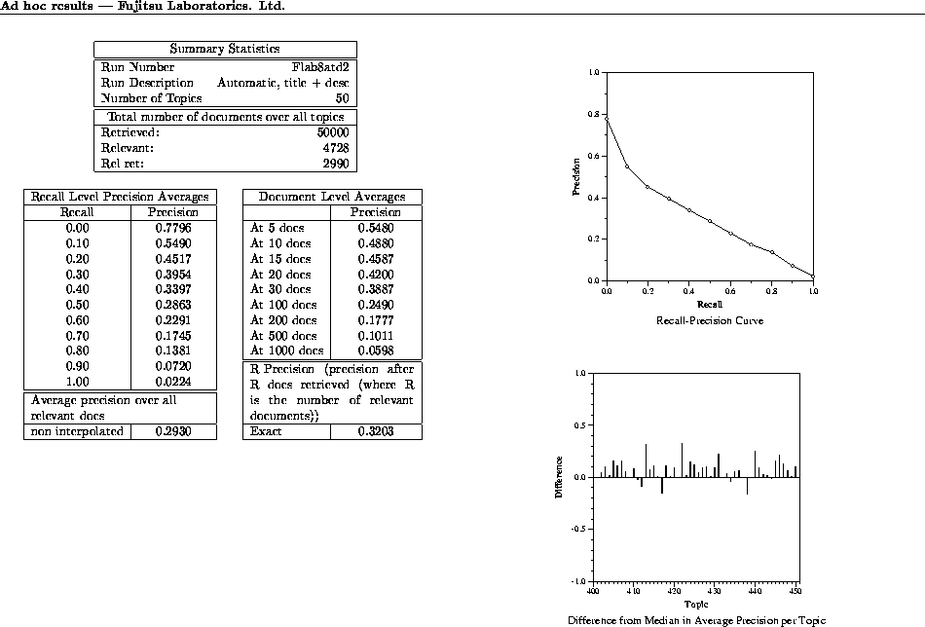

Slide 41
Cystic Fibrosis (CF) Collection
1,239 abstracts of medical journal articles on CF.
100 information requests (queries) in the form of complete English questions.
Relevant documents determined and rated by 4 separate medical experts on 0-2 scale:
  0: Not relevant.
  1: Marginally relevant.
  2: Highly relevant.

Slide 42
CF Document Fields
MEDLINE access number
Author
Title
Source
Major subjects
Minor subjects
Abstract (or extract)
References to other documents
Citations to this document

Slide 43
Sample CF Document
AN 74154352
AU Burnell-R-H. Robertson-E-F.
TI Cystic fibrosis in a patient with Kartagener syndrome.
SO Am-J-Dis-Child. 1974 May. 127(5). P 746-7.
MJ CYSTIC-FIBROSIS: co. KARTAGENER-TRIAD: co.
MN CASE-REPORT. CHLORIDES: an. HUMAN. INFANT. LUNG: ra. MALE.
SITUS-INVERSUS: co, ra. SODIUM: an. SWEAT: an.
AB A patient exhibited the features of both Kartagener syndrome and
cystic fibrosis. At most, to the authors' knowledge, this
represents the third such report of the combination. Cystic
fibrosis should be excluded before a diagnosis of Kartagener
syndrome is made.
RF 001 KARTAGENER M BEITR KLIN TUBERK 83 489 933
002 SCHWARZ V ARCH DIS CHILD 43 695 968
003 MACE JW CLIN PEDIATR 10 285 971
…
CT 1 BOCHKOVA DN GENETIKA (SOVIET GENETICS) 11 154 975
2 WOOD RE AM REV RESPIR DIS 113 833 976
3 MOSSBERG B MT SINAI J MED 44 837 977
…

Slide 44
Sample CF Queries
QN 00002
QU Can one distinguish between the effects of mucus hypersecretion and
infection on the submucosal glands of the respiratory tract in CF?
NR 00007
RD 169 1000 434 1001 454 0100 498 1000 499 1000 592 0002 875 1011
QN 00004
QU What is the lipid composition of CF respiratory secretions?
NR 00009
RD 503 0001 538 0100 539 0100 540 0100 553 0001 604 2222 669 1010
711 2122 876 2222
NR: Number of Relevant documents
RD: Relevant Documents
Ratings code: Four 0-2 ratings, one from each expert

Slide 45
Preprocessing for VSR Experiments
Separate file for each document with just:
  Author
  Title
  Major and Minor Topics
  Abstract (Extract)
Relevance judgment made binary by assuming that all documents rated 1 or 2 by any expert were relevant.

