Slide 1
Probabilistic
Language-Model Based
Document Retrieval

Slide 2
Naïve Bayes for Retrieval
Naïve Bayes can also be used for ad-hoc document retrieval.
Treat each of the n documents as a category with only one training example, the document itself.
Classify queries using this n-way categorization.
Rank documents based on the posterior probability of their category.
For historical reasons, this is called the “language model” (LM) approach.

Slide 3

Generative Model for Retrieval
Query
Ranked
Retrievals:
Doc 1 0.3
Doc 6 0.28
Doc 5 0.18
Doc 2 0.1
Doc 3 0.08
Doc 4 0.06
?
?
?
?
?
?
this test urn has
many words
this test urn has
many words
this test urn has
many words
this test urn has
many words
this test urn has
many words
this test urn has
many words
this test urn has
many words
this test urn has
many words
this test urn has
many words
Doc1 Doc2 Doc3 Doc4 Doc5 Doc6
0.3 0.1 0.08 0.06 0.18 0.28

Slide 4
Smoothing
Proper smoothing is important for this approach to work well.
Laplace smoothing does not work well for this application.
Better to use linear interpolation for smoothing.

Slide 5
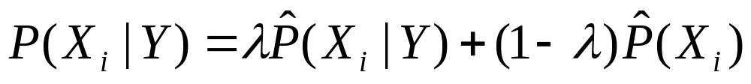
Linear Interpolation Smoothing
Estimate conditional probabilities P(X_{i} | Y) as a mixture of conditioned and unconditioned estimates:
P(X_{i} | Y) is the probability of drawing word X_{i} from the urn of words in category (i.e. document) Y.
P(X_{i}) is the probability of drawing word X_{i} from the urn of words in the entire corpus (i.e. all document urns combined into one big urn).
^
^

Slide 6
Amount of Smoothing
Value of λ controls the amount of smoothing.
The lower λ is, the more smoothing there is since the unconditioned term is weighted higher (1 ─ λ).
Setting λ properly is important for good performance.
Set λ manually or automatically based on maximizing performance on a development set of queries.
Lower λ tends to work better for long queries, high λ for short queries.

Slide 7
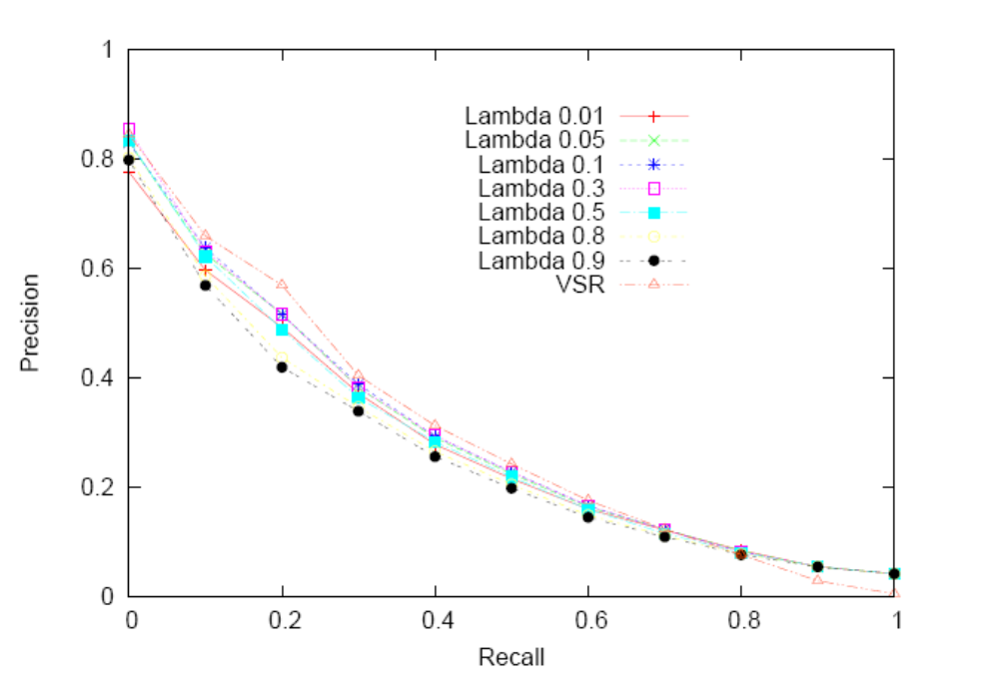
Experimental Results on CF Corpus
Effect of λ Parameter
Given long
queries, large
amount of
smoothing
(λ=0.1) seems
to work best

Slide 8
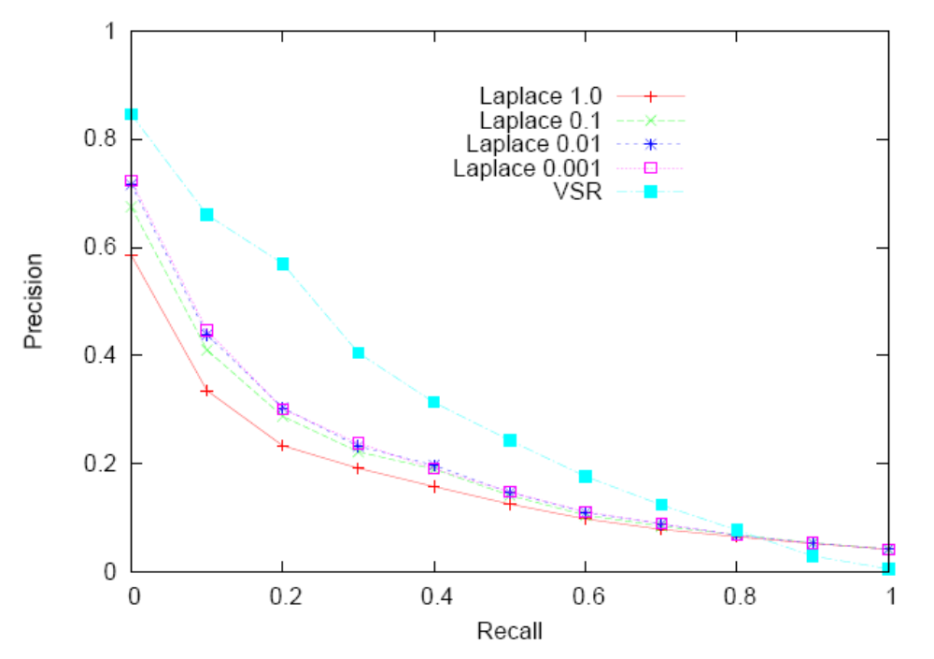
Experimental Results on CF Corpus
Effect of Laplace Smoothing Parameter

Slide 9
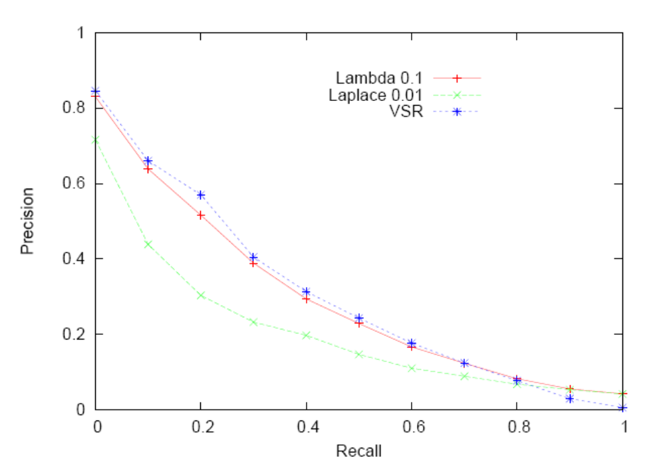
Experimental Results on CF Corpus
Comparison of Smothing Methods and VSR
Laplace smoothing
does much worse.
Linear interp does
about the same as
vector-space

Slide 10
Performance of Language Model Approach
Larger scale TREC experiments demonstrate that the LM approach with proper smoothing works slightly better than a well-tuned vector-space approach.
Need to make LM approach efficient by exploiting inverted index.
  Don’t bother to the compute probability of documents that do not contain any of the query words.

