Slide 1
Web Search
Advances &
Link Analysis

Slide 2
Meta-Search Engines
Search engine that passes query to several other search engines and integrate results.
  Submit queries to host sites.
  Parse resulting HTML pages to extract search results.
  Integrate multiple rankings into a “consensus” ranking.
  Present integrated results to user.
Examples:
  Metacrawler
  SavvySearch
  Dogpile

Slide 3
HTML Structure & Feature Weighting
Weight tokens under particular HTML tags more heavily:
  <TITLE> tokens (Google seems to like title matches)
  <H1>,<H2>… tokens
  <META> keyword tokens
Parse page into conceptual sections (e.g. navigation links vs. page content) and weight tokens differently based on section.

Slide 4
Bibliometrics: Citation Analysis
Many standard documents include bibliographies (or references), explicit citations to other previously published documents.
Using citations as links, standard corpora can be viewed as a graph.
The structure of this graph, independent of content, can provide interesting information about the similarity of documents and the structure of information.
CF corpus includes citation information.

Slide 5
Impact Factor
Developed by Garfield in 1972 to measure the importance (quality, influence) of scientific journals.
Measure of how often papers in the journal are cited by other scientists.
Computed and published annually by the Institute for Scientific Information (ISI).
The impact factor of a journal J in year Y is the average number of citations (from indexed documents published in year Y) to a paper published in J in year Y−1 or Y−2.
Does not account for the quality of the citing article.

Slide 6
Bibliographic Coupling
Measure of similarity of documents introduced by Kessler in 1963.
The bibliographic coupling of two documents A and B is the number of documents cited by both A and B.
Size of the intersection of their bibliographies.
Maybe want to normalize by size of bibliographies?
A
B

Slide 7
Co-Citation
An alternate citation-based measure of similarity introduced by Small in 1973.
Number of documents that cite both A and B.
Maybe want to normalize by total number of documents citing either A or B ?
A
B

Slide 8
Citations vs. Links
Web links are a bit different than citations:
  Many links are navigational.
  Many pages with high in-degree are portals not content providers.
  Not all links are endorsements.
  Company websites don’t point to their competitors.
  Citations to relevant literature is enforced by peer-review.

Slide 9
Authorities
Authorities are pages that are recognized as providing significant, trustworthy, and useful information on a topic.
In-degree (number of pointers to a page) is one simple measure of authority.
However in-degree treats all links as equal.
Should links from pages that are themselves authoritative count more?

Slide 10
Hubs
Hubs are index pages that provide lots of useful links to relevant content pages (topic authorities).
Hub pages for IR are included in the course home page:
  http://www.cs.utexas.edu/users/mooney/ir-course

Slide 11
HITS
Algorithm developed by Kleinberg in 1998.
Attempts to computationally determine hubs and authorities on a particular topic through analysis of a relevant subgraph of the web.
Based on mutually recursive facts:
  Hubs point to lots of authorities.
  Authorities are pointed to by lots of hubs.

Slide 12
Hubs and Authorities
Together they tend to form a bipartite graph:
Hubs
Authorities

Slide 13
HITS Algorithm
Computes hubs and authorities for a particular topic specified by a normal query.
First determines a set of relevant pages for the query called the base set S.
Analyze the link structure of the web subgraph defined by S to find authority and hub pages in this set.

Slide 14
Constructing a Base Subgraph
For a specific query Q, let the set of documents returned by a standard search engine (e.g. VSR) be called the root set R.
Initialize S to R.
Add to S all pages pointed to by any page in R.
Add to S all pages that point to any page in R.
S
R

Slide 15
Base Limitations
To limit computational expense:
  Limit number of root pages to the top 200 pages retrieved for the query.
  Limit number of “back-pointer” pages to a random set of at most 50 pages returned by a “reverse link” query.
To eliminate purely navigational links:
  Eliminate links between two pages on the same host.
To eliminate “non-authority-conveying” links:
  Allow only m (m ≅ 4−8) pages from a given host as pointers to any individual page.

Slide 16
Authorities and In-Degree
Even within the base set S for a given query, the nodes with highest in-degree are not necessarily authorities (may just be generally popular pages like Yahoo or Amazon).
True authority pages are pointed to by a number of hubs (i.e. pages that point to lots of authorities).

Slide 17
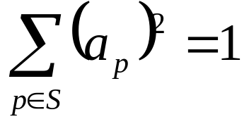
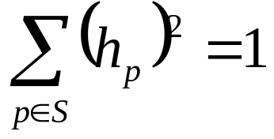
Iterative Algorithm
Use an iterative algorithm to slowly converge on a mutually reinforcing set of hubs and authorities.
Maintain for each page p ∈ S:
  Authority score: a_{p} (vector a)
  Hub score: h_{p} (vector h)
Initialize all a_{p} = h_{p} = 1
Maintain normalized scores:

Slide 18
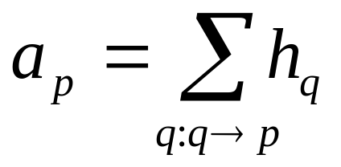
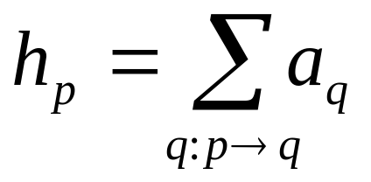
HITS Update Rules
Authorities are pointed to by lots of good hubs:
Hubs point to lots of good authorities:

Slide 19
Illustrated Update Rules
1
4
a₄ = h₁ + h₂ + h₃
2
3
5
h₄ = a₅ + a₆ + a₇
4
6
7

Slide 20
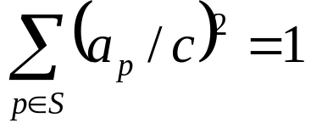
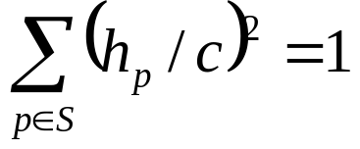
HITS Iterative Algorithm
Initialize for all p ∈ S: a_{p} = h_{p} = 1
For i = 1 to k:
For all p ∈ S: (update auth. scores)
For all p ∈ S: (update hub scores)
For all p ∈ S: a_{p}= a_{p}/c c:
For all p ∈ S: h_{p}= h_{p}/c c:
(normalize a)
(normalize h)

Slide 21
Convergence
Algorithm converges to a fix-point if iterated indefinitely.
Define A to be the adjacency matrix for the subgraph defined by S.
  A_{ij} = 1 for i ∈ S, j ∈ S iff i→j
Authority vector, a, converges to the principal eigenvector of A^{T}A
Hub vector, h, converges to the principal eigenvector of AA^{T}
In practice, 20 iterations produces fairly stable results.

Slide 22
Results
Authorities for query: “Java”
  java.sun.com
  comp.lang.java FAQ
Authorities for query “search engine”
  Yahoo.com
  Excite.com
  Lycos.com
  Altavista.com
Authorities for query “Gates”
  Microsoft.com
  roadahead.com

Slide 23
Result Comments
In most cases, the final authorities were not in the initial root set generated using Altavista.
Authorities were brought in from linked and reverse-linked pages and then HITS computed their high authority score.

Slide 24
Finding Similar Pages Using Link Structure
Given a page, P, let R (the root set) be t (e.g. 200) pages that point to P.
Grow a base set S from R.
Run HITS on S.
Return the best authorities in S as the best similar-pages for P.
Finds authorities in the “link neighbor-hood” of P.

Slide 25
Similar Page Results
Given “honda.com”
  toyota.com
  ford.com
  bmwusa.com
  saturncars.com
  nissanmotors.com
  audi.com
  volvocars.com

Slide 26
HITS for Clustering
An ambiguous query can result in the principal eigenvector only covering one of the possible meanings.
Non-principal eigenvectors may contain hubs & authorities for other meanings.
Example: “jaguar”:
  Atari video game (principal eigenvector)
  NFL Football team (2nd non-princ. eigenvector)
  Automobile (3rd non-princ. eigenvector)

Slide 27
PageRank
Alternative link-analysis method used by Google (Brin & Page, 1998).
Does not attempt to capture the distinction between hubs and authorities.
Ranks pages just by authority.
Applied to the entire web rather than a local neighborhood of pages surrounding the results of a query.

Slide 28
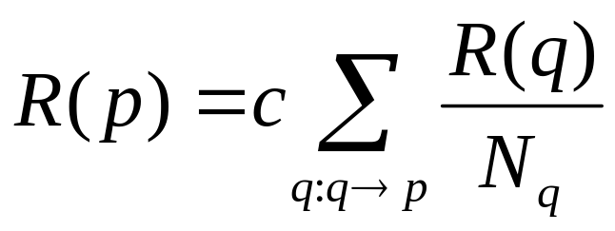
Initial PageRank Idea
Just measuring in-degree (citation count) doesn’t account for the authority of the source of a link.
Initial page rank equation for page p:
  N_{q} is the total number of out-links from page q.
  A page, q, “gives” an equal fraction of its authority to all the pages it points to (e.g. p).
  c is a normalizing constant set so that the rank of all pages always sums to 1.

Slide 29
Initial PageRank Idea (cont.)
Can view it as a process of PageRank “flowing” from pages to the pages they cite.
.1
.08
.05
.05
.03
.09
.08
.03
.03
.03

Slide 30
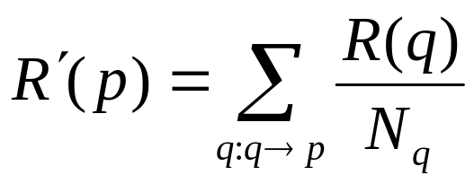
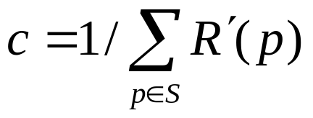
Initial Algorithm
Iterate rank-flowing process until convergence:
Let S be the total set of pages.
Initialize ∀p∈S: R(p) = 1/|S|
Until ranks do not change (much) (convergence)
For each p∈S:
For each p∈S: R(p) = cR´(p) (normalize)

Slide 31
Sample Stable Fixpoint
0.4
0.2
0.2
0.2
0.2
0.4
0.4

Slide 32
Linear Algebra Version
Treat R as a vector over web pages.
Let A be a 2-d matrix over pages where
  A_{vu}= 1/N_{u} if u →v else A_{vu}= 0
Then R=cAR
R converges to the principal eigenvector of A.

Slide 33
Problem with Initial Idea
A group of pages that only point to themselves but are pointed to by other pages act as a “rank sink” and absorb all the rank in the system.
Rank flows into
cycle and can’t get out

Slide 34
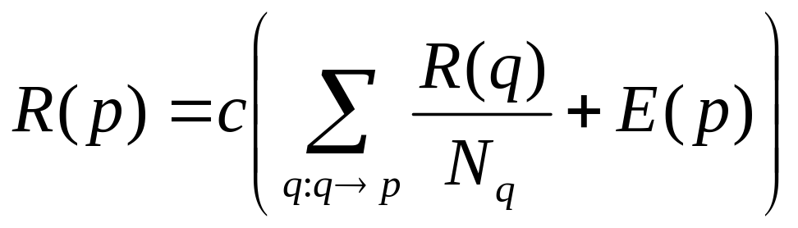
Rank Source
Introduce a “rank source” E that continually replenishes the rank of each page, p, by a fixed amount E(p).

Slide 35
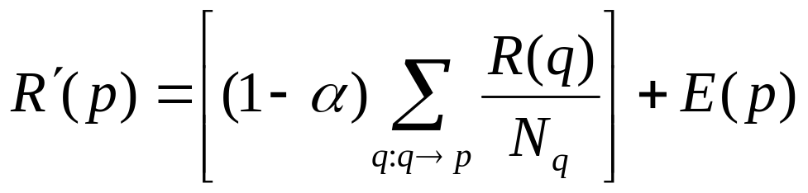
PageRank Algorithm
Let S be the total set of pages.
Let ∀p∈S: E(p) = α/|S| (for some 0<α<1, e.g. 0.15)
Initialize ∀p∈S: R(p) = 1/|S|
Until ranks do not change (much) (convergence)
For each p∈S:
For each p∈S: R(p) = cR´(p) (normalize)

Slide 36
Linear Algebra Version
R = c(AR + E)
Since ||R||₁ =1 : R = c(A + E×1)R
  Where 1 is the vector consisting of all 1’s.
So R is an eigenvector of (A + Ex1)

Slide 37
Random Surfer Model
PageRank can be seen as modeling a “random surfer” that starts on a random page and then at each point:
  With probability E(p) randomly jumps to page p.
  Otherwise, randomly follows a link on the current page.
R(p) models the probability that this random surfer will be on page p at any given time.
“E jumps” are needed to prevent the random surfer from getting “trapped” in web sinks with no outgoing links.

Slide 38
Speed of Convergence
Early experiments on Google used 322 million links.
PageRank algorithm converged (within small tolerance) in about 52 iterations.
Number of iterations required for convergence is empirically O(log n) (where n is the number of links).
Therefore calculation is quite efficient.

Slide 39
Simple Title Search with PageRank
Use simple Boolean search to search web-page titles and rank the retrieved pages by their PageRank.
Sample search for “university”:
  Altavista returned a random set of pages with “university” in the title (seemed to prefer short URLs).
  Primitive Google returned the home pages of top universities.

Slide 40
Google Ranking
Complete Google ranking includes (based on university publications prior to commercialization).
  Vector-space similarity component.
  Keyword proximity component.
  HTML-tag weight component (e.g. title preference).
  PageRank component.
Details of current commercial ranking functions are trade secrets.

Slide 41
Personalized PageRank
PageRank can be biased (personalized) by changing E to a non-uniform distribution.
Restrict “random jumps” to a set of specified relevant pages.
For example, let E(p) = 0 except for one’s own home page, for which E(p) = α
This results in a bias towards pages that are closer in the web graph to your own homepage.

Slide 42
Google PageRank-Biased Spidering
Use PageRank to direct (focus) a spider on “important” pages.
Compute page-rank using the current set of crawled pages.
Order the spider’s search queue based on current estimated PageRank.

Slide 43
Link Analysis Conclusions
Link analysis uses information about the structure of the web graph to aid search.
It is one of the major innovations in web search.
It was one of the primary reasons for Google’s initial success.

