Slide 1
Query Operations
Relevance Feedback &
Query Expansion

Slide 2
Relevance Feedback
After initial retrieval results are presented, allow the user to provide feedback on the relevance of one or more of the retrieved documents.
Use this feedback information to reformulate the query.
Produce new results based on reformulated query.
Allows more interactive, multi-pass process.

Slide 3


Relevance Feedback Architecture
Document
corpus
Query String
Revised
Query
IR
System
Rankings
ReRanked
Documents
1. Doc2
2. Doc4
3. Doc5
.
.
Query
Reformulation
Ranked
Documents
1. Doc1
2. Doc2
3. Doc3
.
.
1. Doc1 ⇓
2. Doc2 ⇑
3. Doc3 ⇓
.
.
Feedback

Slide 4
Query Reformulation
Revise query to account for feedback:
  Query Expansion: Add new terms to query from relevant documents.
  Term Reweighting: Increase weight of terms in relevant documents and decrease weight of terms in irrelevant documents.
Several algorithms for query reformulation.

Slide 5
Query Reformulation for VSR
Change query vector using vector algebra.
Add the vectors for the relevant documents to the query vector.
Subtract the vectors for the irrelevant docs from the query vector.
This both adds both positive and negatively weighted terms to the query as well as reweighting the initial terms.

Slide 6
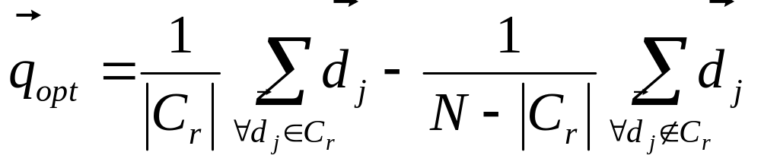
Optimal Query
Assume that the relevant set of documents C_{r} are known.
Then the best query that ranks all and only the relevant queries at the top is:
Where N is the total number of documents.

Slide 7
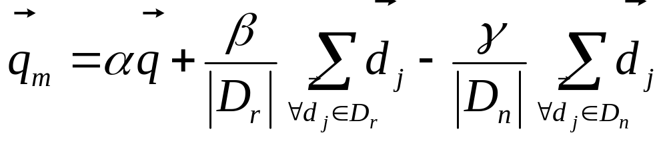
Standard Rochio Method
Since all relevant documents unknown, just use the known relevant (D_{r}) and irrelevant (D_{n}) sets of documents and include the initial query q.
α: Tunable weight for initial query.
β: Tunable weight for relevant documents.
γ: Tunable weight for irrelevant documents.

Slide 8
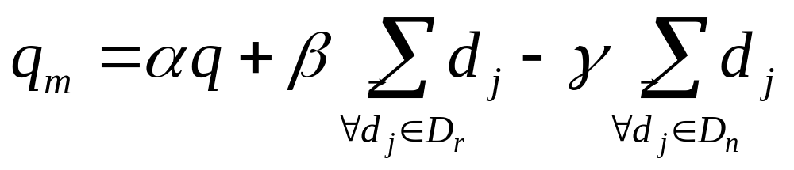
Ide Regular Method
Since more feedback should perhaps increase the degree of reformulation, do not normalize for amount of feedback:
α: Tunable weight for initial query.
β: Tunable weight for relevant documents.
γ: Tunable weight for irrelevant documents.

Slide 9
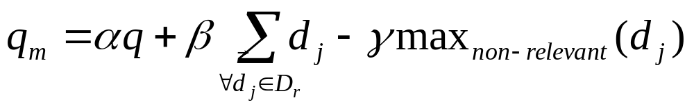
Ide “Dec Hi” Method
Bias towards rejecting just the highest ranked of the irrelevant documents:
α: Tunable weight for initial query.
β: Tunable weight for relevant documents.
γ: Tunable weight for irrelevant document.

Slide 10
Comparison of Methods
Overall, experimental results indicate no clear preference for any one of the specific methods.
All methods generally improve retrieval performance (recall & precision) with feedback.
Generally just let tunable constants equal 1.

Slide 11
Relevance Feedback in Java VSR
Includes “Ide Regular” method.
Invoke with “-feedback” option, use “r” command to reformulate and redo query.
See sample feedback trace.
Since stored frequencies are not normalized (since normalization does not effect cosine similarity), must first divide all vectors by their maximum term frequency.

Slide 12
Evaluating Relevance Feedback
By construction, reformulated query will rank explicitly-marked relevant documents higher and explicitly-marked irrelevant documents lower.
Method should not get credit for improvement on these documents, since it was told their relevance.
In machine learning, this error is called “testing on the training data.”
Evaluation should focus on generalizing to other un-rated documents.

Slide 13
Fair Evaluation of Relevance Feedback
Remove from the corpus any documents for which feedback was provided.
Measure recall/precision performance on the remaining residual collection.
Compared to complete corpus, specific recall/precision numbers may decrease since relevant documents were removed.
However, relative performance on the residual collection provides fair data on the effectiveness of relevance feedback.

Slide 14
Why is Feedback Not Widely Used
Users sometimes reluctant to provide explicit feedback.
Results in long queries that require more computation to retrieve, and search engines process lots of queries and allow little time for each one.
Makes it harder to understand why a particular document was retrieved.

Slide 15
Pseudo Feedback
Use relevance feedback methods without explicit user input.
Just assume the top m retrieved documents are relevant, and use them to reformulate the query.
Allows for query expansion that includes terms that are correlated with the query terms.

Slide 16
Pseudo Feedback Architecture
Document
corpus
Query String
Revised
Query
IR
System
Rankings
ReRanked
Documents
1. Doc2
2. Doc4
3. Doc5
.
.
Query
Reformulation
Ranked
Documents
1. Doc1
2. Doc2
3. Doc3
.
.
Pseudo
Feedback
1. Doc1 ⇑
2. Doc2 ⇑
3. Doc3 ⇑
.
.

Slide 17
PseudoFeedback Results
Found to improve performance on TREC competition ad-hoc retrieval task.
Works even better if top documents must also satisfy additional boolean constraints in order to be used in feedback.

Slide 18
Thesaurus
A thesaurus provides information on synonyms and semantically related words and phrases.
Example:
physician
syn: ||croaker, doc, doctor, MD, medical, mediciner, medico, ||sawbones
rel: medic, general practitioner, surgeon,

Slide 19
Thesaurus-based Query Expansion
For each term, t, in a query, expand the query with synonyms and related words of t from the thesaurus.
May weight added terms less than original query terms.
Generally increases recall.
May significantly decrease precision, particularly with ambiguous terms.
  “interest rate” → “interest rate fascinate evaluate”

Slide 20
WordNet
A more detailed database of semantic relationships between English words.
Developed by famous cognitive psychologist George Miller and a team at Princeton University.
About 144,000 English words.
Nouns, adjectives, verbs, and adverbs grouped into about 109,000 synonym sets called synsets.

Slide 21
WordNet Synset Relationships
Antonym: front → back
Attribute: benevolence → good (noun to adjective)
Pertainym: alphabetical → alphabet (adjective to noun)
Similar: unquestioning → absolute
Cause: kill → die
Entailment: breathe → inhale
Holonym: chapter → text (part to whole)
Meronym: computer → cpu (whole to part)
Hyponym: plant → tree (specialization)
Hypernym: apple → fruit (generalization)

Slide 22
WordNet Query Expansion
Add synonyms in the same synset.
Add hyponyms to add specialized terms.
Add hypernyms to generalize a query.
Add other related terms to expand query.

Slide 23
Statistical Thesaurus
Existing human-developed thesauri are not easily available in all languages.
Human thesuari are limited in the type and range of synonymy and semantic relations they represent.
Semantically related terms can be discovered from statistical analysis of corpora.

Slide 24
Automatic Global Analysis
Determine term similarity through a pre-computed statistical analysis of the complete corpus.
Compute association matrices which quantify term correlations in terms of how frequently they co-occur.
Expand queries with statistically most similar terms.

Slide 25
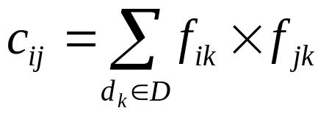
Association Matrix
w₁ w₂ w₃ …………………..w_{n}
w₁
w₂
w₃
.
.
w_{n}
c₁₁ c₁₂ c₁₃…………………c_{1n}
c₂₁
c₃₁
.
.
c_{n1}
c_{ij}: Correlation factor between term i and term j
f_{ik} : Frequency of term i in document k

Slide 26
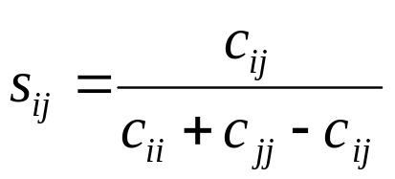
Normalized Association Matrix
Frequency based correlation factor favors more frequent terms.
Normalize association scores:
Normalized score is 1 if two terms have the same frequency in all documents.

Slide 27
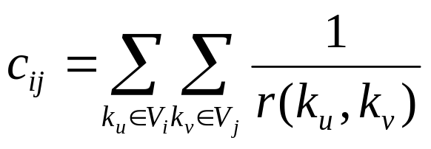
Metric Correlation Matrix
Association correlation does not account for the proximity of terms in documents, just co-occurrence frequencies within documents.
Metric correlations account for term proximity.
V_{i}: Set of all occurrences of term i in any document.
r(k_{u},k_{v}): Distance in words between word occurrences k_{u} and k_{v}
(∞ if k_{u} and k_{v} are occurrences in different documents).

Slide 28
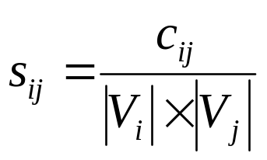
Normalized Metric Correlation Matrix
Normalize scores to account for term frequencies:

Slide 29
Query Expansion with Correlation Matrix
For each term i in query, expand query with the n terms, j, with the highest value of c_{ij} (s_{ij}).
This adds semantically related terms in the “neighborhood” of the query terms.

Slide 30
Problems with Global Analysis
Term ambiguity may introduce irrelevant statistically correlated terms.
  “Apple computer” → “Apple red fruit computer”
Since terms are highly correlated anyway, expansion may not retrieve many additional documents.

Slide 31
Automatic Local Analysis
At query time, dynamically determine similar terms based on analysis of top-ranked retrieved documents.
Base correlation analysis on only the “local” set of retrieved documents for a specific query.
Avoids ambiguity by determining similar (correlated) terms only within relevant documents.
  “Apple computer” → “Apple computer Macbook laptop”

Slide 32
Global vs. Local Analysis
Global analysis requires intensive term correlation computation only once at system development time.
Local analysis requires intensive term correlation computation for every query at run time (although number of terms and documents is less than in global analysis).
But local analysis gives better results.

Slide 33
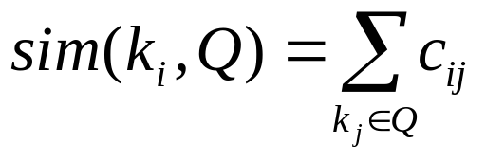
Global Analysis Refinements
Only expand query with terms that are similar to all terms in the query.
  “fruit” not added to “Apple computer” since it is far from “computer.”
  “fruit” added to “apple pie” since “fruit” close to both “apple” and “pie.”
Use more sophisticated term weights (instead of just frequency) when computing term correlations.

Slide 34
Query Expansion Conclusions
Expansion of queries with related terms can improve performance, particularly recall.
However, must select similar terms very carefully to avoid problems, such as loss of precision.

