Slide 1
The Deep Learning Revolution
Raymond J. Mooney
University of Texas at Austin
1
1
Notes:
1
1

Slide 2
Deep Learning Revolution
Recent machine learning methods for training “deep” neural networks (NNs) have demonstrated remarkable progress on many challenging AI problems (e.g. speech recognition, visual object recognition, machine translation, game playing).
However, their capabilities are prone to “hype.”
Deep learning has not “solved” AI and current methods have clear limitations.

Slide 3
Very Brief History of Machine Learning
Single-layer neural networks (1957-1969)
Symbolic AI & knowledge engineering (1970-1985)
Multi-layer NNs and symbolic learning (1985-1995)
Statistical (Bayesian) learning and kernel methods (1995-2010)
Deep learning (CNNs and RNNs) (2010-?)

Slide 4
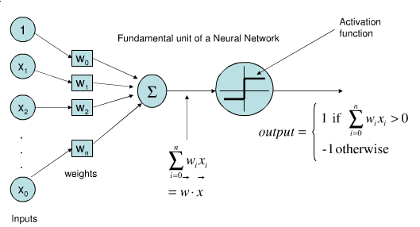
Single-Layer Neural Network (Linear Threshold Unit)
Mathematical model of an individual neuron.

Slide 5
Perceptron
Rosenblatt (1957) developed an iterative, hill-climbing algorithm for learning the weights of single-layer NN to try to fit a set of training examples.
Unable to learn or represent many classification functions (e.g. XOR), only the “linearly separable” ones are learnable.

Slide 6
Perceptron Learning Rule
Update weights by:
where η is the “learning rate,” t is the teacher output, and o is the network output.
Equivalent to rules:
If output is correct do nothing.
If output is high, lower weights on active inputs
If output is low, increase weights on active inputs

Slide 7
Perceptron Learning Algorithm
Iteratively update weights until convergence.
Initialize weights to random values
Until outputs of all training examples are correct
For each training pair, E, do:
Compute current output o for E given its inputs
Compare current output to target value, t , for E
Update weights using learning rule

Slide 8
Perceptron Demise
Perceptons (1969) by Minksy and Papert illuminated the limitations of the perceptron.
Work on neural-networks dissipated during the 70’s and early 80’s.

Slide 9
Neural Net Resurgence (1986)
Interest in NNs revived in the mid 1980’s due to the rise of “connectionism.”
Backpropagation algorithm popularized for training three-layer NN’s.
Generalized the iterative “hill climbing” method to approximate fitting two layers of synaptic connections, but no convergence guarantees.

Slide 10
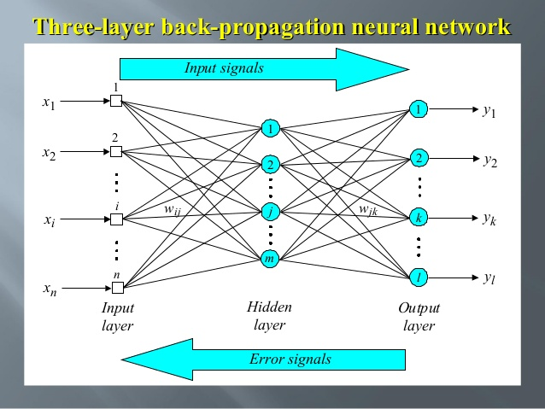
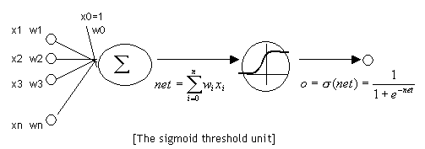
3-Layer NN Backpropagation

Slide 11
Second NN Demise (1995-2010)
Generic backpropagation did not generalize that well to training deeper networks.
Little theoretical justification for underlying methods.
Machine learning research moved to graphical models and kernel methods.

Slide 12
Deep Learning Revolution (2010…)
Improved methods developed for training deep neural works.
Particular successes with:
Convolutional neural nets (CNNs) for vision.
Recurrent neural nets (RNNs) for machine translation and speech recognition.
Deep reinforcement learning for game playing.

Slide 13
Massive Data and Specialized Hardware
Large collections of supervised (crowdsourced) training data has been critical.
Efficient processing of this big data using specialized hardware (Graphics Processing Units, GPUs) has been critical.

Slide 14
CNNs
Convolutional layers learn to extract local features from image regions (receptive fields) analogous to human vision (LeCun, et al., 1998).
Deeper layers extract higher-level features.
Pool activity of multiple neurons into one at the next layer using max or mean.
Nonlinear processing with Rectified Linear Units (ReLUs)
Decision made using final fully connected layers.

Slide 15
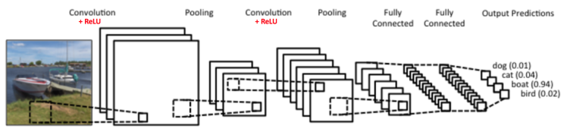
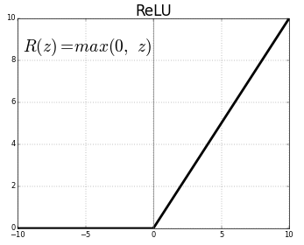
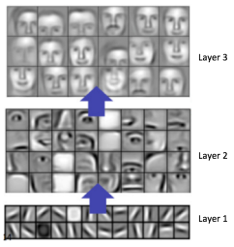
CNNs
Increasingly
broader local
features extracted
from image regions

Slide 16




ImageNet Large Scale Visual Recognition Challenge (ILSVRC)
Recognize 1,000 categories of objects in 150K test images (given 1.2M training images).
Mongoose
Canoe
Missile
Trombone

Slide 17
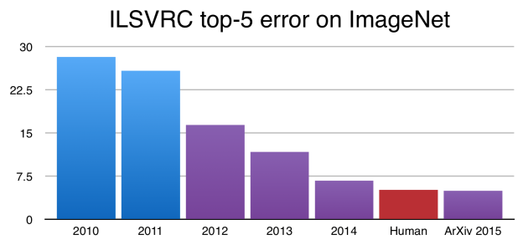
ImageNet Performance Over Time
CNNs
introduced

Slide 18
Recurrent Neural Networks (RNNs)
Add feedback loops where some units’ current outputs determine some future network inputs.
RNNs can model dynamic finite-state machines, beyond the static combinatorial circuits modeled by feed-forward networks.

Slide 19
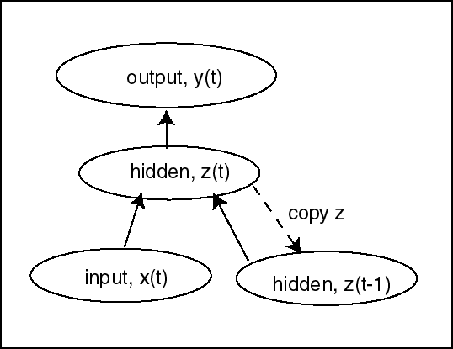
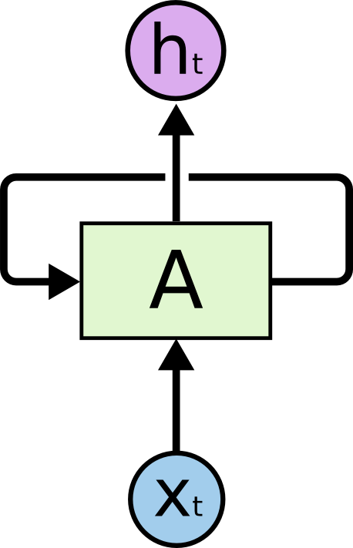
Simple Recurrent Network (SRN)
Initially developed by Jeff Elman (“Finding structure in time,” 1990).
Additional input to hidden layer is the state of the hidden layer in the previous time step.
http://colah.github.io/posts/2015-08-Understanding-LSTMs/

Slide 20

Unrolled RNN
Behavior of RNN is perhaps best viewed by “unrolling” the network over time.
time

Slide 21
Training RNN’s
RNNs can be trained using “backpropagation through time.”
Can viewed as applying normal backprop to the unrolled network.
Training
outputs
y₀
y₁
y₂
y_{t}
B
B
B
B
Training
inputs
backpropagated errors

Slide 22
Vanishing/Exploding Gradient Problem
Backpropagated errors multiply at each layer, resulting in exponential decay (if derivative is small) or growth (if derivative is large).
Makes it very difficult train deep networks, or simple recurrent networks over many time steps.

Slide 23
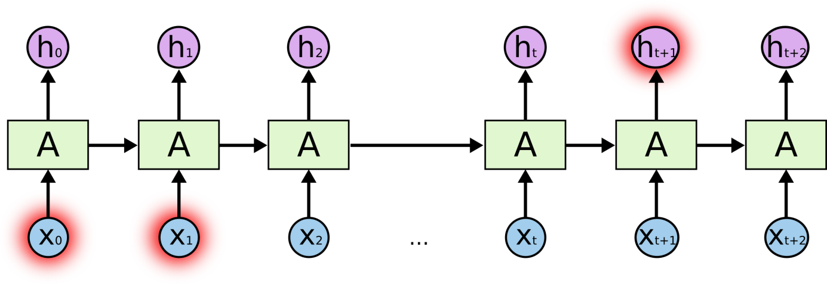
Long Distance Dependencies
It is very difficult to train SRNs to retain information over many time steps.
This make is very difficult to learn SRNs that handle long-distance dependencies, such as subject-verb agreement.

Slide 24
Long Short Term Memory (LSTM)
LSTM networks, add additional gating units in each memory cell (Hochreiter & Schmidhuber, 1997).
Forget gate
Input gate
Output gate
Prevents vanishing/exploding gradient problem and allows network to retain state information over longer periods of time.

Slide 25

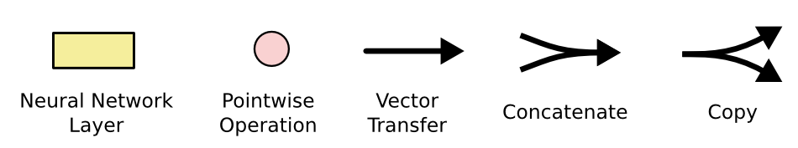
LSTM Network Architecture

Slide 26


Bi-directional LSTM (Bi-LSTM)
Separate LSTMs process sequence forward and backward and hidden layers at each time step are concatenated to form the cell output.
x_{t-1}
x_{t}
x_{t+1}
h_{t-1}
h_{t}
h_{t+1}

Slide 27
Sequence to Sequence (Seq2Seq) Transduction
Encoder/Decoder framework maps one sequence to a "deep vector" then another LSTM maps this vector to an output sequence (Sutskever et al., 2014).
Encoder
LSTM
Decoder
LSTM
I₁, I₂,…,I_{n}
h_{n}
O₁, O₂,…,O_{m}
Train model "end to end" on I/O pairs of sequences.

Slide 28
Neural Machine Translation (NMT)
LSTM Seq2Seq has lead to a new approach to translating human language.
NMT modestly outperforms previous statistical learning approaches to MT (SMT).

Slide 29
NMT Results (Wu et al., 2016)
Experimental results using automated (BLEU) and human evaluation for English→ French translation.
Method | BLEU | Human Rating
SMT | 37.0 | 3.87
NMT | 40.35 | 4.46
Human |  | 4.82

Slide 30
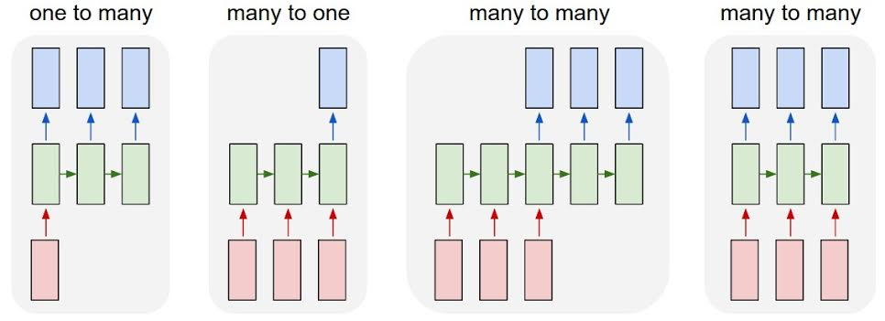
LSTM Application Architectures
Image Captioning
Video Activity Recog
Text Classification
Video Captioning
Machine Translation
POS Tagging, IE,
Language Modeling

Slide 31
Independent Word Vectors
Represent word meanings as vectors based on words with which they co-occur.
Neural approaches based on predicting a word’s context (skip-grams) from its vector (Word2Vec, Mikolov et al., 2013).
Fails to account for lexical ambiguity or dependence of word meaning on context.

Slide 32
Bidirectional Language Model
A standard statistical language model predicts the probability of the next word based on the previous context.
Your program for Project 4 does not _____
A bidirectional language model (BiLM) predicts the word at each position based on both prior and posterior context encoded using an RNN (e.g. LSTM).

Slide 33
Contextualized Word Embeddings
Produce a vector representation for a specific occurrence of a word, by using textual context to compute its meaning.
ELMo (Embeddings from Language Models, Peters et al., 2018) uses the hidden state of a BiLM to compute contextualized word embeddings.

Slide 34
Transformer Networks
An alternate Seq2Seq neural architecture based on attention rather than recurrence (Vaswani et al., 2017).
Attention mechanisms compute the output at each position in the sequence by varying “attention” across different positions in the input sequence.

Slide 35
Transformer Architecture

Slide 36
BERT Contextualized Embeddings
Bidirectional Encoder Representations from Transformers (BERT, Devlin et al., 2018)
Trains a transformer network to predict a fraction of “masked” tokens in an input sentence, or predict the next sentence.

Slide 37
BERT Architecture

Slide 38
Neural Information Retrieval
Word embeddings have been used to improve IR by allowing matching words based on semantic similarity.
Most recent results (Dai & Callan, SIGIR-2019) show improvements to ad-hoc document retrieval using BERT transformer approach.

Slide 39
BERT IR Results

Slide 40
“Cramming” Meaning into Vectors
DNNs force semantics to be encoded into real-valued vectors.
Structured meaning representations that exploit trees, graphs, and logical representations are only imperfectly encoded as vectors.

Slide 41
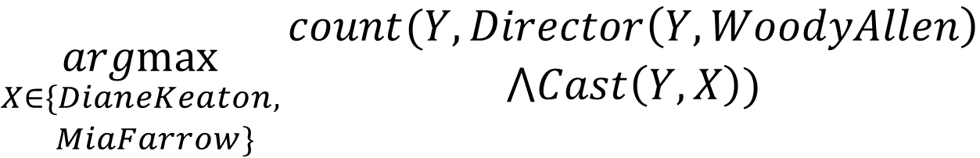
Complex Compositional Questions
“Has Woody Allen made more movies with Diane Keaton or Mia Farrow.”
$$\underset{\begin{aligned}X∈\{DianeKeaton, \\ MiaFarrow\}\end{aligned}}{argmax}{\begin{aligned}count(Y,Director\left(Y,WoodyAllen\right) \\ ⋀Cast\left(Y,X\right))\end{aligned}}$$

Slide 42
Conclusions
Machine learning, and specifically neural nets, has a a long, rich, varied history.
Deep learning has made significant recent progress.
Progress is continuing and holds promise of enabling revolutionary technology.
However, progress has been exaggerated and core AI problems are a long way from completely solved.

