Slide 1
Semantic Parsing for
Question Answering
Raymond J. Mooney
University of Texas at Austin

Slide 2
Semantic Parsing
Semantic Parsing: Transforming natural language (NL) sentences into completely formal logical forms or meaning representations (MRs).
Sample application domains where MRs are directly executable by another computer system to perform some task.
  Database/knowledge-graph queries
  Robot command language

Slide 3

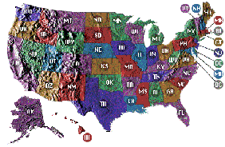
Geoquery:
A Database Query Application
Query application for U.S. geography database containing about 800 facts [Zelle & Mooney, 1996]
Which rivers run through the states bordering Texas?
Arkansas, Canadian, Cimarron,
Gila, Mississippi, Rio Grande …
Answer
Semantic Parsing
Query
answer(traverse(next_to(stateid(‘texas’))))
answer(traverse(next_to(stateid(‘texas’))))
answer(traverse(next_to(stateid(‘texas’))))

Slide 4
Predicate Logic Query Language
Most existing work on computational semantics is based on predicate logic
What is the smallest state by area?
answer(x₁,smallest(x₂,(state(x₁),area(x₁,x₂))))
x₁ is a logical variable that denotes “the smallest state by area”

Slide 5
Functional Query Language (FunQL)
Transform a logical language into a functional, variable-free language (Kate et al., 2005)
What is the smallest state by area?
answer(x₁,smallest(x₂,(state(x₁),area(x₁,x₂))))
answer(smallest_one(area_1(state(all))))

Slide 6
Learning Semantic Parsers
Manually programming robust semantic parsers is difficult due to the complexity of the task.
Semantic parsers can be learned automatically from sentences paired with their logical form.
NL→MR
Training Exs
Semantic-Parser
Learner
Natural
Language
Meaning
Rep
Semantic
Parser

Slide 7
Compositional Semantics
Approach to semantic analysis based on building up an MR compositionally based on the syntactic structure of a sentence.
Build MR recursively bottom-up from the parse tree.
BuildMR(parse-tree)
If parse-tree is a terminal node (word) then
return an atomic lexical meaning for the word.
Else
For each child, subtree_{i}, of parse-tree
Create its MR by calling BuildMR(subtree_{i})
Return an MR by properly combining the resulting MRs
for its children into an MR for the overall parse-tree.

Slide 8
Composing MRs from Parse Trees
What is the capital of Ohio?
S
answer(capital(loc_2(stateid('ohio'))))
NP
answer()
VP
capital(loc_2(stateid('ohio')))
V
∅
NP
capital(loc_2(stateid('ohio')))
WP
answer()
VBZ
DT
N
capital()
PP
What
answer()
∅
∅
loc_2(stateid('ohio'))
is
the
capital
IN
loc_2()
NP
stateid('ohio')
∅
∅
capital()
of
NNP
stateid('ohio')
loc_2()
Ohio
stateid('ohio')

Slide 9
Disambiguation with
Compositional Semantics
The composition function that combines the MRs of the children of a node, can return ⊗ if there is no sensible way to compose the children’s meanings.
Could compute all parse trees up-front and then compute semantics for each, eliminating any that ever generate a ⊗ semantics for any constituent.
More efficient method:
  When filling (CKY) chart of syntactic phrases, also compute all possible compositional semantics of each phrase as it is constructed and make an entry for each.
  If a given phrase only gives ⊗ semantics, then remove this phrase from the table, thereby eliminating any parse that includes this meaningless phrase.

Slide 10

Composing MRs from Parse Trees
What is the capital of Ohio?
S
NP
VP
V
NP
WP
What
VBZ
DT
N
PP
⊗
is
the
capital
IN
loc_2()
NP
riverid('ohio')
of
NNP
riverid('ohio')
loc_2()
Ohio
riverid('ohio')

Slide 11
Composing MRs from Parse Trees
What is the capital of Ohio?
S
NP
VP
⊗
V
∅
NP
capital()
PP
loc_2(stateid('ohio'))
WP
VBZ
DT
N
IN
loc_2()
NP
stateid('ohio')
What
∅
∅
capital()
of
NNP
stateid('ohio')
is
the
capital
loc_2()
∅
∅
capital()
Ohio
stateid('ohio')

Slide 12
Experimental Corpora
GeoQuery [Zelle & Mooney, 1996]
  250 queries for the given U.S. geography database
  6.87 words on average in NL sentences
  5.32 tokens on average in formal expressions
  Also translated into Spanish, Turkish, & Japanese.
Notes:
It’s test on Clang corpora. It’s also tested on an benchmark corpora of semantic parsing.
- Geoquery example: how many cities are there in the US?

Slide 13
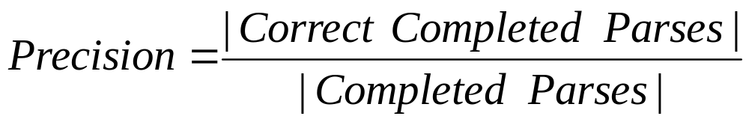
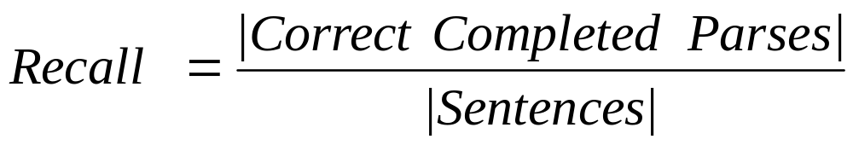
Experimental Methodology
Evaluated using standard 10-fold cross validation
Correctness
  CLang: output exactly matches the correct representation
  Geoquery: the resulting query retrieves the same answer as the correct representation
Metrics
Notes:
Geoquery – using the same evaluation method in previous papers
Why not using partial match:
doesn’t make sense, player 2 instead of player 3, left instead of right
Animation, first show correct, then wrong
Explain what’s precision, what’s recall

Slide 14
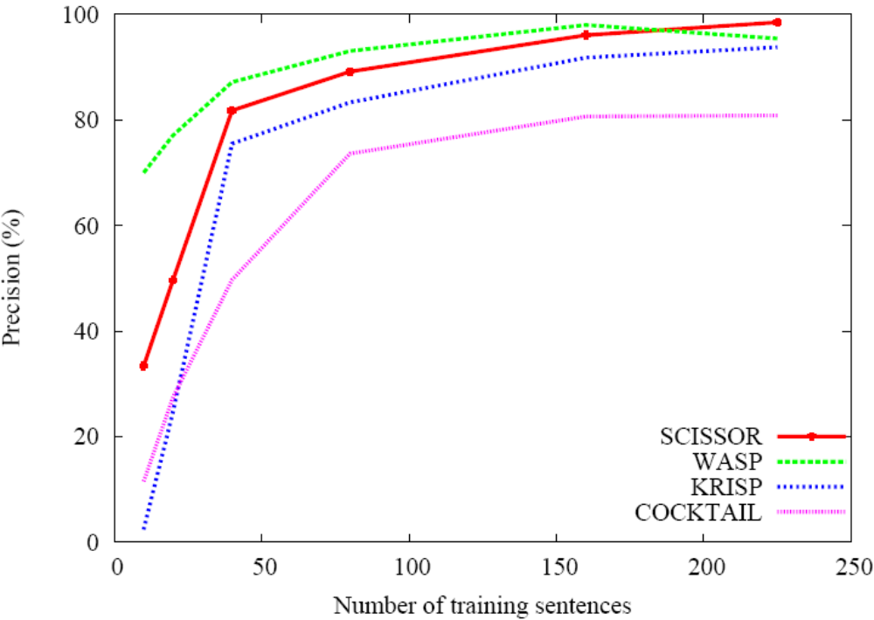
Precision Learning Curve for GeoQuery

Slide 15
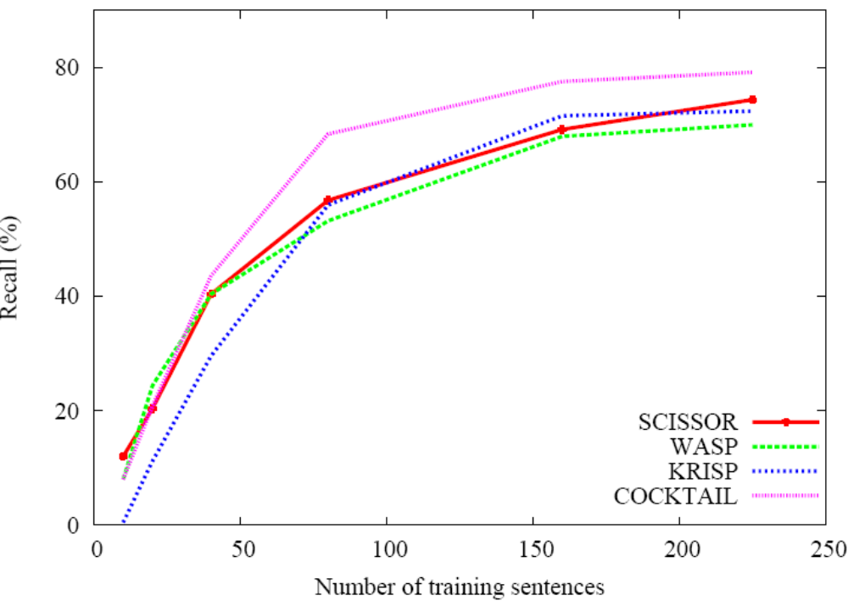
Recall Learning Curve for Geoquery

Slide 16
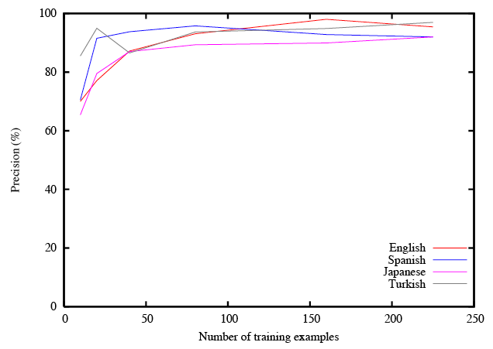
Precision Learning Curve for GeoQuery (WASP)

Slide 17
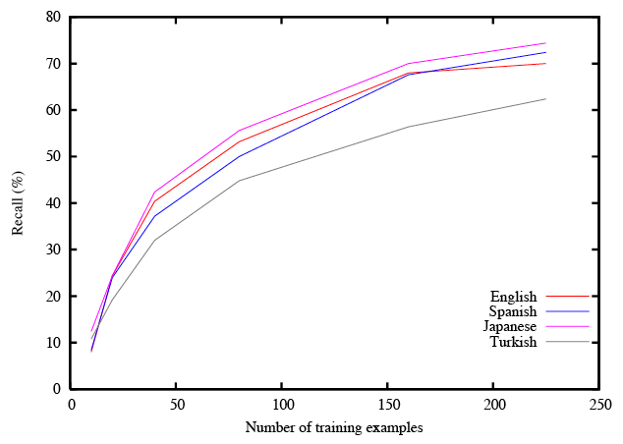
Recall Learning Curve for GeoQuery (WASP)

Slide 18
Conclusions
Semantic parsing maps NL sentences to completely formal computer language.
Semantic parsers can be effectively learned from supervised corpora consisting of only sentences paired with their formal representations.
Can reduce supervision demands by training on questions and answers rather than formal representations.
  Results on FreeBase queries and queries to corpora of web tables.
Full question answering is finally taking off as an application due to:
  Availability of large scale, open databases such as FreeBase, DBPedia, Google Knowledge Graph, Bing Satori
  Availability of speech interfaces that allow more natural entry of full NL questions.

