Slide 1

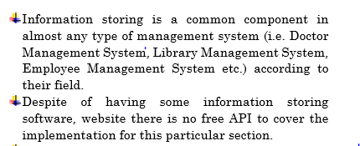
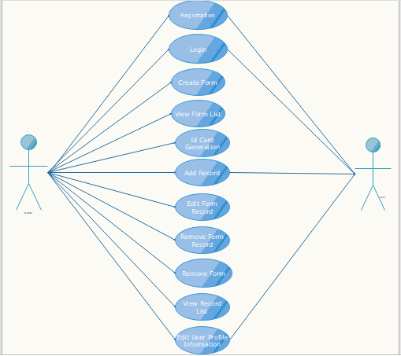
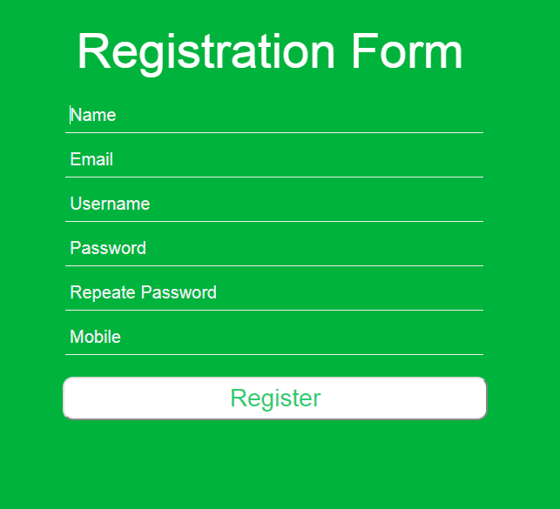
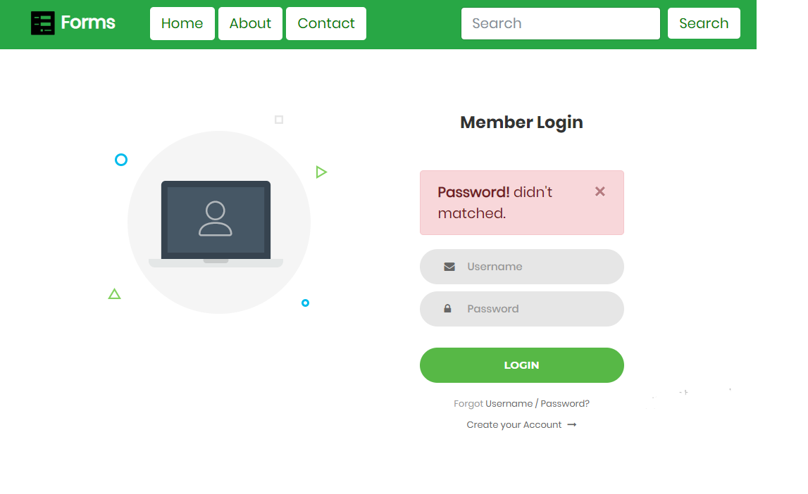
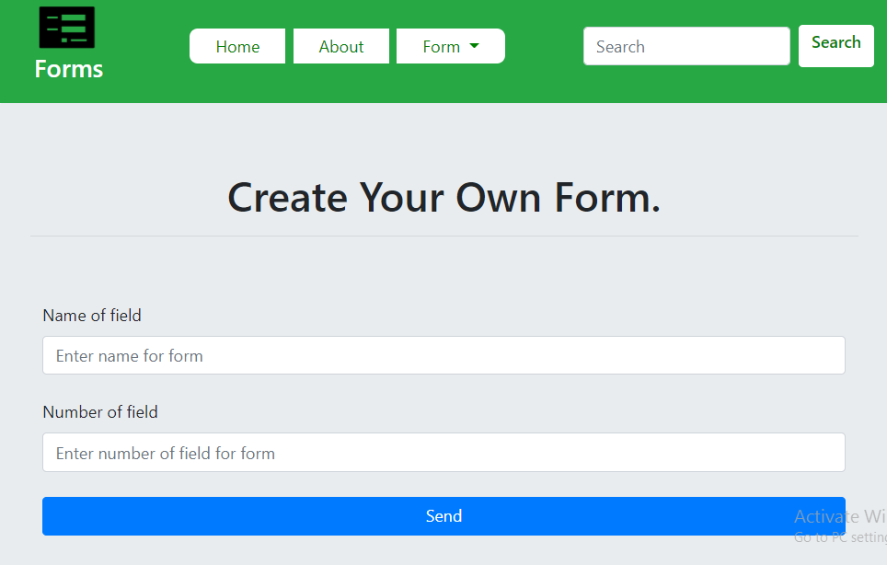
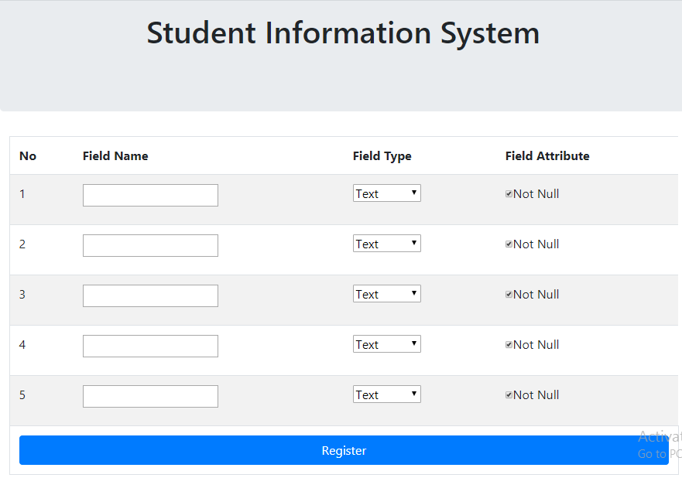
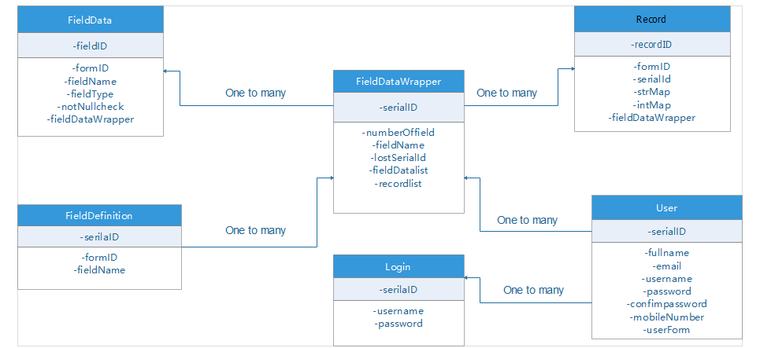
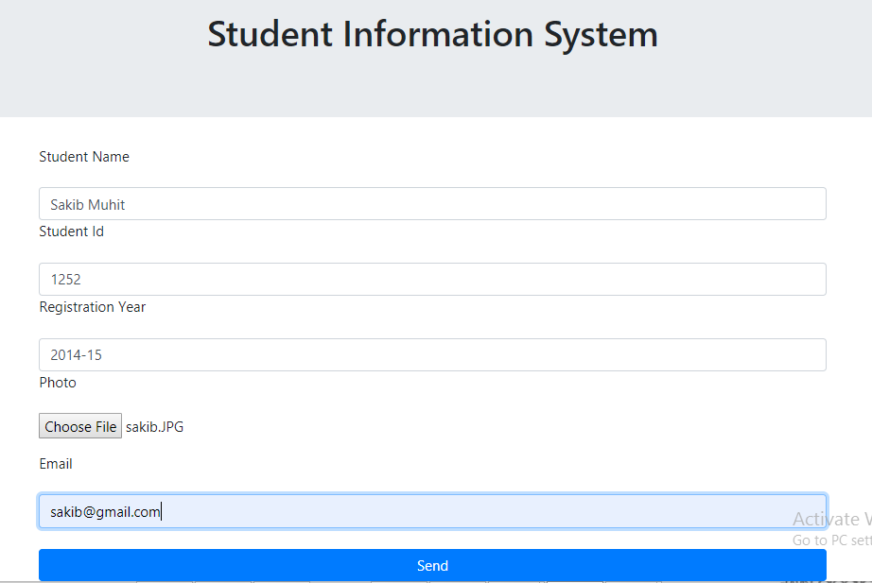
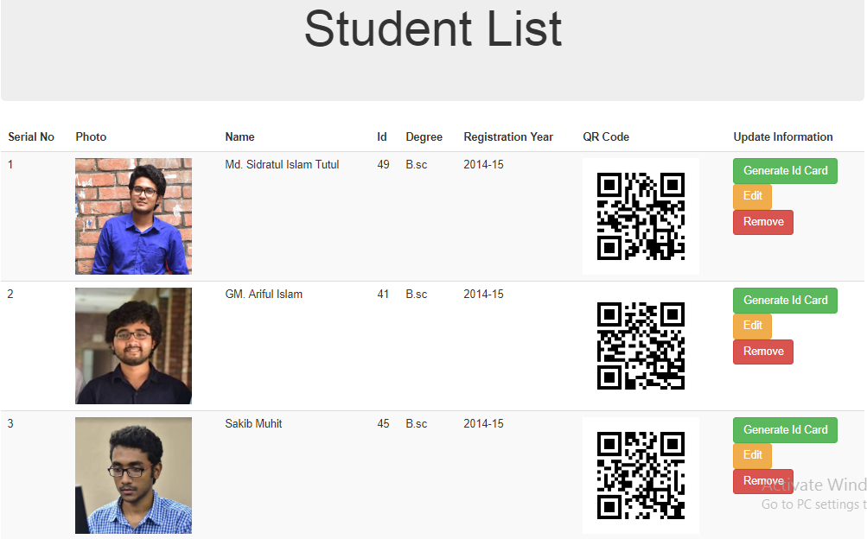

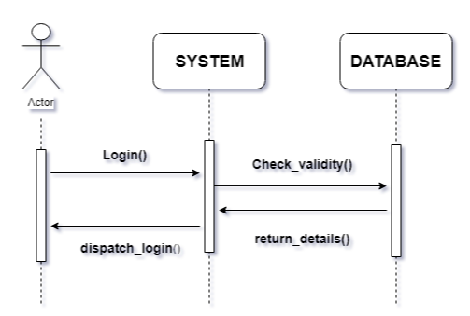
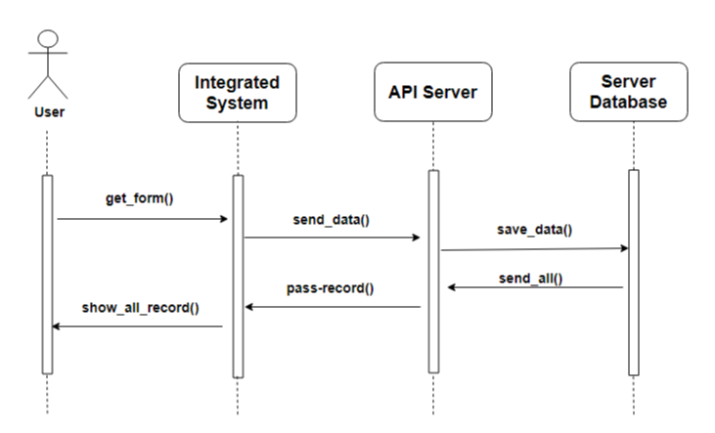

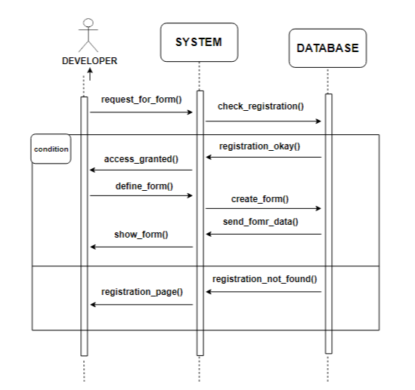

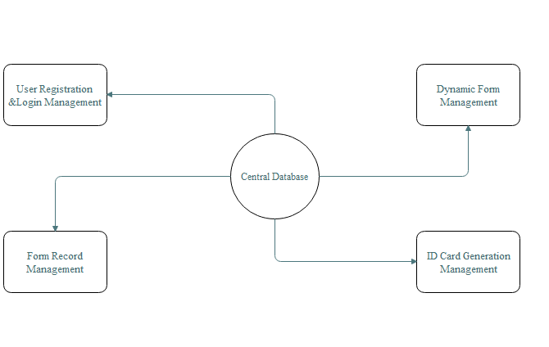

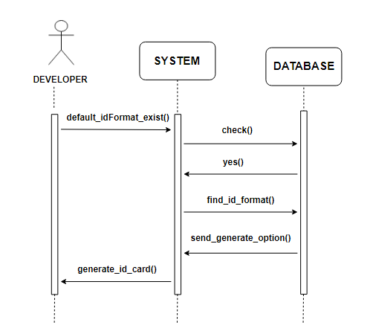

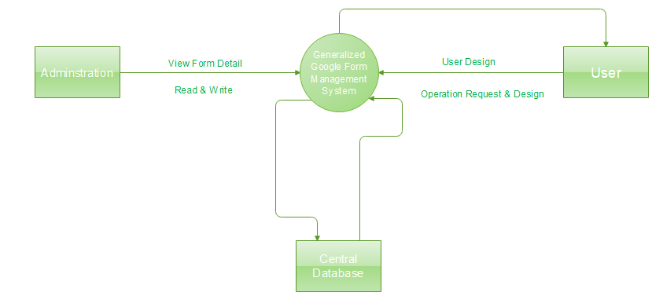


Open source form builder package
Motivation
Hghghgch
Use Case Diagram
Result
Information storing is a common component in almost any type of management system (i.e. Doctor Management System, Library Management System, Employee Management System etc.) according to their field.
Despite of having some information storing software, website there is no free library to cover the implementation for this particular section.
Step 1
Step 2
Approach
Class Diagram
This project will provide an open source library for information storing with form UI that can be integrated to any kind of java project.
QR Code based information searching and ID card
generation is another common component that
needs to be solved in an automated way.
Step 3
Step 4
Sequence Diagram
Step 5
Step 6
Objective
Final Result
Fig. Sequence Diagram
For Login
Fig. Sequence Diagram
Record Saving
Limitation
Custom Designed Identification Card format is not
allowed.
Project is platform dependent. It’s not tested here on other platform yet.
System Model
Future Work
Fig. Sequence Diagram for Form Creation
Context Diagram
Conclusion
h
References
Fig. Sequence Diagram for ID card Generation
Department of Computer Science and Engineering (CSE),JU

