Slide 1

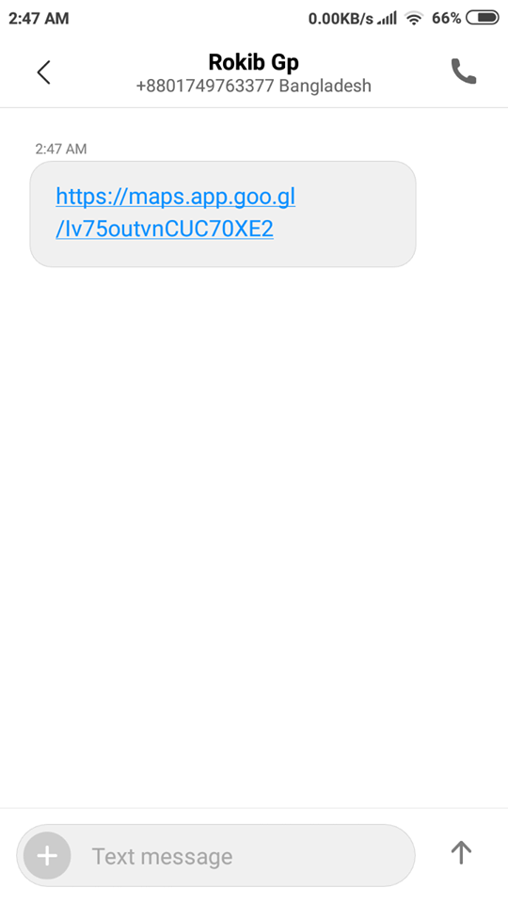
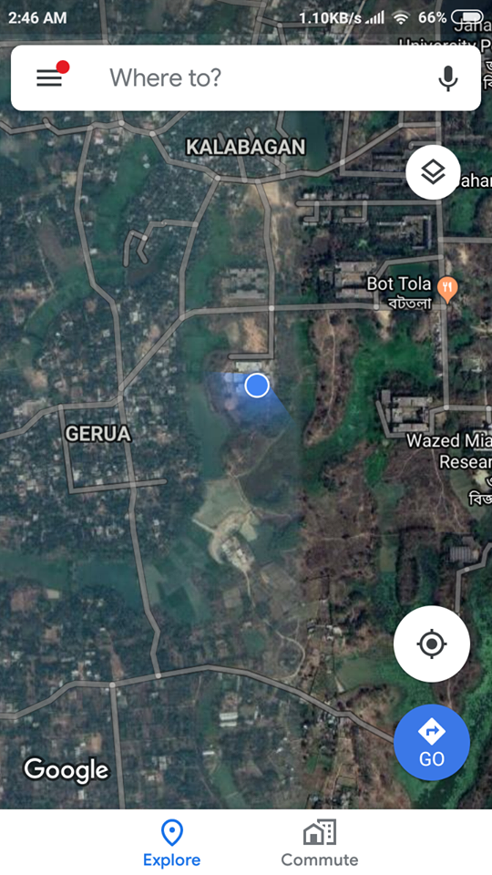

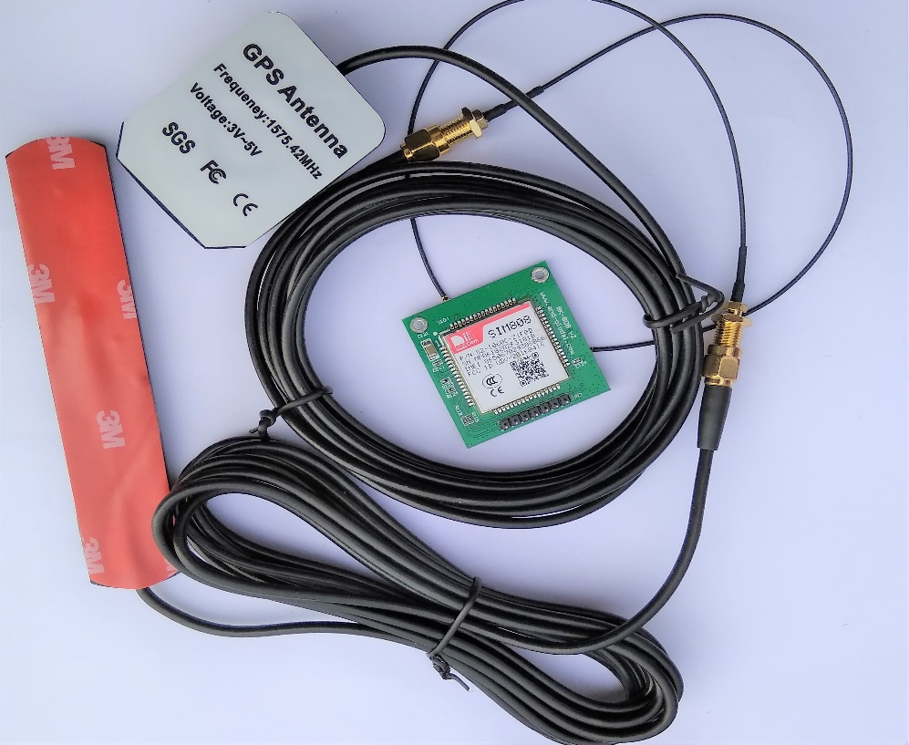

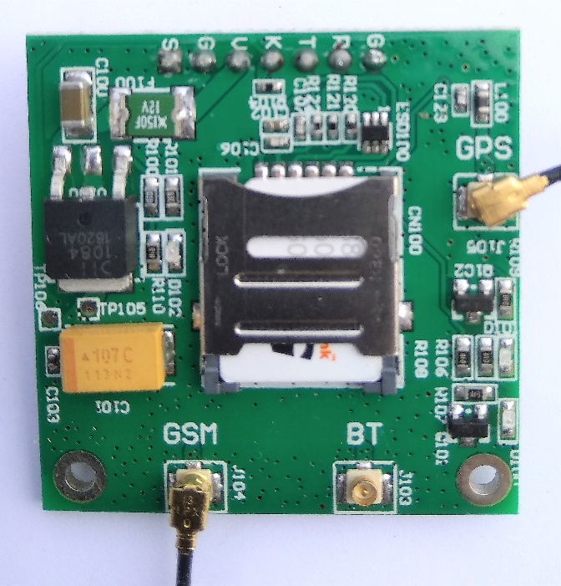
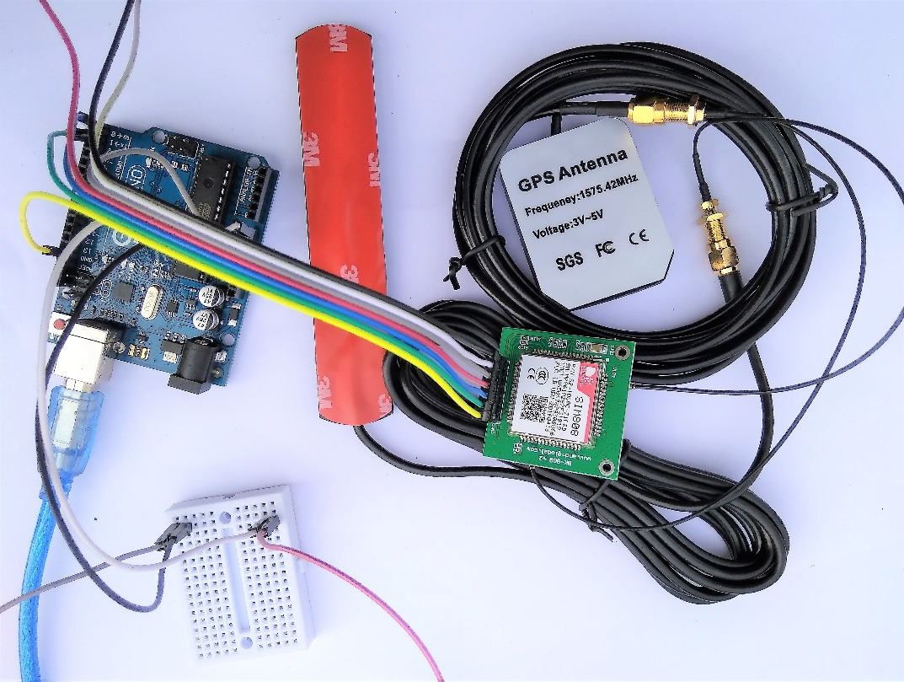
SMART PENDANT FOR WOMEN SAFETY
Md. Rakibul Hasan, Mohammad Torikul Islam Maruf
Supervised by- Sarnali Basak
Assistant Professor
Department of Computer Science and Engineering, Jahangirnagar University, Savar, Dhaka, Bangladesh
Introduction
Design and Implementation
Experimental Results
Abstract
GPS/GSM technology is very useful and developed in many sectors of modern science. By integrating the GPS/GSM device with a fingerprint module, we have implemented a security system especially for women as well as for someone who is seeking for help when they are in critical situation. Now-a-days women safety on streets/outside/vehicle is one of the greatest concern in Bangladesh. To solve this issue, we propose a GPS based safety system that has dual security feature. This device consists of a system that ensures dual alerts in case a woman is harassed or she thinks she is in trouble. It is useful because once an incident occur with a woman, she may or may not get the chance to press the emergency button. Only the user authenticated to the device can start the system by fingerprint scan. Once started, the device requires the woman to constantly scan her finger on the system every one minute, else the system now sends her location to the authorized personnel number through SMS as a security measure. In this case if someone hits the user or the user falls down and get unconscious, the user doesn’t need to do anything. The system automatically starts the dual security features. The device uses GPS sensor along with a GSM modem, fingerprint module and microcontroller based circuit to achieve this system.
Read movement
Set of operations
Device
Device
This project is to develop a device which is useful to the women for their own safety and security. A GPS module and GSM module have been integrated with a Sim808 device. We built a system that will support the user to SMS on a cell phone and make a contact with police station, family member or hospital. Electronic system configuration, a GMS module, a GPS module, a Sim808 device, a fingerprint module etc. are the components of the device.
Fingerprint module or button
Arduino
Signal operated by Sim808 module
Device
User
Sim808 module
Location by GPS
Generate Location
Remote Device
Device
Mobile
GSM & GPS
Figure: Deployment diagram.
Figure: Screenshot of the outcome of the project
(a. The link of the location sent from the sim of the device, b. the location of the device)
Implementation
The implementation is done from the design diagrams. Now for the implementation of the system we can divide it into three subsystems- system implementation, power issue and code upload.
System Implementation
The steps of implementing of the device has been given below-
We connect the GSM antenna and GPS antenna with the SIM808 module.
Discussion And Future Work
Requirement Analysis
Initially the goal of the project is to design and develop a prototype of a portable women security device with GPS service. After the testing of the prototype of the project, industrial manufacturing will help the device to be smaller in size and low cost, that will sustain the project for a very long future for sure.
The project will need to create a server at any related ministry such as Ministry of Children and Women Affairs or The Police Control Room, etc. The expansion of the project can a huge challenge with making the device as small as it can be to carry like a pendant by industrial manufacturing and developing the server room for the surveillance.
The using technique of fingerprint recognition scanner in this device will open a new era in the world of security system devices. It also can be used in other perspective like in hospitals to observe the situation of the patient, etc.
Global System for Mobile Communications
GSM (Global System for Mobile Communications) is a second-generation digital mobile telephone standard using a variation of Time Division Multiple Access. It is the most widely used of the three digital wireless telephone technologies - CDMA, GSM and TDMA.
Global Positioning System
The Global Positioning System (GPS) is a technical marvel made possible by a group of satellites in Earth's orbit. The basic concept behind GPS is that signals are transmitted from the satellites in space and these are received by the receivers on or near to the surface of the earth. Using timing it is possible to determine the distance from each satellite and thereby using a process of triangulation and a knowledge of the satellite positions the position on Earth can be determined.
Fingerprint recognition
Identification, identity verification and access control have been made that simple by fingerprint recognition technology and devices. There is no need to rush to your ID card or identity documents, even in the most stressed situations. All it takes a pre-established record of your biometric identity, a fingerprint recognition system and a touch of your fingertip to prove you are you. Fingerprint recognition is the most developed biometric modality and arguably the only one that offers end-to-end solution, which can be deployed with currently available fingerprint recognition systems.
Hardware Required
Arduino Uno R3
Sim808 GSM
GPS module GY-NEO
Fingerprint Recognition Module
Cable and Connections
Bread Board
Battery
Jumper wires
Micro SD card
SIM card
Smart phone
Software Requared
Google Map
Arduino IDE
Figure: Connecting the GSM antenna and GPS antenna with the SIM808 module
This project is Sponsored by
ICT Division
Government of
Peoples Republic of Bangladesh
ii. Then we insert a sim card to the SIM808 module.
Conclusion
Fast growing economy like Bangladesh’s need to enforce the safety of women on streets, office, or outsides. For the features and natures of our device it is hoped that this safety device will easily be adopted in our country. The project is based on GPS module and its innovative features that will make a great addition to the gadgets for women safety on streets. The idea can be used in other related like projects. It will be long durable and very much effective device. A smart pendant like device is very much easy to carry and not identical for the criminals. The device will be a conducive to reduce the crimes and violence against women.
Figure : Inserting sim card
iii. Now we connect SIM808 module and Fingerprint scanner with arduino.
References
[1] G C Harikiran, K. Menasinkai and S. Shirol. “Smart security solution for women based on Internet Of Things”, IEEE, Chennai, India, 2016. DOI: 10.1109/ICEEOT.2016.7755365.
[2] D. G. Monisha, M. Monisha, G. Pavithra and R. Subhashini. “Women Safety Device and Application-FEMME”, Indian Journal of Science and Technology, Vol 9(10), DOI: 10.17485/ijst/2016/v9i10/88898, March 2016.
[3] M. A. A. Rashed, O.A. Oumar , D. Singh. “A real time GSM/GPS based tracking system based on GSM mobile phone”, IEEE, London, UK, 2014. DOI: 10.1109/FGCT.2013.6767186.
Contacts
Md. Rakibul Hasan
hasan.rokibul60@gmail.com
Mohammad Torikul Islam Maruf
torikulislamtwo@gmail.com
Figure : Connecting SIM808 module and Fingerprint scanner with arduino.

