Slide 1

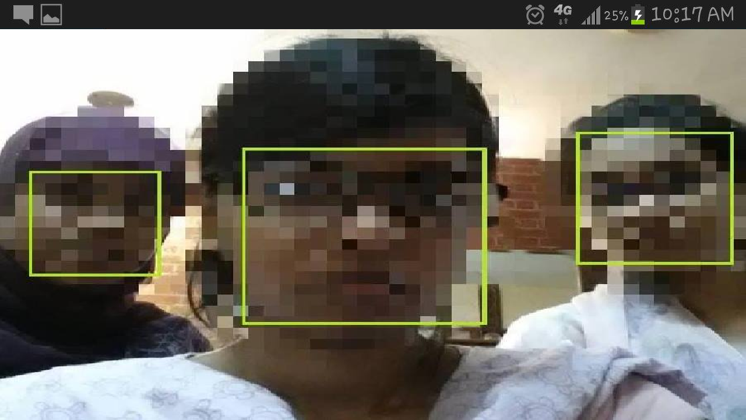
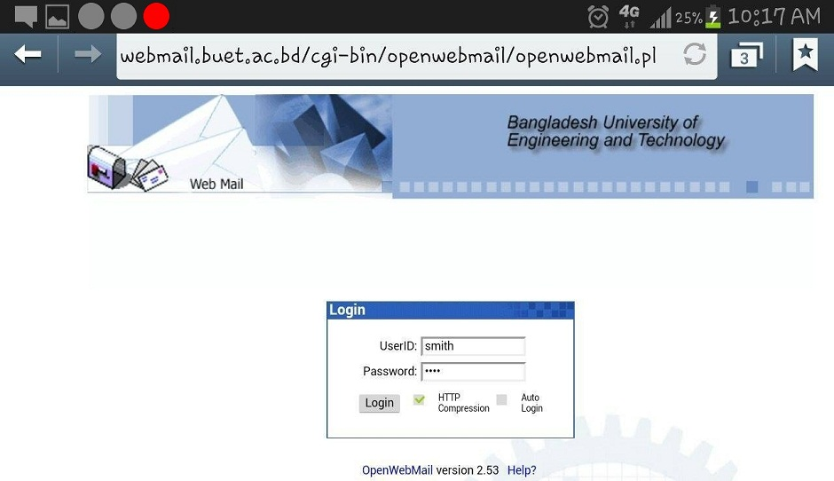
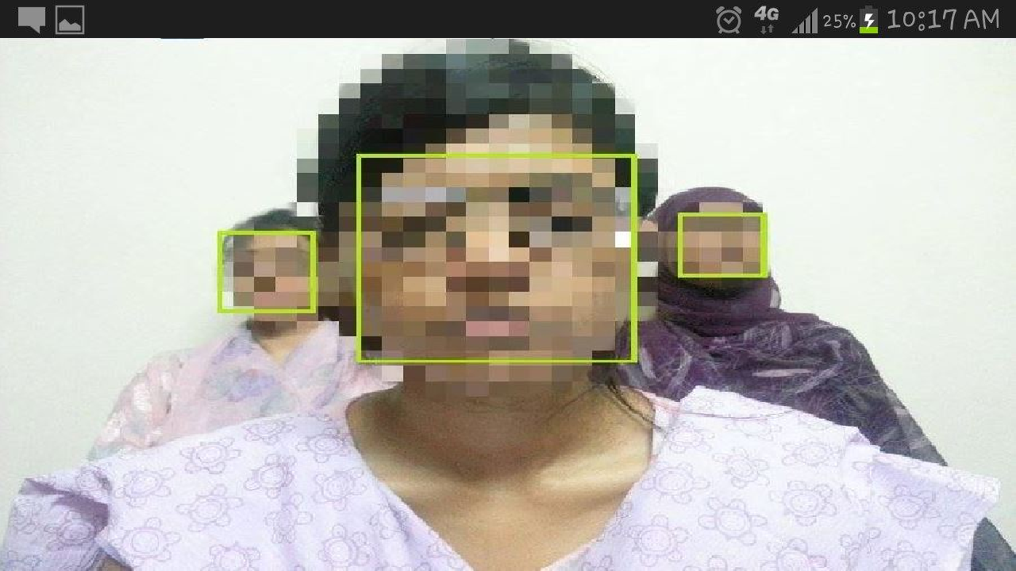
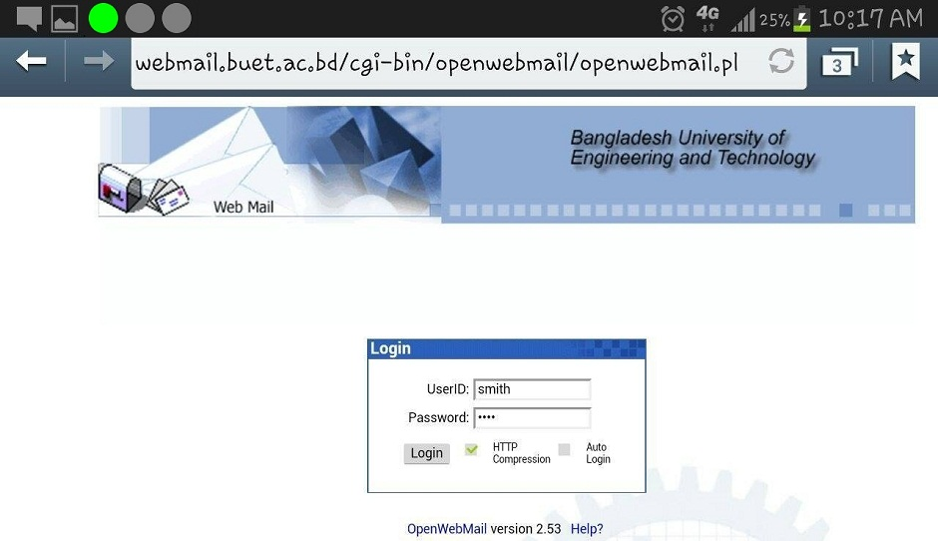
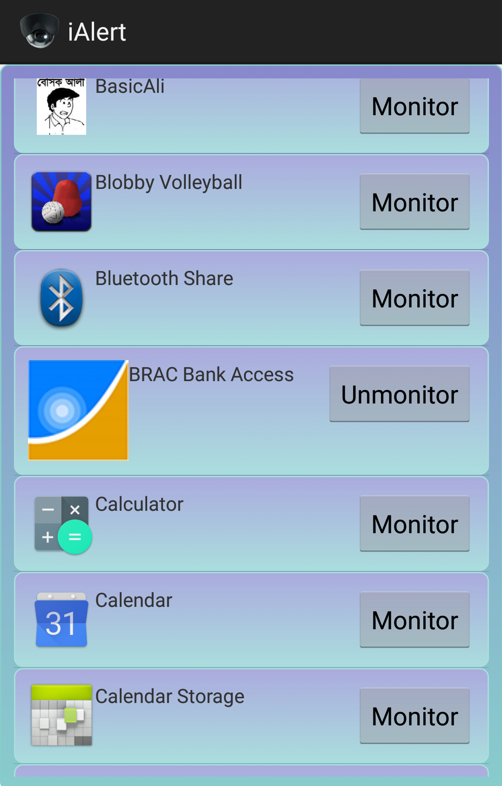
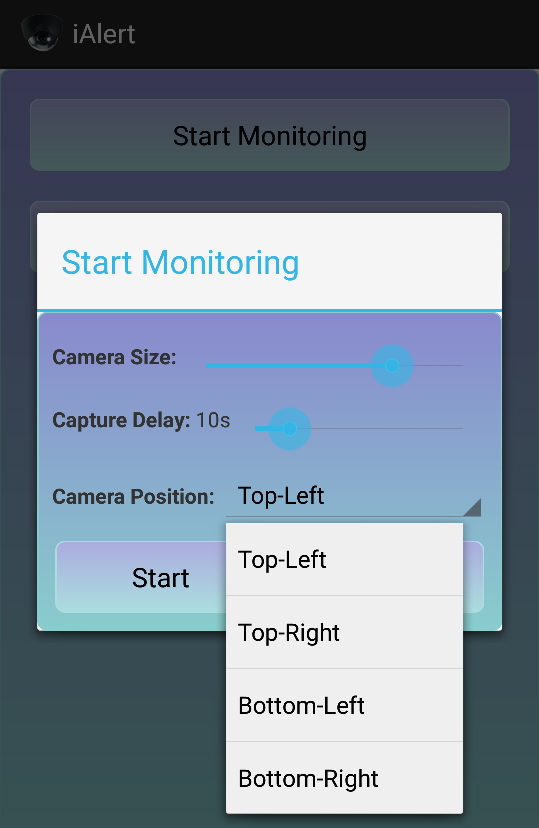
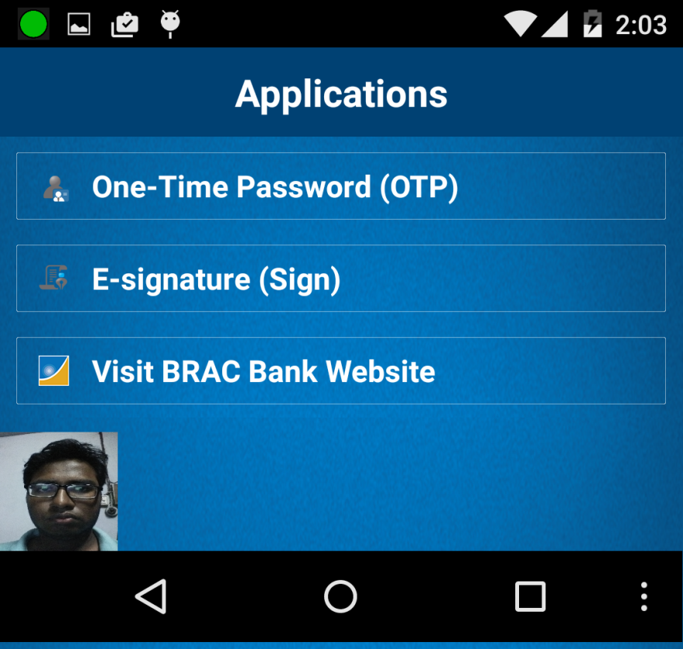
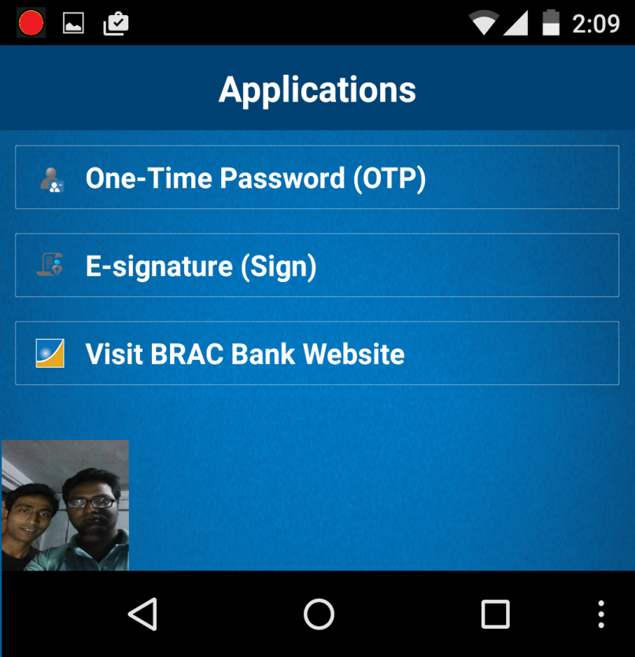
Protecting Mobile Users From Visual
Privacy Attacks
Mahmud Al-Noor Tareq (0905012.mant@ugrad.cse.buet.ac.bd)
Visual Privacy Attacks
Detecting Visual Privacy Attacks
Conclusion
An increasing number of people use mobile devices in public places such as trains, airports, and restaurants.
Visual privacy attack: Un-authorized visual access of the mobile display by bystanders.
ComRes ^{[1]} survey: 71% of the surveyed people have been able to see or read what someone is doing on their computing device
Reactive Solution iAlert-
Combats problem of visual privacy attacks
Enables a mobile user to be aware of the surrounding environment and possible privacy risks
Facilitates working in private at public places
Provides full user control by sensitive application select option and other settings, i.e., camera size, position and scan time.
Can differentiate intruders from friendly shares from face position.
Figure: A user and two bystanders close to the screen (left), and a login screen with high privacy risk indicated by a red light on the top-left corner (right)
Figure: A user and two bystanders far away from the screen (left), and a login screen with no privacy risk indicated by a green light on the top-left corner (right)
Unauthorized people seeing sensitive information could lead to financial loss or public exposure
Android Device Implementation
We have developed an Android Application named iAlert. User can select which applications need to be monitored. When a secured app is started, iAlert opens a camera and checks for visual security risks. It shows green, yellow and red signals.
Objective
Enable mobile users to combat visual privacy attacks, i.e., to work privately on their mobile devices in public places. Also ensure full control of user in the monitoring process.
Future Works
Developing methods for automatically adjusting screen or font size based on visual privacy risks for sensitive tasks.
Identifying highly sensitive areas (e.g., user name Textbox) of applications and ensuring strong privacy for these highly sensitive parts.
Our Solution
Select sensitive applications or tasks to monitor.
Check for intruder using face detection^{[2]}.
Develop linear regression model to determine the distance measured from eye distance, and the angle of the detected faces.
Apply Snellen chart^{[3]} to determine if the displayed text is readable by the bystander.
Check whether the bystander is in a friendly distance or an intruder.
Notify user accordingly analogous to traffic lights.
References
Figure: user can select which apps to monitor from a list (left), and user can set monitoring behavior (right)
[1] http://www.visualdatasecurity.
eu/wp-content/ uploads/2012/07/Visual-Data-Security-White-Paper.pdf
[2] Face detector. http://developer.android.com/reference/android/media/FaceDetector.Face.html
[3] Eye chart. http://www.teachengineering.org/collection/cub_/activities/cub_human/cub_human_lesson06_activity1_eyechart.pdf
Figure: A secured app launched. So a small camera is started. Green signal indicates no bystander (left), and red signal on top-left corner indicates the presence of a bystander (right)
Department of Computer Science and Engineering (CSE), BUET

