Slide 1



CMR COLLEGE OF ENGINEERING &TECHNOLOGY Electronics & Communication Engineering MAJOR PROJECT DWT BASED AUDIO STEGANOGRAPHY USING AES ENCRYPTION
Presented By Batch No: C15
K. Siddhartha – 18H51A04K0
B. Susmita - 18H51A04M7
G. Anudeep - 18H51A04N3
GUIDED BY:
Mrs. A. Jyothi, Assistant Professor, Department of ECE

Slide 2

Contents
Introduction
Abstract
Problem definition
Objectives
Literature Review
Proposed Methodology
Phase-1 status
Phase-2 status
Block diagram
Hardware and Software Requirements
Results
Conclusion
References

Slide 3
INTRODUCTION:
What is steganography?
Steganography comes from a Greek word; it means covered or secret writing.
STEGAN-O-GRAPHY
COVERED WRITING
The goal of steganography is to hide messages in such a way that no one apart from the intended recipient even knows that a message has been sent.

Slide 4
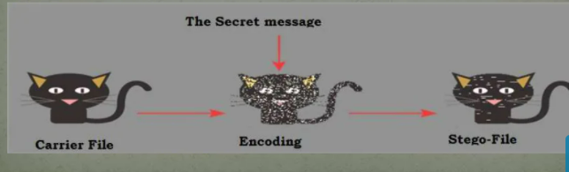
This can be achieved by concealing the existence of information within seemingly harmless carriers or cover.
It can be understood by the following figure.

Slide 5
Abstract:
Embedding secret message into digital sound is called audio steganography.
Audio Steganography is presented where the bits of a secret message are embedded into the cover audio.
In this project a new scheme for digital audio steganography is presented where the bits of a secret message are embedded into the cover audio.

Slide 6
Problem Definition:
As data security has become one of the most important aspects of the growing digital world, there is a need for many data security technologies which can protect and hide the data in the most efficient way.

Slide 7
OBJECTIVES:
The objective of this project is to make software which can help to hide the secret message inside an audio file which will provide security and safety to the secret and confidential information.
In this project we’ll implement a system which will embed a secret text message in an audio file.

Slide 8
LITERATURE REVIEW:
S.NO | TITLE | AUTHOR & YEAR | TECHNIQUE USED | ADVANTAGES & DISADVANTAGES
01. | Analysis of LSB Based Image Steganography | R. Chandramouli and N. Memon,2001 | LSB of each sample in the audio is substituted by one bit of hidden data | Simple and easy for hiding Information. Extraction is easy.
02. | Genetic Algorithm in Audio Steganography. | Nishu Gupta, Mrs.Shailja, 2014. | DES algorithm | Simple Can be attacked by unauthorized users
03. | Secret Message Integrity of Audio Steganography | Uma Mehta, Mr.Daulat Sihag, 2014. | Blowfish algorithm | Efficient Time consuming process in reconstructing the original signal.
04. | Data Hiding System Using Cryptography & Steganography: A Comprehensive Modern Investigation | Aarti Mehndiratta, 2015 | DCT,DES Algorithm | provides high level of security and robustness. The one of the disadvantage of DCT is it works only with the JPEG format for cover image file.

Slide 9
Proposed Methodology:
AES ALOGIRTHM:
AES stands for Advanced Encryption Standard.
AES is a block cipher algorithm.
The key size can be 128/192/256 bits.
Encrypts data in blocks of 128 bits each.
It is a symmetric key algorithm, which means that the same key is used for encrypting and decrypting ​data.
Encryption and decryption using the AES algorithm.

Slide 10
Proposed Methodology:
DWT stands for Discrete Wavelet Transform.
DWT applies on entire audio.
DWT splits component into numerous frequency bands called sub bands known as
LL – Horizontally and vertically low pass
LH – Horizontally low pass and vertically high pass
HL - Horizontally high pass and vertically low pass
HH - Horizontally and vertically high pass
Since Human ears are much more sensitive to the low frequency part (LL sub-band) we can hide secret message in other three parts without making any alteration in LL sub bands. As other three sub-bands are high frequency sub-bands they contain insignificant data. Hiding secret data in these sub-bands doesn’t degrade audio quality that much.
DWT Steganography:

Slide 11
Phase-1 Status
Covered all the objectives of phase 1 and documented the results.
Created an application for encrypting text message.
Successfully performed encryption and conversion of the input text message.
Documented all the results and information related to work completed in phase-1.

Slide 12
Phase-2 Status
Designed Graphical user interface for hiding and retrieving secret text.
Encrypting & hiding secret text in audio file (Steganography).
Retrieving & decrypting secret text from audio file.
Captured all the results and finished the documentation and paper related work.

Slide 13
BLOCK DIAGRAM FOR PROPOSED SYSTEM:
key
key
Cover object
Embedding Process
Stego Audio
Extracting Process
Text message
Text message

Slide 14
BLOCK DIAGRAM FOR AES ENCRYPTION:
128-bit plain text
Round keys
(128-bits)
Pre-round Transformation
K
e
y
E
x
p
a
n
s
i
o
n
Cypher Key
(128,192 or 256 bits)
k0
Round 1
k1
Round 1
Round 2
Sub Bytes
k2
.
.
Shift Rows
.
.
Round N
Mix Columns
kR
Add Round key
128-bit Cypher Text

Slide 15
Hardware & Software Requirements:
Software: Matlab R2014a or above
Hardware:
Operating Systems:
• Windows 10
• Windows 7 Service Pack 1
• Windows Server 2019
• Windows Server 2016
Processors:
Minimum: Any Intel or AMD x86-64 processor
Recommended: Any Intel or AMD x86-64 processor with four logical cores and AVX2 instruction set support
Disk:
Minimum: 2.9 GB of HDD space for MATLAB only, 5-8 GB for a typical installation
Recommended: An SSD is recommended A full installation of all MathWorks products may take up to 29 GB of disk space
RAM:
Minimum: 4 GB
Recommended: 8 GB

Slide 16
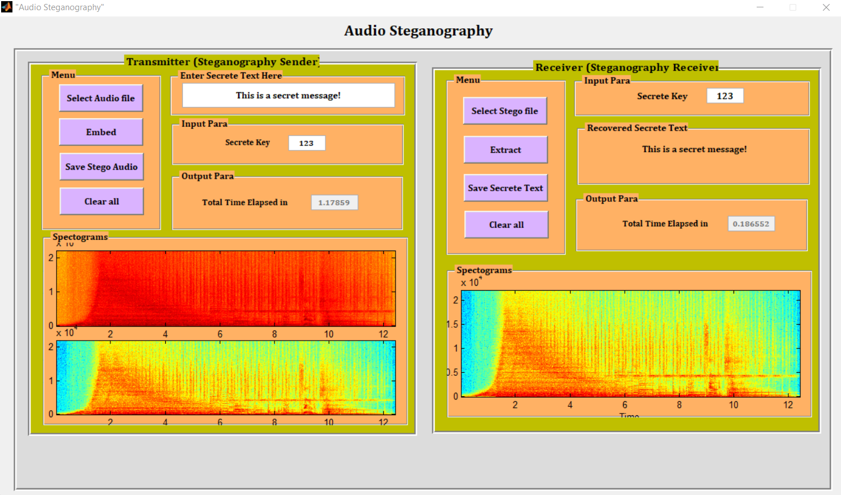
Results and Discussions:
Steganography: Steganography is the technique of hiding secret data within an ordinary, non-secret, file or message in order to avoid detection; the secret data is then extracted at its destination.

Slide 17
Conclusion
Steganography is an information hiding technique where secret message is embedded into unsuspicious cover signal. An effective audio steganographic scheme should possess three characteristics:
Inaudibility of distortion (Perceptual Transparency)
Data Rate (Capacity)
Robustness.
These characteristics are called the magic triangle for data hiding.
This project has proven through informal tests that our audio steganography compression technique is robust. The proposed method produces stego-speech files that are indistinguishable from their equivalent stego- speech files.

Slide 18
Future scope
This project can be further developed into a full fledged software with more encryption techniques making it more robust and secure, it can then be used by any secret agencies to communicate around the world through very simple equipment.

Slide 19
References
[1] "Information Hiding: A survey" (pdf). Proceedings of the IEEE (special issue) 87 (7): 1062–78. doi:10.1109/5.771065. Retrieved 2008-09-02.
[2] A New Text Steganography Method By Using Non-Printing Unicode Characters, Akbas E. Ali, Eng. & Tech. Journal, Vol.28, No.1, 2010
[3] B.r., Roshan Shetty; J., Rohith; V., Mukund; Honwade, Rohan; Rangaswamy, Shanta (2009). Steganography Using Sudoku Puzzle. pp. 623–626. doi:10.1109/ARTCom.2009.116.
[4] Chvarkova, Iryna; Tsikhanenka, Siarhei; Sadau, Vasili (15 February 2008). "Steganographic Data Embedding Security Schemes Classification". Steganography: Digital Data Embedding Techniques. Intelligent Systems Scientific Community, Belarus. Retrieved 25 March 2011.
[5] Johnson, Neil; Duric, Zoran; Jajodia, Sushil (2001). Information hiding: steganography and watermarking: attacks and countermeasures. Springer. ISBN 978-0-7923-7204-2.
[6] Krzysztof Szczypiorski (4 November 2003). "Steganography in TCP/IP Networks. State of the Art and a Proposal of a New System - HICCUPS". Institute of Telecommunications Seminar. Retrieved 17 June 2014.
[7] Kundur D. and Ahsan K. (April 2003). "Practical Internet Steganography: Data Hiding in IP". Texas Wksp. Security of Information Systems. Retrieved 16 June 2014.
[8] Steganography, Technique of Sending Random Passwords on Receiver’s Mobile (A New Technique to Hide Information File with an Image) by Shubhendu S. Shukla, Vijay Jaiswal, Anurag Singh, Sumeet Gupta, IOSR Journal of Computer Engineering (IOSR- JCE) Volume 15, Issue 3 (Nov. - Dec. 2013), PP 17-25.

