Slide 1
AUTOMATIC BILLING SHOPPING CART
Presented By(Grp.16):
Richa Mariam Roy MGP16CS093
Sherin Susan Isaac MGP16CS107
Sidharth S Kumar MGP16CS110
Guided By: Asst.Professor Remya S

Slide 2
Contents
Abstract
Introduction
Literature survey
Existing Solutions
Modules
Results
Current Status
Conclusion
References
Paper Publications

Slide 3
Abstract
Ease one of the unavoidable activity in our lives; shopping experience.
Automatically bill the items bought by the customer.
Using a web application.
Avoid waiting in long queues.
The existing billing system relies on the use of barcode.
However there are slight disadvantages associated with it .
These disadvantages demands for an automated and efficient system.
Brilliant shopping framework utilizing object detection algorithm using Yolov3 algorithm.

Slide 4
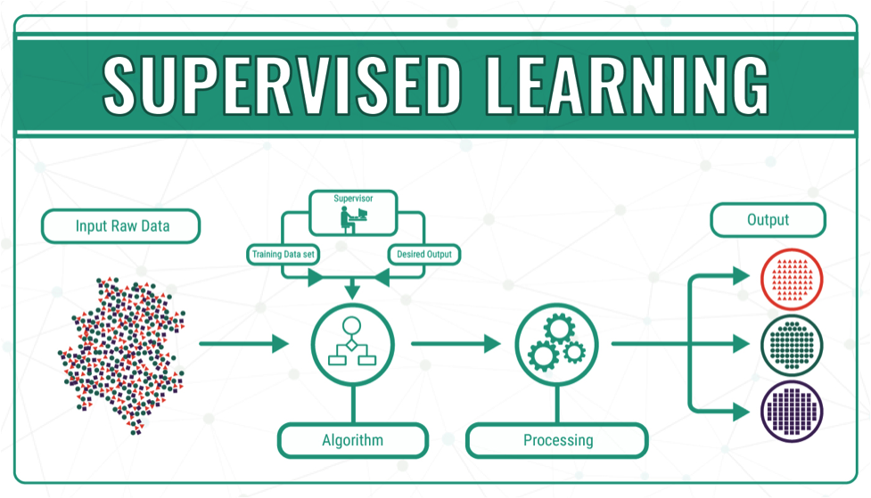
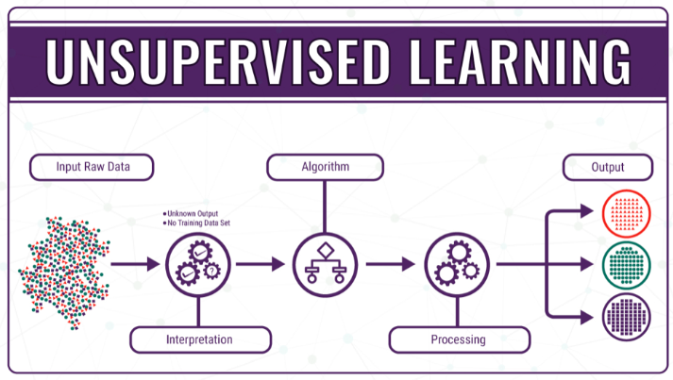
Introduction
“Machine Learning is a field of study that gives the computers the ability to learn without explicitly programmed” .
Supervised learning
Unsupervised learning
Reinforcement learning
Fig 1: Supervised Learning
Fig 2: Unsupervised Learning

Slide 5
Cond…
Convolutional Neural Network (CNN):
CNN is a specific type of artificial neural network that uses perceptrons, a machine learning unit algorithm, for supervised learning, to analyze data.
CNNs apply to image processing, natural language processing and other kinds of cognitive tasks.

Slide 6
Cond…
YOLOv3 :
YOLO is a clever convolutional neural network (CNN) for doing object detection in real-time.
The algorithm applies a single neural network to the full image
Divides the image into regions and predicts bounding boxes and probabilities for each region.
These bounding boxes are weighted by the predicted probabilities.
Notes:
https://towardsdatascience.com/batch-normalization-in-neural-networks-1ac91516821c
As shown above, compared with RetinaNet, YOLOv3 got comparable mAP@0.5 with much faster inference time
For example, YOLOv3–608 got 57.9% mAP in 51ms while RetinaNet-101–800 only got 57.5% mAP in 198ms, which is 3.8× faster.

Slide 7
Literature Survey
Year | Methods | Remarks
2014 | “Smart shopping cart with automatic billing system through RFID and ZigBee”-Chandrasekar, P., & Sangeetha, T. | Implemented with a Product Identification Device Contains microcontroller, LCD, an RFID reader, EEPROM, and ZigBee module.
2015 | “RFID Based Automatic Billing Trolley”-Chandrasekar, P., & Sangeetha, T. | Consists of RFID reader each product has RFID tag. Item name and cost is displayed on the LCD screen.
2016 | “Smart Trolley And Automatic Billing”-Thakur Prerana , Shikha Ranjan, Prachi Kaushik | Consists of RFID, ARM7 , Display, Power supply, Switch, IR sensor pair, Barcode reader Visual Basics. It uses barcode reader as well as RFID.

Slide 8
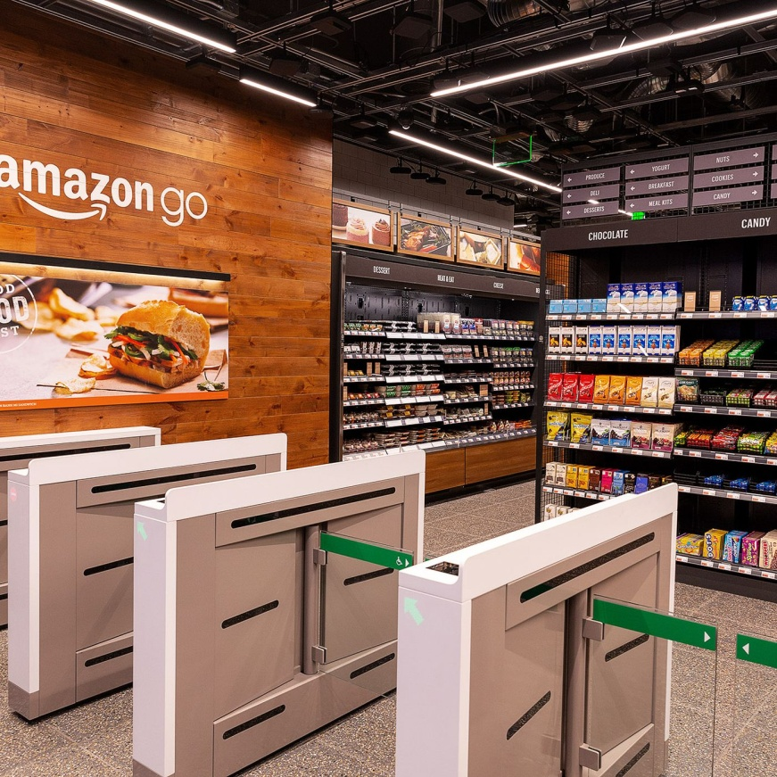
Existing Solutions
Amazon Go
Is a chain of convenience stores the United States operated by the online retailer Amazon. It has 26 open and announced store locations in Seattle, Chicago, San Francisco and New York City, as of 2020.
Fig 3 : Amazon Go

Slide 9
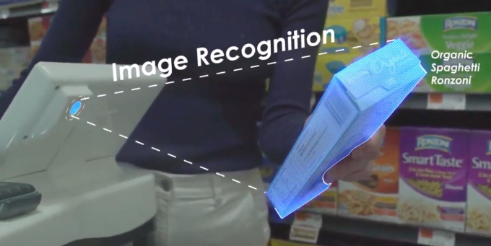
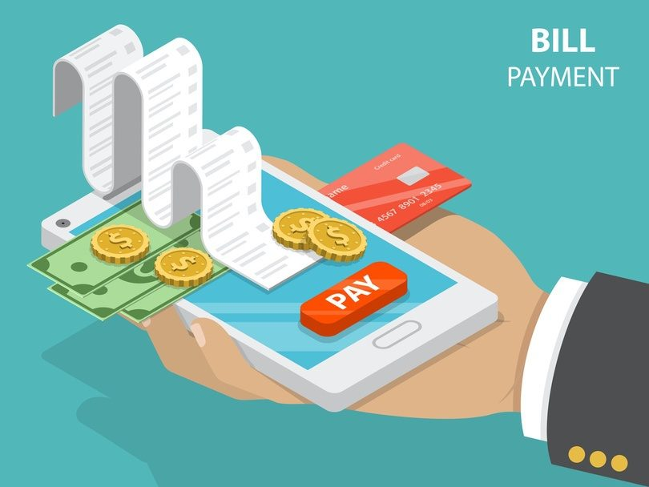
Modules
1. Object recognition Module
2.Billing Module
Fig 4: Object Recognition
Fig 5 : Automatic Billing System

Slide 10
Contd..
Object detection: pre-trained model YOLOv3 trained on COCO dataset is used.
COCO dataset consists of 80 classes: 80,000 training images
and 40,000 validation images.
Billing System: Web application is designed using Tkinter framework.
Language used is python.
Notes:
The algorithm applies the CNN to an entire image. YOLOv3 divides the image into the 19x19 grid cells, and finds the bonding boxes while predicting probabilities for each of these regions.

Slide 11
Algorithm
Algorithm: Yolov3
Input: Input image
Step 1: The input image goes through a CNN resulting (19,19,5,85) dimensional output.
Step 2: After flattening the two dimensions, the output is a volume of shape (19, 19, 425) 2.1. Each cell in a 19x19 grid 2.2. 425 = 5 x 85, each cell contains predictions for 5 boxes
2.3. 85 = 5 + 80 where 5 is because (𝑝𝑐,𝑏𝑥,𝑏𝑦,𝑏ℎ,𝑏𝑤) has 5 numbers, and and 80 is the
number of classes
Step 3: Selection of boxes is based on: 3.1. Score-thresholding(throw away boxes that have detected a class with a score less
than the threshold)
Step 4: Non-max suppression: Compute the Intersection over Union and avoid selecting
overlapping boxes
Output: This gives us YOLO’s final output.

Slide 12
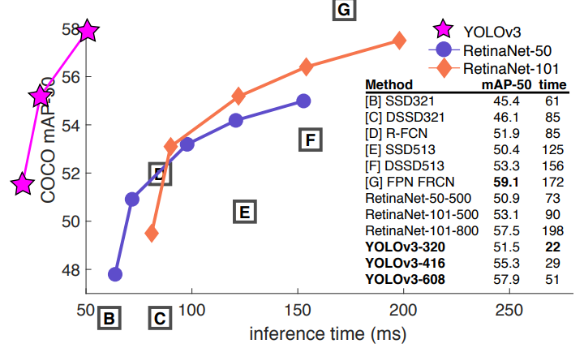
Comparison between Yolov3 and previous work
YOLOv3 got comparable precision@0.5 with much faster inference time
Notes:
Coco -Its dataset contains 330K images, 1.5 million object instances along with greater than 200K labeled.

Slide 13
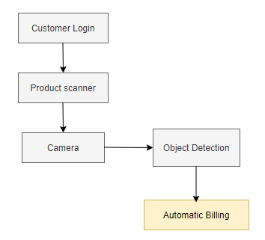
Block diagram

Slide 14
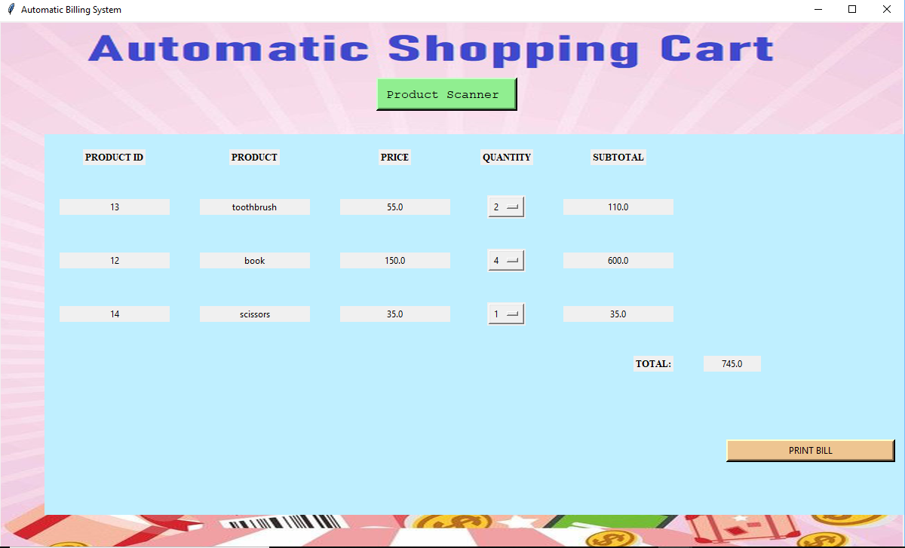
Results
Fig 6: Experimental Output

Slide 15
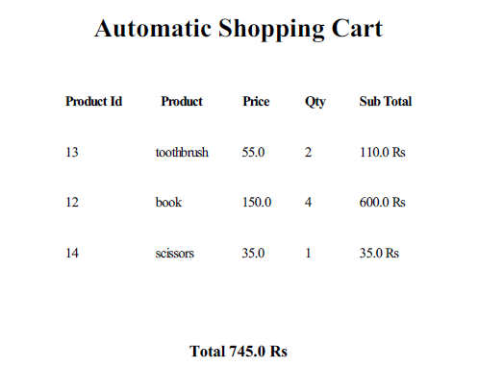
Cond….
Fig 7: Bill Generated

Slide 16
Conclusion
It not only eradicates long queues but also manages the budget of the customer.
It is automated and far better than the existing Barcode system.
The system also has a very quick and easy billing option.
The customer can login to his account using account credentials and start their shopping.
Each product taken by the customer is detected and the corresponding price is displayed.
The final result is the Bill which is generated at the end of the shopping.

Slide 17
References
[1]Dr.Suryaprasad J, Praveen Kumar B O, Roopa D Arjun A K, A Novel Low-Cost Intelligent Shopping Cart, Proceedings of the 2nd IEEE International Conference on Networked Embedded Systems for Enterprise Applications, NESEA 2011, Perth, Australia, December 8-9, 2011
[2] Jadhav Rahul Shankar1 Avale Pradeep Nandkumar2 TaraliShivkumar Vaijanath3 Prof. Pawar S. U 4 “RFID based Automatic Billing Trolley”IJSRD - International Journal for Scientific Research & Development| Vol. 3, Issue 02, 2015 | ISSN (online): 2321-0613
[3] Li, R., Song, T., Capurso, N., Yu, J., Couture, J., & Cheng, X. (2017). IoT Applications on Secure Smart Shopping System. IEEE Internet of Things Journal, 4(6), 1945–1954. doi:10.1109/jiot.2017.2706698
[4] Li, R., Song, T., Capurso, N., Yu, J., Couture, J., & Cheng, X. (2017). IoT Applications on Secure Smart Shopping System. IEEE Internet of Things Journal, 4(6), 1945–1954. doi:10.1109/jiot.2017.2706698
[5] Rajithkumar, B. K., Deepak, G. M., Uma, B. V., Hadimani, B. N., Darshan, A. R., &Kamble, C. R. (2018). Design and Development of Weight Sensors Based Smart Shopping Cart and Rack System for Shopping Malls. Materials Today: Proceedings,5(4),1081410820.doi:10.1016/j.matpr.2017.12.367

Slide 18
Paper Publications
Attended ICMISC International Conference on Machine Learning and Smart Computing, Date:21-22 May,2020 .

Slide 19


