Slide 1

Coding Agents
Claude Code · OpenCode · Kiro CLI · Codex
From autocomplete to autonomous agents — a knowledge sharing session
[Your Name] · [Date]

Slide 2





Agenda
What Are Coding Agents?
1
Evolution from autocomplete to autonomous
The Major Players
2
Claude Code, OpenCode, Codex CLI, Gemini CLI, PearAI
Under the Hood
3
TUI, agentic loop, built-in tools, context management
Comparison & Architecture
4
Feature table, CLI vs IDE vs modular patterns
Practical Tips & Findings
5
What we've learned using these tools

Slide 3
What Are Coding Agents?
2022
Autocomplete
Key Capabilities
GitHub Copilot, tab-complete suggestions
Read & understand entire codebases
Execute shell commands & run tests
Multi-file edits with context awareness
Git operations (branch, commit, PR)
Self-correct based on errors & failures
MCP tool extensibility
2023
Chat + Inline Edit
Cursor, ChatGPT for code Q&A
2024
Agentic Workflows
File edits, shell commands, git integration
2025-26
Autonomous Agents
Plan → execute → test → iterate → PR

Slide 4
The Major Players
Claude Code
OpenCode
Codex CLI
Gemini CLI
Anthropic
Open Source
OpenAI
Google
Terminal-native, deep reasoning,
highest first-pass accuracy (~95%)
Model-agnostic, 120K+ GitHub stars,
privacy-first, BYOM platform
Sandbox-first execution safety,
included with ChatGPT plans
1M token context, free tier,
multimodal inputs, Google Search

Slide 5

Claude Code
by Anthropic · Proprietary · CLI-native
Agentic Search
Auto-navigates codebases without manual context selection
~95%
First-pass accuracy
Context Compaction
Monitors token usage & compresses history automatically
4%
of all GitHub commits
20+ Built-in Tools
Write, Read, Edit, Bash, Task, TodoWrite, Grep, WebSearch…
$20-200
/month (Pro to Max)
Subagent System
Plan (633 tokens), Explore (516), Task (294) specialized prompts
v2.1.63
Latest version
SWE-bench Pro
57.5% accuracy — highest among CLI agents

Slide 6
OpenCode
Open Source · Model-Agnostic · Terminal + Desktop + IDE
BYOM (Bring Your Own Model)
75+ providers via Models.dev — Claude, GPT, Gemini, Ollama local
120K+
GitHub Stars
Build & Plan Agents
800+
Tab to switch between full-access dev and read-only analysis
Contributors
Air-gapped Mode
5M+
Run with local models via Ollama for defense, healthcare, fintech
Monthly active developers
YAML Subagent Architecture
Free
Declarative agents in .opencode/agents/ with permissions
Open source (BYOK for APIs)

Slide 7
Code Agent Philosophy
No Embeddings, classifiers or pattern matching
Lean on simple, flexible tools
Trained on vast tool use datasets

Slide 8
Core Tools
Read- view file contents
Grep/Glob- search code and find files by pattern
Edit- Modify existing files (diff)
Bash – Execute shell commands
Websearch/WebFetch- Search the web and fetch URLS
ToDoRead/TodoWrite – Task Management
Task- Delegate sub-tasks to isolated sub-assistants

Slide 9
How It Works: The Agentic Loop
Every coding agent runs the same fundamental pattern under the hood
User
Prompt
→
LLM
Reasoning
→
Tool
Call
→
Execute
& Return
→
Check:
Done?
↺ Loop until stop_reason ≠ tool_use
Pseudocode
Key Insight
while true:
response = LLM(messages, tools)
if response.stop == 'end_turn':
break // done, show result
tool_name = response.tool_use.name
result = execute(tool_name, args)
messages.append(result)
The agent isn't magic — it's a simple while-loop that calls the LLM, checks if a tool was requested, executes it, and feeds the result back. The intelligence comes from the model; the engineering is the harness.

Slide 10
Built-in Tools: Agent's Toolbox
These tools are what turn an LLM from a text generator into a coding agent
Read
file system read
Write
file system write
Edit
string match & replace
Read file contents with line numbers. Supports pagination for large files, images, PDFs, notebooks.
Create new files or overwrite existing. Sends entire file content. Used for new files.
Exact string replacement in files. Sends only the changed lines — much more token-efficient than Write.
Bash
shell execution
Grep
ripgrep (rg)
Glob
glob pattern match
Execute shell commands in a persistent session. git, npm, pytest, docker — any CLI tool.
Powered by ripgrep under the hood. Regex search across codebase, respects .gitignore.
Fast file pattern matching: **/*.ts, src/**/*.test.js. Returns paths sorted by modification time.

Slide 11
Bash as the main adapter
Thousands of tools in one
One of off Python Script -> Run it -> Delete it
Agent composes small shell tools(rg, jq, pytest, npm) as needed
Let’s model try different things

Slide 12
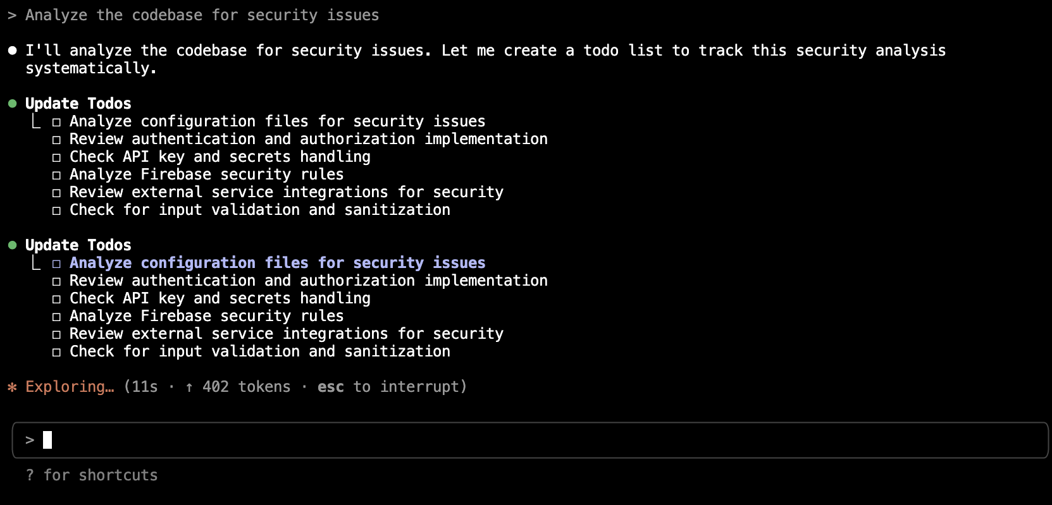
To Do Lists
Exactly one task in progress at a time
Mark tasks completed after finishing
If blocked/error, keep in_progress, create new_task
Useful for complex multi-step tasks

Slide 13
Sandbox environment

Slide 14

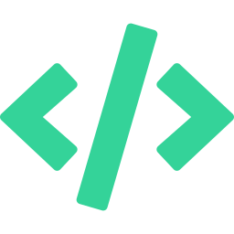


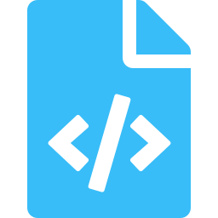
TUI: Terminal User Interface
How coding agents render their interactive terminal experience
TUI Frameworks Under the Hood
What the TUI Gives You
Claude Code
Streaming output — see the agent think in real-time
Ink (React for terminal) — JSX components render to TTY, not DOM
Inline diffs — visual before/after for file changes
OpenCode
Bubble Tea (Go) — Elm architecture: Model → Update → View loop
Tool call visibility — see which tool was invoked & why
Gemini CLI
Permission prompts — approve/deny before execution
TypeScript-based — ReAct loop with shell rendering + checkpoints
Session management — /undo, /compact, /resume
Codex CLI
Rust core — lightweight terminal rendering, minimal UI chrome
File references — @ mentions for fuzzy file search

Slide 15

More Tools & MCP Extensibility
Orchestration Tools
OpenCode-Specific Tools
Task / Agent
Spawn sub-agents with isolated context for complex multi-step work
LSP
Go-to-definition, find references, hover — native code intelligence
TodoWrite
Create & track task lists — agent self-manages progress through steps
List
Directory listing with glob filters, powered by ripgrep
WebFetch
Fetch URL contents for docs, APIs, references
@general
Invoke subagent for complex multi-step searches mid-conversation
WebSearch
Search the web for current info, library docs, error solutions
MCP — Model Context Protocol
GitHub / GitLab
Jira / Linear
Google Drive
The open standard for extending agents with external tools. All major agents support MCP.
Slack
Databases
Custom APIs

Slide 16
Context Management
How agents handle the limited context window without losing track
Tier 1: Tool Output Pruning
Old tool outputs are trimmed from message history. File contents, grep results, and bash outputs that are no longer relevant get dropped first.
Tier 2: Auto-Compaction (~92%)
At ~92-95% capacity, the conversation is summarized automatically. Architectural decisions and key context are preserved; redundant outputs are discarded.
Tier 3: Manual /compact
Developer triggers compaction with a focus hint: /compact focus on auth refactor. Resets the conversation to a condensed summary of what matters.
Each turn re-prices the entire context. Turn 50 processes 50× more input tokens than turn 1. Compact early and often!

Slide 17
Real Workflow: Debugging a Bug
Step-by-step: what tools fire when you say "fix the failing auth test"
1
TodoWrite
Create task list: investigate failure, find root cause, fix, verify
2
Grep
Search for error message pattern across codebase
3
Read
Read the failing test file + the source file it tests (batched)
4
Bash
Run the failing test to reproduce: npm test -- --testPathPattern=auth
5
Edit
Apply the fix — exact string replacement, only changed lines sent
6
Bash
Re-run tests to verify fix passes
7
Bash
git add && git commit — auto-generated commit message

Slide 18
Architecture Patterns
CLI-First
(Claude Code, Codex)
Modular Agents
(OpenCode)
IDE-Integrated
(PearAI, Cursor)
User ↔ Terminal ↔ Agent
Agent reads repo directly
Shell commands for execution
Checkpoints via git
Primary + Subagent system
YAML config per agent
Model swappable per task
Permissions & sandboxing
Editor state + buffers access
Code index for retrieval
Inline edits + chat pane
Model router dispatching

Slide 19


Key Takeaways
CLI agents are no longer autocomplete — they plan, execute, test, and iterate autonomously
Under the hood it's a simple while-loop: LLM → tool call → execute → repeat
The market is split: proprietary polish (Claude Code) vs. open freedom (OpenCode)
Security, sandboxing, and data privacy are key differentiators — not just code quality
MCP is the emerging standard — extend agents with GitHub, Jira, Slack, custom APIs

Slide 20
Questions &
Discussion
Let's talk about your experiences with coding agents!

Slide 21
Codex CLI & Gemini CLI
Codex CLI · OpenAI
Gemini CLI · Google
Sandbox-first execution (Seatbelt / Docker)
3 autonomy levels: Suggest → Auto Edit → Full Auto
Rust-based core for performance
Custom diff-based patching (not string replace)
GitHub Action for automated PR/issues
Included with ChatGPT Plus ($20/mo)
1M token context window (standard)
Free tier: 1,000 req/day on Flash
ReAct reasoning loop + shadow-git checkpoints
Google Search grounding for live info
Multimodal: text, images, PDFs, video
Deep Think mode for complex reasoning

