Slide 1
Elections
Choose wisely, this is your chance to prove if election by popular vote works or not

Slide 2
Announcements
Congratulations to all graduating members
Next week is Movie Night

Slide 3
Elections
Voting Method
No fake voters here!
http://j.mp/2oapeMQ

Slide 4
President
Kaan Goksal
Brice Nsiangani

Slide 5
Vice-President
Tyler Flynn
Brice Nsiangani
Kaan Goksal

Slide 6
CTF Captain
Wesley Cheung
Brice Nsiangani

Slide 7
Vice-CTF Captain
Wesley Cheung
Joshua Jacob
Tyler Flynn
Brice Nsiangani

Slide 8
External Communications Admin
Caleb Hess
Jacob Butler
Brice Nsiangani
Tommaso Pieroncini

Slide 9
Internal Communications Admin
Brice Nsiangani
Tommaso Pieroncini

Slide 10
Website Admin
Andrew Ray
Harsh Gupta
Brice Nsiangani
Tommaso Pieroncini

Slide 11
A/V Admin
Harsh Gupta
Brice Nsiangani

Slide 12
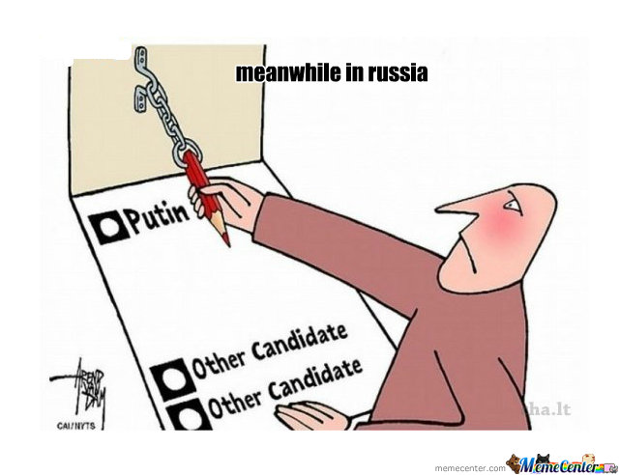
Allow the votes

Slide 13
Congratulations to all our new officers!

Slide 14
Password Hashing

Slide 15
What’s going on
Logging on requires two things
Username
Password
Imagine you’re a hacker
Discover a vulnerability in the web application
Get access to list of all the usernames and passwords
Game over for every single one of those users

Slide 16
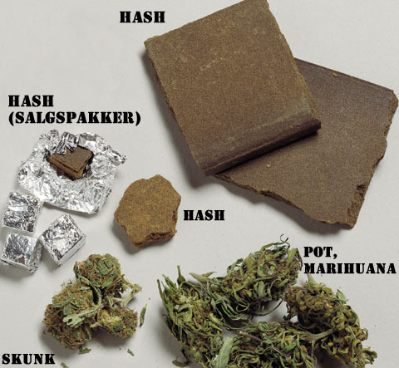
So passwords are bad
How do you store a password without storing the password?
With a ton of this

Slide 17
What is password hashing?
Hashes are one way functions
Fixed length “fingerprint”
Ex.
hash("hello") = 2cf24dba5fb0a30e26e83b2ac5b9e29e1b161e5c1fa7425e73043362938b9824 hash("hbllo") = 58756879c05c68dfac9866712fad6a93f8146f337a69afe7dd238f3364946366
Notes:
How does login process work
Want cryptographic hashes (SHA256, SHA512, WHIRLPOOL)
Not hash functions used to implement data structures – designed to be fast, not secure

Slide 18
So we’re safe now!
Not quite
Dictionary and Brute Force Attacks
Notes:
Easy – guess the word, if it’s the same hash as the one you’ve got, then you’ve found the password!
Difference between dictionary and brute force?
Derive every hash from scratch every time?

Slide 19
Lookup Tables
Lookup Table:
Input: Your hash
Output: The password
https://crackstation.net/
E4ba5cbd251c98e6cd1c23f126a3b81d8d8328abc95387229850952b3ef9f904
Rainbow Table
Similar to lookup table, but uses less space
Not as fast but fast enough
Notes:
There are tables to crack any md5 hash of a password up to 8 characters
Fundamental problem – you hash your pass and I hash my pass, and we get the same hash every time

Slide 20

Adding Salt
Hash the password differently each time
Hash(“hello” + “QxLUF1bgIAdeQX”)
hash("hello" + "bv5PehSMfV11Cd")
Salt does not need to be secret – attacker can’t precompute their lookup tables without the salt
Notes:
Salt = random string prepended/appended to password before hashing
To check if hash is correct, we need the salt to be stored with password hash

Slide 21
Common errors
Using the same salt for all your passwords
Using the username as the salt
Using a short salt
If only 3 ASCII characters, 95x95x95 possibilities = 857,375 salts
If each lookup table costs 1MB of most common passwords, collectively less than 1 TB
Good rule of thumb: Make hash same size as output of hash function:
Ex. If SHA256 generates 32 byte value, then have a 32 byte salt
Notes:
Same salt? Can compute a lookup table
Username? Predictable, lookup tables can be computed for common usernames
Short salt? Attacker can build lookup table for every possible salt

Slide 22

sash wringing, mash flinging, hash-slinging slasher
Some fun schemes people have used
md5(sha1(password))
md5(md5(salt) + md5(password))
sha1(sha1(password))
sha1(str_rot13(password + salt))
md5(sha1(md5(md5(password) + sha1(password)) + md5(password)))
NO. JUST NO.
Notes:
Problem: attacker typically has source code access
Not difficult to reverse engineer algorithm – only ups the difficulty by a constant factor
Better to use well tested, well known functions

Slide 23
Hash Collisions
Cryptographic hash functions
MD5 Collision resistance in 2^18 time.
Less than a second on normal computer
With dedicated FPGAs or GPUs, easily break insecure hashes
Best for now
256 bit output and above
Standard construction such as PBKDF2
SHA-256, SHA-512, WHIRLPOOL, etc.
Notes:
Crypto functions – designed to make collisions very small
Attacks can make collisions easier
Password-Based Key Derivation Function 2 – RSA labs

Slide 24
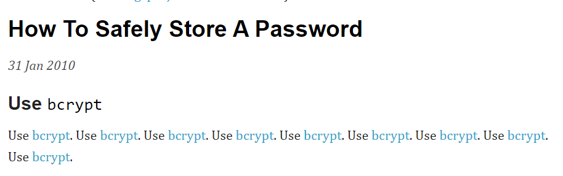
Takeaways
Don’t make your own hash functions
Use well known libraries that already implement this for you
Java.security.SecureRandom
Python’s os.urandom
C/C++’s CryptGenRandom
/dev/random or /dev/urandom
Ton of great info from
Crackstation.net
Notes:
Bcrypt is a scalable hash function - slow
Just increase a weight factor

