Slide 1
SQL Injection
09-15-16
Siddarth senthilkumar

Slide 2

Club news
CSAW CTF: THIS WEEKEND!!
6PM Friday – if you want to be awesome, you’ll stop by
10AM Saturday
Tacos, Food, Fun, Hacking, Coolness, etc.
If you join our team, YOU could get excused from your classwork to compete in the finals!!
Next week Cisco
Car hacking
Email list issues, our bad
Join #thedeepestweb on freenode IRC to chill with past GreyHat alumni and talk to really cool people

Slide 3
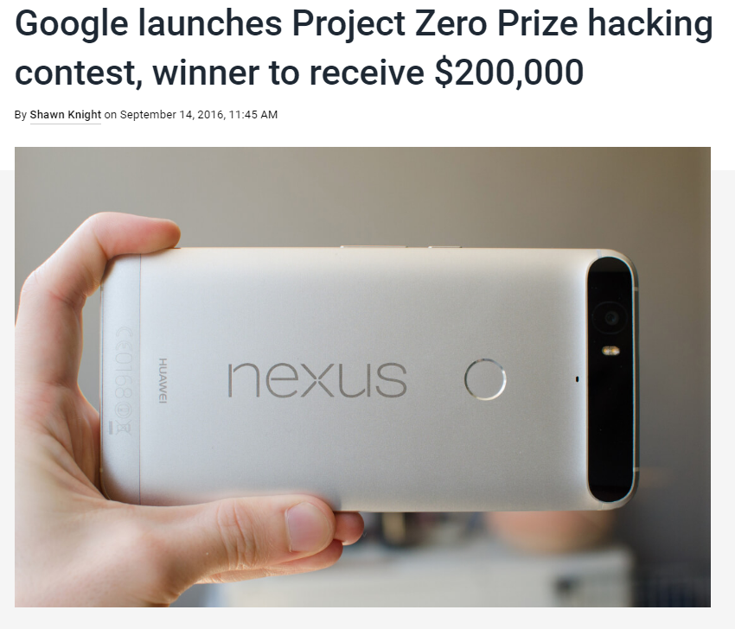
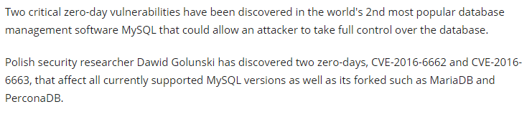
Other cool news
Google says bye to HTTP
No Patch from Oracle yet!
Notes:
MySQL Inject a path into malicious library into wrapper file used by many MySQL packages

Slide 4

3 Types of sql injection
Simple
Error based
Blind
Notes:
Simple – We’ll see in a bit
Error Based – Look at error messages that leak implementation details about database
Blind – Generic error message

Slide 5
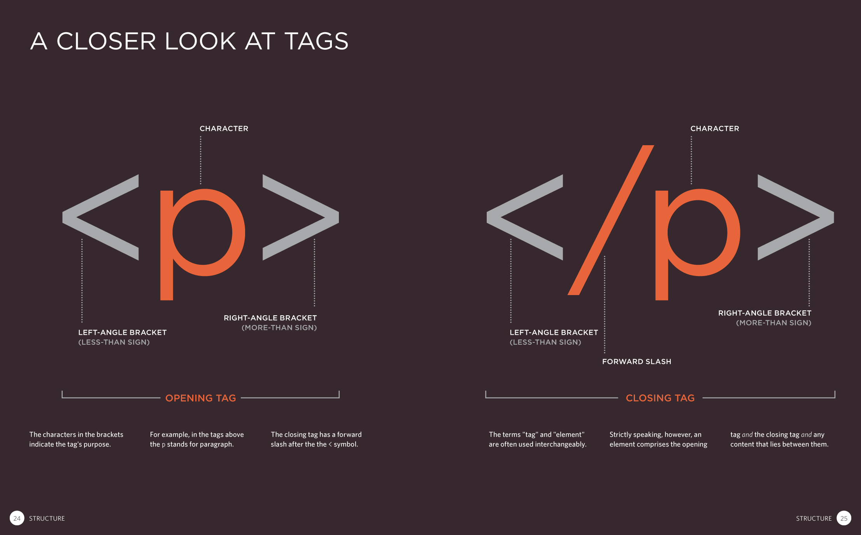
Network security basics
OWASP – Open Web Application Security Project
Everyone uses the internet
But how does it “work”?
Notes:
OWASP – non profit focused on improving security of software worldwide.
Best Practices
All the materials are free, books, etc.

Slide 6
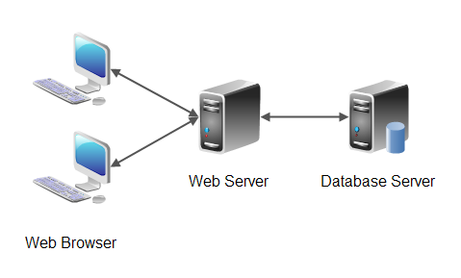
Web server architecture

Slide 7

languages
Web Browser
HTML/CSS
JavaScript
JSON
Web Server
Python
PHP
ASP
Perl
Ruby
Database
SQL
NoSQL

Slide 8
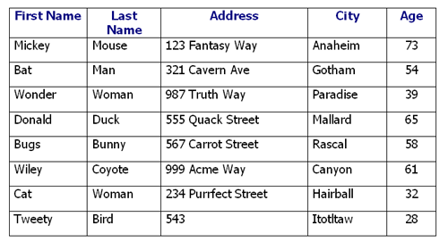
SQL is a query language
You don’t “program” in SQL – not intended to be able to write for loops, complex if/else structures, etc.
Databases are organized as tables.
Column name
Row of data - a tuple
Table Name
ADDRESS

Slide 9
SQL 101
Structured Query Language
Standard programming language for interacting with databases
Example Commands:
SELECT – retrieve data
DROP – delete table
INSERT – add row to table
UPDATE – modify row in a table
DELETE – remove row from table
-- Comments are written with a dash dash space in front

Slide 10
Sample sql statements
>SELECT FIRST_NAME FROM ADDRESS WHERE LAST_NAME=‘Mouse’;
<Mickey>
>SELECT * FROM ADDRESS WHERE AGE>60;
<Mickey, Mouse, 123 Fantasy Way, Anaheim, 73>
<Donald, Duck, 555 Quack Street, Mallard, 65>
<Wiley, Coyote, 999 Acme Way, Canyon, 61>
>SELECT * FROM ADDRESS WHERE TRUE;

Slide 11
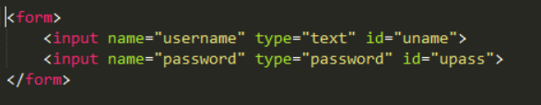

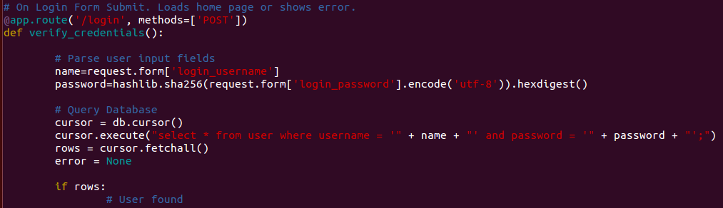
How users interact with the database

Slide 12
SQL Injection
Inject SQL commands with unsanitized user data
Steal, modify, destroy data
What does unsanitized mean?
Sanitization – cleaning
Clean input by removing all special characters; disallow certain characters, etc.
Very dangerous to directly process user input without sanitizing it first.
Notes:
User input is evaluated directly without any preprocessing
To remove special characters and such

Slide 13
Let’s take another look at that script
Important part:
cursor.execute(“select * from user where username=‘” + name + “’ and password = ‘” + password + “’;”)
The input NAME and PASSWORD are not sanitized at all! They interact DIRECTLY with the database!
> This is an attack vector.
Notes:
If you’re being astute – not really true.
What am I doing with the password field, and why?

Slide 14
How can we attack this input
cursor.execute(“select * from user where username=‘” + name + “’ and password = ‘” + password + “’;”)
Can we input text into the username field to execute arbitrary SQL code?
Let’s say we want this statement to be run:
select * from user where username=‘’ OR TRUE; --
What do we input into the username?
‘ OR TRUE; --
The result?
cursor.execute(“select * from user where username=‘’ OR TRUE; -- ’ and password=‘???’;
This gives us all the tuples in that table!
select * from user where username=‘’ OR TRUE; -- ‘ AND password = ‘????’;
Notes:
Attention – why did I put the two dashes?

Slide 15
Quick Easy example
https://2013.picoctf.com/problems/injection/index.php
Notes:
If you came to CTF practice last year this will look familiar
Simple, textbook SQL injection – make a statement that evaluates to TRUE for every row
Side Note: This is why we always store password hashes!

Slide 16


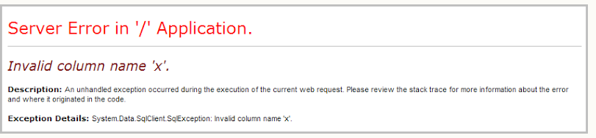
Error based sql injection
Maybe a normal query to the database for a website looks like this:
What happens if we do this?
X = 1 is not valid SQL syntax iff there is no column in the database called X
So the server may throw an error message like this:
This is terrible! The server is leaking internal database information to the user via an error, making this the perfect target for error based SQL injection.
Write more complicated SQL statements that leak details such as table names, column names, and even data types
Notes:
Before, we guessed at the table names. Now, we have the server giving it all up to us by default.
Won’t go into details of it but just know that error based SQL injection is a simple task.

Slide 17
Ok, the web app developer got a bit smarter
He fixes the problem by creating a default error page – perhaps just a blank page. Whenever the site experiences an internal error due to a request, it serves up the default error page.
Is it secure now?

Slide 18
Blind sql injection
Form queries resulting in Boolean values, and interpreting the output HTML pages
Happens when web app configured to show generic error messages but still not mitigated SQLi vulnerable code.
When database doesn’t output the data from the database, attacker steals data by asking database true/false questions about it.
Blackhat guy - “Blind attacks are essentially playing 20 questions with web server”
Sped up with automation tools.
Burpsuite
SQLmap
8 letter username takes ~56 requests
Notes:
~7 requests per character.
Using binary search character by character, an 8 letter username takes 56 requests.

Slide 19
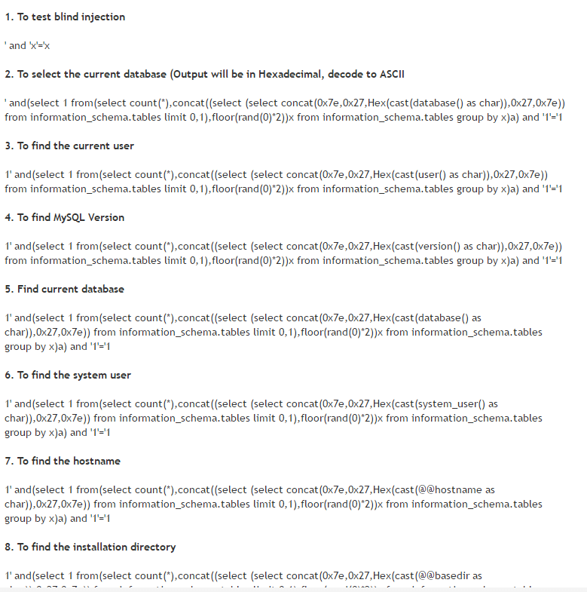
Cheat sheets

Slide 20
Blind sql injection demo
http://web2014.picoctf.com/injection4/

Slide 21
Other attacks
Time based SQL Injection attacks
Instead of figuring HTML output, inject:
Encoding based
More
waitfor delay '00:00:10'--

Slide 22
SQL injection is a very common attack
Oracle
MySpace
LinkedIn
JP Morgan
Ashley Madison
Sony
Any time you read in the news “x million usernames and passwords stolen from ____”, it was probably SQLi

Slide 23
disclaimer
Companies don’t tend to like when you purposefully attack their websites. (selfish, right?)
Using automated tools is “noisy” – easily detectable.
Don’t test these things on websites unless you explicitly have permission from the site owner to do so.
If you want to practice:
CTF problems
http://www.codebashing.com/sql_demo
Google “SQL Injection practice” – demo vulnerable web servers available for download
OverTheWire

Slide 24
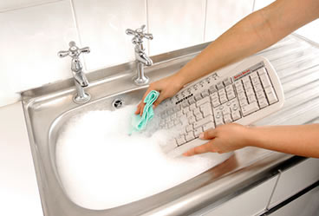

Mitigation
Always sanitize your inputs!
Never trust the user!
Don’t leak implementation to user!

Slide 25
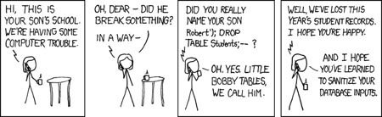
Questions?
xkcd
Did I really give a presentation on SQLi if I didn’t show you this comic?

