Slide 1
Padding Oracle Attacks
To get a head start, please go here!:
http://130.207.1.252/
GreyHat – 11/03/16
Siddarth senthilkumar

Slide 2
Overview
1) Basic Math
2) Block Ciphers
3) Padding & Padding Oracles
4) Demo
5) Real World Examples

Slide 3
Demo Step 0
Follow instructions here:
http://130.207.1.252/

Slide 4
What is Cryptography
How to send information securely from one party to another securely
It should be Hard to crack the original message without the key
Ciphertext, plaintext, key
Notes:
Purpose: Insecure Channels. Always assume someone reads
Ciphertext, Plaintext

Slide 5
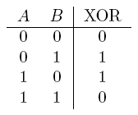
1) Basic Math
On computer, all information is stored as bits.
Encrypting bits == Encrypting message
Important Property:
K ⊕ P ⊕ K = P
Think of the first XOR as encrypting, second XOR as decrypting.
K ⊕ P = C
C ⊕ K = P
Example: K = 68, P = 90
68 ⊕ 90 = 1000100 ⊕ 1011010 = 0011110 = 30
30 ⊕ 68 = 0011110 ⊕ 1000100 = 1011010 = 68
Notes:
One Time Pad uses just XOR, but has practical issues
To combat issues, other encryption standards made

Slide 6
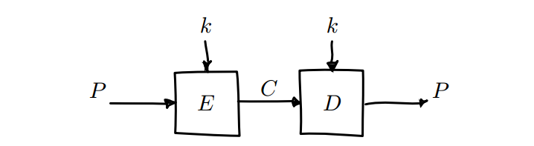
2) Block Ciphers
Symmetric Encryption
Take a plaintext block of bits, encrypt it using key.
Take a ciphertext block of bits, decrypt it using the key.
Examples: AES, DES, Blowfish, RC5
Have Modes of Operation
Notes:
2 ways to do a block cipher – dumb way, and a better way

Slide 7
ECB Mode
ECB – Electronic Codebook Mode. Take a block of plaintext, encrypt, repeat. Insecure.
Identical plaintexts map to identical ciphertexts!
Crack with frequency analysis
Notes:
ECB problem: identical plaintexts encrypt to identical ciphertexts.
Illustrate problem visually

Slide 8
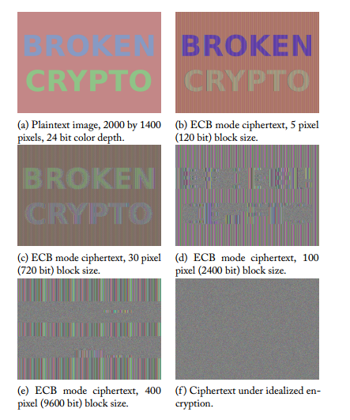

Slide 9
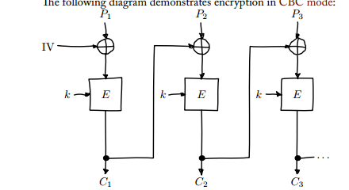
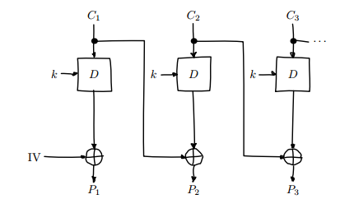
CBC Mode
Cipher Block Chaining – Use output of one encryption as input for the next.
Ensures each block will have different output, even if each block has same plaintext.
ENCRYPTION DECRYPTION

Slide 10
3) Padding
Assume a block size of 16 bytes.
Let’s say the plaintext completely fills a bunch of blocks until the last block, where it only fills 10 bytes.
Still need 16 bytes in that last block! Need to pad plaintext somehow.
Carefully chosen pad – application needs to distinguish plaintext bytes from pad bytes

Slide 11
Padding (Cont’d)
Most common – PKCS#7
The value of each added byte is the number of bytes that are added, i.e. N bytes, each of value N are added.
Ex. Let’s say there are 5 bytes remaining in an 8 byte block for which we are creating a pad.
[a8 b3 44 05 05 05 05 05]
What if we don’t need a pad?
[a8 b3 44 42 13 09 c12 31] [08 08 08 08 08 08 08 08]
If it had been a 16 byte block, would have looked like
[…..][10 10 10 10 10 10 10 10 10 10 10 10 10 10 10 10]

Slide 12
Padding Oracle
Oracle – something from the Matrix that tells you your future
Padding Oracle – something that tells you whether a given block has valid padding or not
So, let’s say I have a ciphertext block that I submit to a server
Server decrypts it using its private key, and has a plaintext
It checks “is this padding valid” – aka repeating number of bytes padded
If yes, tells you “your pad was valid”. If no, tells you “your pad was not valid”
BROKEN!

Slide 13
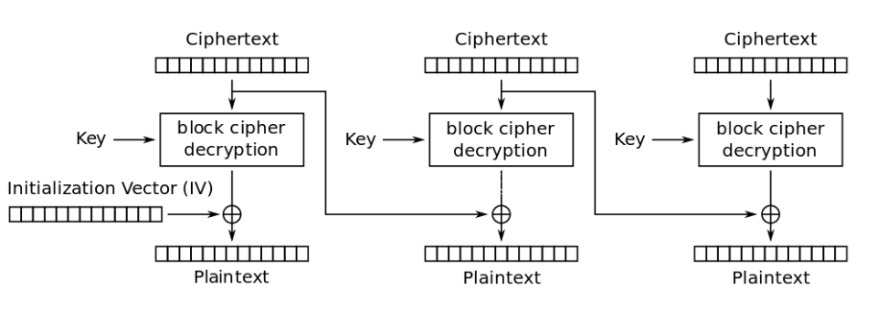
B-But…How?
C1
C1’
C2
We are going to make our own version of C1, call it C1’.
We submit C1’ + C2 to the server.
The server will tell us “This was a valid pad!”
We use C1’, C1, and C2 to get P2.
P2

Slide 14
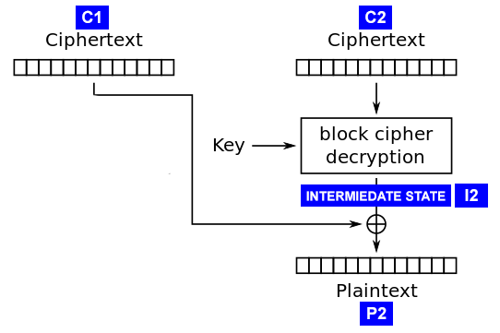

Where does our attack begin?
C1’
C1
Some properties of Intermediate Stage:
1) P2 = I2 ⊕ C1
2) I2 = P2 ⊕ C1
We make a C1’
-> Bytes [1, 15] are junk
-> Byte [16] = 00
C1’ ⊕ I2 = P2’
While server says “Padding NOT OK”:
Try C1’[16] = 01, 02, …, FF
When server says “PADDING OK”
-> P2’[16] must have been 01
P2’
P2
I2 = C1’ ⊕ P2'
I2[16] = C1'[16] ⊕ P2'[16]
P2[16] = C1[16] ⊕ I2[16]

Slide 15
How to get the other bytes before?
We aim to get a pad of 02 02 decrypted by the server
Goal: P2’ = [ __________________________ 02 02]
Currently, we know I2[16].
Let’s make a C1’ so that P2’[16] becomes 02
C1’[16] = P2’[16] ⊕ I2[16]
C1’[16] = 02 ⊕ I2[16]
We now have a byte C1’[16] so that P2’[16] will be 02
Let C1’ = [ _______________ 00 XX] <- XX is C1’[16]
⊕ I2 = [ ____________________ ]
--------------------------------------------------------
P2’ = [ ________________?? 02]
Increment 00 in C1’ until the ?? In P2’ is 02. When that happens, server will respond “PADDING OK!”
I2 = C1’ ⊕ P2'
I2[15] = C1'[15] ⊕ P2'[15]
P2[15] = C1[15] ⊕ I2[15]

Slide 16
Review
C1
C2
We are going to make our own version of C1, call it C1’.
We submit C1’ + C2 to the server.
The server will tell us “This was a valid pad!”
We use C1’, C1, and C2 to get P2.
P2

Slide 17
That was all for decrypting a single block. What about the rest?
Now, just repeat the process for every single block in the message!
Exception:
The very first block
If the IV is a secret, then we don’t know the C1 for the first block, so can’t use padding oracle against it.
At any rate, this isn’t a big deal –
Hopefully the first block is something like “Dear Aunt Sally” anyway

Slide 18

Analysis
Essentially, for each byte of the C1’, we check all 256 values to figure out which one results in a valid pad.
How many queries does it take to crack a message?
= 256 queries/byte * 16 bytes / block * n blocks / message
= 4096n queries/message
Let’s say there are 1000 blocks in your message
(1000 * 16 bytes = 16KB)
4096 * 1000 = 4 096 000 queries / message
If each query takes 1ms, that’s about 4 096 000 ms, or ~68 minutes
On average, we only need to make half those queries
~34 minutes to crack a message

Slide 19
Demo
http://crypto.chal.csaw.io:8001/

Slide 20
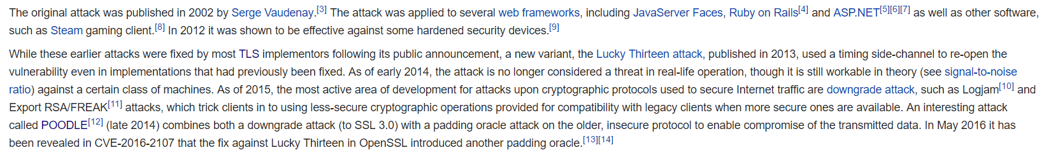
Have Padding Oracle Attacks Happened in Real Life?
Yes!!

Slide 21
References/Questions?
http://robertheaton.com/2013/07/29/padding-oracle-attack/

