Slide 1
One time pad & Many Time pad
09-??-16
Siddarth senthilkumar

Slide 2
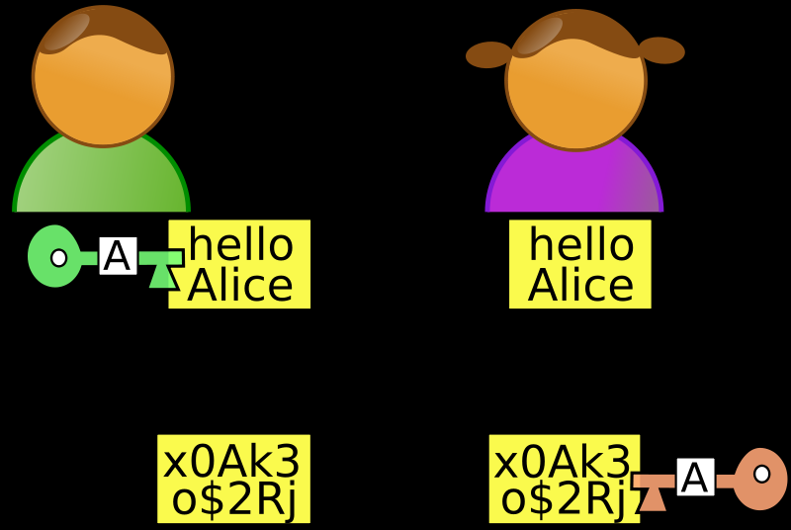

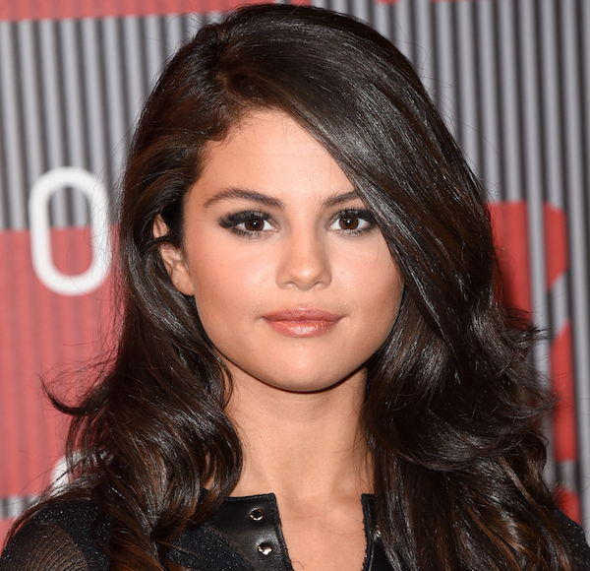

What is cryptography
BOB
ALICE
- How to send information securely from one party to another securely
- It should be Hard to crack the original message without the key.
Plaintext
Insecure
Ciphertext
Eve
Notes:
If you look carefully I wrote securely twice because that’s important – varying definitions securely:
Integrity, confidentiality, authentication (know who sent msg)
Eves: NSA/government agency, your dad, your girlfriend – doesn’t matter
- What do we mean by hard?

Slide 3
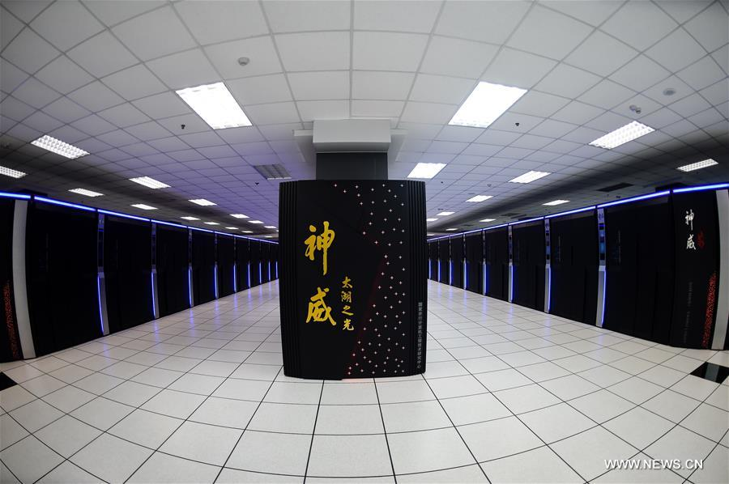
Notes:
National Supercomputing Center - Wuxi China
Our computers – 2-4 cores
This computer – 10 million cores
I can’t even imagine the number one million. Single spaced 1,000,000 characters = 328 pages.

Slide 4
What is cryptography
- Send information from one party to another securely
- It should be Hard to get the message text without the key.
Always assume there is someone else who reads your text.
How algorithm works should NOT be a secret!
Ex. IBM DES
Ex. Enigma
Ex. RC4
Ex. Open Smart Grid Protocol
Ex. More
- Main Tool: Math
DON’T DO IT!
Notes:
What is Hardness? -> Even if every computer in the world was working for a hundred years to bruteforce
Always Assume: Starbucks, free wifi, unsecure. Capture traffic. Bank cannot be so nonchalant about you using their site on insecure channel. Need cryptography. HTTPS.

Slide 5
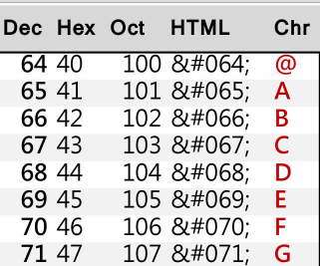
How data is stored on computer
Letter you want to store on a computer:
G
Look up on ASCII Table.
G = 71
Bits and Bytes
0s and 1s – base 2
In base 2, 71 = 0100 0111
8 bits = 1 byte.
Hexadecimal
Easier way for humans to read larger quantities of bits.
Just another base – base 16
0100 0111 becomes 47 in hex
Why not just keep it in decimal? Hex can easily be converted to binary by a human – 4 in binary is 0100, 7 in binary is 0111. 16 is 1111

Slide 6
realization
All information on computer is bits
If we figure out a way to encrypt bits, we can encrypt the message.
Vocabulary:
Plaintext – The message to be encrypted. “The readable English”
Ciphertext – A scrambled message. May look like “a9z1!@a$h0l3”
Key – Something you use to convert the Plaintext to Ciphertext, and vice-versa

Slide 7
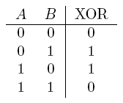
XOR Review
XOR = Exclusive OR
Important Property:
A ⊕ B ⊕ A = B
Think of the first XOR as encrypting, second XOR as decrypting
A is the key.
Example: D = 68, Z = 90
68 ⊕ 90 = 1000100 ⊕ 1011010 = 0011110 = 30
30 ⊕ 68 = 0011110 ⊕ 1000100 = 1011010 = 68
Notes:
All probably did truth tables in Geometry with T’s and F’s.
Do Ex. First – 68 = plaintext, 90 = key, 30 = ciphertext

Slide 8
One Time pad
“Perfect cryptography” – cannot be cracked if implemented correctly
How does it work?
1) Come up with a key that is at least as long as the message/data.
2) Encryption: Ciphertext = plaintext ⊕ key
3) Decryption: Plaintext = ciphertext ⊕ key
Provably Perfectly Secure; cannot be cracked - ever.

Slide 9
Why is it perfectly secure?
Let’s say we want to brute force attack the one time pad.
This means:
1) Guess every single key possible until we get the right key.
2) Then XOR the ciphertext with the key to get plaintext.

Slide 10
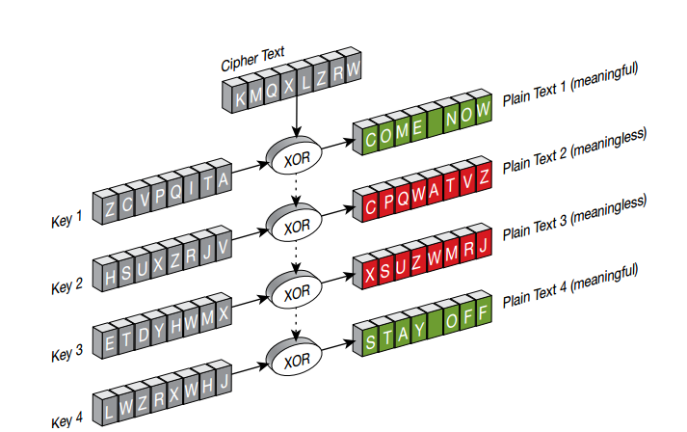
Impossible to know which key yielded the actual message! Brute forcing the key will never work because you have no idea whether you brute forced the right key.

Slide 11
Thanks for coming
Cryptography Solved! OTP is perfect.
Next meeting same place, same time.
Keep eye out for upcoming CTF competitions.
Join our mailing lists if you haven’t already done so

Slide 12
Important problems with the otp
1) Key MUST be truly random – if you can guess the key, it’s a bad key.
2) Key must be at LEAST as long as message to be encrypted
3) Probably most important:
Key must be used only once. After you encrypt one message with the key, never reuse that key.
Notes:
if so space inefficient to have key length, just make really long key then use that for all your messages!
Restrictions with key re-use:
Meet up, exchange hard disk full of meaningless data for key.
What do you do after the key runs out? Reuse?
How do you implement this in the real world? Can’t just “meet up”, defeats the purpose.

Slide 13
Important considerations
3) Key must be used only once. After you encrypt one message with the key, never reuse that key.
Why?
Let’s say you have:
C1 = M1 ⊕ K
C2 = M2 ⊕ K
Then:
C1 ⊕ C2 = (M1 ⊕ K) ⊕ (M2 ⊕ K) = M1 ⊕ M2 ⊕ 0 = M1 ⊕ M2
What can you do with this?

Slide 14
OTP: Key Reuse attack
With M1 ⊕ M2, you can perform frequency analyses on certain bit patterns to deduce characters of each message.
Crib Drag: - Guess words/characters, continue.
M1 = HELLOWORLD
M2 = TODAYTHURS
(M1 ⊕ M2) ⊕ TODAY111111… = HELLO010101
Why? Because M2 ⊕ M2 = 0000000, and 000000 ⊕ M1 = M1
Continuing:
HELLOWORLD ⊕ (M1 ⊕ M2) = TODAYTHURS
XOR is commutative and associative!
Notes:
Crib drag – Guess words in the

Slide 15
Lets break perfect crypto
https://github.com/SpiderLabs/cribdrag
http://pastebin.com/a27ALwhv
Python 3 users: use Py -2 if you have Python 2 on your system already

Slide 16
Practical issues with otp
Key has to be very long – at least as long as message – and must be truly random (as opposed to pseudorandom)
Key can only be used once; once it’s used it has to be thrown away.
Sharing the key securely can be a pain
Notes:
Recap

Slide 17
Other cryptosystems
RSA
AES
DES / 3DES
PGP
Quantam Cryptography
Notes:
That’s all!

Slide 18
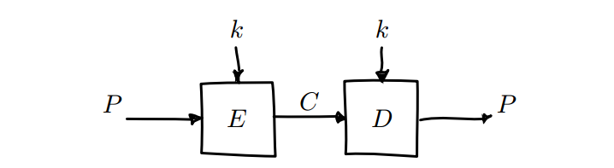
Block ciphers
Symmetric Encryption
Take a block of bits, encrypt it using key. Take a ciphertext block, decrypt it using the key.
Advantage – key doesn’t have to be as long as the message, just as long as a block.
Have Modes of Operation
Notes:
Symmetric – Didn’t solve problem of sharing keys
See if solve large key problem.

Slide 19
ECB Mode
ECB – Electronic Codebook Mode. Take a block of plaintext, encrypt, repeat. Insecure.
Notes:
ECB problem: identical plaintexts encrypt to identical ciphertexts.
Illustrate problem visually

Slide 20
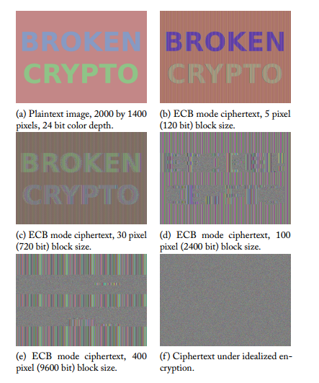

Slide 21
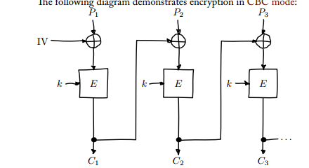
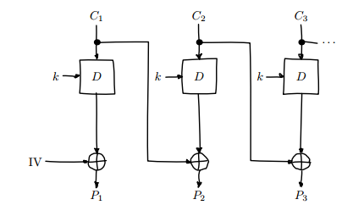
CBC Mode
Cipher Block Chaining – Use output of one encryption as input for the next.
Ensures each block will have different output, even if each block has same plaintext.
ENCRYPTION DECRYPTION
Notes:
IV = Initialization Vector. Random but doesn’t have to be secret.
If IV is predictable – Eve can make a guess about Alice’s data, XOR with own predicted IV, XOR with Alice’s known IV, set this to plaintext.
Then the server will encrypt w/ IV(EVE) XOR GUESS XOR IV(EVE) XOR IV(ALICE) = GUESS XOR IV(ALICE) -> if the guess is correct, our ciphertext is identical to Alice’s and we know her data.
Don’t use key as IV either. Intercepting will allow Eve to figure out the key by modifying some ciphertext.

Slide 22
Padding
Preferred Method: PKCS7 – the value of each padded byte is the same as the number of bytes being added
Example:
Block Size = 16 Bytes
The last block uses 10 bytes
The padding will be
0x06 0x6 0x06 0x06 0x06 0x06
If it is exactly 16 characters, you add an entire extra block of [16] * 16

