Slide 1
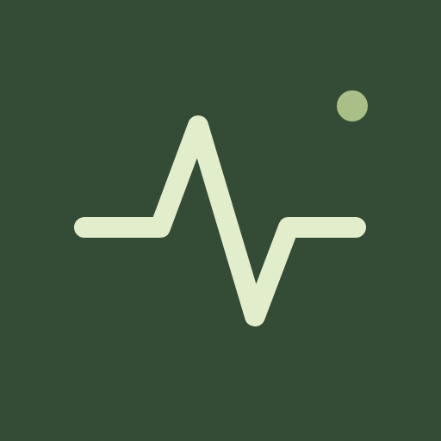
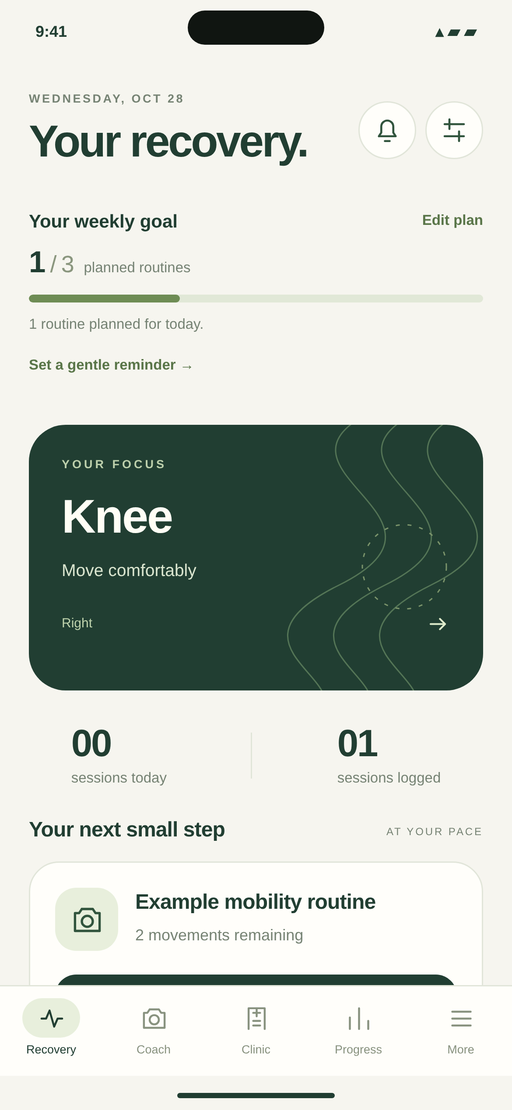

rebound.
CONGRESSIONAL APP CHALLENGE
Small steps.
A steadier routine.
A recovery companion for athletes
and everyday people.
Ritvik Saidapur
Siddharth Senthilkumar
North Carolina’s 4th District · NC-04
Native UI preview · example data
rebound.
CONGRESSIONAL APP CHALLENGE / NC-04
01
Notes:
Ritvik: Introduce yourselves as Ritvik Saidapur and Siddharth Senthilkumar, presenting Rebound for NC-04. Our goal is to make a clinician-cleared recovery routine easier to understand and follow between appointments. Rebound combines a weekly plan, reminders, guided movement practice, and a personal record. The screen shown here is rendered from our current native components using example data, not a real patient or a clinical result. Do not claim that the prototype speeds healing or replaces a clinician.

Slide 2
THE PROBLEM
Recovery needs more than instructions.
Between appointments, a patient still needs clarity, confidence, and consistency.
01
02
03
CLARITY
CONFIDENCE
CONSISTENCY
What is my plan
today?
Am I moving as
intended?
How will I
remember?
A routine should be easy to
find and understand.
Instructions need a useful
visual reference.
The next step should fit into
an ordinary week.
rebound.
CONGRESSIONAL APP CHALLENGE / NC-04
02
Notes:
Siddharth: Describe a hypothetical person returning from an injury. They may have instructions but still struggle to remember a routine or understand a movement when they are on their own. These three questions explain the design problem we chose. We are not presenting survey findings, measured adherence statistics, or evidence that the app has improved clinical outcomes. The intended audience includes athletes and everyday people following an individually cleared plan.

Slide 3
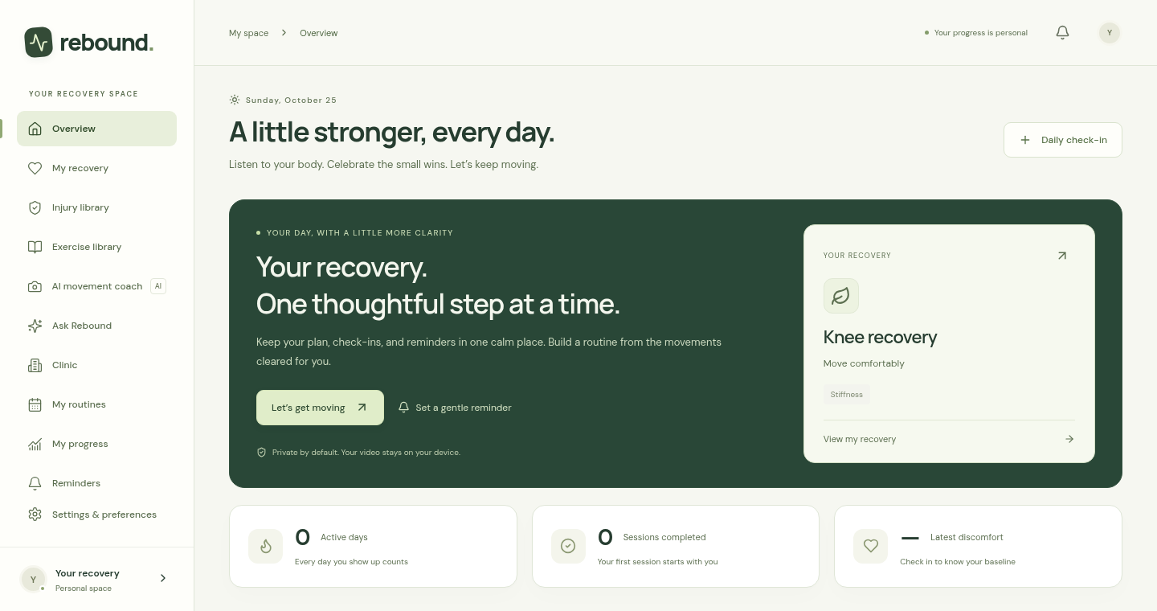
THE SOLUTION
One calm place for the next step.
Rebound brings the plan, practice, and personal record together.
01
Plan
Know what is
scheduled.
02
Practice
See the movement and
work at your pace.
03
Reflect
Log a session and
prepare for a check-in.
rebound.
Website interface capture · no patient data
03
Notes:
Ritvik: Walk through the main loop. First, find the next planned routine. Second, use an illustrated movement guide and a camera estimate when the movement is supported. Third, record the session and how the day feels. The website and iPhone client share the app’s saved routines and guided workflows, while the native iPhone home and Coach library have their own presentation. Browser and device storage are separate; this is not automatic cross-device synchronization.

Slide 4
CONSISTENCY, WITH ROOM TO REST
A week you
can follow.
01
A meaningful weekly goal
Count completed routines against the days in your plan.
02
A timely nudge
Choose reminder days and a time that fits your routine.
03
Rest belongs in the plan
Extra sets do not earn extra goal credit.
rebound.
Native UI preview · example data · progress measures routine completion, not healing
04
Notes:
Siddharth: Point to the weekly progress bar above the green recovery-focus card. The example is one of three planned routines complete. A routine earns credit once on its scheduled local date after the run is finished. Extra sets and duplicate saves do not inflate the goal, and dates before a routine was created are excluded. The plan does not demand catch-up exercise on rest days. The reminder shortcut suggests scheduled routine days, but the user still chooses and confirms notification days and time. Existing native reminders are independent and can still alert after completion.

Slide 5
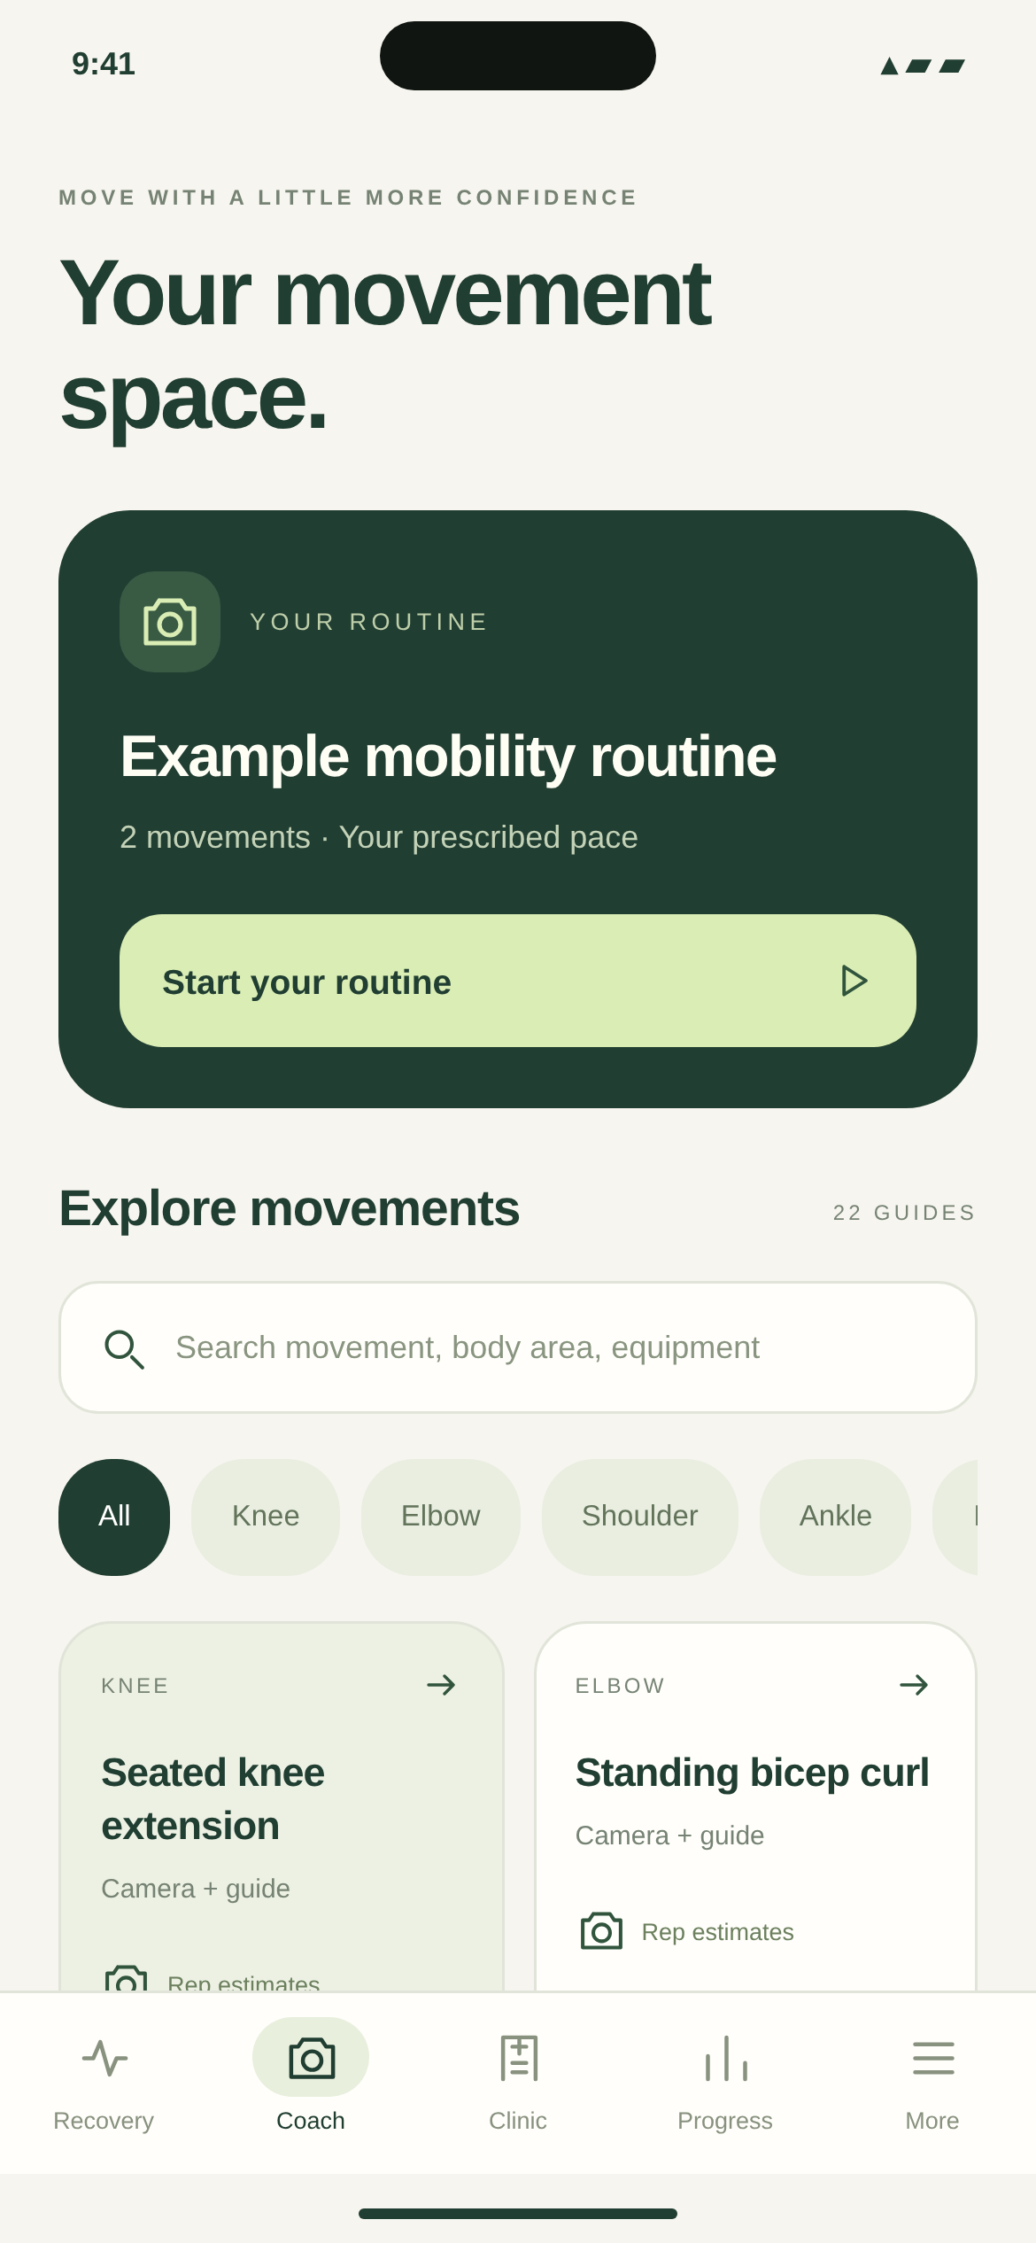
THE COACH
Learn the movement.
Then practice.
Start the routine first.
Explore the library when you need it.
22
illustrated movement guides
Step-by-step teaching
Slow practice for supported camera movements
Band and dowel examples with individual clearance
rebound.
Native UI preview · example data · exercise choice and dose require individual clearance
05
Notes:
Ritvik: Show the native Coach screen: a routine action first, followed by a searchable movement library. The catalog contains 22 guides; that is not a claim to cover every injury. Sixteen guides reference previously checked NHS instructions, while six examples retain review-pending labels. Supported camera movements ask for two slow practice cycles. Equipment examples include bands and a light dowel, but the app cannot determine resistance, band anchoring, or a safe clinical range. Do not describe the illustrations as validated biomechanical simulations.

Slide 6
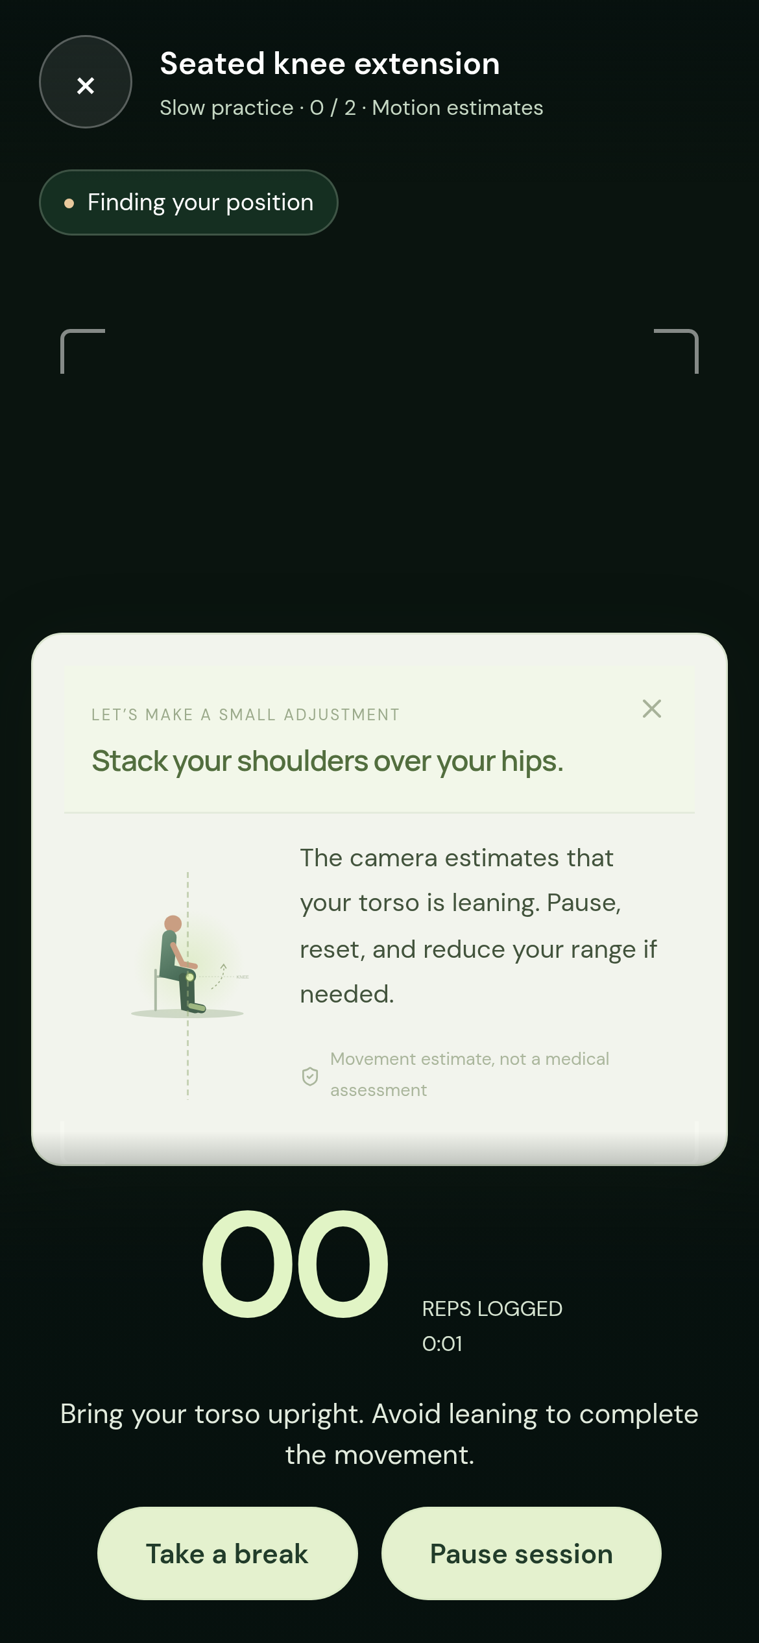
ON-DEVICE CAMERA COACH
Guidance where
you are looking.
A full-screen view
A large rep counter and simple controls.
A timely correction cue
An illustrated adjustment appears inside the camera view.
Pause, breathe, resume
Stillness pauses the session; set breaks support pacing.
rebound.
Interface test preview · camera feed omitted · estimates are experimental, not clinical assessment
06
Notes:
Siddharth: Explain that the coach runs pose estimation locally on camera frames, then checks movement geometry and timing. Poor visibility, framing, lighting, or detected misalignment can stop counting and show an illustrated cue. The full-screen view includes a counter, pause/exit controls, inactivity pause, and optional set breaks. This slide is a UI test capture with the camera feed omitted; synthetic landmarks opened the correction panel. It is not human accuracy evidence. Nine guides offer experimental estimates across eight motion protocols. The other guides provide mirror/manual counting. Band curls use elbow checks; band rows do not have a validated automatic protocol.

Slide 7
PRIVACY AND CARE
Your camera. Your choice.
Normal coaching does not automatically record or upload a clip.
01
02
03
Process locally
Review before
sharing
Keep care
connected
Pose estimation runs on the
device during coaching.
A separate short recording
is reviewed before the user
chooses to share.
Clinic workflows support
clinician plans and explicitly
shared clips.
Clinic delivery requires configured services and connected accounts. Rebound does not diagnose injuries.
rebound.
CONGRESSIONAL APP CHALLENGE / NC-04
07
Notes:
Ritvik: Separate live coaching from recording. Enabling the coach does not automatically save or upload video. The native recorder is a separate action with a review step, and uploads require a configured Clinic service, authentication, and a connected clinician. The current repository includes these workflows, but a live clinical service is not deployed by the prototype update. Symptom follow-up is conservative and rule-based by default. Optional AI explanations need configured services and opt-in; they do not create a diagnostic or injury-specific prescription.

Slide 8
HOW IT WORKS
Built around one shared recovery loop.
A native iPhone experience, shared guided workflows, and local pose processing.
EXPO + REACT NATIVE
REACT + TYPESCRIPT
MEDIAPIPE / SUPABASE
iPhone
Shared app
Camera + care
Recovery home, Coach library,
reminders, and native recording.
Routine state, check-ins, guided
sessions, and web presentation.
Local pose estimates; optional
authenticated Clinic services.
Camera frame
Pose landmarks
Movement checks
Counter or cue
Local video input
Joint estimates
Visibility + timing
Feedback in the view
rebound.
CONGRESSIONAL APP CHALLENGE / NC-04
08
Notes:
Siddharth: Explain the actual architecture. The mobile home and Coach library are React Native. Detailed guides and Clinic workflows use an origin-restricted WebView connected to the web app. A bridge transfers validated recovery snapshots and explicit actions. MediaPipe estimates pose landmarks, and a rule-based tracker checks geometry, visibility, view, and timing. The app does not load a newly trained exercise-video classifier. Supabase integration is optional and must be deployed and configured. AI assistance: OpenAI Codex helped with implementation and debugging. Be ready to explain the system and describe this assistance honestly; verify current district and challenge requirements.

Slide 9
VIDEO DEMONSTRATION
See Rebound in action.
SHOW THE LOOP
01
Plan
Show the weekly goal and
next routine.
02
Practice
Open a cleared guide and
the camera coach.
ADD YOUR DEMO VIDEO
16:9 video placeholder
03
Reflect
Save a session and show
the updated record.
rebound.
Suggested demo: 60–90 seconds · replace this placeholder with your own recording in Canva
09
Notes:
Both presenters: This slide reserves a 16:9 region for your actual video. In Canva, delete the placeholder elements, upload your recording, place it inside this area, and preview playback. Suggested sequence, not an official duration rule: about 15 seconds on the weekly plan, 35–45 seconds on a supported exercise/camera and correction, then 15–20 seconds saving and viewing progress. Use only individually cleared movements. If footage uses a simulation, label it. Explain tracking limitations and do not claim measured accuracy. Test playback from the actual presenting device, keep an offline backup, and verify the current Congressional App Challenge video instructions separately.

Slide 10
NEXT STEPS
A strong prototype. A clear next step.
Keep improving usefulness while measuring what the system can actually do.
01
Validate on people and iPhones
ENGINEERING CHECKS
Measure rep errors and specific form errors against qualified
observers.
73
02
Evaluate exercise-specific video data
Resolve data rights, labels, and band-assisted movement
coverage.
browser checks passed
03
Connect a dependable care workflow
Plus web build, native type-check,
and iOS JavaScript export.
Configure Clinic services, stable HTTPS hosting, and signed
native builds.
rebound.
Engineering checks are not clinical validation; no human-video accuracy percentage is established
10
Notes:
Ritvik: Report the evidence precisely. There are 73 browser cases checked, including the added weekly-goal integration case, plus successful web build, native type-check, and iOS JavaScript export. Those checks include synthetic landmarks and browser streams; they do not establish real-person form accuracy or physical iPhone performance. No new human-video model has been trained or deployed. Dataset permissions and movement mappings remain unresolved. The next steps are qualified human-observer evaluation, physical device checks, and dependable service/hosting setup. Do not call the app clinically validated or fully trained for every exercise.

Slide 11
rebound.
A clearer plan.
A steadier routine.
Helping people understand the next step
and make room for the routine.
Ritvik Saidapur · Siddharth Senthilkumar
NC-04 / Congressional App Challenge
rebound.
CONGRESSIONAL APP CHALLENGE / NC-04
11
Notes:
Siddharth: Close with the intended benefit: a clearer plan and a steadier routine between appointments. Invite questions about the weekly goal, the coach, privacy, or how the prototype was built. Avoid turning the product’s goal into a claim of proven injury recovery improvement. If asked about AI accuracy, explain the current experimental coverage and evaluation plan honestly. Thank the audience on behalf of Ritvik Saidapur and Siddharth Senthilkumar, NC-04.

Slide 12
APPENDIX
Sources, identity, and tool credits.
Rebound identity + app evidence
Current app icon, native components, web UI, and repository branch rebound-mvp.
Movement and pose references
NHS sitting / strength / flexibility / balance guidance; Google MediaPipe Pose documentation.
Logo + typography
Congressional App Challenge
CAC: congressionalappchallenge/houseofcode2024 · frontend/src/assets/CAC-logo.svg.
Manrope and DM Sans: SIL Open Font License.
Official CAC repository asset.
Event identification; no
endorsement implied.
Tools + status
React, TypeScript, Expo, React Native, MediaPipe, optional Supabase. OpenAI Codex assisted
implementation, debugging, and this presentation.
Screens use example data. Camera slide is a UI test preview, not patient footage. Full source links and import instructions accompany the deck.
rebound.
CONGRESSIONAL APP CHALLENGE / NC-04
12
Notes:
Reference links: https://github.com/sidsenthilkumar-dev/congressapp/tree/rebound-mvp ; https://github.com/congressionalappchallenge/houseofcode2024/blob/main/frontend/src/assets/CAC-logo.svg ; https://www.nhs.uk/live-well/exercise/sitting-exercises/ ; https://www.nhs.uk/live-well/exercise/strength-exercises/ ; https://www.nhs.uk/live-well/exercise/flexibility-exercises/ ; https://www.nhs.uk/live-well/exercise/balance-exercises/ ; https://chuoling.github.io/mediapipe/solutions/pose.html ; https://docs.expo.dev/ . The CAC website was not accessible from this cloud environment, so this deck does not assert current competition rules or eligibility. Confirm current requirements with the district office. The presenter supplied the names and NC-04; no school, clinician involvement, interviews, patient results, or original student coding claims have been invented. Logos retain their source colors and proportions.

