Slide 1
OPEN AGENT HACKATHON 2026 · THE AGENT THAT CAN EXPLAIN WHY
Tracebound
ONE INSPECTABLE ANSWER
Don’t just name
the cause.
Cause
Payments timeout
and retry cascade
Show why.
5 support
0 contradict
An evidence-first incident agent that tests competing explanations, preserves provenance, and recommends a reversible next step.
Reversible action only
Siddharth Srivastava
github.com/sidsri14/tracebound
TRACK 2

Slide 2
TRACEBOUND
PROBLEM
Symptoms arrive fast. Proof does not.
FRAGMENTED OPERATIONAL TRUTH
THE GAP
Metrics
Deploys
A dashboard can show that checkout errors rose.
WHY?
Incidents
Runbooks
It cannot prove whether the cause was a deploy, traffic spike, database saturation, or a downstream dependency.
A plausible summary is not enough when omitted evidence changes the response.
02

Slide 3
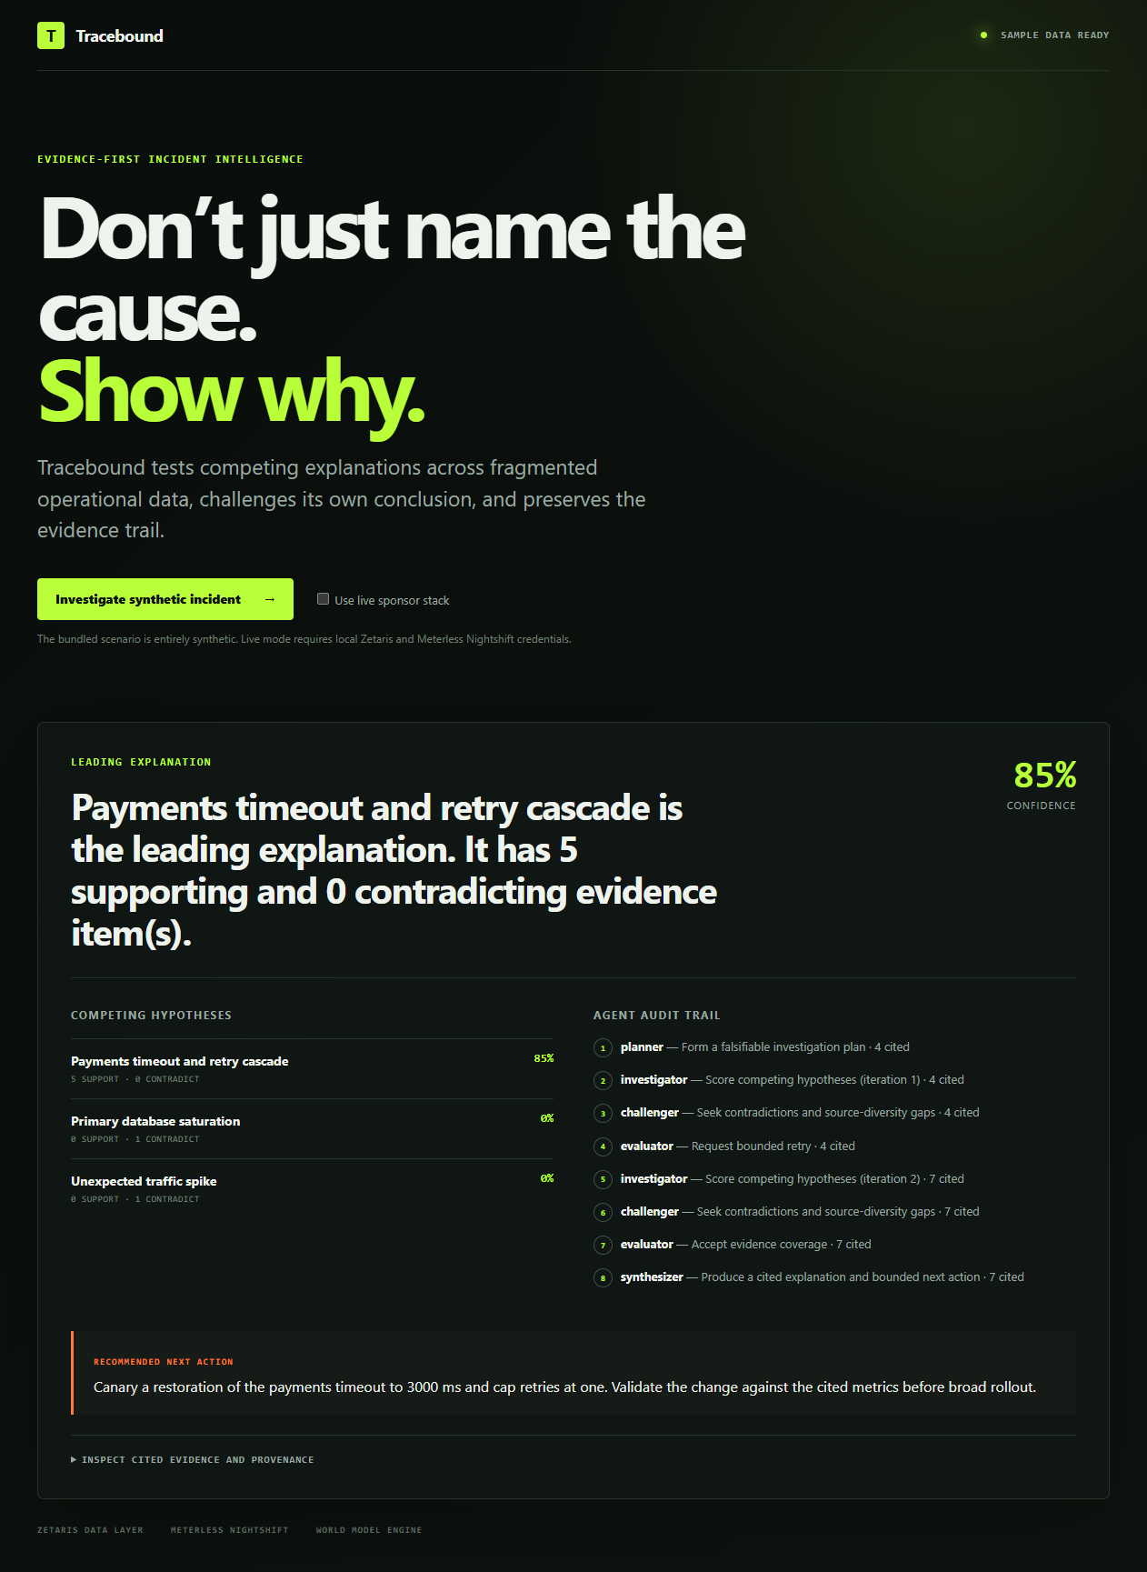
TRACEBOUND
PRODUCT
One answer stays inspectable.
BUNDLED SYNTHETIC INCIDENT
Payments timeout
and retry cascade
SYNTHETIC DATA
85.4%
deterministic sample confidence
5 supporting records
0 contradicting records
Reversible action
Canary the previous 3,000 ms timeout and cap retries at one.
03

Slide 4
TRACEBOUND
METHOD
The first pass is not the final answer.
Tracebound widens evidence once, then stops. The loop is bounded by design.
01
02
03
04
05
Planner
Investigator
Challenger
Evaluator
Synthesizer
Falsifiable plan
Score evidence
Find gaps
Accept or retry
Cited answer
ONE BROADER RETRY
Maximum two passes
No unbounded reflection loop
04

Slide 5
TRACEBOUND
EVIDENCE
Support and contradiction separate the cause.
SUPPORTED CHAIN
Deploy changed timeout + retries
COMPETING EXPLANATIONS CONTRADICTED
3,000 → 1,500 ms · 1 → 3 retries
Unexpected traffic spike
Latency crossed the new timeout
Request volume stayed flat.
Payments p95 reached 2,100 ms
Primary database saturation
Retries rose 3.1×; traffic stayed flat
Utilization remained normal at 62%.
Traffic ruled out as the trigger
The best explanation must survive alternatives—not merely sound plausible.
05

Slide 6
TRACEBOUND
SPONSOR STACK
Sponsor technology sits on the decision path.
Each boundary is explicit, observable, and fail-closed.
01
Zetaris
Retrieves governed evidence through bounded REST SQL.
IMPLEMENTATION STATUS
World Model Engine
Validates, deduplicates, ranks, and explains context selection.
Implemented
02
Adapters + hermetic tests
03
Meterless Nightshift
Runs each live reasoning stage through its OpenAI-compatible runtime.
Pending
Live end-to-end account verification
04
NVIDIA route
Records the model actually returned; Nemotron is never assumed.
If a provider fails, live mode stops. Sample output is never substituted silently.
Implemented path · live sponsor verification pending
06

Slide 7
TRACEBOUND
WORKING PROOF
Reproducible software, not a mock-up.
Local checks verify the product path. They do not claim live sponsor calls.
9
3
2
0
passing automated tests
synthetic incident cases
maximum investigation iterations
production dependency vulnerabilities
VERIFIED SOFTWARE
TypeScript build and typecheck
Browser UI and public MIT repository
Docker build and API smoke test
Stable evidence IDs and append-only JSONL trace
07

Slide 8
TRACEBOUND
TRUST
Evidence is visible. Hidden reasoning stays private.
01
02
Provenance
Falsifiability
Stable content-derived IDs and source locators keep every claim traceable.
Every hypothesis can receive both supporting and contradicting evidence.
03
04
Bounded reflection
Operational safety
One broader retry improves coverage without creating an unbounded agent loop.
The recommendation is reversible. Tracebound never executes remediation.
08

Slide 9
TRACEBOUND
CLOSE
If you cannot inspect why,
do not act.
Tracebound turns a plausible explanation into a testable decision record.
EXPLAIN
CHALLENGE
ACT SAFELY
Link every claim to evidence and provenance.
Test competing causes before accepting an answer.
Recommend the smallest reversible next step.
Next: verify a non-secret live sponsor run, then extend governed connectors.
github.com/sidsri14/tracebound
09

