Slide 1
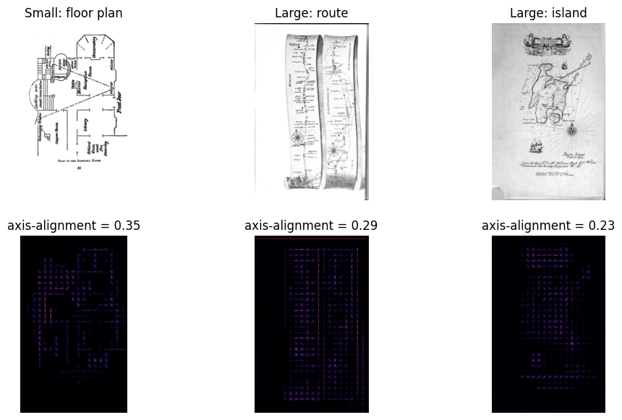
Feature 1: Wall Direction Gradients

Slide 2
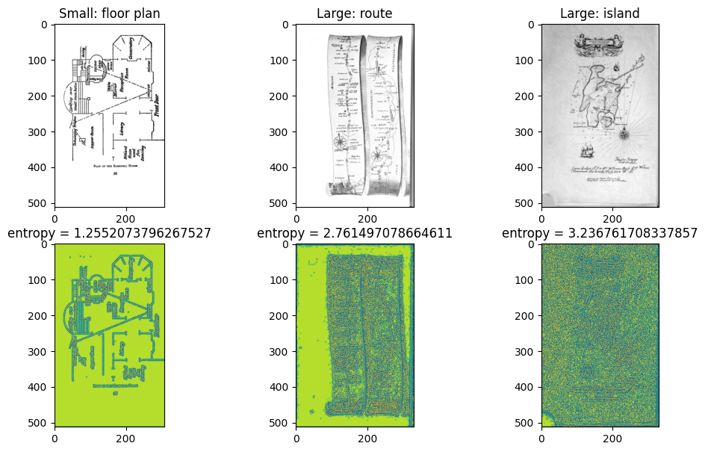
Feature 2: Empty rooms vs Busy Textures

Slide 3
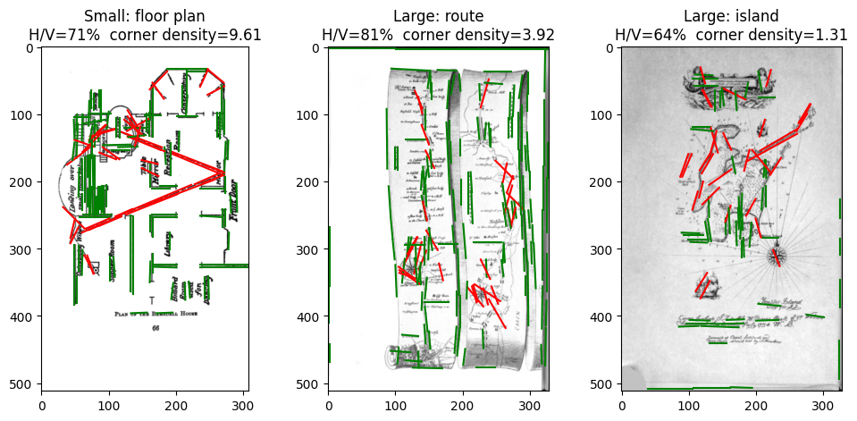
Feature 3: Hough lines + Harris corners
*good as not a primary feature

