Slide 1
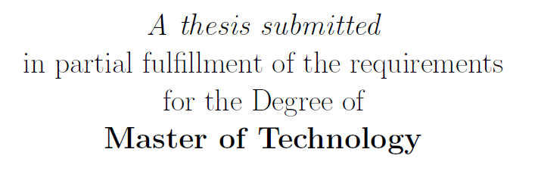

Constitutive modelling of Rubber-like materials
by
Siddhartha Srivastava
Supervisor: Prof. C.S. Upadhyay
Indian Institute of Technology Kanpur
14th August 2015
Siddhartha Srivastava
Constitutive modelling of Rubber-like materials
1

Slide 2
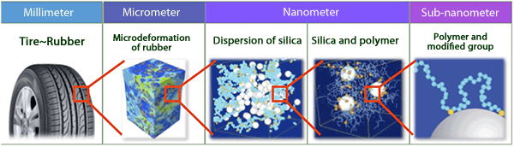
Why do we need this?
Introduction
Motivation
Applications: Tires and tubes industry, Vibration dampers, Window seals in aircraft and spacecrafts and many more…
Saturated Rubber
Polyacrylic rubber, Silicone rubber, EPM (ethylene propylene rubber), EPDM (ethylene propylene diene rubber)
Unsaturated Rubber
Natural isoprene (natural rubber), polybutadiene, styrene butadiene, nitrile rubber
Properties:
Large deformation
Enhanced properties by adding fillers.
Long chain polymers
Branching
Crystallization induced by thermal/ mechanical loading
Multi-scale material pattern [Toyo tires]
Stress-Strain (Natural Rubber)
Siddhartha Srivastava
Constitutive modelling of Rubber-like materials
2

Slide 3
Mechanical Properties
Stress-Strain curves
Experiment: Monotonic loading
Natural Rubber:
30% Recycled rubber
30% Calcium carbonate
5% Carbon black
Non-linear behaviour
Strain Rate dependence
Large range of strain rate
Similar rate-dependent behaviour irrespective of amount of fillers
EPDM:
10% CaCO3
5% Carbon Black
[Ref: Thesis by AS Khan (2015)]
Siddhartha Srivastava
Constitutive modelling of Rubber-like materials
3

Slide 4
Mechanical Properties
Stress-Strain curves
Experiment: Segment-wise cyclic loading
Mullin’s Effect: Virgin material curve envelopes stress-softened material curve
40% unrecovered strain set after a period of 2 months
Hysteresis in stress softened material curve
Siddhartha Srivastava
Constitutive modelling of Rubber-like materials
4

Slide 5
Mechanical Properties
Stress-Strain curves
What did we learn?
Non-linearity
Stress softening (Mullin’s effect)
Residual strain
Rate dependence
Hysteresis
Large Deformation
Siddhartha Srivastava
Constitutive modelling of Rubber-like materials
5

Slide 6
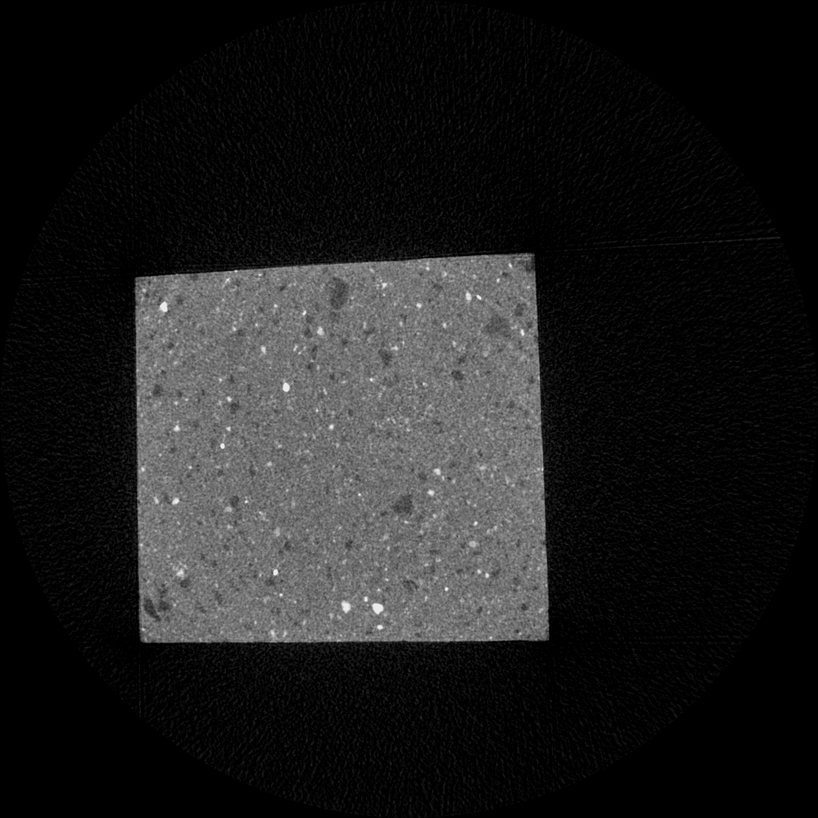
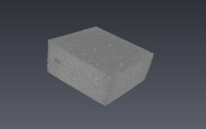
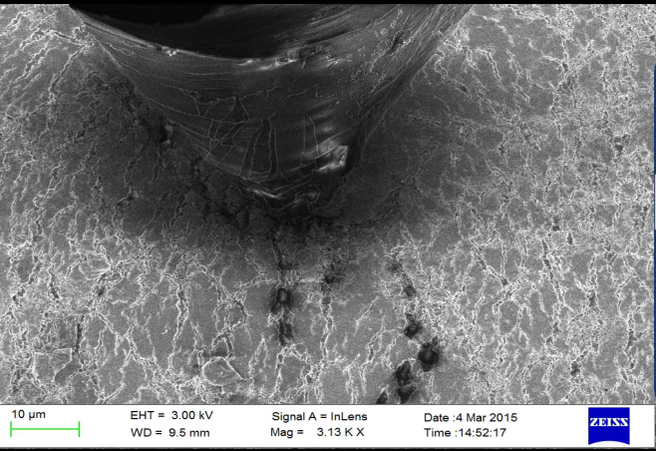
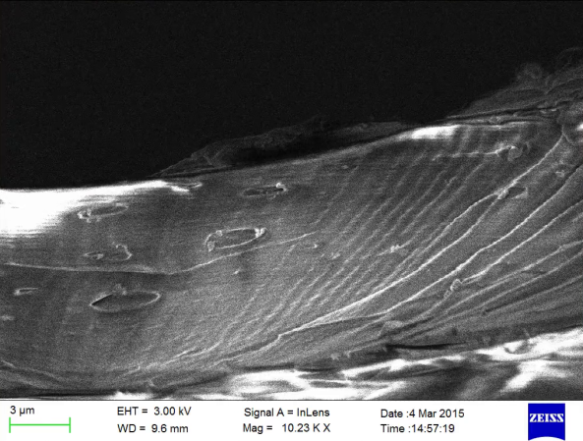
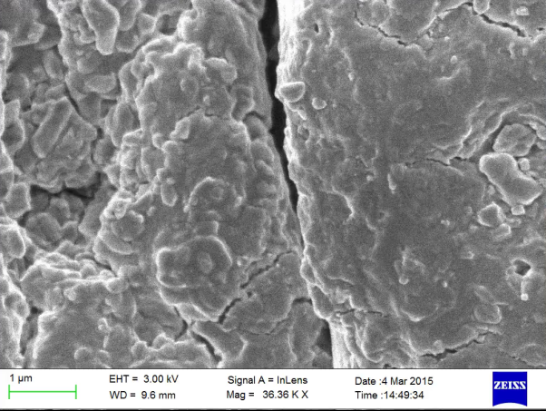
Multi-scale Phenomenon
Millimetres to Microns
Microstructure: Void Growth
Post-loaded sample of Natural rubber shows growth in voids volume ratio
Strain samples of EPDM shows void growth near a crack tip
CT-Scan of Natural Rubber
Scanning Electron Micrograph images of EPDM material near strained crack tip
Siddhartha Srivastava
Constitutive modelling of Rubber-like materials
6

Slide 7
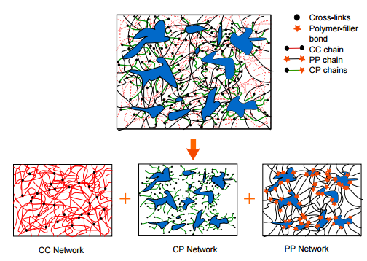
Multi-scale Phenomenon
Internal structure
Network Chains
Random orientation in unloaded sample
Orientation induced by loading
New structures like fibrillar and lamella are formed
Anisotropy induced via loading
Rubber Matrix decomposition in network chains [Itskov etal.]
Networks between polymeric chains and fillers
Siddhartha Srivastava
Constitutive modelling of Rubber-like materials
7

Slide 8


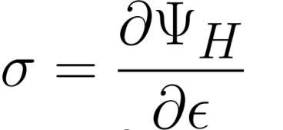
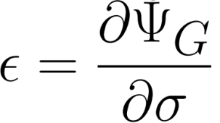
Constitutive Modelling
Literature Survey
First step: Non-linearity
Free Energy Forms (Isothermal Case):
Helmholtz free energy
Gibbs free energy
Legendre transform
Conjugate pairs
Similar expressions for other work conjugate pairs.
Effort is employed majorly on formulating thermodynamically admissible free energy forms. Both statistical mechanics approaches (for instance, see Arruda and Boyce 1993) and phenomenological approaches (for instance, see Ogden1972) are used to formulate these functions
Popular models by
Generalized Mooney-Rivlin solid , Generalized polynomial rubber elasticity potential, Ogden model, Arruda-Boyce 8 chain model, Ogden-Storakers hyperelastic foam and Blatz-Ko foam rubber etc.
[Ref: http://solidmechanics.org/Text/Chapter3_5/Chapter3_5.php]
Siddhartha Srivastava
Constitutive modelling of Rubber-like materials
8

Slide 9
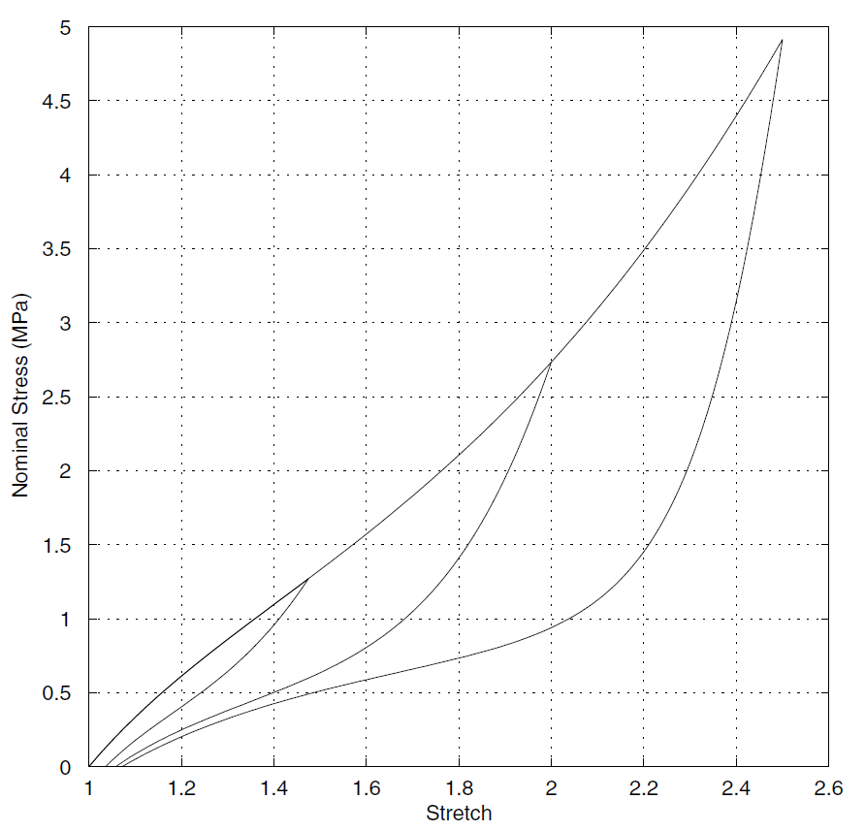
Constitutive Modelling
Literature Survey
Going beyond conservative systems
Pseudo-elasticity
Stress softening
Residual strain
Dissipation potential
Modified hyperelastic response to include damage parameters with initial value of unity
Damage parameter asymptotically decreases to zero with increase in maximum deformation seen by the material
This concept can be extended to include non virgin hysteresis too
[Ref: Dorfmann and Ogden (2003)]
Siddhartha Srivastava
Constitutive modelling of Rubber-like materials
9

Slide 10
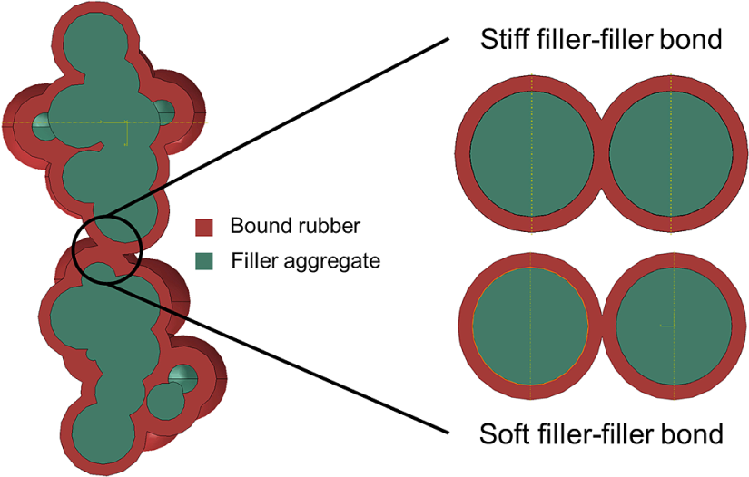
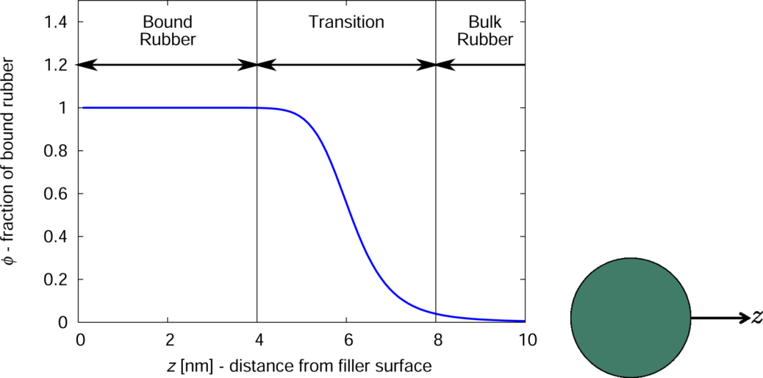
Constitutive Modelling
Literature Survey
Going beyond conservative systems
Hard and soft phases
Rubber matrix contains 2 phases (Hard and Soft)
Free energy is the sum of free energy of both phases.
Hard Phase gets irreversibly converted to soft phase on loading.
Representative work:
Beatty and Krishnaswamy (2000), Sodhani and Reese (2014)
Siddhartha Srivastava
Constitutive modelling of Rubber-like materials
10

Slide 11
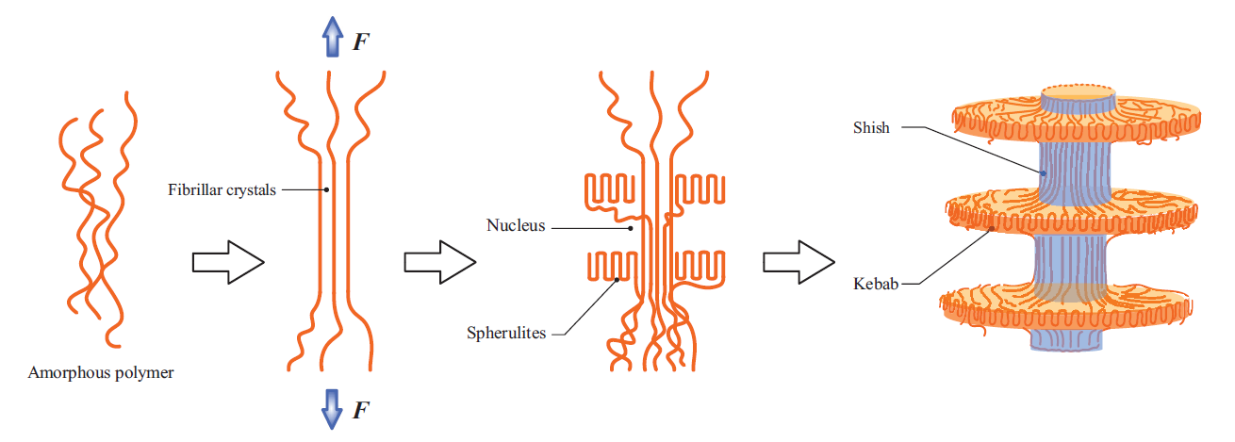
Constitutive Modelling
Literature Survey
Going beyond conservative systems
Strain induced crystallization
Formation of Shish-Kebab structure in tension [Ref: Itskov et. al. 2014]
Total Strain energy = Sum of strain energy of different network (eg. Pure rubber (CC) network Polymer-Aggregate (PP) network Aggregate-fibrillar crystal (ST) network Aggregate-lamellar crystal (FL) network.
The probability distribution of the networks in different directions differ for loading and unloading case.
Siddhartha Srivastava
Constitutive modelling of Rubber-like materials
11

Slide 12
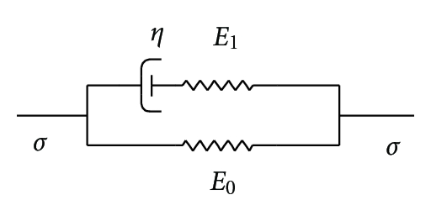
Constitutive Modelling
Literature Survey
Phenomenological models
Modelling by combining spring, damper and slider in different arrangements.
Viscoelastic material:
Combination of spring and damper system
Popular model include Kelvin-Voigt model and Maxwell model
Generalized Maxwell model
Damaged viscoelastic material:
Generally the hyperelastic spring in a viscoelastic material is replaced by a damaged spring
The damage increases with maximum deformation
Damaged viscoelastic plastic material:
Networks of elasticity, viscosity and inelasticity are used in series/parallel/mixed arrangement
Loading induces damage on few or all the networks
Siddhartha Srivastava
Constitutive modelling of Rubber-like materials
12

Slide 13
Constitutive Modelling
Literature Survey
Modelling Techniques
Hyperelastic models
Free energy functions ψ (F)
Mooney-Rivilin, Ogden and Arruda-Boyce model
Good fit with quasi-static and monotonic experiments
No viscous effect, hysteresis or residual strain
Pseudo-elasticity
Hard and Soft phases
Strain induced crystallization
Viscoelastic material
Damaged viscoelastic material
Damaged viscoelastic plastic material
Representative work:
Rivilin (1960), Arruda and Boyce (1993), Ogden (1972)
Siddhartha Srivastava
Constitutive modelling of Rubber-like materials
13

Slide 14
Constitutive Modelling
Literature Survey
Modelling Techniques
Hyperelastic models
Pseudo-elasticity
Free energy functions ψ (η,F)
Damaged elasticity
Stress softening and quasi-static hysteresis
No viscous effect
Hard and Soft phases
Strain induced crystallization
Viscoelastic material
Damaged viscoelastic material
Damaged viscoelastic plastic material
Representative work:
Ogden and Roxburgh (1999), Dorfmann and Ogden (2003)
Siddhartha Srivastava
Constitutive modelling of Rubber-like materials
14

Slide 15
Constitutive Modelling
Literature Survey
Modelling Techniques
Hyperelastic models
Pseudo-elasticity
Hard and Soft phases
Soft phase ≡ Rubbery phase
Hard Phase ≡ chain-filler bonds
Hard phase transforms to soft phase on loading
Mullin’s effect but no viscous effect
Strain induced crystallization
Viscoelastic material
Damaged viscoelastic material
Damaged viscoelastic plastic material
Representative work:
Beatty and Krishnaswamy (2000), Sodhani and Reese (2014)
Siddhartha Srivastava
Constitutive modelling of Rubber-like materials
15

Slide 16
Constitutive Modelling
Literature Survey
Modelling Techniques
Hyperelastic models
Pseudo-elasticity
Hard and Soft phases
Strain induced crystallization
Network models
Strain history dependent probability of networks
Total Strain energy = Sum of strain energy of network
Mullin’s effect but no viscous effect
Viscoelastic material
Damaged viscoelastic material
Damaged viscoelastic plastic material
Representative work:
Itskov et.al.(2014), Rault et.al.(2006), Flory (1962)
Siddhartha Srivastava
Constitutive modelling of Rubber-like materials
16

Slide 17
Constitutive Modelling
Literature Survey
Modelling Techniques
Hyperelastic models
Pseudo-elasticity
Hard and Soft phases
Strain induced crystallization
Viscoelastic material
Phenomenological model
Equilibrium and Non-equilibrium branches
Viscous effect and hysteresis due viscous dissipation
No stress softening and permanent strain set
Damaged viscoelastic material
Damaged viscoelastic plastic material
Representative work:
Reese and Govindjee (1998), Bergstrom and Boyce (1998)
Siddhartha Srivastava
Constitutive modelling of Rubber-like materials
17

Slide 18
Constitutive Modelling
Literature Survey
Modelling Techniques
Hyperelastic models
Pseudo-elasticity
Hard and Soft phases
Strain induced crystallization
Viscoelastic material
Damaged viscoelastic material
Damaged elasticity
Damaged/undamaged viscous branch
Introduces stress-softening
No permanent strain set
Damaged viscoelastic plastic material
Representative work:
Simo (1987), Kaliske and Rothert (1998)
Siddhartha Srivastava
Constitutive modelling of Rubber-like materials
18

Slide 19
Constitutive Modelling
Literature Survey
Modelling Techniques
Hyperelastic models
Pseudo-elasticity
Hard and Soft phases
Strain induced crystallization
Viscoelastic material
Damaged viscoelastic material
Damaged viscoelastic plastic material
Introduces permanent strain set
Cost: too complex and too many parameters
Representative work:
Meihe and Keck (2000), Lion (1996)
Siddhartha Srivastava
Constitutive modelling of Rubber-like materials
19

Slide 20

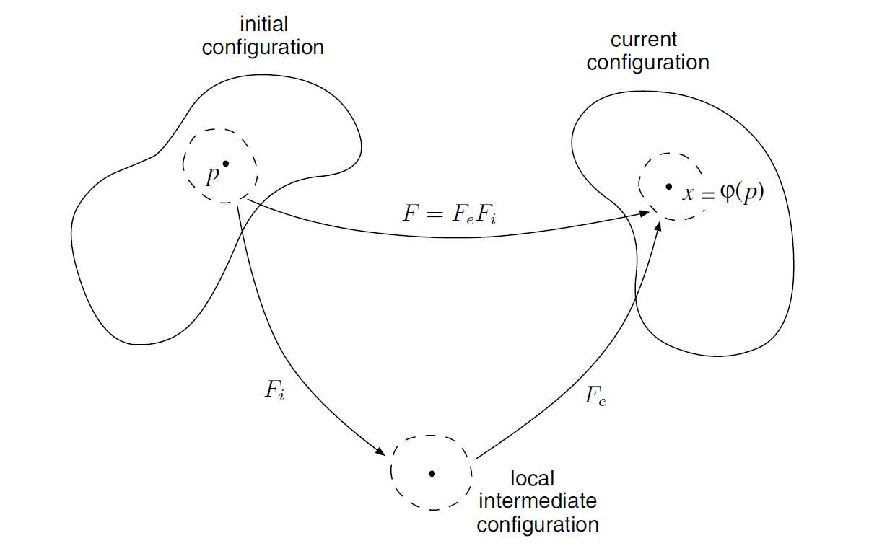
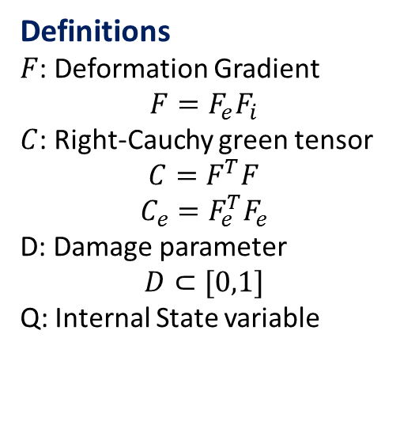
Constitutive Modelling
Mathematical Formulation
Damaged viscoelastic plastic model
Helmholtz energy:
Definitions
$F$: Deformation Gradient
$$F=F_{e}F_{i}$$
$C$: Right-Cauchy green tensor
$$C=F^{T}F$$
$$C_{e}=F_{e}^{T}F_{e}$$
D: Damage parameter
$$D⊂[0,1]$$
Q: Internal State variable
Siddhartha Srivastava
Constitutive modelling of Rubber-like materials
20

Slide 21

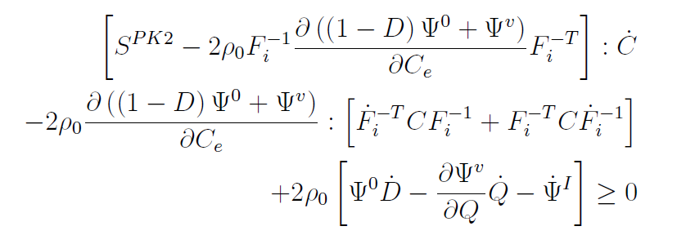
Constitutive Modelling
Mathematical Formulation
Thermodynamic admissibility
Claussius-Duhem inequality (Isothermal version):
On substituting the energy form into the inequality, we get,
Siddhartha Srivastava
Constitutive modelling of Rubber-like materials
21

Slide 22



Constitutive Modelling
Mathematical Formulation
Thermodynamic admissibility
We can fix Fi, Q, D and vary C, we get stress as
And dissipation as,
Siddhartha Srivastava
Constitutive modelling of Rubber-like materials
22

Slide 23
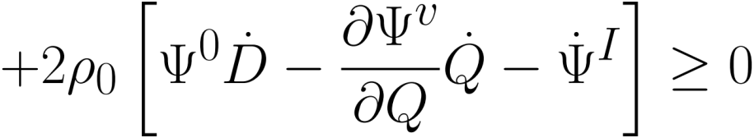
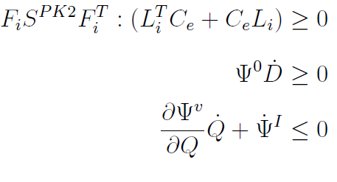
Constitutive Modelling
Mathematical Formulation
Thermodynamic admissibility
Dissipation can further be reduced to following form:
Now assuming a strong form of dissipation,
Siddhartha Srivastava
Constitutive modelling of Rubber-like materials
23

Slide 24


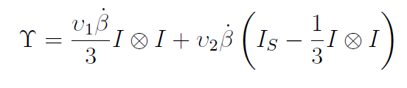


Constitutive Modelling
Mathematical Formulation
Evolution Laws
Assuming linear evolutions (sufficient but not necessary !!!) of inelasticity and damage,
Where,
Yield surface:
Loading –unloading condition:
Siddhartha Srivastava
Constitutive modelling of Rubber-like materials
24

Slide 25

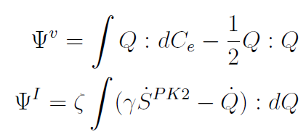
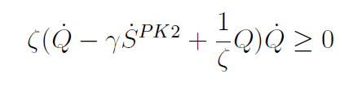
Constitutive Modelling
Mathematical Formulation
Viscous evolution
Motivated by generalized Maxwell’s model we take evolution law of the form:
This can be achieved by taking the following energy forms,
So that the dissipation inequality reduces to
Siddhartha Srivastava
Constitutive modelling of Rubber-like materials
25

Slide 26
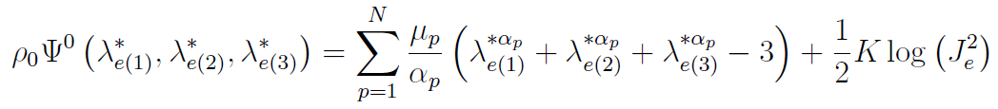
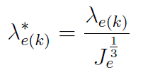
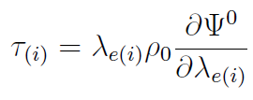
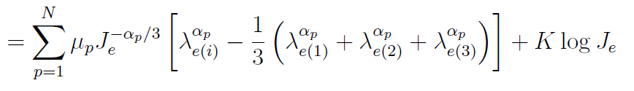
Constitutive Modelling
Mathematical Formulation
Hyperelastic form
Ogden type material
Free energy form:
Where the eigenvalues of elastic isochoric stretch tensor are related to the eigenvalues of elastic stretch tensor by the relation,
And the Kirchhoff Stress is given as
Siddhartha Srivastava
Constitutive modelling of Rubber-like materials
26

Slide 27

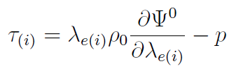
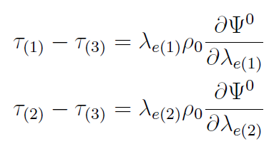
Constitutive Modelling
Mathematical Formulation
Incompressibility constraint
The Kirchhoff stress for this case can then be given by adding an extra hydrostatic stress as,
On eliminating this additional pressure we get,
Siddhartha Srivastava
Constitutive modelling of Rubber-like materials
27

Slide 28


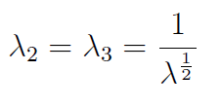
Constitutive Modelling
Mathematical Formulation
1D reduction: Simple axial loading
Let us define (WLOG) 1 direction to be the loading direction. Then the stresses in 2-3 direction for a simple axial test will be given as,
We can also take stretch to be symmetric in 2-3 direction, i.e. if we assume the stretch in 1 direction to be given as
Then,
Note: The implication of no transverse stress condition along with the assumed evolution equation is that there is no inelastic growth in 2-3 direction. Similar arguments can be made for evolution of Q
Siddhartha Srivastava
Constitutive modelling of Rubber-like materials
28

Slide 29

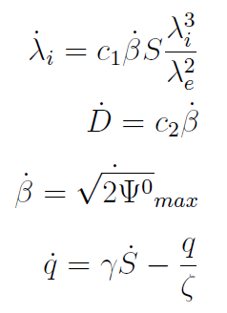
Constitutive Modelling
Mathematical Formulation
1D reduction: Evolution equations
Stretch assumes multiplicative decomposition given as,
The evolution equations can then be reduced to following 1-D form given as
Where S and q represents the (1,1) component of Second Piola-Kirchoff stress and Q tensor respectively
Siddhartha Srivastava
Constitutive modelling of Rubber-like materials
29

Slide 30
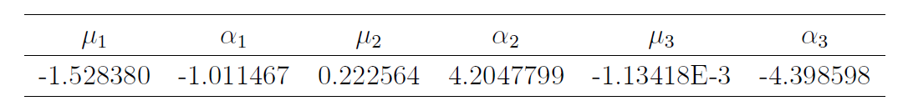
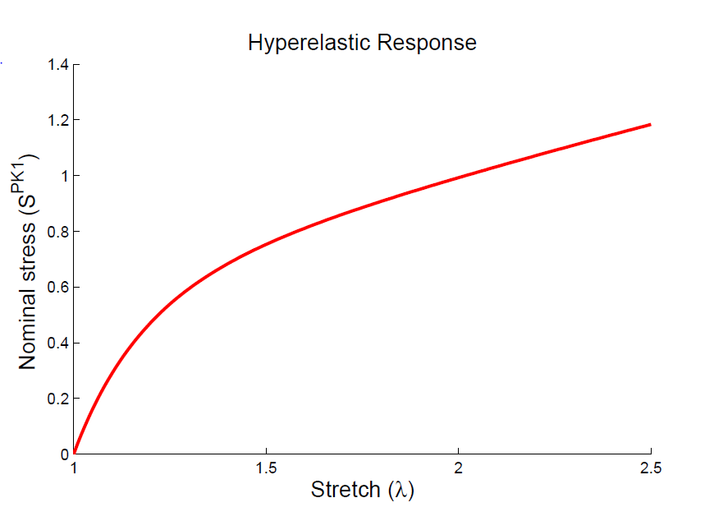
Constitutive Modelling
Results
Qualitative behavior: Hyperelastic response
Siddhartha Srivastava
Constitutive modelling of Rubber-like materials
30

Slide 31
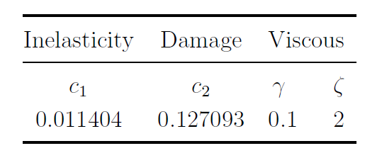
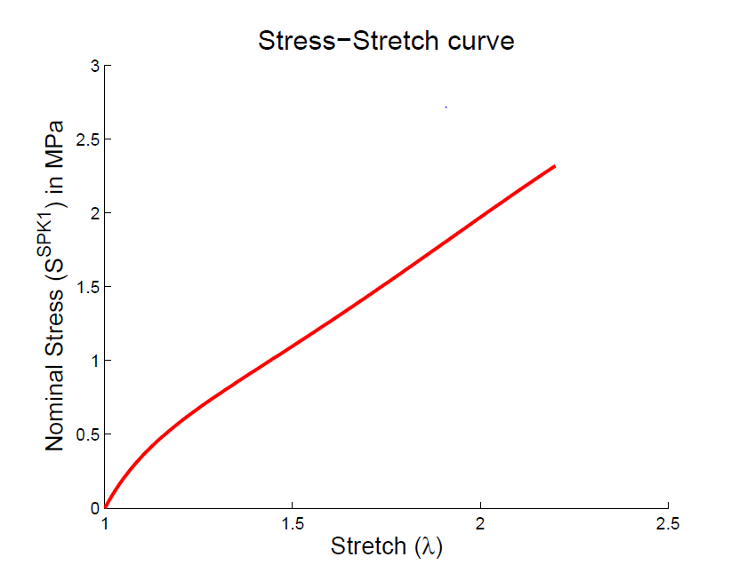
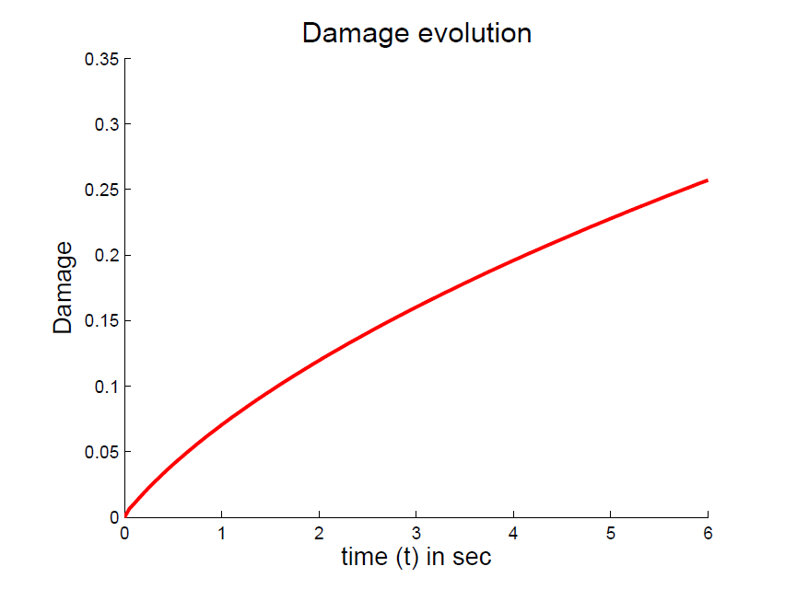
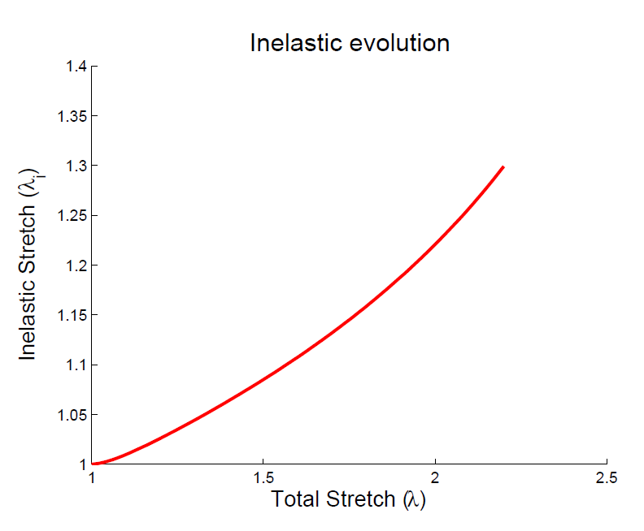
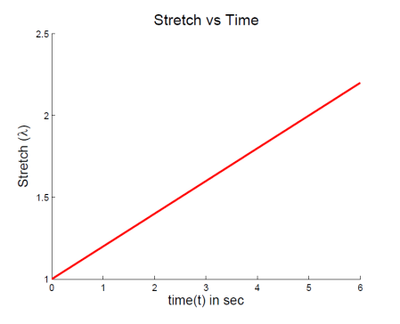
Constitutive Modelling
Results
Qualitative behavior: Monotonic Loading
Siddhartha Srivastava
Constitutive modelling of Rubber-like materials
31

Slide 32
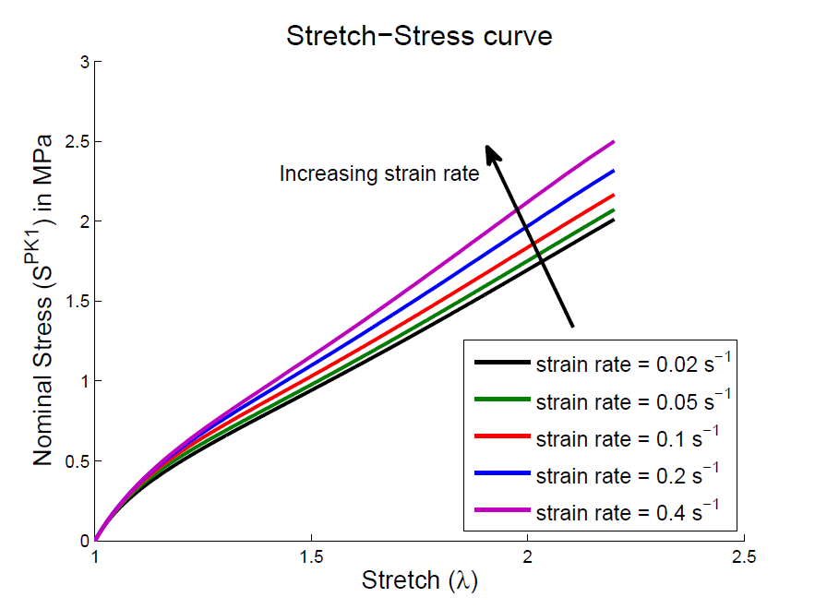
Constitutive Modelling
Results
Qualitative behavior: Viscous Effect
Siddhartha Srivastava
Constitutive modelling of Rubber-like materials
32

Slide 33
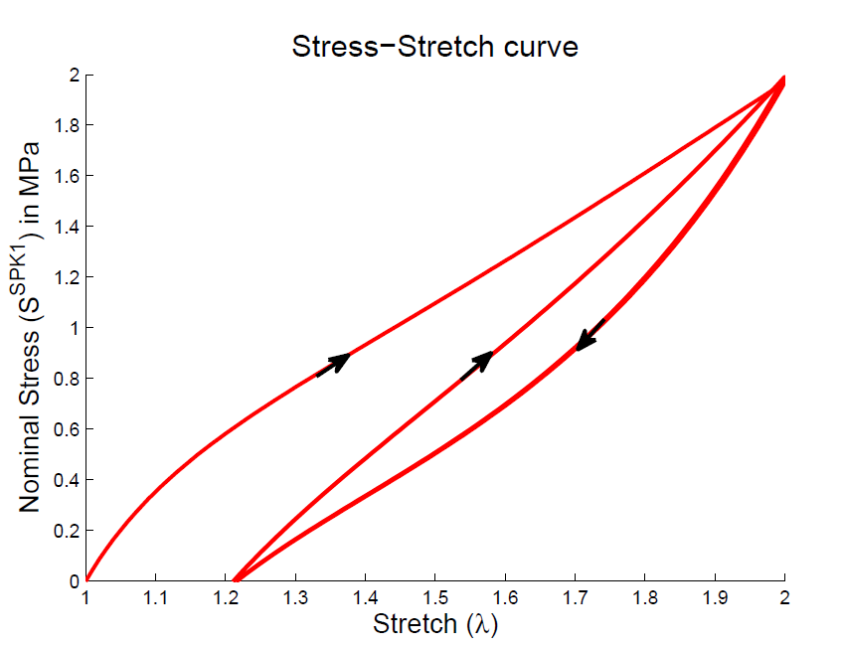
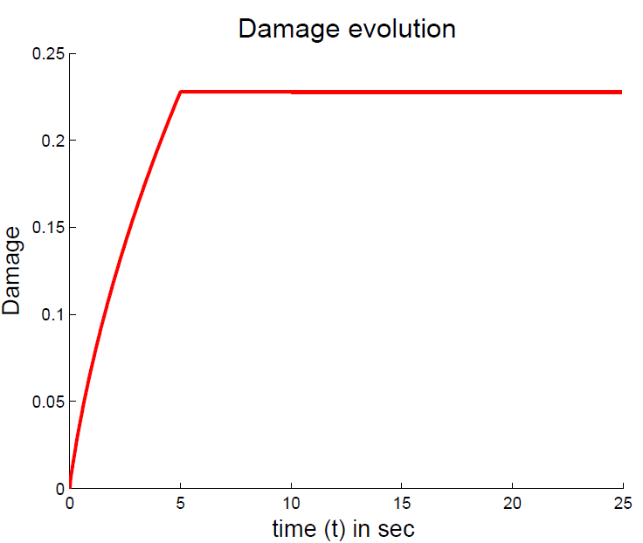
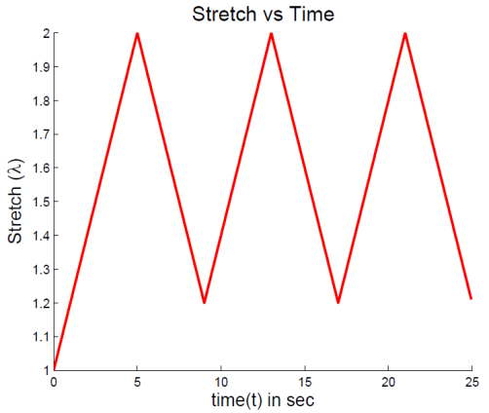
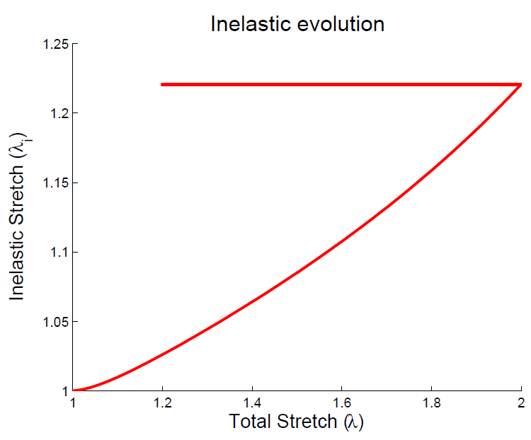
Constitutive Modelling
Results
Qualitative behavior: Cyclic Loading
Siddhartha Srivastava
Constitutive modelling of Rubber-like materials
33

Slide 34
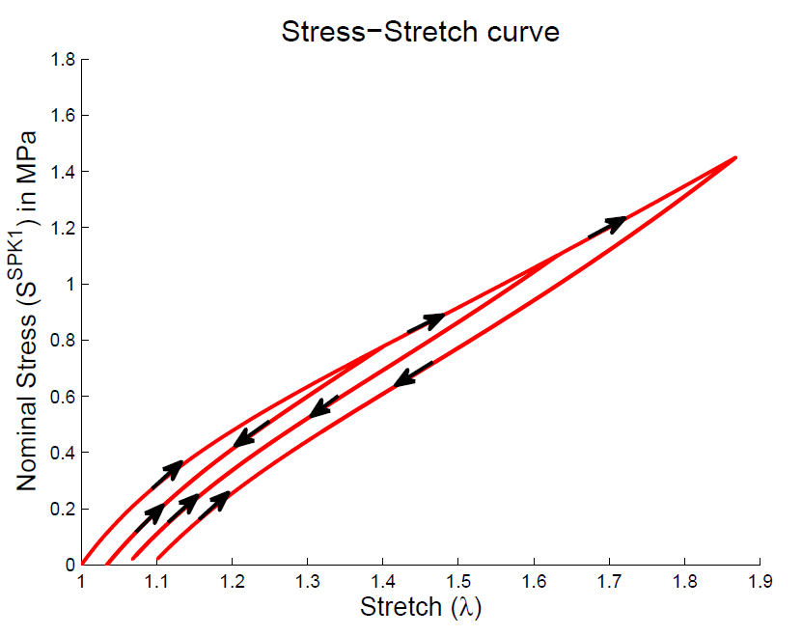
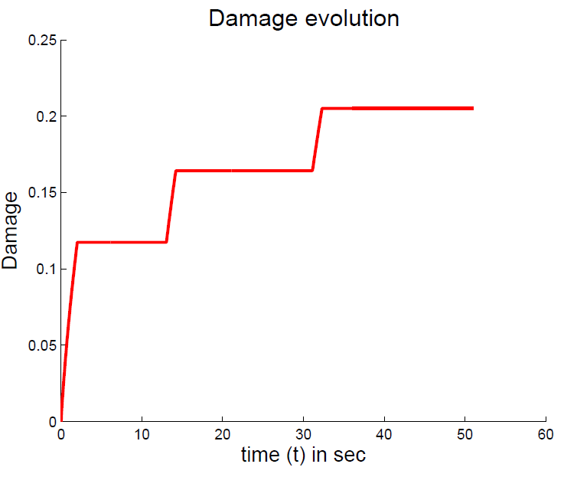
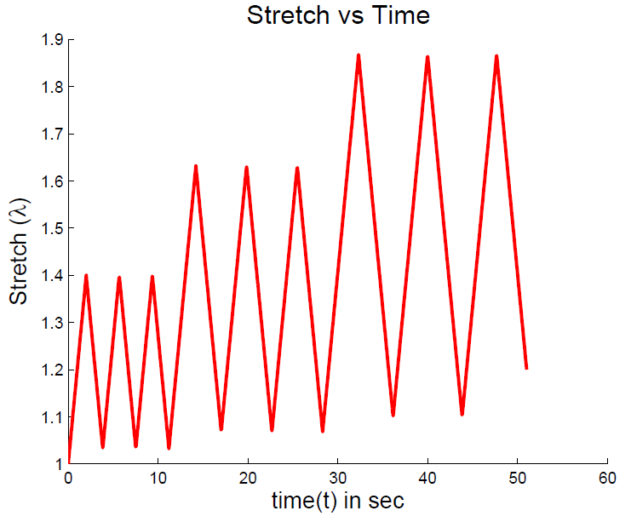
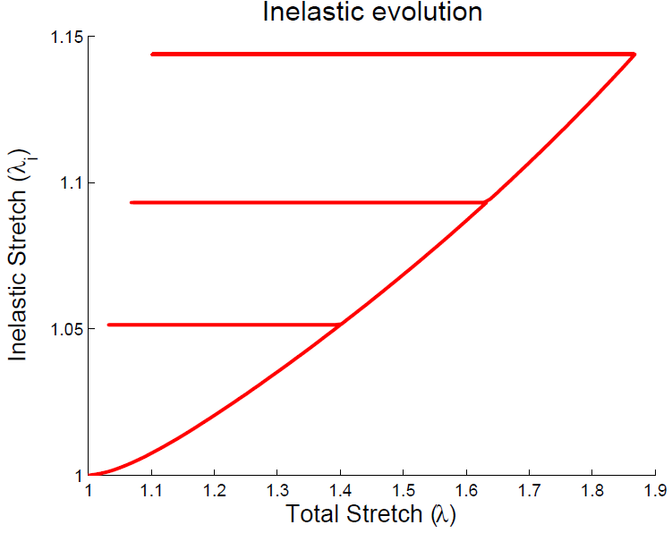
Constitutive Modelling
Results
Qualitative behavior: without viscous branch
Siddhartha Srivastava
Constitutive modelling of Rubber-like materials
34

Slide 35
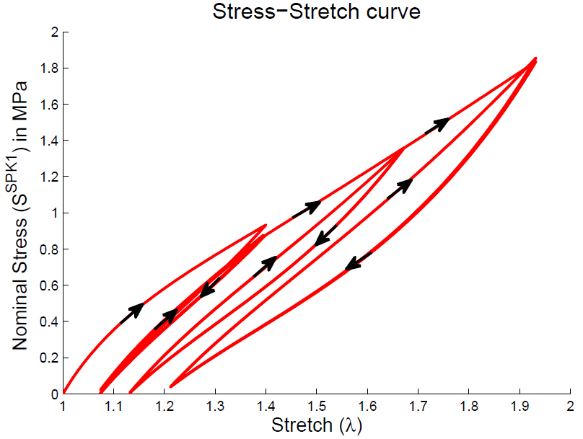
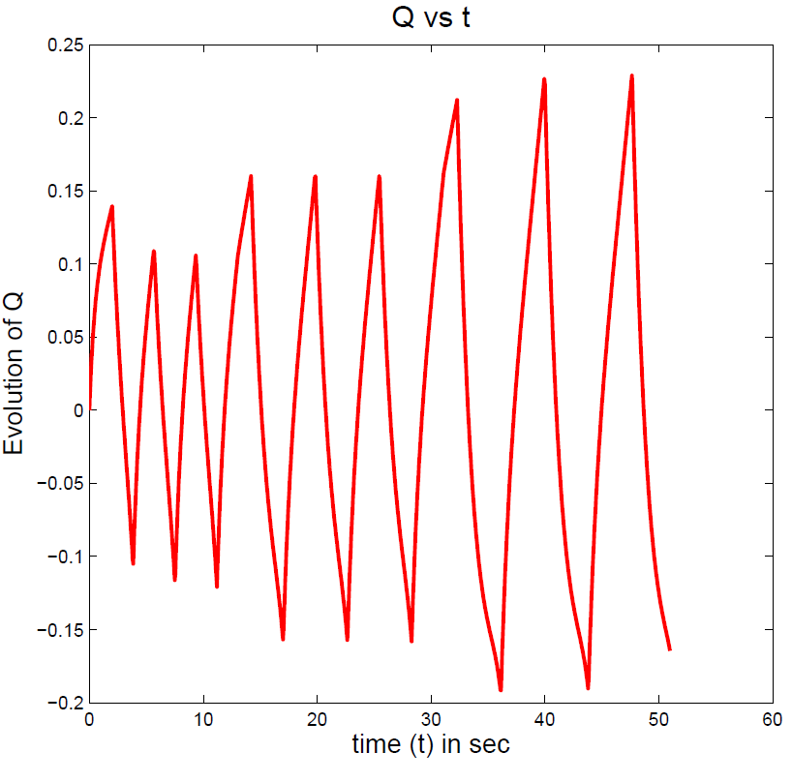
Constitutive Modelling
Results
Qualitative behavior: with viscous branch
Siddhartha Srivastava
Constitutive modelling of Rubber-like materials
35

Slide 36
Conclusion
Summary
All models are wrong but some models are useful!!!
Reviewed literature on “Rubber elasticity” with focus on constitutive modelling techniques like multiphase material modeling, strain induced crystallization and other phenomenological approaches like pseudo-elasticity and damage mechanics.
Developed a damaged viscoelastic plastic model and verified its thermodynamic admissibility.
Verified the qualitative behavior of this model in simple axial tensile loading case.
The 1D axial case required only 4 parameters other than parameters for the hyperelastic form.
Siddhartha Srivastava
Constitutive modelling of Rubber-like materials
36

Slide 37
Future Scope
Non-virgin hysteresis
Does it solve everything?
Same dissipation in stress-softened hysteresis irrespective of strain rate.
Healing ??
Siddhartha Srivastava
Constitutive modelling of Rubber-like materials
37

Slide 38
Thank You
Siddhartha Srivastava
Constitutive modelling of Rubber-like materials

Slide 39
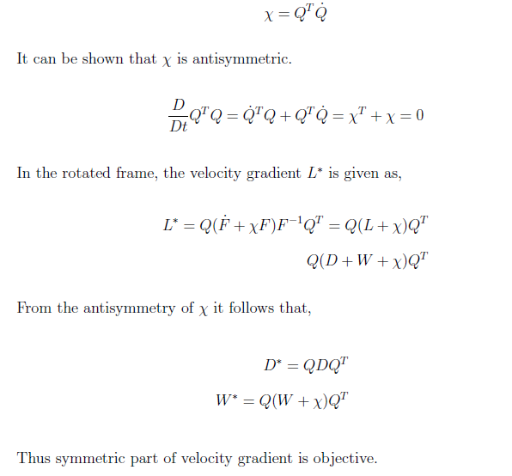
Answers
Objectivity
Objectivity of rate of deformation tensor
Nonlinear Elasticity II
Siddhartha Srivastava
Constitutive modelling of Rubber-like materials
Siddhartha Srivastava

Slide 40




Answers
CD inequality
Substituting energy form to CD inequality
Nonlinear Elasticity II
Siddhartha Srivastava
Constitutive modelling of Rubber-like materials
Siddhartha Srivastava

Slide 41




Answers
Viscous branch
1D small strain linear viscous branch
Nonlinear Elasticity II
Siddhartha Srivastava
Constitutive modelling of Rubber-like materials
Siddhartha Srivastava

Slide 42
Answers
Constitutive Theory
Rules of the game
Axioms:
Thermodynamic Determinism (CD inequality)
Memory
Equipresence
Local action
Objectivity
Admissibility
Simplifications:
Material Symmetry -> Isotropy
Internal State variables
Nonlinear Elasticity II
Siddhartha Srivastava
Constitutive modelling of Rubber-like materials
Siddhartha Srivastava

Slide 43
Reference
Rivlin, RS. Proceedings of First Symposium on Naval Structural Mechanics, 1960. p. 169.
Arruda, E.M., Boyce, M.C., 1993. A three-dimensional constitutive model for the large stretch behavior of rubber elastic materials. J. Mech. Phys. Solids 41, 389–412.
Mullins, L., 1969. Softening of rubber by deformation. Rubber Chemistry and Technology 42, 339±362.
Reese, S., Govindjee, S., 1998. A theory of finite viscoelasticity and numerical aspects. International Journal of Solids and Structures 35, 3455±3482
Simo , J.C., 1987. On a fully three-dimensional finite-strain viscoelastic damage model; formulation and computational aspects. Computer Methods in Applied Mechanics and Engineering 60, 153±173
Lion, A., 1996. A constitutive model for carbon black filled rubber. Experimental investigations and mathematical representations. Continuum Mechanics and Thermodynamics 8, 153±169.
Beatty, M.F., Krishnaswamy, S., 2000. A theory of stress-softening in incompressible isotropic materials. J. Mech. Phys. Solids 48, 1931–1965
Bergstrom, J.S., Boyce, M.C., 1998. Constitutive modelling of the large strain time-dependent behavior of elastomers. J. Mech. Phys and Solids 46, 931–954.
P. J. Flory, J. Am. Chem. Soc. 84, 2857 (1962).
Nonlinear Elasticity II
Siddhartha Srivastava
Constitutive modelling of Rubber-like materials
Siddhartha Srivastava

Slide 44
Reference
Govindjee, S., Simo, J.C., 1991. A micro-mechanically based continuum damage model for carbon black-filled rubbers incorporating the Mullins effect. J. Mech. Phys. Solids 39, 87–112.
Miehe, C., Keck, J., 2000. Superimposed finite elastic-viscoelastic-plastoelastic stress response with damage in filled rubbery polymers. Experiments, modelling and algorithmic implementation. J. Mech. Phys. Solids 48, 323–365.
Finite Element-Based Micromechanical Modeling of Microstructure Morphology in Filler-Reinforced Elastomer Deepanshu Sodhani and Stefanie Reese Institute of Applied Mechanics, RWTH Aachen University, Mies-van-der-Rohe Strasse 1, Aachen, Germany
Kaliske, M., Rothert, H., 1998. Constitutive approach to rate-independent properties of filled elastomers. Int. J. Solids Struct. 35, 2057–2071.
Ogden, R.W., 1972. Large deformation isotropic elasticity: on the correlation of theory and experiment for incompressible rubberlike solids. Proc. R. Soc. Lond. A 326, 565–584.
Ogden, R.W., Roxburgh, D.G., 1999. A pseudo-elastic model for the Mullins effect in filled rubber. Proc. R. Soc. Lond. A 455, 2861– 2878
J. Rault, J. Marchal, P. Judeinstein, and P. A. Albouy, Macromolecules 39, 8356 (2006).
Nonlinear Elasticity II
Siddhartha Srivastava
Constitutive modelling of Rubber-like materials
Siddhartha Srivastava

