Slide 1

A quantum annealing approach for learning Boltzmann machines as function approximators and/or samplers
Siddhartha Srivastava, Veera Sundararaghavan
Multi-Scale Structural Simulations Laboratory
University of Michigan, Ann Arbor
Notes:
Hello everyone my name is Siddhartha and I’ll be talking about Boltzmann machine which is a machine learning model. And the main emphasis of this talk will be on how can you use quantum annealers to train these Boltzmann machines or BM in short

Slide 2
Outline
Applications in machine learning
Definition and properties
Review of some classical training strategies
Proposed training method using Quantum annealing
New challenges and their resolution
Notes:
Here is an outline of this talk. I will first show you some applications of BM. I will then define these models and discuss some of its key features. We will then discuss a popular training strategies which will illustrate that current training strategies are restricted to a special class of BM. Then I will present the Quantum annealing approach which can work for any general class of BM.
But this new technique introduces some new challenges. And these challenges prohibits one from transferring this BM to other computing devices. Our last few slides will be dedicated to resolving this problem.

Slide 3
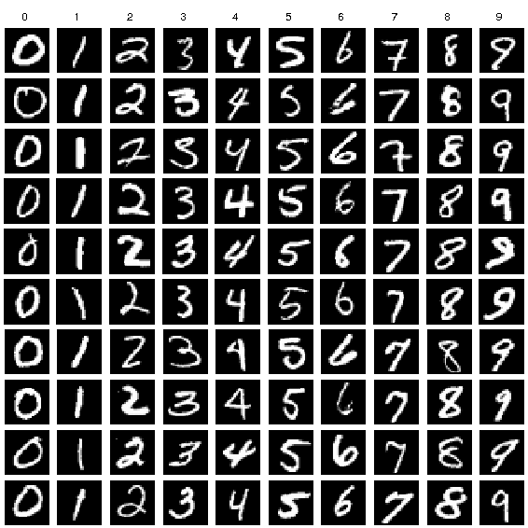
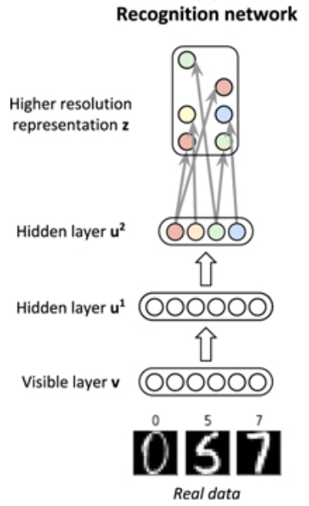
Application: Labeled data generation
Handwritten numbers
Benedetti, Marcello, John Realpe-Gómez, and Alejandro Perdomo-Ortiz. "Quantum-assisted helmholtz machines: a quantum–classical deep learning framework for industrial datasets in near-term devices." Quantum Science and Technology 3.3 (2018): 034007.
Labeled training Data (mnist)
Notes:
Alrigtht, so lets start with some applications.
Here is an example where one is trying to generate a labelled data. In this case it is a picture of a hand written number along with a classifier which tells you what that number is.

Slide 4
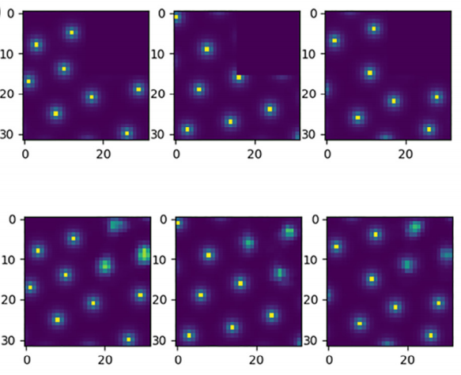
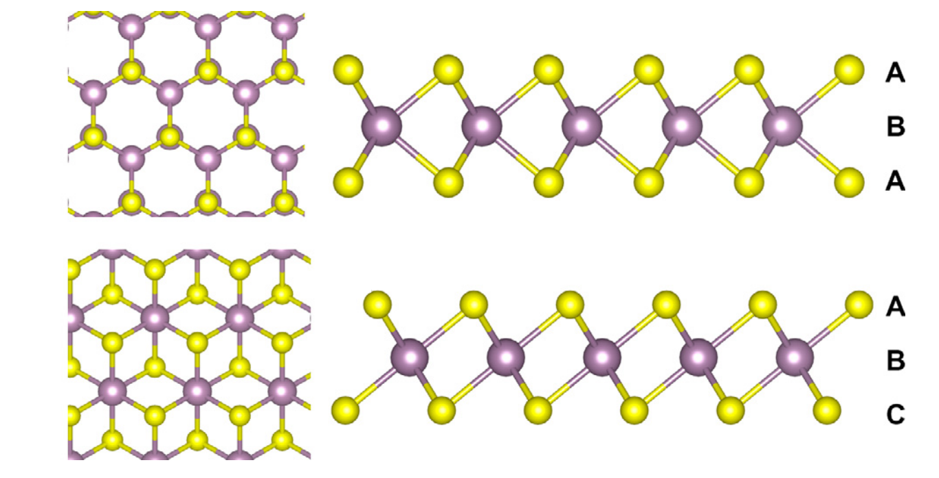
Application: Recovering missing data
Chemical vapor deposition (CVD) growth for a MoS2 monolayer
Liu, Jeremy, et al. "Boltzmann machine modeling of layered MoS2 synthesis on a quantum annealer." Computational Materials Science 173 (2020): 109429.
Incomplete Data
Reconstructed Data
Notes:
Then you may not want to generate the whole sample but just fill in some missing data. Here you have atomistic scale images representing the structure of Molybedenum bi Sulfide which is missing data in first quadrant and we want the Boltzmann machine to recover this missing data.

Slide 5
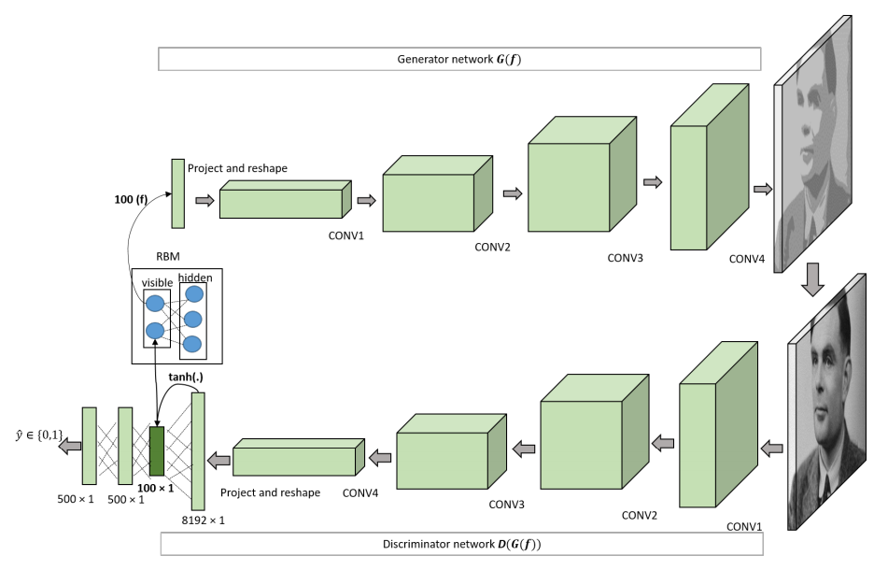
Application: Machine Learning architectures
Associative adversarial networks
Arici, Tarik, and Asli Celikyilmaz. "Associative adversarial networks." arXiv preprint arXiv:1611.06953 (2016).
Intermediate layer of the discriminator reads the visible layer of the RBM network (the associative memory).
RBM Samples generate inputs for the generator network (as opposed to noise sampling).
This layer that is visible to the associative memory represents a feature space that can capture latent factors of variations in the data
Notes:
In all our examples so far we have used BM as machine learning models for sampling.
And it stands tor reason that you can integrate it with other machine learning approach to create a more robust ML architectures. In this example, Boltzmann machine is used as the interface layer between the generative and discriminative layer of an Associative Adverserial network. Here they are useful in defining more complicated priors than the usual gaussian variables

Slide 6
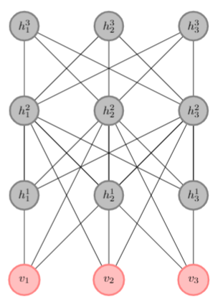
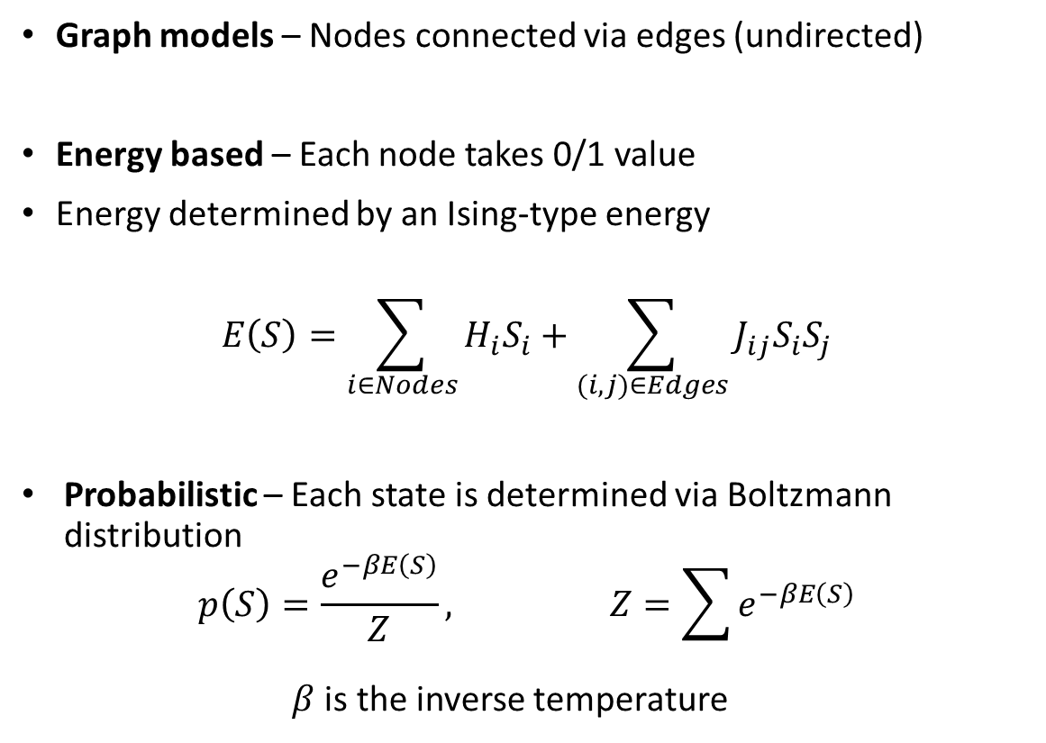
Boltzmann machine are probabilistic energy-based graph models
Graph models – Nodes connected via edges (undirected)
Energy based – Each node takes 0/1 value
Energy determined by an Ising-type energy
$$E\left(S\right)=\sum_{i∈Nodes}{H_{i}S_{i}}+\sum_{(i,j)∈Edges}{J_{ij}S_{i}S_{j}}$$
Probabilistic – Each state is determined via Boltzmann distribution
$$p\left(S\right)=\frac{e^{−βE\left(S\right)}}{Z}, Z=\sum{e^{−βE\left(S\right)}}$$
$β$ is the inverse temperature
1
1
0
0
0
1
1
1
0
1
0
0
Notes:
Alright so now that we have seen some applications of BM, we can now define what these objects are?
They are probabilistic energy-based graph models. Lets look at each of these terms one by one.
Graph models means they are defined on a network of nodes connected through edges
You can define a state of this graph by assigning each node a 0/1 value. Based on the state you can determine the energy of graph using something like an Ising model and hence the term energy-based.
Finally they are called probabilistic because each state occurs with a probability determined by this energy dependent function also known as Boltzmann distribution.

Slide 7
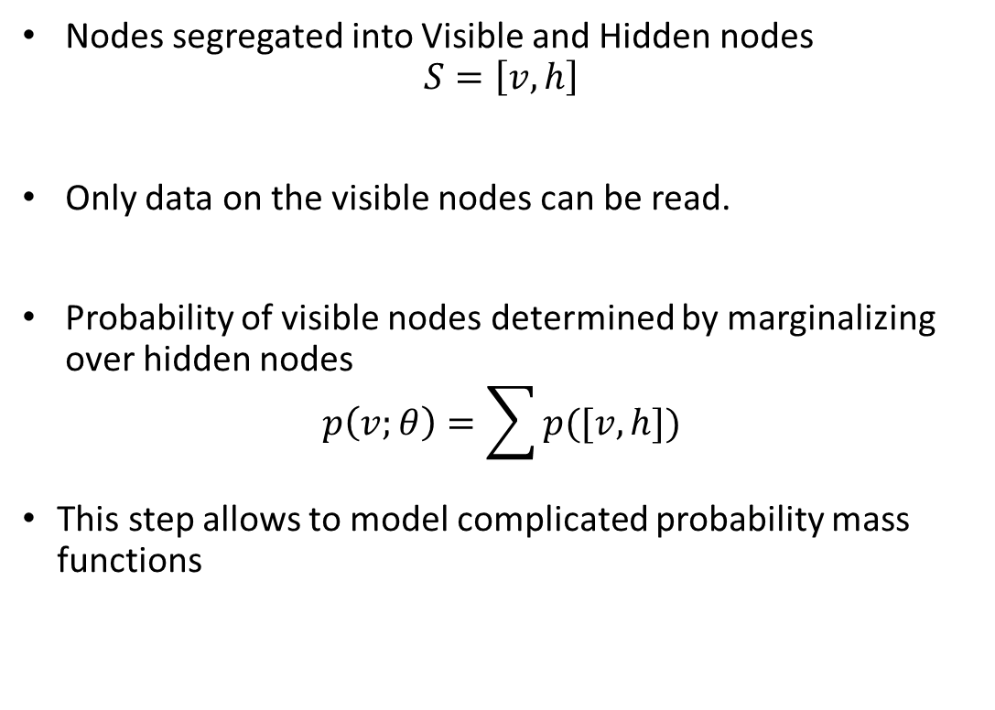
User can only read part of the nodes
Nodes segregated into Visible and Hidden nodes
$$S=\left[v,h\right]$$
Only data on the visible nodes can be read.
Probability of visible nodes determined by marginalizing over hidden nodes
$$p\left(v;θ\right)=\sum{p([v,h])}$$
This step allows to model complicated probability mass functions
Grey nodes may have any value
User reads pink nodes
Notes:
But what makes these models special is that the nodes are segregated into visible and hidden nodes. Users can only read data on the visible nodes. …
In this figure user only reads the pink nodes and he can interpret the state of these nodes based on the application.
The probability of any visible state can be estimated by summing over all hidden nodes. Here, I am denoting the parameters of model with theta.
And it is this step that distinguishes Boltzmann machine from just Ising models .. it allows modeling of complicated probability mass functions

Slide 8
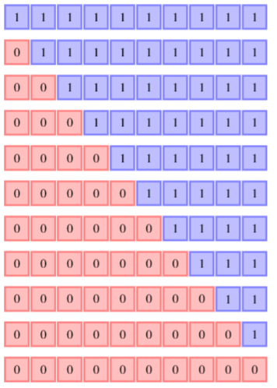
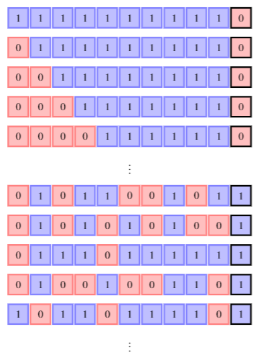
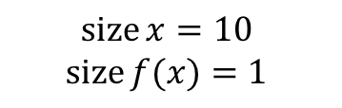
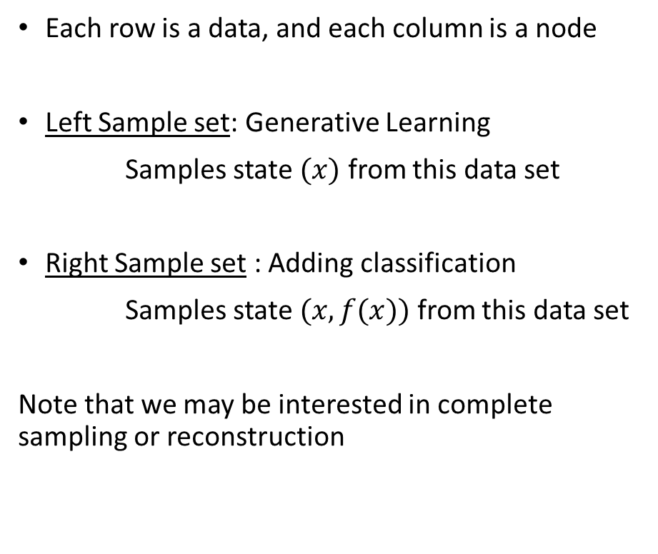

Representing data-sets for visible nodes
Each row is a data, and each column is a node
Left Sample set: Generative Learning
Samples state $(x)$ from this data set
Right Sample set : Adding classification
Samples state $(x,f(x))$ from this data set
Note that we may be interested in complete sampling or reconstruction
Ordered Phase
Random Phase
Set of states with ‘0’ on left and ‘1’ on right
Distinguish between Random and ordered phase
$$\operatorname{size}{x}=10$$
$$\operatorname{size}{f(x)}=1$$
$$\operatorname{size}{x}=10$$
Notes:
In regard to training, the data sets contain arrays of states of visible layers. Here these states are represented by the rows.
In the data-set on the left, you simply want the BM to sample a state, x , of size 10 from it. Now this example set share a certain common property that is it has all zeros to left and all 1s to right and atmost 1 boundary in the middle.
In contrast on right you have data set which contains two kind of points one represents an ordered phase and one is random phase. And when you sample from this set, you also want to know what you have sampled so you add this last bit to data which identifies its type. Now you can think of it as sampling (x,f(x)) rather than just x.
And keep in mind while it may seem like I am talking about complete sampling, but we may just want to do partial reconstructions.

Slide 9
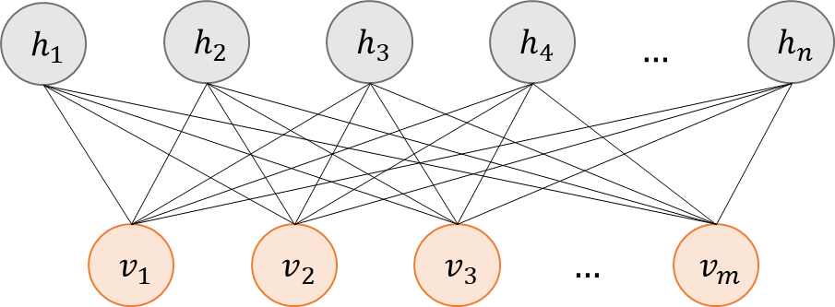
Estimation of gradients is challenging
Optimize for Log-likelihood based cost (KL Divergence, Negative Log-likelihood)
$$\frac{∂\left(−\log{p(v^{∗})}\right)}{∂θ}=𝔼_{h}\left(\frac{∂E(v,h)}{∂θ} | v^{∗}\right)−𝔼_{v,h}\left(\frac{∂E(v,h)}{∂θ}\right)$$
Exact estimation prohibited due to exponentially large number of states
Estimating expectation using Monte Carlo-based techniques takes time to equilibrate
Another idea: Use “simpler” graph-structures
Restricted Boltzmann machine - Bipartite graph of hidden and visible layer
Contrastive Divergence / Negative Sampling
Hinton, Geoffrey E., Simon Osindero, and Yee-Whye Teh. "A fast learning algorithm for deep belief nets." Neural computation 18.7 (2006): 1527-1554
Notes:
For training, you usually do likelihood maximization that is increase the log probability of a data.
And you may be inclined to estimate the gradients and apply gradient descent or some variant, but the problem is that they are very hard to compute exactly.
These expectations are over exponentially large possibilities of state.
So the next best thing is to use Monte-Carlo methods but then again it takes a lot of time for them to equilibrate.
Another thing that one can do is to look at graph which are in some way easier to solve-
Here we have a Restricted Boltzmann machine or RBM - that has a bipartitite structure
These machines have been popular just because they are easier to train using something known as Contrastive divergence method

Slide 10
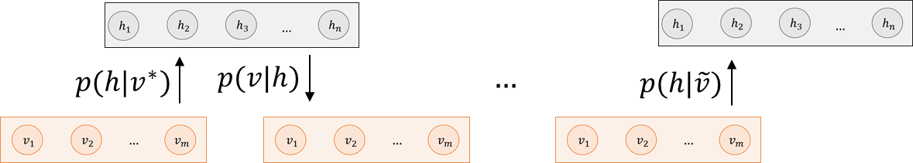
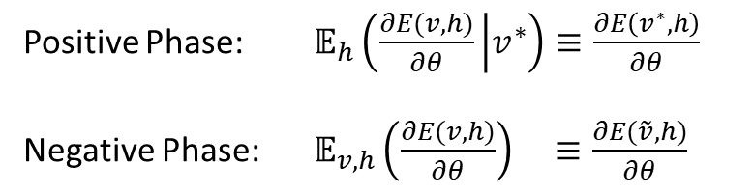
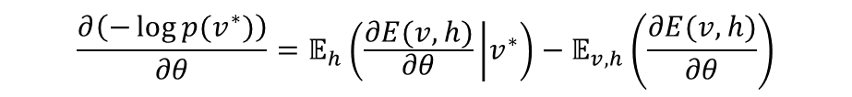
Computational Complexity is determined by the topology of the graph
$$\frac{∂\left(−\log{p(v^{∗})}\right)}{∂θ}=𝔼_{h}\left(\frac{∂E(v,h)}{∂θ} | v^{∗}\right)−𝔼_{v,h}\left(\frac{∂E(v,h)}{∂θ}\right)$$
Maximizing likelihood of a data state
Contrastive Divergence / Negative Sampling
Hinton, Geoffrey E., Simon Osindero, and Yee-Whye Teh. "A fast learning algorithm for deep belief nets." Neural computation 18.7 (2006): 1527-1554
Idea: Start with a data (desired) state and check if you are moving away from it.
Positive Phase: $𝔼_{h}\left(\frac{∂E(v,h)}{∂θ} | v^{∗}\right)≡\frac{∂E\left(v^{∗},h\right)}{∂θ}$
Negative Phase: $𝔼_{v,h}\left(\frac{∂E(v,h)}{∂θ}\right) ≡\frac{∂E(\tilde{v},h)}{∂θ}$
Notes:
So, lets talk about Contrastive Divergence or CD method. It is a great example that shows .. How the bipartite topology of a graph can be used for simplifying the training process.
Now again we want to do a maximum likelihood estimations.
But rather than exact estimation of expectations we will approximate it.
The key idea is … that you start with the desired state of the visible node, independently update hidden nodes and then the visible nodes and so on.
You can do this independently because there are no connections within each layer.
If you do this for few steps and you have moved away from the initial data state then you haven’t trained enough, while if you are still near the initial data then your training is close to completion. You can formalize these ideas in terms of so called positive and negative phase .. And they cancel each other for a trained BM

Slide 11
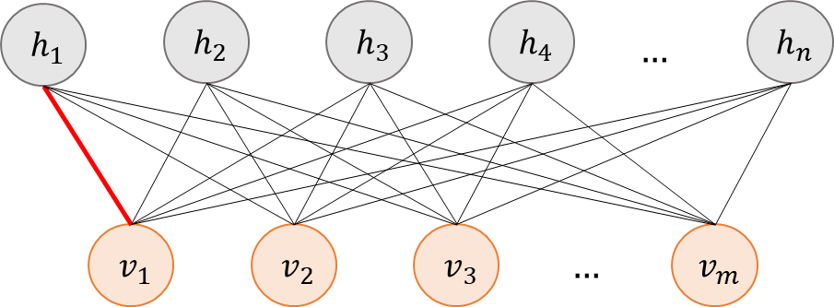
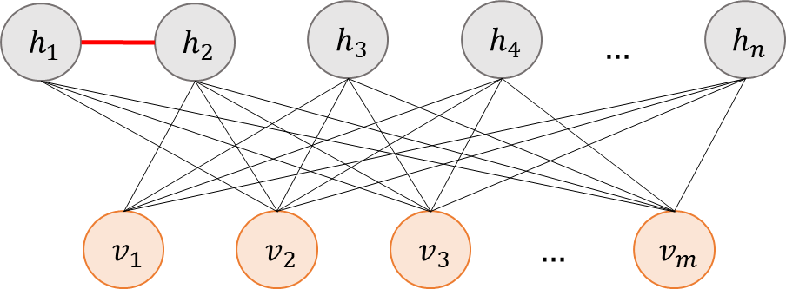
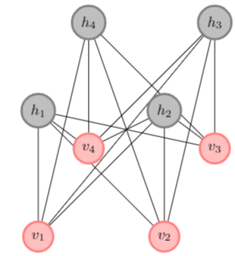
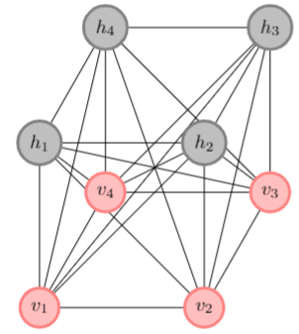
Computational Complexity is determined by the topology of the graph
Ease of computation doesn’t depend on just sparsity but the overall topology of graph, e.g., presence of cycles, multipartite graph etc.
Less complex
Moderately complex
In general, adding edges to a network increases representation capability but also the cost of computation
Deep RBM[1]
Limited BM[2]
Representation Capability
Computation complexity
RBM[1]
BM
[1] Ruslan Salakhutdinov and Geoffrey Hinton. Deep boltzmann machines. In Artificial intelligence and statistics, (2009)
[2] Liu, Jeremy, et al. "Boltzmann machine modeling of layered MoS2 synthesis on a quantum annealer." Computational Materials Science (2020)
Notes:
So it is fair to say that the computational complexity not just depends on the number of connections but also the topology of the graph.
In this example, the image to the left is easier to solve than the one on the right – The reason for this is that you can make independent inferences of hidden and visible layer in the left case and use this in your training.
But in general, it is true that adding more edges to a network increases its representation capability and possibly its training cost.
So in this case the easiest to train is RBM, then you can stack multiple hidden layers to get a Deep RBM, you can add some connections within hidden layer to get Limited Boltzmann machine and on top of the food chain you have General Boltzmann machine – which is a fully connected graph
Any graph that you can think off will be a subset of a complete graph

Slide 12
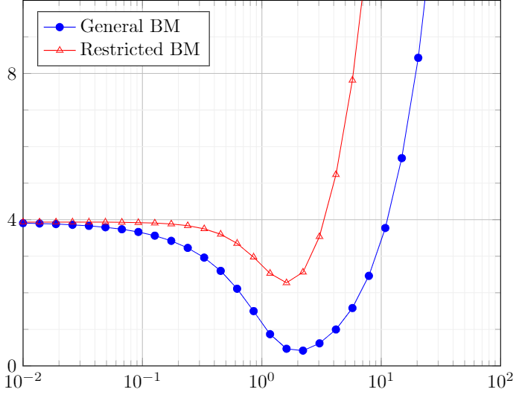

Tradeoffs between representability and computational cost
Gradient based approximations for general BM is difficult due to calculation of expectations
Use Contrastive Divergence techniques for simpler graphs – RBM
But General BM is more representable than RBM
The solution to this problem is an effective low-cost sampler for Boltzmann machine
Quantum Annealer
KL Divergence
$$β$$
Generative training with 4 hidden nodes
Notes:
Lets quickly recap the Tradeoffs between representability and computational cost
Training general BM is difficult, and the most computationally expensive part is sampling.
In contrast RBM can be raining using CD but have low representation capability.
In this example, one of our previous data set was trained with 4 hidden nodes and you are looking at the training cost at different temperatures for a trained model.
It is fair to say that General BM performs better than restricted BM
But to summarize everything we have seen so far, all our problems can be solved with a good sampler for ising model. And that is where Quantum annealer comes to our rescue

Slide 13
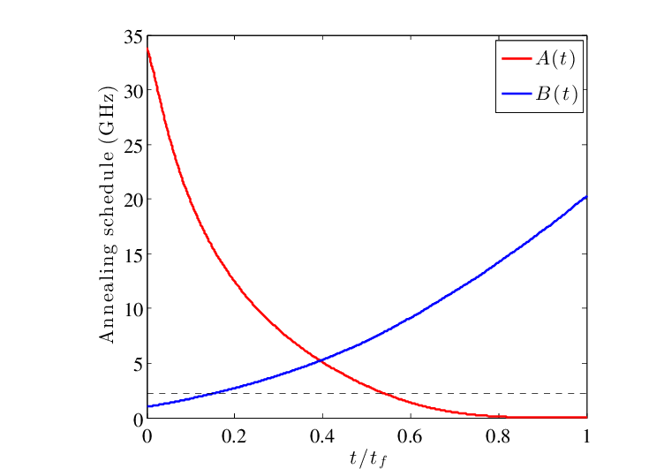
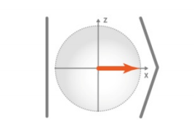
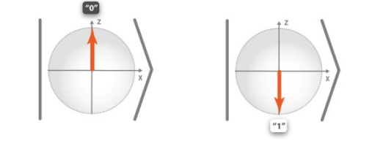
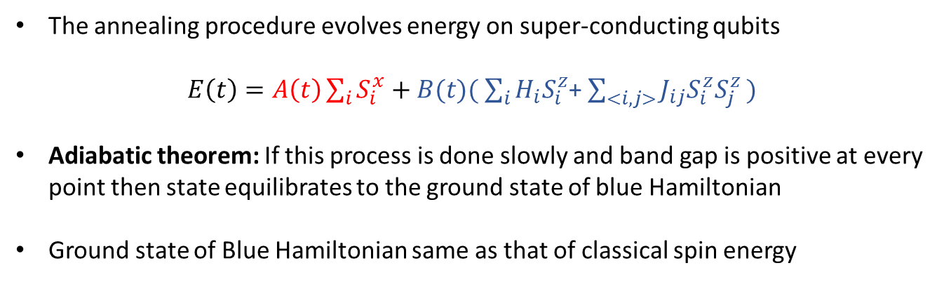
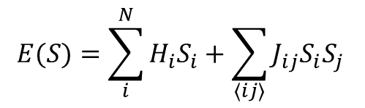
Quantum Annealing
The annealing procedure evolves energy on super-conducting qubits
$E\left(t\right)=A\left(t\right)\sum_{i}{S_{i}^{x}}+B(t)( \sum_{i}{H_{i}S_{i}^{z}}$+ $\sum_{<i,j>}{J_{ij}S_{i}^{z}S_{j}^{z })}$
Adiabatic theorem: If this process is done slowly and band gap is positive at every point then state equilibrates to the ground state of blue Hamiltonian
Ground state of Blue Hamiltonian same as that of classical spin energy
$$E(S)=\sum_{i}^{N}{H_{i}S_{i}}+\sum_{⟨ij⟩}{J_{ij}S_{i}S_{j}}$$
Benefits:
1. Finds the minimum in a single computation
2. Savings in energy consumption by reduced computation time
Notes:
Quantum Annealing refers to slowly changing from one Hamiltonian to the other and observing the final Quantum state of a system.
Adiabatic theorem tells us that if we do this slowly enough and maintain a positive bandgap then the final state is the ground sate of blue Hamiltonian
In this case, quantum state goes from red to blue state which are represented using these cartoons.
Now you can already guess that there is some relation between the blue quantum state and state of ising model – These up and down arrows can be treated as 1 and 0 values of the ising states
In fact, the Blue state gives the global minimizer of the Ising energy and you can get this in one simulation. And this means a lot of saving in computational expense

Slide 14
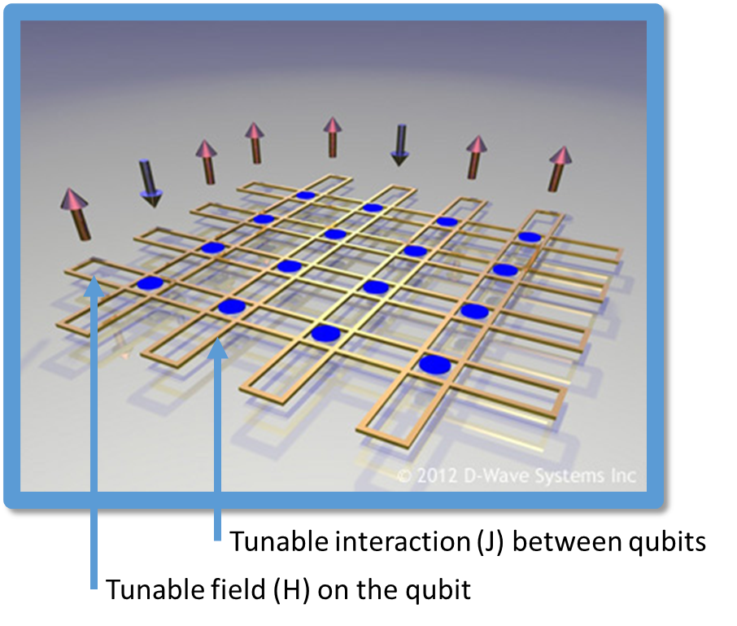
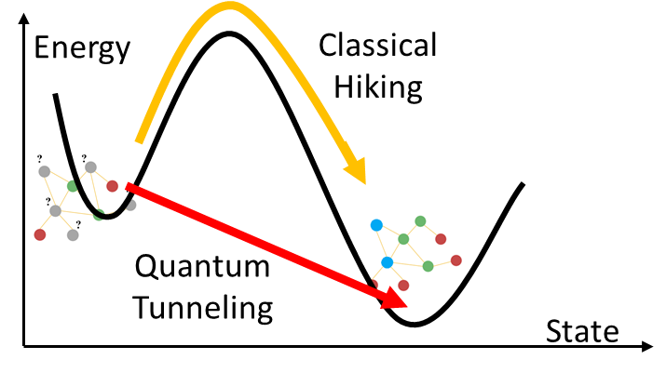
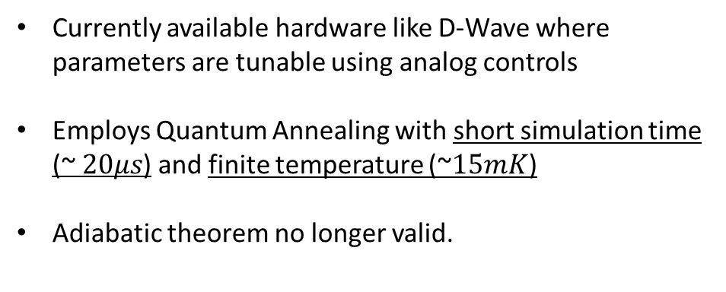
Quantum Annealing
Currently available hardware like D-Wave where parameters are tunable using analog controls
Employs Quantum Annealing with short simulation time (~ $20μs$) and finite temperature (~$15mK$)
Adiabatic theorem no longer valid.
What does Quantum annealing give?
Independent samples based on Boltzmann distribution
Notes:
Currently there are hardware like Dwave machines where you can encode any ising Hamiltonian using analog knobs.
But there is a caveat, and we are going to exploit it. The current hardware employs this method with fast evolution of Hamiltonian at low but finite temperature.
Therefore, adiabatic theorem is no longer valid.
So the question is what does Quantum annealing give? In qualitative sense you can think that .. at a low temp quantum effects are still valid which lets you tunnel between local and global minima.
But due to finiteness of temperature, you end up getting a sample set of states. And the good thing is that these states follow a Boltzmann distribution naturally .. And this is exactly what we want in our application.

Slide 15
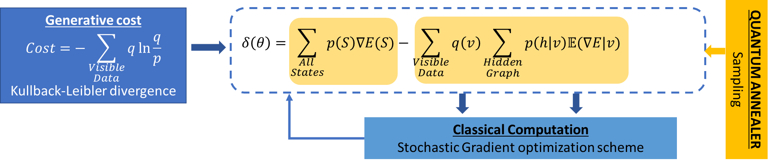
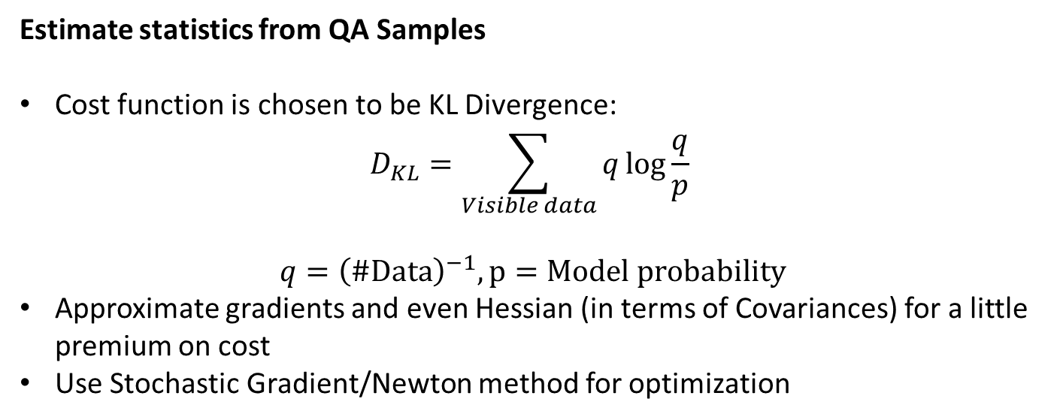
Generative learning
Estimate statistics from QA Samples
Cost function is chosen to be KL Divergence:
$$D_{KL}=\sum_{Visible data}{q\log{\frac{q}{p} }}$$
$$q={\left(\#Data\right)}^{−1}, p=Model probability$$
Approximate gradients and even Hessian (in terms of Covariances) for a little premium on cost
Use Stochastic Gradient/Newton method for optimization
Data Set
Notes:
Now with Quantum annealers, problem is quite simple. It already gives you independent samples. And you can use that to calculate the expected derivatives.
In this case we will consider the cost as the KL Divergence.
You can approximate the gradients and even hessian with a little bit premium on cost.
And then you can use your favorite version of stochastic approach to train this model .. as you do in most machine learning problems,
Here is an illustration of the gradient-based approach.
Quantum annealer samples the states for a given parameter theta..
classical computer estimates the gradients and updates the parameters using steepest descent.

Slide 16
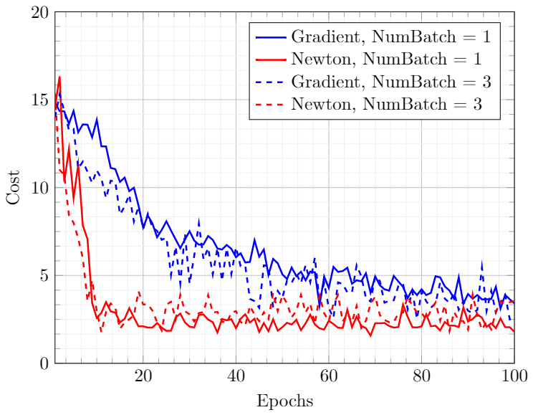
Generative learning
Data Set
Notes:
So now we can apply this approach. Here is how the result looks like for mini-batch style stochastic method. In this you randomly distribute your data set into different batches and run optimizations for each of these minibatches.
Newton approaches show faster convergence than gradient based.
You can see that even the single batch case i.e. the non stochastic problems show fluctuation and that is due to the errors in the sampling process.

Slide 17
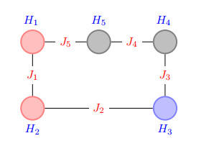

Classification of state (Discriminative learning)
Graph decomposed as:
(a) Visible Input (Pink)
(b) Visible output (Blue)
(c) Hidden (grey)
Phase 0
Phase 1
State $(x,f(x))$
Notes:
Now we also want to include a node which identifies the class of a problem which earlier we described as a tuple (x,f(x))
Here f(x) is the class.
In this case the graph can be decomposed into three components: visible input to denote x, visible output to denote f(x) and some hidden graph.
In the cartoon to the right, I have highlighted these nodes in different colors.

Slide 18
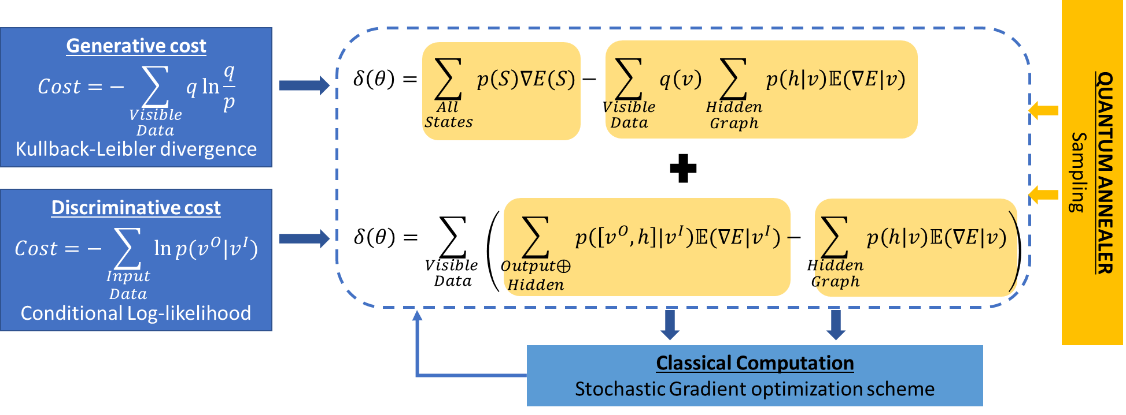
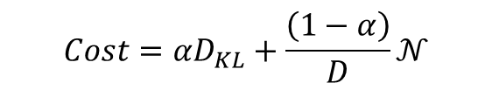
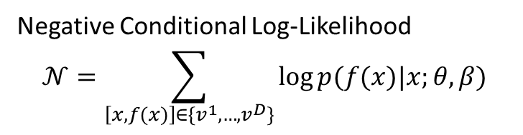
Including classification cost
Optimize for $p(f(x)|x)$
Negative Conditional Log-Likelihood
$$𝒩=\sum_{\left[x,f(x)\right]∈\{v^{1},…,v^{D}\}}{\log{p(f(x)|x;θ,β)}}$$
$$Cost=αD_{KL}+\frac{\left(1−α\right)}{D}𝒩$$
Phase 0
Phase 1
Notes:
Now in this case we will optimize cost for conditional log likelihood: where we want to maximize the probability f(x) given x
Now the complete cost can be written as interpolation between the generative cost of KL Divergence and classification cost of Negative conditional log likelihood,
With this we can update our illustration for generative learning to account for classification cost
And again gradients and hessians can be estimated from the samples. And updates will be made as summing over the descent directions.

Slide 19
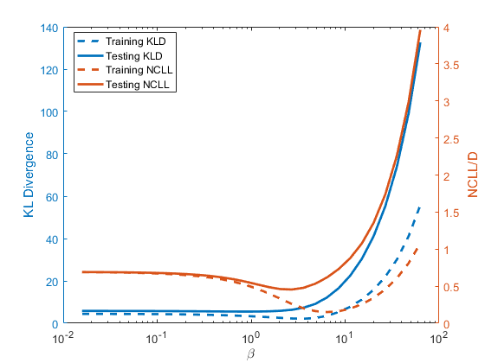
Including classification cost
Phase 0
Phase 1
80/20 split of Training/Testing Data
Notes:
Well now, we can train the model for this data, that we mentioned earlier.
Here I have plotted the different components of costs at various values of temperature (beta is inverse temperature).
Now we do see a dip in the training cost and testing cost at a given temperature (lets say near beta = 3)… and you might be inclined to think that it is the temperature that we annealed our model
But the answer is not that easy

Slide 20
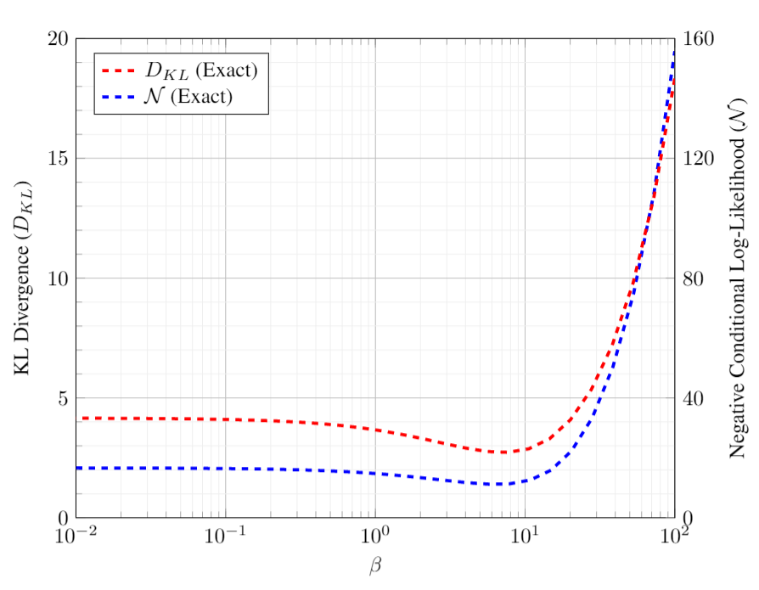
New challenge: Temperature ($β$) is unknown
Annealing temperature is unknown and dependent on the simulated graph.
Need to evaluate $β$ to implement model in different machines
Observation: $log p=−βE−\log{Z}$
Linear Regression:
$$β^{∗}=−\frac{\sum{\left(E−𝔼\left(E\right)\right)\left(\log{p}−𝔼\left(\log{p}\right)\right)}}{\sum{{\left(E−𝔼\left(E\right)\right)}^{2} }}$$
$$β^{∗}$$
Trained BM may not have the best performance at the Training temperature ($β^{∗}$)
Notes:
Infact annealing temperature is unknown and even worse it depends on the graph that you are simulating.
Now if you want to reuse this model on other computers, you need to evaluate this beta.
And for that you can observe that for Boltzmann distribution, there is a linear relationship between log of probability of a sample and its energy
You can use linear regression on the samples to evaluate the training beta.
So we do this, and now we realize that this training beta might not correspond to the one where we are seeing this dip in cost.

Slide 21
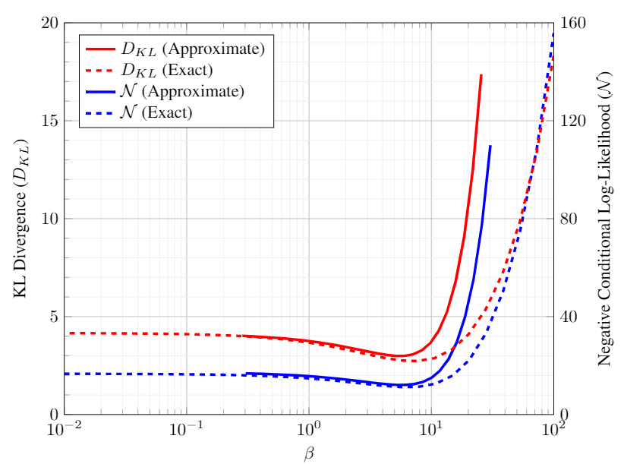
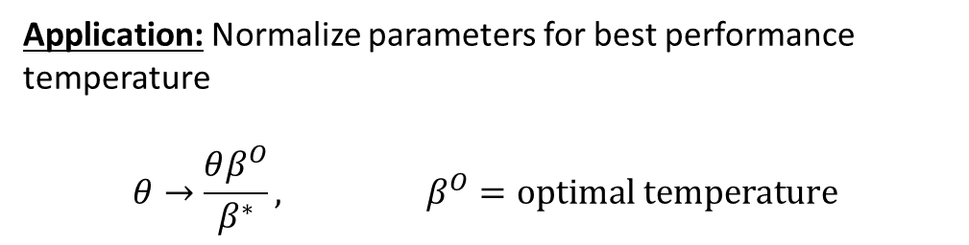

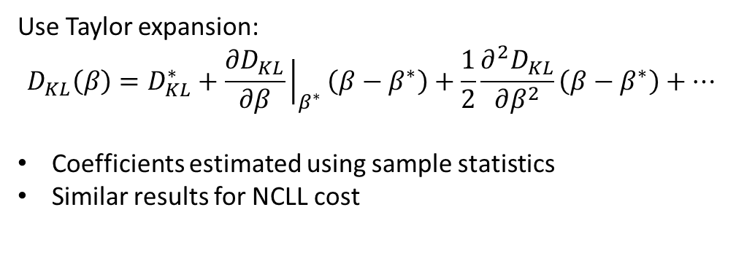
Approximating the cost at different $β$
Application: Normalize parameters for best performance temperature
$$θ→\frac{θβ^{O}}{β^{∗}}, β^{O}=optimal temperature$$
Use Taylor expansion:
$$D_{KL}\left(β\right)=D_{KL}^{∗}+\frac{∂D_{KL}}{∂β}{\left.​\right|}_{β^{∗}}\left(β−β^{∗}\right)+\frac{1}{2}\frac{∂^{2}D_{KL}}{∂β^{2}}\left(β−β^{∗}\right)+…$$
Coefficients estimated using sample statistics
Similar results for NCLL cost
$$β^{∗}$$
$$β^{O}$$
We have resolved the issue of transferability of the BM to different computing devices.
Notes:
So that motivated us to look at the behavior of model when keep the parameter constant but change the temperature.
The reason why we want to do that is – so that we can normalize our parameters like this. And then our model will be optimal at beta=1.
And then we can translate our model to different machine renormalize the beta wherever necessary.
Now the problem is that these costs cannot be estimated exactly due to the complexity of the problem.
Here we are able to plot the dotted lines only because these are toy problems.
So to approximate these costs, the main idea is to write the taylor expansion about the annealing temperature.
Now the great thing is that the coefficients for the cost can be estimated using the samples
With this we have fully resolved the issue of transferability of the BM to different computing devices.. Moreover, we have found the local behavior of BM, which we can use to optimize for a specific machine.

Slide 22
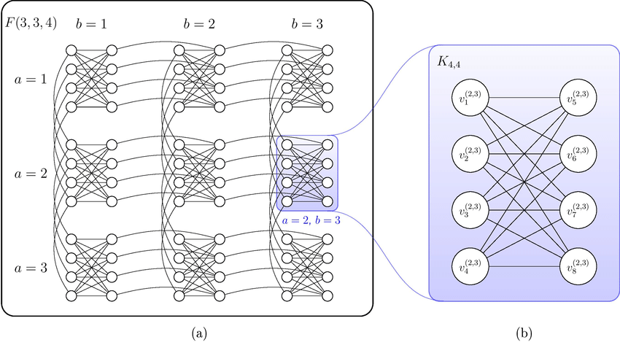
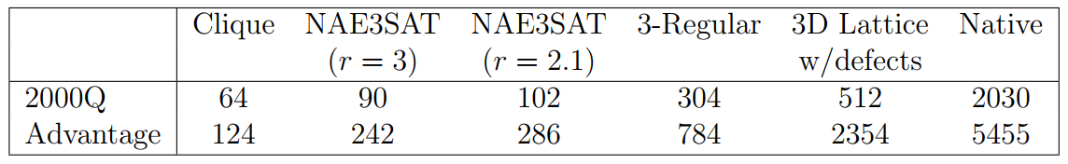
Summary for Boltzmann Machine
State of the art: Present training methods utilize topological features of a graph for reducing computational complexity
Advantage of current work: Training via QA samples works on a general BM. Sparse BMs enjoy additional computational advantages by allowing embedding of larger graphs in the hardware
Resolution of possible problems: The issue of transferability of BM is resolved
A MATLAB library is now available which implements this training method
Future work: As a next step, we will apply this method for problems concerning Process-Structure-Property (PSP) linkages in materials science
vs
Notes:
So the current methods utilize topological features of graph and that limits the kind of BM that can be efficiently trained.
In our method, general BM’s can be trained. Sparsity in BM still give some advantage in terms of the size of the problem that can reproduced on a Quantum annealer.
In this image I am showing you a portion of the Dwave graph. As you can see it is not fully connected. Therefore, the maximum size of that can be represented on QA is dependent on its sparsity as shown in this table.
The current QA system can solve a general BM or Clique of size 124, which is out of scope of a classical computer.
We already made the matlab library available to public. And we are currently looking at machine learning problems with PSP linkages in materials science.

Slide 23
Thank you

