Slide 1
A Bioinformatics Approach to the Security Analysis of Binary Executables
Scott Miller
New Mexico Institute of Mining and Technology

Slide 2
Summary
The concept of this thesis is to draw an analog to a similar analysis problem in Biology and thus leverage existing analysis techniques. After development and analysis, the technique of this thesis is used for two applications: determining the interrelation of various malicious software and evaluating the differences among different versions of the same executable. Preliminary analysis supports this technique as a tool to consider binary executables on a per-instruction level that does not require executables to follow any coding or interface standards. Based on initial results, improved result presentation and graphical visualizations, improved result filtering, and application/evaluation to a broader scope should be pursued.

Slide 3
Acknowledgements
NSF/Scholarship for Service
NMIMT/CS Department
Thesis committee – Dr. Liebrock (advisor), Dr. Horst Clausen, Dr. Jeanine Cook
Technical and general reviewers
NMIMT Educational Outreach/Distance Instruction

Slide 4
Outline
Motivation
Background
Bioinformatics Analogy
Technique
Application: Software version analysis
Application: Virus analysis
Conclusions

Slide 5
Motivation
Threat
Computer systems are ubiquitous…
Increasing reliance, increasing value
Decreasing tolerance for compromise
Increasing motivation/reward for exploitation
…and our reliance on these systems is advancing the development of malicious code.

Slide 6
Motivation
Defense
Current defense: policy, software, hardware
New threats necessarily require patches
Patches require verification
Time available for verification is decreasing
The very tools we use to defend ourselves are contributing to the problem.

Slide 7
Background
Malicious Code Analysis
Human reverse engineering
Structural analysis
Alias analysis
Functional analysis
  Single-instruction consideration
  No dependence on execution environment

Slide 8
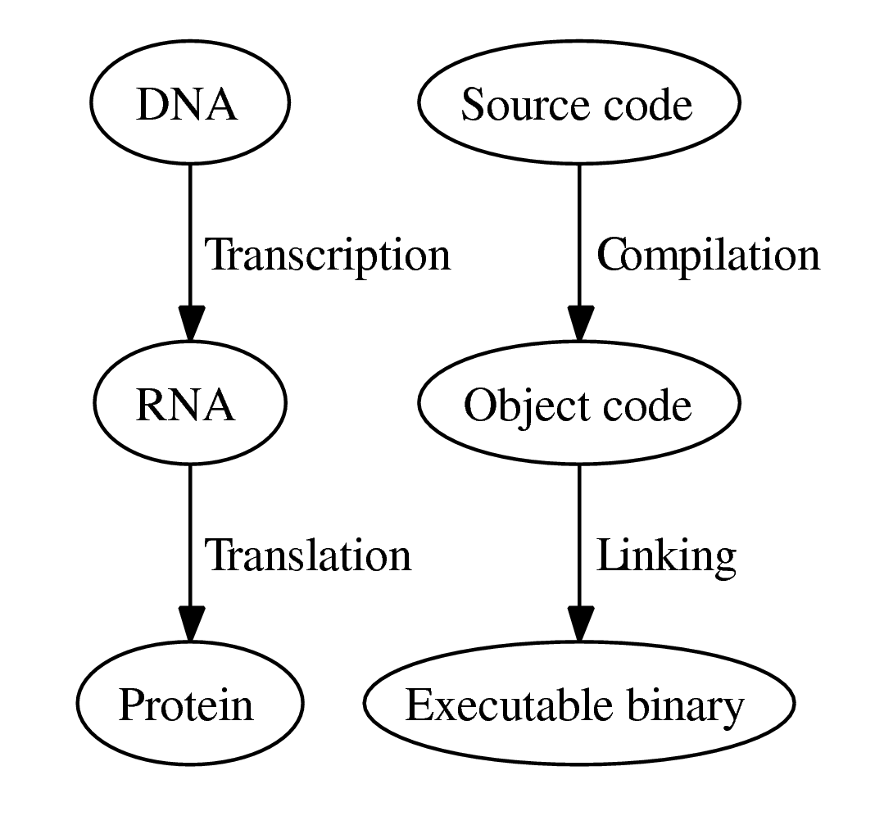
Bioinformatics Analogy
Functional analysis from code is not new…

Slide 9

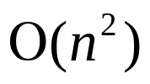
Bioinformatics Analogy
Basic Local Alignment Search Tool
Selects from possible matches in time
Extends simple pattern matching with integer score
One of the first bioinformatics alignment tools
Remains one of the strongest tools

Slide 10
Technique
Alignment Scoring Example
Match adds one (+1)
Difference subtracts one (-1)
Actual scoring constants determined using Karlin-Altschul analysis
Align #1 |  | T | H | E | S | E
Align #2 |  | T | H | E | S | I | S
Score | 0 | 1 | 2 | 3 | 4 | 3 | 2 | 3

Slide 11
Technique
Scoring for Binaries
Karlin-Altschul analysis on over 553,901,654 instructions
Instructions reduced to 4-byte format
Operator class, truncated to one byte
mov ebp, esp
Operands, truncated to two bytes
Operator, truncated to one byte

Slide 12

Technique
Scoring for Binaries
(+6) Exact match, operator and operands
(+5) Good match, operator
(+4) Fair match, operator class
(-4) No match
Estimation threshold

Slide 13
Outline
Motivation
Background
Bioinformatics Analogy
Technique
Application: Software version analysis
Application: Virus analysis
Conclusions

Slide 14
Application: Version Analysis
Sendmail
Program | Distribution | Date released | Likely compiler
postfix-2.2.8 | SUSE (i386) | 1/7/2006 | gcc 3.4.5
chromium-0.9.12 | SUSE (i386) | 9/13/2005 | gcc 3.4.4
sendmail-8.13.5 | SUSE (i386) | 9/16/2005 | gcc 3.4.4
sendmail-8.13.4 | Fedora (i386) | 3/27/2005 | gcc 3.3.6
sendmail-8.12.9 | Mandrake (i586) | 3/29/2003 | gcc 3.2.2
sendmail-8.9.1 | Redhat (i386) | 7/7/1998 | gcc 2.8.1

Slide 15
Application: Version Analysis
Raw Results
Score | Len | File A |  |  | File B
 |  | Name | Section | Off | Name | Section | Off
5095 | 899 | sendmail-8.13.5 | _init | 0 | sendmail-8.13.4 | _init | 0
4829 | 905 | sendmail-8.12.9 | _init | 0 | sendmail-8.13.4 | _init | 0
4797 | 899 | sendmail-8.12.9 | _init | 0 | sendmail-8.13.5 | _init | 0
4588 | 931 | sendmail-8.13.5 | _init | 5 | sendmail-8.13.4 | (_init) | 11
4488 | 907 | sendmail-8.12.9 | (_init) | 32 | sendmail-8.13.4 | _init | 5
... | ... | ... | ... | ... | ... | ... | ...
Top results are associated with GCC-3 automatic code templates

Slide 16
Code templates common
in GCC-3
sendmail-8.13.5-1.i386.rpm |  | sendmail-8.13.4-2.i386.rpm
 | _init: |  | _init:
push | ebp | push | ebp
mov | ebp,esp | mov | ebp,esp
sub | esp,0x8 | sub | esp,0x8
call | 9f08 (chroot@plt+0x4c) | call | 9f08 (__memmove_chk@plt+0x48)
call | 9f88 (chroot@plt+0xcc) | call | 9f88 (__memmove_chk@plt+0xc8)
call | 991bc (sleep+0x2b82) | call | 9a048 (sleep+0x2b96)
leave |  | leave
ret |  | ret
 | SSL_CTX_set_tmp_ |  | SSL_CTX_set_tmp_
 | rsa_calback@plt-0x10: |  | rsa_callback@plt-0x10:
push | DWORD PTR [ebx+4] | push | DWORD PTR [ebx+4]
jmp | DWORD PTR [ebx+8] | jmp | DWORD PTR [ebx+8]
add | BYTE PTR [eax],al | add | BYTE PTR [eax],al
 | SSL_CTX_set_tmp_ |  | SSL_CTX_set_tmp_
 | rsa_calback@plt: |  | rsa_callback@plt:
jmp | DWORD PTR [ebx+12] | jmp | DWORD PTR [ebx+12]
push | 0x0 | push | 0x0
jmp | 8c3c (_init+0x18) | jmp | 8c20 (_init+0x18)
 | ... |  | …
Typical GCC-3 entry point
GCC-3 external symbol resolutions
Most common GCC-3 external call invocation

Slide 17
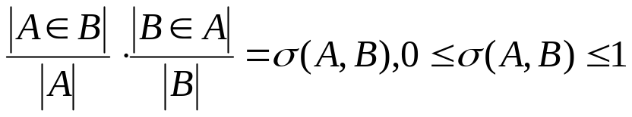
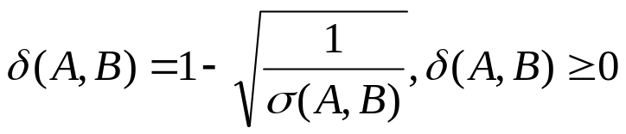
Application: Version Analysis
Phylogenetic Analysis
Provides aggregate consideration
Considers binary match coverage
Similarity:
Distance:
Prog. A | α | β | β | β | β | ε | ζ | γ | η
Prog. B | α | β | β | γ | δ

Slide 18
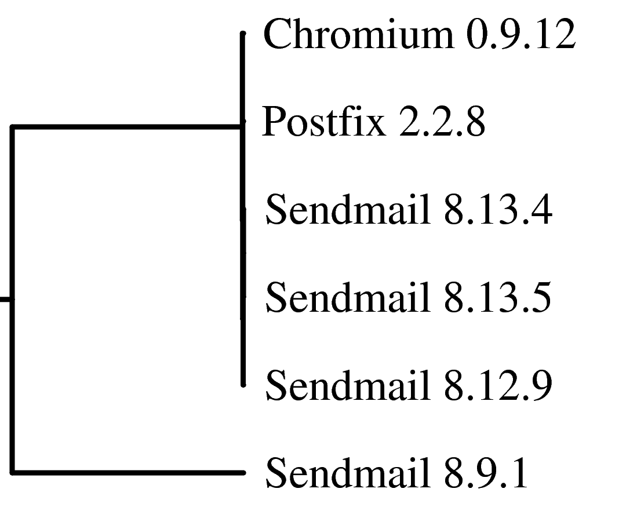
Application: Version Analysis
Phylogenetic Analysis
PHYLIP Unweighted Pair Group Method with Arithmetic mean (UPGMA)
Sendmail 8.9.1 distant because of use of GCC-2 compiler instead of GCC-3

Slide 19
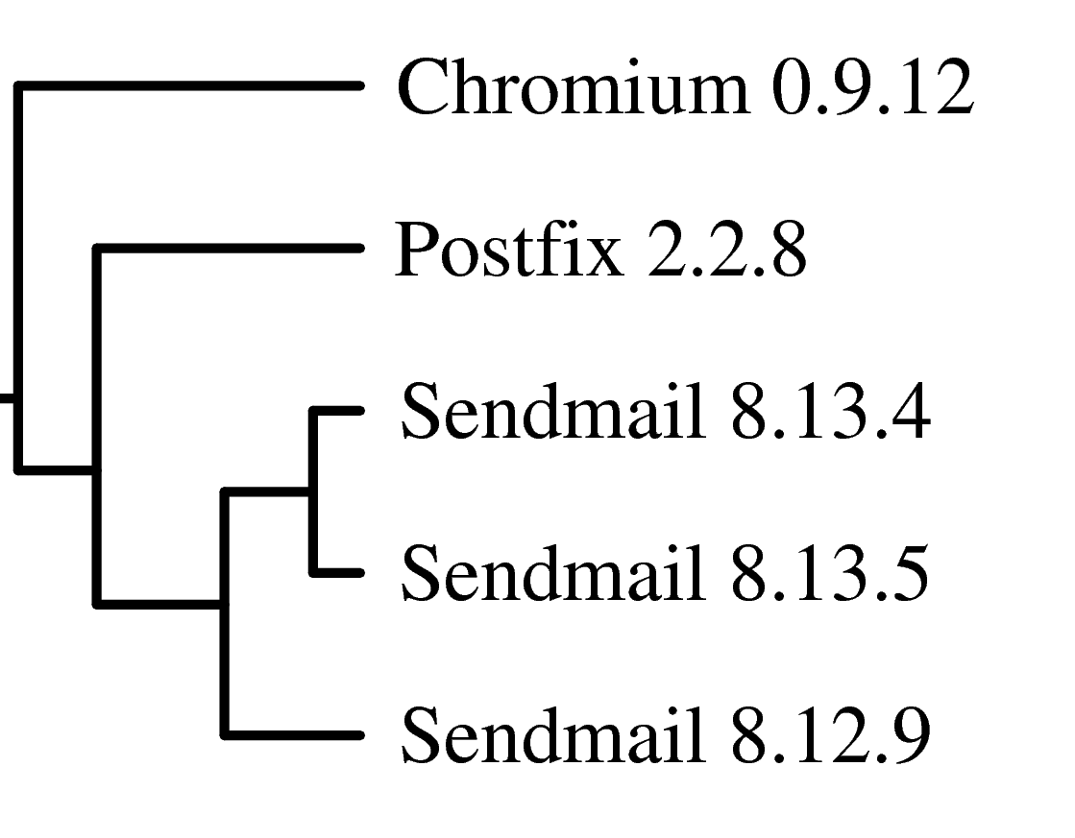
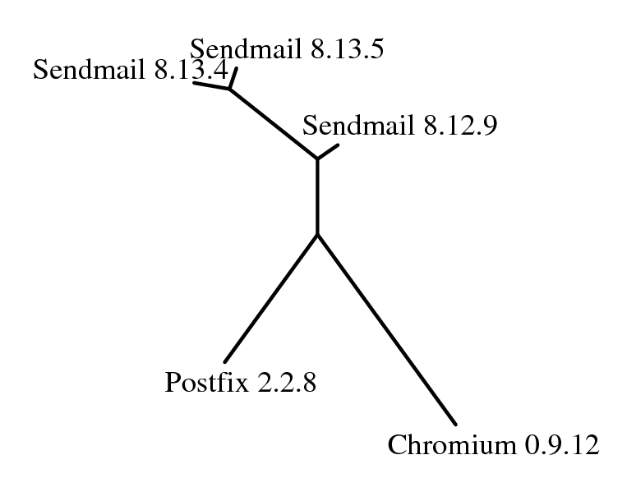
Application: Version Analysis
Phylogenetic Analysis
Both the UPGMA (left) and Nearest-Neighbor (right) methods generate similar phylograms that reflect known relationships.

Slide 20
Application: Virus Analysis
MyDoom
Viruses are typically compressed (‘packed’) then optionally encrypted (‘scrambled’)
Analysis of MyDoom
  Packed MyDoom.A, MyDoom.L, MyDoom.Q
  Unpacked MyDoom.A, MyDoom.L, MyDoom.Q

Slide 21
Application: Virus Analysis
Raw Results
Score | Len | File A |  | File B
 |  | Name | Offset | Name | Offset
3146 | 544 | MyDoom.L | 3324 | MyDoom.A | 5706
1613 | 280 | MyDoom.L | 5233 | MyDoom.A | 7677
1573 | 284 | MyDoom.L | 7745 | MyDoom.A | 9980
1513 | 265 | MyDoom.L | 2836 | MyDoom.A | 5031
1477 | 251 | MyDoom.L | 6170 | MyDoom.A | 8550
1055 | 204 | MyDoom.L | 4145 | MyDoom.A | 6541
949 | 205 | MyDoom.A(packed) | 8206 | MyDoom.L(packed) | 7198
895 | 189 | MyDoom.L(packed) | 7198 | MyDoom.Q(packed) | 9989
889 | 170 | MyDoom.A(packed) | 8201 | MyDoom.Q(packed) | 9984
849 | 148 | MyDoom.A(packed) | 16849 | MyDoom.Q(packed) | 9984
849 | 148 | MyDoom.A(packed) | 16849 | MyDoom.Q(packed) | 20273
849 | 148 | MyDoom.A(packed) | 8201 | MyDoom.Q(packed) | 20273
828 | 144 | MyDoom.A(packed) | 8206 | MyDoom.A(packed) | 16849
827 | 144 | MyDoom.L(packed) | 16946 | MyDoom.Q(packed) | 9989
... | ... | ... | ... | ... | ...

Slide 22
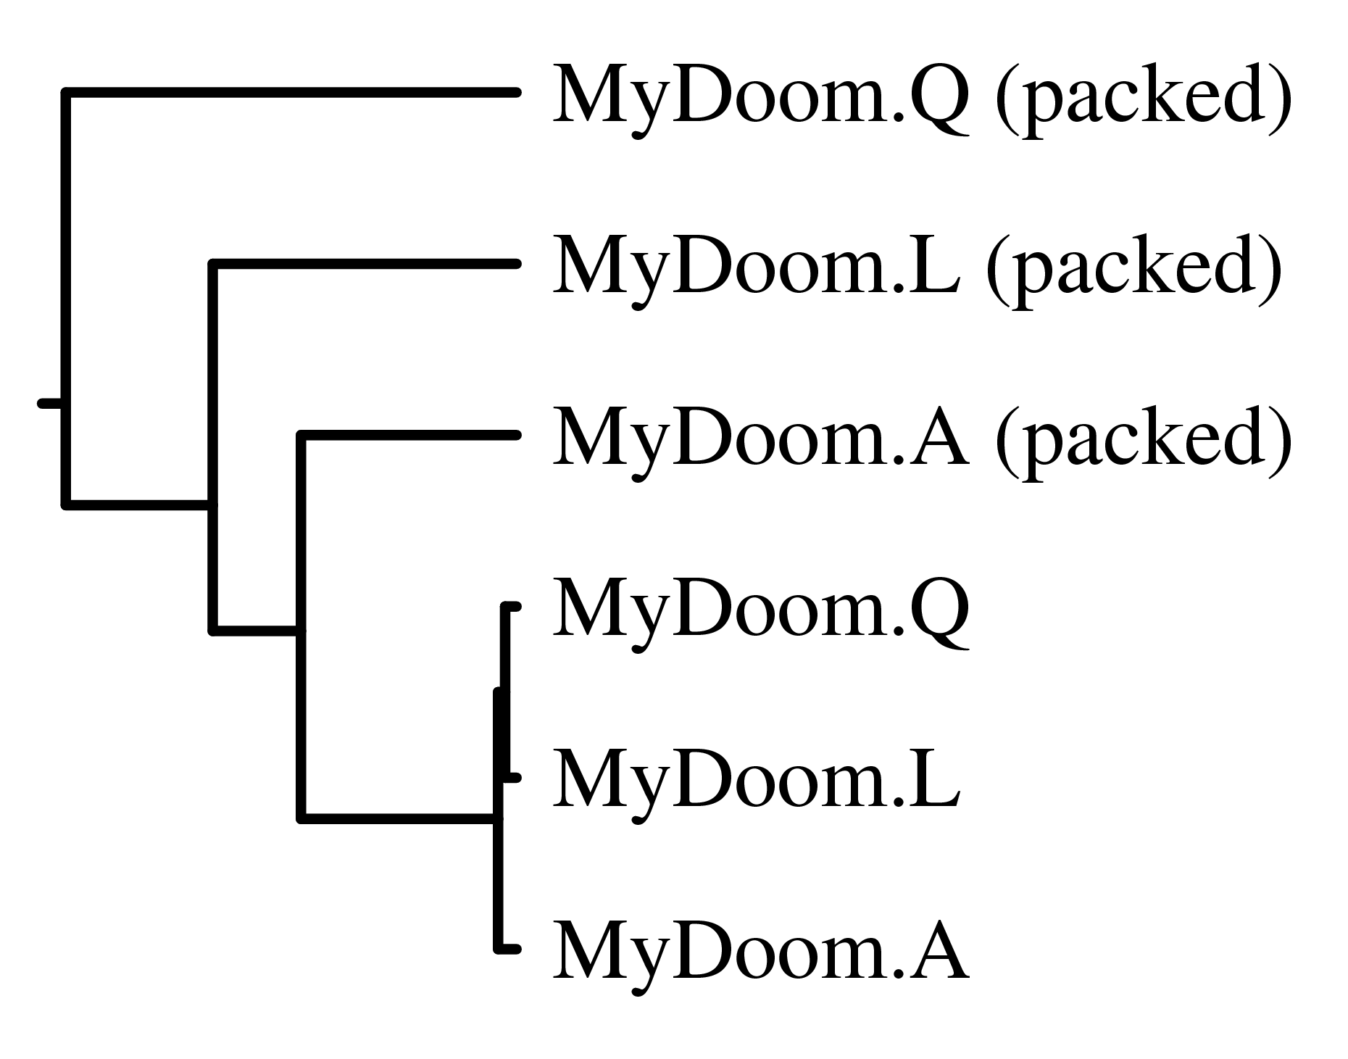
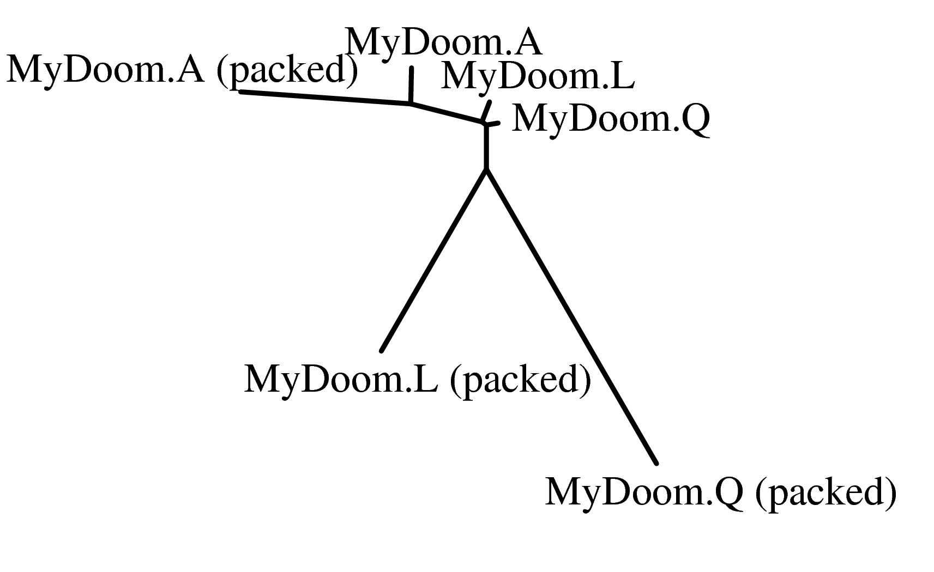
Application: Virus Analysis
Phylogenetic Analysis
UPGMA tree (left) reflects known relations but Nearest-Neighbor graph (right) may indicate a more complicated relationship between packed and unpacked viruses.

Slide 23
Outline
Motivation
Background
Bioinformatics Analogy
Technique
Application: Software version analysis
Application: Virus analysis
Conclusions

Slide 24
Conclusions
Simple analogy to bring tools from bioinformatics to security analysis
Initial analysis indicates potential
  Historical classification of never-before-seen code that can provide useful indications of the code's origin -- compiler, author, and likely ancestors
  Identification of functional motifs already identified by expensive, conventional reverse-engineering techniques
  Functional prediction of unknown binaries
  Identification and separation of source code, compiler, and environment

Slide 25
Conclusions
Future Work
Formal determination of threshold value
Improve match filtering/motif identification
Optimize implementation
Improve visualization and user interface
Broaden application scope
  Develop reverse engineering database
  Analysis of memory dumps
  Critical comparison against known reverse engineering analysis

Slide 26
Selected References
BLAST: S. Altschul et al., Basic Local Alignment Search Tool, 1990
Malware genomics: E. Carrera et al., Digital Genome Mapping - Advanced Binary Malware Analysis, 2004
Malware: Offensive Computing, 2006
Alias analysis: S. Debray et al., Alias Analysis of Executable Code, 1998
Structural analysis: H. Flake, Structural Comparison of Executable Objects, 2004
PHYLIP: J. Felsenstein, PHYLIP, 2005
`Packers’: M. Oberhumer et al., The Ultimate Packer for eXecutables, 2004.

