Slide 1

Exploratory Analysis
Total Rows: 3333
14% cases are of churn and 86% non churn. That means our model needs to give accuracy better than 86% with good recall and precision
No nulls in any column

Slide 2

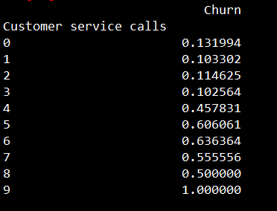
Customer Service Calls
It looks like as the numbers of calls to customer increases, the probability of that customer being churned also increases

Slide 3
Area Codes
Total of 3 area codes
  408
  415
  510

Slide 4
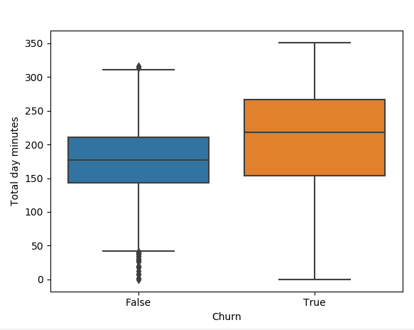
Total day minutes vs Churn
It looks like “Total day minutes” have huge variance for churned customers, but there could be a lurking variable behind this explanation

Slide 5
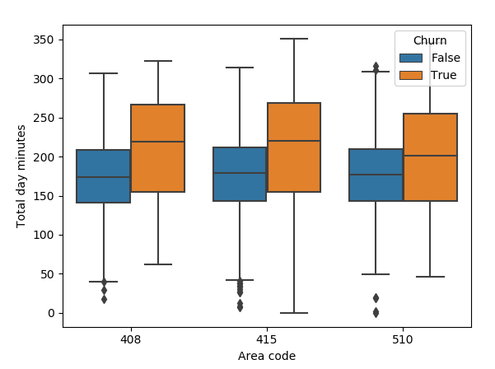
Area codes vs churn vs Total day minutes
Looks like two area codes have more variance in Total day minutes across churn categories. This might be because of some variables are contributing towards this factor

Slide 6
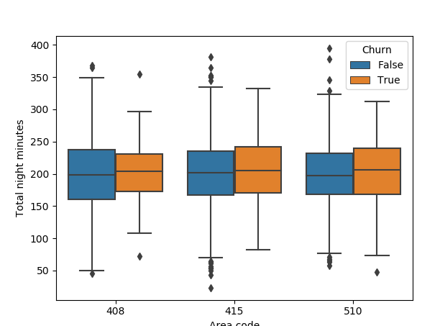
Area codes vs churn vs Total night minutes
No major difference

Slide 7
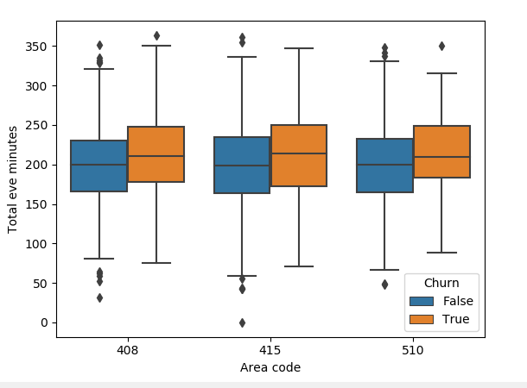
Area codes vs churn vs Total eve minutes
Looks like two area codes have more variance in Total day minutes across churn categories. Need to drill more on this

Slide 8
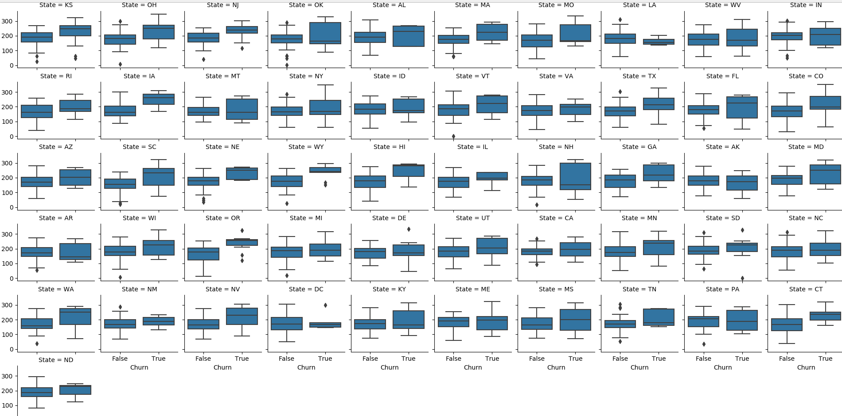
State
Total 51 states. Out of those 11 states have churn ratio greater than 20%
Few states like OR,NJ,IA,WY,HI,OR,WA,DC have a lot of difference in “Total Day minutes” for churned customers as compare to non-churned customers

Slide 9
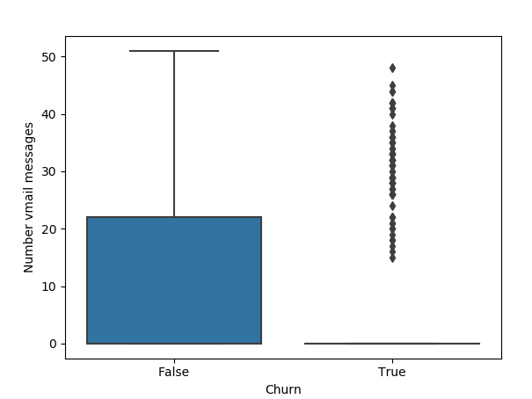
Number vmail messages vs Churn
It looks like people who are more likely to churn use very less vmail messages, or they are not aware of it, and probably increasing the awareness might reduce the churn rate

Slide 10
Important features to consider
Total day minutes
Number vmail messages
Customer Service calls
Area Code
State

Slide 11

Models

Slide 12
XGBoost
Split the dataset into 70/30 ratio, and applied XGBoost algorithm with following parameters after doing multiple rounds of cross validation
model = xgb.XGBClassifier(
objective = 'binary:logistic'
,early_stopping_rounds = 5
,booster = 'gbtree'
,learning_rate = 0.1
,max_depth = 8
,colsample_bytree = .9
,n_estimators = 100
,subsample = 0.8
)

Slide 13
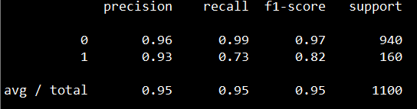
XGBoost Evaluation Metrics
Accuracy: 95%
Classification Report:

Slide 14
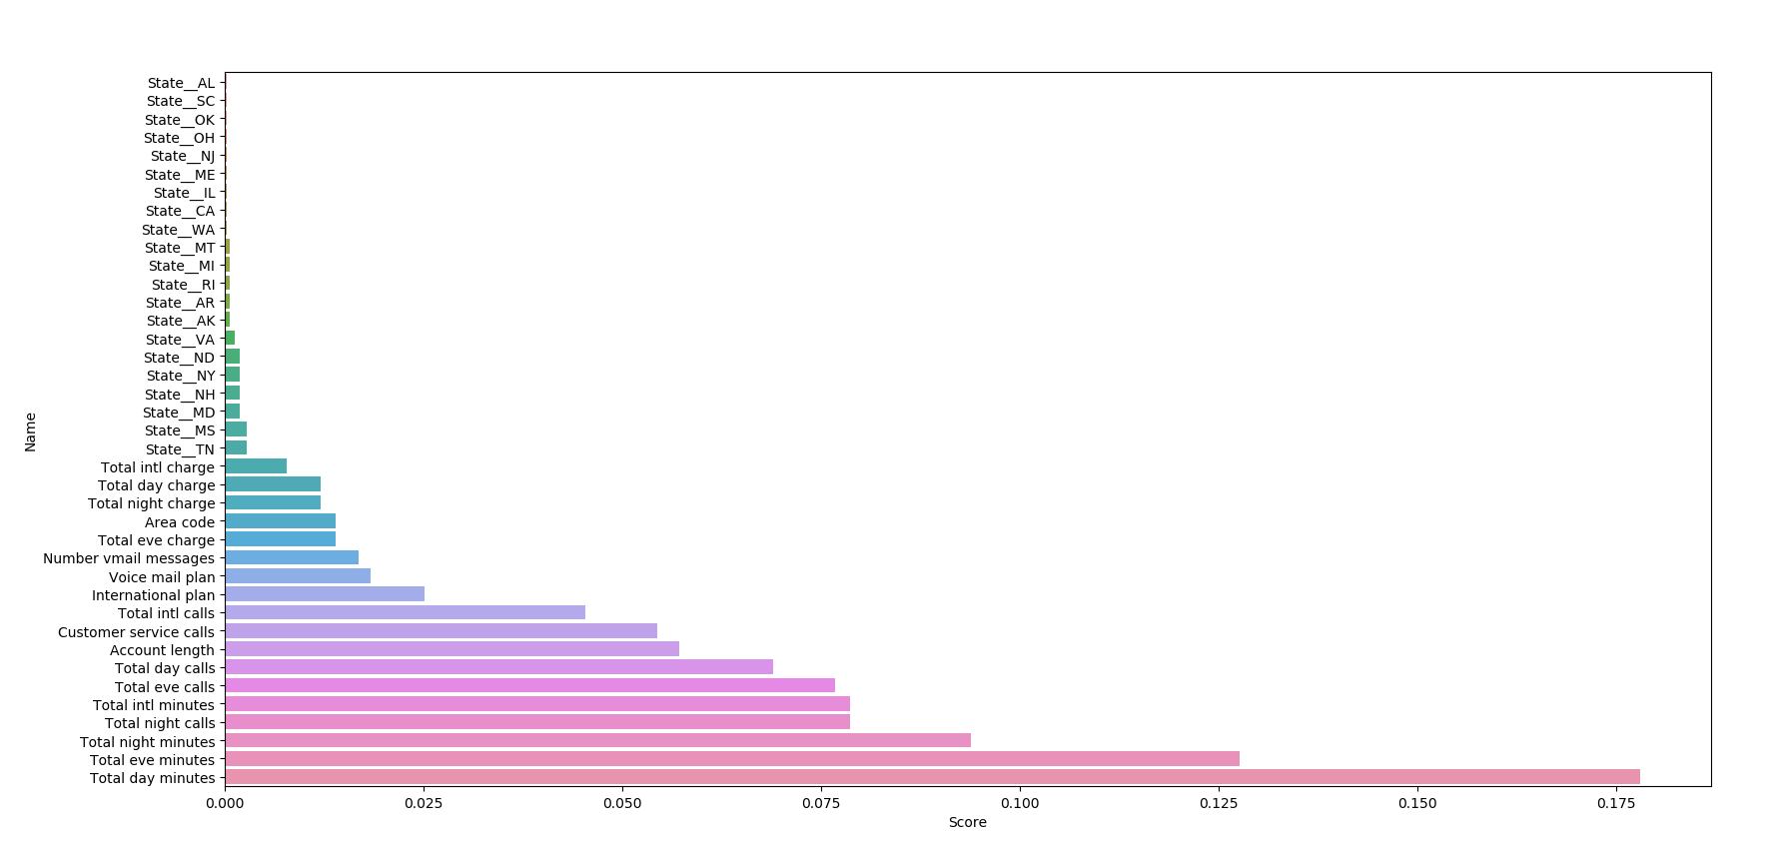
XGBoost Feature Importance

Slide 15
Decision Trees
Split the dataset into 70/30 ratio, and applied Decision tree algorithm with following parameters after doing multiple rounds of cross validation
model = DecisionTreeClassifier(class_weight = "balanced"
,max_depth = 6
,min_samples_split = 8
,random_state = 6)

Slide 16
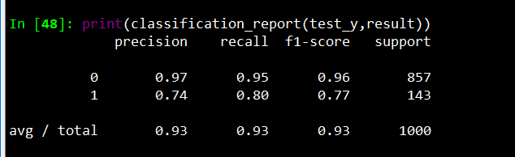
Decision Tree Evaluation metrics
Accuracy: 93%
Classification Report:

Slide 17
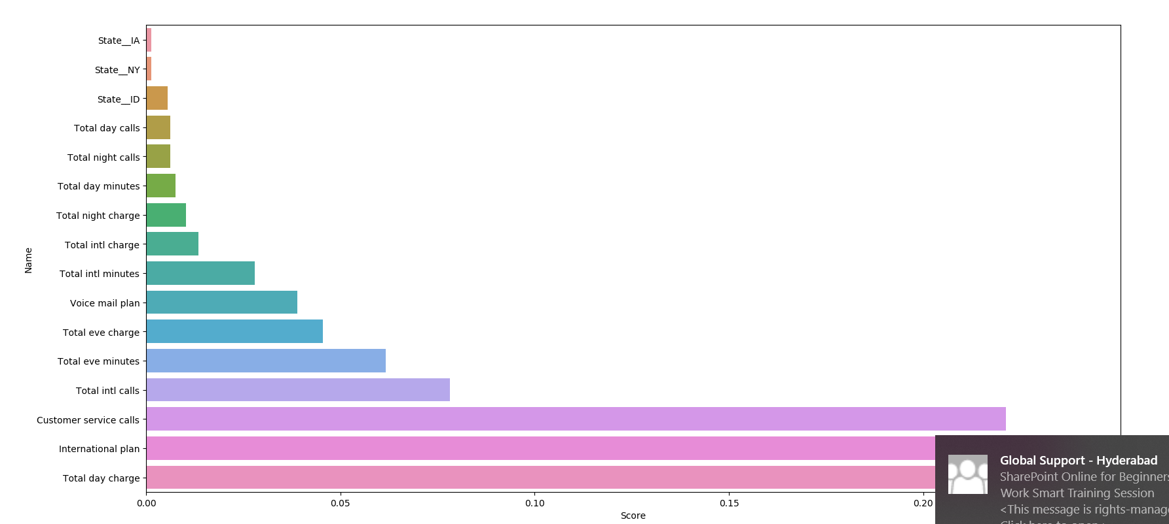
Decision tree Feature Importance

Slide 18
Final Model
Decision trees
I will choose Decision tree as it is performing better on churn customers as compare to XGBoost model

Slide 19
Enhance Model
Generate additional features using the existing features
Capture more data related to customer behavior like Age, salary, customer service call feedback etc..
Try out other algorithms from following categories: bagging, boosting, stacking

Slide 20
Arrest customer churn
Deploy the model and use the result of model to roll out promotions accordinlgy

