Slide 1
32 BIT RISC PROCESSOR
Sidharth Thomas – 16112087
Shubhanshu Agarwal – 16118078
Khyati Kiyawat – 16111018
Athul P – 16116012
Kaustubh Nayyar – 16116030
Varun Rathore - 16116074
Under the guidance of Prof. Vaskar Raychoudhary

Slide 2
WHY RISC ?
Simple addressing modes
Simple instruction formats
Focuses on Software
Requires less Hardware
Fixed Size Instructions
Register-to-Register Operations
Single-Clock

Slide 3
INSTRUCTION SET ARCHITECTURE
“ISA is what lives for years while implementation may change”
Based on MIPS ISA with few modifications

Slide 4
INSTRUCTION FORMAT
R-Type :
Field Positions | 0 | rs | rt | rd | shamt | funct
Bit Positions | 31:26 | 25:21 | 20:16 | 15:11 | 10:6 | 5:0
I-Type :
Field Positions | 35 or 43 | rs | rt | Address
Bit Positions | 31:26 | 25:21 | 20:16 | 15:0
J-Type :
Field Positions | 000010 | Address
Bit Positions | 31:26 | 25:0

Slide 5
INSTRUCTIONS
R-Type Instructions :
add
sub
and
or
xor
slt
J-Type Instructions :
jump

Slide 6
INSTRUCTIONS (con’d)
I-Type Instructions :
addi
andi
lw
sw
ori
xori
slti
bne
beq

Slide 7
DESIGNING CONTROL UNIT
Table : Opcodes
 | Signal Name | R-type | lw | sw | beq | addi | bne | andi | ori | xori | slti | jump
INPUT | Op5 | 0 | 1 | 1 | 0 | 0 | 0 | 0 | 0 | 0 | 0 | 0
 | Op4 | 0 | 0 | 0 | 0 | 0 | 0 | 0 | 0 | 0 | 0 | 0
 | Op3 | 0 | 0 | 1 | 0 | 1 | 0 | 1 | 1 | 1 | 1 | 0
 | Op2 | 0 | 0 | 0 | 1 | 0 | 1 | 1 | 1 | 1 | 0 | 0
 | Op1 | 0 | 1 | 1 | 0 | 0 | 0 | 0 | 0 | 1 | 1 | 1
 | Op0 | 0 | 1 | 1 | 0 | 0 | 1 | 0 | 1 | 0 | 0 | 0

Slide 8
DESIGNING CONTROL UNIT (con’d)
Table : Output Control Signals
 | Signal Name | R-Type | lw | sw | beq | addi | ori | andi | jump
OUTPUT | RegDst | 1 | 0 | X | X | 0 | 0 | 0 | 0
 | ALUSrc | 0 | 1 | 1 | 0 | 1 | 1 | 1 | 0
 | MemtoReg | 0 | 1 | X | X | 0 | 0 | 0 | 0
 | RegWrite | 1 | 1 | 0 | 0 | 1 | 1 | 1 | 0
 | MemRead | 0 | 1 | 0 | 0 | 0 | 0 | 0 | 0
 | MemWrite | 0 | 0 | 1 | 0 | 0 | 0 | 0 | 0
 | Branch | 0 | 0 | 0 | 1 | 0 | 0 | 0 | 0
 | Jump | 0 | 0 | 0 | 0 | 0 | 0 | 0 | 1

Slide 9
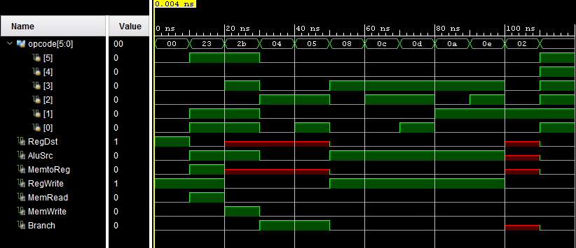
DESIGNING CONTROL UNIT (con’d)
Fig : Waveform for Control Unit

Slide 10
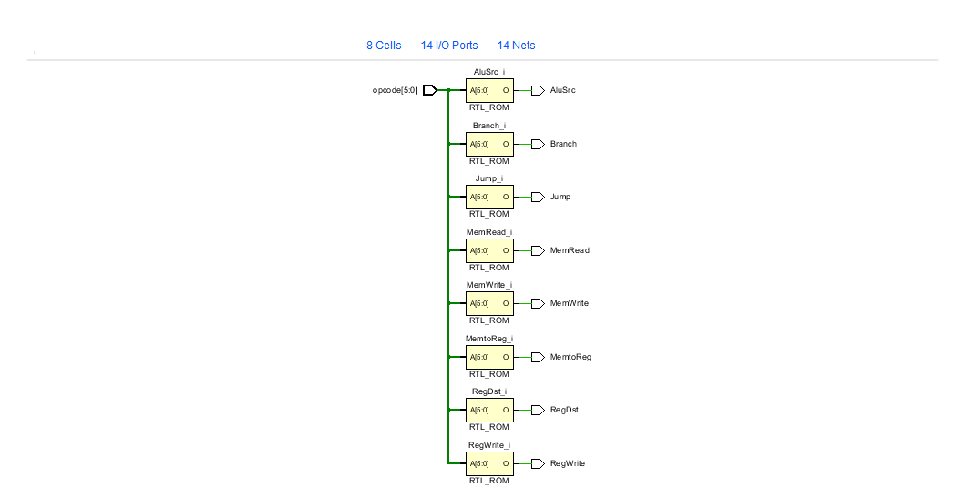
DESIGNING CONTROL UNIT (con’d)
Fig : Control Unit RTL Schematics

Slide 11
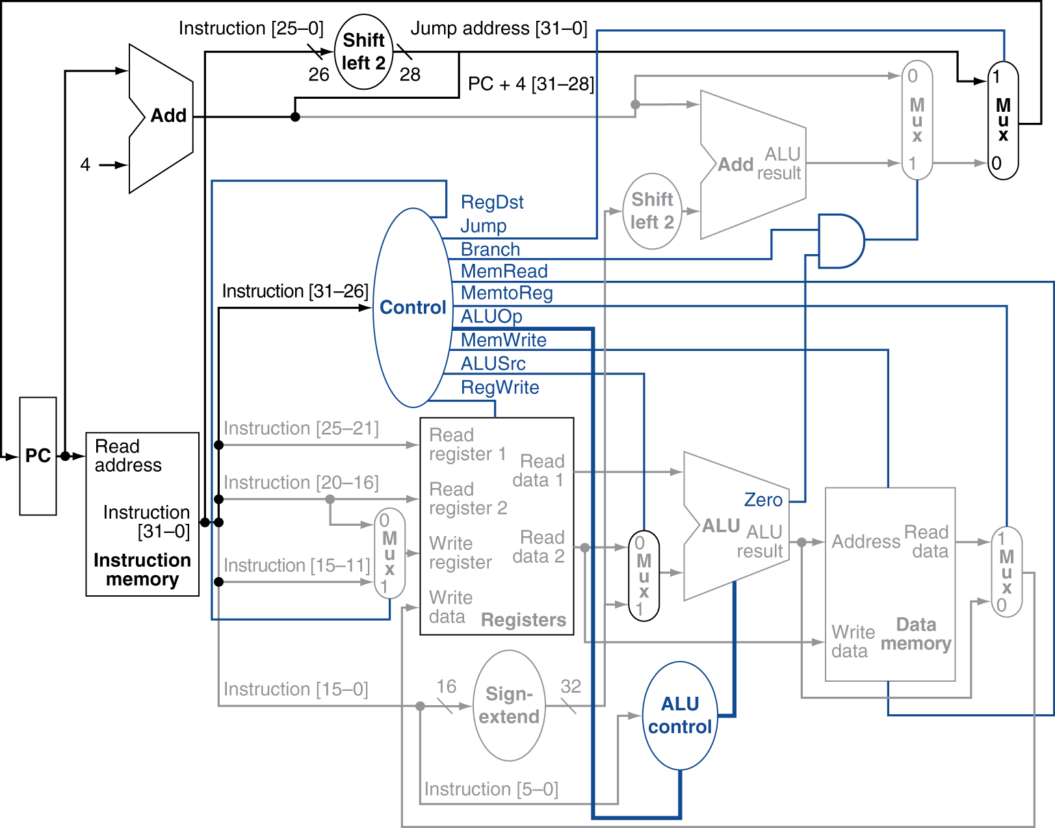
PROGRAM COUNTER
Fig : Program Counter

Slide 12
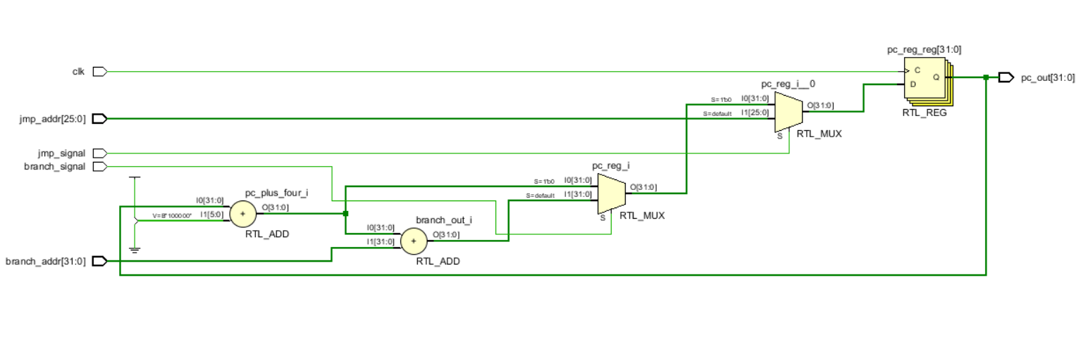
PROGRAM COUNTER (con’d)
Fig : RTL Schematics of Program Counter

Slide 13
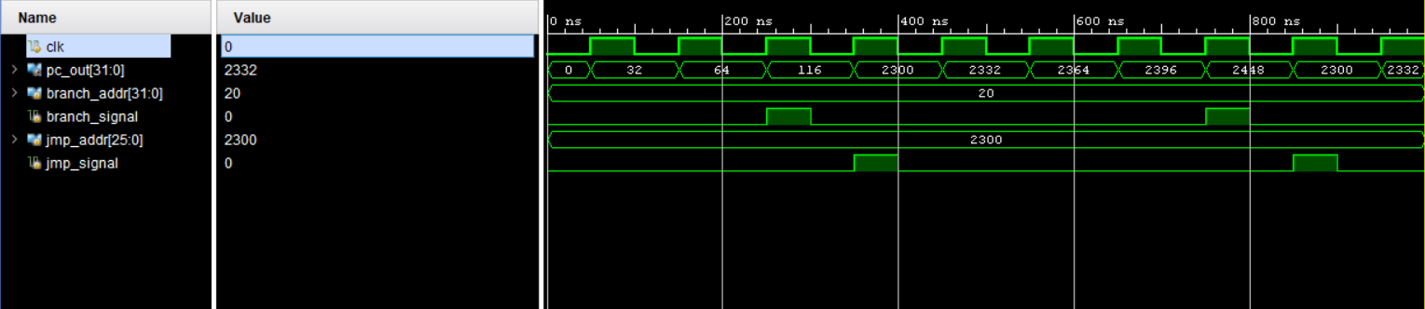
PROGRAM COUNTER (con’d)
Fig : Program Counter Waveform

Slide 14
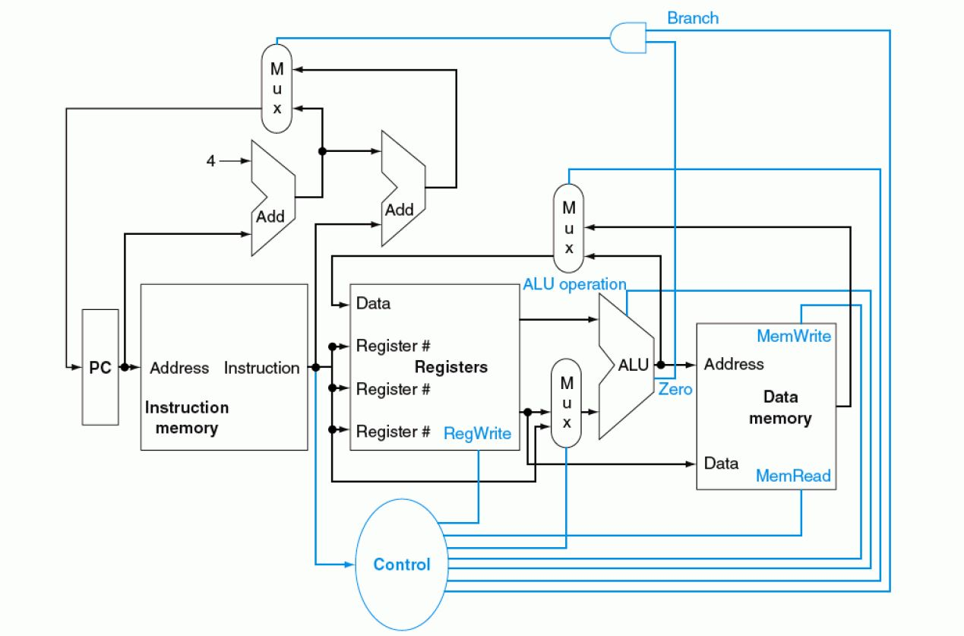
INSTRUCTION MEMORY
Stores 128 32bit-Intructions
Outputs are divided into Opcode, rs, rt, rd, address, constant values etc.
Decoded values feed register file
Fig : Position of Instruction memory in the datapath

Slide 15
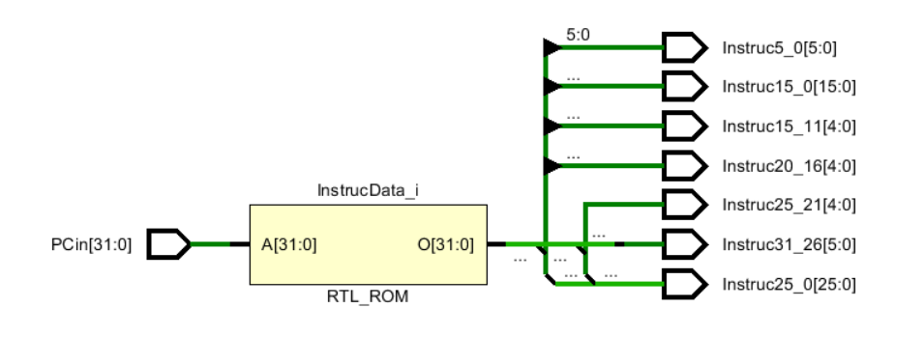
INSTRUCTION MEMORY (con’d)
Fig : Instruction Memory RTL Schematics

Slide 16
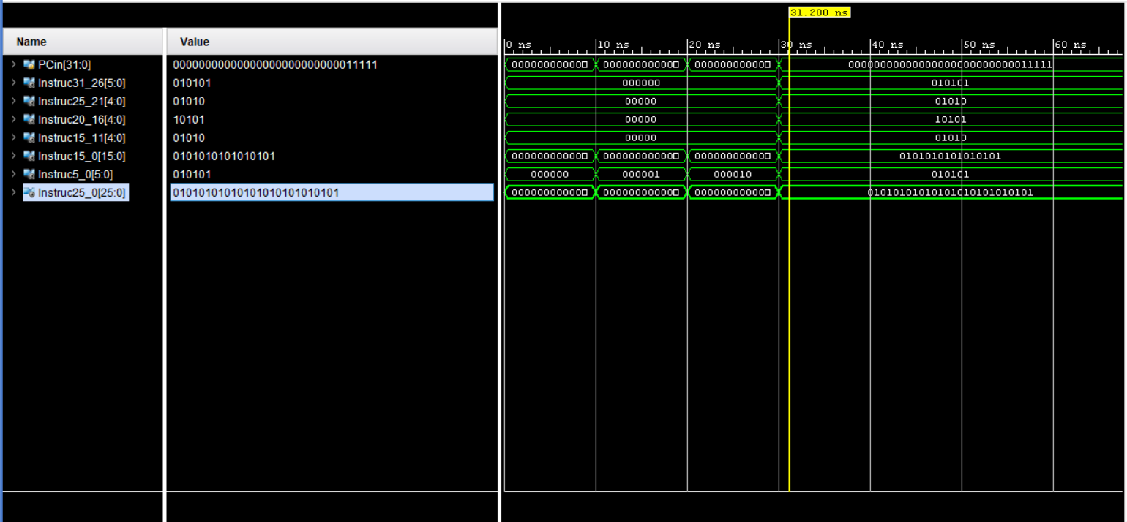
INSTRUCTION MEMORY (con’d)
Fig : Waveform of Instruction Memory

Slide 17
REGISTER FILE
32, 32bit-General purpose registers
Registers are named in the MIPS convention
Fig : Position of Register File in Datapath

Slide 18
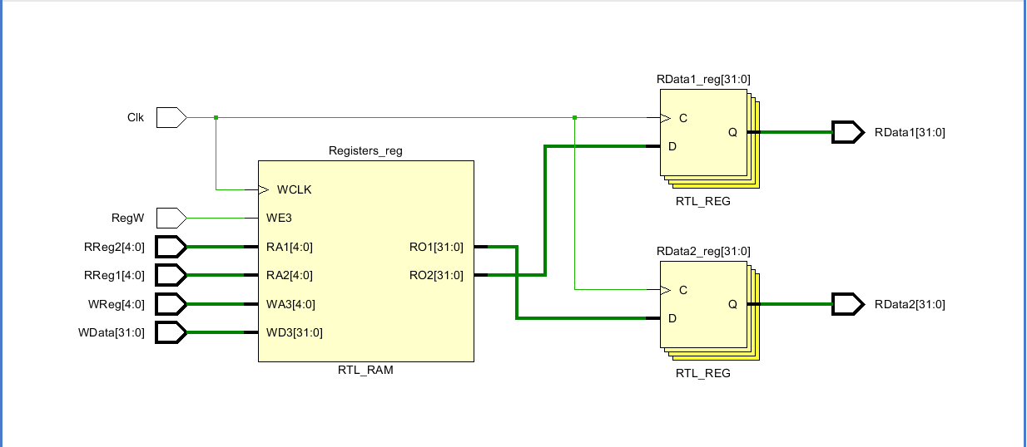
REGISTER FILE (con’d)
Fig : RTL Schematics of Register file

Slide 19
ALU CONTROL UNIT
Generates 4-bit ALU Opcode using Opcode and function code (for R type)
I - type instructions
Function | addi | lw | sw | beq | bne | andi | ori | xori | slti
ALU_op[3] | 0 | 0 | 0 | 1 | 1 | 0 | 0 | 0 | 0
ALU_op[2] | 0 | 0 | 0 | 0 | 0 | 0 | 0 | 0 | 1
ALU_op[1] | 0 | 0 | 0 | 0 | 0 | 0 | 1 | 1 | 0
ALU_op[0] | 0 | 0 | 0 | 0 | 0 | 1 | 0 | 1 | 0

Slide 20
ALU CONTROL UNIT (con’d)
R - type instructions
Function | add | sub | and | or | xor | slt
ALU_op[3] | 0 | 1 | 0 | 0 | 0 | 0
ALU_op[2] | 0 | 0 | 0 | 0 | 0 | 1
ALU_op[1] | 0 | 0 | 0 | 1 | 1 | 0
ALU_op[0] | 0 | 0 | 1 | 0 | 1 | 0

Slide 21
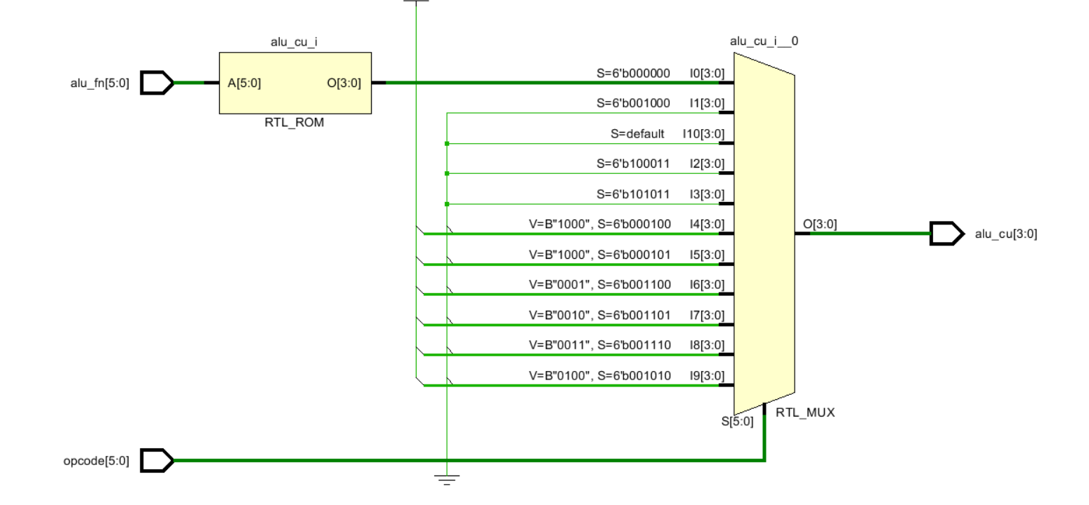
ALU CONTROL UNIT (con’d)
Fig : RTL Schematics of ALU control unit

Slide 22
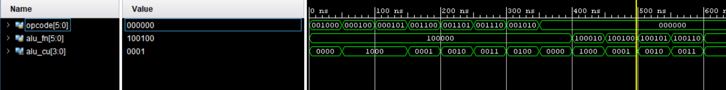
ALU CONTROL UNIT (con’d)
Fig : Waveform of ALU control unit

Slide 23
ALU
Brain of the processor
Fig : Position of ALU in the datapath

Slide 24
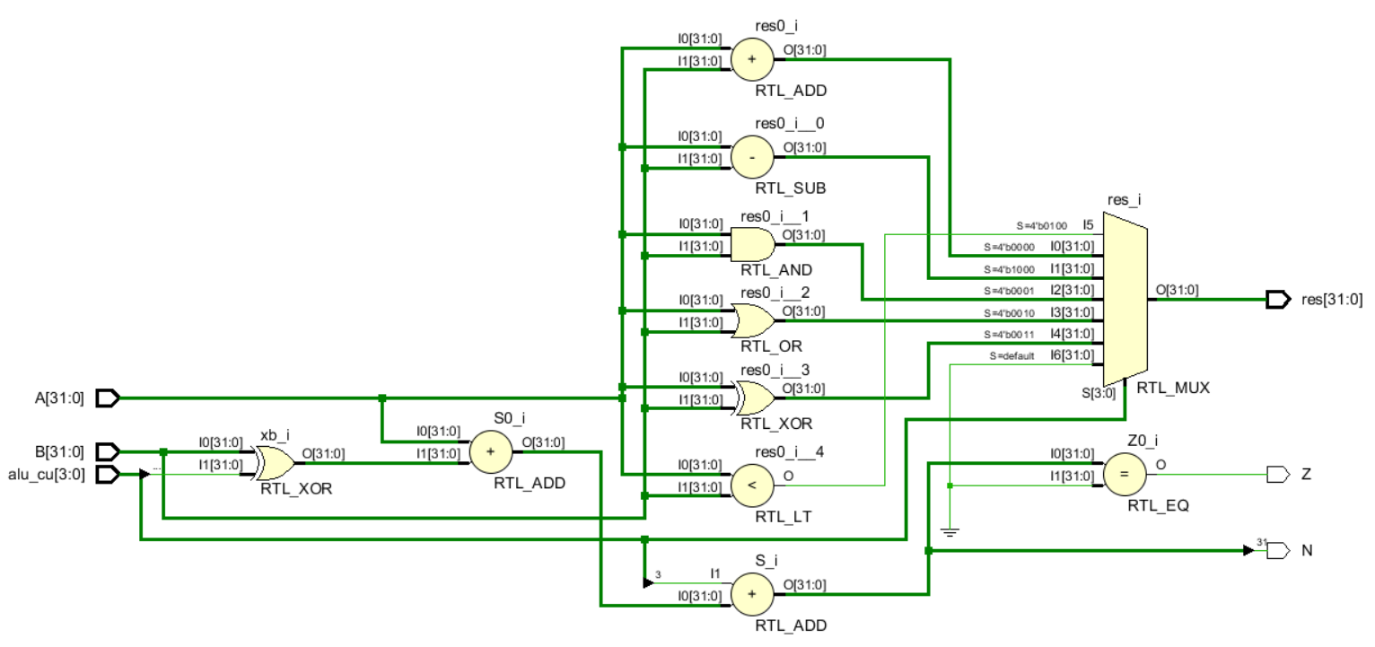
ALU (con’d)
Fig : RTL Schematics of ALU

Slide 25
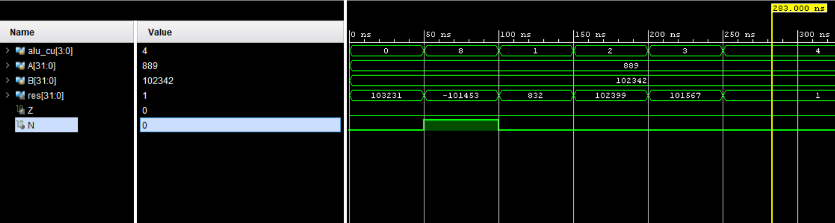
ALU (con’d)
Fig : Waveform of ALU

Slide 26
DATA MEMORY
Fig : Position of Data Memory in the datapath

Slide 27
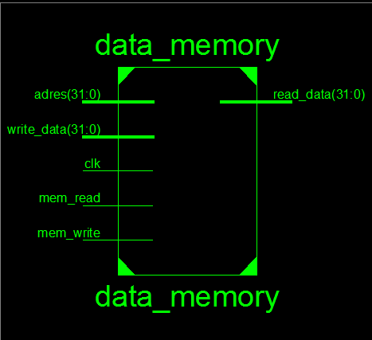
DATA MEMORY(con’d)
Fig : RTL Schematics of Data Memory

Slide 28
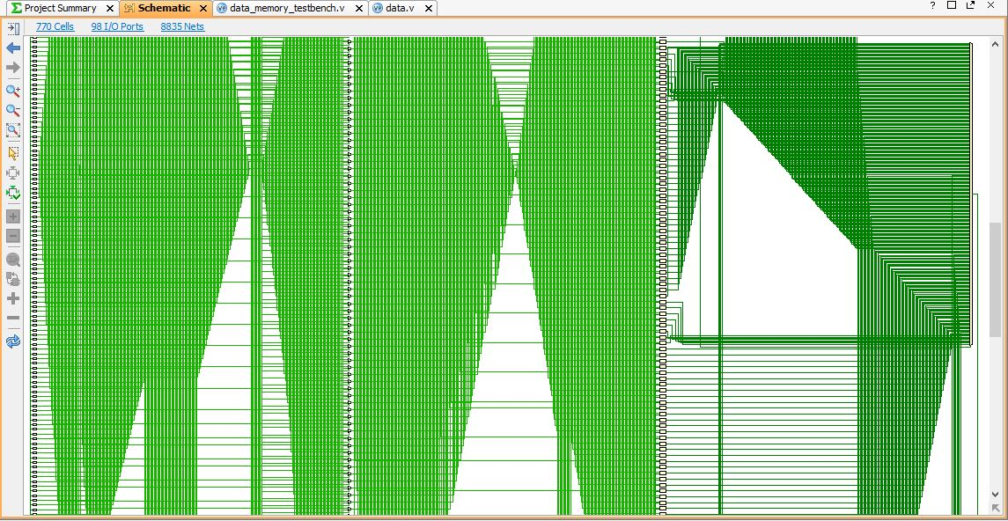
DATA MEMORY(con’d)
Fig : RTL Schematics of Data Memory

Slide 29
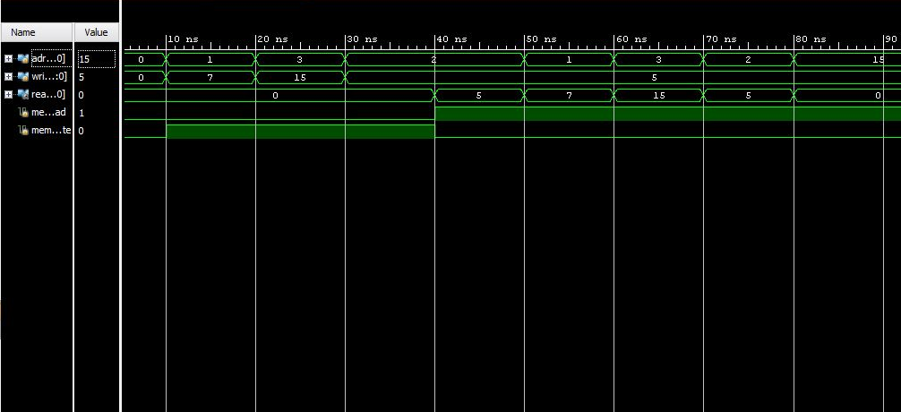
DATA MEMORY(con’d)
Fig : Waveform of Data Memory

Slide 30
What’s Left
Building the datapath
Pipeline implementation

Slide 31
REFERENCES
Computer Organization and Architecture, 8th edition-William Stallings
Computer Organization and Design, 4th edition- D.A. Patterson, J.L. Hennessey
Digital Design and Computer Architecture- D.M. Harris, S.L. Harris
Computation Structures- MIT Course EECS 6.004
A Report on 16- bit RISC Processor by R.K.S. Parihar, S.Reddy (BITS Pilani)

Slide 32


