Slide 1
Division wise Priority product mapping configuration: Available in WFSA
Divisions configured On SKU level
Divisions configured On Sub Brand level
3D-Mankind,Activus Mankind
Templar , Gravitas , Ocularis
Divisions configured On Brand level
Mankind, Discovery, Future Mankind, Life Mankind, Star Mankind Neo Mankind, Zesteva, Transplantation, Nobelis, Aspiris Mankind , Cerebris, Curis, Onco Mankind, Diacar, Procare, Victrix Mankind

Slide 2
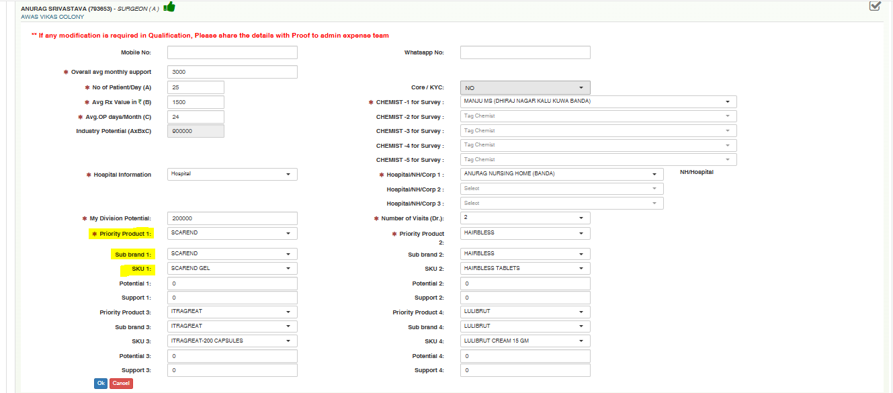
SKU wise configuration(3D-Mankind, Activus)

Slide 3
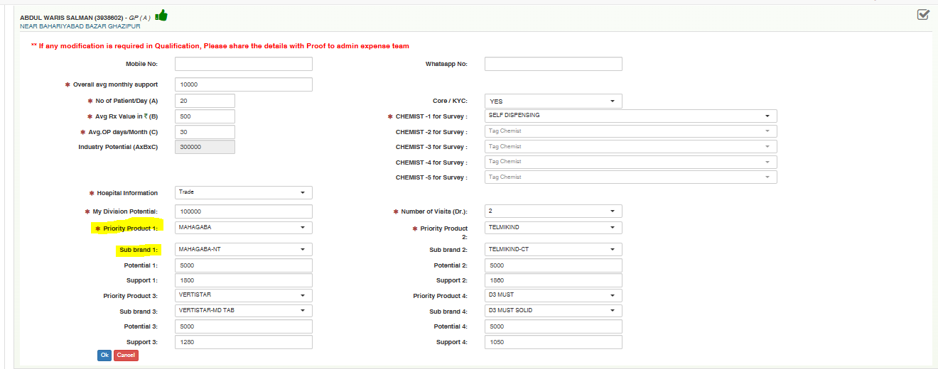
Sub Brand wise configuration(Templar, Ocularis, Gravitas)

Slide 4
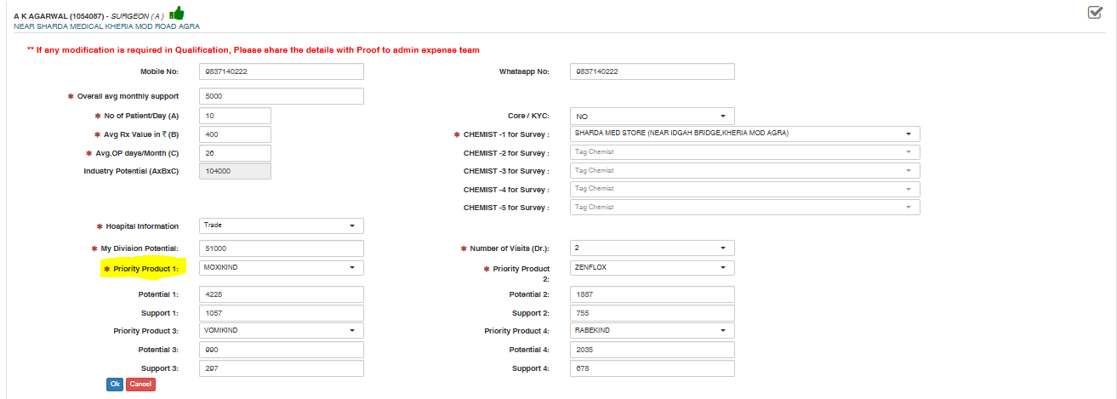
Brand wise configuration(Rest all Pharma Divisions)

Slide 5
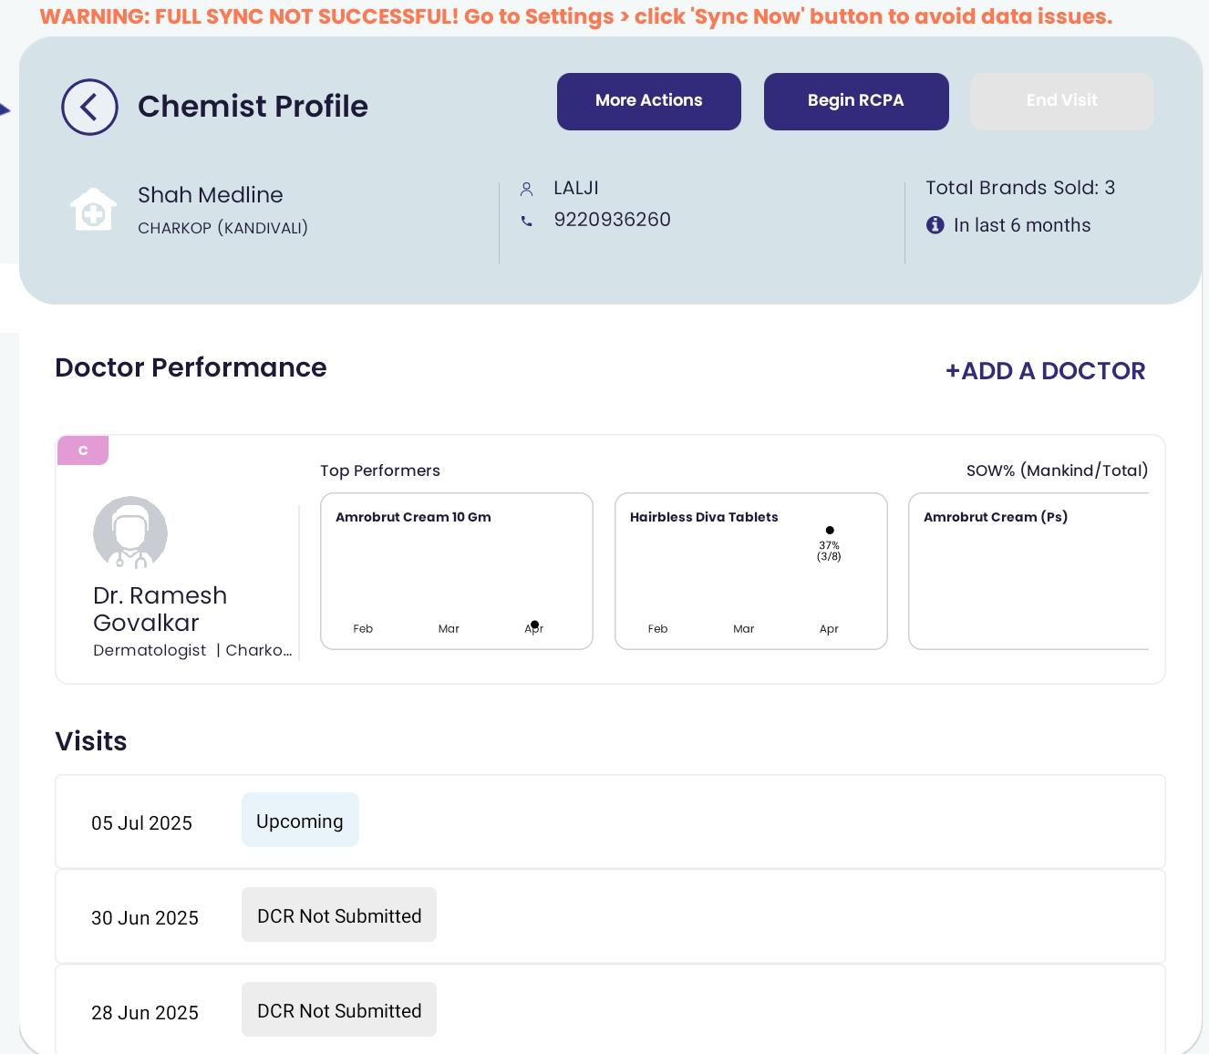
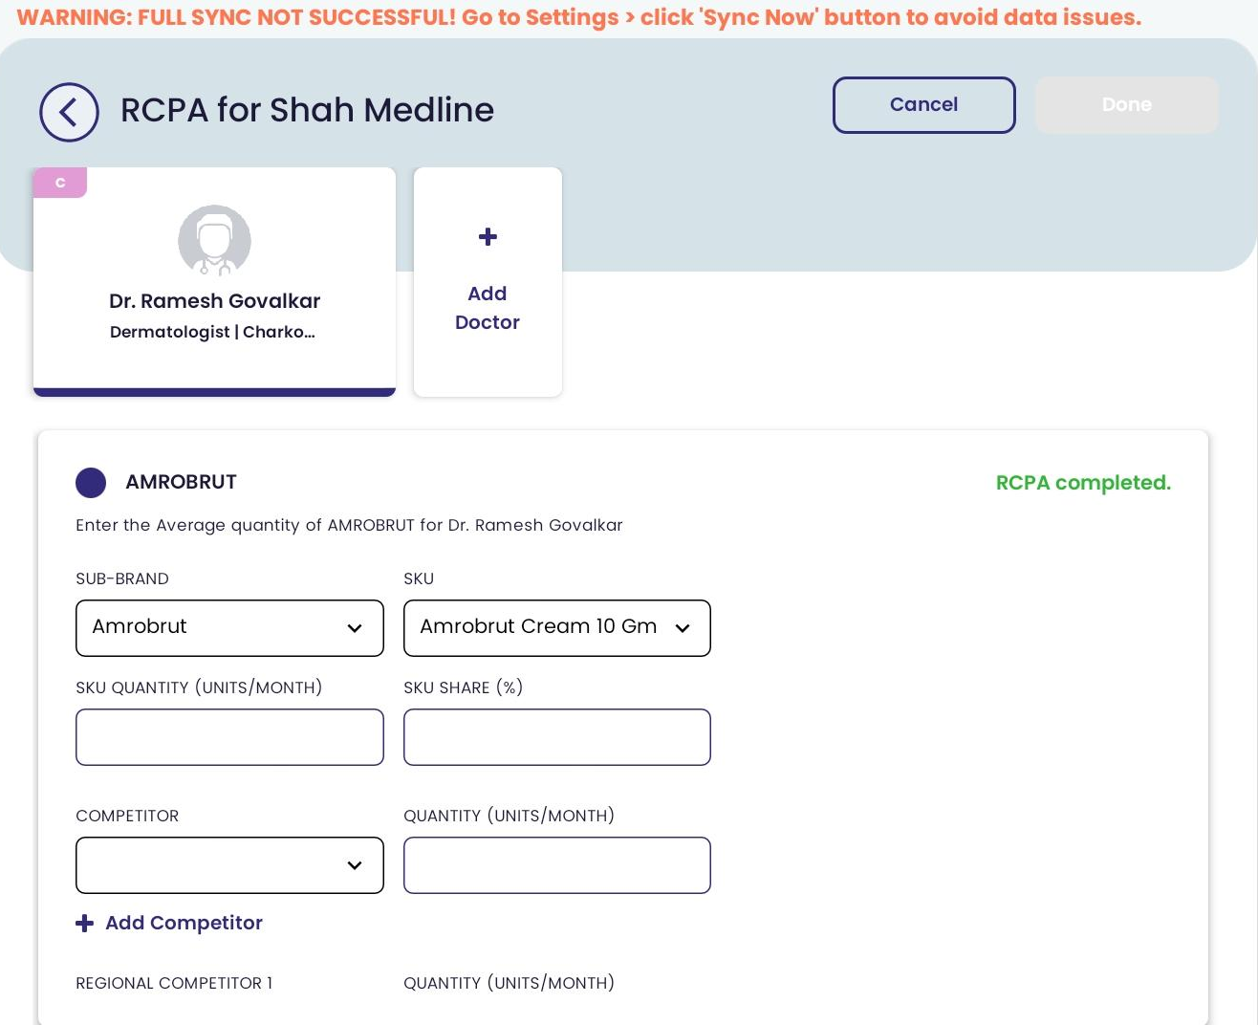
RCPA based upon SKU(3D-Mankind)

Slide 6
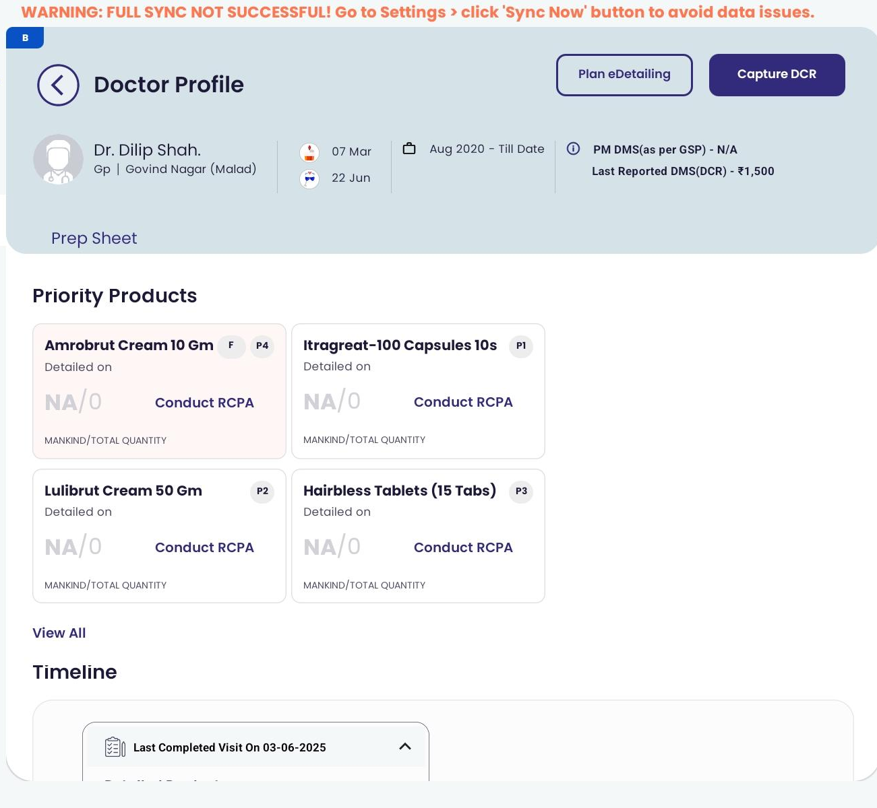
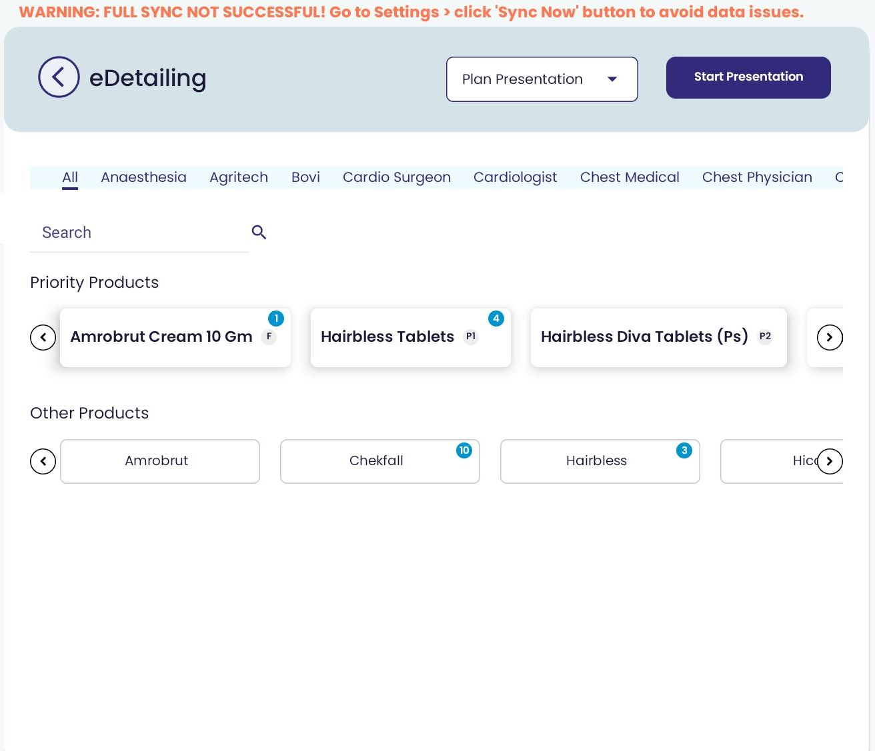
E-Detailing based upon SKU(3D-Mankind)

Slide 7
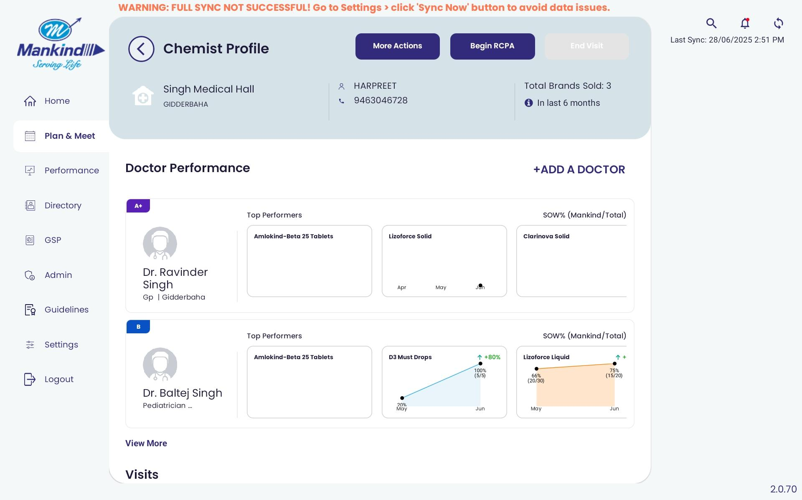
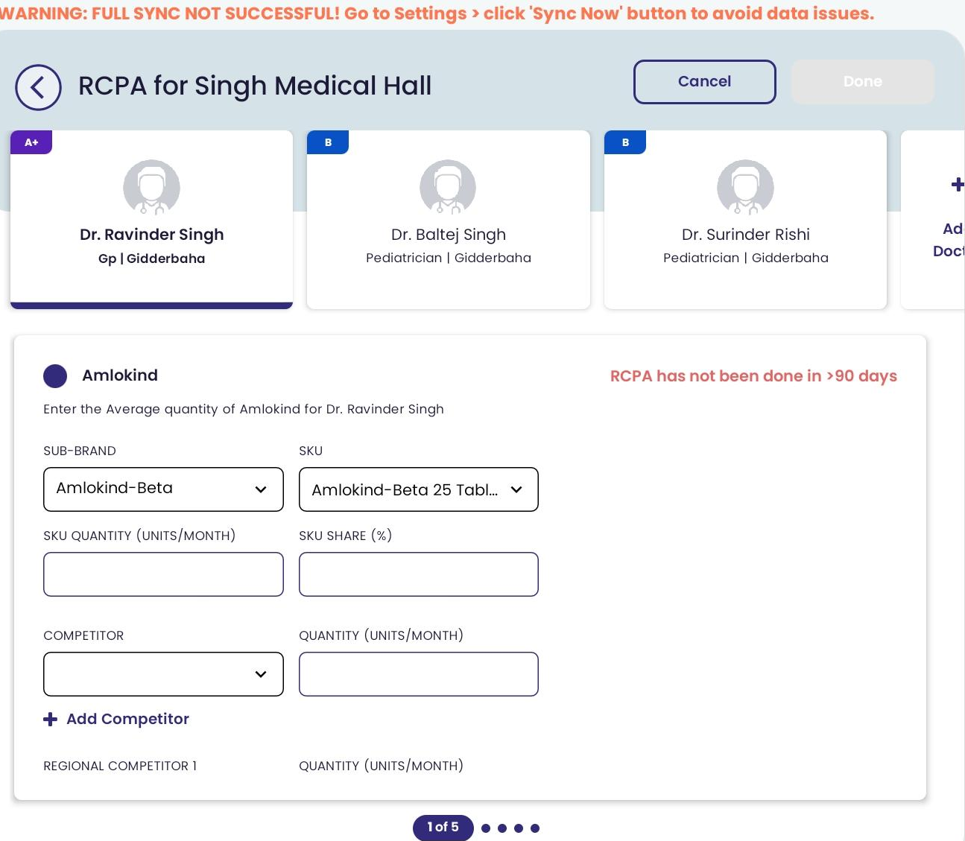
RCPA based upon Sub-brand(Gravitas)

Slide 8
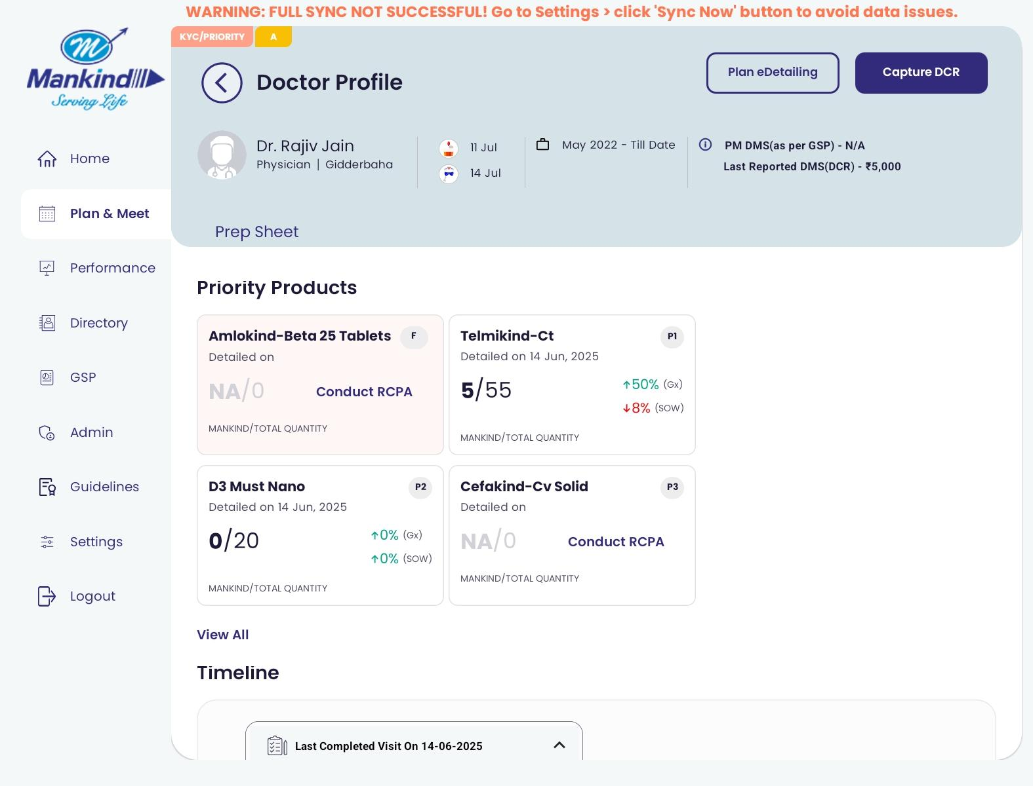
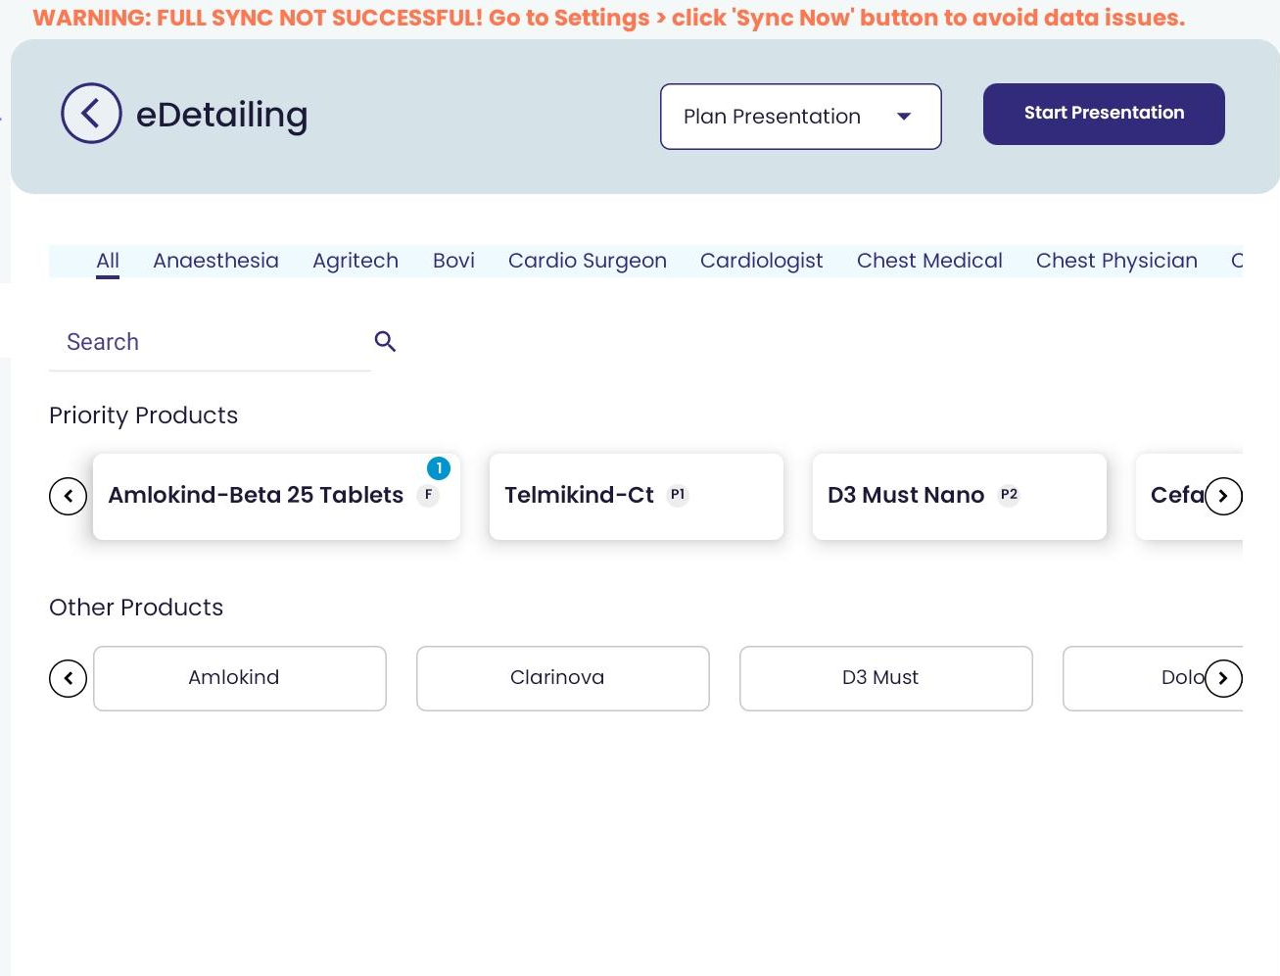
E-Detailing based upon Sub-brand(Gravitas)

Slide 9
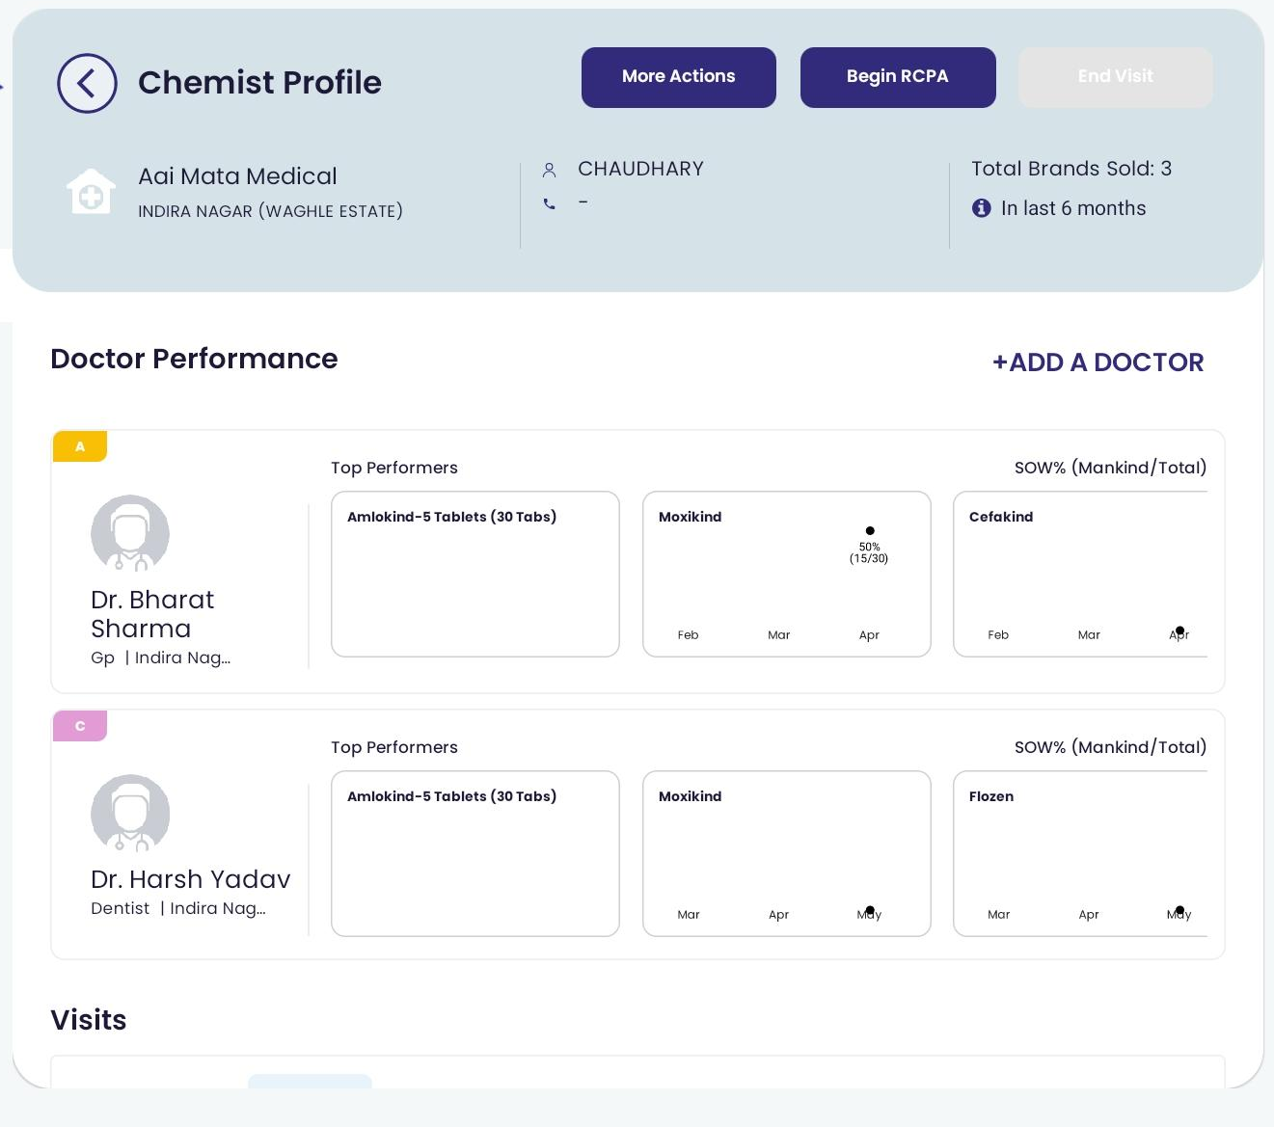
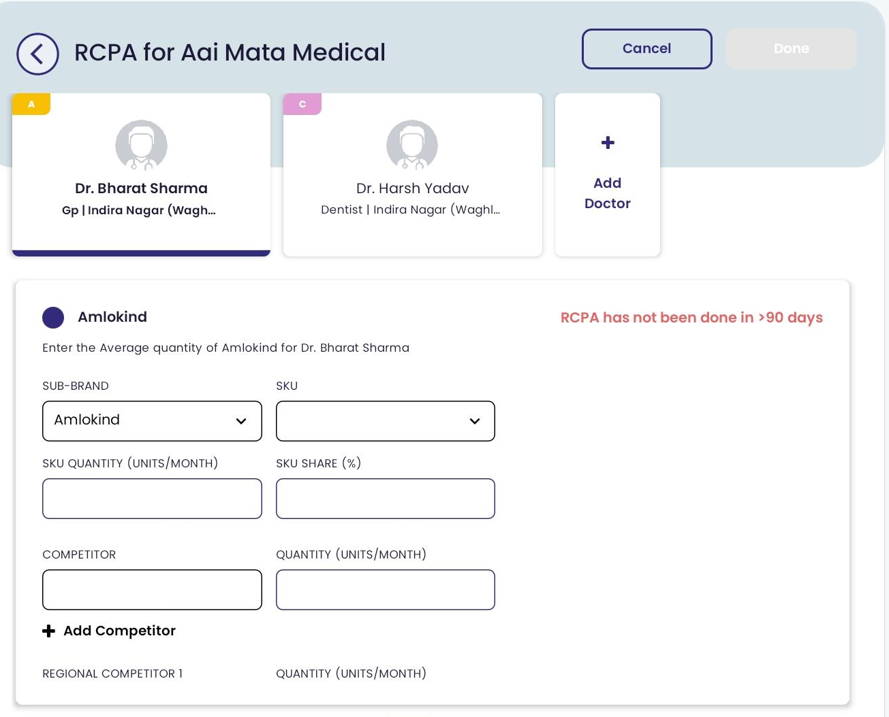
RCPA based upon Brand(Mankind)

Slide 10
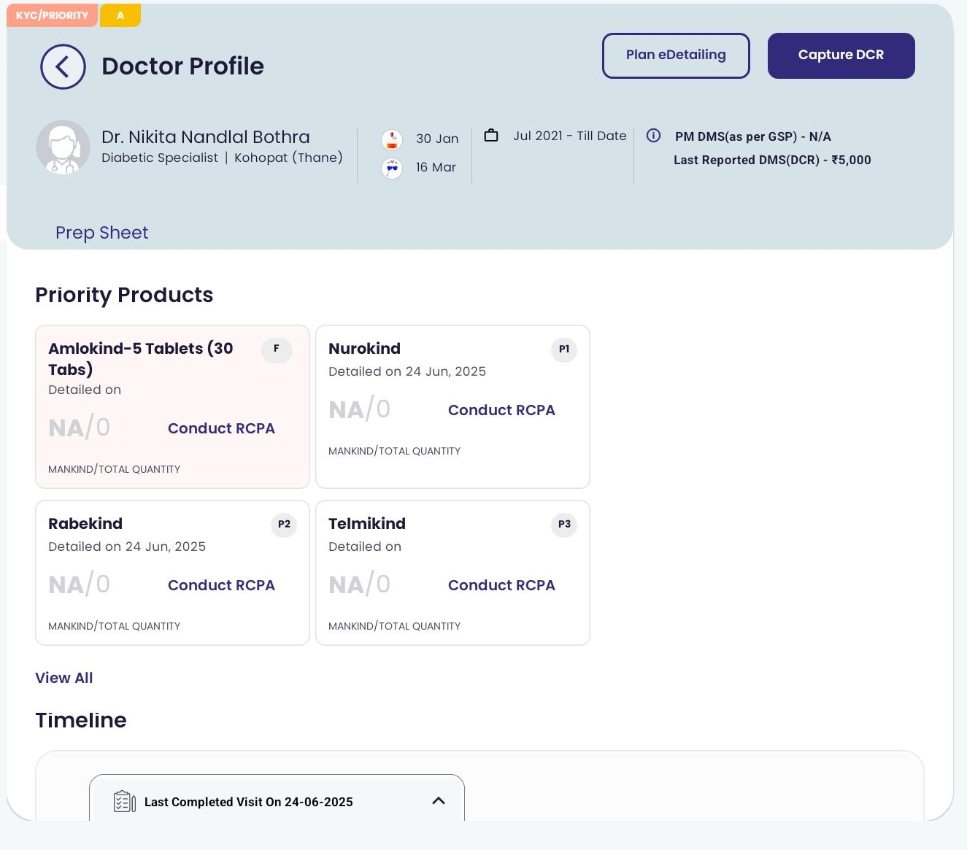
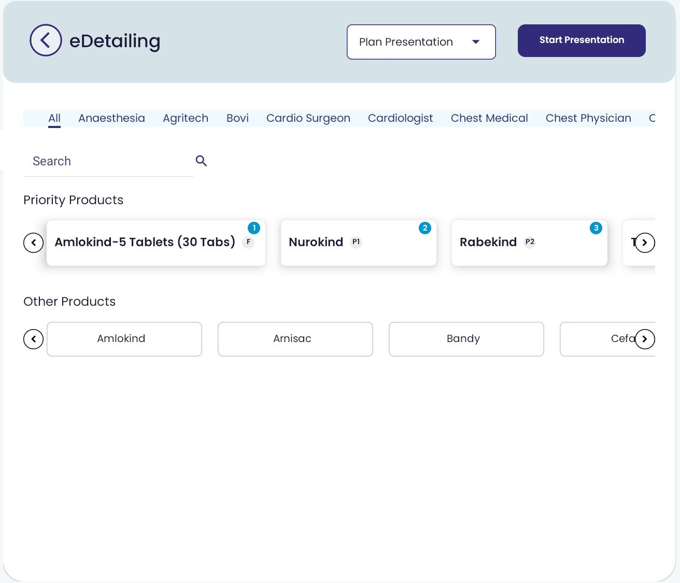
E-Detailing based upon Brand (Mankind)

Slide 11
E-Detailing Slide configuration in CMS Module(WSFA)

Slide 12
CMS Portal Workflow Steps
Select Division Name
Select Mother Brand Name
Select SKU Name
Select State Name
Select Speciality Name
We’ll need to use the Featured option and set the duration if we want to feature the file, and if we do not want to feature it, then do not select the Featured option
Select Zip file from source path and save.

Slide 13
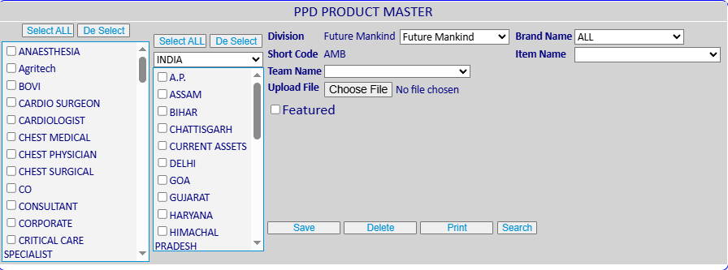
Step#1

Slide 14
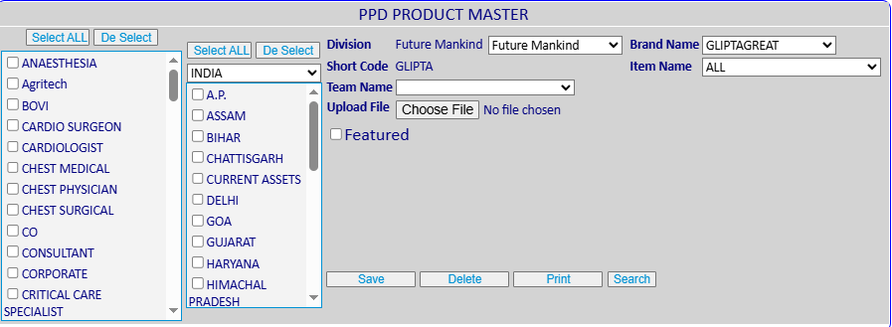
Step#2

Slide 15
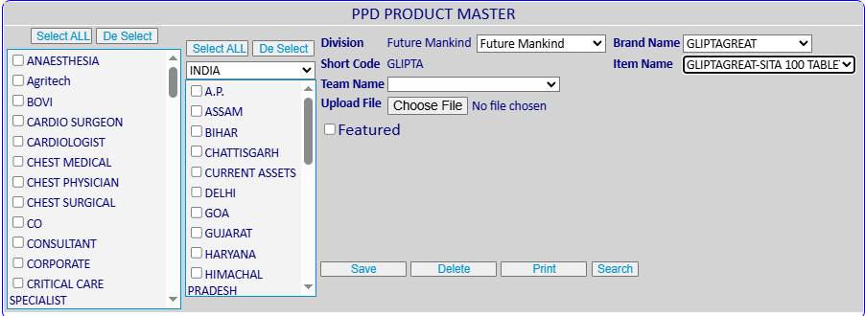
Step#3

Slide 16
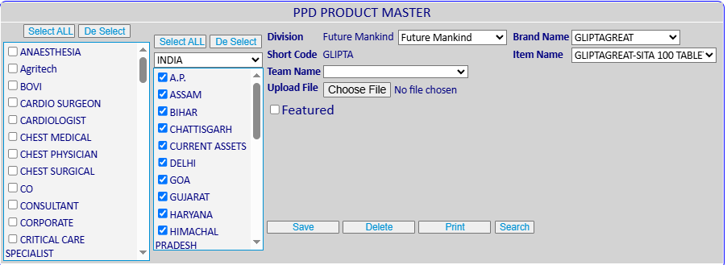
Step#4

Slide 17
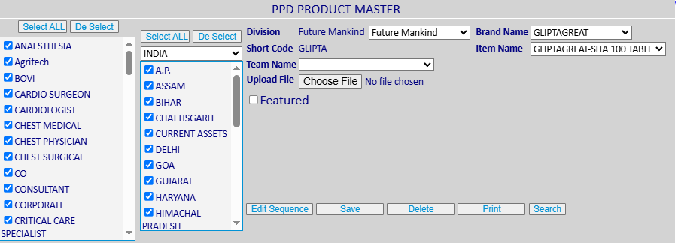
Step#5

Slide 18
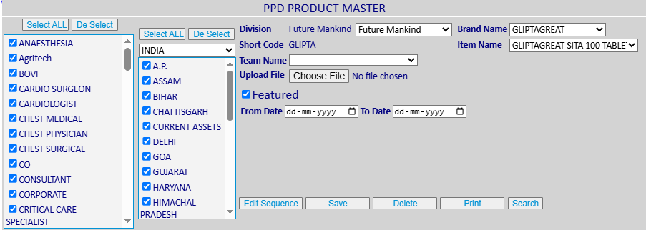
Step#6

Slide 19
Change Request from Business
“One of the key business requirement from each Division is for specialty-wise brand prioritization by HCP specialty (with up to 10 products per specialty).
Thus, If the Brand feature module can be enhanced to function at an HCP level within each division, we can lock in HO-driven priority brands as Feature Products, while still allowing the MR to customize their P1 to P4 brands based on individual HCP preferences.
Since, the RCPA module already supports Feature and Priority brands, thus this would be the most cost-effective and seamless way to address the business requirement while retaining existing functionality within Superman CRM.
Request you to kindly evaluate the feasibility of this enhancement.”

Slide 20
Recommended Behaviour
Current System Behavior:
WSFA: This Supports configuring Product Priority mapping at all three levels—SKU, Sub-brand, and Brand.
CMS: Supports slide-mapping configuration at Specialty and State levels. Also allows configuration for mapping featured Products (SKUs) with specific durations.
Superman: Currently displays slides at the Division level only.
Recommended Behavior:
Superman: Should be able to support displaying slides at the Specialty level as well.
Impacts:
The system will identify a doctor's specialty and dynamically display Product (SKU) slides based on the Specialty-level mappings configured within the CMS module.

Slide 21
Thank You

