Slide 1
Web Programming

Slide 2
HTML
It a language(Not programming language)(Because we parse it we don’t execute it)
It follows special Syntax(Tags/Markup)
Its case-insensitive
Layout of Page/Structure of page
Structure of the page
Markup Syntax(Uses tags)
Extension must be ".html"
Ignores extra white space

Slide 3
Tags Rules
Write tag inside angular bracket(< >)
e.g:<title>
All the tag must be closed(Few exceptions are there)
e,g:</title>
Attributes: Properties of tag
Attribute must be written inside starting tag angular bracket
Comments:
<!-- This can be single line Comment and multi line comment also -->

Slide 4
Basic Tags
HTML -> HTML document start and ends with this tag
HEAD -> Information/config of web page/document
TITLE -> Page title(Inside head tag)
BODY -> page content(bgcolor)
P -> For paragraph
CENTER -> Put content in center
HR -> horizontal line(No need to close)
BR -> Line break(No need to close)
B -> bold
I -> Italic
U -> Underline
Strong -> Strong string
pre -> Show as it is writter in code

Slide 5
Heading Tags
H1,h2,h3,h4,h5,h6 -> H1 is the largest heading and h6 is the smallest heading

Slide 6
List Tags:
Two types of List:
Ordered List: List with numbers/alphabet/roman numerals
OL -> Create List
(type=1|a|A|I|i)
LI -> List item
Unordered List:listing with bullets
UL -> Create List
(type = circle|disc|square)
LI -> List item

Slide 7
Table Tags:
(here we can pass height and width attribute with table,tr,td,th)
TABLE ->(attr: border=2 bgcolor="red")
TR -> (attr: bgcolor="red") Table row
TD ->(attr : bgcolor="red" align="left|right|center") table element
TH ->(attr : bgcolor="red") table Heading element
TBODY -> Table body
THEAD -> table head

Slide 8
Image Tags
IMG -> Include image in the page
(src = "PATH_TO_IMAGE" height=value width=value)
Figure Tag:
FIGURE -> include the image
FIGCAPTION -> image name

Slide 9
Form Tag:
For User Interaction(Purpose: Submit data to server and also provides the validation)
FORM ->(attr: action="PATH_TO_SERVER" method="TYPE_OF_REQUEST")
Button Tag:
BUTTON ->creates the button
(type = submit|button)
Note:
If button tag is used then do not write type attribute or use submit value for type attribute to submit data to server
If input tag is used to create button then type must be submit to submit data to server

Slide 10
Input Tag:
INPUT ->(attr: type="text|password|button|checkbox|date|file|radio|submit|tel|url|email|number|reset|range|image" value="USER_DEFINED" name="NAME_OF_INPUT_DATA" placeholder="PLACEHOLDER OF INPUT TAG"
)
TEXTAREA ->(attr:rows=10 cols=30) this tag creates textarea for multiline input
Attributes:
width=100:width in pixel(For type image)
height=100:height in pixel(For type image)
maxlength=10: maximum no of character
required:compulsory(Don't use on radio and checkbox)

Slide 11
Input Tag:
Attributes:
readonly:Read only input
multiple: select multiple files(for type file)
autocomplete="on|off": for autocomplete feature
disabled:disable the input
checked attribute must be used with radio and checkbox only
accept attribute is used with file type
Note:
type=reset create button that empty all input tag fields
type=email is for form level validation means when form tries to submit data there it validates
radio is used to select single out of many option but checkbox is used to select multiple option out of many option

Slide 12
Select Tag
SELECT ->create the dropdown
OPTION -> item of the dropdown
(selected ->selects the default value)

Slide 13
More Tags:
Definition/Description List:
DL ->Create Definition list
DT -> Definition Item title
DD -> definition item defintion
Anchor Tag:
A -> Link to other page
(href = "url" target="_blank|_parent|_self|_top")
Iframe Tag:
IFRAME -> open other web page in same page inside a box
(src="url" title="string" height=value width=value allowfullscreen)
DIV Tag:
Group the multiple HTML tags
Create a block

Slide 14
More Tags:
ADDRESS -> for address
BLOCKQUOTE -> create quotes
ABBR -> for abbreviation
SUMMARY -> for summary text
PROGRESS -> creates progress bar
(value = integer_value max="integer_value")
MARQUEEE -> move the text
(height=value width=value direction=left|right|up|down scrolldelay=value behavior=scroll|slide|alternate bgcolor=colorname loop=times_value)
Fieldset Tag:
FIELDSET -> create a boudary or a field
LEGEND -> name of fieldset

Slide 15
Multimedia Tags:
VIDEO->Creates the video UI HTML5 Player
(height=value width=value poster="Path_to_image" controls|loop|muted|preload|autoplay)
SOURCE-> Link to the audio/video.No need to close it
(src="path_to_audio/video" type="mime_type")
AUDIO -> creates the audio UI HTML5 player
(controls|loop|autoplay|muted|preload)
EMBED -> Include audio/video/image(Slow)
(src="path_to_file" height=value width=value type="mime_type")

Slide 16
HTML5
New version of HTML
HTML5 features:
Events
Extra attributes
New forms(input tag types)
Canvas
SVG
Multimedia tags
Drag and drop features
Microdata
WebRTC
CORS
MATHML
Websocket

Slide 17
CSS

Slide 18
CSS
Cascading Style Sheet
Style the HTML
Language
Use selectors to select the tag and apply the properties
We can write style tag anywhere on the page(prefer is HEAD tag)
Three ways of using CSS:
Inline CSS: Use style attribute in the tag
style="font-weight:bolder"
Internal CSS : Use style tag in same document
External CSS:: Use seperate file.File extension must be .css and use Link tag to import it(Prefer Head Tag)
<link rel="stylesheet" href="file_path">

Slide 19
CSS Syntax
selector{
property:value;
property:value;
......
/*Comment here */
}

Slide 20
CSS Selector
It is used to identify the HTML tag
We can also use id and class attributes value to select TAG
ID is used to selected a single tag
e.g #ID_NAME
CLASS is used to selected multiple tag
e.g .CLASS_NAME
selector1 selector2{} -> selector 2 is inside selector 1 Tag
e.g: .class #id{}
e.g: #id div{}
selector1,selector2{} ->Apply CSS on both selector
e.g: a,p{}
e.g: .xyz,#abc{}

Slide 21
CSS Selector
tagname[attribute=value] ->Select by attribute
e.g: input[type=text]{}
selector:active ->If selector is active or not. Use it with anchor tag
selector:checked ->if selector is checked. Use this with radio and checkbox
selector::first-letter ->selects first letter(char) in the selector Tag
selector::first-line -> selects first line in selector tag
selector:nth-child(N)-> selects the Nth tag of that selector.
selector:last-child ->selects the last tag of that selector
selector:first-child ->selects the first tag of that selector

Slide 22
CSS basic property
CSS property list:
background-color -> set background color
color -> set text color
height -> set height of block
width -> set width of block
text-align -> set the alignment of text
border -> set the border
background-image -> set background image
margin -> set margin
padding -> set padding

Slide 23
Colors:
Use color name
Use color hexcode
e.g. #12AB45
Set color by rgb(RED_VALUE,GREEN_VALUE,BLUE_VALUE).min-value is 0 and max-value is 255
e.g: rgb(100,200,100)
Set color by rgba(RED_VALUE,GREEN_VALUE,BLUE_VALUE,ALPHA_VALUE). alpha-value range 0.0 - 1.0 and it is used to define transparency
e.g: rgba(100,200,100,0.5)
Set color by hsl(HUE_VALUE,SATURATION_VALUE,LIGHTNESS_VALUE). range is 0 to 100%

Slide 24
Box Model
All tags got the box model
CSS uses box-model to control margin border padding and content size
content -> size of content
padding -> internal distance from content
border -> border size
margin -> outer distance from near by block

Slide 25
Flex Properties
Automatically adjust the position
Apply this on outer block flex will automatically adjust inner blocks
display : flex applies the flex. then we can use below flex properties
flex-direction : row|column|row-reverse|column-reverse
justify-content: flex-start|flex-end|center|space-around|space-evenly|space-between
Align-content ,align-items
flex-wrap:wrap|no-wrap
Flex-grow ,align-self ,gap ,flex-shrink
Note:
It align the content in the direction of flex-direction
align-items and align-content works at 90 degree angle of justify-content.

Slide 26
Measurement
px → pixel
vh → view height(in %)
vw → view width(in %)
em → relative the parent block font size
rem → relative to font size the page
cm → centimeter
% → size in percentage of available area

Slide 27
Position Property:
fixed -> Fixed on the view area
static -> Simple flow of page. Does not follow top left right bottom
sticky -> move with the scroll bar. When scroll bar is not moving this value act as fixed.If top left right bottom applied then act as fixed(mixed of relative and fixed)
absolute -> Move with the scroll bar
relative -> Simple flow of page and position of block relative to parent block. Does follow top left right bottom
Offset:
top: value in measurement
left : value in measurement
right : value in measurement
bottom : value in measurement

Slide 28
Bootstrap
CSS library
Predefined component
Bootstrap includes HTML and CSS based design templates for typography, forms, buttons, tables, navigation, modals, image carousels and many other, as well as optional JavaScript plugins
Bootstrap is a free front-end framework for faster and easier web development
Responsive Design

Slide 29
Advantage of Bootstrap
Easy to use:Anybody with just basic knowledge of HTML and CSS can start using Bootstrap
Responsive features:Bootstrap's responsive CSS adjusts to phones, tablets, and desktops
Mobile-first approach:In Bootstrap 5, mobile-first styles are part of the core framework
Browser compatibility:Bootstrap is compatible with all modern browsers (Chrome, Firefox, Edge, Safari, and Opera)

Slide 30
Bootstrap
How to import it?
1.Download Library and import using Link tag
2.Use CDN link and import using Link Tag

Slide 31
Bootstrap grid
It breaks row into 12 columns
Use number of columns to decide the width of block inside row
So row is more like a wrapper for columns

Slide 32
Javascript
Programming Language
No relation with Java
Easy language
Multi Paradigm
Event Driven programming
It is designed for Browser
Purpose is to make web page dynamic
; at the end of every statement is not compulsary but if statements are in same line then compulsary
EMCAScript Is the standard specification for this language
https://tc39.es/ecma262

Slide 33
Javascript
We can use it in two ways with HTML
Internal JS: write in same HTML file
Write code in script tag(Prefer head and at the end of body)
External JS : seperate JS file
extension must be .js
Link using script tag
<script src="path_to_js_file"></script>
Do not write Js code in same script tag that is used for importing external script

Slide 34
Variables
No need to mention datatype of data
Create variable by var/let/const keyword
var variable
let variable
const variable
reassign value of any datatype to variable
redeclration is also allowed of only variable created by var

Slide 35
Comments
//single line comment
/*multi line comment*/

Slide 36
Operators
Airthmatic operators:
+,-,/,*,++,--,%,**(exponential)
Assignment operators:
-=,+=,*=,/=,%=,**=
String Concat
+,+=
Comparison Operators:
==,===,!=,!==,>,<,>=,<=,?:
Logical Operators:
&&,||,!

Slide 37
If-else statements:
Syntax:
if(expression){
//statements
}
If-else statement:
Syntax:
if(expression){
//statements
}else{
//statements
}

Slide 38
If-else statements:
If-Else-if statement:
if(expression){
//statements
}else if(expression){
//statements
}else if(expression){
//statements
}else{
//statements
}

Slide 39
Datatypes:
String
Number
Boolean
Arrays
Object
undefined(Variable without value)

Slide 40
Dialog Box:
Dialog Box:
1.Alert: shows info/error means some kind of information
alert(string)
2.Prompt: show info and also take from user and returns the string in JS
variable = prompt(string)

Slide 41
Typecasting
parseInt(string) -> Converts to Integer
parseFloat(string) -> Converts to Float

Slide 42
Loops
1.For Loop:
Syntax:
for(initialization;condition; increment/decrement){
//statements
}
2.While Loop:
while(expression){
//statements
}
3.Do while Loop
do{
//statements
}while(expression)

Slide 43
Loops:
for (key in object) {
//statements
}
for (variable of iterable) {
//statements
}

Slide 44
Strings
Collection of characters
Datatype
Access is by Subscript or []
string_variable[index]
string_variable.length -> gives the length of string

Slide 45
Strings
Syntax
string_variable.property
string_variable.function(arg)
Function List:
.startsWith(str) ->returns true if given string starts with str
.endsWith(str) ->returns true if given string ends with str
.charAt(index) -> retuns the character at index
.includes(str) > check if string contains the str or not
.toUpperCase() -> converts to uppercase
.toLowerCase() -> converts to lowercase
.indexOf(str) -> returns the first occurance starting index
.lastIndexOf(str) ->returns the last occurance starting index

Slide 46
Arrays
Collection of any type of data
Array can store any type of data
Access every element by index
array_variable[index]
Syntax:
array_variable.property
array_variable.function(arg)

Slide 47
Arrays
Function List:
.indexOf(arg) -> returns the first occurance index of arg in array
.lastIndexOf(arg) ->returns the last occurance index of arg in array
.push(element) -> Insert element at the end of array
.unshift(element) ->Insert element at the starting of array
.pop() ->removes the last element of array
.shift() -> removes the first element of array
.splice(starting_index,count) -> removes number of element from in between of array
.join(delimiter) ->creates string by joining array of element by delimiter
.includes(element) -> check given element is present in array or not
.reverse() -> returns the reverse of array

Slide 48
Functions:
function is a block of code designed to perform a particular task.
function function_name(argument){
//statements
return value
}
Anonymous Function: useful for callbacks or functions as arguments
function(argument){
//statements
return value
}
We can assign anonymous function to a variable

Slide 49
Functions
Arrow Key function: Useful for callbacks or function as arguments or single liner functions
(arguments) =>{
//statements
return value
}
We can assign it to a variable
If number of argument is 1 then () are optional
If single statement and that statement is return statement then {} and return keyword is optional
Arrow key function does not bind to the this scope

Slide 50
Object:
Key-value pair/property-value pair
We can store in value
Property name can be string or numbers also
Syntax:
var object_variable = {
property : value,
property : value
}

Slide 51
Object
Access property/members:
object_variable.property
object_variable[property]
If property exists it'll access that property or If you are assigning some value to property and that property does not exist it'll create the property
Inside Object use anonymous function

Slide 52
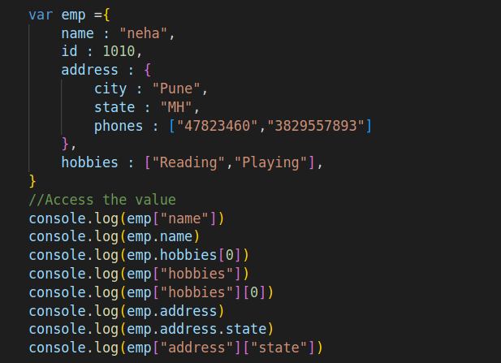
Object

Slide 53
Events
Something occurred
User action or some task success or error creates a event
We bind a function for that event and that function will execute whenever that event is fired
click,mouseover,mouseenter,mouseleave
focus -> when focus on input box to type something
blur -> When focus goes out of input box
change -> when value change in input box
submit -> when form starts the submission of data

Slide 54
DOM
Document Object Model
Browser gets the code(HTML,CSS,JS) parses the code
Browser creates the DOM of each tag
After creating DOM of each tag ,
browser render by DOM
JS Object
document Object:
It is top level object for page
It contains DOM of all tags

Slide 55
window Object :
Top level object
Created of each tab in modern browser
It contains document object and other details related to that tab like history,location,etc
Known as BOM(Browser Object Model)
window->document->DOM OF TAGS

Slide 56
DOM
Function to select DOM inside document object
document.getElementById(argument)
document.getElementsByTagName(argument)
document.getElementsByClassName(argument)
document.getElementsByName(argument)

Slide 57
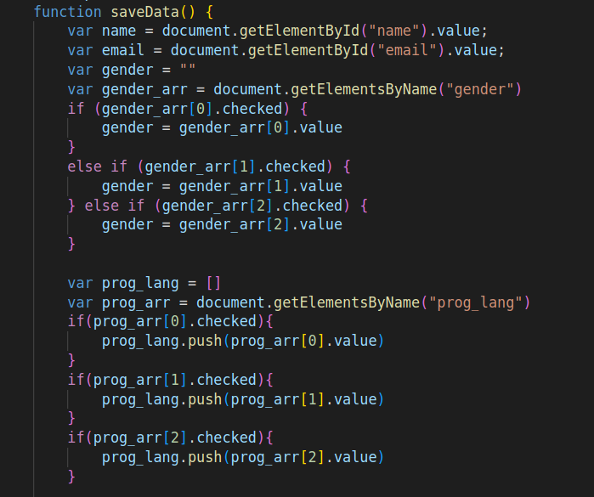
DOM

Slide 58
Validation
1.User level validation
Validation written by user
2.Form level validation
Validation implemented by form tag like required,email, etc
Also validate on submit event
Submit event:
Form fire this event when it tries to submit data
If submit event handler function return false then form will not submit data to the server else if returns true form will submits data

Slide 59
Scopes
Three types of scopes:
1.Global:Outside function var,let,const
2.Function : function creates this scope: var,let,const
3.Block : creates by {}:let,const
Global let and var keyword variables are accessible everywhere
Variable declared with let and var follow function scope means if they are declared inside function then cannot be accessed outside
Variable declared with let keyword follow block scope means if declared inside block cannot accessed outside of block

Slide 60
Object Oriented Concepts
Here creating object by function(Constructor)
function Employee(){
this.name = "Neha"
this.id = 0
this.salary = 0
this.get_tax = function(){
return 0.10* this.salary
}
}
Here new keyword is creating object and function is acting a constructor
var emp1 = new Employee() // Now Employee is acting as constructor

Slide 61
var emp2 = new Employee()
var emp3 = new Employee()
Employee() // Normal Function Call
emp1.email = "sid@gmail.com"

Slide 62
//Initialize property by argument: Parameterized constructor
function Student(id,name,salary) {
this.name = name;
this.id = id;
this.salary = salary;
this.get_tax = function(){
return 0.10 * this.salary
}
}
var emp1 = new Student(1,"Siddhant",1000)
var emp2 = new Student(2,"Anubhav",2000)
var emp3 = new Student(3,"Rajat",3000)

Slide 63
Prototyping
Inheritance
Do not create cyclic prototype
All the objects are prototype of "Object" at top level
By below syntax we can change prototype of any object Constructor.prototype = new Some_Constructor()
By setPrototypeOf function we are selecting and changing prototype of particular object
Object.setPrototypeOf(obj,new Protype_constructor())

Slide 64
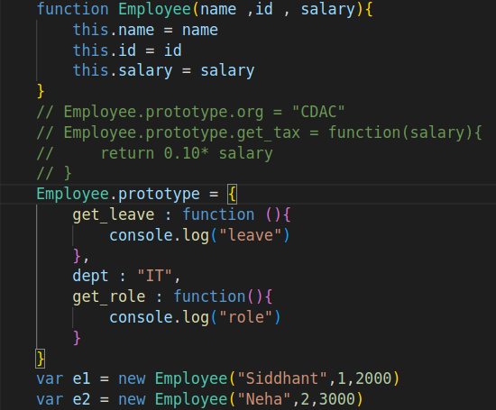
Prototyping

Slide 65
Class Syntax
class ClassName {
constructor(arguments){
this.property=value
}
function_name(){
}
}
Here constructor must be constructor
Here write all the variable inside constructor with "this"
Use normal function without function keyword

Slide 66
Inheritance:
class ClassName extends ClassName{
constructor(arguments){
super()
this.property=value
}
function_name(){
}
}

Slide 67
Date
Create Object for current date:
var d = new Date()
->By variable access function
console.log(d.getDay())
console.log(d.getMonth()) // starting from 0
console.log(d.getFullYear())
console.log(d.getHours())
console.log(d.getMinutes())
console.log(d.toDateString())
console.log(d.toISOString())
console.log(d.toLocaleString())

Slide 68
Date
Create date Object for any date
var my_dob = new Date(2000,0,10)
order of argument : year,month,date,hour,minutes,seconds

Slide 69
Regular expressions:
Pattern Matching
Validation
^ -> line starting with
$ -> Line ending with
. -> Any character
* -> Zero or more occurance
+ -> one or more occurance
[] -> Range
{} -> exact occurance
| -> or

Slide 70
Regular Expression:
string.replace(/expression/,string)
string.replaceAll(/expression/g,string)
string.search(/expression/)
string.match(/expression/)
string.matchAll(/expression/g)

Slide 71
Canvas:
->For 2D drawing
To create canvas:
<canvas></canvas>
Functions list:
cavnas.getContext("2d") -> To get 2d drawing function
canvas_object.fillStyle = "color"
canvas_object.fillRect(left,top,width,height)

Slide 72
Canvas:
canvas_object.moveTo(left,top)
canvas_object.lineTo(left,top)
canvas_object.stroke(draw)
canvas_object.font = "FontSize Fontfamily" -> set font
canvas_object.fillText("String",left,top) -> Draw the text

Slide 73
Jquery:
Library of JS
Manipulation of DOM
Animation
Events handling
Two Ways to import JQuery:
1.Download file and import using script tag
2.Use CDN link import using script tag

Slide 74
Jquery
General Syntax of Jquery to access DOM and apply function:
$(CSS_SELECTOR).function()
$(CSS_SELECTOR) selects the TAG and .function() apply on that tag
Perform all task afer page/document is loaded:
function passed to ready function will execute after page/document is ready/rendered
$(document).ready(function(){
//Write your code here
})

Slide 75
Jquery Functions:
.val() -> equivalent to .value property
.html() -> equivalent to .innerHTML property
.text() -> equivalent to .innerText property
.append() or .appendTo() -> append to the innerHTML property or append to any tag
.prepend() or .prependTo() -> prepend to any tag
.css() ->Change CSS
.addClasss() ->add CSS classes
.removeClass() -> remove CSS classes

Slide 76
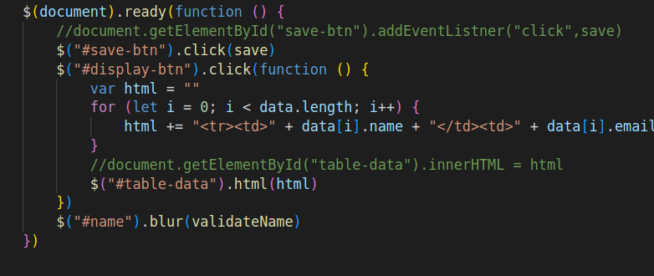
Jquery Events:
.on(event,function) -> Listener
$(selector).click(function)
$(selector).eventFunction(handler_function)

Slide 77
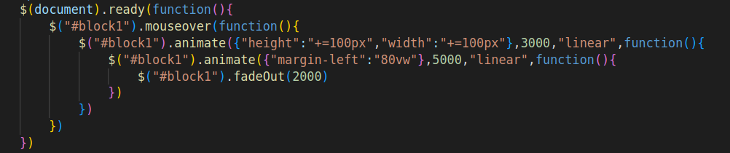
Jquery Animations:
.hide([duration],[easing],[complete]) -> Hide tag.easing values are two linear and swing.Duration values are in milliseconds on slow or fast.complete is the function
.show() -> show tag
.toggle() -> Hide and show tag
.animate() ->Create animation. Works on only Some measurement related CSS property.
.fadeIn()
.fadeOut()
.slideUp()
.slideDown()

Slide 78
Jquery Plugin:
Just another library works with jquery or give extra supports to jquery
Jquery.Color Link: Supporting library for animation. It manipulates the color
https://github.com/jquery/jquery-color

Slide 79
Nodejs
Runs on Chome V8 JS engine
Runtime environment
Its JS without DOM, and any browser functionality
Added features
Many features added through modules
Asynchronous Programming(Available Also in JS)
File extension must be .js
Wherever you are typing path use linux relative path
Nodejs uses built-in module and external libraries

Slide 80
Nodejs
Install :
Download LTS version from https://nodejs.org/en/
Execute the code:
node filename

Slide 81
Print
console.log(variable)
console.log(string)

Slide 82
Modules
Create separate file for code/function/Object/variable
Export function/variable/Object by exports.variable_name. Prefer this syntax for functions and variable
Export function/variable/Object by module.exports = variable. Prefer this syntax for Object.To export one object from the file
Use require("modulename") to import the module
For user defined module pass the path of that module to require function
For built-in module and external module pass the module name to the require function

Slide 83
User Input:
use inbuilt "readline" module
Create Interface(Connect with standard input and standard output)
var inp = readline.createInterface({
input : process.stdin,
output : process.stdout
})
Take input using question() function
inp.question(“String”,function(input_data){
})

Slide 84
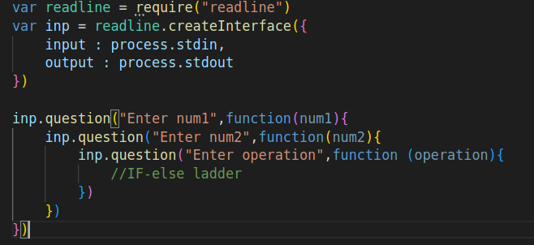
User Input:

Slide 85
File handling
Use fs module
Contains both Synchronous and Asynchronous function
readFileSync() returns the buffer type not String data
To convert buffer into string use .toString() function
If file does not exist writeFileSync() will create it and then write data
If you any previous data in file writeFileSync() will overwrite it
for readFileSync() and appendFileSync(),the file must be there otherwise they will give error
readFile() returns the data in Buffer/Bytes format
To Convert to string use .toString()
data must be in string format
writeFile() will overwrite the data and if file is not there create the file

Slide 86
File handling
Synchronous file handling:
writeFileSync()
readFileSync()
appendFileSync()
Asynchronous file handling:
writeFile()
readFile()
appendFile()

Slide 87
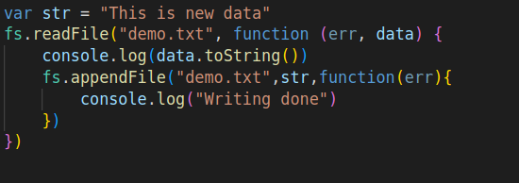
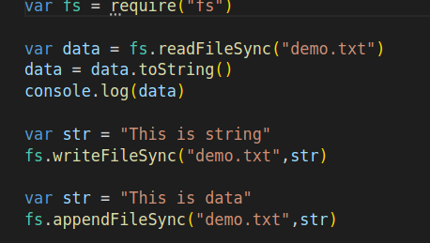
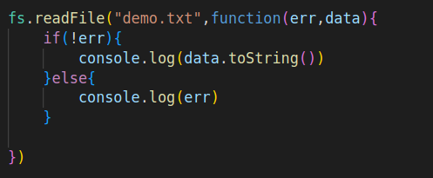
File handling

Slide 88
Timers:
Execute functions based on time
Timer functions:
setTimeout(function,time) -> execute once after the timeout is over
setInterval(function, time) -> execute periodically
setImmediate(function, time) -> execute immediately
clearTimeout(timer_object) -> stops the timeout
clearInterval(timer_object) -> stop the periodic execution
Note:
time in above function must be passed in milliseconds

Slide 89
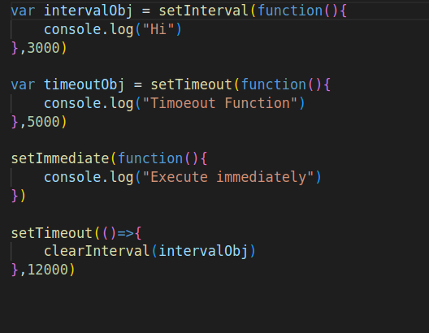
Timers:

Slide 90
Communication Models
Communication Models:
1.Request Response Model:
Client must request the server then server will respond(e.g HTTP)
if client wants to send any data, client send data with the request and server will process that and send response data packet
2.Publisher Subscriber model:(MQTT)
Broker is the server
Publisher only publishes data
Subscriber automatically gets the data because they are subscribed to that data , they do not request

Slide 91
HTTP
Hypertext transfer protocol
Its a protocol ( a set of rules for "How to follow request response")
RFC2616(This is draft of the rules of HTTP protocol)
https://datatracker.ietf.org/doc/html/rfc2616
Website/webapp follows this protocol
Browser creates the request packet and send it to the server
Server creates the response packet and send it back to browser
In Http server is not going to record the states of the previous request response cycle: HTTP is stateless protocol
default port of HTTP servers is 80

Slide 92
MIME Type
Type of data in http transporting
https://www.iana.org/assignments/media-types/media-types.xhtml
application/json → for JSON Data
application/csv → For CSV Data
text/html → For html data

Slide 93
Request Packet
It consist of data and metadata(data about data and data about the sender and the server)
Headers contains metadata and body contains data
[Headers][Request Body]
GET /mx-linux-blog/ HTTP/3
Host: mxlinux.org
User-Agent: Mozilla/5.0 (X11; Linux x86_64; rv:99.0) Gecko/20100101 Firefox/99.0
Accept: text/html,application/xhtml+xml,application/xml;q=0.9,image/avif,image/webp,*/*;q=0.8
Accept-Language: en-US,en;q=0.5
Accept-Encoding: gzip, deflate, br
Connection: keep-alive
Content-Type : x-www-form-urlencoded

Slide 94
Response Packet
It consist of data and metadata(data about data and data about the sender and the server)
Headers contains metadata and body contains data
[Headers][Response Body]
HTTP/3 200 OK
date: Mon, 20 Jun 2022 03:50:03 GMT
content-type: text/html; charset=UTF-8

Slide 95
Types of Request
GET -> Retrieve the data from server -> Sends data with the URL to the server. Browser always creates GET request from address bar
POST -> Save/Create new record on server -> Send data in the request body
PUT -> Update the record on server -> Send data in request body
DELETE -> Delete record on server -> Send data in URL
PATCH -> Update record on server -> Send data in request body
TRACE -> Test
CONNECT -> To create connection
OPTIONS -> for configurations
HEAD -> Same as get except response will not have the body.Test the Resource on server wether its available or not

Slide 96
Status code:
100 -> continue
200 -> Successful request processing
201 -> Record created
400 -> Bad Request(Wrong config in Request packet)
401 -> Unauthorized
404 -> Resource/path not found
500 -> Server internal issue

Slide 97
URL:
Address of resource
Syntax:
[protocol]://[hostname][:port][path][?querystring]
e.g.:
http://www.google.com
PROTOCOL:HTTP
HOSTNAME: www.google.com
PORT:80
PATH : /

Slide 98
URL:
http://www.google.com/search
PROTOCOL:HTTP
HOSTNAME: www.google.com
PORT:80
PATH : /search
http://www.google.com:8000/search
PROTOCOL:HTTP
HOSTNAME: www.google.com
PORT:8000
PATH : /search
http://192.168.1.5:8000/search
PROTOCOL:HTTP
HOSTNAME: 192.168.1.5
PORT:8000
PATH : /search

Slide 99
Print
http://192.168.1.5:8000/register?name=sid&password=123
PROTOCOL:HTTP
HOSTNAME: 192.168.1.5
PORT:8000
PATH : /register
QUERYSTRING(In x-www-form-urlencoded format): name=sid&password=123
For local system:
->HOSTNAME address is 127.0.0.1 or localhost
http://localhost:8000/users
http://127.0.0.1:8000/users

Slide 100
Domain Name:
.com [should be allocated to commercial websites]
xyz.com [Name of the system/Name of IP address 100.10.10.2]
app.xyz.com [app is subdomain. Means it is used to redirect request to certain program(app that is one server) on the xyz.com]
www.xyz.com
server1.xyz.com [server1 here is subdomain . Might be configured to use server1 that is running on 8000]
server2.xyz.com [server2 here is subdomain . Might be configured to use server2 that is running on 8001]
server3.xyz.com [server3 here is subdomain . Might be configured to use server3 that is running on 8002]
server4.xyz.com [server4 here is subdomain . Might be configured to use server4 that is running on 8003]

Slide 101
Nodejs http module:
Use "http" module
createServer is creating server and take callback function as argument.This callback function will execute for every request
.listen() is starting the server on some given PORT

Slide 102
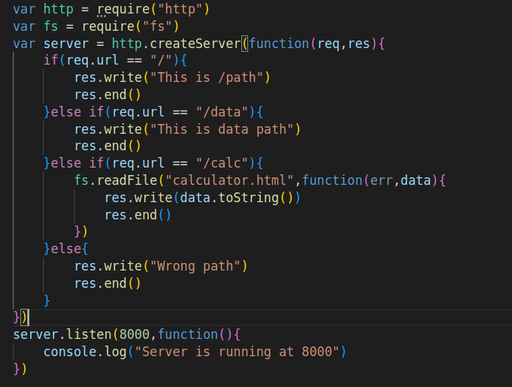
Nodejs http module:

Slide 103
Asynchronous Programming
Promise:
Async functions returns the Promise
Promise have many states
If we want to get data from Promise we should parse(resolve) it
To resolve that use .then() and if promise failed use .catch()

Slide 104
async:
Use this keyword to create asynchrnous
if async is used on function then function returns promise
async function(arg){
//statements
}
var variable = async function(arg){
//statements
}
var variable = async () =>{
//statements
}

Slide 105
await:
resolves the promise
Stops the current flow means current flow will not move to the next statement
await must be used inside async function
async function caller(){
var x = await fetch_data()
//here await will wait here to resoolve the promise
console.log(x.toUpperCase())
}
caller()

Slide 106
Either use async-await or Promise constructor
//Promise callback function two argument first must be resolve second must be reject
var x = new Promise((resolve, reject) => {
var data = fs.readFileSync("demo.txt").toString()
if (data) {
resolve(data) // here returning a resolve function this will be handled by then function
} else {
reject("No data") // here returning reject function this will be handled by catch function
}
})
x.then((data) => console.log(data)).catch(err => console.log(err))

Slide 107
Package Management:
Tool Name :npm
Manages the library installation and uninstalltion and updation
handles dependency
Downloads from npm repository(store on website) and installs also
https://www.npmjs.com/
Package.json FIle:
Contains details of the project:Name,License,Author version.. etc
and also package list that we are using in current project

Slide 108
Install Library/package in current folder:
It creates a node_modules folder and installs inside it
it automatically creates the package.json and package-lock.json if they do not exist.It will update the package name and version in package.json and all dependecy list in package-lock.json
npm install package_name
Install Library/package globaly:
npm install package_name -g

Slide 109
Uninstall library:
npm uninstall package_name
npm uninstall package_name -g
Update the library:
npm update package_name
Install library from package.json:
npm install
Initiate the project:
Creates package.json and write project details inside it
npm init

Slide 110
Node REPL
Read Print Eval Loop
Execute statements line by line
Testing small statements
Perform single statement task
Start node REPL:
node
Exit:
ctrl+d

Slide 111
Node Event Loop:
This is executing the JS code
This is single threaded
It got multiple phases
https://nodejs.org/en/docs/guides/event-loop-timers-and-nexttick/

Slide 112
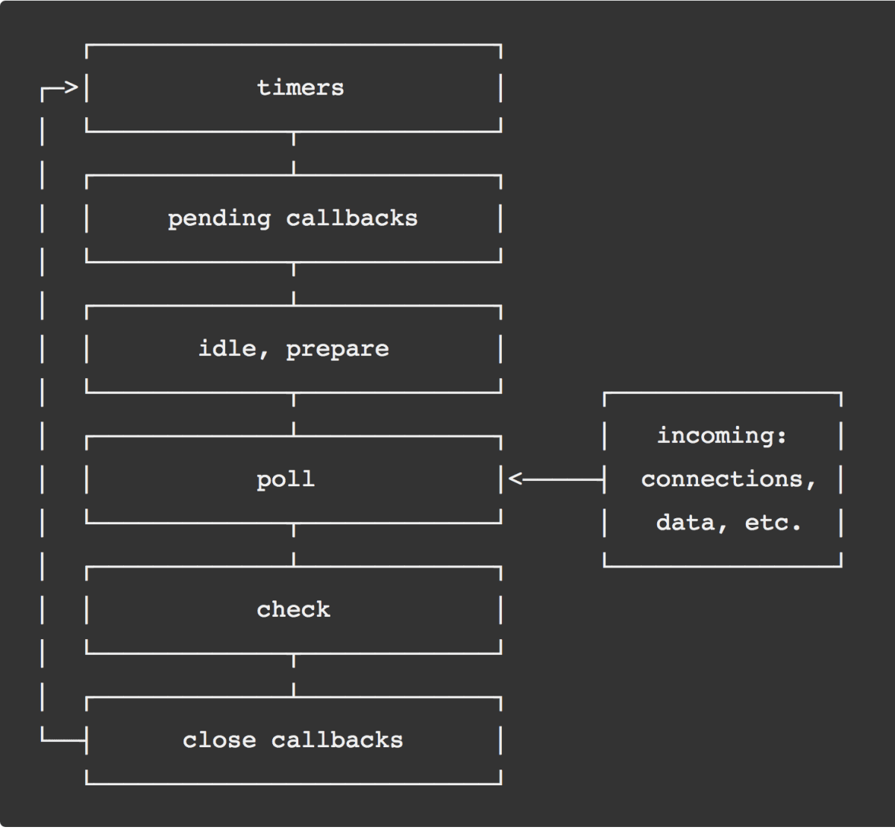
Nodejs Event Loop

Slide 113
Node Event Loop:
Each phase has a FIFO queue of callbacks to execute.
timers: this phase executes callbacks scheduled by setTimeout() and setInterval().
pending callbacks: executes I/O callbacks deferred to the next loop iteration.
idle, prepare: only used internally.
poll: retrieve new I/O events; execute I/O related callbacks (almost all with the exception of close callbacks, the ones scheduled by timers, and setImmediate()); node will block here when appropriate.
check: setImmediate() callbacks are invoked here.
close callbacks: some close callbacks, e.g. socket.on('close', ...).

Slide 114
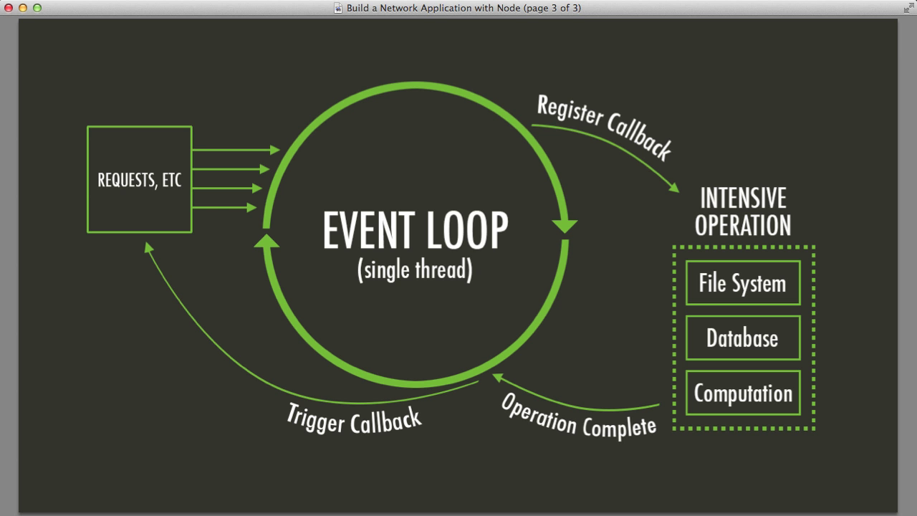
Node Event Loop:

Slide 115
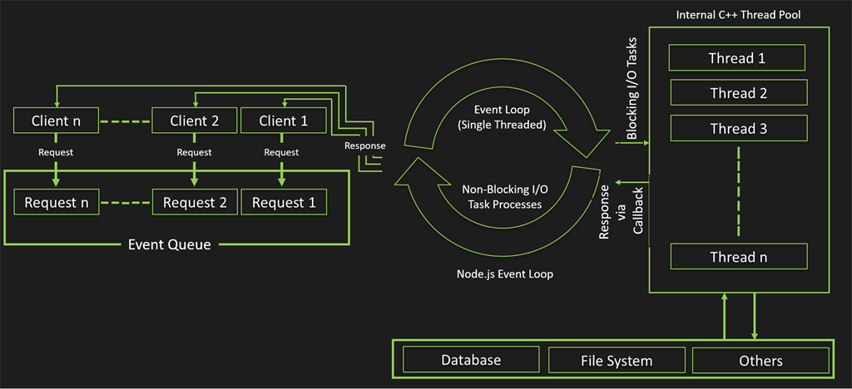
Node Event Loop:

Slide 116
JSON
https://www.json.org/json-en.html
Javascript Object Notation
Data interchange format
Data is represented in JSON format for transmission
client -----------------> Server
<----------------
JSON

Slide 117
JSON:
JSON is string
JSON got two format:
1.List/JSON Arrays: Arrays
'["Apple","mango"]'
2.Key-Value pair/JSON Object: Similar to object
'{"name" : "Siddhant","id" : 10}'

Slide 118
JSON:
Convert JSON to Object
JSON.parse(JSON_DATA)
Convert Object to JSON
JSON.stringify(Object_data)
Note : In Object,do not write any function

Slide 119
AJAX:
Asynchronous Javascript and XML
Synchronous communication
Submit data to the server get response and refresh/reload the page to show response
Asynchronous communication
Submit data to the server get response and no need to reload the page. The whole communication is in backend of the page

Slide 120
AJAX
AJAX uses XML to transfer the data
AJAX is implemented by XMLHttpRequest Object
How to implement?
Create Object of XMLHttpRequest and perform the request

Slide 121
Plain JS AJAX:
1.Create Object of XMLHttpRequest
2.Open request(Set type of request and server address)
3.Optional(Set headers)
4.Register callback function(Receive the data here by this.responseText ) on onreadystatechange.This callback function will execute for every change of state(readyState) of request
5.Send request

Slide 122
Ready State:
0-> Request is not initialized yet
1-> Request initialized
2-> Server received the request
3-> Server processing the request
4-> You got the response

Slide 123
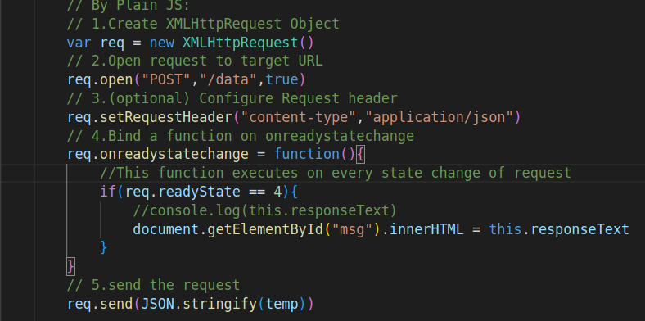

Slide 124
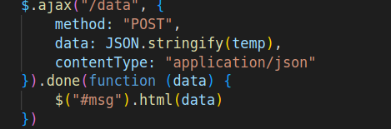
Jquery AJAX:
1.Call the $.ajax() function and pass all configuration
2.Recieve data .done() use callback function to use the data

Slide 125
Express
Web framework/Library
Giving simple ways to handle path(Got robust routing)
Middleware to add functionality

Slide 126
Express
Project Setup :
Create folder
Open terminal/command window in that folder
Initiate the project
Add details or skip
Install library
Package Name: express
Do not install globally(recommended)

Slide 127
How to handle Path?
app.TYPE_OF_REQUEST("PATH",function(req,res){
//process request and write response
})
app.get() →Handle get request
app.post() →Handle post request
app.put() →Handle put request
app.delete() → Handle delete request

Slide 128
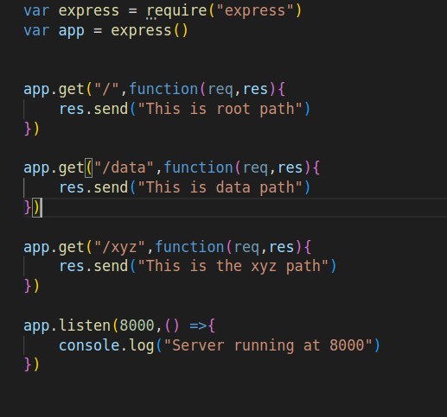

Slide 129
To serve static files(HTML/CSS/JS/Images....etc):
Create a folder and put all static(Files for the browser/client) files there
add following line in your code
app.use(express.static("FOLDERNAME"))

Slide 130
To Parse the request:
Use body-parser module
It'll convert it to the object
Integrate it with app.use()
For Urlencoded format:
app.use(bodyParser.urlencoded({extended:true}))
For JSON form:
app.use(bodyParser.json())
After parsing if type of request is GET access data object by req.query and if type of request is POST access data object by req.body

Slide 131
React:
Frontend framework
In react,React generates the JS,HTML,CSS code for browser
SPA(Single page application)
Two phases:
Development:
If project is in development. In this case react uses a development server. Development server runs on 3000 port by default
Production:
If project is released and deployed on server for public

Slide 132
React Project Setup
Project Setup:
Run following command
npx create-react-app app-name
Go inside app-name folder
Run command to start the app
npm start
Work inside src folder
Press ctrl+c to terminate

Slide 133
Startup code flow:
public/index.html -> src/index.js ->src/App.js(Component|Work here and after this) -> User defined component

Slide 134
JSX:
Similar to HTML but more restrict rules and got extra features
Tag must be closed like input also br tag also
<br/>
Comment
{/*Comment here*/}
Write any JS expression in {expression} inside JSX. That expression must return something
Here write attribute in Camel Notation
use className attribute instead of class

Slide 135
Component:
Fundamental building block of the page
Depends on UI hierarchy and information architecture
Component Name must start with Upper case letter
Component name and file name should be same(But you can change)
Inside return function we can write JSX
Inside return we must have one root/parent tag. Means Adjacent Tags
JSX must be inside return function. We can also assign to variable but finally should be used inside return function
We can use two syntax's for Component
1.Function Syntax
2.Class Syntax

Slide 136
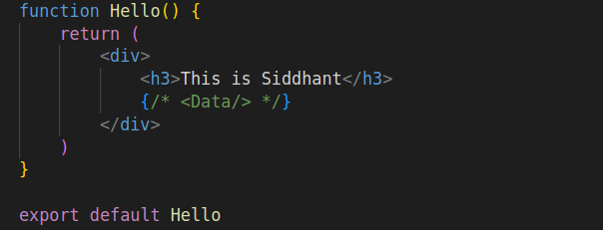
Function Component:

Slide 137
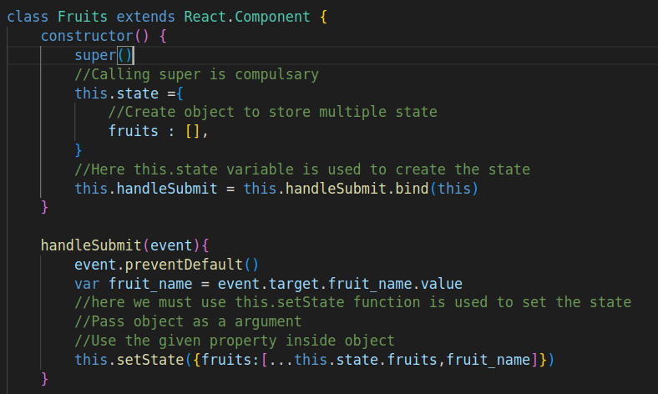
Class Component:

Slide 138
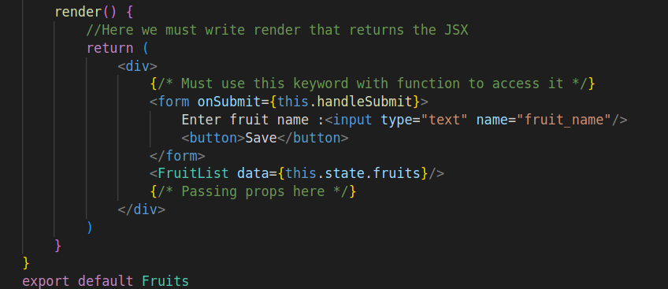
Class Component:

Slide 139
Import Statement for Components:
import ComponentName from "FilePath"
->Then use the Component as JSX
<Component/>
or
<Component></Component>

Slide 140
State:
State is used to retain the value and re-render the component if value changed
How to use?
import {useState} from "react"
var [state,setState] = useState(DefaultValue)

Slide 141
State
state is variable and setState is function
Access value directly by state variable
But Assign value by setState function and this function will re-render component also
setState simply assigned the value and re-render the component
set is compulsory prefix for function name

Slide 142
props
Share data among Components
We can pass data from parent Component to the child Component
Only to the next child
Parent can pass data to only next child through props
How to share among Components?
Pass data from parent to next child then to next child then to next child and so on

Slide 143
React CSS
Create a seperate CSS file and import that file
//Importing CSS here
import "./Style.css"
For inline CSS use style attribute
style ={{propertyName : "value"}}
In Inline CSS property name is in Camel Notation

Slide 144
Lift up the state
Several components need to reflect the same changing data. We recommend lifting the shared state up to their closest common ancestor.
Whenever you want to pass data of state to other hierarchy though props then move the state to the common parent
You should rely on the top-down data flow.
Lifting state involves writing more “boilerplate” code than two-way binding approaches, but as a benefit, it takes less work to find and isolate bugs

Slide 145
Context
Context provides a way to pass data through the component tree without having to pass props down manually at every level.
Context data is available in downwards direction from Provider
Provider: Shares the data in Downwards hierarchy
Consumer: Access that data from Context
Data is passed top-down (parent to child) via props, but such usage can be cumbersome for certain types of props
Context is designed to share data that can be considered “global” for a tree of React components, such as the current authenticated user, theme, or preferred language.

Slide 146
Context
1.First Create File for Context and use createContext function to create it. Context should not exported default.
export const NameContext = createContext(DefaultValue)
2.Use Provider to add data to Context
Provider Syntax:
<ContextVariable.Provider value = {Pass data here}>
<Component/>
</ContextVariable.Provider>

Slide 147
Context
3.Acess data by Consumer or useContext()
There are two to access data from Context:
1.Use Consumer: Access data directly in JSX
<ContextVariable.Consumer>
{value => //Write component code and access data from value variable}
</ContextVariable.Consumer>
2.Use useContext function: Access inside Component function
var variable = useContext(ContextVariable)
Here variable will recieve the value from Provider

Slide 148
Conditional Rendering:
Setting up UI based on some state
{stateValue : <Component/> or JSX ? <Component/> or JSX }

Slide 149
Composition Vs Inheritance
Composition : Using Components Together
1.Containment: Create a generic Component and use it as wrapper for other Component. Mostly used for UI themeing and genric Components like list, button , inputbox
->Pass the Components as children and access it by props. children property
<Component>
{Pass Anything Here}
</Component>
2.Speclization: Create special Component for special task
Inheritance: Inheriting property of one Component inside other Component
Composition is better at creating component tree so inheritance is not needed

Slide 150
Lifecycle
There are few lifecycle function execute at different phase of Component rendering lifecycle
https://reactjs.org/docs/react-component.html#the-component-lifecycle
1.Mounting: loading the component and rendering it
constructor()
getDerivedStateFromProps()
render()
componentDidMount()

Slide 151
Lifecycle
2.Update: Re-render the component
getDerviedStateFromProps()
shouldComponentUpdate()
render()
getSnapshotBeforeUpdate()
componentDidUpdate()
3.Unmount: destory the component
componentWillUnmount()

Slide 152
React Redux
React Redux is the official React UI bindings layer for Redux.
It lets your React components read data from a Redux store, and dispatch actions to the store to update state.
State Management
Redux itself is a standalone library that can be used with any UI layer or framework, including React, Angular, Vue, Ember, and vanilla JS
React Redux implements many performance optimizations internally, so that your own component only re-renders when it actually needs to.

Slide 153
React Redux
Install:
npm install react-redux @reduxjs/toolkit

Slide 154
React Redux
Reducer: Manipulate the state
Action:By this we decide which reducer to use.It contains two parameters
1.type : Type of action , select the reducer to update the state
2.payload : contains data

Slide 155
React Redux Use:
Step :
1.Create Store
import {configureStore} from "@reduxjs/toolkit"
export default configureStore({
reducer :{
//later we will add reducer
}
})
2.Use Provider to apply store on Top level Component
import {Provider} from "react-redux"
import store from "./Store"

Slide 156
React Redux Use:
3.Create Slice and reducer function
4.Now Add slice to reducer in Store
5.Use useDispatch hook Dispatcher to send action and data
import {useDispatch} from "react-redux"
import {add} from "./FruitNameSlice"
var dispatch = useDispatch()
dispatch(add(e.target.value))
6.Use useSelector to access data
var fruit_name = useSelector((state) => state.fruitName.fruit_name)

Slide 157
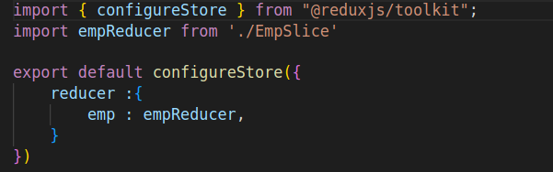
Store:

Slide 158
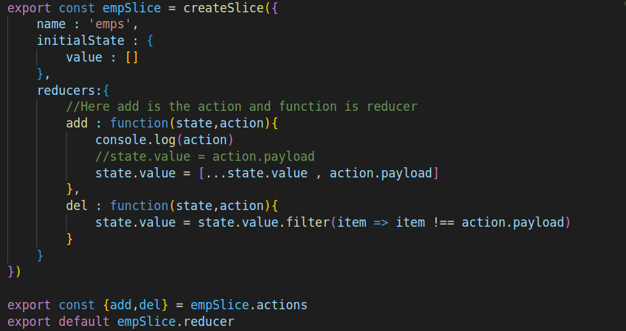
Slice:

Slide 159
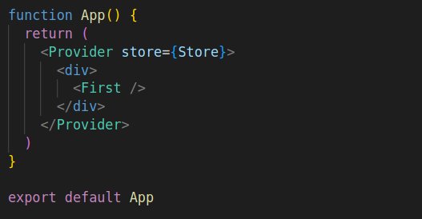
Provider:

Slide 160
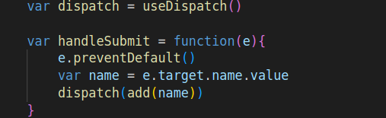
Dispatch Action and Select state:

Slide 161
Web Security
Security Threat is defined as a risk that which, can potentially harm Computer systems & organizations.
Whenever an Individual or an Organization creates a website, they are vulnerable to security attacks.
Security attacks are mainly aimed at stealing altering or destroying a piece of personal and confidential information, stealing the hard drive space, and illegally accessing passwords.

Slide 162
Web Security Threats
Cross Site Scripting
Attackers inserts client-side script into web pages. For Example: Submission of forms. It is a term used to describe a class of attacks that allow an attacker to inject client-side scripts into other users’ browsers through a website.
SQL Injection:
Manipulate your data or your database by inserting a rough(SQL string) code into your query.

Slide 163
Virus,Worms,Malware,Spyware:
The primary difference between a virus and a worm is that viruses must be triggered by the activation of their host; whereas worms are stand-alone malicious programs that can self-replicate and propagate independently as soon as they have breached the system
Denial Of Service:
An attack meant to shut down a machine or network, making it inaccessible to its intended users. DoS attacks accomplish this by flooding the target with traffic, or sending it information that triggers a crash.

Slide 164
Phishing:
Phishing attacks are the practice of sending fraudulent communications that appear to come from a reputable source.
Ransomware:
Ransomware is a type of malware attack in which the attacker locks and encrypts the victim's data, important files and then demands a payment to unlock and decrypt the data.
Code Injection:
Code Injection is the general term for attack types which consist of injecting code that is then interpreted/executed by the application. This type of attack exploits poor handling of untrusted data.
Etc.

