Slide 1

Notes:
This is Padrino. / The money padrino for your wedding. //

Slide 2

Notes:
Every money app does the same thing. / It tells you what you already spent. //

Slide 3

Notes:
That is not help. / That is a receipt. // A wedding needs someone who acts. //

Slide 4

Notes:
A wedding in El Paso costs about twenty thousand dollars. / Three in four couples get hit with a fee they never saw coming. / And parents cover about half. //

Slide 5

Notes:
So we built Padrino. / You connect your bank. / Once. //

Slide 6

Notes:
Then you walk the path, / one milestone at a time. / A step is only done when your bank says so. //

Slide 7

Notes:
Every payment gets checked against your bank. / The photographer came in a hundred dollars over? / Padrino caught it. / Tio Javier sent four fifty? / Verified. //

Slide 8

Notes:
You just talk to it. / Mom and Dad sent five hundred. / Padrino turns that into one card. // You tap Do it. / Nothing changes without you. //

Slide 9

Notes:
Send it a quote. / Eleven thousand on paper. / Fourteen thousand once the service charge and tax hit. / You see it before you sign. //

Slide 10

Notes:
It reads the fine print. / What you would owe if you cancel, / date by date, / before you are locked in. //

Slide 11

Notes:
It finds money. / A hundred forty five a month in subscriptions you forgot. / Over a thousand dollars by the wedding. / And the money you live on stays untouched. //

Slide 12

Notes:
It brings the family in. / Every padrino gets a link. / The money goes straight to you, / and the bank confirms it. //

Slide 13

Notes:
It finds real El Paso vendors. / Save one. / Ask if they are free on your date. //

Slide 14

Notes:
And it writes the email for you. / Can you waive the cake cutting fee? //

Slide 15

Notes:
Eleven traditions. / Pick one, or mix. / Your wedding, your way. //

Slide 16

Notes:
Budget apps watch your money. // Padrino moves it. //

Slide 17
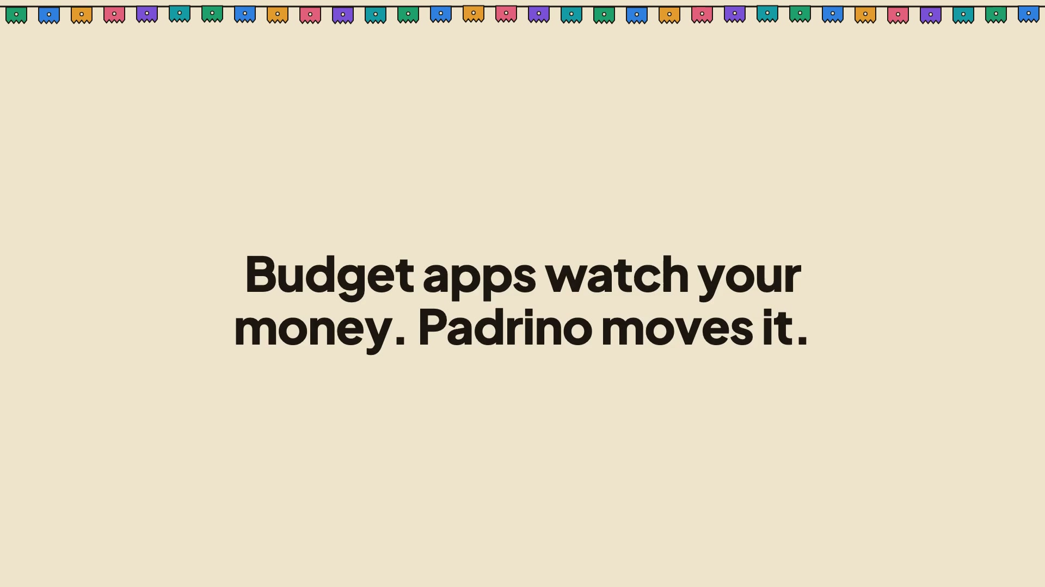
Notes:
Weddings first. / Then quinceañeras, / babies, / first homes. //

Slide 18

Notes:
In a Mexican wedding, a padrino covers part of the day. / Padrino covers all of it. // I'm Sid. / This is Padrino.

