Slide 1
2-d Arrays

Slide 2
Two Dimensional Arrays
We have seen that an array variable can store a list of values
Many applications require us to store a table of values
Subject 1
Subject 2
Subject 3
Subject 4
Subject 5
Student 1
75 | 82 | 90 | 65 | 76
68 | 75 | 80 | 70 | 72
88 | 74 | 85 | 76 | 80
50 | 65 | 68 | 40 | 70
Student 2
Student 3
Student 4

Slide 3
Contd.
The table contains a total of 20 values, five in each line
  The table can be regarded as a matrix consisting of four rows and five columns
C allows us to define such tables of items by using two-dimensional arrays

Slide 4
Declaring 2-D Arrays
General form:
  type array_name [row_size][column_size];
Examples:
  int marks[4][5];
  float sales[12][25];
  double matrix[100][100];

Slide 5
Initializing 2-d arrays
int a[2][3] = {1,2,3,4,5,6};
int a[2][3] = {{1,2,3}, {4,5,6}};
int a[][3] = {{1,2,3}, {4,5,6}};
All of the above will give the 2x3 array
1 2 3
4 5 6

Slide 6
Accessing Elements of a 2-d Array
Similar to that for 1-d array, but use two indices
  First indicates row, second indicates column
  Both the indices should be expressions which evaluate to integer values (within range of the sizes mentioned in the array declaration)
Examples:
  x[m][n] = 0;
  c[i][k] += a[i][j] * b[j][k];
  a = sqrt (a[j*3][k]);

Slide 7
Example
int a[3][5];
A two-dimensional array of 15 elements
Can be looked upon as a table of 3 rows and 5 columns
col0
col1
col2
col3
col4
row0
a[0][0]
a[0][1]
a[0][2]
a[0][3]
a[0][4]
row1
a[1][0]
a[1][1]
a[1][2]
a[1][3]
a[1][4]
row2
a[2][0]
a[2][1]
a[2][2]
a[2][3]
a[2][4]

Slide 8
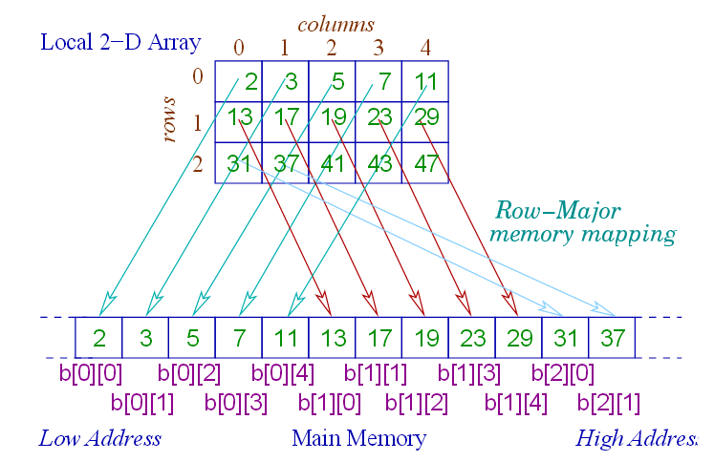

Slide 9
How is a 2-d array stored in memory?
Starting from a given memory location, the elements are stored row-wise in consecutive memory locations (row-major order)
    x: starting address of the array in memory
    c: number of columns
    k: number of bytes allocated per array element
  a[i][j] ➔ is allocated memory location at
  address x + (i * c + j) * k
a[0]0] a[0][1] a[0]2] a[0][3] a[1][0] a[1][1] a[1][2] a[1][3] a[2][0] a[2][1] a[2][2] a[2][3]
Row 0
Row 1
Row 2

Slide 10
Array Addresses
Output
3221224480
3221224484
3221224488
3221224492
3221224496
3221224500
3221224504
3221224508
3221224512
3221224516
3221224520
3221224524
3221224528
3221224532
3221224536
int main()
{
int a[3][5];
int i,j;
for (i=0; i<3;i++)
{
for (j=0; j<5; j++) printf("%u\n", &a[i][j]);
printf("\n");
}
return 0;
}

Slide 11
How to read the elements of a 2-d array?
By reading them one element at a time
  for (i=0; i<nrow; i++)
  for (j=0; j<ncol; j++)
  scanf (“%f”, &a[i][j]);
The ampersand (&) is necessary
The elements can be entered all in one line or in different lines

Slide 12
How to print the elements of a 2-d array?
By printing them one element at a time
  for (i=0; i<nrow; i++)
  for (j=0; j<ncol; j++)
  printf (“\n %f”, a[i][j]);
  The elements are printed one per line
  for (i=0; i<nrow; i++)
  for (j=0; j<ncol; j++)
  printf (“%f”, a[i][j]);
  The elements are all printed on the same line

Slide 13
Contd.
  for (i=0; i<nrow; i++)
  {
  printf (“\n”);
  for (j=0; j<ncol; j++)
  printf (“%f ”, a[i][j]);
  }
  The elements are printed nicely in matrix form

Slide 14
Example: Matrix Addition
int main()
{
int a[100][100], b[100][100],
c[100][100], p, q, m, n;
scanf (“%d %d”, &m, &n);
for (p=0; p<m; p++)
for (q=0; q<n; q++)
scanf (“%d”, &a[p][q]);
for (p=0; p<m; p++)
for (q=0; q<n; q++)
scanf (“%d”, &b[p][q]);
for (p=0; p<m; p++)
for (q=0; q<n; q++)
c[p][q] = a[p][q] + b[p][q];
for (p=0; p<m; p++)
{
printf (“\n”);
  for (q=0; q<n; q++)
  printf (“%d ”, c[p][q]);
}
return 0;
}

Slide 15
Passing 2-d Arrays as Parameters
Similar to that for 1-D arrays
  The array contents are not copied into the function
  Rather, the address of the first element is passed
For calculating the address of an element in a 2-d array, we need:
  The starting address of the array in memory
  Number of bytes per element
  Number of columns in the array
The above three pieces of information must be known to the function

Slide 16
Example Usage
void add (int x[15][25], int y[15][25], int rows, int cols)
{
:
}
int main()
{
int a[15][25], b[15]25];
:
:
add (a, b, 15, 25);
:
}
Parameter passing

Slide 17
Dynamic Memory Allocation

Slide 18
Dynamic Allocation of 2-d Arrays
Recall that address of [i][j]-th element is found by first finding the address of first element of i-th row, then adding j to it
Now think of a 2-d array of dimension [M][N] as M 1-d arrays, each with N elements, such that the starting address of the M arrays are contiguous (so the starting address of k-th row can be found by adding 1 to the starting address of (k-1)-th row)
This is done by allocating an array p of M pointers, the pointer p[k] to store the starting address of the k-th row

Slide 19
Contd.
Now, allocate the M arrays, each of N elements, with p[k] holding the pointer for the k-th row array
Now p can be subscripted and used as a 2-d array
Address of p[i][j] = *(p+i) + j (note that *(p+i) is a pointer itself, and p is a pointer to a pointer)

Slide 20
Dynamic Allocation of 2-d Arrays
int **allocate (int h, int w)
{
int **p;
int i, j;
p = (int **) malloc(h*sizeof (int *) );
for (i=0;i<h;i++)
p[i] = (int *) malloc(w * sizeof (int));
return(p);
}
void read_data (int **p, int h, int w)
{
int i, j;
for (i=0;i<h;i++)
for (j=0;j<w;j++)
scanf ("%d", &p[i][j]);
}
Allocate array
of pointers
Allocate array of
integers for each
row
Elements accessed
like 2-D array elements.

Slide 21
Contd.
void print_data (int **p, int h, int w)
{
int i, j;
for (i=0;i<h;i++)
{
for (j=0;j<w;j++)
printf ("%5d ", p[i][j]);
printf ("\n");
}
}
int main()
{
int **p;
int M, N;
printf ("Give M and N \n");
scanf ("%d%d", &M, &N);
p = allocate (M, N);
read_data (p, M, N);
printf ("\nThe array read as \n");
print_data (p, M, N);
return 0;
}

Slide 22
Contd.
void print_data (int **p, int h, int w)
{
int i, j;
for (i=0;i<h;i++)
{
for (j=0;j<w;j++)
printf ("%5d ", p[i][j]);
printf ("\n");
}
}
int main()
{
int **p;
int M, N;
printf ("Give M and N \n");
scanf ("%d%d", &M, &N);
p = allocate (M, N);
read_data (p, M, N);
printf ("\nThe array read as \n");
print_data (p, M, N);
return 0;
}
Give M and N
3 3
1 2 3
4 5 6
7 8 9
The array read as
1 2 3
4 5 6
7 8 9

