Slide 1
File Handling

Slide 2
Storage seen so far
All variables stored in memory
Problem: the contents of memory are wiped out when the computer is powered off
Example: Consider keeping students’ records
  100 students records are added in array of structures
  Machine is then powered off after sometime
  When the machine is powered on, the 100 records entered earlier are all gone!
  Have to enter again if they are needed

Slide 3
Basic operations on a file
Open
Read
Write
Close
Mainly we want to do read or write, but a file has to be opened before read/write, and should be closed after all read/write is over

Slide 4
Opening a File: fopen()
FILE * is a datatype used to represent a pointer to a file
fopen takes two parameters, the name of the file to open and the mode in which it is to be opened
It returns the pointer to the file if the file is opened successfully, or NULL to indicate that it is unable to open the file

Slide 5
Example: opening file.dat for write
FILE *fptr;
char filename[ ]= "file2.dat";
fptr = fopen (filename,"w");
if (fptr == NULL) {
printf (“ERROR IN FILE CREATION”);
/* DO SOMETHING */
}

Slide 6
Modes for opening files
The second argument of fopen is the mode in which we open the file.

Slide 7
Modes for opening files
The second argument of fopen is the mode in which we open the file.
  "r" : opens a file for reading (can only read)
    Error if the file does not already exists
    "r+" : allows write also

Slide 8
Modes for opening files
The second argument of fopen is the mode in which we open the file.
  "r" : opens a file for reading (can only read)
    Error if the file does not already exists
    "r+" : allows write also
  "w" : creates a file for writing (can only write)
    Will create the file if it does not exist
    Caution: writes over all previous contents if the flle already exists
    "w+" : allows read also

Slide 9
Modes for opening files
The second argument of fopen is the mode in which we open the file.
  "r" : opens a file for reading (can only read)
    Error if the file does not already exists
    "r+" : allows write also
  "w" : creates a file for writing (can only write)
    Will create the file if it does not exist
    Caution: writes over all previous contents if the flle already exists
    "w+" : allows read also
  "a" : opens a file for appending (write at the end of the file)
    "a+" : allows read also

Slide 10
Writing to a file: fprintf( )
fprintf() works exactly like printf(), except that its first argument is a file pointer. The remaining two arguments are the same as printf
The behaviour is exactly the same, except that the writing is done on the file instead of the display
FILE *fptr;
fptr = fopen ("file.dat","w");
fprintf (fptr, "Hello World!\n");
fprintf (fptr, “%d %d”, a, b);

Slide 11
Reading from a file: fscanf( )
fscanf() works like scanf(), except that its first argument is a file pointer. The remaining two arguments are the same as scanf
The behaviour is exactly the same, except
  The reading is done from the file instead of from the keyboard (think as if you typed the same thing in the file as you would in the keyboard for a scanf with the same arguments)
  The end-of-file for a text file is checked differently (check against special character EOF)

Slide 12
Reading from a file: fscanf( )
FILE *fptr;
fptr = fopen (“input.dat”, “r”);
/* Check it's open */
if (fptr == NULL)
{
printf(“Error in opening file \n”);
exit(-1);
}
fscanf (fptr, “%d %d”,&x, &y);
EOF checking in a loop
char ch;
while (fscanf(fptr, “%c”, &ch) != EOF)
{
/* not end of file; read */
}

Slide 13
Reading lines from a file: fgets()
Takes three parameters
  a character array str, maximum number of characters to read size, and a file pointer fp
Reads from the file fp into the array str until any one of these happens
  No. of characters read = size - 1
  \n is read (the char \n is added to str)
  EOF is reached or an error occurs
‘\0’ added at end of str if no error
Returns NULL on error or EOF, otherwise returns pointer to str

Slide 14
Reading lines from a file: fgets()
FILE *fptr;
char line[1000];
/* Open file and check it is open */
while (fgets(line,1000,fptr) != NULL)
{
printf ("Read line %s\n",line);
}

Slide 15
Writing lines to a file: fputs()
Takes two parameters
  A string str (null terminated) and a file pointer fp
Writes the string pointed to by str into the file
Returns non-negative integer on success, EOF on error

Slide 16
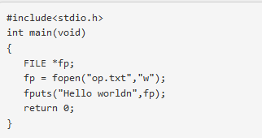

Slide 17
Reading/Writing a character: fgetc(), fputc()
Equivalent of getchar(), putchar() for reading/writing char from/to keyboard
Exactly same, except that the first parameter is a file pointer
Equivalent to reading/writing a byte (the char)
char fgetc(FILE *fp);
int fputc(char c, FILE *fp);
Example:
  char c;
  c = fgetc(fp1); fputc(c, fp2);

Slide 18
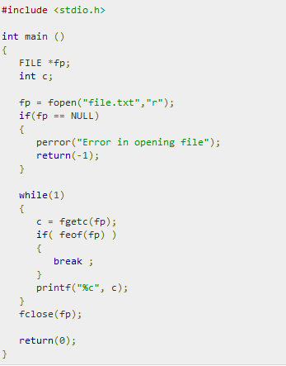
feof()

Slide 19
Closing a file
Should close a file when no more read/write to a file is needed in the rest of the program
File is closed using fclose() and the file pointer
FILE *fptr;
char filename[]= "myfile.dat";
fptr = fopen (filename,"w");
fprintf (fptr,"Hello World of filing!\n");
…. Any more read/write to myfile.dat….
fclose (fptr);

