Slide 1
Searching

Slide 2
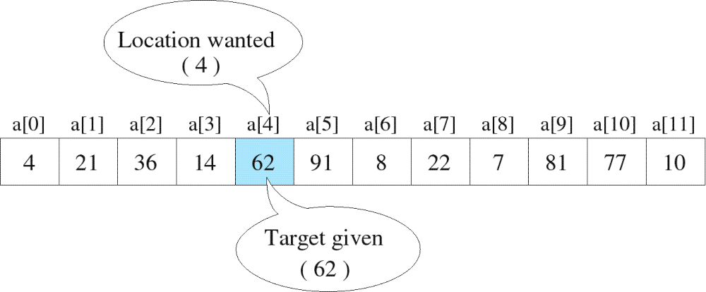
Searching
The process used to find the location of a target among a list of objects
  Searching an array finds the index of first element in an array containing that value

Slide 3
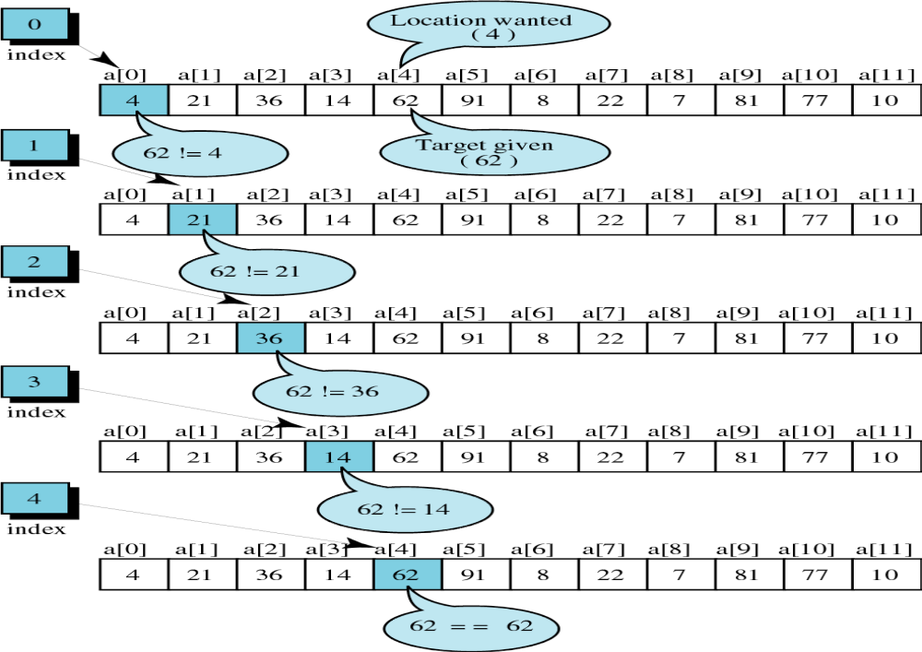
successful

Slide 4
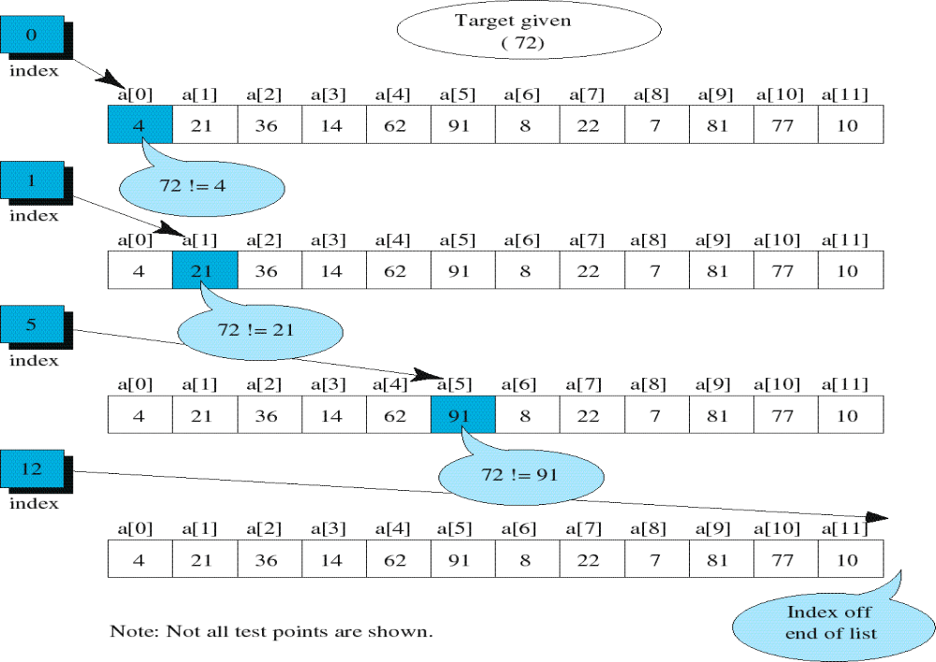
unsuccessful

Slide 5
Unordered Linear Search
Search an unordered array of integers for a value and return its index if the value is found. Otherwise, return -1.
A[0] A[1] A[2] A[3] A[4] A[5] A[6] A[7]
Algorithm:
Start with the first array element (index 0)
while(more elements in array){
if value found at current index, return index;
Try next element (increment index);
}
Value not found, return -1;
14 2 10 5 1 3 17 2

Slide 6
Unordered Linear Search
// Searches an unordered array of integers
int search(int data[], //input: array
int size, //input: array size
int value){ //input: search value
// output: if found, return index;
// otherwise, return –1.
for(int index = 0; index < size; index++){
if(data[index] == value)
return index;
}
return -1;
}

Slide 7


Slide 8
Binary Search
Binary search. Given value and sorted array a[], find index i
such that a[i] = value, or report that no such index exists.
Invariant. Algorithm maintains a[lo] ≤ value ≤ a[hi].
Ex. Binary search for 33.
6
13
14
25
33
43
51
53
64
72
84
93
95
96
97
0
1
2
3
4
5
6
7
8
9
10
11
12
13
14
lo
hi

Slide 9
Binary Search
Binary search. Given value and sorted array a[], find index i
such that a[i] = value, or report that no such index exists.
Invariant. Algorithm maintains a[lo] ≤ value ≤ a[hi].
Ex. Binary search for 33.
6
13
14
25
33
43
51
53
64
72
84
93
95
96
97
0
1
2
3
4
5
6
7
8
9
10
11
12
13
14
lo
mid
hi

Slide 10
Binary Search
Binary search. Given value and sorted array a[], find index i
such that a[i] = value, or report that no such index exists.
Invariant. Algorithm maintains a[lo] ≤ value ≤ a[hi].
Ex. Binary search for 33.
6
13
14
25
33
43
51
53
64
72
84
93
95
96
97
0
1
2
3
4
5
6
7
8
9
10
11
12
13
14
lo
hi

Slide 11
Binary Search
Binary search. Given value and sorted array a[], find index i
such that a[i] = value, or report that no such index exists.
Invariant. Algorithm maintains a[lo] ≤ value ≤ a[hi].
Ex. Binary search for 33.
6
13
14
25
33
43
51
53
64
72
84
93
95
96
97
0
1
2
3
4
5
6
7
8
9
10
11
12
13
14
lo
mid
hi

Slide 12
Binary Search
Binary search. Given value and sorted array a[], find index i
such that a[i] = value, or report that no such index exists.
Invariant. Algorithm maintains a[lo] ≤ value ≤ a[hi].
Ex. Binary search for 33.
6
13
14
25
33
43
51
53
64
72
84
93
95
96
97
0
1
2
3
4
5
6
7
8
9
10
11
12
13
14
lo
hi

Slide 13
Binary Search
Binary search. Given value and sorted array a[], find index i
such that a[i] = value, or report that no such index exists.
Invariant. Algorithm maintains a[lo] ≤ value ≤ a[hi].
Ex. Binary search for 33.
6
13
14
25
33
43
51
53
64
72
84
93
95
96
97
0
1
2
3
4
5
6
7
8
9
10
11
12
13
14
lo
mid
hi

Slide 14
Binary Search
Binary search. Given value and sorted array a[], find index i
such that a[i] = value, or report that no such index exists.
Invariant. Algorithm maintains a[lo] ≤ value ≤ a[hi].
Ex. Binary search for 33.
6
13
14
25
33
43
51
53
64
72
84
93
95
96
97
0
1
2
3
4
5
6
7
8
9
10
11
12
13
14
lo
hi

Slide 15
Binary Search
Binary search. Given value and sorted array a[], find index i
such that a[i] = value, or report that no such index exists.
Invariant. Algorithm maintains a[lo] ≤ value ≤ a[hi].
Ex. Binary search for 33.
6
13
14
25
33
43
51
53
64
72
84
93
95
96
97
0
1
2
3
4
5
6
7
8
9
10
11
12
13
14
lo
hi
mid

Slide 16
Binary Search
Binary search. Given value and sorted array a[], find index i
such that a[i] = value, or report that no such index exists.
Invariant. Algorithm maintains a[lo] ≤ value ≤ a[hi].
Ex. Binary search for 33.
6
13
14
25
33
43
51
53
64
72
84
93
95
96
97
0
1
2
3
4
5
6
7
8
9
10
11
12
13
14
lo
hi
mid

Slide 17
Example: Binary Search
Searching for an element k in a sorted array A with n elements
Idea:
  Choose the middle element A[n/2]
  If k == A[n/2], we are done
  If k < A[n/2], search for k between A[0] and A[n/2 -1]
  If k > A[n/2], search for k between A[n/2 + 1] and A[n-1]
  Repeat until either k is found, or no more elements to search
Requires less number of comparisons than linear search in the worst case (log₂n instead of n)

Slide 18
int main() {
int A[100], n, k, i, mid, low, high;
scanf(“%d %d”, &n, &k);
for (i=0; i<n; ++i)
scanf(“%d”, &A[i]);
low = 0; high = n – 1; mid = (high + low)/2;
while (high >= low) {
if (A[mid] == k) {
printf(“%d is found\n”, k);
break;
}
if (k < A[mid])
high = mid – 1;
else
low = mid + 1;
mid = (high + low)/2;
}
If (high < low) printf(“%d is not found\n”, k);
}

