Slide 1
Sorting

Slide 2
Bubble Sort
Stage 1: Compare each element (except the last one) with its neighbor to the right
  If they are out of order, swap them
  This puts the largest element at the very end
  The last element is now in the correct and final place
Stage 2: Compare each element (except the last two) with its neighbor to the right
  If they are out of order, swap them
  This puts the second largest element next to last
  The last two elements are now in their correct and final places
Stage 3: Compare each element (except the last three) with its neighbor to the right
  Continue as above until you have no unsorted elements on the left

Slide 3
Example of Bubble Sort
Stage 1
Stage 2
Stage 3
Stage 4
7
2
8
5
4
2
7
5
4
8
2
5
4
7
8
2
4
5
7
8
2
7
8
5
4
2
7
5
4
8
2
5
4
7
8
2
4
5
7
8
2
7
8
5
4
2
5
7
4
8
2
4
5
7
8
(done)
2
7
5
8
4
2
5
4
7
8
2
7
5
4
8

Slide 4
Code for Bubble Sort
void bubbleSort(int[] a) {
int stage, inner, temp;
for (stage = length - 1; stage > 0; stage--) { // counting down
for (inner = 0; inner < stage; inner++) { // bubbling up
if (a[inner] > a[inner + 1]) { // if out of order...
temp = a[inner]; // ...then swap
a[inner] = a[inner + 1];
a[inner + 1] = temp;
}
}
}
}

Slide 5
Mergesort

Slide 6
Basic Idea
Divide the array into two halves
Sort the two sub-arrays
Merge the two sorted sub-arrays into a single sorted array
Sorting the sub-arrays: is done recursively (divide in two, sort, merge) until the array has a single element (base condition of recursion)

Slide 7
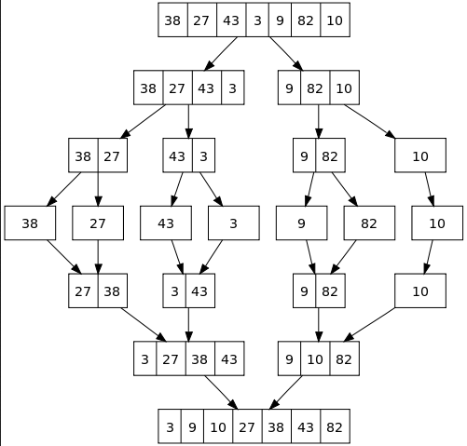
Merge Sort: Sorting an array recursively
void mergeSort(int arr[], int l, int r)
{
if (l < r)
{
int m = (l+r)/2;
// Sort first and second halves
mergeSort(arr, l, m);
mergeSort(arr, m+1, r);
merge(arr, l, m, r);
}
}

Slide 8
Merging Two Sorted Arrays
Problem: Two sorted arrays A and B are given. We are required to
produce a final sorted array C which contains all elements of A and B.
i
3 | 4 | 7 | 8 | 9
i
3 | 4 | 7 | 8 | 9
j
2 | 5 | 7
j
2 | 5 | 7
k
k
2
3 | 4 | 7 | 8 | 9
3 | 4 | 7 | 8 | 9
2 | 5 | 7
2 | 5 | 7
2 | 3
2 | 3 | 4

Slide 9
3 | 4 | 7 | 8 | 9
3 | 4 | 7 | 8 | 9
2 | 5 | 7
2 | 5 | 7
2 | 3 | 4 | 5
2 | 3 | 4 | 5 | 7
3 | 4 | 7 | 8 | 9
3 | 4 | 7 | 8 | 9
2 | 5 | 7
2 | 5 | 7
2 | 3 | 4 | 5 | 7 | 7
2 | 3 | 4 | 5 | 7 | 7 | 8

Slide 10
Merge Code
3 | 4 | 7 | 8 | 9
2 | 5 | 7
2 | 3 | 4 | 5 | 7 | 7 | 8 | 9

