Slide 1

CS60010: Deep Learning Spring 2023 Sudeshna Sarkar
Transformer- Part 3
Sudeshna Sarkar
16 Mar 2023

Slide 2
Pre-training

Slide 3
CS60010: Deep Learning Spring 2022 Sudeshna Sarkar
BERT etc
Sudeshna Sarkar
11 May 2022

Slide 4
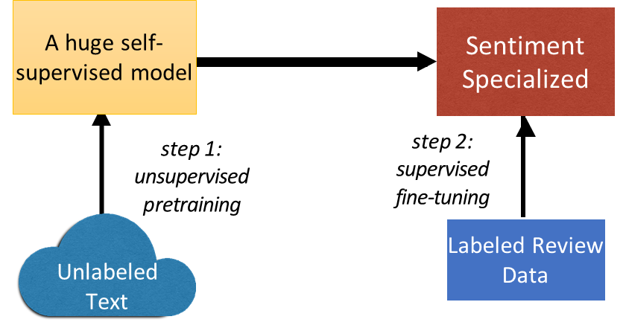
Transfer Learning
Leverage unlabeled data to cut down on the number of labeled examples needed.
Take a network trained on a task for which it is easy to generate labels, and adapt it to a different task for which it is harder.
Train a really big language model on billions of words, transfer to every NLP task!
Notes:
Pre-training: Use these big LMs as text encoders
Enable downstream models to focus on task at hand, instead of learning how language works,

Slide 5
Contextualized Word Embedding
Contextualized Word Embedding
Contextualized
Word Embedding
…
the
river
bank
…
…
money
in
the
bank
…
Contextualized Word Embedding
Train contextual representations on text corpus
…
own
blood
bank
…
Notes:
Examples

Slide 6
Uni-directional language models
Why are LMs unidirectional?
Reason 1: Directionality is needed to generate a well-formed probability distribution.
Reason 2: Words can “see themselves” in a bidirectional encoder.
Language models only use left context or right context, but language understanding is bidirectional.
Slide from Jacob Delvin

Slide 7
Word structure and subword models
We assume a fixed vocab of tens of thousands of words, built from the training set.
All novel words seen at test time are mapped to a single UNK.
taaaasty
laern
tarnsformerify

Slide 8
The byte-pair encoding algorithm
Start with a vocabulary containing only characters and an “end-of-word” symbol.
Using a corpus of text, find the most common adjacent characters “a,b”; add “ab” as a subword.
Replace instances of the character pair with the new subword; repeat until desired vocab size.
Common words end up being a part of the subword vocabulary, while rarer words are split into (sometimes intuitive, sometimes not) components.
In the worst case, words are split into as many subwords as they have characters.
taa## aaa## sty
la## ern##
Transformer## ify

Slide 9
pretraining
pretrained word embeddings
Pretraining whole models
In modern NLP:
All (or almost all) parameters in NLP networks are initialized via pretraining.
Pretraining methods hide parts of the input from the model, and train the model to reconstruct those parts.
This has been exceptionally effective at building strong:
representations of language
parameter initializations for strong NLP
models.
Probability distributions over language that we can sample from

Slide 10
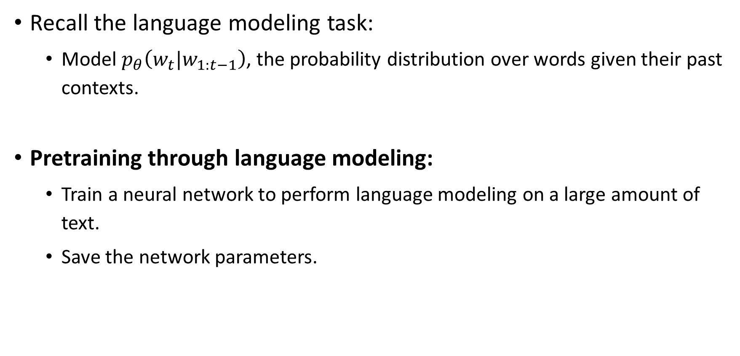
Pretraining through language modeling
Recall the language modeling task:
Model $p_{θ}\left(w_{t}|w_{1:t−1}\right)$, the probability distribution over words given their past contexts.
Pretraining through language modeling:
Train a neural network to perform language modeling on a large amount of text.
Save the network parameters.

Slide 11

The Pretraining / Finetuning Paradigm
Pretraining can improve NLP applications by serving as parameter initialization.
Step 1: Pretrain (on language modeling)
Lots of text; learn general things!
Step 2: Finetune (on your task)
Not many labels; adapt to the task!
goes to
make tasty tea END
☺/☹
(Transformer, LSTM, ++ )
(Transformer, LSTM, ++ )
Iroh
goes
to
make
tasty
tea
… the movie was …

Slide 12
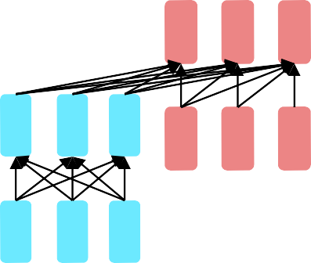
Pretraining for three types of architectures
The neural architecture influences the type of pretraining, and natural use cases.
Gets bidirectional context – can condition on future!
How do we train them to build strong representations?
Encoders
Encoder-
Decoders
Good parts of decoders and encoders?
What’s the best way to pretrain them?
Language models! What we’ve seen so far.
Nice to generate from; can’t condition on future words
Decoders

Slide 13
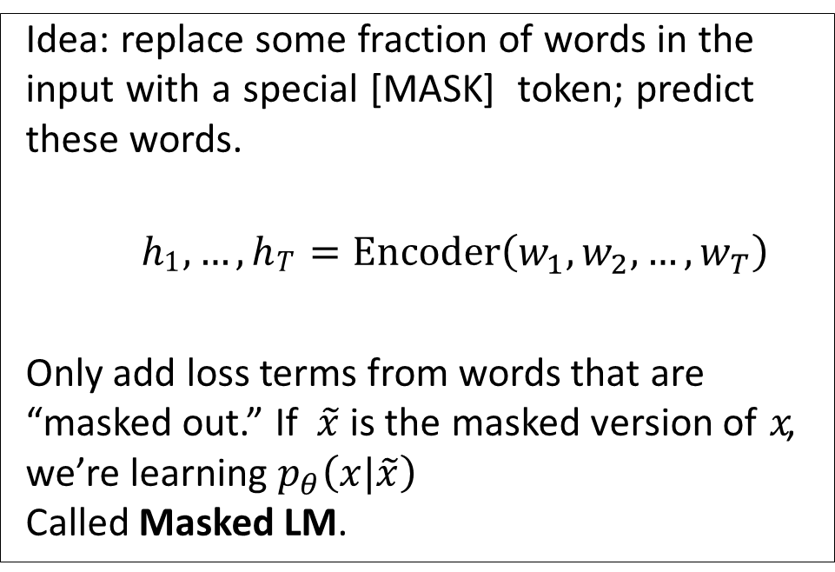
Pretraining encoders: what pretraining objective to use?
So far, we’ve looked at language model pretraining. But encoders get bidirectional context, so we can’t do language modeling!
Idea: replace some fraction of words in the input with a special [MASK] token; predict these words.
ℎ₁, … , ℎ_{𝑇} = Encoder$\left(w_{1},w_{2}, …,w_{T}\right)$
Only add loss terms from words that are “masked out.” If $\tilde{x}$ is the masked version of $x$, we’re learning $p_{θ}\left(x|\tilde{x}\right)$
Called Masked LM.
went
store
ℎ₁, … , ℎ_{𝑇}
I [M] to the [M]
[Devlin et al., 2018]

Slide 14
BERT: Bidirectional Encoder Representations from Transformers
Devlin et al., 2018 proposed the “Masked LM” objective and released the weights of a pretrained Transformer, a model they labeled BERT.
Some more details about Masked LM for BERT:
Predict a random 15% of (sub)word tokens.
Replace input word with [MASK] 80% of the time
Replace input word with a random token 10% of the time
Leave input word unchanged 10% of the time (but still predict it!)
Why? Doesn’t let the model get complacent and not build strong representations of non-masked words. (No masks are seen at fine-tuning time!)
[Predict these!]
went to
store
Transformer Encoder
I pizza to
the [M]
[Replaced]
[Not replaced]
[Masked]
[Devlin et al., 2018]

Slide 15












Bidirectional transformer LMs
BERT is essentially the “encoder” part of a transformer with 15% of inputs replaced with [MASK]
Input:
I [MASK] therefore I [MASK]
Output: I think therefore I am
Main idea: needing to predict missing words forces the
model to “work hard” to learn a good representation
Without the need for masked self-attention! This makes it bidirectional
position-wise softmax
position-wise nonlinear network
repeated Nx
masked self-attention
position-wise encoder
randomly mask out
some input tokens
mask = replace with [MASK]

Slide 16
Training of BERT
vocabulary size
Approach 1:
Masked LM
Predicting the masked word
Linear Multi-class
Classifier
Randomly replace 15% of the tokens with [MASK]
……
BERT
潮水
[MASK]
……
退了
就
知道
Notes:
Can we compare BERT and ELMO??

Slide 17
Training of BERT
Approach 2: Next Sentence Prediction
yes
[CLS]: the position that outputs classification results
Linear Binary
Classifier
[SEP]: the boundary of two sentences
Approaches 1 and 2 are used at the same time.
Randomly swap the order of the sentences 50% of the time
BERT
[CLS]
醒醒
吧
[SEP]
你
沒有
妹妹

Slide 18
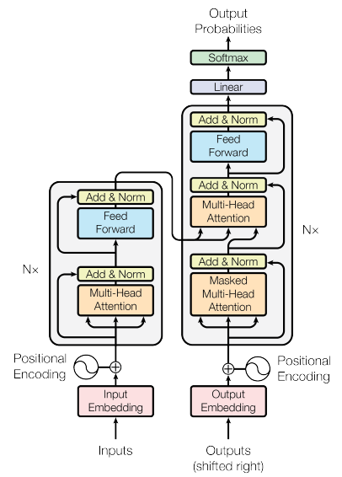
Bidirectional Encoder Representations from Transformers (BERT)
BERT = Encoder of Transformer
Learned from a large amount of text without annotation
Encoder
……
BERT
潮水
退了
就
知道
……

Slide 19
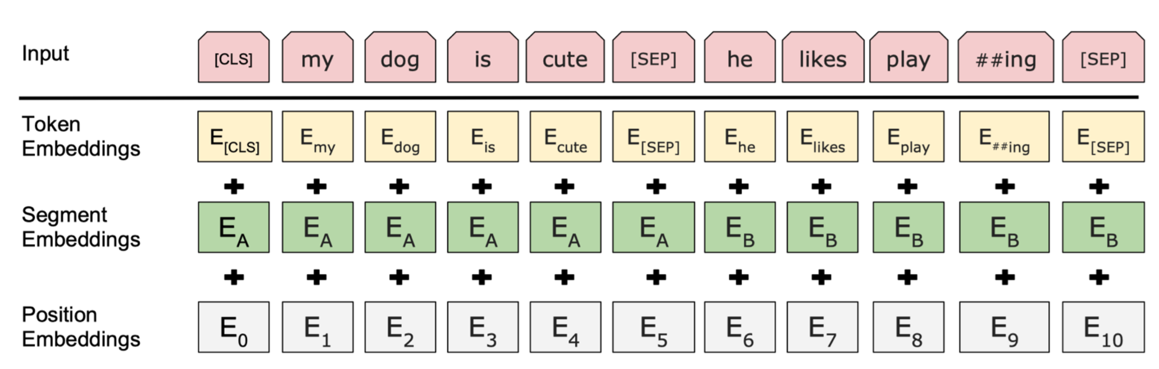
BERT
Multi-layer self-attention (Transformer)
Input: a sentence or a pair of sentences with a separator and subword representation

Slide 20
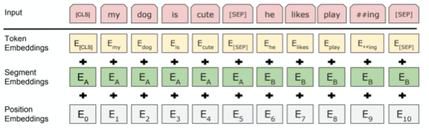
Input Representation
Hidden state corresponding to [CLS] will be used as the sentence representation
Use 30,000 WordPiece vocabulary on input.
Each token is sum of three embeddings
Single sequence is much more efficient.
Slide from Jacob Delvin

Slide 21
How to use BERT – Case 1
class
Linear Classifier
Trained from Scratch
Input: single sentence,
output: class
Example:
Sentiment analysis
Document Classification
BERT
Fine-tune
[CLS]
w₁
w₂
w₃
sentence
Notes:
(https://arxiv.org/abs/1805.12471)

Slide 22
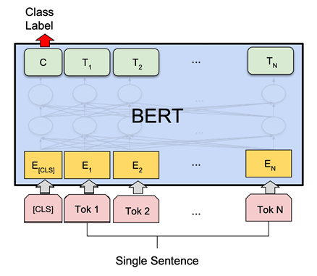
Sentence Classification
CLS token is used to provide classification decision

Slide 23
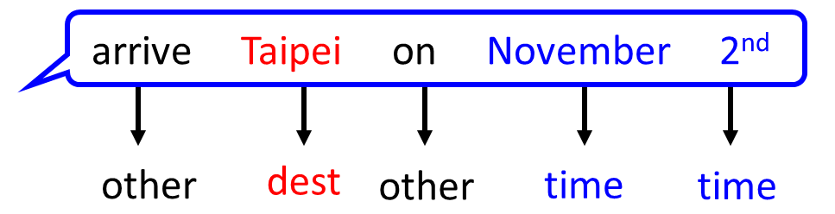
How to use BERT – Case 2
class
class
class
Linear Cls
Linear Cls
Linear Cls
Input: single sentence,
output: class of each word
Example: Slot filling
BERT
[CLS]
w₁
w₂
w₃
sentence
Notes:
(https://arxiv.org/abs/1805.12471)

Slide 24
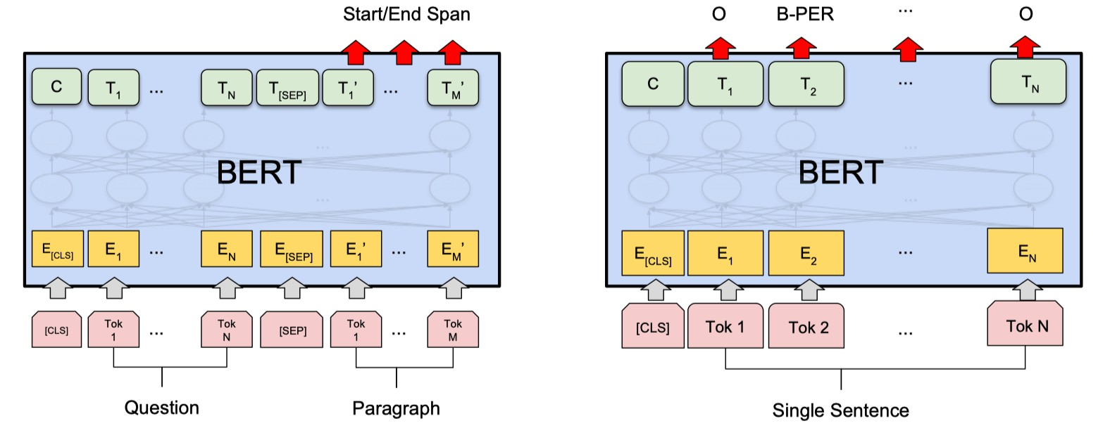
Tagging with BERT
Can do for a single sentence or a pair
Tag each word piece
Example tasks: span-based question answering, name-entity recognition, POS tagging

Slide 25
How to use BERT – Case 3
Class
Input: two sentences, output: class
Example: Natural Language Inference
Linear Classifier
Given a “premise”, determining whether a “hypothesis” is T/F/ unknown.
BERT
[CLS]
w₁
w₂
[SEP]
w₃
w₄
w₅
Sentence 1
Sentence 2
Notes:
determining whether a “hypothesis” is true (entailment), false (contradiction), or undetermined (neutral) given a “premise”.

Slide 26
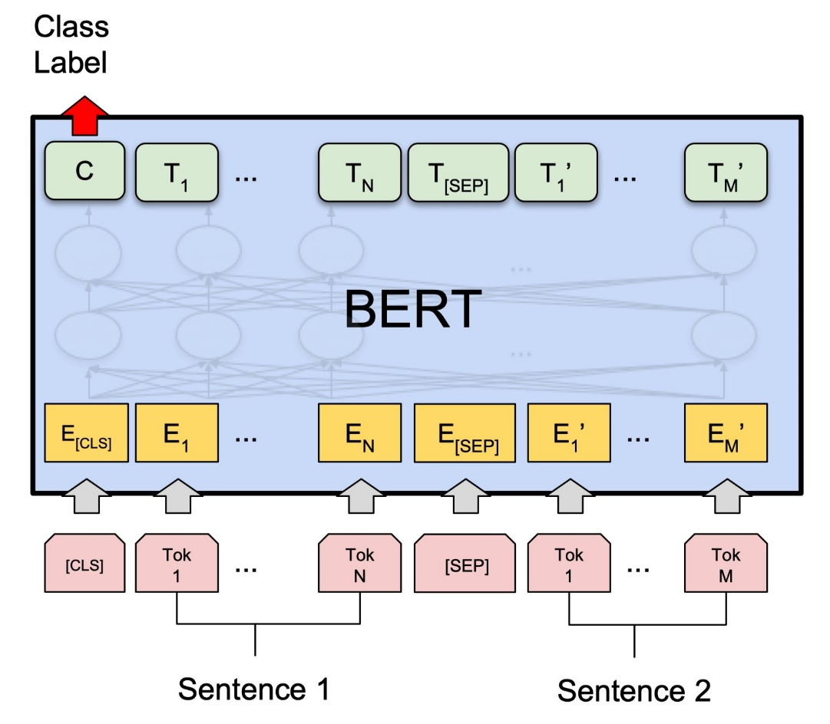
Sentence-pair Classification with BERT
Feed both sentences, and CLS token used for classification
Example tasks:
Textual entailment
Question paraphrase detection
Question-answering pair classification
Semantic textual similarity
Multiple choice question answering

Slide 27
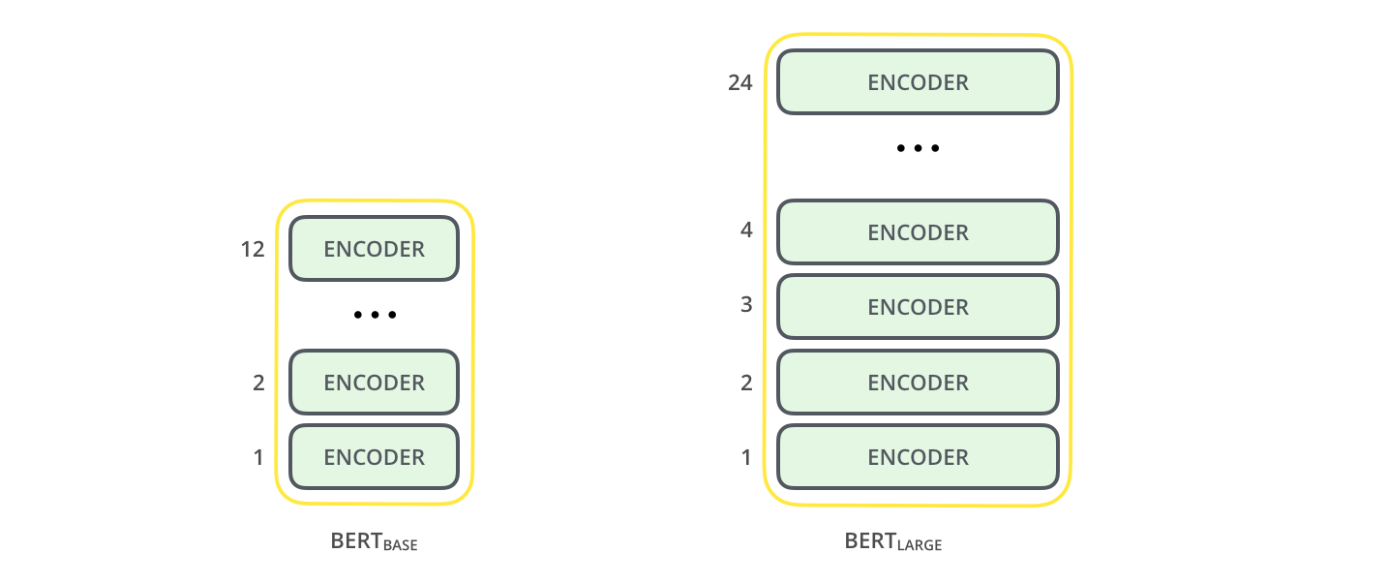
Model Architecture
BERT BASE
12 layers, 768-dim per word-piece token
12 heads.
Total parameters = 110M
BERT LARGE
24 layers, 1024-dim per word-piece token
16 heads.
Total parameters = 340M
BERT is basically a trained Transformer Encoder stack.

Slide 28
Model Details
Data: Wikipedia (2.5B words) + BookCorpus (800M words)
Batch Size: 131,072 words (1024 sequences * 128 length or 256 sequences * 512 length)
Training Time: 1M steps (~40 epochs)
Optimizer: AdamW, 1e-4 learning rate, linear decay
BERT-Base: 12-layer, 768-hidden, 12-head
BERT-Large: 24-layer, 1024-hidden, 16-head
Trained on 4x4 or 8x8 TPU slice for 4 days
Slide from Jacob Delvin

Slide 29
Evaluation of BERT
General Language Understanding Evaluation (GLUE) benchmark: Standard split of data to train, validation, test, where labels for the test set is only held in the server.
Sentence pair tasks
MNLI, Multi-Genre Natural Language Inference
QQP, Quora Question Pairs
QNLI, Question Natural Language Inference
STS-B The Semantic Textual Similarity Benchmark
MRPC Microsoft Research Paraphrase Corpus
RTE Recognizing Textual Entailment
WNLI Winograd NLI is a small natural language inference dataset
Single sentence classification
SST-2 The Stanford Sentiment Treebank
CoLA The Corpus of Linguistic Acceptability

Slide 30
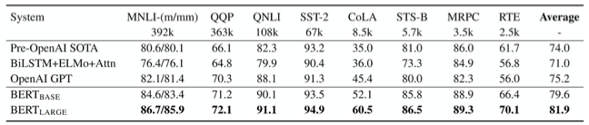
GLUE Results
MultiNLI
Premise: Hills and mountains are especially sanctified in Jainism. Hypothesis: Jainism hates nature. Label: Contradiction
CoLa
Sentence: The wagon rumbled down the road. Label: Acceptable
Sentence: The car honked down the road.
Label: Unacceptable
Slide from Jacob Delvin

Slide 31
Results
Fine-tuned BERT outperformed previous state of the art on 11 NLP tasks
Since then was applied to many more tasks with similar results
The larger models perform better, but even the small BERT performs better than prior methods
Variants quickly outperformed human performance on several tasks, including span-based question answering — but what does this mean is less clear
Started an arms race (between industry labs) on bigger and bigger models

Slide 32
Limitations of pretrained encoders
Those results looked great! Why not used pretrained encoders for everything?
If your task involves generating sequences, consider using a pretrained decoder; BERT and other pretrained encoders don’t naturally lead to nice autoregressive (1-word-at-a-time) generation methods.
make/brew/craft
goes to
make tasty tea END
Pretrained Encoder
Pretrained Decoder
Iroh
goes
to
[MASK] tasty
tea
Iroh
goes to
make
tasty
tea
29

Slide 33
Extensions of BERT
You’ll see a lot of BERT variants like RoBERTa, SpanBERT, +++
Some generally accepted improvements to the BERT pretraining formula:
RoBERTa: mainly just train BERT for longer and remove next sentence prediction!
SpanBERT: masking contiguous spans of words makes a harder, more useful pretraining task
It’s
bly
irr##
esi## sti## bly
BERT
SpanBERT
[MASK]
irr##
esi##
It’
[MASK] [MASK] [MASK] [MASK]
good
sti## [MASK] good
[Liu et al., 2019; Joshi et al., 2020]

Slide 34
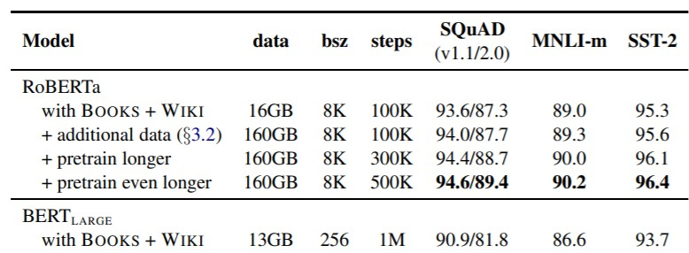
Extensions of BERT
A takeaway from the RoBERTa paper: more compute, more data can improve pretraining even when not changing the underlying Transformer encoder.
[Liu et al., 2019; Joshi et al., 2020]

Slide 35

Full Finetuning vs. Parameter-Efficient Finetuning
Finetuning every parameter in a pretrained model works well, but is memory-intensive. But lightweight finetuning methods adapt pretrained models in a constrained way.
Leads to less overfitting and/or more efficient finetuning and inference.
Full Finetuning
Adapt all parameters
Lightweight Finetuning
Train a few existing or new parameters
☺/☹
☺/☹
(Transformer, LSTM, ++ )
(Transformer, LSTM, ++ )
… the movie was …
… the movie was …
[Liu et al., 2019; Joshi et al., 2020]

Slide 36
Parameter-Efficient Finetuning: Prefix-Tuning, Prompt tuning
Prefix-Tuning adds a prefix of parameters, and freezes all pretrained parameters.
The prefix is processed by the model just like real words would be.
Advantage: each element of a batch at inference could run a different tuned model.
☺/☹
(Transformer, LSTM, ++ )
… the movie was …
Learnable prefix parameters
33
[Li and Liang, 2021; Lester et al., 2021]

Slide 37


Parameter-Efficient Finetuning: Low-Rank Adaptation
Low-Rank Adaptation Learns a low-rank “diff” between the pretrained and finetuned
weight matrices.
Easier to learn than prefix-tuning.
_{𝑊 ∈ ℝ}𝑑×𝑑
_{B ∈ ℝ}𝑘×𝑑
☺/☹
(Transformer, LSTM, ++ )
_{A ∈ ℝ}𝑑×𝑘
𝑊 + AB
… the movie was …
34
[Hu et al., 2021]

Slide 38
Pretraining encoder-decoders: what pretraining objective to use?
For encoder-decoders, we could do something like language modeling, but where a prefix of every input is provided to the encoder and is not predicted.
w_{𝑇+2}, … ,
ℎ₁, … , ℎ_{𝑇} = Encoder (w₁, … , w_{T})
ℎ_{𝑇+1}, … , ℎ₂ =Decoder( w₁, … , w_{𝑇}, ℎ₁, … , ℎ_{𝑇})
The encoder portion benefits from bidirectional context; the decoder portion is used to train the whole model through
w_{𝑇+1}, … , w_{2𝑇}
language modeling.
w₁, … , w_{𝑇}
[Raffel et al., 2018]

Slide 39



Pretraining encoder-decoders: what pretraining objective to use?
What Raffel et al., 2018 found to work best was span corruption. Their model: T5.
Replace different-length spans from the input with unique placeholders; decode out the spans that were removed!
This is implemented in text preprocessing: it’s still an objective that looks like language modeling at the decoder side.

Slide 40
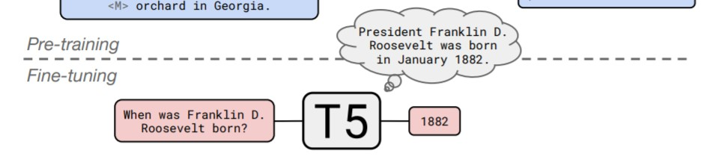

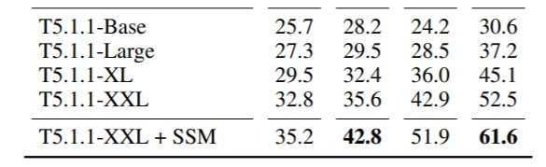
Pretraining encoder-decoders: what pretraining objective to use?
A fascinating property of T5: it can be finetuned to answer a wide range of questions, retrieving knowledge from its parameters.
NQ: Natural Questions WQ: WebQuestions TQA: Trivia QA
220 million params
770 million params
3 billion params
11 billion params
All “open-domain”
versions
[Raffel et al., 2018]

Slide 41
Pretraining for three types of architectures
The neural architecture influences the type of pretraining, and natural use cases.
Language models! What we’ve seen so far.
Nice to generate from; can’t condition on future words
All the biggest pretrained models are Decoders.
Decoders

Slide 42
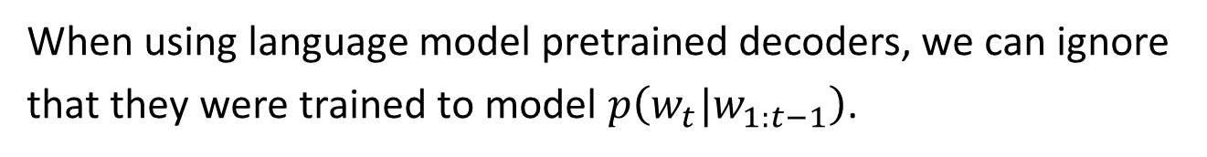
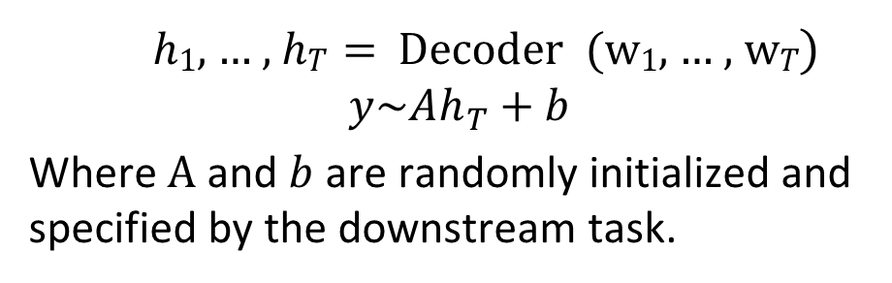
Pretraining decoders
When using language model pretrained decoders, we can ignore that they were trained to model $p\left(w_{t}|w_{1:t−1}\right)$.
☺/☹
We can finetune them by training a classifier
on the last word’s hidden state.
Linear
A, b
ℎ₁, … , ℎ_{𝑇}
ℎ₁, … , ℎ_{𝑇} = Decoder (w₁, … , w_{𝑇})
$$y\sim Ah_{T}+b$$
Where A and $b$ are randomly initialized and specified by the downstream task.
w₁, … , w_{𝑇}
Gradients backpropagate through the whole network.
the linear layer hasn’t been pretrained and must be learned from scratch.]

Slide 43
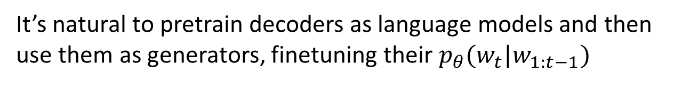
Pretraining decoders
It’s natural to pretrain decoders as language models and then use them as generators, finetuning their $p_{θ}(w_{t}|w_{1:t−1})$
w_{2 w3 w4 w5 w6}
This is helpful in tasks where the output is a sequence with a vocabulary like that at pretraining time!
Dialogue (context=dialogue history)
Summarization (context=document)
A, b
ℎ₁, … , ℎ_{𝑇}
w_{1 w2 w3 w4} w₅
[Note how the linear layer has been pretrained.]

Slide 44
Generative Pretrained Transformer (GPT) [Radford et al., 2018]
2018’s GPT was a big success in pretraining a decoder!
Transformer decoder with 12 layers, 117M parameters.
768-dimensional hidden states, 3072-dimensional feed-forward hidden layers.
Byte-pair encoding with 40,000 merges
Trained on BooksCorpus: over 7000 unique books.
Contains long spans of contiguous text, for learning long-distance dependencies.
43
[Devlin et al., 2018]

Slide 45
Generative Pretrained Transformer (GPT) [Radford et al., 2018]
How do we format inputs to our decoder for finetuning tasks?
Natural Language Inference: Label pairs of sentences as entailing/contradictory/neutral
Premise: The man is in the doorway
Hypothesis: The person is near the door
entailment
Radford et al., 2018 evaluate on natural language inference.
Here’s roughly how the input was formatted, as a sequence of tokens for the decoder.
[START] The man is in the doorway [DELIM] The person is near the door [EXTRACT]
The linear classifier is applied to the representation of the [EXTRACT] token.

Slide 46
GPT-3, In-context learning, and very large models
So far, we’ve interacted with pretrained models in two ways:
Sample from the distributions they define (maybe providing a prompt)
Fine-tune them on a task we care about, and take their predictions.
Very large language models seem to perform some kind of learning without gradient
steps simply from examples you provide within their contexts.
GPT-3 is the canonical example of this. The largest T5 model had 11 billion parameters.
GPT-3 has 175 billion parameters.

Slide 47
GPT-3, In-context learning, and very large models
Very large language models seem to perform some kind of learning without gradient steps simply from examples you provide within their contexts.
The in-context examples seem to specify the task to be performed, and the conditional distribution mocks performing the task to a certain extent.
Input (prefix within a single Transformer decoder context):
“
thanks -> merci hello -> bonjour mint -> menthe otter -> ”
Output (conditional generations):
loutre…”

Slide 48
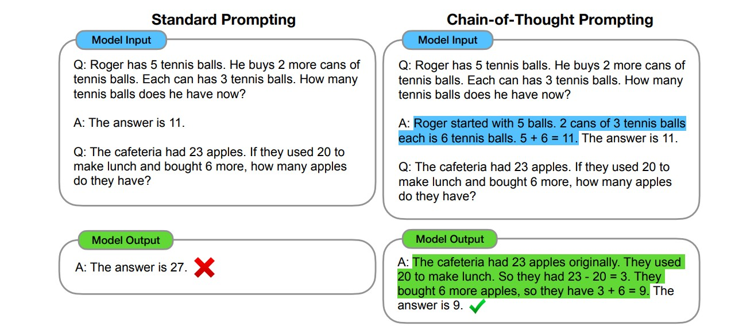
The prefix as task specification and scratch pad: chain-of-thought
[Wei et al., 2023]

Slide 49
What kinds of things does pretraining teach?
There’s increasing evidence that pretrained models learn a wide variety of things about
the statistical properties of language. Taking our examples from the start of class:
Stanford University is located in , California. [Trivia]
I put fork down on the table. [syntax]
The woman walked across the street, checking for traffic over shoulder. [coreference]
I went to the ocean to see the fish, turtles, seals, and . [lexical semantics/topic]
Overall, the value I got from the two hours watching it was the sum total of the popcorn
and the drink. The movie was _. [sentiment]
Iroh went into the kitchen to make some tea. Standing next to Iroh, Zuko pondered his destiny. Zuko left the . [some reasoning – this is harder]
I was thinking about the sequence that goes 1, 1, 2, 3, 5, 8, 13, 21, [some basic
arithmetic; they don’t learn the Fibonnaci sequence]
Models also learn – and can exacerbate racism, sexism, all manner of bad biases.
More on all this in the interpretability lecture!

Slide 50
Hard to do with BERT
BERT cannot generate text (at least not in an obvious way)
Masked language models are intended to be used primarily for “analysis” tasks

Slide 51
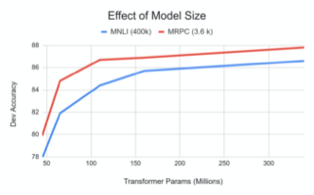
Effects of Model Size
Big models help a lot
Going from 110M -> 340M params helps even on datasets with 3,600 labelled examples
Improvements have not asymptoted
Slide from Jacob Delvin

Slide 53


GPT et al.
One-directional (forward) transformer models do have one big advantage over BERT.
Generation is not really possible with BERT, but a forward (masked attention) model can do it!
GPT (GPT-2, GPT-3, etc.) is a classic example of this
position-wise softmax
position-wise nonlinear network
repeated Nx
masked self-attention
position-wise encoder

Slide 54
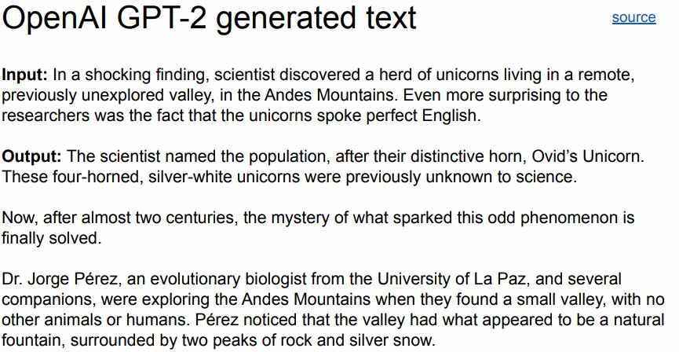
GPT et al.
position-wise softmax
position-wise nonlinear network
repeated Nx
masked self-attention
position-wise encoder

Slide 55
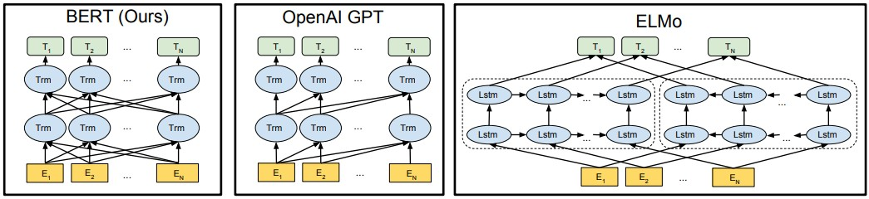
Pretrained language models summary
bidirectional transformer
+ great representations
- can’t generate text
one-directional transformer
+ can generate text
- OK representations
bidirectional LSTM
- OK representations
(largely supplanted by BERT)

Slide 56
Pretrained language models summary
Language models can be trained on very large and unlabeled datasets of text.
Internal learned representations depend on context: the meaning of a word is informed by the whole sentence!
Can even get us representations of entire sentences (e.g., the first output token for BERT)
Can be used to either extract representations to replace standard word embeddings…
…or directly finetuned on downstream tasks (which means we modify all the weights in the whole language model, rather than just using pretrained model hidden states)

Slide 57
Improved variants of BERT
RoBERTa
Bigger batch size is better!
Next sentence prediction doesn’t help
Pretrain on more data for as long as possible!
XLNet
Key Ideas
Autoregressive: use context to predict the next word
Bidirectional context from permutation language modeling
Self-attention mechanisms, uses Transformer-XL backbone

Slide 58
ALBERT
ALBERT: A Lite BERT for Self-supervised Learning of Language Representations (Lan et al, Google and TTI Chicago, 2019)
Innovation #1: Factorized embedding parameterization
Use small embedding size (e.g., 128) and then project it to Transformer hidden size (e.g., 1024) with parameter matrix
Innovation #2: Cross-layer parameter sharing
Share all parameters between Transformer layers
1024
x
100k
128
x
100k
1024
x
128
vs
x
Slide from J. Delvin

Slide 59
GPT-2, BERT
Transformers, GPT-2, and BERT
A transformer uses Encoder stack to model input, and uses Decoder stack to model output (using input information from encoder side).
But if we do not have input, we just want to model the “next word”, we can get rid of the Encoder side of a transformer and output “next word” one by one. This gives us GPT.
If we are only interested in training a language model for the input for some other tasks, then we do not need the Decoder of the transformer, that gives us BERT.

