Slide 1
CS 60038: Advances in Operating Systems Design
Virtualization

Slide 2
What is Virtualization?
A technology to create virtual representations of servers, storage, networks, or other physical machines
Mimics the function of physical hardware to run multiple virtual machines simultaneously on a single physical machine
Efficient use of hardware resources by dividing and distributing the resources across multiple users while maintaining security and confidentiality of individual user's information
Provides flexibility of resource usage – creates an abstraction of the physical resources available

Slide 3
Virtualization on top of Traditional OS
Application
Application
Application
API/Libraries
API/Libraries
API/Libraries
Guest OS
Guest OS
Guest OS
Hypervisor
Host OS
Server Hardare

Slide 4
Types of Virtualization
Process virtualization
The virtual machine supports an application binary interface (ABI) that contains user instructions and system calls – virtualization of a single process
Examples: Java Virtual Machines, Dynamic translators
Namespace Virtualization
Lightweight virtualization, multiple logical VMs that share the same OS kernel
Example: Chroot++ that isolates VMs by partitioning all objects into namespaces, Linux containers

Slide 5
Types of Virtualization
System Virtualization
Virtualizes the OS and the apps
The VMs support a complete instruction set architecture including user and system instructions
Example: Classic VMs with a guest OS

Slide 6
Popek and Goldberg Virtualization Requirements
Set of conditions sufficient for a computer architecture to support system virtualization efficiently
Introduced by Gerald J. Popek and Robert P. Goldberg in their 1974 article "Formal Requirements for Virtualizable Third Generation Architectures"
Virtual Machine Monitors (VMM): Software that creates and runs virtual machines (VMs)
Also called Hypervisors; we'll discuss in more details later

Slide 7
Popek and Goldberg Virtualization Requirements
Equivalence / Fidelity
A program running under the VMM should exhibit a behavior essentially identical to that demonstrated when running on an equivalent machine directly.
Resource control / Safety
The VMM must be in complete control of the virtualized resources.
Efficiency / Performance
A statistically dominant fraction of machine instructions must be executed without VMM intervention.

Slide 8
The Core of Virtualization
A process that allows a computer to share its hardware resources with multiple digitally separated environments
Each virtualized environment runs within its allocated memory, processing power and storage
Each virtual environment is logically separated from the others, and cannot access the resources allocated to other virtual environments – thus, provides an isolated environment from other virtual instances (called sandboxing)
Sandboxing helps in providing the security supports for each such virtual environments (we'll later discuss this in detail)

Slide 9
Core Concepts
Virtual Machines (VMs)
A software-defined computational environment that runs on a physical computational environment (desktop computers or servers) with a separate operating system and computing resources
The physical computational environment is called a host machine
The virtual machines are called the guest machines
Multiple VMs can run on a single physical machine

Slide 10
Core Concepts
Hypervisors (also called the Virtual Machine Monitors)
A software component or middleware that provides an abstraction of the physical hardware to the virtual machines.
Hypervisor manages multiple VMs on a single physical machine
Ensures that each VM gets the allocated resources and does not interfere with the other VMs running on the same physical machine (provides sandboxing across the VMs)

Slide 11
Type of Hypervisors
Type 1 Hypervisor (Bare Metal Hypervisor)
A hypervisor program installed directly on the computer's hardware instead of the operating system
Have better performance, are typically used by enterprise applications on the servers or data centers

Slide 12
Type 1 Hypervisors
Examples:
VMware hypervisors like vSphere, ESXi and ESX
Microsoft Hyper-V
Oracle VM Server
Citrix Hypervisor
Guest App
Guest App
Guest App
Guest OS
Virtual Machine Monitor (VMM)
Host Hardware

Slide 13
Type of Hypervisoprs
Type 1 Hypervisor (Bare Metal Hypervisor)
A hypervisor program installed directly on the computer's hardware instead of the operating system
Have better performance, are typically used by enterprise applications on the servers or data centers
Type 2 Hypervisor (Hosted Hypervisor)
A hyperviosr program installed on a host OS
Suitable for end-user computing

Slide 14
Type 2 Hypervisors
Guest App
Guest App
Guest App
Examples:
VMware Fusion
Oracle VirtualBox
Guest OS
Virtual Machine Monitor (VMM)
Host OS
Host Hardware

Slide 15
Application Binary Interface (ABI)
An interface between two binary program modules
One of these modules is often a library or the OS facility
Defines how data structures or computational routines are accessed in machine code
API defines this access in source code, which is a relatively high-level, hardware-independent, often human-readable format

Slide 16
Application Binary Interface (ABI)
Details covered by an ABI include the following:
Processor instruction set, with details like register file structure, stack organization, memory access types, etc.
Sizes, layouts, and alignments of basic data types that the processor can directly access
Calling convention, which controls how the arguments of functions are passed, and return values retrieved; for example, it controls the following:
Whether all parameters are passed on the stack, or some are passed in registers
Which registers are used for which function parameters
Whether the first function parameter passed on the stack is pushed first or last
Whether the caller or callee is responsible for cleaning up the stack after the function call
How an application should make system calls to the operating system, and if the ABI specifies direct system calls rather than procedure calls to system call stubs, the system call numbers
In the case of a complete operating system ABI, the binary format of object files, program libraries, etc.

Slide 17
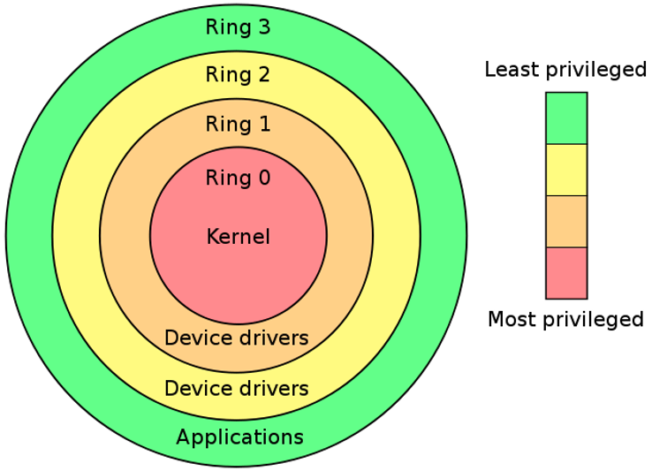
Protection Rings
A mechanism to protect data from faults and malicious behavior
Thus supports both fault-tolerance and security
Supports the layer of privilege within the architecture of an OS

Slide 18
Modes of Protection Ring
Supervisor Mode
Allows execution of all instructions (including priviledged instructions)
Give access to different address space, memory management hardware and other peripherals
OS runs in this mode
Hypervisor Mode
Modern CPUs offer x86 virtualization instructions for hypervisor to control Ring 0 hardware access.
Insert new privilege level below Ring 0, and new machine code instructions at Ring 1, intended to be executed by the hypervisor (hardware-assisted virtualization)

Slide 19
CPU Virtualization – Key Issues
Protection Levels: Ring 0 (Most privileged, privileged instructions cannot be executed outside Ring 0), Ring 3 (User mode)
Requirements for efficient virtualization:
Privileged Instructions: Trap if executed in user mode
Sensitive instructions: Those affects important system states
If a sensitive instruction is privileged, we can support efficient "trap and emulate" approach
Virtualized instructions can be emulated as native execution, plus exception handling code that emulates privileged instructions

Slide 20
CPU Virtualization: Key Issues
For x86 architecture, not all sensitive instructions are privileged
Some instructions exhibit different behaviors in user and privileged modes
For example, If CR4.UMIP=1 is set, then the SGDT, SIDT, SLDT, SMSW and STR instructions can only run in Ring 0.

Slide 21
Full vs Para Virtualization
Full Virtualization
Application running on the guest OS is completely abstracted from the underlying hardware
OS is unaware that it is a guest, and the hypervisor translates all OS calls to the actual hardware access
Para-virtualization
The guest OS is recompiled prior to installation inside a VM
Does not implement full isolation of OS but rather provides a different API (hypercalls) which is utilized for actual hardware access

Slide 22
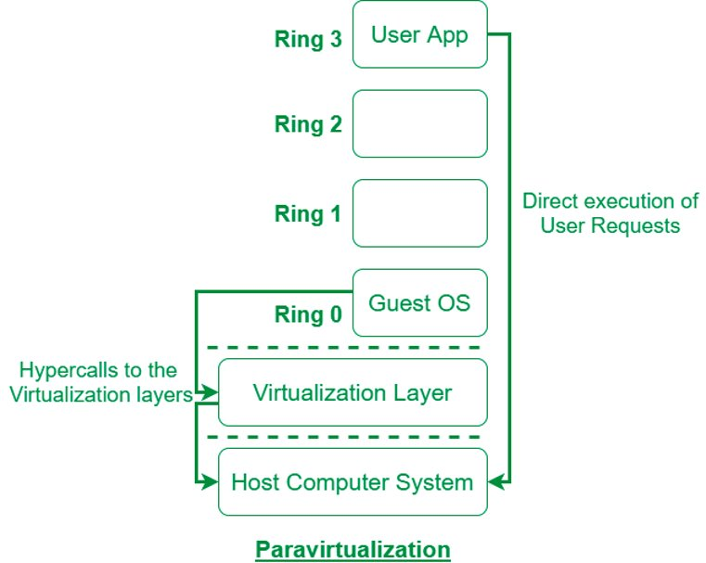
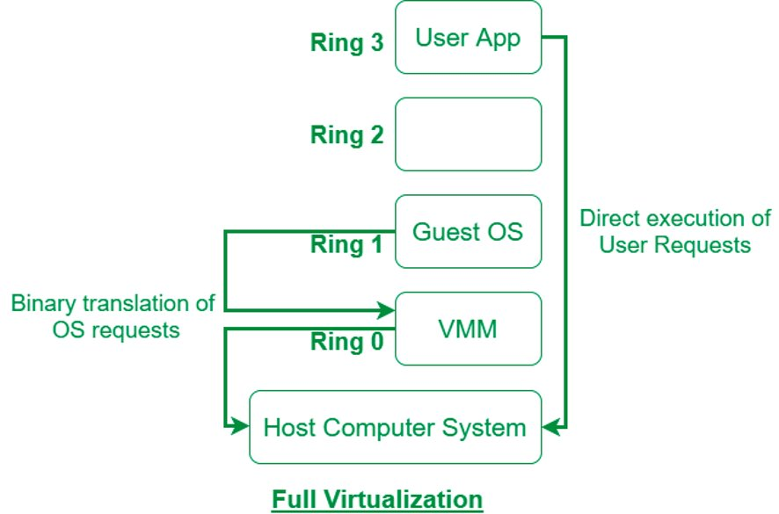
Full vs Para Virtualization
Image Source: https://www.geeksforgeeks.org/difference-between-full-virtualization-and-paravirtualization/

Slide 23
Para Virtualization
Not fully interface compatible, but provides better performance
Guest OSes must be modified to use VMM's interface
ABI remains unchanged
Therefore, applications need not to be modified
Guest OS is aware of virtualization (not in case of full virtualization)
Privileged instructions are replaced by hypervisor calls (hypercalls)
No need for binary translations

Slide 24
Hardware Assisted Virtualization
Use of a computer's physical components (hardware) to support the software that creates and manages VMs.
Both Intel and AMD support virtualization for their modern processors
Intel supports virtualization through the VT-x technology; the CPU flag for the VT-x capability is Virtual Machine eXtension (VMX)
AMD developed its first generation of virtualization extensions under the codename “Pacifica” and initially published them as AMD Secure Virtual Machine (SVM); later marketed them under AMD Virtualization, abbreviated AMD-V.
Notably, Intel and AMD use different instruction sets for virtualization

Slide 25
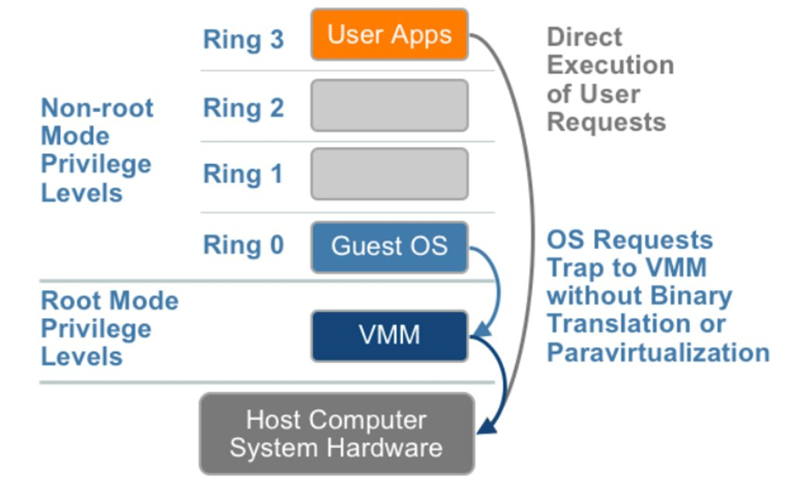
Hardware Assisted Virtualization
Image Source: https://thecustomizewindows.com/2014/09/hardware-assisted-virtualization/

Slide 26
Comparing Virtualization Techniques
Parameter​ | Full Virtualization​ | Para-virtualization​ | Hardware Assisted Virtualization​
Generation​ | 1st​ | 2nd​ | 3rd​
Performance​ | Good​ | Better in certain cases​ | Fair​
Used By​ | VMWare, Microsoft, KVM​ | VMWare, Xen​ | VMware, Xen, Microsoft​
Guest OS Modification​ | Not needed​ | Updated to issue hypercalls​ | Not needed​
Guest OS hypervisor independent?​ | Yes​ | XenLinux runs only on hypervisors​ | Yes​
Technique​ | Direct execution​ | Hypercalls​ | Exit to root mode on privileged instructions​
Compatibility​ | Excellent​ | Poor​ | Excellent​

Slide 27
Intel VT-x
Intel virtualization technology supports the followings:
CPU Virtualization
Enables abstraction of the CPU to a VM; supports live migration from one CPU to another, as well as nested virtualization
Memory Virtualization
Allows abstraction isolation and monitoring of memory on a per virtual machine (VM) basis
Allows live migration of VMs, fault tolerance
Supports feature like direct memory access (DMA) remapping and extended page tables

Slide 28
Intel VT-x
Intel virtualization technology supports the followings:
I/O Virtualization
Facilitate offloading of multi-core packet processing to network adapters as well as direct assignment of virtual machines to virtual functions, including disk I/O
Examples: Intel® Virtualization Technology for Directed I/O (VT-d), Virtual Machine Device Queues (VMDQ), Single Root I/O Virtualization (SR-IOV, a PCI-SIG standard), and Intel® Data Direct I/O Technology (Intel® DDIO) enhancements, etc.
Graphics Virtualization
Allows VMs to have full and/or shared assignment of the graphics processing units (GPU) and the video transcode accelerator engines integrated in Intel system-on-chip products.
Enables usages such as workstation remoting, desktop-as-a-service, media streaming, and online gaming.

Slide 29
Basic Concepts in Intel VT-x
Virtual Machine Monitor (VMM):
VMM acts as a host and has full control of the processor(s) and other platform hardware.
A VMM is able to retain selective control of processor resources, physical memory, interrupt management, and I/O.
Guest Software:
Each virtual machine (VM) is a guest software environment.

Slide 30
Basic Concepts in Intel VT-x
VMX Root/Non-root Operations:
VMM runs in VMX root operation (Similar to the traditional OS with no virtualization – CPU executes priviledged instructions from supervisor mode)
Guest software/OS runs in VMX non-root operation
VMX Transitions:
Transitions between VMX root operations and VMX non-root operations
VM Entries
Transition from VMX root operations to VMX non-root operations
VM Exits:
Transition from VMX non-root operation to VMX root operation

Slide 31
Basic Concepts in Intel VT-x
Virtual Machine Control Structure (VMCS):
A data structure in memory that exists exactly once per VM (or more precisely one per each VCPU -- Virtual CPU)
The VMM manages the VMCS for each VM.
With every change of the execution context between different VMs, VMCS is restored for the current VM
Defining the state of the VM’s virtual processor and VMM control Guest software using VMCS
Extended Page Table:
A mechanism that uses a second layer to convert the guest's physical address to the host's physical address

Slide 32
Virtual Machine Control Structure (VMCS)
Instead of fixing the x86 architecture to (optionally) make it Popek-Goldberg compliant and have all critical instructions trap if not run in Ring 0, Intel added the non-root mode in the VT-x architecture
Allows the system to switch the CPU state completely to that of the guest and switches back to the original host state on a certain event in the guest.
VMCS facilitates this switching in the CPU state from guest to host and vice versa
4 KB block in memory that holds the complete CPU state of both the host and the guest (segment registers, GDT and IDT pointers, certain MSRs etc.) as well as some control bits (for example, when to exit).

Slide 33
Virtual Machine Control Structure (VMCS)
VMCS consists of six logical groups:
Guest-state area: Processor state saved into the guest state area on VM exits and loaded on VM entries.
Host-state area: Processor state loaded from the host state area on VM exits.
VM-execution control fields: Fields controlling processor operation in VMX non-root operation.
VM-exit control fields: Fields that control VM exits.
VM-entry control fields: Fields that control VM entries.
VM-exit information fields: Read-only fields to receive information on VM exits describing the cause and the nature of the VM exit.

Slide 34
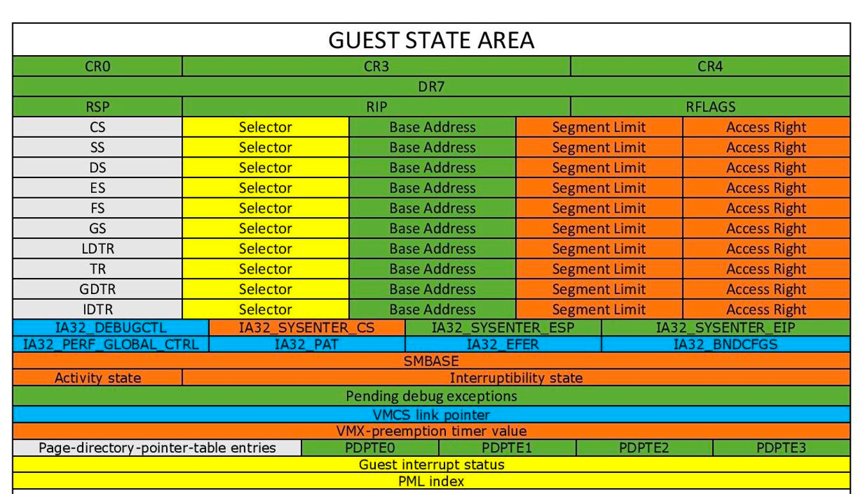
VMCS Layout – Guest State Area

Slide 35
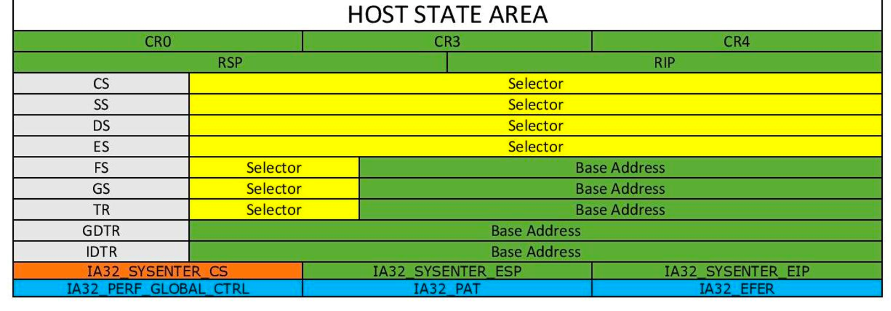
VMCS Layout – Host State Area

Slide 36
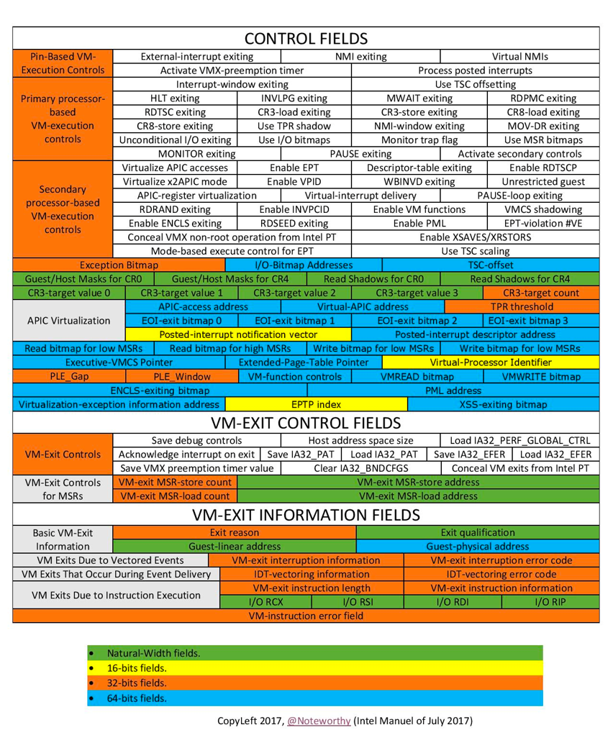
VMCS Layout

Slide 37
VMCS Operations
VM entries load processor state from the guest-state area.
A VMM can optionally configure VM entry to follow this loading by injecting an interrupt or exception.
The CPU effects this injection using the guest Interrupt Descriptor Table (IDT), just as if the injected event had occurred immediately after VM entry
This feature removes the need for a VMM to emulate delivery of these events

Slide 38
VMCS Operations
VM exits save processor state to the guest-state area and then load processor state from the host-state area
All VM exits use a common entry point to the VMM.
To simplify the design of a VMM, every VM exit saves into the VMCS detailed information specifying the reason for the exit
Many exits also record an exit qualification, which provides further details
Example: if the MOV CR instruction causes a VM exit, the exit reason would indicate “control-register access”; the exit qualification would indicate (1) the identity of the control register (for example, CR0); (2) whether the MOV was to or from the control register; and (3) which general-purpose register was the source or destination of the instruction.

Slide 39
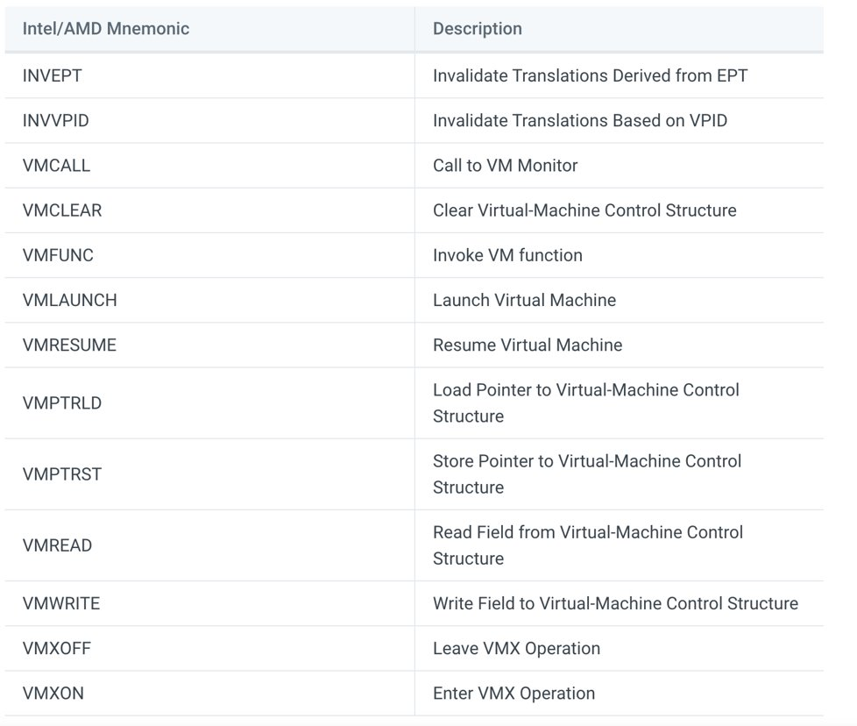
VMX Instructions

Slide 40
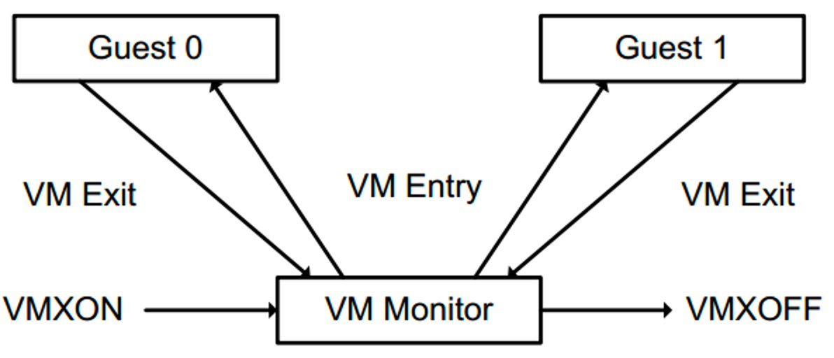
VMM Life Cycle

Slide 41
VMM Life Cycle
Software enters VMX operation by executing a VMXON instruction.
Using VM entries, a VMM can then turn guests into VMs (one at a time).
The VMM effects a VM entry using instructions VMLAUNCH and VMRESUME
It regains control using VM exits.
VM exits transfer control to an entry point specified by the VMM.
The VMM can act appropriately to the cause of the VM exit and can then return to the VM using a VM entry.
Eventually, the VMM may decide to shut itself down and leave VMX operation.
It does so by executing the VMXOFF instruction.

Slide 42
Memory Virtualization
Access to the MMU needs to be virtualized
Otherwise, the guest OS may directly access the physical memory
Physical memory is divided among multiple VMs
Two levels of translation required
Guest OS: Guest virtual address -> guest physical address
VMM: Guest physical address -> Machine address
Extended page tables (EPT) in VT-x or Nested page table in AMD-v facilitates this two-level translation

Slide 43
Two Level Paging
Process 1
Process 2
Process 1
Process 2
Guest Physical Memory
Guest Physical Memory
VM 1
Machine Memory

Slide 44
Shadow Page Table
Software-based mechanism to handle two-level paging at the VMM.
Shadow page tables provide a map between the guest OS's virtual memory pages and the underlying physical machine pages.
Deny the guest OS any access to the actual page table entries by trapping access attempts and emulating them in software
Guest page tables are read-only (maintained for each VM separately). When guest attempts to update, VMM intercepts (traps) and emulate the effects on the corresponding shadow page table
Avoids the mapping from guest virtual address to guest physical address

Slide 45
Second Level Address Translation (SLAT)
Also known as nested paging, a mechanism for hardware-assisted virtualization
Avoid the overhead associated with software-managed shadow page tables
AMD supports SLAT through Rapid Virtualization Indexing (RVI); Intel uses Extended Page Tables (EPT).
Treat each "guest physical address" as the "host virtual address"
The host page table can be viewed conceptually as nested within the guest page table
A hardware page table walker can treat the additional translation layer almost like adding levels to the page table.

Slide 46
Extended Page Tables (EPT)
Intel second-generation x86 virtualization technology for MMU
Supports in Intel's Core i3, Core i5, Core i7 and Core i9 CPUs
EPT translates addresses as follows:
One page table is maintained by the guest OS, which is used to generate the guest’s physical address
The other page table is maintained by VMM, which maps the guest’s physical address to the host’s physical address.
For each memory access operation, EPT MMU directly gets the guest’s physical address from the guest page table and then use it to get the host’s physical address from the VMM mapping table.

