Slide 1

CS 60038: Advances in Operating Systems Design
Extended Berkeley Packet Filter (eBPF)

Slide 2
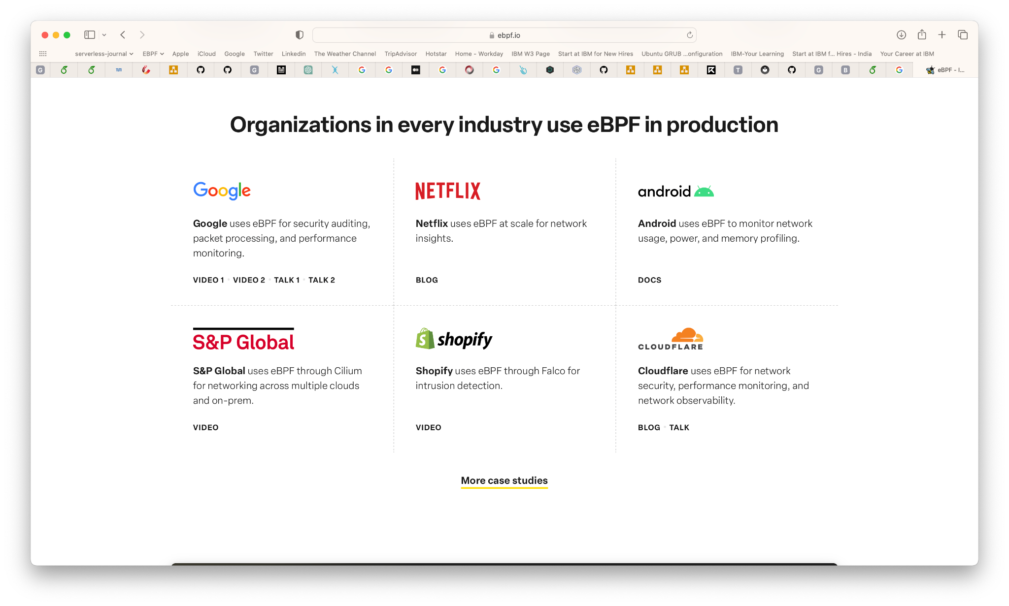
Introduction
Revolutionizes Production Process across Industries
GKE Dataplane V2, an opinionated dataplane, to make Linux kernel Kubernetes-aware
Android to monitor network usage, power, and memory profiling.
Cloudflare for Enhanced Network Security, Performance Monitoring, and Observability.
Netflix Unveils Flow Exporter
Apple for kernel security monitoring.
Facebook for Enforcing encryption at scale, for Traffic Optimization Systems for a Fast and Reliable User Access.

Slide 3
LKM vs eBPF
To overcome the limitation of user space code using system calls to access the kernel, Linux provides kernel modules (LKM) that can be loaded into the kernel at run time.
To provide sandboxing of these LKMs, Linux provided BPF (Berkeley Packet Filter), originally in BSD, as a way of running in kernel programs.
Examples of these include utilities such as tcpdump.
Originally, Berkeley Packet Filter (BPF) was designed for capturing and filtering network packets.
However, its scope has vastly expanded, and it now encompasses a wide range of use cases beyond networking.
eBPF provides a virtual machine-like environment within the Linux kernel, allowing users to write, compile, and run programs that can interact with various kernel subsystems.

Slide 4
eBPF Background
What ?
eBPF allows developers to safely inject code into a kernel sandbox, functioning as a privileged virtual machine within the kernel space.
Why ?
By leveraging eBPF, developers can enhance the functionalities of the OS without the need for modifying kernel code or loading a kernel module.
Also optimizes current kernel capabilities required for specific business use case.
How ?
The programs are event-driven, executing when the kernel or an application encounters a hook point. Numerous pre-defined hook points are available, including system calls, function entry/exit, kernel tracepoints, and network events.

Slide 5
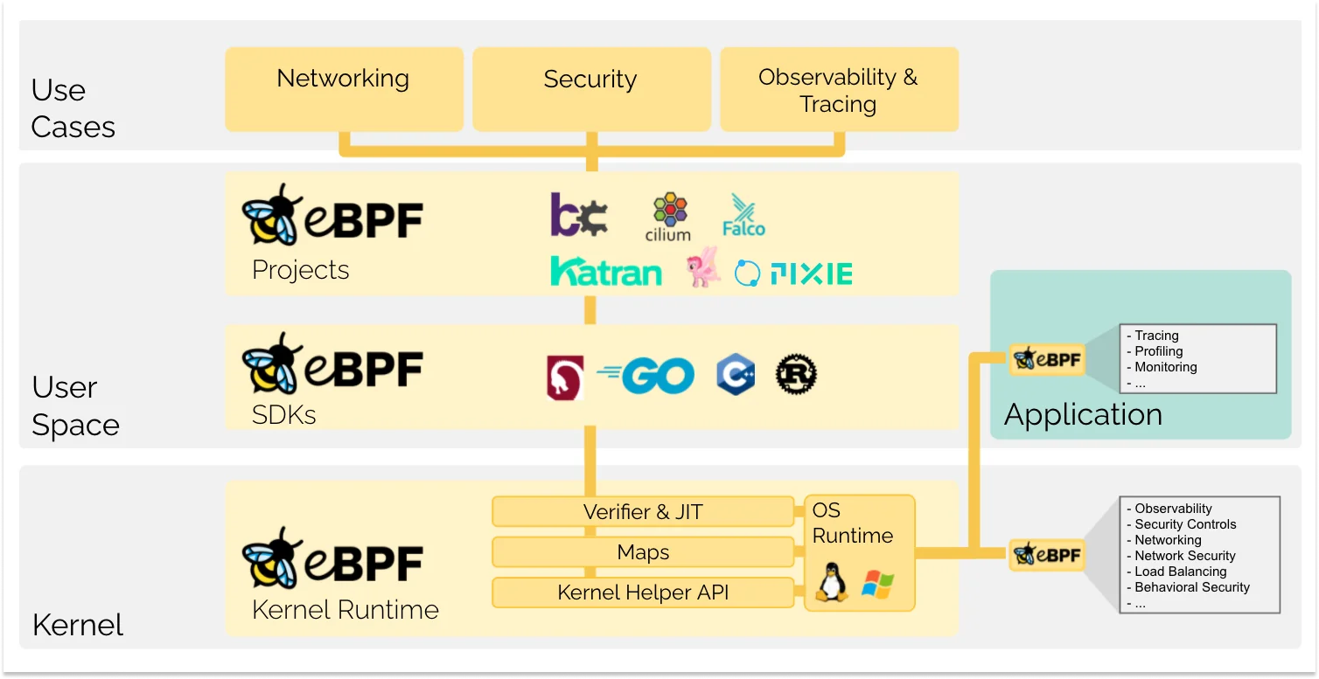
Usage of eBPF
To implement custom network functions such as load balancing, packet filtering, and routing, all within the kernel, providing high performance and flexibility.
Tp enforce security policies by monitoring system calls, network activity, and other kernel events, detecting and preventing unauthorized actions.
Enables system & application monitoring by attaching probes to various kernel subsystems, allowing developers and administrators to gain deep insights into the performance and behaviour of their systems.
Help identify performance bottlenecks and optimize system behaviour by modifying kernel data structures and functions on-the-fly.

Slide 6
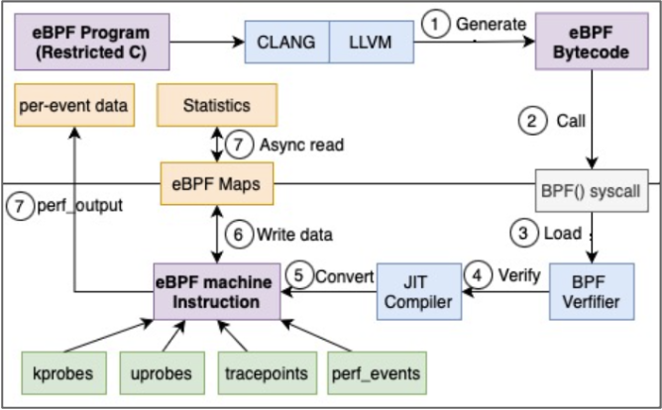
How eBPF Works
Writing eBPF Programs:
Users write eBPF programs using a restricted C-like language.
These programs are event-driven and are triggered by specific events such as system calls, network packets, or tracepoints.
eBPF programs can be written using the LLVM (Low-Level Virtual Machine) compiler collection with the BPF backend, which supports the eBPF instruction set.
Compiling and Loading:
Once written, the eBPF program is compiled into bytecode, which can be loaded into the kernel using the bpf() system call.
This bytecode is platform-independent and can be executed on any Linux system with eBPF support.

Slide 7
How eBPF Works
Verification:
To ensure safety, the kernel verifies the loaded bytecode using a verifier component.
The verifier checks for several conditions, such as illegal memory access, infinite loops, and proper resource usage, preventing potentially harmful or poorly written programs from running.
Just-In-Time (JIT) Compilation:
After verification, the bytecode is translated into native machine code for the target platform using a Just-In-Time (JIT) compiler.
This step significantly improves performance by avoiding interpretation overhead during execution.

Slide 8
How eBPF Works
Execution:
The eBPF program is executed by the in-kernel eBPF virtual machine in response to specific events.
The eBPF VM ensures isolation and safety while providing kernel data structures and functions access.
Interaction with User-space:
eBPF programs can communicate with user-space applications using eBPF maps, key-value data structures shared between the kernel and User-space.
This allows for efficient and flexible data exchange between the two domains.

Slide 9
eBPF Components
Programs are written in restricted C. eBPF backend for LLVM/Clang
sudo clang -g -O2 -emit-llvm -c testProg.bpf.c -o - | llc -march=bpf -filetype=obj -o testProg.o
eBPF Verifier
Verified to finish (no loops), no unreachable instructions, reads to uninitialized registers, or memory access to arbitrary pointers restricted kernel function calls and data structure access
eBPF Maps / Perf Event Ring Buffer
Memory Mapped, bi-directional data structures for storage.
Allow sharing of data between eBPF Kernel programs and also between kernel and use-space program
Helper Functions
Kernel functions exposed to eBPF Programs

Slide 10
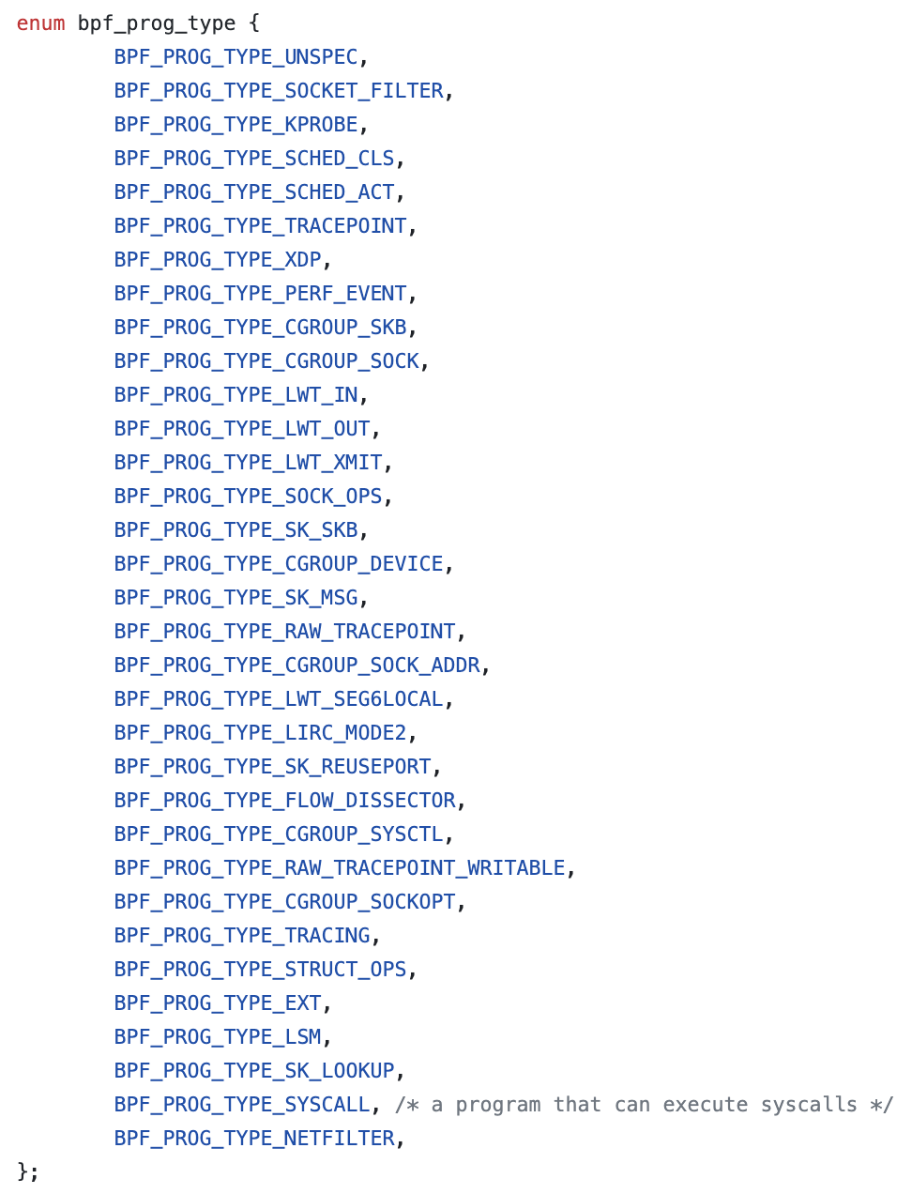
eBPF Program Types
An eBPF program can be attached at multiple different places within the kernel
For performance engineering, the hooks are
Kprobes/Uprobes
Tracepoints
USDT
PerfEvents
https://github.com/torvalds/linux/blob/master/include/uapi/linux/bpf.h

Slide 11
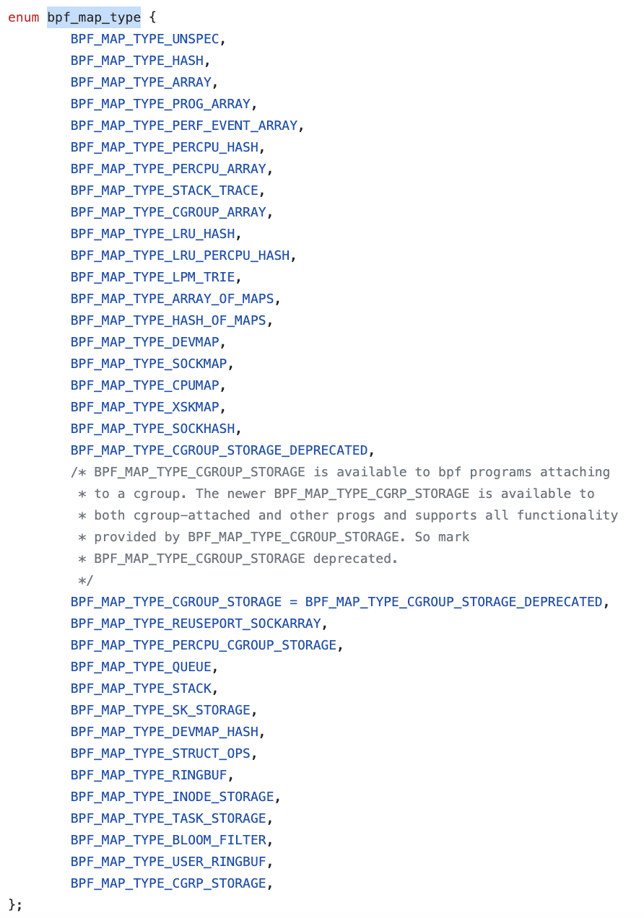
eBPF Maps
https://github.com/iovisor/bcc/blob/master/docs/reference_guide.md#maps
https://github.com/torvalds/linux/blob/master/include/uapi/linux/bpf.h

Slide 12
eBPF Maps
BPF_MAP_CREATE
Create a map with the desired type
and attributes in attr:
int fd;
union bpf_attr attr = {
.map_type = BPF_MAP_TYPE_ARRAY; /* mandatory */
.key_size = sizeof(__u32); /* mandatory */
.value_size = sizeof(__u32); /* mandatory */
.max_entries = 256; /* mandatory */
.map_flags = BPF_F_MMAPABLE;
.map_name = "example_array"; };
fd = bpf(BPF_MAP_CREATE, &attr, sizeof(attr));
BPF_MAP_LOOKUP_ELEM
Lookup key in a given map using
attr->map_fd, attr->key,
attr->value.
Returns zero and stores found element into attr->value on success, or negative error on failure.
int *val= bpf_map_lookup_elem(& example_array, &value);
BPF_MAP_UPDATE_ELEM
BPF_MAP_DELETE_ELEM
https://github.com/torvalds/linux/blob/master/include/uapi/linux/bpf.h

Slide 13
eBPF Development Tools
eBPF uses the BPF Compiler Collection (BCC), a toolkit to create efficient and simple kernel tracing programs.
A range of useful examples is provided with the BCC, which requires Linux 4.1 or above. BCC provides a C wrapper around LLVM and provides Python and Lua based front ends.

Slide 14

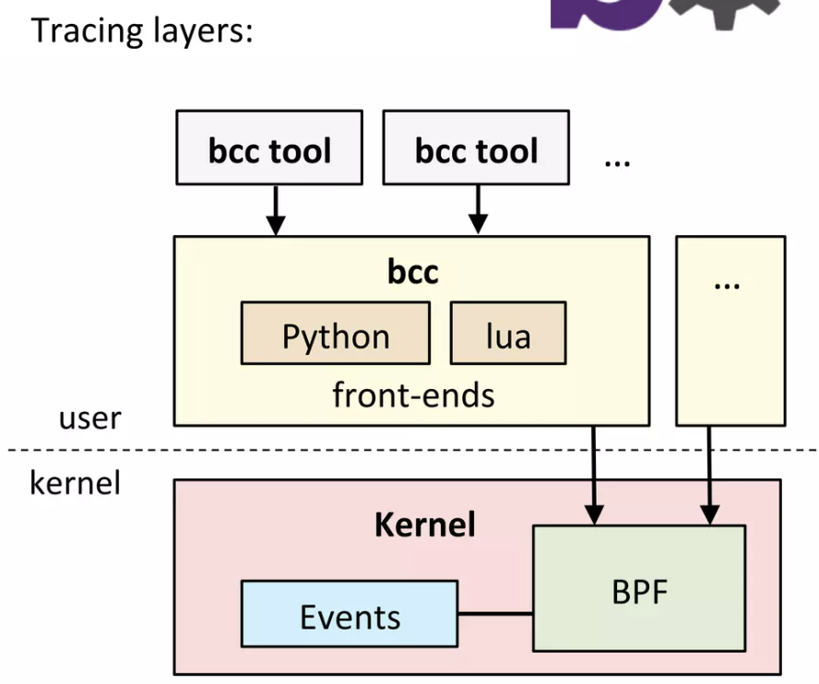
bcc tools
BPF Compiler Collection
https://github.com/iovisor/bcc
Lead Developer: Brenden Blanco
It includes tracing tools
Provide BPF Front-ends:
Python
Lua
C++
C helper libraries
Golang (gobpf)

Slide 15
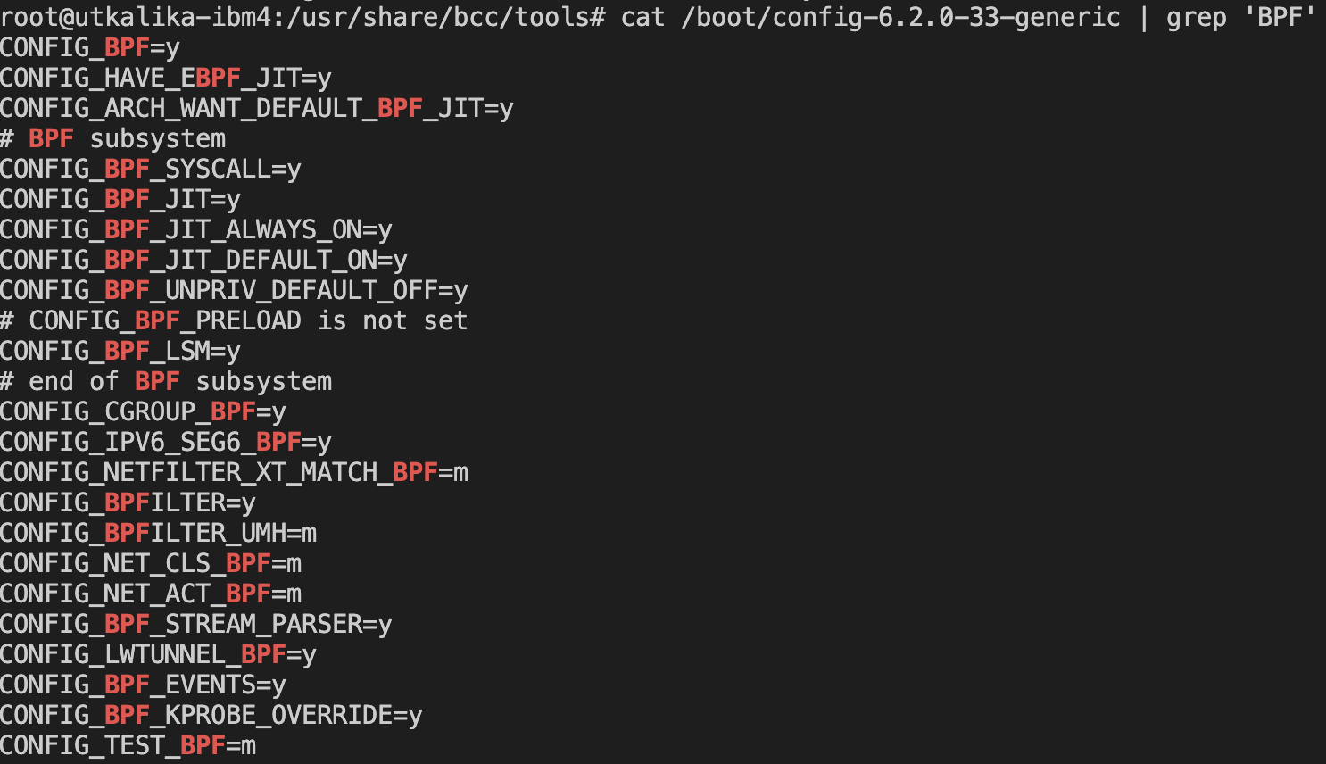
bcc tool Installation
Go to: https://github.com/iovisor/bcc/blob/master/INSTALL.md
Kernel Configuration:
In general, to use these features, a Linux kernel version 4.1 or newer is required.
In addition, the kernel should have been compiled with the following flags set
cat /boot/config-’uname -r’ | grep 'BPF'
cat /boot/config-6.2.0-33-generic | grep 'BPF'
Install bcc from package or from the source
Tools will be installed under /usr/share/bcc/tools.

Slide 16
bcc/Python (C & Python)
#!/usr/bin/python
#
# This is a Hello World example that formats output as fields.
from bcc import BPF
from bcc.utils import printb
# define BPF program
prog = """
int hello(void *ctx) {
bpf_trace_printk("Hello, World!\\n");
return 0;
}
"""
# load BPF program
b = BPF(text=prog)
b.attach_kprobe(event=b.get_syscall_fnname("clone"), fn_name="hello")
# header
print("%-18s %-16s %-6s %s" % ("TIME(s)", "COMM", "PID", "MESSAGE"))
# format output
while 1:
try:
(task, pid, cpu, flags, ts, msg) = b.trace_fields()
except ValueError:
continue
except KeyboardInterrupt:
exit()
printb(b"%-18.9f %-16s %-6d %s" % (ts, task, pid, msg))
Full Code: https://github.com/iovisor/bcc/tree/master/examples/tracing/hello_fields.py

Slide 17
eBPF Programs - BPF CO-RE vs libbpf-bootstrap
Writing bpf program in C
These small programs are portable and also know as BPF CO-RE.
Compile Once Run Everywhere
Libbpf is a user-space library / API for loading and interacting with bpf programs.
Libbpf handles the execution and is delivered a header files, which contain C function declarations and more.

Slide 18
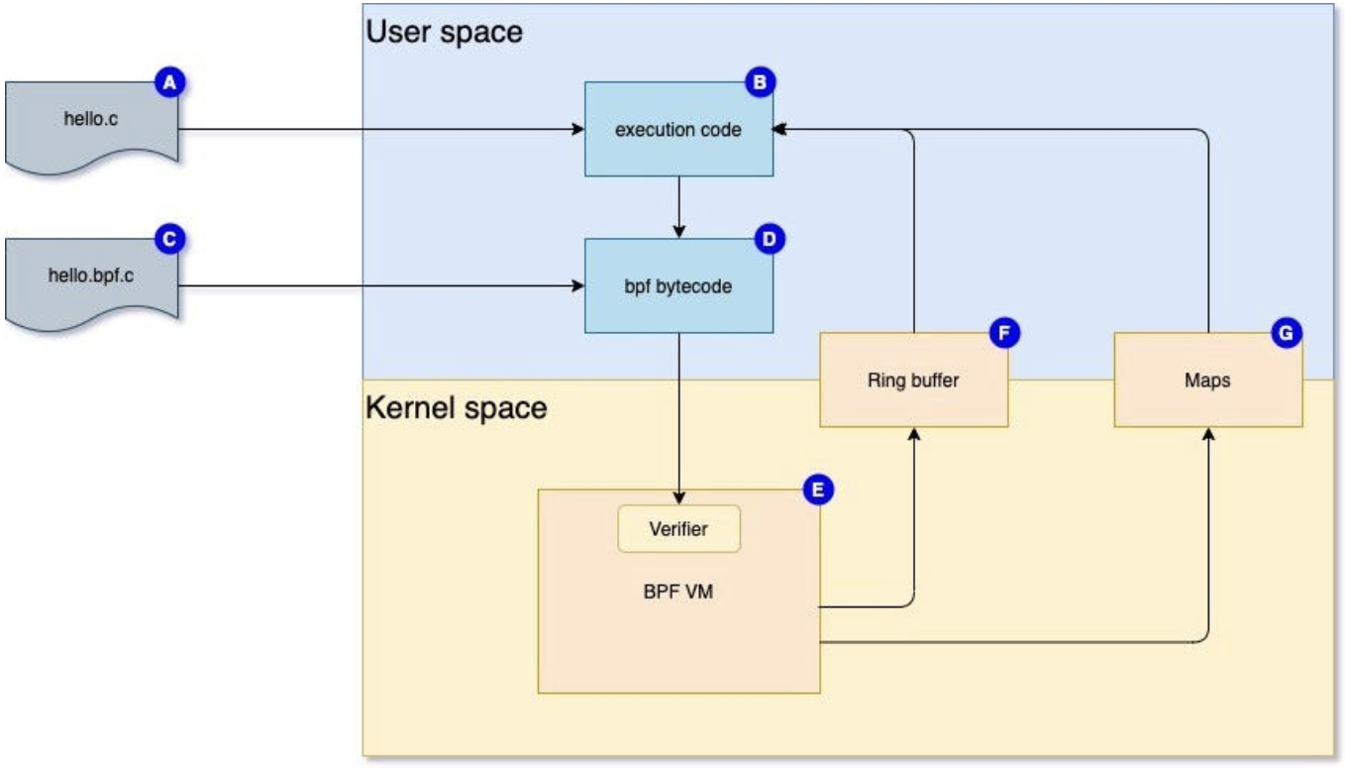
eBPF Programs - BPF CORE vs libbpf-bootstrap
Most minimal programs require at least two pieces of code (A & C), which are actually the code for execution (B) and the actual bpf program to execute as bytecode (D) in the BPF VM (E), which is actually an in-kernel VM.
Before execution there is always a validation done by the verifier.
When the actual bpf program is executed it will use the ring buffer (F) to prepare and send data to the execution code.

Slide 19
eBPF Programs - BPF CORE vs libbpf-bootstrap
Maps (G) are the actual storage containers that deliver abstracted data containers
Support multiple data types and share data with the user space executed program.
The ring buffer uses the maps to store the prepared data.

Slide 20
Installation – Pre-requisites
Linux Operating system with the latest kernel (uname -r).
Ensure that the Linux kernel headers are installed and available.
Ensure that you have the latest version of Clang/LLVM installed. Clang will be used by our Makefile to compile the actual C program.
For compiling everything you must have the libbpf sources available at libbpf-bootstrap/libbpf. Or just customize the Makefile for this.

Slide 21
eBPF CO-RE Application – maps.bpf.c
#include "vmlinux.h"
#include <bpf_helpers.h>
#include "maps.h"
struct {
__uint(type, BPF_MAP_TYPE_HASH);
__uint(max_entries, 128);
__type(key, pid_t);
__type(value, struct event);
} execs SEC(".maps");
SEC("tracepoint/syscalls/sys_enter_execve")
int tracepoint__syscalls__sys_enter_execve(struct trace_event_raw_sys_enter *ctx){
struct event *event;
pid_t pid;
u64 id;
uid_t uid = (u32) bpf_get_current_uid_gid(); id = bpf_get_current_pid_tgid();
pid = (pid_t)id;
if (bpf_map_update_elem(&execs, &pid, &((struct event){}), 1)) {
return 0;
} event = bpf_map_lookup_elem(&execs, &pid);
if (!event) {
return 0;
} event->pid = pid;
event->uid = uid;
bpf_get_current_comm(&event->comm,
sizeof(event->comm)); return 0;
}
char LICENSE[] SEC("license") = "GPL";
Check /sys/kernel/debug/tracing/events

Slide 22
eBPF CO-RE Application – maps.c Snippet (loading)
. . .
int main(int argc, char **argv) {
struct maps_bpf *obj;
int err = 0;
struct rlimit rlim = {
.rlim_cur = 512UL << 20,
.rlim_max = 512UL << 20,
};
const struct argp argp = {
.options = opts,
.parser = parse_arg,
.doc = argp_program_doc,
};
int fd;
err = setrlimit(RLIMIT_MEMLOCK, &rlim);
if (err) {
fprintf(stderr, "failed to change rlimit\n");
return 1;
}

Slide 23
eBPF CO-RE Application – maps.c Snippet (loading)
. . .
obj = maps_bpf__open();
if (!obj) {
fprintf(stderr, "failed to open and/or load BPF object\n");
return 1;
}
err = maps_bpf__load(obj);
if (err) {
fprintf(stderr, "failed to load BPF object %d\n", err);
goto cleanup;
}
err = maps_bpf__attach(obj);
if (err) {
fprintf(stderr, "failed to attach BPF programs\n");
goto cleanup;
}
fd = bpf_map__fd(obj->maps.execs);
printf("printing executed commands\n");
while (1) {
print_execs(fd);
fd = bpf_map__fd(obj->maps.execs);
}
. . .
Refer for Full Code https://github.com/sartura/ebpf-hello-world/

Slide 24
Compilation
We will need a static version of libbpf:
$ git clone https://github.com/libbpf/libbpf && cd libbpf/src/
$ make BUILD_STATIC_ONLY=1 OBJDIR=../build/libbpf DESTDIR=../build INCLUDEDIR=
LIBDIR= UAPIDIR= install
To build steps is provided here:
$ bpftool btf dump file /sys/kernel/btf/vmlinux format c > vmlinux.h
$ clang -g -O2 -target bpf -D__TARGET_ARCH_x86_64 -I . -c maps.bpf.c -o maps.bpf.o
$ bpftool gen skeleton maps.bpf.o > maps.skel.h
$ clang -g -O2 -Wall -I . -c maps.c -o maps.o
$ clang -Wall -O2 -g maps.o libbpf/build/libbpf.a -lelf -lz -o hello
$ sudo ./maps

Slide 25
Further Readings
https://arnold-van-wijnbergen.medium.com/introduction-b914e6e976f3 - libbpf code
https://arthurchiao.art/blog/firewalling-with-bpf-xdp/
https://www.slideshare.net/brendangregg/velocity-2017-performance-analysis-superpowers-with-linux-ebpf
https://www.slideshare.net/RayJenkins1/understanding-ebpf-in-a-hurry-149197981
https://www.vamsitalkstech.com/cloud/an-introduction-to-ebpf-architecture-part-2/
https://github.com/gojue/ebpf-slide
https://unzip.dev/0x00c-ebpf/
https://www.sartura.hr/blog/simple-ebpf-core-application/

