Slide 1
Object-Oriented Systems CS60059
Dr. RAJIB MALL
Professor
Department Of Computer Science & Engineering
IIT Kharagpur.

Slide 2


About The Instructor
RAJIB MALL
B.E. , M.E., Ph.D from Indian Institute of Science, Bangalore
Worked with Motorola (India)
Senior engineer and later as project manager
Shifted to IIT, Kharagpur in 1994
Currently Professor

Slide 3


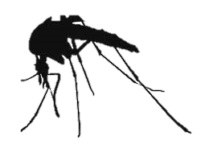

Motivation for Crediting this Course
You have got a sophisticated gun
You are the proud owner of the nice gun!
Wanted to use it…
Opportunity came …
You claimed you make good use of your gun!

Slide 4
Motivation cont…
You learnt Java, C++, …
You know the syntax and semantics well.
You have written small programs that work.
You claimed you are an expert object-oriented software developer!!
This syndrome is not restricted to students alone…

Slide 5
Plan of The Course
Basic concepts
UML
Designing using UML
Testing OO programs
Object-oriented principles
Patterns
≈ 35%
?
≈ 5%
≈ 60%

Slide 6
Grading
Class Test 1 --- End Aug 10%
Mid Sem --- End Sep 25%
Class Test 2 --- End Oct 10%
End Sem --- End Nov 50%
Class attendance + Participation -- 5%
Bonus (Extra Marks) --- ???

Slide 7
Introduction
Object-oriented design (OOD) techniques are now extremely popular:
Inception in early 1980’s and nearing maturity.
Widespread acceptance in industry and academics.
Unified Modelling Language (UML) became an ISO standard (ISO/IEC 19501) in 2004.

Slide 8




Schematic Object-Oriented Solution for LIS
reference-books
members
issue-books
controller

Slide 9
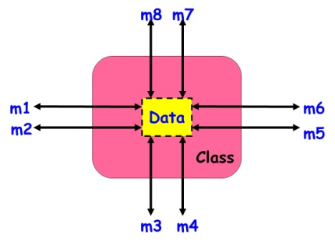
Object-Oriented Development
A system is designed as a set of interacting objects.
Objects are often real-world entities:
Examples: an employee, a book etc.
Can also be conceptual objects :
Controller, manager, etc.
An object consists of data (attributes) and functions (methods) that operate on data.
Encapsulation.

Slide 10
Class Diagram

Slide 11


Class
Template for object creation:
Instantiated into objects
Examples: Employee, Book, etc.
Sometimes not intended to produce instances:
Abstract classes

Slide 12
UML Class Representation
A class represents a set of objects having similar attributes, operations, relationships and behavior.
Class Name
Can it have any attributes not explicitly declared here?
Window
size: Size visibility: boolean
Attributes
Yes. A class implicitly has a few association attributes…
display() hide()
Operations

Slide 13
Alternate Representations of a Class in UML
LibraryMember
LibraryMember
LibraryMember
Member Name
Membership Number
Address
Phone Number
E-Mail Address
Membership Admission Date
Membership Expiry Date
Books Issued
issueBook( );
findPendingBooks( );
findOverdueBooks( );
returnBook( );
findMembershipDetails( );
Why?
Attributes
issueBook( );
findPendingBooks( );
findOverdueBooks( );
returnBook( );
findMembershipDetails( );
Methods

Slide 14
Class Attribute Examples
Java Syntax | UML Syntax
Date birthday | birthday:Date
Public int duration=100 | +duration:int = 100
Private Student students[0..MAX_Size] | -students[0..MAX_Size]:Student

Slide 15
Visibility of Class of Members
Visibilty | Java Syntax | UML Syntax
public | public | +
protected | protected | #
package |  | ~
private | private | -
?

Slide 16
Methods
Methods are the operations supported by an object:
Means for manipulating the data of an object.
Invoked by sending a message (method call).
Examples: display(), calculate_salary(), issue-book(), getMemberDetails(), etc.
Window
size: Size visibility: boolean
display() hide()

Slide 17
Method Examples
Java Syntax | UML Syntax?
void move(int dx, int dy) | ~move(int dx,int dy)
public int getSize() | +int getSize()

Slide 18
Are Methods and Messages Synonyms?
No
Message was the original concept in object-orientation…
Methods are the later simplifications…
Sometimes used as synonyms

Slide 19
Are Methods and Operations Synonyms?
No
An operation can be implemented by multiple methods.
Known as polymorphism
In the absence of polymorphism-–the two terms are synonyms.

Slide 20
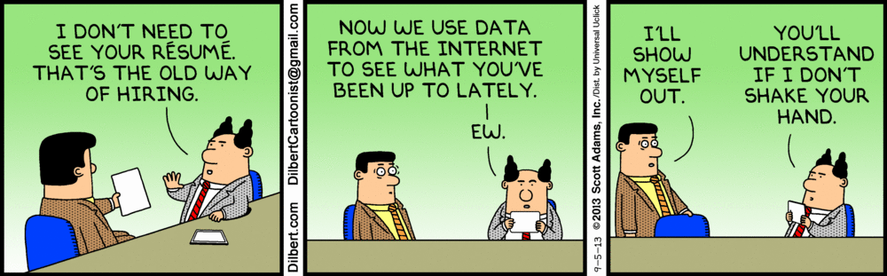

Slide 21
What Are the Different Types of Relationships That May Exist Among the Classes in an OO Program?
Four types of class relationships:
Inheritance
Association
Aggregation/Composition
Dependency

Slide 22
Inheritance
Allows us to define a new class (derived class) by extending an existing class (base class).
Represents generalization -specialization relationship.
Allows redefinition of the existing methods (method overriding).
LibraryMember
Base Class
Faculty
Students
Staff
Derived
Classes
UnderGrad
PostGrad
Research

Slide 23
Inheritance Example
Animal
“A Dog ISA Animal”
Dog

Slide 24
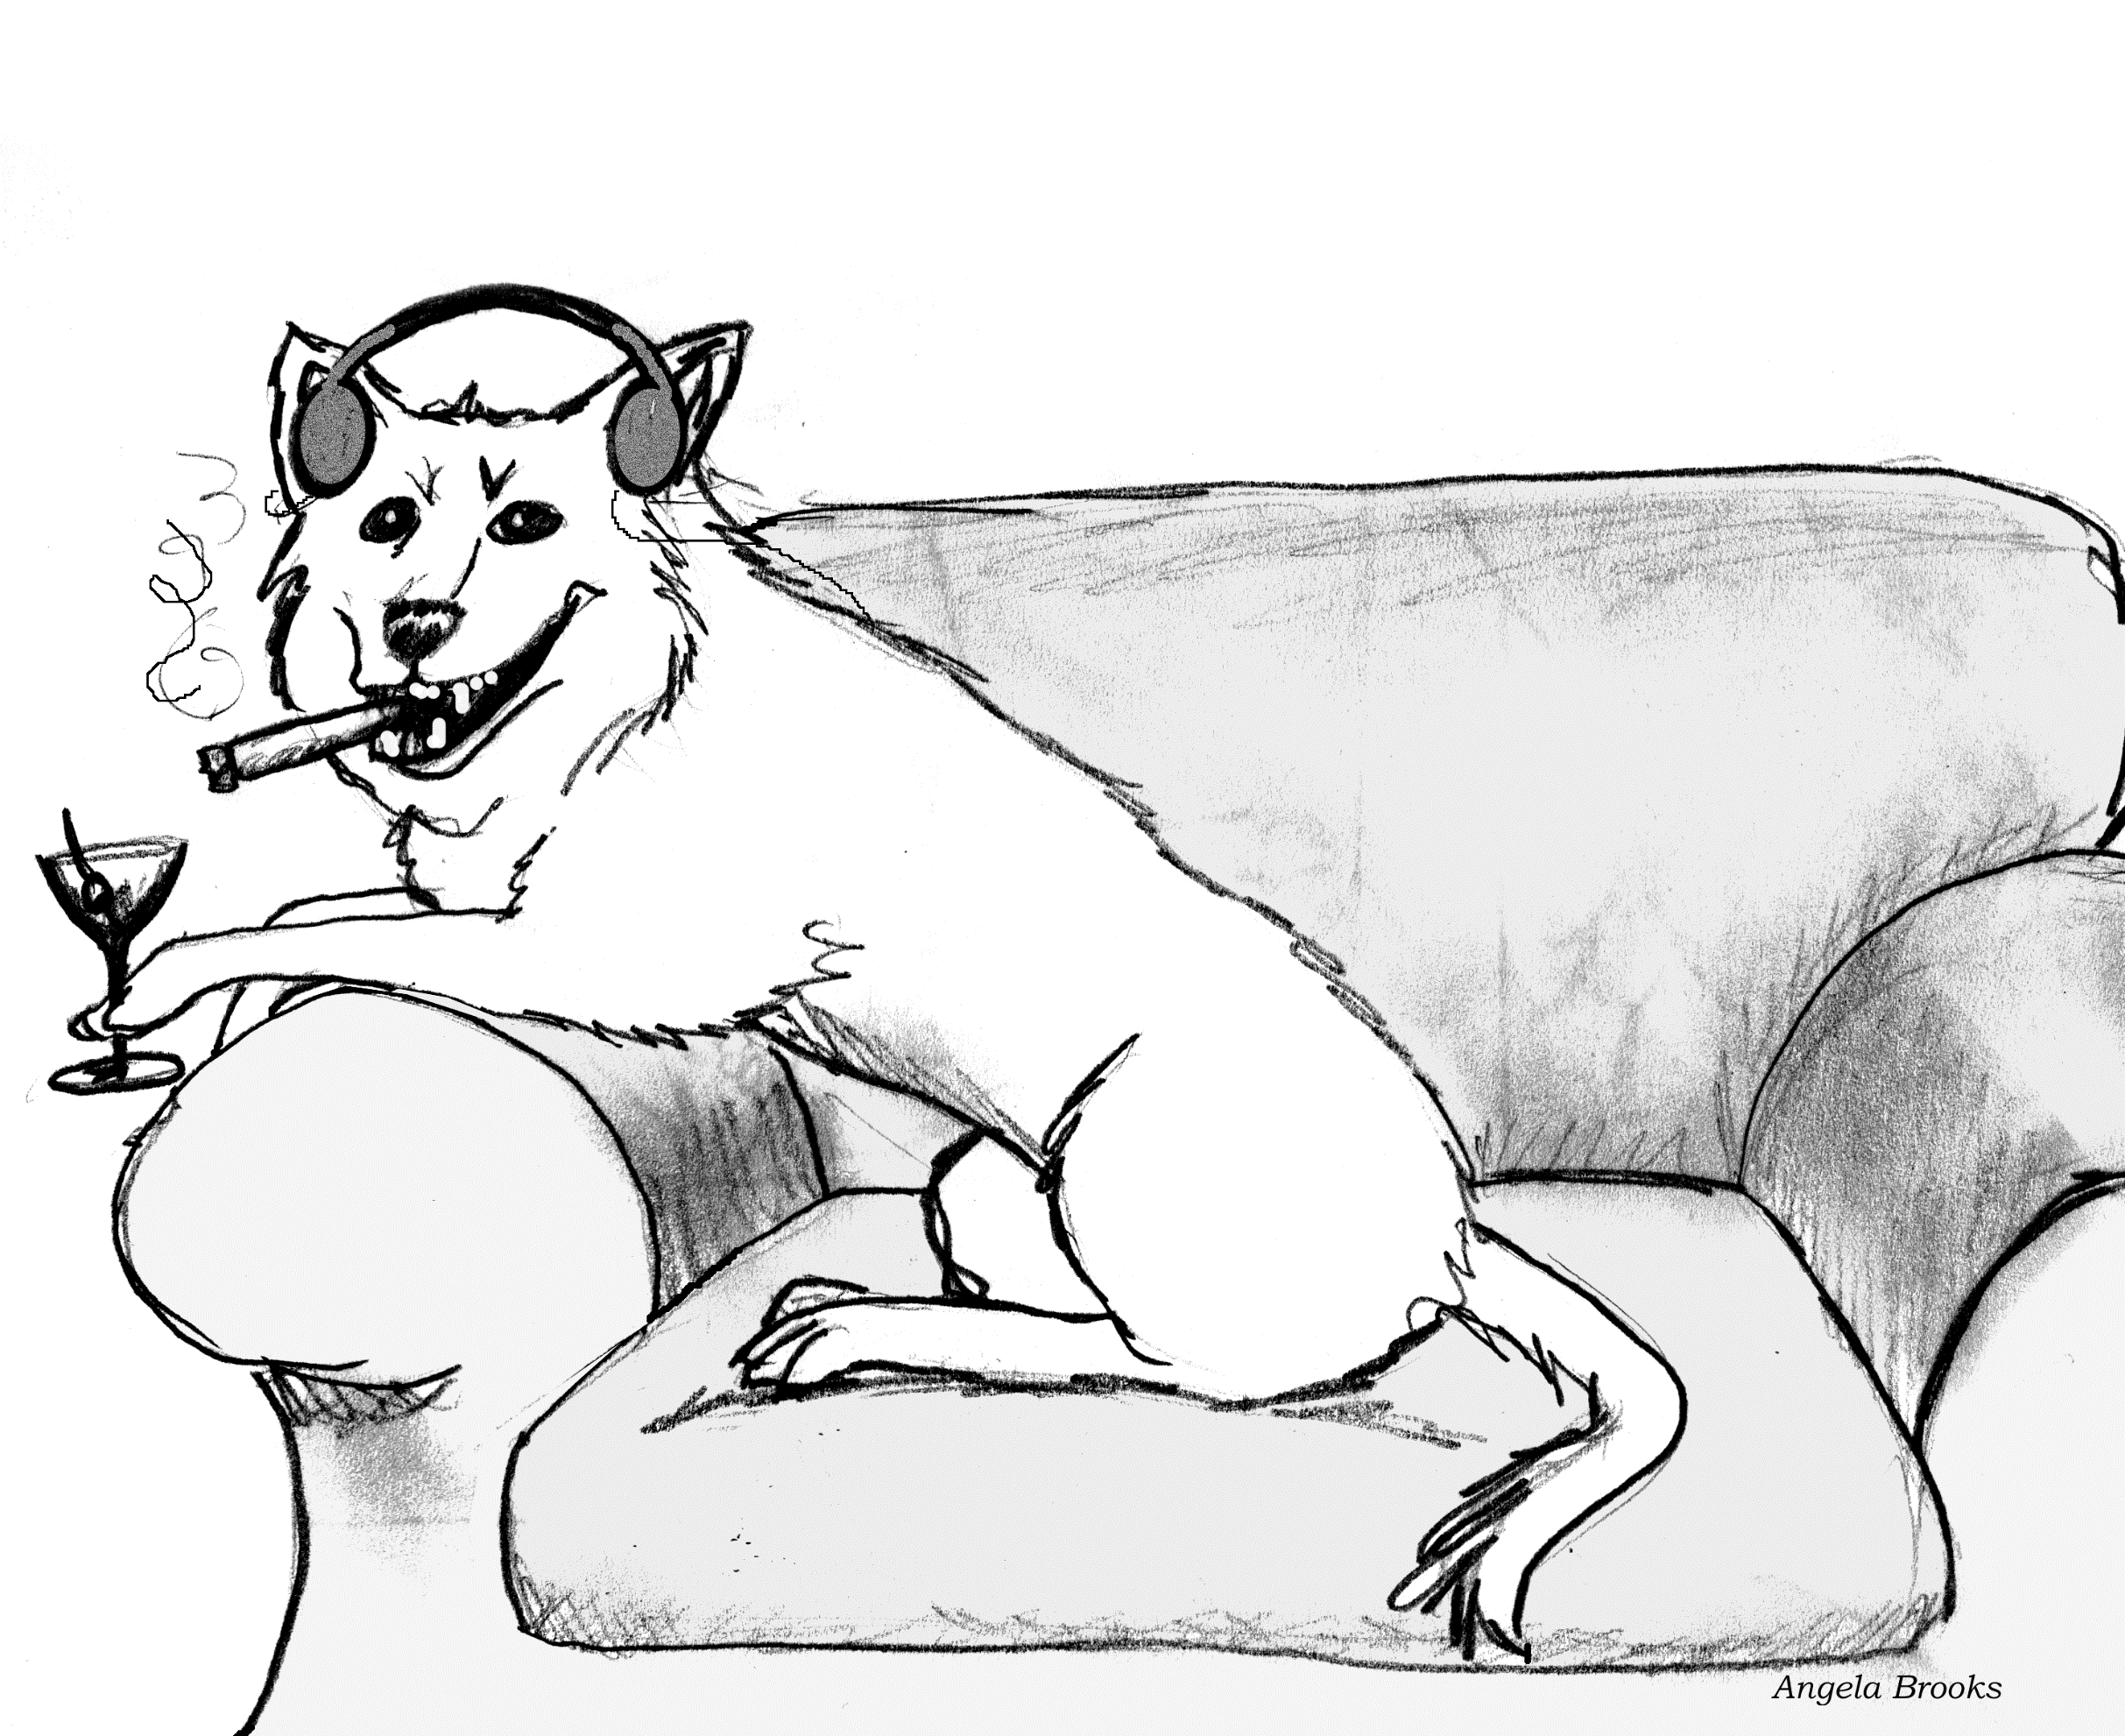
Hmmm… not really…

Slide 25
Inheritance: One More Example
Library Member
“A Student ISA Library Member”
“A Faculty ISA Library Member”
Student
Faculty

Slide 26
Inheritance: Semantics
Lets a subclass inherit attributes and methods of a base class.
LibraryMember
Base Class
Faculty
Students
Staff
Derived
Classes
UnderGrad
PostGrad
Research

Slide 27
Inheritance: An Alternate Representation
LibraryMember
Base Class
Faculty
Students
Staff
Derived
Classes
UnderGrad
PostGrad
Research

Slide 28
Inheritance Example
Library
Book
issuable
reference
Issuable
Single Volume
Book
Issuable
BookSet
Reference
Single Volume
Book
Reference
BookSet
Discriminator: allows to group subclasses into
clusters that correspond to a semantic category.

Slide 29
Multiple Inheritance
LibraryMember
Base Class
LibraryMember
Base Class
Faculty
Students
Staff
Derived
Classes
Faculty
Students
Staff
Multiple
Inheritance
UnderGrad
PostGrad
Research
UnderGrad
PostGrad
Research

Slide 30
Multiple Inheritance: Can Cause Repeated Inheritance…
LibraryMember
Base Class
May lead to inconsistency
In C++ handled by using virtual base class
In Java handled by using Interface class
Faculty
Students
Staff
Multiple
Inheritance
UnderGrad
PostGrad
Research

