Slide 1
Class Diagram Design and Code Generation
Lect 2—3
8-8-2023

Slide 2
What Are the Different Types of Relationships That May Exist Among the Classes in an OO Program?
Four types of class relationships:
Inheritance
Association
Aggregation/Composition
Dependency

Slide 3
Inheritance
Allows us to define a new class (derived class) by extending an existing class (base class).
Represents generalization -specialization relationship.
Allows redefinition of the existing methods (method overriding).
LibraryMember
Base Class
Faculty
Students
Staff
Derived
Classes
UnderGrad
PostGrad
Research

Slide 4
Inheritance Example
Animal
“A Dog ISA Animal”
Dog

Slide 5
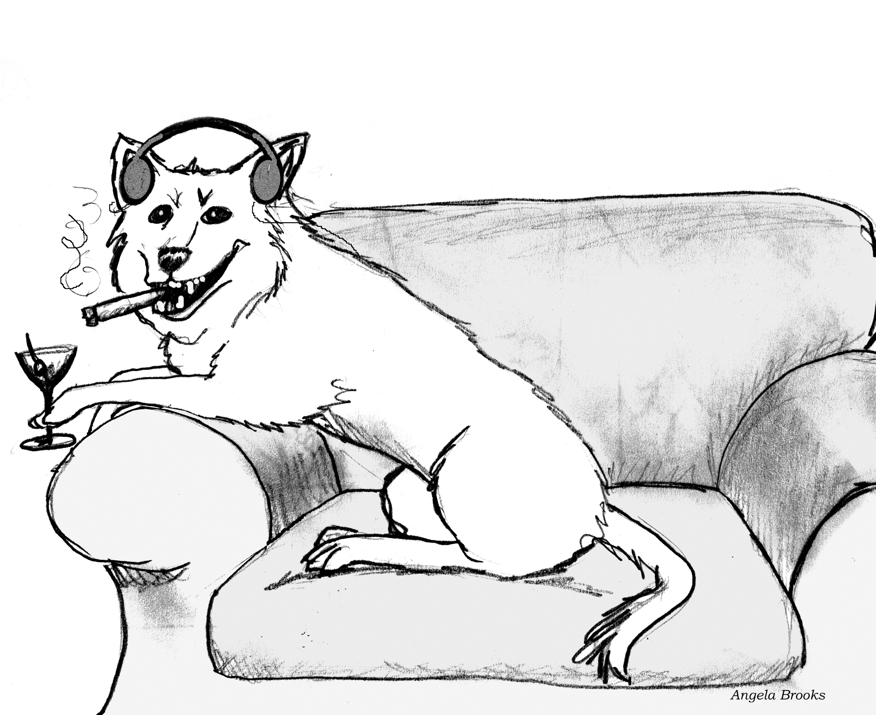
Hmmm… not really…

Slide 6
Inheritance: One More Example
Library Member
“A Student ISA Library Member”
“A Faculty ISA Library Member”
Student
Faculty

Slide 7
Inheritance: Semantics
Lets a subclass inherit attributes and methods of a base class.
LibraryMember
Base Class
Faculty
Students
Staff
Derived
Classes
UnderGrad
PostGrad
Research

Slide 8
Inheritance: An Alternate Representation
LibraryMember
Base Class
Faculty
Students
Staff
Derived
Classes
UnderGrad
PostGrad
Research

Slide 9
Inheritance Example
Library
Book
issuable
reference
Issuable
Single Volume
Book
Issuable
BookSet
Reference
Single Volume
Book
Reference
BookSet
Discriminator: allows to group subclasses into
clusters that correspond to a semantic category.

Slide 10
Multiple Inheritance
LibraryMember
Base Class
LibraryMember
Base Class
Faculty
Students
Staff
Derived
Classes
Faculty
Students
Staff
Multiple
Inheritance
UnderGrad
PostGrad
Research
UnderGrad
PostGrad
Research

Slide 11
Multiple Inheritance: Can Cause Repeated Inheritance…
LibraryMember
Base Class
May lead to inconsistency--- very difficult bugs
In C++ handled by using virtual base class
In Java handled by using Interface class
Faculty
Students
Staff
Multiple
Inheritance
UnderGrad
PostGrad
Research

Slide 12
Inheritance Implementation in Java
Inheritance is declared using the "extends" keyword
Even when no inheritance is defined, in Java a class implicitly extends a class called Object.
class Person{
private String name;
private Date dob;
...
}
Person
- name: String
- dob: Date
class Employee extends Person{
private int employeeID;
private int salary;
private Date startDate;
...
}
Employee
- employeeID: int
- salary: int
- startDate: Date
Object Reference
Employee anEmployee = new Employee();

Slide 13
Objects myRectangle and myBox
Rectangle
Rectangle myRectangle = new Rectangle(5, 3);
Box myBox = new Box(6, 5, 4);
Box
length
6.0
length
5.0
myRectangle
myBox
width
3.0
width
5.0
height
4.0
Object Reference

Slide 14
More Generalization Examples…
Mammal
Quadruped
Feline
Lizard
Tiger
Lion
Puma

Slide 15
Poor Generalization
(violates “is a” or “is a kind of” heuristic)
Person
attributes
operations
Arm
Leg
Head
attributes
attributes
attributes
operations
operations
operations
Notice Any problems?

Slide 16
Generalization - Multiple Classification
Discriminator
Doctor
Female
#3
role
Nurse
<<abstract>>
Person
Male
Gender
#1
patient
#2
Physical-
therapist
Is it good?
Patient
Ans: Poor Model
#2

Slide 17
Inheritance Pitfalls
Inheritance certainly promotes reuse…
Indiscriminate use can result in poor quality programs.
Base class attributes and methods visible in derived class…
Leads to tight coupling and break of encapsulation
LibraryMember
Faculty
Students
Staff
UnderGrad
PostGrad
Research

Slide 18
Association Relationship
Enables two objects to communicate with each other…
How implemented in a program?
One object must “know” the object reference (ID) of the corresponding object in an association.
Usually binary:
But in general can be n-ary.
Teacher
teaches
Course
credits
Student

Slide 19

Association – Example
In a home TV system,
A TV object has an association with a Laptop object
It may receive signals from the Laptop
TV may be associated with remote
TV may receive a signal (command)
Laptop
1
1
TV
Connected to
1
Remote
commands
1

Slide 20
1-1 Association – Example
has
Rakesh Shukla
760901-1234
has
V. Ramesh
691205-5678
Keshab Parhi
Person
Tax_files
Person
1
1
Tax_files
has

Slide 21
Association-end Multiplicity – Example
motherOf
Ambalika
Bhim
motherOf
Kunti
Yudhistir
motherOf
Ambika
Arjun
Women
People
Woman
1
*
People
Mother of

Slide 22
Association: UML Syntax
Class A
role B
Class B
role A
A Person works for a Company.
Role
Person
Company
employee
employer
works for
Association Name

Slide 23
Roles in Association
Role names??
Laptop
1
Source
Display
1
TV
Connected to
Slave
Master
1
Remote
commands
1

Slide 24
Association -- More Examples
Multiplicity: The number of objects from one class that relate with a single object in an associated class.
Library Member
_{0..5}
Book
1
borrowed by
Lion
*
eats
Human
*

Slide 25
Navigability
Key
Door
*
opens
0..5

Slide 26
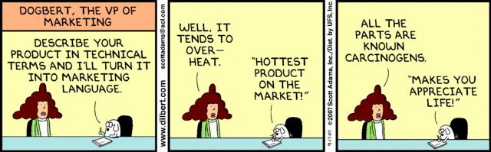

Slide 27
Association – Multiplicity: Exercise
A teacher teaches 1 to 3 courses (subjects)
Each course is taught by only one teacher.
A student can take between 1 to 5 courses.
A course can have 10 to 300 students.
Teacher
1
teaches
1..3
Course
1..5
takes
Student
10..300
Notes:
1.

Slide 28
Quiz: Draw Class Diagram
A Student can take up to five Courses.
A student needs to enroll in at least one course.
Up to 300 students can enroll in a course.
An offered subject in a semester should have at least 10 registered students.
Notes:
1.

Slide 29
Student
credits
Enrolment
Course
10..300
1..5
Enrols in

Slide 30
Identify Whether Correct or Wrong
Student
credits
hasEnrolmentOf
Course
Enrols in
10..300
1..5
Student
credits
hasEnrolmentOf
Course
Enrols in
10..300
1..5
Student
credits
hasEnrolmentOf
Course
Enrols in
10..300
1..5
Student
credits
hasEnrolmentOf
Course
Enrols in
10..300
1..5

Slide 31
Quiz: Read the Diagram
Teacher
teaches
Course
1..2
0..3
*
0..5
Door
Key
opens

Slide 32
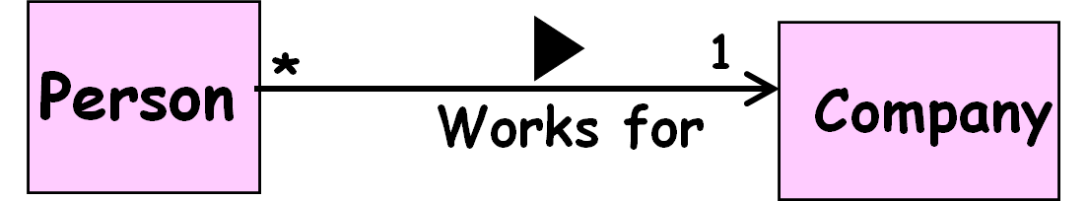
Association and Link
A link:
An instance of an association
Exists between two or more objects
Dynamically created and destroyed as a run of a system proceeds
For example:
An employee joins an organization.
Leaves that organization and joins a new organization etc.

Slide 33
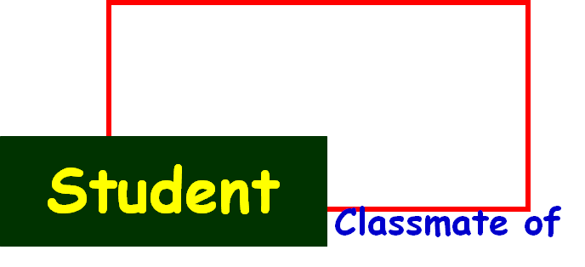
Association Relationship
A class can be associated with itself (unary association).
Give an example?
An arrowhead used along with name:
Indicates direction of association.
Multiplicity indicates # of instances taking part in the association.
*
*

Slide 34
Unary (Self) Association: Example 0
*
Person
*
Friend of

Slide 35
Unary Association: Example 1 Computer Network
Connects to
*
Computer
*

Slide 36
Computer Network: Object Diagram
Node1
Node2
Node3
Node4
Node5
Node6
Node7
Node8

Slide 37
Unary Association: Example 2
Connected to
next
LinkedListNode
previous

Slide 38


Slide 39
Unary (Reflexive) Association: Example 3
Course
*
is pre-requisite for
*
has pre-requisite of

Slide 40
Implementing Association Relationship: Example 1
Store a reference variable of the associated class.
Bookname: OOSD
Author: Gamaa
ISBN: 12234434
abook
Book Reference
Book instance
Book:
memberName: AKK
Member Number: 412323
Member
Book
abook
1
Borrowed by
1

Slide 41
public class Member{
private Book book;
public issueBook(Book abook){
setBook(abook);
abook.setLender(this);
}
private setBook(Book abook){
book=abook;
}
…
}
Member
Book
1
Borrowed
by
1

Slide 42
public class Book{
private Member member;
public setLender(Member aLender){
member=aLender;
}
…
}
Book
Member
1
1
Borrowed
by

Slide 43
Naming Association Attribute
The association attribute name is derived from:
Role names, if present
If not present, name of the class to which it is associated
Member
1
Borrowed
by
1
Book

Slide 44
Association Implementation: Quiz
Student
credit
Enrolment
Course
1..300
enrols
1..5
Class Student {
Course Enrolment[5];
…
}
Class Course {
Student credit[300];
…
}

Slide 45
Association Exercise 1
Develop class model: A Person works for a Company. A Company employs one person.
Role
Implicit attribute of Company
Implicit attribute of Person
Person
Company
employee
employer
1
works for
1
Association Name
Write Code
Observe: Bidirectional navigation.
Implement in Java…

Slide 46
Exercise 1: Solution
public class Company {
private Person employee;
public void employPerson(Person p){
employee=p;
p.setCompany(this);
}
public class Person {
private Company employer;
public Company getWorksFor() {
return employer;
}
public void setCompany(Company c) {
employer=c;
}
}

Slide 47
1-1 Association: Example 3
1
has
1
Advertiser
Account
public class Advertiser {
private Account account;
public Advertiser() {
account = new Account(this);
}
public Account getAccount() {
return account;
}
}
Write code for Advertiser
Now, Write code for Account
Notes:
If Advertiser accesses only Account, but not vice versa, the class Account can be made a local attribute in the Advertiser class

Slide 48
1-1 Association
Advertiser
1
1
Account
public class Advertiser {
private Account account;
public Advertiser() {
account = new Account(this);
}
public Account getAccount() {
return account;
}
}
public class Account {
private Advertiser owner;
publicAccount(Advertiser owner) {
this.owner = owner;
}
public Advertiser getOwner() {
return owner;
}
}

Slide 49
Quiz: Read Banking System Class Model
Bank
1
has
*
Account
Audit() :void
Checking
Audit() :void
Saving
Audit() :void
MoneyMarket
Audit() :void
A Bank has many Accounts
Checking, Savings, MoneyMarket are Account types

Slide 50
Quiz: Read UML class diagram
has
CPU
Controller
1
0..2
1..4
1
DiskDrive
SCSIController
controls
A CPU has upto two Controllers
SCSIController is a special type of Controller
A SCSIController controls 1-4 DiskDrives

Slide 51
Java Code?
CPU
has
Controller
1
*
class CPU {
Controller [ ] myCtlrs=new Controller[100]; ???
}
class Controller {
CPU myCPU;
}
class SCSIController extends Controller {
DiskDrive [ ] myDrives= new DiskDrive[4];
}
Class DiskDrive {
SCSIController mySCSI;
}
1..4
1
DiskDrive
SCSIController
controls

Slide 52
Implementing Association Multiplicities
Fixed multiplicity:
The reference field can be
Book [] book=new Book[10];.
When the upper end is *:
Java collections need to be used
Collections facility was added to Java as a part of JDK 1.2
Member
1
Book
Borrowed
by
1..10

Slide 53


Slide 54
Association Class

Slide 55
Need for Association Class
In many cases information associated with the links between objects needs to be maintained.
*
credits
*
Student
Course
Example:
A student takes a course and gets a grade for it.
The grade only makes sense if we know the student and the course. Also the semester to be remembered.
The obtained grade is not an attribute of either class.

Slide 56
Association Class
Not unusual for an association relation has its own attributes and methods:
Example 1: A teacher teaches a subject:
A teacher may teach the same subject multiple times over many semesters
Each time the students may be different
Example 2: A person works for a company
The date he joined a company
Pay scale and grade at which joined, and so on
A person may join a company multiple times
teaches
Teacher
Subject
Teacher
Subject
Taught
Person
Company
Employment

Slide 57
Association Class
An association class is shown as a class symbol:
Attached to the association symbol by a dashed line.
Association class has:
Same name as the association relation because...
It represents the association!
Course
*
Student
Registration

Slide 58
Association Class
*
credit
*
Student
Course
Student
*
*
Course
Credit

Slide 59
Association Class: Example 1
Server
1
Connection
Client
*
Connection
baudRate
protocol
total Cost
Disconnect
reportUsage
rerouteLink
• These attributes don’t belong
to either the Client or Server
class.
• They are attributes of the
connection itself.
• An association class can have methods as well as attributes.

