Slide 1
Association Class

Slide 2
Java Collections
When association-end multiplicities is *, need to use Collections.
Collections were added to Java as part of JDK 1.2
Operations supported:
Add
Remove
Access individual objects (Iterators)

Slide 3
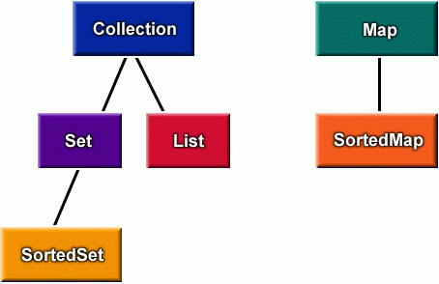
Java Collections
Java collections are of three basic types:
List (Ordered)
Set (Unordered)
Map (Key-value pairs)
Info

Slide 4
Bit of History…
Pre Java SDK1.2, Java provided a handful of data structures:
Hashtable
Vector
Bitset
These were for the most part good and easy to use:
But were not organized into a general framework.
These legacy data structures retrofitted to new model in SDK1.2 .
Info

Slide 5
«interface»
Collection
«interface»
Map
«interface»
Set
«interface»
List
«interface»
Queue
«interface»
SortedMap
HashSet
«interface»
SortedSet
Vector
ArrayList
LinkedList
TreeMap
HashMap
Info
Linked HashSet
TreeSet

Slide 6

Java Collections
 |  | Implementations
 |  | Hash Table | Resizable Array | Balanced Tree | Linked List
Interfaces | Set | HashSet |  | TreeSet
 | List |  | ArrayList |  | LinkedList
 | Map | HashMap |  | TreeMap
Info

Slide 7
Three Basic Java Collections
List : Sequences
Ordering is implicit
it is legitimate to ask questions like “what is the first object in the sequence?”
Add book as first book etc.
Sets: Unordered collection
Maps: Qualified associations
Each entry involves a pair of objects.
A map is also called as a dictionary.
it is legitimate to ask questions like “what value - if any - is associated with the following key?” or
“does this map contain the following key?”.
For all types of Collections:
Can create an Iterator object to access each item in the collection once.
Info

Slide 8
Which List to Use?
LinkedList:
Good if the list changes size (grows or shrinks) frequently
Good for accessing either end of the list, but slower when accessing items in the middle of the list
ArrayList:
Good if accessing elements by specific position, but slow for adds and removes.
Info

Slide 9
Vector class vs ArrayList
Info
Vector similar to an ArrayList, but synchronized for multithreaded programming.
ArrayList is faster since it is non-synchronized, while vector is thread-safe
Vectors retained mainly for backward-compatibility with old java.
Used as base class for Stack implementation.

Slide 10
Which Set to Use?
HashSet:
Good efficiency in most cases
TreeSet:
Useful when an iterator will access the elements of the set in a specific order based on their value (e.g. Strings would be kept in alphabetical order.)
Info

Slide 11
Which Map to Use?
HashMap:
Efficient in most cases
TreeMap:
An iterator obtained from the key set will access the elements of the map in key order.
Info

Slide 12
Collection: Basic operations
ArrayList<Integer> numbers = new ArrayList<>();
ListIterator<Integer> iterate = numbers.listIterator();
while(iterate.hasNext()) {
System.out.print(iterate.next() + ", ");
}
int size( );
boolean isEmpty( );
boolean contains(Object element);
boolean add(Object element); // Optional
boolean remove(Object element); // Optional
Iterator iterator( );
Info

Slide 13
Collection: Iterator
public interface Iterator {
boolean hasNext( );
// true if there is another element
Object next( );
// returns the next element (advances the iterator)
void remove( );
// removes the element returned by next }
Info

Slide 14
Code for Association Multiplicity
class Customer{
private ArrayList <Account> accounts = new ArrayList<Account>();
public Customer() {
Account defaultAccount = new Account();
accounts.add(defaultAccount);
}
}
Customer
has
Account
1
1..*

Slide 15
HW: Write Code for Example Association Relationships
Library Member
Book
1
borrowed by
*
Employee
employed by
1
Company
*

Slide 16
Association Class
*
credit
*
Student
Course
Student
*
*
Course
Credit

Slide 17
Association Class: Example 1
Server
1
Connection
Client
*
Connection
baudRate
protocol
total Cost
Disconnect
reportUsage
rerouteLink
• These attributes don’t belong
to either the Client or Server
class.
• They are attributes of the
connection itself.
• An association class can have methods as well as attributes.

Slide 18
Association Class: Example 2
12
5
Person
*
Skill
*
How many association class objects?
Competency
An association class is a “normal” class, and may include attributes, methods, relations, inheritance etc.
For every person-skill link, there a competency object…
-level
-date acquired

Slide 19
Implementing Association Class
Module
*
Student
Module
Student
1
Registration
*
Registration
Class Diagram
Mark: Integer
Mark: Integer
Class Diagram
:Module
a:Student
:Module
:Student
:Registration
:Registration
Mark = 76
Mark = 76
b:Student
:Student
:Registration
:Registration
Object Diagram
Mark = 89
Object Diagram
Mark = 89

Slide 20
Reification
Student
*
*
Course
Credit
Student
*
Credit
*
Course
Reification means “Replacing an association class with a normal Class”.
Dictionary: Reification is when you treat something abstract as a physical thing.

Slide 21
Association Class: Java Code
Pass the Student to Registration.
public class Module {
private Vector <Registration> reg=new Vector<Registration>();
public void enrol(Student st) {
reg.addElement( new Registration(st) );
}
...
}
Maintain the link to Registration
class Registration {
private Student student;
private int mark;
Registration(Student st) {
student = st; mark = 0;
}
...
}
Module
Student
1
*
Registration
Mark: Integer
Keep track of the Student reference.

Slide 22
Association Class: Example 3
RealEstate
Developer
1
*
Client
Contract
An association class is a “normal” class, and may include relations, inheritance etc.
Amount
Contract #
Date

Slide 23
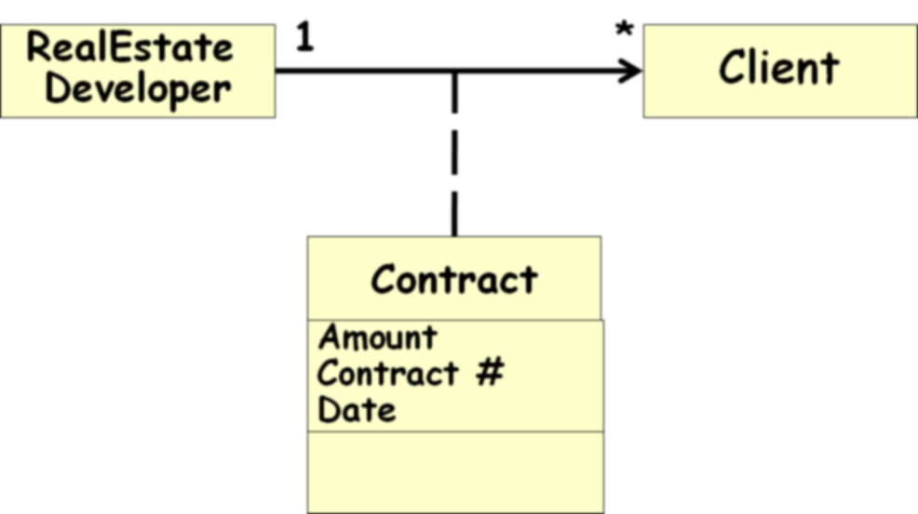
public class RealEstateDeveloper{
private Vector <Contract> contracts= new Vector <Contract>();
public void buy(Client c){contracts.add(new Contract(c))};
}
public class Client{
private Address address;
public Address getCurrentAddress(){}
}
public class Contract{
private Client client;
private int contractNo;
public Contract(Client c){ client=c;}
}
RealEstDev
Client
1
*
Contract
ConNo: Integer

Slide 24
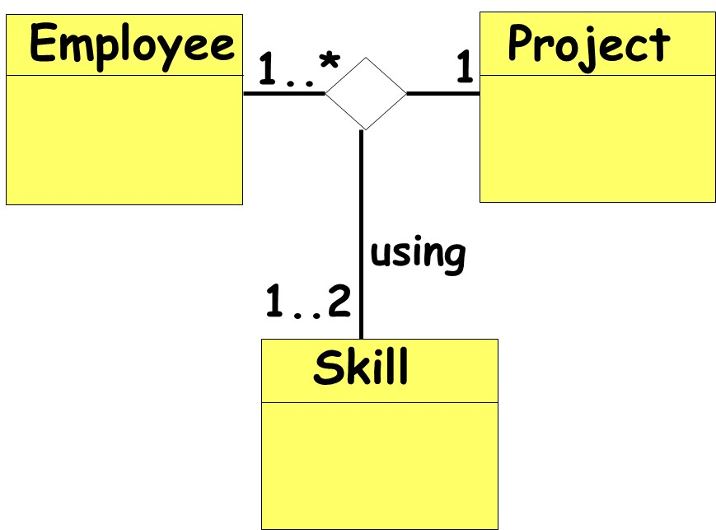
Ternary Association
Some times three (or more) classes may be associated.
An object of an association class:
Stores the details for the two associated classes.

Slide 25
Ternary Association
Man
Woman
1
1
marry
1..3
Priest
and we can add more classes to the diamond…

Slide 26
Implementation of Ternary Association
There are several ways in which ternary association can be implemented.
One is to decompose it into a set of binary associations.
Man
Marriage
Woman
1
1
1
1
Participates in
Participates in
*
Performed by
1..3
Priest

Slide 27
Record
Info
Goals
Player
Team
11
1
As association arity increases, implementation complexity increases… We shall exclude from our discussions 3ary and higher-ary associations…
*
Season

Slide 28
Association Quiz
Book
Editor
title: String
*
1
name: String
Edited by
editor: String
myBooks: Book
What is wrong?
Association denoted by symbol not attributes.
Implementation (pointers, arrays, vectors, ids etc) is left to the detailed design phase.
Wrong arrow type

Slide 29
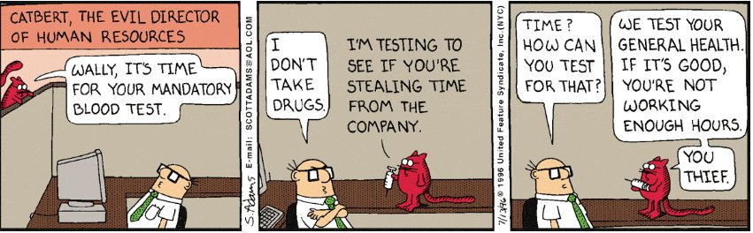

Slide 30
Qualified Association

Slide 31
Qualified Association
Allows us to express uniqueness…
Implemented by hash tables, maps, dictionaries.
How to read?
There exists upto one file for each instance of filename in the directory .
Class
Student
belongs
*
1
Class
0..1
Student
Roll
Read
1
Directory
file name
0..1
File

Slide 32
Qualified Association
1
Bank
0..1
Account
accno
Qualifier hints at setting up efficient access to linked objects:
For example, access accounts based only on the account number;
Implement to avoid a linear search through all accounts.

Slide 33
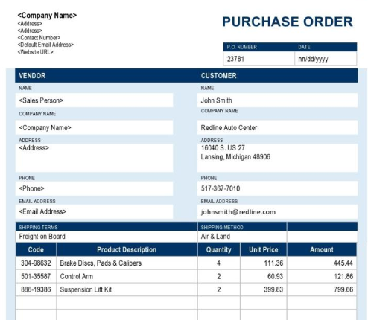
Setting up Qualified Association -- An Example
An order has of many Order lines.
How do you represent: There is at most one Order Line in the Order for each instance of Product.
Order
1
*
Order Line
Has Line item
1
Order
0..1
Order Line
Product
Line item

Slide 34
Qualified Association…
League
1
*
Player
nickName
1
0..1
League
nickName
Player
The second conveys more information…
Hints on implementation…
Effectively reduces multiplicity…

Slide 35
Qualified Association: Implementation
1
0..1
League
nickName
Player
public class League {
private Map players=new HashMap;
public void addPlayer (String nickName, Player p) {
if(!players.containsKey(nickName))
players.put(nickName, p);
}
}
public class Player {
private League
league;
}

Slide 36
Converting to Qualified Association
Role
Person
Company
employee
employer
*
works for
1
Association Name
Assume company assigns each employee a unique empId.
Give qualified association representation…
Person
employer
Company
employee
works for
empId
0..1
1

Slide 37


Slide 38
Types of Class Relationships
Relation
Generalization
Association
Dependency
Binary Association
N-ary Association
Aggregation
Composition
Notes:
38

Slide 39
Overdoing Associations
Avoid unnecessary Associations
PersonInfo
Address
E-Mail
Birthday
PersonInfo
Name
Address
E-Mail
Birthday
Person
Name
1
1
Avoid This…
Do This

Slide 40
“Or” Association
Used when all association combinations in a class model are not valid.
Example:
A person can have an insurance contract with an insurance company
Also a company can have an insurance contract with an insurance company
A person and a company CANNOT have the same insurance contract with an insurance company.
Skip

Slide 41
“Or” Association Example
Skip
1
Insurance Company
*
Insurance Contract
*
*
{or}
1..*
1..*
Person
Company

Slide 42
Summary of Implementation of Association
1-to-1 association:
Role names become attributes
1-to-many association:
Translate into a Vector or ArrayList
Qualified association:
Translate into a Map or Hash table
Notes:
Not covered in Fall 91 class

Slide 43
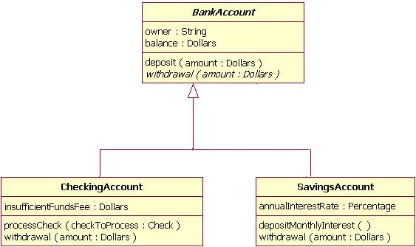
Which sentences are true?
a) CheckingAccount implements BankAccount
b) CheckingAccount and SavingAccount are BankAccount
c) CheckingAccount and SavingAccount are associated
d) BankAccount is associated to CheckingAccount
e) SavingAccount can processCheck
f) CheckingAccount has a balance

