Slide 1
Aggregation, Composition, and Dependence Relationships Among Classes
Lect 5—6
14-08-2023

Slide 2
Aggregation Relationship
Represents whole-part relationship
Represented by a diamond symbol at the aggregator end.
Often indistinguishable from plain association. However:
Aggregate usually creates the components.
Aggregate usually invokes the same operations on all its components.
Usually aggregate is owner of the components:
But may share with other objects
*
*
1
Company
Person
Club
employs
memberOf

Slide 3
Aggregation: Two Examples
1
*
*
1
Document
Paragraph
Line
1
*
*
1
Company
Person
Club
employs
memberOf

Slide 4
Aggregation cont…
An aggregate object contains other objects.
Aggregation limited to tree hierarchy:
No circular inclusion relation.
1
*
Line
Paragraph

Slide 5
Composition
A stronger form of aggregation
The whole is sole owner of its part.
A component can belong to only one whole
The life time of the part is dependent upon the whole.
Circle
1
Point
Circle
3..*
Point
Polygon

Slide 6
Composition Relationship
Life of item is same as that of order
Order
Item
1
*

Slide 7
Composition: Alternate Notation
Car
4
1
Wheel
Engine
2
1
Door
Chassis
1
1
Axle
Steering

Slide 8
Composition
An object (component) may be a part of ONLY one composite.
Whole is responsible for the creation and disposition of its parts.
Window
whole
1
*
Frame
part

Slide 9

Aggregation vs. Composition
Composition:
Composite and its components have the same life line.
Aggregation:
Lifelines are different.
Consider an order object:
Aggregation: If order items can be changed or deleted after placing an order.
Composition: Otherwise.

Slide 10
Composition versus Aggregation
1
*
Order
Item
Composition
1
Order
*
Item
Aggregation

Slide 11
Implementing Composition…
public class Car{ private Wheel wheels[4]; public Car (){ wheels[0] = new Wheel(); wheels[1] = new Wheel(); wheels[2] = new Wheel(); wheels[3] = new Wheel(); } }
1
4
Car
Wheel

Slide 12


Slide 13
Aggregation: Code Example
An aggregation relationship is usually represented as a data field in the aggregated class.
public class Person {
/** Other Data fields */
private ArrayList<Name> name =new ArrayList<Name>() ;
}
Person
*
Name

Slide 14
Often Inner Classes are Used
If House is used only in the Person class:
Declare it as an inner class in Person.
public class Person {
private Name name;
private House house;
...
class House {
...
}
}

Slide 15
Implementing Aggregation: Ex 1
import java.util.ArrayList;
public class CarShop{
CarCompany company; Manager manager;
private ArrayList<SalesPerson> people = new ArrayList<SalesPerson>();
private ArrayList<Car> cars = new ArrayList<Car>();
}
*
Car
1
Car Shop
*
Salesman

Slide 16
Deciding Whether to Use Composition or Aggregation…
Use composition if:
Lifetime of part is bound with lifetime of composite
There is an obvious physical or logical assembly
Some properties of composite propagate to parts (e.g., location)
Operations applied to composite propagate to parts (e.g., destruction, movement, etc)

Slide 17
Aggregation versus Composition
public class A{
public void operation(B b) {
b.operation();
}
}
public class B{
public void operation() {
}
}
public class A {
private B b;
public A(B b){
this.b = b;
}
public void operation(){
b.operation();
}
}
public class B {
public void operation() {
}
}

Slide 18
Class Dependency
Dependent Class
Independent Class
Any change to the independent class would necessitate a change to the dependent class.
A class may be dependent on another class due to a variety of reasons.

Slide 19
Dependency
Dependency relationship between two classes X and Y can arise due to a variety of reasons:
X has an attribute of class Y
X has a template attribute with a parameter of class Y
X has a method with an input argument of class Y
X has a method with an output argument of class Y
X has of a method containing a local variable of class Y
Etc.

Slide 20
Dependency
Common Dependences are caused by:
Local variables
Parameters
Return values
Example:
Class A { Class B {
B Foo(B x) { …
B y = new B(); …
return y; …
}
} }

Slide 21
Dependence – Examples
class MyDependentClass{
void myFunction1( MyReferencedClass r ) { .. }
MyreferencedClass myFunction2( .. ) { .. }
void myFunction3( .. ){ MyReferencedClass m .. }
}
MyClass
att: int
myFunction()
dependence
arrow
MyReferencedClass

Slide 22
Association Vs. Aggregation
Is aggregation an association?
Is composition an aggregation?

Slide 23
Summary of Three Class Relations
Car
aggregation: "is part of"
Symbolized by empty diamond
composition: “is made of”
Stronger version of aggregation
The parts live and die with the whole
Symbolized by a filled diamond
dependency: “Depends on”
Represented by dotted arrow.
1
1
aggregation
Engine
Book
composition
1
*
Page
dependency
Lottery Ticket
Random

Slide 24
UML Class Relations: Notation Summary
Class
Generalization
Relationship
dependency
Object
Aggregation
Association
Object Composition
Association
Object Association
n
m
1..*
1
*
*
Will always be “1”

Slide 25
Aggregation Composition
Faculty
SalesOrder
1..5
1
(team-teaching is possible)
*
1..*
Course
SalesOrderLineItem

Slide 26
Multiplicity Quiz #1
Whole
Class diagram
1
3
5
2
Part A
Part B
Read
One Whole is associated with 5 Part A
One Part A is associated with 1 Whole
One Whole is associated with 2 PartB
One PartB is associated with 3 Whole
PA
Object diagram
PA
W
PB
W
PA
PB
PB
W
PA
W
PA
W
W
PA

Slide 27
Class Relation Hints
Composition
B is a permanent part of A
A contains B
A is a permanent collection of Bs
Subclass / Superclass
A is a kind of B
A is a specialization of B
A behaves like B
Association (Collaboration)
A delegates to B
A needs help from B
A invokes service of B.

Slide 28
Class Diagram Inference Based on Text Analysis (based on Dennis, 2002)
A common or improper noun implies a class e.g. Book
A proper noun implies an object (instance of a class): CSE Dept, OOSD, etc.
An adjective implies an attribute e.g. price of book
A “doing” verb implies an operation (method)
Can also imply a relationship e.g. student issues Book
A “having” verb implies an aggregation relationship
An adverb implies an attribute of an operation e.g. fast loading of image…

Slide 29
Identify Class Relations
Faculty & student
Hospital & doctor
Door & Car
Member & Organization
People & student
Department & Faculty
Employee & Faculty
Computer Peripheral & Printer
Account & Savings account

Slide 30
Identify Classes & Relations
A square is a polygon
Shyam is a student
Every student has a name
100 paisa is one rupee
Students live in hostels
Every student is a member of the library
A student can renew his borrowed books
The Department has many students

Slide 31
Identify Classes & Relations
A country has a capital city
A dining philosopher uses a fork
A file is an ordinary file or a directory file
Files contain records
A class can have several attributes
A relation can be association or generalization
A polygon is composed of an ordered set of points
A programmer uses a computer language on a project

Slide 32
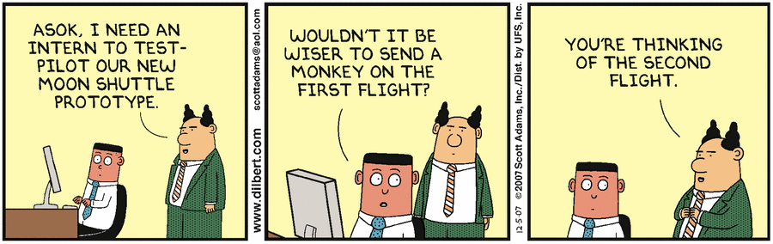

Slide 33
Exercise
The B.Tech program of IITKgp Computer Science Department:
comprises of many B.Tech batches.
Each B.Tech batch consists of many B.Tech students.
CSE Department has many listed courses.
A course may be offered in either spring or Autumn semesters
A course is either listed as an elective course or a core course.
Each B.Tech students need to credit between 30 to 32 course offerings.
A student might repeat a course if he/she desires

Slide 34
Model Solution
BTech Program
*
1
BTech Batch
1
Autumn
*
Student
Semester
*
offered in
Spring
*
30..32
credits
Course List
1
Course
Core
Elective
Course Credit

Slide 35
State Machine Diagrams

Slide 36
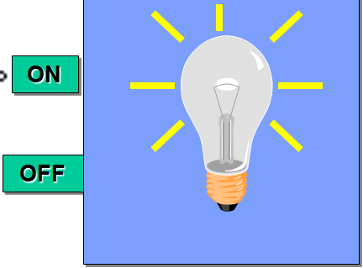
Stateless vs. Stateful Objects
State-independent (modeless):
Type of objects that always respond the same way to an event.
State-dependent (modal):
Type of objects that react differently to events depending on its state or mode.
Use state machine diagrams for modeling objects with complex state-dependent behavior.
Lamp On
on
off
on
Lamp Off
off

Slide 37

Stateful Classes
Give examples of some classes that have non-trivial state models:
Lift controller: Up, down, standstill,…
Game software controller: Novice, Moderate, Advanced…
Gui: Active, Inactive, clicked once, …
Robot controller: Obstacle, clear, difficult terrain…
Controller classes are an important class of statefull examples:
A controller may change its mode depending on sensor inputs and user inputs.

Slide 38
Stateful Classes
In a client-server system:
Servers are stateless, clients are stateful.
Common stateful objects:
Controllers:
A game controller may put the game in expert, novice or intermediate modes.
Devices:
A Modem object could be dialing, sending, receiving, etc.
Mutators (objects that change state or role)
A RentalVideo is rented, inStore, or overDue

Slide 39
Event-Based Programming
Traditional programs have single flow of control:
Represented using flowchart or activity diagram
Event-driven systems :
In contrast, depending on an event occurrence, corresponding handler is activated
Programming these using traditional approach is not suitable, and would at the least cause wasteful computations.
Represented using state machines.

Slide 40
What Kind of Behavior?
In general, state machines are suitable:
For describing event-driven, discrete behavior
Inappropriate for modeling continuous behavior
threshold
There is no support currently in UML for modeling continuous behavior
time

Slide 41
Why Create A State Model?
Tackle complexity
Document:
For review, explaining to others, etc.
Generate code automatically
Generate test cases

Slide 42
Finite State Automaton
A machine whose output behavior is not only a direct consequence of the current input,
But past history of its inputs
Characterized by an internal state which captures its past history.
ON
OFF

Slide 43
Basic State Machine Diagram
Graphical representation of automata behavior…
on
Lamp On
on
off
Lamp Off
off

Slide 44
Outputs and Actions
Automaton generates outputs during transition.
Alternate representations.
on
Lamp On
on
Lamp On
display(”on”)
off
on/display(”on”)
off
on
off
off
Lamp Off
Lamp Off
Mealy automaton
Moore automaton

Slide 45
Event-Driven Behavior
Event types:
Object interactions:
synchronous object operation invocation (call event)
asynchronous signal reception (signal event)
Occurrence of time instants (time event)
interval expiry
calendar/clock time
Change in value of some entity (change event)
Event Instance = an instance of an event (type)
occurs at a particular time instant and has no duration

Slide 46
Event Examples
Signal event
collision
Move
Stop
state
transition
state
startAutopilot(normal)
Manual
Automatic
Call event
when(11:49pm)
Time event
Idle
Active
after (2 seconds)

Slide 47
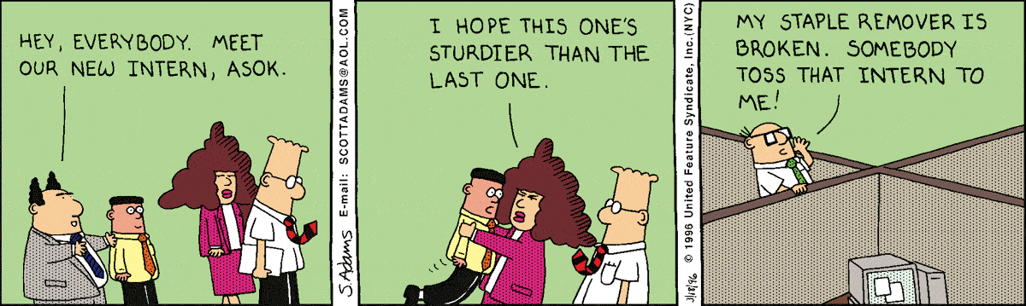

Slide 48
Exercise 0: Draw State Machine Diagram of a Keyboard?
Press any key: lower case ASCII code is sent to computer…
Once press the caps lock key: upper case ASCII code will be sent on a key press…
Any key/
send-lower-
Case-code
Default
Caps Lock
CapsLocked
Caps Unlock
AnyKey/
Send-upper-
Case-code

Slide 49
Exercise 1: State Machine Diagram of a Library Book
A library book to start with, is present in a shelf…
When borrowed out, it is not on shelf…
Returned, on shelf…
initial state
On shelf
state
discarded
Returned
Borrowed
transition
On loan
final state

Slide 50
Exercise 2: Construct State Model
A car is in idle mode when ignition is off:
Changes to initial mode when ignition is keyed ON.
The car accelerates when the acceleration pedal is pressed.
While accelerating, the car goes into a cruise mode, as soon as cruise switch is set to ON.
Cruise mode is turned off either when brake is applied or the cruise switch is turned off
Cruise mode can be resumed by setting cruise switch to ON.
When ignition is turned off the car goes to idle mode.
Cruise Controller

Slide 51
Cruise Controller
Idle
Initial
Ignition On
Idle
Acccel Pedal Pressed
Ignition Off
Accelerating
Cruising off
Break Pressed
Cruise Switch OFF
Cruise
Switch ON
Cruise
Switch ON
Cruising

Slide 52
Exercise 3
Model a keyboard using UML state machine diagram:
Transmits key code on each key stroke.
Breaks down after entering 100,000 key strokes.

Slide 53
Solution
/n=0
Default
[n=100,000]
KeyStroke
keyStroke/
n++, transmit code
Broken

Slide 54
Exercise 4: Draw State Machine: GUI Accepts only Balanced Parentheses
(
Balanced
Not
Balanced
start
end
)
*
*
Inputs are any characters
No nesting of parentheses
No “output” other than any state change
Notes:
54

Slide 55
Example 5: Draw State Machine: GUI Accepts only upto 3 Nested parentheses
end
(
(
(
OK
Wait 1
Wait 2
Wait 3
start
)
)
)
*
*
*
*
)
(
Error
How can we extend this machine to handle arbitrarily deep nesting of parentheses?
*
Notes:
55

Slide 56
How to Model Nested parentheses?
(/count++
(/count=1
OK
Wait
start
end
)[count==1] /count=0
)[count>1]/ count--
A state machine, but not just a state machine --- an EFSM
Notes:
56

Slide 57
Extended State Machines
Addition of variables (“extended”)
Lamp On
ctr : Integer
off
on/ctr = ctr + 1
Lamp Off

Slide 58
UML State Machine Model

Slide 59
State Chart Diagram
FSMs suffer from a few severe shortcomings:
What are the shortcomings of FSM?
State chart is based on the work of David Harel [1990]:
Overcomes important shortcomings of FSM
Extends FSM in 2 major ways: Concurrent states and hierarchy.

Slide 60

Robot: State Variables
Power: On, OFF
Movement: Walk, Run
Direction: Forward, Backward, left, Right
Left hand: Raised, Down
Right hand: Raised, down
Head: Straight, turned left, turned right
Headlight: On, Off
Turn: Left, Right, Straight
How many states in the state machine model?
FSM: exponential rise in number of states with state variables

Slide 61
Event | State
turnOn | Activated
turnOff | Deactivated (Idle)
stop | Stopped
walk | Walking
run | Running
raiseLeftArm | LeftArmRaised
lowerLeftArm | LeftArmLowered
lowerLeftArm | LeftArmLowered
raiseRightArm | RightArmRaised
lowerRightArm | RightArmLowered
turnHead | HeadTurned(direction)
speak | Talking(text)

Slide 62
State Chart Diagram Cont…
State chart avoids two problems of FSM:
State explosion
Lack of support for representing concurrent states
A hierarchical state model:
Makes use of composite states --- OR and AND states.

Slide 63
Features of State Charts
Two major features introduced :
Nested states
Concurrent states
Several other features have also been added:
History state
Broadcast messages
Actions on state entry and exit
…
Nested State
s11
s21
s12
s22
Concurrent State

Slide 64
Nested State Diagrams
Hierarchical organization is a classic way to control complexity:
of programs
of documentation
of objects
…
Why not state diagrams?
superstates
substates

Slide 65
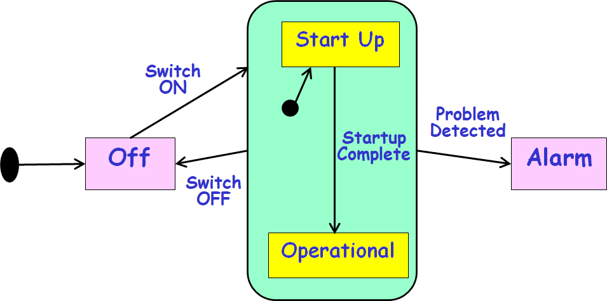
State Chart Diagram Cont…
Basic elements of state chart diagram:
Initial State: A filled circle
Final State: A filled circle inside a larger circle
State: Rectangle with rounded corners
Transitions: Arrow between states, also boolean logic condition (guard)‏
State chart in UML is called state machine:
As it not only models state behavior but also generates code…
Off
Alarm

Slide 66
State Machine Diagram
State machine is the code that implements a model and runs on a computer.
In contrast, a state chart is a description of a state machine,

Slide 67
UML State Machine Diagram: Syntax
A state is drawn with a round box, with three compartments for:
name
state variables
actions performed
A transition is drawn with a labeled arrow,
event causing the transaction
guard condition
Action to perform

Slide 68
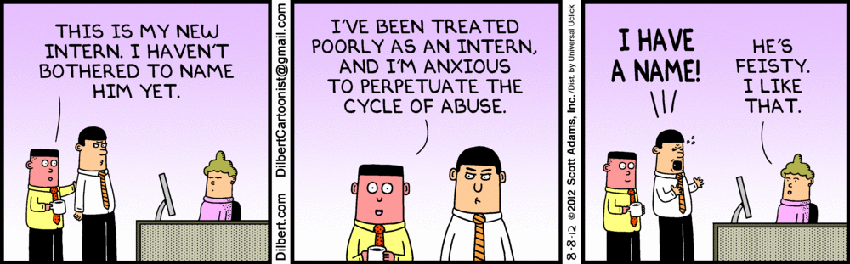

Slide 69
Syntax of UML State machine
State: Rectangle with rounded corners
Name tab
Action label:
Entry
Exit
Do
Typing password
Entry/ set echo invisible
Exit / set echo normal
Do / read character

Slide 70
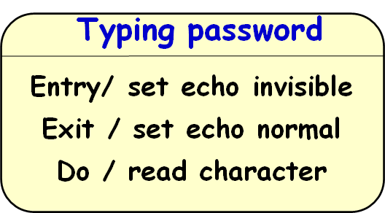
Predefined Action Labels
“entry/”
Identifies an action to be performed upon entry to the state
“exit/”
Identifies an action to be performed upon exit from the state (exit action)
“do/”
Identifies an ongoing activity (“do activity”) that is performed as long as the modeled element is in the state or until the computation specified by the action expression is completed

Slide 71
“Do” Activities
The thread executes until:
The action completes or
The state is exited through an outgoing transition
Error
“do” activity
entry/printf(“error!”)
do/while (true) alarm.ring();

Slide 72
Basic UML State Model Syntax
“top” state
State
Initial
pseudostate
Top
Trigger
Ready
Transition
stop
/ctr = 0
Done
Final
state
Action
stop

Slide 73
Guards
Boolean predicates to indicate Conditional execution of transitions
bid [value < 100] /reject
Selling
Happy
bid [value >= 200] /sell
bid [(value >= 100) & (value < 200)] /sell
Unhappy

Slide 74
Eliminating Duplicated Transitions
Duplicate transitions usually exist when some transition can happen from every state:
“error”
“quit”
“abort”
These duplicates can be combined into a single transition:
A transition from a superstate holds for all of its substates!

