Slide 1
UML State Machine Model
Lect 7--8
21-08-2023

Slide 2
State Machine: Eliminating Duplicated Transitions
Duplicate transitions usually exist when some transition can take place from every state:
“error”
“quit”
“abort”
These duplicates can be combined into a single transition:
A transition from/to a superstate holds for all its substates!

Slide 3
Hierarchical State Machines
Obtained by replacing transition from every substate by a single transition from superstate…
LampOff
LampFlashing
flash/
entry/lamp.off()
FlashOn
off/
entry/lamp.on()
1sec/
1sec/
on/
on/
FlashOff
on/
LampOn
entry/lamp.off()
entry/lamp.on()

Slide 4
Group Transitions
Higher-level transitions
Default transition to
the initial pseudostate
LampOff
LampFlashing
flash/
LampFlashing
entry/lamp.off()
FlashOn
off/
entry/lamp.on()
1sec/
1sec/
on/
FlashOff
on/
LampOn
entry/lamp.off()
entry/lamp.on()
Group transition

Slide 5
Completion Transitions
Triggered by a completion event:
Generated automatically when an immediately nested state machine terminates.
completion
transition (no trigger)
Committing
Phase1
CommitDone
Phase2

Slide 6
A Heart Monitor Application: Convert to Hierarchical State Machine
Start Up
Problem Detected
Switch
ON
Switch OFF
Off
Startup Complete
Alarm
Switch OFF
Problem Detected
Operational

Slide 7
Heart Monitor Revisited
ON
Start Up
Transition from
Super state
Switch
ON
Startup Complete
Problem Detected
Off
Alarm
Switch OFF
Operational

Slide 8
Complete Diagram for Heart Monitor Application
Quiz: Convert to AND-State…
The number of states and transitions have grown quickly
StartUp Battery
Start Up Mains
Alarm Battery
Off
Alarm Mains
Operational Battery
Why do the states and transitions grow fast?
Operational mains

Slide 9
Heart Monitor as Concurrent State Machine

Slide 10
Introducing Hierarchy
f
g
h
i
j
A
B
C
D
E
k
k
k
k
k
m
Z
super-state S
S
f
A
g
B
h
C
i
D
j
E
k
m
Z
sub-states

Slide 11
Dialling
Basic Composite State: OR state
Start
entry/start dial tone
exit/stop dial tone
digit(n)
Encode

Slide 12
Composite State: AND State
Composite states can have:
– concurrent substates -and- relationship
• substate separated from others by dotted line
– disjoint substates -or- relationship
• transitions between substates
Overhead Projector
On Desk
Light Off
On Floor
Light On

Slide 13
Exercise 1: Develop State Machine Model
In a chess game:
Black and white sides take turn to play.
The game ends anytime when:
Either there is a checkmate, or
There is a stalemate.

Slide 14
Chess
White’s
turn
stalemate
white moves
black moves
checkmate
Black’s turn

Slide 15
Handling Interrupted States
Sometimes it is necessary to interrupt a complicated procedure:
And then resume exactly from where you stopped
Consider installing a program on your computer
“Out of memory: please delete some files and hit continue”
In many situations a normal course of processing is interrupted and then resumed
How can this be handled in a nested state diagram?

Slide 16
History
Transit to a higher level state and then return to resume the activity at which transited.
Diagnosing
suspend/
Diagnostic1
Diagnostic2
Step11
Step21
resume/
Step12
Step22
H*

Slide 17
Orthogonality
Multiple simultaneous perspectives on the same entity.
age
financialStatus
Child
Poor
Adult
Rich
Retiree

Slide 18
Orthogonal Regions
Combine multiple simultaneous descriptions
age
financialStatus
Child
Poor
Adult
age
financialStatus
Child
Rich
Retiree
Poor
Adult
Retiree
Rich

Slide 19
Orthogonal Regions - Semantics
All mutually orthogonal regions detect the same events and respond to them “simultaneously”
Usually reduces to interleaving of some kind.
Person
legalStatus
financialStatus
LawAbiding
Poor
robBank/
robBank/
Outlaw
Rich

Slide 20
Common Misuse of Orthogonality
Using regions to model independent objects
Person1
Person2
Person1
Person2
Child
Child
Adult
Adult
Retiree
Retiree

Slide 21
Exercise : Simple Elevator System (Partial)
The elevator is by default at the ground floor.
When idle and a button at the same or a higher floor is pressed:
It moves up when button at any upper floor is pressed and halts when the requesting floor is reached.
When idle and a button at the same or a lower floor is pressed:
It moves down. Halts when requesting floor is reached.
If inactive at a floor for more than 10 minutes:
It moves down to the ground floor.

Slide 22
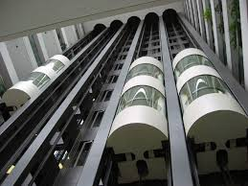
Simple Elevator System
Lift
Call
Lift
Call
Lift
Call
Lift
Call
Lift
Call
Lift
Call
Lift
Call

Slide 23
Elevator: State Machine Representation
On Ground
Floor
[H]
Moving
Up
up floor
arrive
at floor
Moving to
Ground Floor
arrive
at floor
up floor
[H]
Moving
Down
arrive at floor
Idle
[L]
down floor
time-out
H: Higher L: Lower

Slide 24
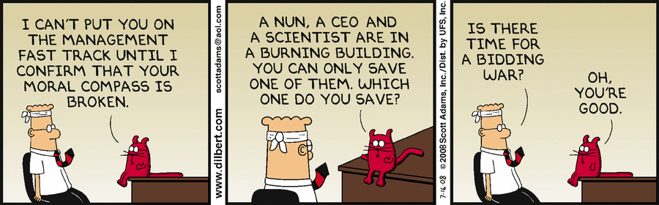

Slide 25
Encoding State Machine Diagrams

Slide 26
Translating State Machine to Code
Complicacy:
State machines have many concepts that are not directly supported in programming languages ---- neither procedural nor OO languages, for example:
States, events, transitions, composite states, concurrent states, history, etc
Notes:
26

Slide 27
Mapping State Model to Program Code
General Idea: How to Generate Code?
on
Initialize Object
Lamp On
Wait for Event
on/display(”on”)
Handle Event
off
off
Lamp Off
Terminate Object
stop

Slide 28
How to Encode an FSM?
Three main approaches:
Doubly nested switch in loop
State table
State Design Pattern

Slide 29
3 Principal Ways
Doubly nested switch in loop:
Scalar variables store state --- Used as switch discriminator for first level switch
Event type is discriminator in second switch
Hard to handle concurrent states, composite state, history, etc.
State table: Straightforward table lookup
Design Pattern:
States are represented by classes
Transitions handled by methods in classes

Slide 30
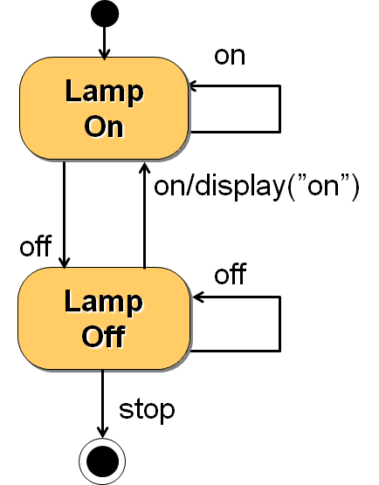
Doubly Nested Switch Approach
int state, event; /* state and event are variables */
while(TRUE){
switch (state){ /* Wait for event */
Case state1: switch(event){
case event1: state=state2; etc…; break;
case event2:…
default:
}
Case state2:switch(event){…
…. }
}}

Slide 31
State Table Approach
From the state machine, we can set up a state transition table with a column for the actions associated with each transition
Present state | Event | Next state | Actions
BTN_off | e1 | BTN_off | none
 | e2 | BTN_on | set red LED flashing
BTN_on | e1 | BTN_on | none
 | e2 | BTN_off | reset red LED flashing

Slide 32
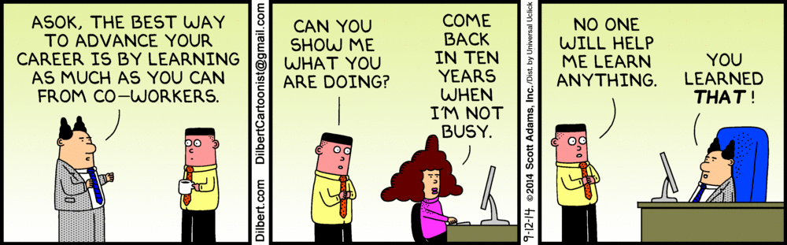

Slide 33
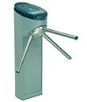
Turnstile: Exercise 2
A turnstile check gate would be installed at a railway station.
When the turnstile is powered on:
It starts in the locked state.
When a commutator drops a one rupee coin:
The gate gets unlocked and a message “Gate Open” appears.
Exactly one person is allowed to pass through before the gate gets locked.
If more than one person try to pass through, an alarm is sounded and gate gets locked.
Also when any one tries to jump over the gate:
An alarm is started and gate is locked.

Slide 34
Turnstile Exercise cont…
When the alarm is ON:
A message “Please wait: Gate temporarily blocked” is displayed.
If any one still inserts a coin, it return the coin without unlocking the gate.
The alarm is reset when an attendant swipes a card and the gate starts at the locked state.
When any one inserts a coin when the gate is already open:
The coin is returned.
If there is a power failure any time:
The gate gets locked and “Power fail: inoperative” message is displayed and coins are not accepted.

Slide 35
Turnstile: First-Cut State Model
Locked
coin/ Unlock
Unlocked
jump/ Alarm
pass/ Lock
coin/Return coin
Alarm

Slide 36
Turnstile: Final State Model
powerOFF
powerOFF
coin/return
powerON
Locked
coin
Unlocked
pass
cardSwipe
jump
multiple pass||jump
Alarm
Entry/ display

Slide 37
C Code
enum State {Locked, Unlocked, Alarm, PowerOFF};
enum Event {Pass, Coin, multiplePass, jump, cardSwipe};
static State s = Locked;
void Transition(Event e){
switch(s){
case Locked:
switch(e){
case Coin:
s = Unlocked;
Unlock();
break;
case Jump:
s=Alarm;
Alarm();
break;
}
break; cont…

Slide 38
case Unlocked:
switch(e){
case Coin: returnCoin();
break;
case Pass: s = Locked;
Lock();
break;
case jump:
case multiplePass: s=Alarm;
Alarm();
break;}
break;
case Alarm: …. … ….

Slide 39
public class Turnstile{
enum state{ Locked, Unlocked, Alarm}
public Turnstile(){ state=Unlocked;}
public pass(){
if(state== Unlocked) state=Locked;}
public coin(){
switch(state){
case Locked: state=Unlocked; break;
case Unlocked: returnCoin(); break;
}}
public jump(){…}
…}
Java Code

Slide 40
Ex. 3: Course Registration Software
When a course is created, it is open for registration, and number of students is made 0.
If the course is open and a student registers, the student count incremented.
A course can be cancelled anytime:
The registered students are notified and their registration cancelled.
If registered student number reaches 100:
The course is closed for registration, and it is allocated a room and a time slot.

Slide 41
Exercise 3: State Transition Diagram
[ count < 100 ]
register student
create/
count=0
Open
entry: Register student
Increment count
Cancel/
Notify registered students
[ count = 100 ]/
Finalize course
Canceled
Cancel/
Closed
Notify registered students
Notes:
41

Slide 42
Home Work: ATM
To withdraw money:
customer inserts the ATM card.
Authentication is done by checking an entered PIN.
If PIN is incorrect:
Customer asked to enter PIN again
On three unsuccessful attempts, the card is seized and account is locked.
On correct entry amount requested is dispensed and card ejected.

Slide 43
Home Work
How to handle code generation for composite AND and OR states?
How to generate code for history state?

Slide 44
Use Case Modelling

Slide 45
Diagnostic: Video Store Information System
A Video Store Information System needs to support the following business functions:
Recording information about videos the store owns
This database is searchable by staff and all customers
Find the videos borrowed by a customer
Access by staff and also the customer. It involves video database searching.
Staff can record video rentals and returns by customers. It involves video database searching.
Staff can maintain customer, video and staff information.
Managers of the store can generate various reports.
Draw Use Case Diagram

Slide 46
Diagnostic Problem: Solution
Video Store Information System
Rent/Return
Videos
«include»
Staff
Search for
Videos
Customer
Maintain
Customers
«include»
Maintain
Videos
Maintain
Staff
Generate
Reports
Manager

Slide 47
Use Case Model of a Problem
Consists of a set of “use cases”
It is the central model:
Other models must conform to this model…
Not really an object-oriented model, it is functional model of a system.

Slide 48
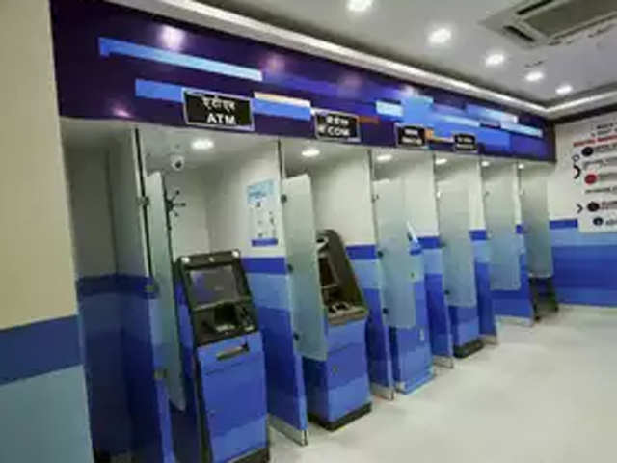
What is a Use Case?
A way in which a system can be used by users to achieve some specific goal. Ex: Withdraw money
Corresponds to a high-level requirement.
Defines external behavior without revealing internal structure of system
Set of related scenarios tied together by a common goal.

Slide 49
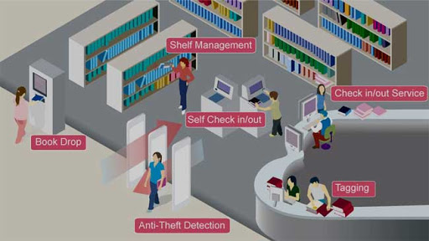
Example Use Cases
Library information system:
issue-book
query-book
return-book
create-member
add-book, etc.

Slide 50
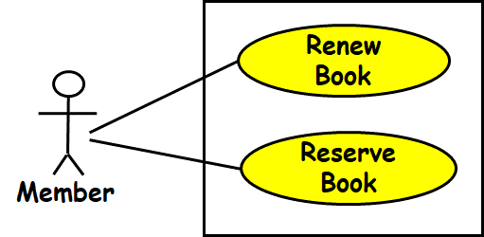
Use Cases Cont…
Normally, use cases are independent of each other
Implicit dependencies may exist
Example: In a Library Automation System, renew-book and reserve-book are independent use cases.
But in actual implementation of renew-book--- A check is made to see if the book has been reserved using reserve-book.

Slide 51
An Example Use Case Diagram
Tic-tac-toe game
Play Move
Player
Use case model

Slide 52
Representation of Use Cases
A use case is represented by an ellipse
System boundary is represented by a rectangle
Users are represented by stick person icons (actor)‏
Communication relationship between actor and use case by a line
External system by a stereotype
Tic-tac-toe game
Play Move

Slide 53
What is a Connection?
A connection is an association between an actor and a use case.
Depicts a usage relationship…
Connection does not indicate data flow
Tic-tac-toe game
Play Move

Slide 54
System Boundary Box
Release 3
Release 2
Release 1
Search For Items
<<system>>
Payment Processor
Place Order
Customer
Obtain Help
Customer Support
Submit Taxes
Time
Tax Authority

Slide 55
Relationships between Use Cases and Actors
An actor is connected to a use case by an association relation:
Indicates that the actor and the use case communicate with one another.
update
grades
faculty

Slide 56


Another Example Use Case Diagram
Video Store Information System
Rent Videos
Clerk
<<external system>>
Credit Authorization Service
. . .

Slide 57
Yet Another Use Case Example
Telephone Catalog
Check Status
Salesperson
Place Order
Fill Orders
Shipping Clerk
Customer
Establish credit
Supervisor

Slide 58
Why Develop A Use Case Diagram?
Serves as requirements specification
How is identification of actors useful in software development?
Identifies different categories of users:
Helps in implementing appropriate interfaces for each category of users.
Helps in preparing appropriate documents (e.g. user’s manual).

Slide 59
Exercise1: Video Store Information System
Video Store Information System supports the following business functions:
Recording information about videos the store owns
This database is searchable by staff and all customers
Information about a customer’s borrowed videos
Access by staff and also the customer. It involves video database searching.
Staff can record video rentals and returns by customers. It involves video database searching.
Staff can maintain customer, video and manager can maintain the staff information.
Manager of the store can generate various reports.

Slide 60
Exercise 1: Solution
Video Store Information System
Rent/Return
Videos
«include»
Staff
Search for
Videos
Customer
Maintain
Customers
«include»
Maintain
Videos
Maintain
Staff
Generate
Reports
Manager

Slide 61
Use Case Description
Name
Actors
Trigger
Preconditions
Post conditions
Success Scenario
Alistair Cockburn “Writing Effective Use Cases”
Alternatives flows

Slide 62
Triggers
What starts a use-case?
Examples:
Customer initiates a claim report by clicking a button on a web page
Customer inserts ATM card
System clock is 10:00
etc.

Slide 63
Preconditions
What the system needs to be true before running the use-case.
Examples:
The use has logged on
Requested Book is issued out
User account has been created
The membership has expired

Slide 64
Post-Conditions
A post-condition is the outcome of a use-case.
Examples:
Money is transferred to the user account
User is logged in
The file is saved to the hard-disk
Minimal guarantee:
The things that a system can promise, holding even when the use case execution ended in failure
Example: Money is not transferred unless authorization is granted by the user
Success guarantee:
What happens after a successful conclusion of the use-case.
Example: Transaction logged; Money is transferred

Slide 65
Success Scenario
The success scenario is the main story-line of the use-case:
Under the assumption that everything is okay, no errors or problems occur
Typically, it is composed of a sequence of action steps
Interaction step
Administrator enters course name, code and description
System validates course code
System adds the course to the db and shows a confirmation message
Validation Step
Interaction Step
Internal Change Step

Slide 66
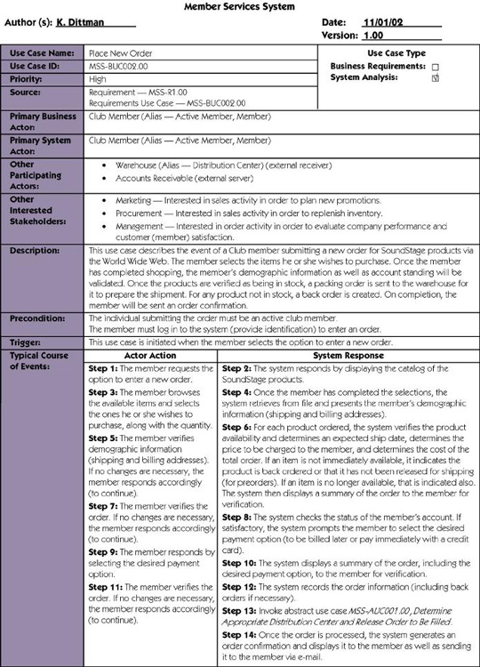

Slide 67
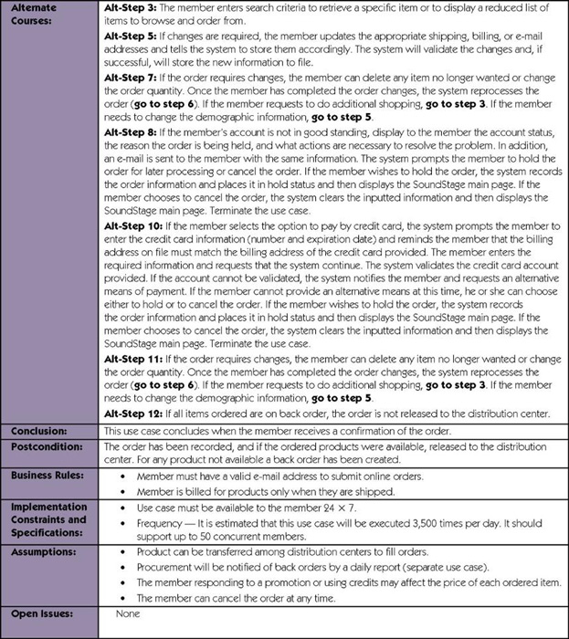

Slide 68
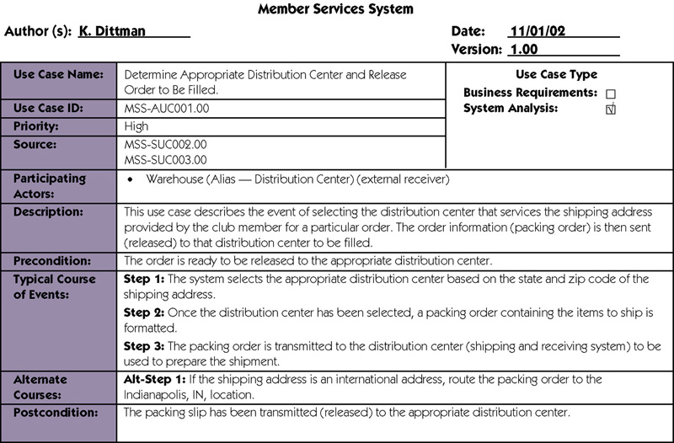

Slide 69
Use Case Description: Issue Video
Actors: Staff
Preconditions:
Staff has logged on to the system and selected ‘Issue Video’ option
Basic course
Staff scans the video bar code and the member’s card
System retrieves member’s account and video details
Staff presses OK
System generates transaction summary
Alternative courses
3. If membership dues pending then …

Slide 70
Use Case Description: Change Flight
Actors: traveler
Preconditions:
Traveler has logged on to the system and selected ‘change flight itinerary’ option
Basic course
System retrieves traveler’s account and flight itinerary from client account database
System asks traveler to select itinerary segment she wants to change; traveler selects itinerary segment.
System asks traveler for new departure and destination information; traveler provides information.
If flights are available then
…
System displays transaction summary.
Alternative courses
If no flights are available then …

Slide 71
ATM Money Withdraw Example
Actors: Customer
Pre Condition:
ATM must be in ready state
Post Condition:
The current amount of cash in the user account is the amount before withdraw minus withdraw amount
A receipt is printed for the withdrawn amount

Slide 72
ATM Money Withdraw - Mainline Scenario
Actor Actions | System Actions
1. Begins when a Customer arrives at ATM
2. Customer inserts a Credit card into ATM | 3. System verifies the customer ID and status
5. Customer chooses “Withdraw” operation | 4. System asks to enter operation type
7. Customer enters the cash amount | 6. System asks for the amount to be withdrawn
 | 8. System checks if withdraw amount is legal
 | 9. System dispenses the cash
 | 10. System deduces the withdraw amount from account
 | 11. System prints a receipt
13. Customer takes the cash and the receipt | 12. System ejects the cash card

Slide 73
ATM Money Withdraw (cont.)
Alternative flow of events:
Step 3: Customer authorization failed. Display an error message, cancel the transaction and eject the card.
Step 8: Customer has insufficient fun in his account. Display an error message, and go to step 6.
Step 8: Customer exceeds his legal amount. Display an error message, and go to step 6.
Exceptional flow of events:
Power failure in the process of the transaction before step 9, cancel the transaction and eject the card.

Slide 74
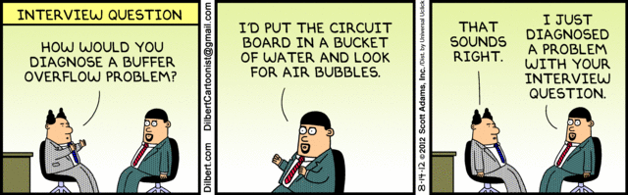

Slide 75
Guidelines for Effective Use Case Writing
Use simple sentence…
Do not have both system and actor doing something in a single step…
Bad: “Get the amount from the user and give him the receipt.”
Any step should lead to some progress:
Bad: “User clicks a key”
System
Actor
Actor asks for money
System asks for amount
Actor gives the amount
System produce the money

Slide 76
Identification of Use Cases
1. Actor-based:
- Identify the actors related to a system or organization.
For each actor, identify the processes they initiate or participate in.
2. Event-based
Identify the external events that the system must respond to.
Relate the events to actors and use cases.

Slide 77
Factoring Use Cases
Two main reasons for factoring:
Complex use cases need to be factored into simpler use cases for better design
Helps represent common behavior across different use cases
Three ways of factoring:
Generalization
Include
Extend

Slide 78
Generalization
The child use case inherits the behavior of the parent use case.
The child may add to or override some of the behavior of its parent.
parent
child

Slide 79
Generalization Example 1
Registration
Under-graduate
registration
Graduate
registration

Slide 80
Factoring Use Cases Using Generalization
Pay membership fee
Pay through credit card
Pay through library pay card

Slide 81
Include
When you have a piece of behavior that is similar across many use cases
Break this out as a separate use-case and let the other ones “include” it
Examples of use case include
Validate user interaction
Sanity check on sensor inputs
Check for proper authorization

Slide 82
Factoring Use Cases Using Include
Base use case
Common
use case
<<include>>
Base use case 2
Base use case 1
<<include>>
<<include>>
<<include>>
<<include>>
Common use case 1
Common use case 2
Common use case 3

Slide 83
Example of Factoring Use Cases Using Include
Issue Book
Renew Book
<<include>>
<<include>>
Check Reservation

Slide 84
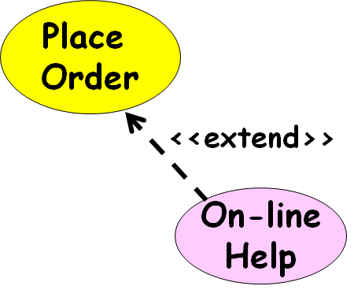
Extend
Use when a use-case can optionally do a little bit more:
Captures the normal behavior
Captures the extra behavior in a separate use-case

Slide 85
Factoring Use Cases Using Extend
Base
use case
Common
use case
<<extend>>

Slide 86
Factoring Use Cases Using Extend
Order
Item
Show
Catalog
<<extend>>

Slide 87
Extension Point
The base use case may include/extend other use cases:
At certain points, called extension points.
Note the direction of the arrow
Perform Sale
After checkout
<<extend>>
Gift wrap Product

Slide 88
Use Case Relationships
Order Product
Supply Customer Data
Arrange Payment
<<include>>
<<include>>
<<include>>
Place Order
Cash Payment
Credit Payment
Sales Person
<<extend>>
Salesperson asks for catalog
Request Catalog

Slide 89
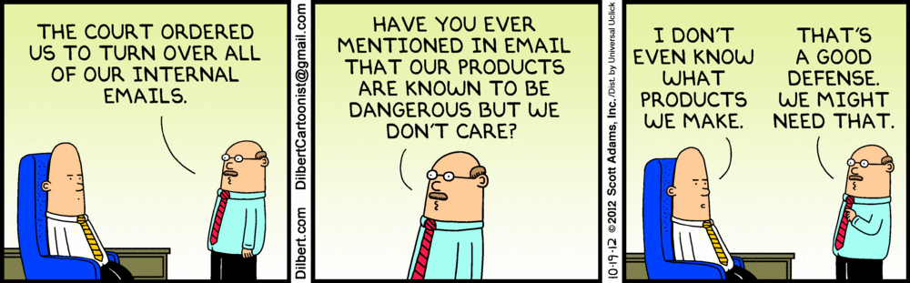

Slide 90
Exercise 2: Use Case Model for Course Management Software
At the beginning of each semester,
Each professor shall register the courses that he is going to teach.
A student can select up to four-course offerings.
During registration a students can at any time request a course catalogue showing course offerings for the semester.
Information about each course such as professor, department and prerequisites would be displayed.
The registration system sends information to the billing system so the students can be billed for the semester.
For each semester, there is a period of time during which dropping of courses is permitted.
Professors must be able to access the system to see which students signed up for each of their course offerings.

Slide 91
Exercise 2: Model Solution
Course Management Software
Register
Course
offering
See Course List
Show registration
Professor
<<Extend>>
{ reg courses< 5 courses}
Register course
<<External>>
Billing System
Student
{ if today<set date }
Drop Course
Calendar

Slide 92
Effective Use Case Modelling
Use cases should be named and organized from the perspective of the actor.
Use cases should start off simple and at as much high view as possible.
Can be refined and detailed further.
Use case diagrams represent functionality:
Should focus on the "what" and not the "how".

Slide 93
Hierarchical Organization of Use Cases
use case 1
use case 3
External users
use case 2
use case 3.1
use case 3.3
Subsystems
use case 3. 2
use case 1
use case 3
Methods
use case 2

Slide 94
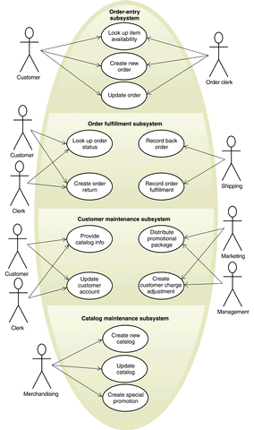
Too many use cases at any level should be avoided!

Slide 95
Use Case Packaging
Accounts
Query balance
Print
Balance sheet
Receive
grant
Make
payments

Slide 96
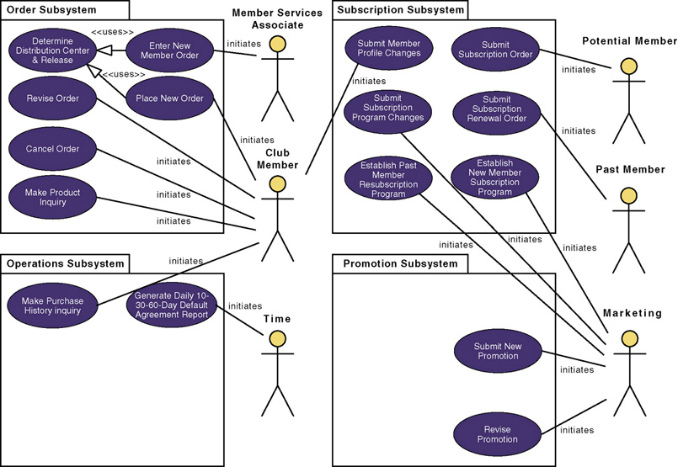
Use-Case Model using Packaging

Slide 97
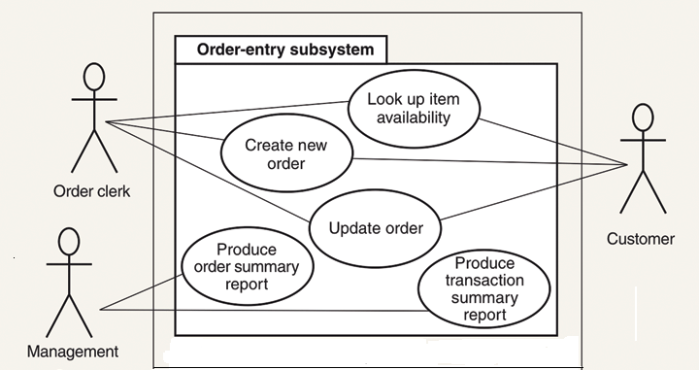
Use Cases of Order Entry Subsystem

Slide 98
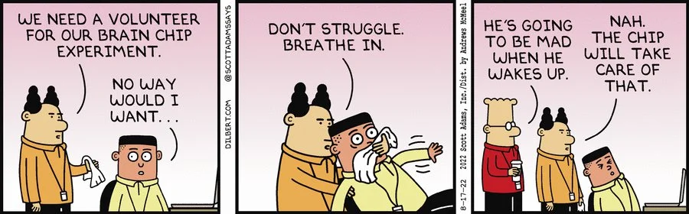

Slide 99
Use Case Style Notes (Ambler, 2005)
A Use case name should begin with a verb.
While use cases do not explicitly imply timing:
Order use cases from top to bottom to imply timing -- it improves readability.
The primary actors should appear in the left.
Do not use arrows on the actor-use case relationship.
To initiate scheduled events include an actor called “time”
Do not show actors interacting with each other.
<<include>> should rarely nest more than 2 deep.

Slide 100
Exercise: Home Assignment System - Use Case Model
HAS will be used by the instructor to:
Distribute the homework assignments,
Review the students’ solutions,
Distribute suggested solution,
Assign grade to each assignment.
Students can:
Download assignments and model solutions
Submit their assignment solutions and view grade
System:
Automatically reminds the students a day before an assignment is due.

Slide 101
Quiz: Naïve Solution (Inferior)
Remind Student
Calendar
Distribute Assignments
Get Assignment
Post Model
Solutions
Submit Assignment
<<Extends>>
Student
Distribute Grade
Get Model Solutions
Instructor
View
Assignment
Submissions
Get Grade

Slide 102
Quiz: Alternate (Better) Solution
Distribute Assignments
Post Model
Solutions
Student
Distribute Grade
Instructor
Submit Assignment
Remind Student
Calendar

Slide 103
HW: Video Rental Store Software
A video rental store has a large collection of video CDs and DVDs in VHS and MP4 format as well as music CDs.
A person can become member a member by depositing Rs. 1000 and filling up details such as name, address, and telephone number. A member can cancel his membership and take back his deposit, if he has no dues outstanding against him.
Whenever the store purchases a new item, details such as price and date of procurement are entered. The daily rental charge is also entered by the manager. After passage of a year, the daily rental charge is automatically halved.
A member can, at a time, take on loan at most two video CDs and one music CD. The details are entered by a store clerk and a receipt indicating the daily rental charge should be printed by the software.
Whenever a member returns his loaned item(s), the due amount to be paid is displayed. After the amount is paid, the items are marked returned.
If a customer loses or damages any item, the full price of the item is charged to him and the item is removed from the inventory.
If an item is not lent out by anyone for even once over a year, the item is sold at 10% of the purchase price and is removed from the inventory.
The manager can, at any time, check the profit/loss account.

Slide 104
HW: IIT Security Software
The staff and students of IIT register their vehicle by filling up a form which a security staff would enter into the system.
Each time a vehicle enters or leaves the campus, a camera reads the registration number of the car, and the model of the car. If the car is registered, the check gate should lift automatically to let in (or out) the vehicle. The details regarding the entry and exit of the vehicle are registered in the database. For outside vehicles, the driver needs to enter the purpose of entry, the model number, the registration number, and a photograph of the vehicle is stored in the database.
When an outside vehicle leaves the campus, the details are automatically registered in the database. For any external vehicle that is inside the campus for more than 8 hours, the driver is stopped by the security personnel manning the gate, queried to satisfaction, and the response are recorded. Considering that there have been several incidence of speeding and rough driving, the security personnel are empowered to telephone the registration number of errant vehicles to the main gate. For outside vehicles, the driver is quizzed at the check gate and his future entry is barred if the response is not satisfactory. For inside vehicles, a letter is issued to the dean to deal with the employee or student as the case might be.
The security officer can check the data regarding the number of vehicles going in and coming out of the campus (over a day, month or year), the total number of vehicles currently inside the campus.

Slide 105
HW: Personal Library System
The software is required to manage the collection of books by individuals.
A person can have a few hundreds of books. The details of all the books such as name of the book, year of publication, date of purchase, price, and publisher must be entered. A book is to be given a unique serial number by the computer which would be written by the owner using a pen on the book. Before a friend can be lent a book, he must be registered. The registration data would include name of the friend, address, land line number, and mobile number. Before a friend is issued a book, the various books outstanding against him also with the date borrowed are displayed. The date of issue and the title of the book are stored. When a friend returns a book, the date of return is stored and the book is removed from his borrowing list. Up on query, the software should display the name, address, and telephone numbers of each friend against whom books are outstanding along with the titles of the outstanding books and the date on which those were issued.
The owner of the library software, when he borrows books from his friends, would enter the details regarding the title of books borrowed, and the date borrowed. Similarly, the return details of books would be entered. The software should be able display all the books borrowed from various friends. The owner should be able to query about the availability of a particular book, the total number of books in the personal library,

