Slide 1
Interaction Diagrams

Slide 2
What are Interaction Diagrams?
Can model the way a group of objects collaborate to realize some behaviour.
How many interaction diagrams to draw for a development project?
Typically each interaction diagram realizes behaviour of a single use case
Draw one sequence diagram for each use case.

Slide 3
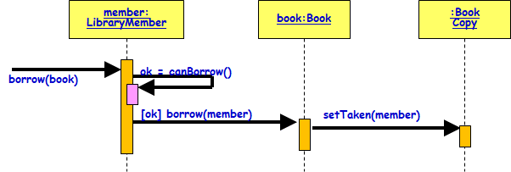
Interaction Diagrams
Three kinds:
Interaction overview diagram
Sequence and Collaboration (now communication diagram in UML 2.0) diagrams.
Sequence and Collaboration diagrams are actually equivalent:
But, portray different perspectives
As we shall see:
These diagrams play a very important role in any design process.

Slide 4
Interaction Overview Diagram
Focuses on the overview of the flow of control of the interactions.
It is a variant of the Activity Diagram:
Nodes are sequence diagrams.
Describes the interactions where messages and lifelines are hidden…

Slide 5
Interaction Overview Diagram
Each individual activity is pictured as a frame:
Can contain nested interaction diagrams.
Makes the interaction overview diagram useful to deconstruct a complex scenario:
Otherwise would require multiple if-then-else paths to be illustrated as a single sequence diagram"

Slide 6
sd Withdrawal
Skip
ref
Authenticate
Interaction Overview Diagram
PIN OK
PIN NOK
sd
sd
:User
:ATM
:Bank
:User
:ATM
withdraw
msg (“illegal entry”)
msg (“amount”)
amount (a)
chkAcct (a)
sd
sd
:User
:ATM
:Bank
:User
:ATM
:Bank
enough bal
not enough bal
money
msg(“amount too big”)
receipt
sd
:User
:ATM
msg (“card”)

Slide 7
A First Look at Sequence Diagrams
Captures how objects interact with each other:
To realize some behavior.
Time ordering of messages.
Can model:
Simple sequential flow, branching, iteration, recursion, and concurrency.
member: LibraryMember
book:Book
:Book Copy
borrow(book)
ok = canBorrow()
[ok] borrow(member)
setTaken(member)

Slide 8
Simple Rule: Develop One Sequence diagram for every use case
Use Case
Return Book
member: LibraryMember
book:Book
:Book Copy
ok = canBorrow()
borrow(book)
Borrow Book
Borrow Book
[ok] borrow(member)
Search Book
setTaken(member)

Slide 9
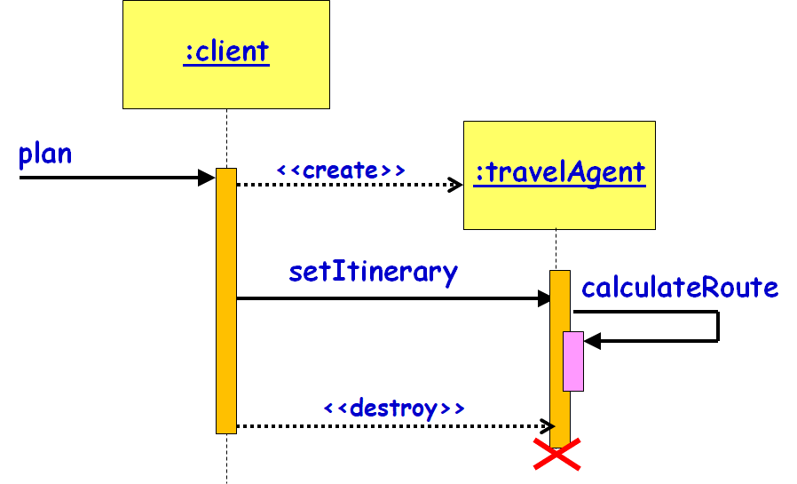
Sequence Diagram
Shows interaction among objects as a two-dimensional chart
Objects are shown as boxes at top
If object created during execution:
Then shown at appropriate place in time line
Object existence is shown as dashed lines ‏
Object activeness, shown as a rectangle on lifeline

Slide 10
Elements of A Sequence Diagram
Messages are shown as arrows.
Each message labelled with corresponding message name.
Each message can be labelled with some control information.
Two types of control information:
condition ([])‏
iteration (*)‏
member: LibraryMember
book:Book
:Book Copy
borrow(book)
ok = canBorrow()
[ok] borrow(member)
setTaken(member)

Slide 11
Gist of Syntax
iteration marker *[for all objects]
[condition]
Message is sent only if the condition is true
self-delegation
a message that an object sends to itself
Loops and conditionals:
UML2 uses a new notation called interaction frames to support these
member: LibraryMember
book:Book
:Book Copy
borrow(book)
ok = canBorrow()
[ok] borrow(member)
setTaken(member)

Slide 12
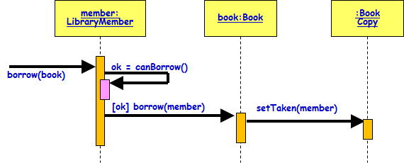
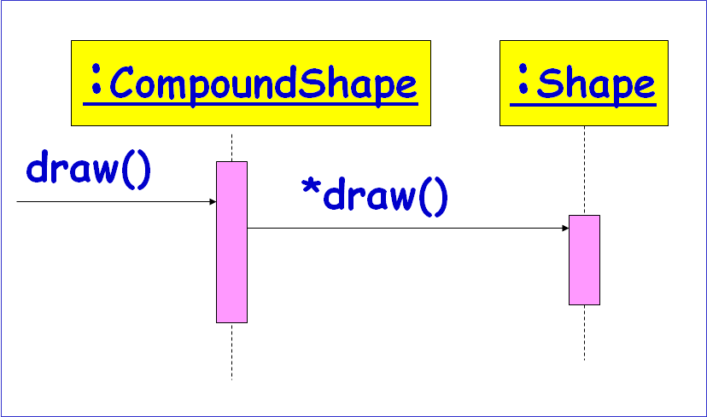
Control logic in Interaction Diagrams
Conditional Message
[ variable = value ] message()
Message is sent only if clause evaluates to true
Iteration (Looping)
* [ i := 1..N ] message()
“*” is required; [ ... ] clause is optional
The message is sent many times to possibly multiple receiver objects.

Slide 13
Elements of A Sequence Diagram
X-Axis (objects)
member: LibraryMember
book:Book
:Book Copy
borrow(book)
Object
Life Line
Y-Axis (time)
ok = canBorrow()
message
Activation box
[ok] borrow(member)
setTaken(member)
condition
How do you show Mutually exclusive conditional message?
13

Slide 14
Sequence Diagrams
How to represent Mutually exclusive conditional messages? Eg. msg2 to ClassB or msg3 to classC,
:ClassA
:ClassB
:ClassC
msg1( )
[flag = true] msg2( )
[flag = false] msg3( )

Slide 15
Representing an object
Class name, preceded by object name and colon:
Write object's name if it clarifies the diagram
Object's "life line" represented by dashed vertical line
Object
Anonymous
Active object
Object of unknown Class
Smith : Patient
:Patient
Smith
Active object
Object
LifeLine
Name syntax: <object name>:<class name>

Slide 16
Messages between objects
Message (method call) indicated by a horizontal arrow to other object:
Dashed arrow back indicates return
different arrowheads Sync/Async calls
Message name
Guard condition
arguments
[registered] Admit (pateintID, room type)
: Hospital
:Controller
Procedure Call
:Controller
:Controller
16
asynchronous
Synchronous flow of control
return

Slide 17
Example Sequence Diagram
member: LibraryMember
book:Book
:Book Copy
ok = canBorrow()
borrow(book)
[ok] borrow(member)
setTaken(member)

Slide 18
Elements of a Sequence Diagram
object
Activation
lifetime
message

Slide 19
Example Cont…
Sequence of message sending

Slide 20
Another Example of A Sequence Diagram
:Library
Boundary
:Library
Book
Renewal
Controller
:Library
Book
Register
:Book
:Library
Member
renewBook
find MemberBorrowing
displayBorrowing
selectBooks
bookSelected
* find
[reserved]
[reserved]
apology
update
apology
confirm
confirm
updateMemberBorrowing
Sequence Diagram for the renew book use case

Slide 21
Message Arrows for Communication
Message arrows represent the type of communications between two objects in a sequence diagram:
Synchronous message :
Sending object suspends action and waits for the response to the message
Asynchronous message:
Sending object continues with its operations without waiting for the response
A return of control from the synchronous message
A creation of a new entity
(filled head)
(open head)

Slide 22
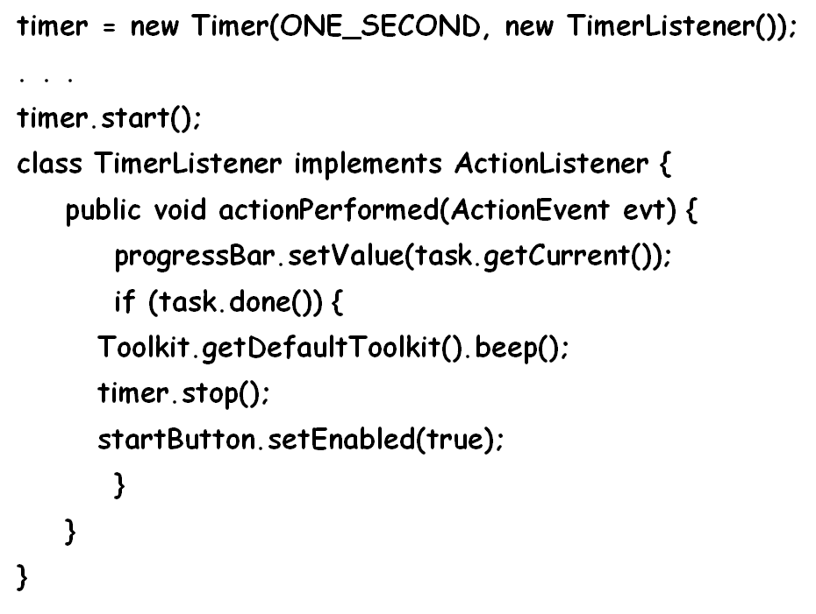
Asynchronous Message Example
An example is Timer handling in Java:
An object that implements ActionListener may register itself as a listener for a Timer object
The Timer object will store a handle to the object,
Later, when the Timer expires, an event will be issued to the object's 'actionPerformed' method
If the object had to wait for the timer to expire:
It could have wasted a long period of potential computation time.

Slide 23
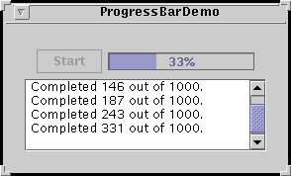
Example
timer = new Timer(ONE_SECOND, new TimerListener());
. . .
timer.start();
class TimerListener implements ActionListener {
public void actionPerformed(ActionEvent evt) {
progressBar.setValue(task.getCurrent());
if (task.done()) {
Toolkit.getDefaultToolkit().beep();
timer.stop();
startButton.setEnabled(true);
}
}
}

Slide 24
Another Asynchronous Message Example
:ActionListener
inv:Inventory
addActionListener(self:ActionListener)
Time
…continue operation…
The eventual
response is
called a callback
actionPerformed(e: ActionEvent)

Slide 25
Return Values
Optional --- indicated using a dashed arrow:
Label indicates the return value.
Don’t need when it is obvious what is being returned, e.g. getTotal()
Model a return value only when you need to refer to it elsewhere:
Example: A parameter passed to another message.
v
25

Slide 26
Summary of Kinds of Arrows
Procedure call or other kind of nested flow of control
(The sender losses control until the receiver finishes handling the message)
Flat flow of control(The sender does not expect a reply)
Return
(Unblocks a synchronous send)

Slide 27
Synchronous Messages
Flow of control, typically implemented as a method call.
The routine that handles the message is completed before the caller resumes execution.
:A
:B
doYouUnderstand()
return (optional)
Caller Blocked
yes

Slide 28
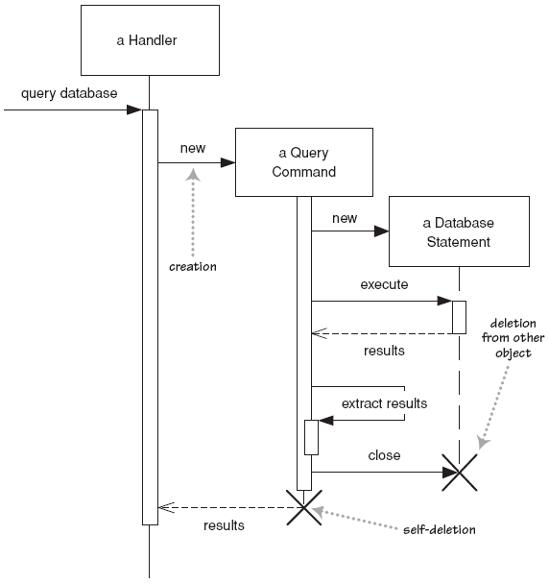
Lifetime of objects
creation: Dotted arrow with 'new' or create written above it
Notice that an object created, appears at point of call.
deletion: an X at bottom of object's lifeline
Java doesn't explicitly delete objects; they fall out of scope and are garbage-collected
28

Slide 29
Method calls
Activation: thick box over object's life line; drawn when object's method is already on the stack
Either that object is running its code, or it is on the stack waiting for another object's method to finish
Nest to indicate recursion
Activation
:Controller
Nesting
Activation

Slide 30
Object Creation
An object may create another object via a <<create>> message.
:A
<<create>>
:B

Slide 31
Object Destruction
An object may destroy another object via a <<destroy>> message.
An object may also destroy itself.
But, how do you destroy an object in Java?
Avoid modeling object destruction unless memory management is critical.
:A
:B
<<destroy>>

Slide 32
Looping
Iteration example UML 1.x:
:CompoundShape
:Shape
draw()
*draw()

Slide 33
Exercise 0
A user can use a travel portal to plan a travel
When the user presses the plan button, a travel agent applet appears in his window
Once the user enters the source and destination,
The travel agent applet computes the route and displays the itinerary.
Then travel agent applet gets destroyed once the user presses any key

Slide 34
Exercise 0: Solution
:client
:travelAgent
plan
<<create>>
setItinerary
calculateRoute
[any key press]
<<destroy>>
34

Slide 35
Exercise 1
A traffic police uses a traffic violation app to find the details of any traffic violation by entering the violation id. Details of the interactions are the following:
The police first presses the view button in the Violation dialog box of the app.
This request is conveyed to the server object
The server object asks for the violation id
Once the police enters the violation id, the server queries the DBproxy object using the id
Based on the response received from the DBProxy, the server creates a violation object and passes it to the dialog box for display.

Slide 36
Exercise 1: Solution
:Violations Dialog
:Violations server
:Violations DBProxy
Police
view
view
id=getID()
getViolation(id)
v:Traffic Violation
<<create>>
May be a pseudo-method
v
DB is queried and the result is returned as an object
display(v)
36

Slide 37
Method Population in Classes
Which methods should a class have?
Methods of a class are determined from the interaction diagrams…
:Registration
:Registration
form
manager
RegistrationManager
add course
(joe, math 01)
addCourse(Student,Course)
Notes:
37

Slide 38
Example Sequence Diagram: Borrow Book Use Case
member: LibraryMember
book:Book
:Book Copy
borrow(book)
ok = canBorrow()
[ok] borrow(member)
setTaken(member)

Slide 39
Sequence Diagram: Frames
A frame consists of:
1) Diagram identifier
2) Participants in a rectangle depicting the participating objects:
A dotted line that extends for the time period of the interaction
3) Messages to communicate among the participants
order process
:client
:order
:inventory
update
Locate item

Slide 40
Depicting a Frame Graphically
sd sample
:client
:order
:inventory
Interaction
Frame
update
operator
op1
Interaction
Frame
Operation
Name:
(e.g. loop)
Interaction Frame
Operand
Locate item

Slide 41

Frame Operator
ALT
[guard_1]
interaction_1
…
[guard_n]
interaction_n
Divided into a set of interactions by dotted lines
interaction_i is executed if guard_i is true

Slide 42
Frame Operators
Frame Operator | Meaning
Alt | Alternative fragment for conditional logic expressed in the guards
Loop | Loop fragment while guard is true. Can also write loop(n) to indicate looping n times.
Opt | Optional fragment that executes if guard is true
Par | Parallel fragments that execute in parallel
Region | Critical region within which only one thread can run

Slide 43
Fragment Operators: Full List
Skip
Conditional: operator “opt”
Loop: operator “loop”
Branching: operator “alt”
Reference: operator “ref”
Parallel: operator “par”
Critical Region: operator “critical”
Interrupt: operator “break”
Assertion: operator ‘’assert’’
Notes:
43

Slide 44
Example Sequence Diagram
order
:StoreFront
:Cart
:Inventory
loop
AddItem
ReserveItem
Need not show: Implicit Return
Checkout
ConfirmOrder
ProcessOrder
PlaceItemInOrder

Slide 45
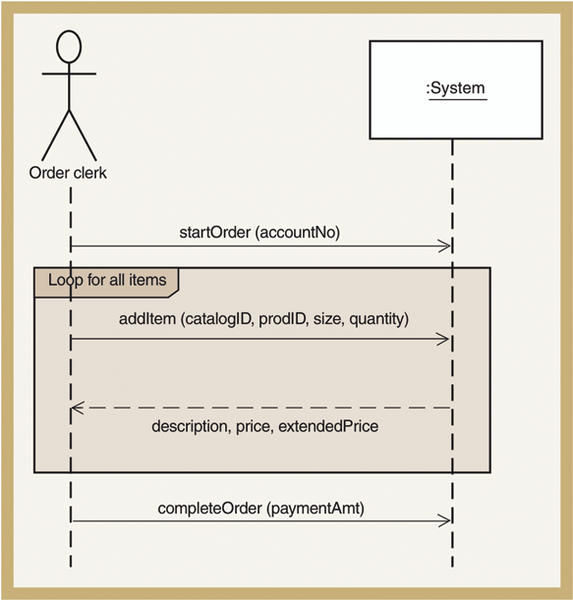
Sequence Diagram for Telephone Order use case
Repeat
Everything in
the rectangle

Slide 46
Alternative Fragment
sd sample
client
order
inventory
Combined
Interaction
Fragment
Interaction
Fragment
Operation
Name:
(Alternative)
Alt
[new_cust=yes]
cr_custinfo()
Interaction
Fragment
guards
[new_cust= no]
get_custinfo()
Cr_order( )
Interaction
Fragment
Operands

Slide 47
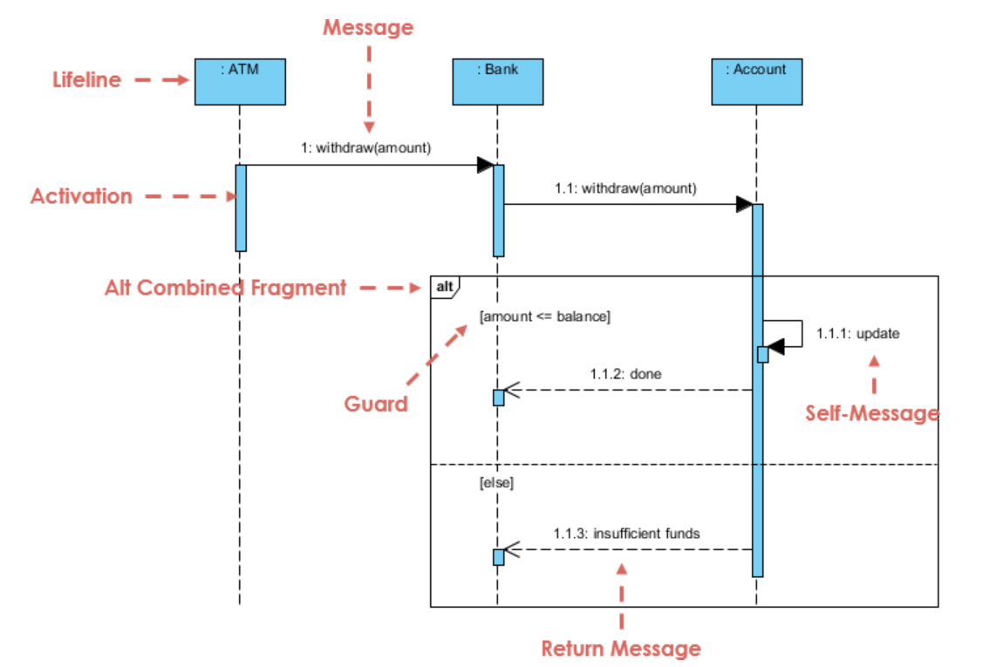
Example 2

Slide 48
Loop Fragment : Example
Search
:SearchEngine
:Repository
loop
[hasNext]
getNext()
test(item)
break
[found]
process(item)

Slide 49
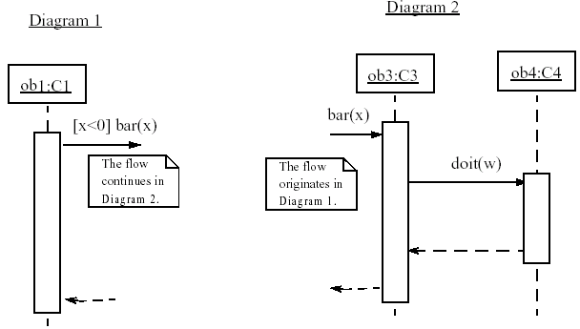
Linking Sequence Diagrams
If one sequence diagram is too large or refers to another diagram, indicate it with either:
an unfinished arrow and comment
a "ref" frame that names the other diagram

Slide 50
Nesting of Frames
:Foo
:Bar
m1
opt
[colour = red]
Loop
[n<100]
calculate
distribute

