Slide 1
Interaction Diagrams and Activity Diagrams
Lect 10 -- 11
28-08-2023

Slide 2
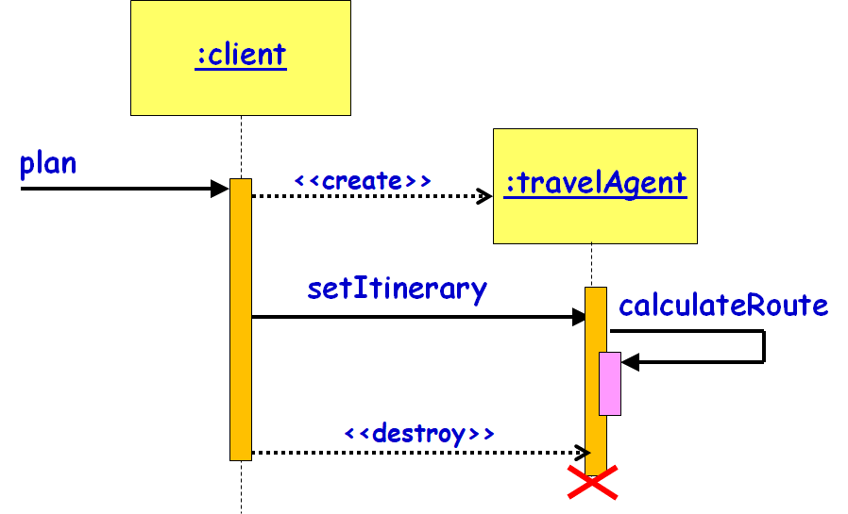
Sequence Diagram
Shows interaction among objects as a two-dimensional chart
Objects are shown as boxes at top
If object created during execution:
Then shown at appropriate place in time line
Object existence is shown as dashed lines ‏
Object activeness, shown as a rectangle on lifeline

Slide 3
Depicting a Frame Graphically
sd sample
:client
:order
:inventory
Interaction
Frame
update
operator
op1
Interaction
Frame
Operation
Name:
(e.g. loop)
Interaction Frame
Operand
Locate item

Slide 4
Nesting of Frames
:Foo
:Bar
m1
opt
[colour = red]
Loop
[n<100]
calculate
distribute

Slide 5
Exercise 1: Draw Sequence Diagram
“Compute Price” use case is invoked by customer in the context of a specific order to calculate price of the order.
All the line items are examined to determine their prices, which are based on the pricing rules of the order line’s products.
Then the overall discount is computed, which is based on rules tied to the customer.

Slide 6
Solution : First Identify Classes
“Compute Price” use case is invoked by customer in the context of a specific order to calculate price of the order.
All the line items are examined to determine their prices, which are based on the pricing rules of the order line’s products.
Then the overall discount is computed, which is based on rules tied to the customer.

Slide 7
Exercise 8: Example Answer
:Customer
:Order
:OrderLine
:Product
calculatePrice
Loop
For all line items
getQuantity
getProduct
getPricingDetails
getDiscountInfo
calculateDiscounts

Slide 8
Exercise 2: Print Server
A print server is an active object
Client applications send jobs to the print server
The print server enqueues a received object by calling a queue object
The job server takes up jobs one by one from the queue:
Prints them by sending them to the printer proxy

Slide 9
Exercise 2: Solution
Printing A
Document
Active object
:PrintServer
:Queue
:Printer Proxy
Client
Application
print(doc,client)
enqueue(job)
loop
[queue-not-empty]
job=dequeue()
print(job)
status
9

Slide 10
Code Generation
:Employee
:EmployeeDB
Emp=getEmployee(empId)
Public class EmployeeDB{
public Employee getEmployee(String empId){
…
}
}

Slide 11

Write Java Code…
:ShapeFactory
makeSquare
:Square
<<create>>
Public class ShapeFactory{
public Shape makeSquare(){
return new Square(); }
}

Slide 12
Exercise 3
:TreeMap
:TreeNode
clear
<<destroy>>
Public class TreeMap{
private TreeNode t;
public void clear(){
t=null;
}
}
Write Java Code

Slide 13
PurchaseItem Use Case: Exercise 4
Write Java Code for Controller
:Controller
purchase
<<create>>
:Purchase
public Class Controller {
private Purchase myPurchase;
private Payment myPayment;
public void purchase() {
myPurchase = new Purchase();
myPurchase.buyGrocery();
myPayment = new Payment( cashTender );
}
// . .
}
buyGrocery
<<create(cashTender)>>
:Payment

Slide 14
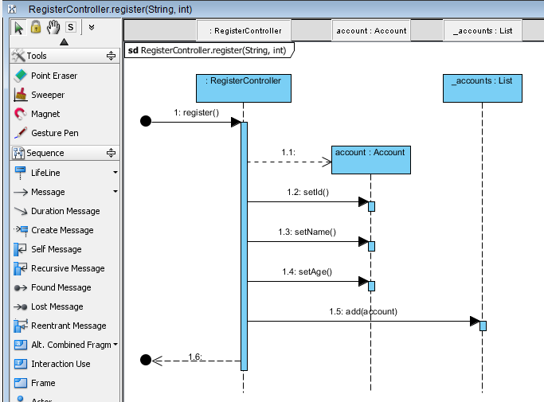
<<Create>>

Slide 15
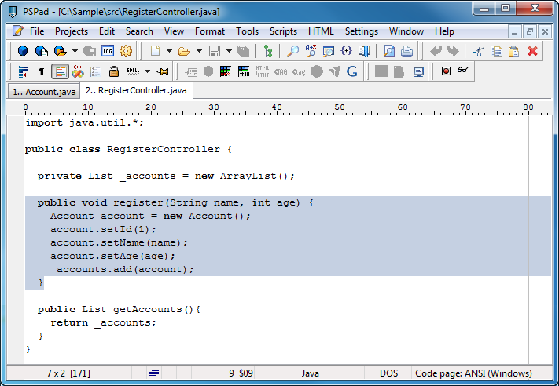

Slide 16
Ex 5: Sequence Diagram : Enroll Student
Write Java Code for AssgSubCmd
u:URSDatabase
stu:Student
procCmd(cmd)
parseCommand(cmd)
a:AssgSubCmd
<<create>>
execute()
getStudent(id)
return stu
getSubject(subId)
[if stu != NULL and sub != NULL]
return sub
addSubject(sub)

Slide 17
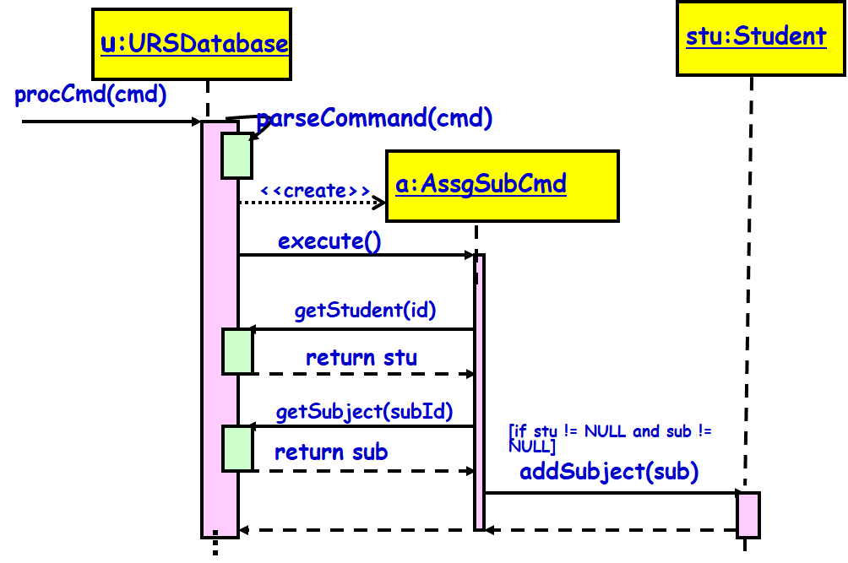
Ans: Java Code
class AssgSubCmd{
private URSDatabase u;
public execute(){
Student stu = u.getStudent(id);
Subject sub = u.getSubject(subId);
if (stu != null && sub != null){
stu.addSubject(sub);
}
}
}
Exercise 5

Slide 18
Exercise 6: Write Java Code for Sequence Diagram
:Account
:Order
:ShoppingBasket
[ValidUser]
return()
alt
placeOrder(Order: iOrderNo)
ref
return()

Slide 19
public void newTransaction(){
// behavior is an Interaction
if (ValidUser) // Alt combined fragment
{
placeOrder(iOrdNo); }
else
{
return;
}
}

Slide 20
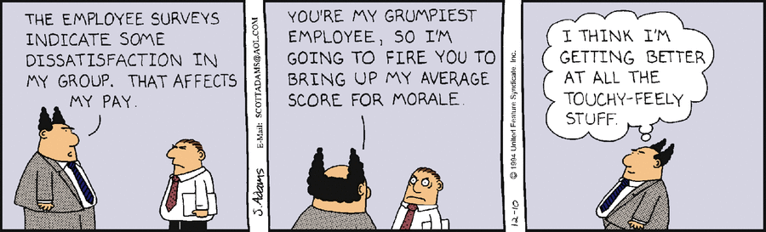

Slide 21
Collaboration Diagram
Known as Communication Diagram in UML 2
Shows both structural and behavioural aspects:
Objects are collaborators, shown as boxes
Messages between objects shown as labelled arrow placed near links
Messages are prefixed with sequence numbers to show relative sequencing
3 : notify()
4 : update()
s1 :StockQuote
Subscriber
1 : attach(s1)
6 : getState()
p : Stock
QuotePublisher
5 : update()
s2 :StockQuote
Subscriber
2 : attach(s2)
7 : getState()
21

Slide 22
Sequence to communication Diagram
objects
p : StockQuotePublisher
s1 : StockQuoteSubscriber
s2 : StockQuoteSubscriber
attach(s1)
attach(s2)
Procedure call, RMI, JDBC, …
Observer
design
pattern
Time
notify()
update()
{update < 1 minutes}
getState()
update()
getState()
3 : notify()
4 : update()
s1 :StockQuoteSubscriber
1 : attach(s1)
6 : getState()
p : StockQuotePublisher
5 : update()
s2 :StockQuoteSubscriber
2 : attach(s2)
7 : getState()

Slide 23
Collaboration Diagram for the renew book use case
:Book
6: * find
9: update
:Library
Boundary
:Library
Book
Renewal
Controller
:Library
Book
Register
:Book
:Library
Member
:Library
Book
Register
[reserved]
renewBook
find MemberBorrowing
displayBorrowing
8: apology
10: confirm
selectBooks
bookSelected
5: book
Selected
* find
[reserved]
[reserved]
[reserved]
apology
update
:Library
Boundary
1: renewBook
:Library
Book
Renewal
Controller
apology
7: apology
3: display
Borrowing
confirm
2: findMemberBorrowing
confirm
4: selectBooks
updateMemberBorrowing
12: confirm
:Library
Member
updateMemberBorrowing

Slide 24
Activity Diagram

Slide 25
Activity Diagram
Not present in earlier modelling languages:
Possibly based on event diagram of Odell [1992]
Often used to represent processing steps involving a group of use cases (workflow) :
Activities may not correspond to methods
An activity is a state with an internal action and has one incoming and one outgoing transition.
Vaguely similar to a flowchart
Fill Order

Slide 26
Uses of Activity Diagram
Normally employed in business process modelling.
Spans one or more use cases
Carried out during requirements analysis and specification stage.
Useful in developing use cases and test cases.

Slide 27
Activity diagram Example
Activity
Join
[order reject]
Receive
Pack
Ship
Close
Order
Order
Order
Order
[order
accepted]
Decision
Merge
Fork
Object
Send
Make
Payment
Accept
Invoice
Invoice
Payment

Slide 28
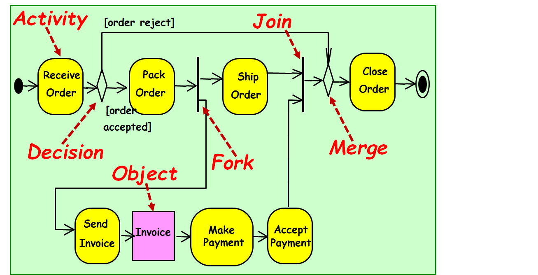
Activity Diagram Elements
Initial node
Activity final node
Action
Action Flow/Object flow/edge
Fork
Join
Decision
Merge
Object

Slide 29
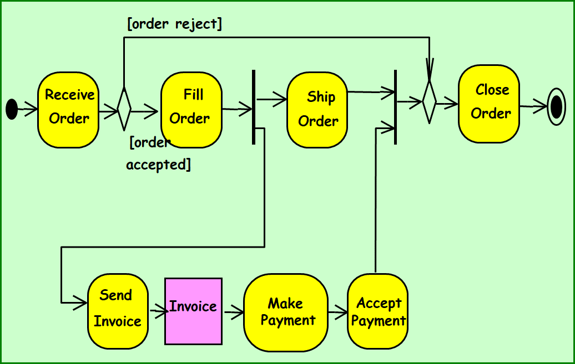
Nodes in Activity Diagram
UML 2.0 defines several types of nodes in an activity diagram:
Activity nodes
Object nodes
Control nodes

Slide 30
Activity
The fundamental unit for execution or behavior.
Represents some transformations or processing in the modeled system
Few Examples: Receive order, Check order, Ship order, Ship invoice, etc.
Receive order

Slide 31
Flows
Flows in an activity diagram do not have labels.
Two types:
Control-flow transitions indicate completion of an action and possibly start of another
Object-flow transitions indicate that an action inputs or outputs an object

Slide 32
Controlling Steps
Borrowed from state machines
Initial state
Final state
Decision and merge
Fork and join
Notes:
32

Slide 33
Initial and Final Nodes
Initial node: filled circle.
Final node: Circle around filled circle
An activity diagram can have zero or more final nodes
First Action

Slide 34
Decision
A diamond with one flow entering and several leaving.
[Drink contains
alcohol]
[else]
[Customer Is less than 21 Years Old]
Customer Orders Drink
[Customer Is At least 21 Years Old]
Serve Drink
guard

Slide 35
Decision and merge
Calculate
Cost
[cost < 50]
Charge
Account
[cost >= 50]
Get
Authorization
Notes:
35
Use merge instead of dummy state before join.

Slide 36
Fork
Denotes the beginning of parallel actions.
Verify Order Products Are In Stock
Receive Order
Verify Customer Has Available Credit

Slide 37
Join
Models Synchronization: several flows entering and only one leaving.
All incoming flows must reach it before processing can continue.
This denotes the end of parallel processing.
Verify Order Products Are In Stock
Accept Order
Verify Customer Has Available Credit
Synchronization bar

Slide 38

Summary of Activity Diagram Nodes
Three type of nodes:
Action nodes: executable activity
Control nodes: coordinate flows in an activity diagram between nodes
Object nodes: indicate an instance of a particular object, may be available at a particular point in the activity
Receive order

Slide 39
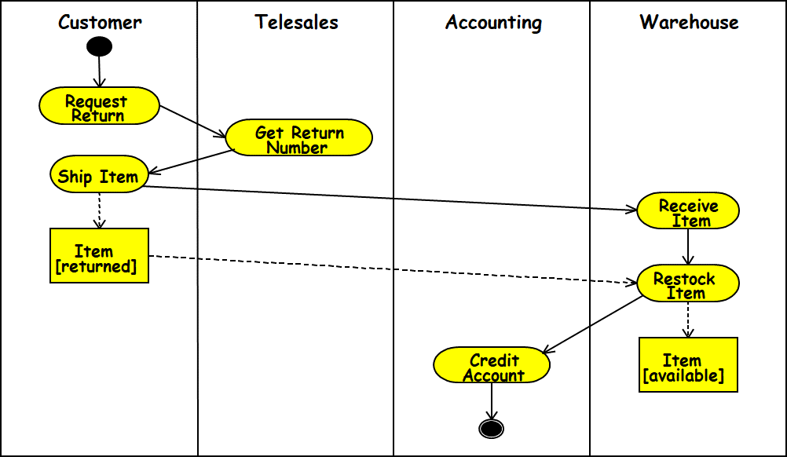
Swim Lane
Swim lanes are used to represent who performs which activities.
Each action is assigned to one swim lane.
Activity flows can cross lanes.
Relative ordering of swim lanes has no semantic significance.

Slide 40
Customer
Sales
Stockroom
Request service
Take Order
Pay
Pack Order
Dispatch Items
Collect items

Slide 41
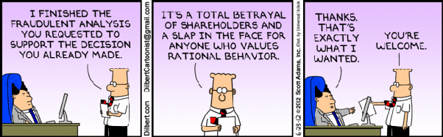

Slide 42
Object Flow
Take Order
Order
[Taken]
Pack Order
Take Order produces an order object.
Pack Order takes an order object as input.
Dashed lines used with object flow have the same semantics as normal transition.
Notes:
More about semantics of dashed line in pitfalls section.
A step parameter refers to the parameters of the operations invoked by action states. Take Order and Fill Order can be subactivity states, whereupon the parameters are in the first/last action state in the subactivity graph, recursively.

Slide 43
The transition between an object parameter and an activity node is represented with a dashed line, instead of a solid line
Customer
Sales
Stockroom
Request service
: Order [placed]
:Order [entered]
Take Order
Pay
Pack Order
: Order [filled]
:Order [delivered]
Collect order
Deliver order

Slide 44
Signals
Signals are essentially for message interactions with external systems/processes.
Usually appear in pairs of sent and received signals, because often response is expected for sent signals.
Request Payment
Receive Payment
Send signal
Accept signal

Slide 45
Received Signals
A received signal:
Indicates that the activity receives an event from an outside process.
An activity listens to signals, and the diagram defines how the activity reacts.
A ‘time signal’ occurs on passage of time
For example, each month end might trigger a signal.

Slide 46
Signals
Basically, signals are flow triggers.
Send signal Time signal Accept signal

Slide 47
Process Order
Request Payment
Receive
Payment
Ship Order
Report
Meter Reading
Receive
Cancel Request
Cancel Order
At end of month

Slide 48
Activity Diagram vs Flow Chart
Can represent parallel activity and synchronization aspects
Swim lanes:
Allows grouping activities based on who is performing them
Example: Academic department vs. Hostel

Slide 49
Activity Diagram Example: Student Registration
initial
Initialize
activity
Add student
fork/spawn
Notify Teacher
Notify Billing
Synchronization
[count >= 100]
[ count < 100 ]
guard
Finalize course
final

Slide 50
Another Example Activity Diagram: student admission process at IIT
Academic Section
Accounts Section
Hostel Office
Hospital
Department
check
student
records
receive
fees
allot
hostel
create
hospital
record
receive
fees
register
in
course
conduct
medical
examination
allot
room
issue
identity card

Slide 51
Item Ordering: Example 3
Customer
Telesales
Accounts
Warehouse
Request
Order
Take
Order
Generate
Invoice
Pay Bill
Invoice
Pack
Order
Verify
Account
Ship
Order
Notes:
Diagram assumes that:
1) Receive Item and the OFS Item can be traversed in parallel. Same for Credit Account and Item OFS.
2) Restock item will not start until its Item input has arrived.
3) State machine can terminate with hanging Item OFS.
These are natural assumptions for an object flow language, but UML is state machine based.

Slide 52
Item Returning: Example 4
Customer
Telesales
Accounting
Warehouse
Request
Return
Get Return
Number
Ship Item
Receive
Item
Item
[returned]
Restock
Item
Credit
Item
Account
[available]
Notes:
Diagram assumes that:
1) Receive Item and the OFS Item can be traversed in parallel. Same for Credit Account and Item OFS.
2) Restock item will not start until its Item input has arrived.
3) State machine can terminate with hanging Item OFS.
These are natural assumptions for an object flow language, but UML is state machine based.

Slide 53
Uses and Abuses of Activity Diagrams
Activity diagrams are useful to show behavior that spans multiple use cases:
Describe the workflow of the overall process.
Capture multiple objects and their high-level interactions
Activity diagrams are particularly helpful for representing an overview of concurrent processes
Activity diagrams are not used for describing how an object behaves over its lifetime. Use a state diagram instead.

Slide 54
Quiz 1: Order Processing
The customer service Department receives orders and sends out invoices to the customer.
It passes on the order to the order processing Department to process the order
For a rush order, the customer service Department prepares for an overnight delivery by express mail:
Otherwise it prepares to send by speed post.
As soon as the payment is received by the finance Department from the customer:
The order is dispatched by the customer service Department and it also closes the order.

Slide 55
Customer services department
Order Processing department
Receive order
Finance department
Fill order
Send invoice
[rush order]
[Else]
Overnight delivery
Ordinary delivery
Receive payment
Quiz 1:
Answer
Close order

Slide 56
Package Diagrams
A package is a grouping of several classes:
Java packages are a good example
Package diagrams show module dependencies.
Useful for large projects with multiple binary files
Order Capture
UI
AWT
Mailing List
UI
Order Capture
Application
Mailing List
Application
Dependency
Oracle
Interface
Domain
Orders
Customers
Sybase
Interface
Database
Interface
{abstract}

Slide 57
Component Diagram
Captures physical structure of the implementation.
Purpose:
Organize source code
Construct an executable release
Specify dependencies

Slide 58
Component Diagram
What is a component?
A piece of software that can be independently purchased and upgraded, and can integrate seamlessly into customers’ existing software.
Order
Controller
Order Controller
UML 1 notation
UML 2 notation

Slide 59
Ball and Socket notation for Interfaces
Ball and socket notation is new in UML 2.0.
Components that consume (require) an interface:
Display a "socket" labeled with the interface name .
Components that provide (implement) an interface:
Display a "ball" labeled with the interface name.
Combining the two:
A compact way to say that Consumer talks to the provider via the named interface.

Slide 60
Component Diagram: Example
Library
UI
Librarian
DB
Ports can be named, such as the Security and Data ports
Database

Slide 61
Deployment Diagram
The deployment diagram shows:
How a software system will be physically deployed in the hardware environment.
Its main purpose is:
Show where the different components of the system will physically run and
How they will communicate with each other.
Since the diagram models the physical runtime:
A system's operation staff make considerable use of this diagram.

Slide 62
Deployment Diagram
Node:
A node represents a physical machine.
can host a program artifact.
To model a node, draw a three-dimensional cube with the name of the node at the top.
Physical nodes should be labeled with the stereotype device
Program Artifact:
Files, assemblies, DLL, or scripts
An artifact is usually a component

Slide 63
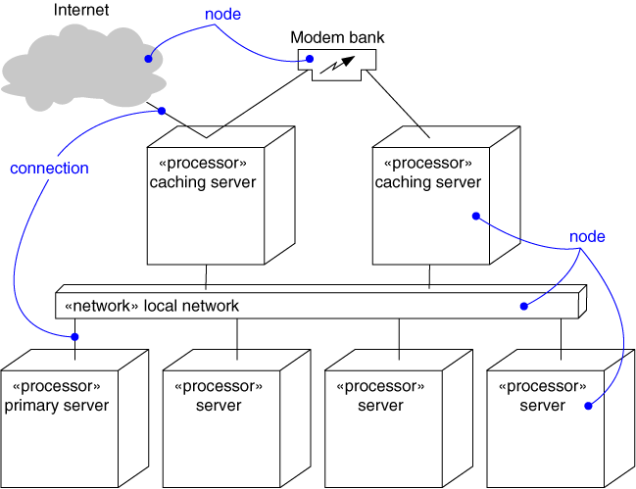
Deployment Diagram
Captures the topology of a system’s hardware
(A piece of hardware)

Slide 64
Architectural Modeling Using Deployment Diagram
Terminal
2
Terminal
Terminal
X
1
Branch
Server
ATM X
Terminal
1
Branch
Hub
Central
Terminal
Server
Bank
2
ATM 1
ATM 2
Terminal
X

Slide 65
End (UML Syntax & Semantics)

Slide 66
A Design Process
We discuss a design process based largely on Larman’s approach:
Also synthesizes features from various other methodologies.
From requirements specification, an initial model (domain model) is developed (OOA):‏
Analysis model is iteratively refined into a design model.
Design model is implemented using an OO language.

Slide 67
OOAD
Iterative and Incremental
OOA OOD/OOP
Definition
of
the problem
Domain Model
Use case model
Construction
of
the solution
Specification
Program

Slide 68
OOA versus OOD?
Analysis:
An elaboration of requirements.
Independent of any specific implementation
Design:
A refinement of the analysis model.
Takes implementation constraints into account

Slide 69
Design Process
OOA
OOD
User interface
Issues or GUI
prototype
Use case
diagram
Interaction
diagram
Informal
Requirements
SRS
document
Domain
model
Class
diagram
Code
Glossary

Slide 70
Domain Modelling
Represent objects appearing in the problem domain.
Also capture object relationships.
Three types of objects are identified:
Boundary objects
Entity objects
Controller objects

Slide 71
Boundary Objects
Handle interaction with actors:
User interface objects
Often implemented as screens, menus, forms, dialogs etc.
These do not perform any processing:
But may only validate input, format output, etc.

Slide 72
Entity Objects
Hold information over long term:
e.g. Book, BookRegister, Member
Normally are dumb servers:
Responsible for storing data, fetching data etc.
Elementary operations on data such as searching, sorting, etc.
Often appear as nouns in the problem description...

Slide 73
Controller Objects
Help to realize use case behavior:
Interface with the boundary objects
Coordinate the activities of a set of entity objects
Embody most of the business logic:
Take overall responsibility for use case execution.
Usually a use case is realized by one controller.

Slide 74
Controller Classes
Controller classes coordinate, sequence, transact, and otherwise control other objects…
Name attributed to Smalltalk MVC mechanism:
Where these objects were called controllers
Controller
Boundary
Entity

Slide 75
Example Use Case Realization
Boundary 1
Controller
Boundary 2
Entity 1
Entity 2
Entity 3
A use case is realized through the collaboration of
a controller and several boundary and entity objects

Slide 76
Identification of Boundary Objects
Need one boundary object :
For every actor-use case pair
Tic-tac-toe game
Supermarket
Prize scheme
register
customer
Customer
Clerk
Play Move
register
sales
Sales Clerk
select
winners
Player
Manager

Slide 77
Identification of Controller Objects
Examine the use case diagram:
Add one controller class for each use case.
Later on, some controllers may be removed or may need to be split into two or more controller classes if they have too much responsibility.
Supermarket
Prize scheme
Tic-tac-toe game
register
customer
Customer
Clerk
Play Move
register
sales
Sales Clerk
select
winners
Player
Manager

Slide 78
Identification of Entity Objects
Usually appear as common nouns in the problem description.
From the list of nouns, need to exclude:
Users (e.g. accountant, librarian, etc)
Passive verbs (e.g. Acknowledgment)
Those with which you can not associate any methods
Those with which you can not associate any data to store
Surrogate users may exist as classes:
Library member

Slide 79
Identify Classes
A partial requirement:
Of course, not all nouns will correspond to a class or object in the final solution
The user must be allowed to specify each product by
its primary characteristics, including its name and
product number. If the bar code does not match the
product, then an error should be generated to the
message window and entered into the error log. The
summary report of all transactions must be structured
as specified in section 7.A.

Slide 80
Identify Entity Classes
Eliminate improbable nouns:
Improbable nouns: Nouns with which no attributes or methods can be associated
The user must be allowed to specify each product by
its primary characteristics, including its name and
product number. If the bar code does not match the
product, then an error should be generated to the
message window and entered into the error log. The
summary report of all transactions must be structured
as specified in section 7.A.

Slide 81
Noun Analysis: Another Example
A trading house maintains names and addresses of its regular customers. Each customer is assigned a unique customer identification number (CIN). As per current practice, when a customer places order, the accounts department first checks the credit-worthiness of the customer.

Slide 82
Identify Classes by Noun Analysis
A partial requirements document:
Not all nouns correspond to a class in the domain model
A trading house maintains names and addresses of its regular customers. Each customer is assigned a unique customer identification number (CIN). As per current practice, when a customer places order, The accounts department first checks the credit-worthiness of the customer.

Slide 83
It is Challenging to Identify Classes!
Often it is challenging to decide:
Whether something should be represented as a class
Example:
Should an employee's address be represented as a set of instance variables or as an Address object
When a class becomes too complex,:
It should be decomposed into multiple smaller classes to distribute the responsibilities

Slide 84
Identification of Entity Objects: Some Hints
Usually:
Appear as data stores in DFD
Occur as aggregate objects
The aggregator corresponds to registers in physical world
CustomerRegister
*
CustomerRecord

Slide 85
Naming Classes
Class names should be singular nouns
Examples: Member, Student, Book
Book
Member
Student

Slide 86
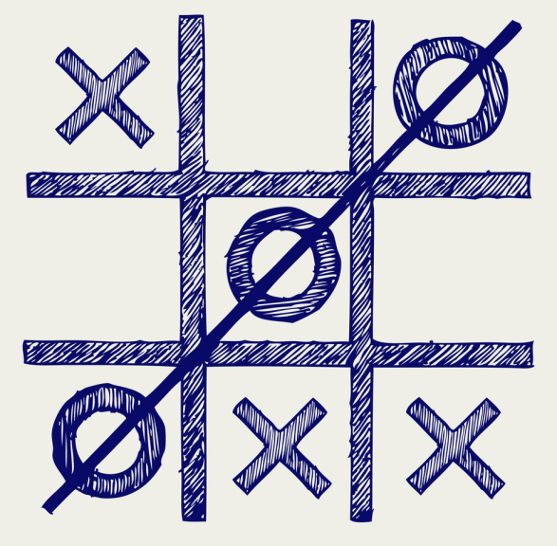
Example 1: Tic-Tac-Toe Computer Game
A human player and the computer make alternate moves on a 3X3 square.
A move consists of marking a previously unmarked square.
The user inputs a number between 1 and 9 to mark a square
Whoever is first to place three consecutive marks along a straight line (i.e., along a row, column, or diagonal) on the square wins.

Slide 87
Example 1: Tic-Tac-Toe Computer Game cont…
As soon as either of the human player or the computer wins,
A message announcing the winner should be displayed.
If neither player manages to get three consecutive marks along a straight line,
And all the squares on the board are filled up,
Then the game is drawn.
The computer always tries to win a game.

Slide 88
Example 1: Tic-Tac-Toe Use Case Model
Tic-tac-toe game
Play Move
Player

