Slide 1
SOLID Principles
Lect 14
05-09-2023

Slide 2
SOLID Principles --- Use to Avoid Poor Design
Acronym of 5 acronyms:
SRP: Single Responsibility Principle
OCP: Open-Closed Principle
LSP: Liskov Substitution Principle
ISP: Interface Segregation Principle
DIP: Dependency Inversion Principle

Slide 3
The Open/Closed Principle (OCP)
based on an article of that title by Robert Martin
Notes:
3

Slide 4
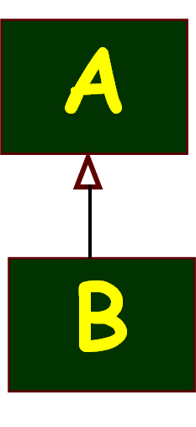

Statement of OCP Principle
Classes should be open for extension, but closed for modification.
Open: A class is open if it can be extended:
Add data members and operations through inheritance.
Closed: A class is closed if it is available for use by other components but it cannot be changed:
It can be put under a configuration control tool, allowing read only access.
Notes:
4

Slide 5
Origin
The open/closed principle was first discussed as a fundamental object-oriented principle:
by Bertrand Meyer in: “Object Oriented Software Construction”, Prentice-Hall, 1988.
In large and complex systems, changes are frequent. Possible reasons:
Changing requirements
Latent errors
Performance issues
Notes:
5

Slide 6
Motivation
A small change to a class should not cause a cascade of changes in other classes.
Open/closed principle statement:
Once a class has been successfully tested --- it should never be changed, only extended to meet any changes required.

Slide 7
Consequence of OCP Violation
A simple change to a class:
Requires changes to be made to several other classes…
Seemingly unrelated classes get affected…
An example:
A programmer extended class A in minor ways but was surprised to see the methods of base class break down.

Slide 8
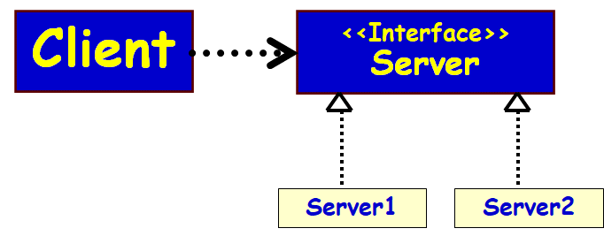
Solution
If you are not changing working code:
You are unlikely to break it.
Define an abstract or interface class:
Extend the interface/abstract class whenever any new feature is required.
The client class selects the appropriate object through dynamic binding.
This principle referred to as:
Program to an Interface.

Slide 9
Key Design Ideas of OCP
Open:
Can add functionality or data by extending it.
Closed:
Can not modify it.
Its protocol available to other classes for usage, but itself does not change.
That is, it has a stable interface
Implemented with interface/abstract classes

Slide 10
The Role of Interface/Abstract Class
It is very difficult to build a class that would never be required to change.
Two unavoidable reasons for changes:
Latent errors force change. We can’t fix incorrect operation by extension. The component itself must be fixed.
Performance problems force change. Met usually by changing an algorithm or some data structure.
Changes due to other reasons:
Can be achieved through extension.
Notes:
10

Slide 11
How to Prevent Clients to Change Even When a Server Class Changes?
When a server class changes:
Clients of the class should not be required to change.
How to achieve?
Principle: Let a server class implement some agreed Interface.

Slide 12
Programming to an Interface
When we program to an Interface:
A change to a server class implementing the Interface will not even require recompilation of clients.
What we can’t do is change the Interface definition.
Any change here may force changes on its clients.
How to handle this?
Notes:
12

Slide 13
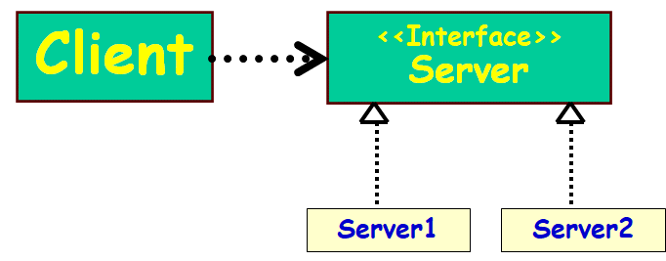
Using Interface for Decoupling…
How to avoid changing and recompiling clients each time server changes?
Instead of making supplier as a concrete class, make it an interface.
Concrete providers should not be subclasses of a concrete server,
but instead be realizations of interfaces…
Client
Server
How to do this?

Slide 14
OCP: Client-Server Example
Client
Server
OCP violation:
When server changes would require changes to the client.
Client
<<Interface>>
Server
OCP Compliant
Server1
Server2

Slide 15
Use Interfaces/Abstract Classes
Use of interfaces/Abstract Classes is a key idea in the Open/Closed Principle.
Interfaces are implemented, but are themselves closed to modification.
Since Interfaces have no implementation, they have no latent errors to fix and no performance issues.

Slide 16
OCP Through Use of Interfaces
Component 2
Component 1
Component 3
Component 4
Component 5

Slide 17
Review: OCP Achieved Using Abstract Classes
Client
<<abstract>>
Server
<<Uses>>
Server1
Server2
New types of servers can be added, by extending (or specializing) the Abstract Server class.

Slide 18
Example 1
The details of the employees of an educational Institute are maintained in an employee roster
The educational Institute has various types of employees:
Faculty
Technical staff
Secretary
Construct the domain model…

Slide 19
Example 1: Naïve Solution
Emp
Roster
*
OCP Violation
Employee
+int EmpType
Faculty
+getOffice()
Staff
+getDept()
Secretary
+getTypeSpeed()
Engineer
+getEngTYpe()
void printEmpRoster(Employee[] emps) {
for (int i; i<emps.size(); i++) {
if (emps[i].empType == FACULTY)
printFaculty((Faculty)emps[i]);
else if (emps[i].empType ==STAFF)
printStaff((Staff)emps[i]);
else if (emps[i].empType == SECRETARY)
printSecretary((Secretary)emps[i]);
}
}
What if we need to add Engineer??
Notes:
19

Slide 20
OCP Compliant Solution
Emp
Roster
*
<<Interface>>
Employee
+printInfo()
Faculty
+printInfo()
Staff
+printInfo()
Secretary
+printInfo
Engineer
+printInfo()
void printEmpRoster(Employee[] emps) {
for (int i; i<emps.size(); i++) {
emps[i].printInfo();
}
}
When Engineer is added, printEmpRoster() does not even need to recompile. PrintEmpRoster() is open to extension, closed for modification.
Notes:
20

Slide 21
Role of Interfaces/Abstract classes
Dependencies vanish when Interfaces or Abstract classes are used :
Effectively decouples clients and servers…
Use of Interfaces/ abstract classes is fundamental to design pattern solutions.
Client
<<abstract>>
Server
<<Uses>>
Server1
Server2

Slide 22
Java code
Client
<<abstract>>
Server
<<Uses>>
Server1
Server2
public abstract class AbstractServer{ public abstract void operation(); }
public class ConcreteServer extends AbstractServer { private int attribute; public void operation() { // implementation of operation } }

Slide 23
Example 2: Naïve Solution
Shape
shapeType : int
Circle
Square
origin : Point
radius : float
length : float
center : Point
width : float
drawCircle(circle: CircleData)
drawSquare(square : SquareData)
ShapeEditor
drawShape(shape : ShapeData)

Slide 24
class Shape { int shapeType; } class Rectangle extends Shape { Rectangle() { super.shapeType=1; } } class Circle extends Shape { Circle() { super.shapeType=2; } }
// Inferior Solution class ShapeEditor { public void drawShape(Shape s) { if (s.shapeType==1) s.drawRectangle(); else if (s.shapeType==2) s.drawCircle(); } }

Slide 25
Example 2 OCP-Compliant Solution
<<Interface>>
ShapeInterface
SmartShapeEditor
SmartShapeEditor is closed against changes from adding new shapes
It is open for extension, e.g. drawing new shapes
Just add new shapes and relink
drawShape(shape: ShapeInterface)
draw()
move()
public void
drawShape(ShapeInterface shape){
shape.draw();
}
Circle
Square
draw()
move()
draw()
move()

Slide 26
// Open-Close Principle – Compliant Solution abstract class Shape{ void draw(); } class Rectangle extends Shape{ public void draw() { // draw the rectangle } }
class ShapeEditor{ public void drawShape(Shape s) { s.draw(); } }

Slide 27
Achieving OCP
OCP usually achieved using:
Abstract/interface classes
Composition (plug-in)
Should you prefer Abstract class or Interface?
Ans: Depends. If some code needs to be shared, abstract class should be used. Otherwise, Interface classes.

Slide 28
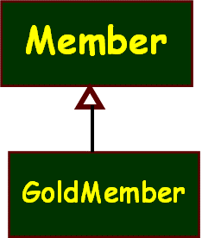
Exercise
At a supermarket, members were being given special discounts.
Later, the “gold member” category was introduced and these members were given further discounts.
Different member categories were identified by suitable value assignments to “type” attribute the of Member class.
a)What, if any, would be the problem, if a “platinum category members” is to be introduced?
b)How to solve the problem?
c)Give class diagram for your solution.
Member
type : int
name : String

Slide 29
a) Violation of OCP. Would require change to working code.
b) Clients should be able to program to Abstract class or Interface.
<<Abstract>>
Member
name : String
Solution
Concrete
Member
Gold
Member
Platinum
Member

Slide 30
Liskov Substitution Principle (LSP)
Ref: Barbara Liskov, “Data Abstraction and Hierarchy”, ACM SIGPLAN Notices, 23, 5 (May 1988)
Notes:
30

Slide 31
LSP Statement
A base class object should be substitutable with any of its derived class objects…
B
Logger
Logger
Now you require to support creation of Logs on remote machines
D
createLog
createLog
Careless extensions can cause problems…
NetworkLogger
Asks remote machine IP…
Derived class objects should not violate the behavior expected of the base class!

Slide 32
LSP: Statement of Principle
A
Methods using references to a class:
Must be able to use objects of any class derived from it without knowing the specifics of the derived object.
The base class provides a protocol that clients can use:
Without regard to the specific derived class responding to the client’s messages.
abstract class Credit {
...
abstract boolean validateCredit( Account a, int amt, CreditCard c);
...
}
B
EduCredit
BizCredit
IndividualCredit
IndianAccount
USAccount
UKAccount
EUAccount
JPAccount
OtherAccount
VISACard
AmExpCard
StoreCard
Notes:
32

Slide 33
Liskov Substitution Principle
“An instance of a derived class should be able to replace any instance of its super class.”
In effect, the base class establishes a basic behavior (functionality) that clients know of.
If a derived class violates the contract, then a violation of LSP occurs.

Slide 34
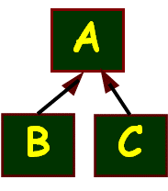
LSP in Plain English…
Any subclass object should always be seamlessly usable in place of its parent class object.
Corollary - All derived classes must honour contracts of their base classes:
IS A ➔ same public behavior
Pre-conditions can only get weaker (at most)
Post-conditions can only get stronger (at least)

Slide 35
Liskov’s Pre- and Post-conditions
Preconditons should not get strengthened in a derived class:
Precondition is the constraints that the input parameter to a method call should satisfy for the method to run correctly.
The parameters which work with the supertype, at least that much must work with the subtype
Postconditions should not get weakened in a derived class:
Post-condition is the constraint that the output result of a method should satisfy in a successful run
What is guaranteed by the supertype should also be guaranteed by the subtype

Slide 36
Pre conditions can only Get Weaker
Example:
void drive(car v); //super type
Now consider subtype overrides
void drive(Maruti m); //sub type
void drive(vehicle v); //sub type
✗
✓

Slide 37
Post conditions can only Get Stronger
Example:
Car create(); //super type
Now consider subtype overrides
Vehicle create(); //sub type
Maruti create(); //sub type
✗
✓

