Slide 1
Liskov Substitution Principle (LSP)
Ref: Barbara Liskov, “Data Abstraction and Hierarchy”, ACM SIGPLAN Notices, 23, 5 (May 1988)
Lect 15--16
11-09-2023
Notes:
1

Slide 2
LSP Statement
A base class object should be substitutable with any of its derived class objects…
B
Logger
Logger
Now you require to support creation of Logs on remote machines
D
createLog
createLog
Careless extensions can cause problems…
NetworkLogger
Asks remote machine IP…
Derived class objects should not violate the behavior expected of the base class!

Slide 3
LSP: Statement of Principle
A
Methods using references to a class:
Must be able to use objects of any class derived from it without knowing the specifics of the derived object.
The base class provides a protocol that clients can use:
Without regard to the specific derived class responding to the client’s messages.
abstract class Credit {
...
abstract boolean validateCredit( Account a, int amt, CreditCard c);
...
}
B
EduCredit
BizCredit
IndividualCredit
IndianAccount
USAccount
UKAccount
EUAccount
JPAccount
OtherAccount
VISACard
AmExpCard
StoreCard
Notes:
3

Slide 4
Liskov Substitution Principle
“An instance of a derived class should be able to replace any instance of its super class.”
In effect, the base class establishes a basic behavior (functionality) that clients know of.
If a derived class violates the contract, then a violation of LSP occurs.

Slide 5
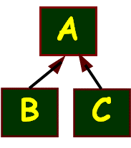
LSP in Plain English…
Any subclass object should always be seamlessly usable in place of its parent class object.
Corollary - All derived classes must honour contracts of their base classes:
IS A ➔ same public behavior
Pre-conditions can only get weaker (at most)
Post-conditions can only get stronger (at least)

Slide 6
Liskov’s Pre- and Post-conditions
Preconditons should not get strengthened in a derived class:
Precondition is the constraints that the input parameter to a method call should satisfy for the method to run correctly.
The parameters which work with the supertype, at least that much must work with the subtype
Postconditions should not get weakened in a derived class:
Post-condition is the constraint that the output result of a method should satisfy in a successful run
What is guaranteed by the supertype should also be guaranteed by the subtype
A method should at least work with parameters with which it was already working…
A method should at most return values which it was already returning…

Slide 7
Pre conditions can only Get Weaker
Example:
void drive(car v); //super type
Now consider subtype overrides
void drive(Maruti m); //sub type
void drive(vehicle v); //sub type
✗
✓

Slide 8
Post conditions can only Get Stronger
Example:
Car create(); //super type
Now consider subtype overrides
Vehicle create(); //sub type
Maruti create(); //sub type
✗
✓

Slide 9
The Square-Rectangle Problem
You thought square is a special type of Rectangle, so it is natural to derive a square from a rectangle…
Rectangle
Clients (users) of Rectangle expect
that setting height leaves width
unchanged (and vice versa)
Square does not fulfill this.
Client algorithms can get confused
Hack: A client attempts to identify subclasses and use if/switch (RTTI) to take specific actions…
height : double
width : double
+ setHeight (: double)
+ setWidth (: double)
Square
+ setHeight (: double)
+ setWidth (: double)
Class Square extends Rectangle{
void setHeight (double h) {
super.setHeight(h);
super.setWidth(h);
}
void setWidth(double w) {
setHeight(w);
}
This creates further problems!
Any problem?

Slide 10
LSP Implication
class Square extends Rectangle {
public void setWidth(int width) {
super.setWidth(width);
super.setHeight(width);
}
public void setHeight(int height) {
super.setHeight(height);
super.setWidth(height);
}
}
Class Client{
…
void clientOfRectangle(Rectangle r) {
r.setWidth(10);
r.setHeight(20);
print(r.area());
}
Void test(){
Rectangle r = new Square(…);
clientOfRectangle(r); // what would be printed?}
Rectangle
-int width;
-int height
+getWidth()
+setWidth()
+getHeight()
+setHeight()
+area();
Square
+getWidth()
+setWidth()
+getHeight()
+setHeight()

Slide 11

Where is the Problem?
clientOfRectangle() method made the following reasonable assumption:
Changing the width of a Rectangle leaves its height unchanged.
Clients of rectangle need to know they are working with a square:
If they want to take advantage of square’s property: height = width.

Slide 12
LSP: Analysis of the Problem
Deriving a square from a rectangle implies:
One of the state variables --- height or width is redundant.
Mathematically, a square may be a rectangle:
But, behaviorally a Square is not a Rectangle!
The behavior of a Square object is not consistent with the behavior of a Rectangle object!
Notes:
12

Slide 13
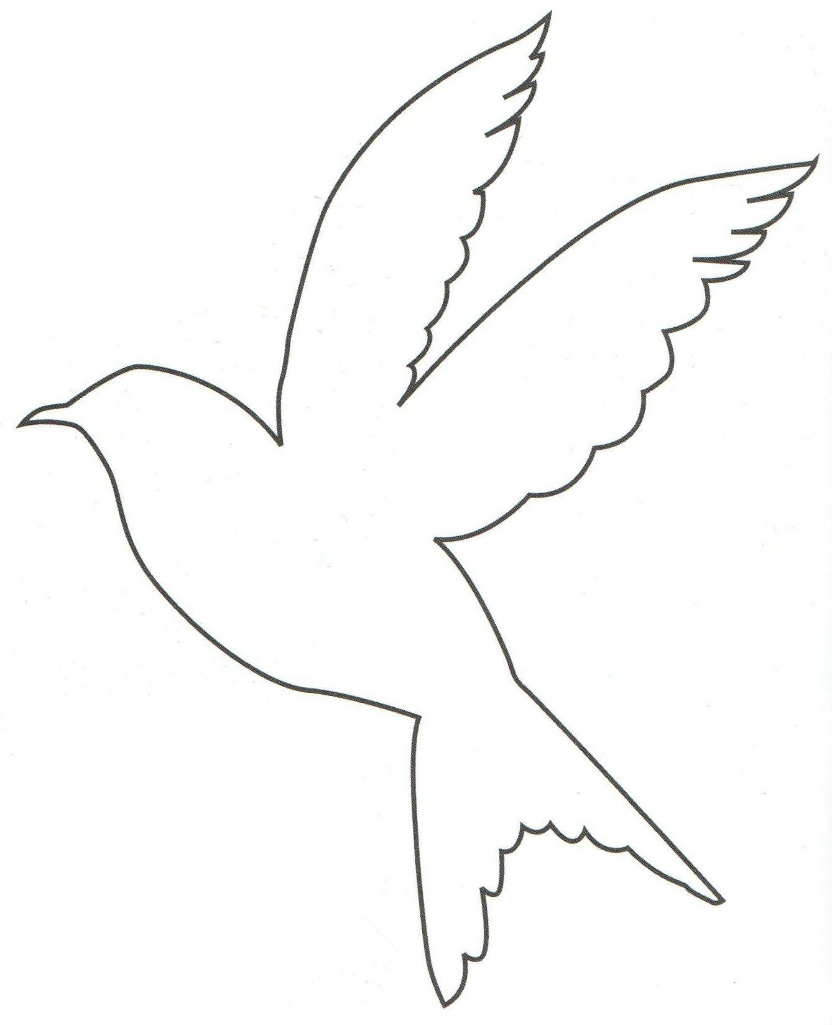

Using Inheritance Another Example…
class Bird { // has beak, wings,...
public void fly(); // Bird can fly
};
class Parrot extends Bird { // Parrot is a bird
public void mimic(); // Can Repeat words...
};
// ...
Parrot mypet;
mypet.mimic(); // my pet being a parrot can Mimic()
mypet.fly(); // my pet “is-a” bird, can fly
Bird
OK
Parrot

Slide 14
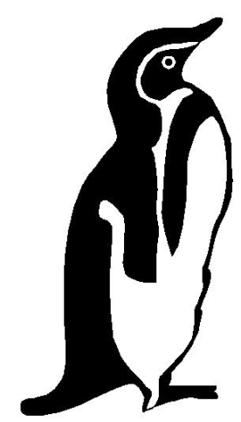
Penguins Fail to Fly!
class Penguin extends Bird {
public void fly() {
error (“Penguins don’t fly!”); }
};
void PlayWithBird (Bird abird) {
abird.fly(); // OK if Parrot.
// if bird happens to be Penguin...OOOPS!!
}
Bird
Penguin
Does not model: “Penguins can’t fly”
It models “Penguins may fly, but if they try it is error”
Run-time error if attempt to fly → not desirable
Check Substitutability - Fails LSP

Slide 15
Analysis of Failure Examples
LSP implies:
“is-a” relationship is based on behavior, not some intrinsic mental model.
The behavior of a rectangle:
Change its height and you leave its width unchanged…
Does not apply to squares and so square objects are not rectangle objects.

Slide 16
Simple Solution: Avoid Concrete Super Classes
All Super classes should be abstract.
Only leaf classes should be concrete.
Still some would say Why? Let’s see another example…
A class to provide accounts in a bank.
CurrentAccount
+withdrawAmt()
Change required: The bank wants to cater to savings accounts. How would you do that?

Slide 17
Naive Solution
Concrete superclass
CurrentAccount
+withdrawAmt()
The subclass inherits the shared functionalities
SavingsAccount
+addInterest()

Slide 18
Handling Changes…
CurrentAccount
+withdrawAmt()
Now the bank decides:
Allow a CurrentAccount to become overdrawn…
but not SavingsAccount.
How to do this?
SavingsAccount
+addInterest()

Slide 19
A Possibility…
public class CurrentAccount { ...
void withdraw (double amt) { if (this instanceof SavingsAccount) {
// check if becoming overdrawn }
else balance -= amt; } ...
}
Check the type of the account
What are some of the problems with this solution?

Slide 20
A Problem with the Solution
The superclass needs to take care of subclasses!
Public class CurrentAccount { void withdraw (double amt) { if (this instanceof SavingsAccount) {
If(becoming overdrawn){
error(“not allowed”); return;} }
balance -= amt; } }
If there is a new subclass, changes to the base code will be necessary:
…the super class is not closed.

Slide 21
Example Problem…
Consider adding a few new functionalities.
Example: Unlimited free cheque books in current account:
-- but not on SavingsAccounts.
void issueChequeBook (CurrentAccount a) { if (a instanceof SavingsAccount) return; dispatchChequeBook(); }
What is causing the problems?

Slide 22
The Root of the Problem
LSP Violation
CurrentAccount
+printChequeBook()
Superclass should only provide an interface that is implemented by all subclasses
Here it is also providing a default implementation…
SavingsAccount
+addInterest()
void issueChequeBook(CurrentAccount a) { if (a instanceof SavingsAccount) return; printChequeBook(); }

Slide 23
General LSP Solution
All super classes should be abstract.
<<abstract>>
Shape
Client
<<abstract>>
Account
<<Uses>>
Rectangle
Square
Savings
Current
Overrides with code that checks if becoming overdrawn

Slide 24
When is LSP of No Concern?
Faculty, Staff, Secretary and Engineer all have the same set of attributes and operations,
No new types of employees envisioned.
Employee
+printInfo()
generalization
Faculty
+printInfo()
Staff
+printInfo()
Secretary
+printInfo
Engineer
+printInfo()

Slide 25
Summary
The Liskov Substitution Principle (LSP) states:
Every method call that operates on a base class reference should operate similarly when a derived class object is substituted for the base object.
In doing this, it should not need to know which specific derived object it is dealing.
Notes:
25

Slide 26
The Single Responsibility Principle
based on an article of that title by Robert Martin
Notes:
26

Slide 27
Single Responsibility Principle
Each responsibility is a reason to change a class:
A Class should have only one reason to change.
How to know whether a class has many responsibilities?
The class’s responsibility is described using several “and”s…
SRP violation Reduces class cohesion

Slide 28
Single-Responsibility Principle (SRP)
Also referred to as “modularity”
If a class has two responsibilities:
The code for these get coupled, and often need to change together.
How to solve this problem?
Solution hint: delegate!

Slide 29
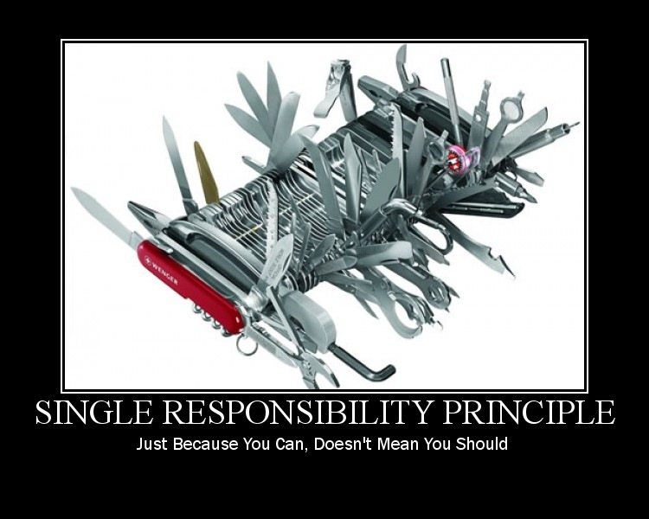

Slide 30

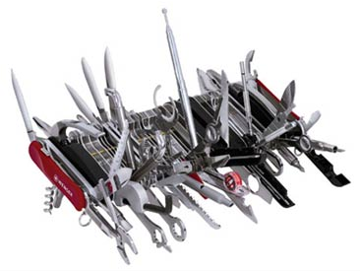
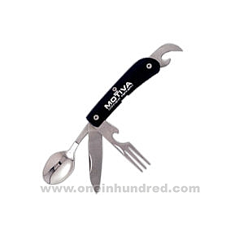
SRP: Main Idea…

Slide 31
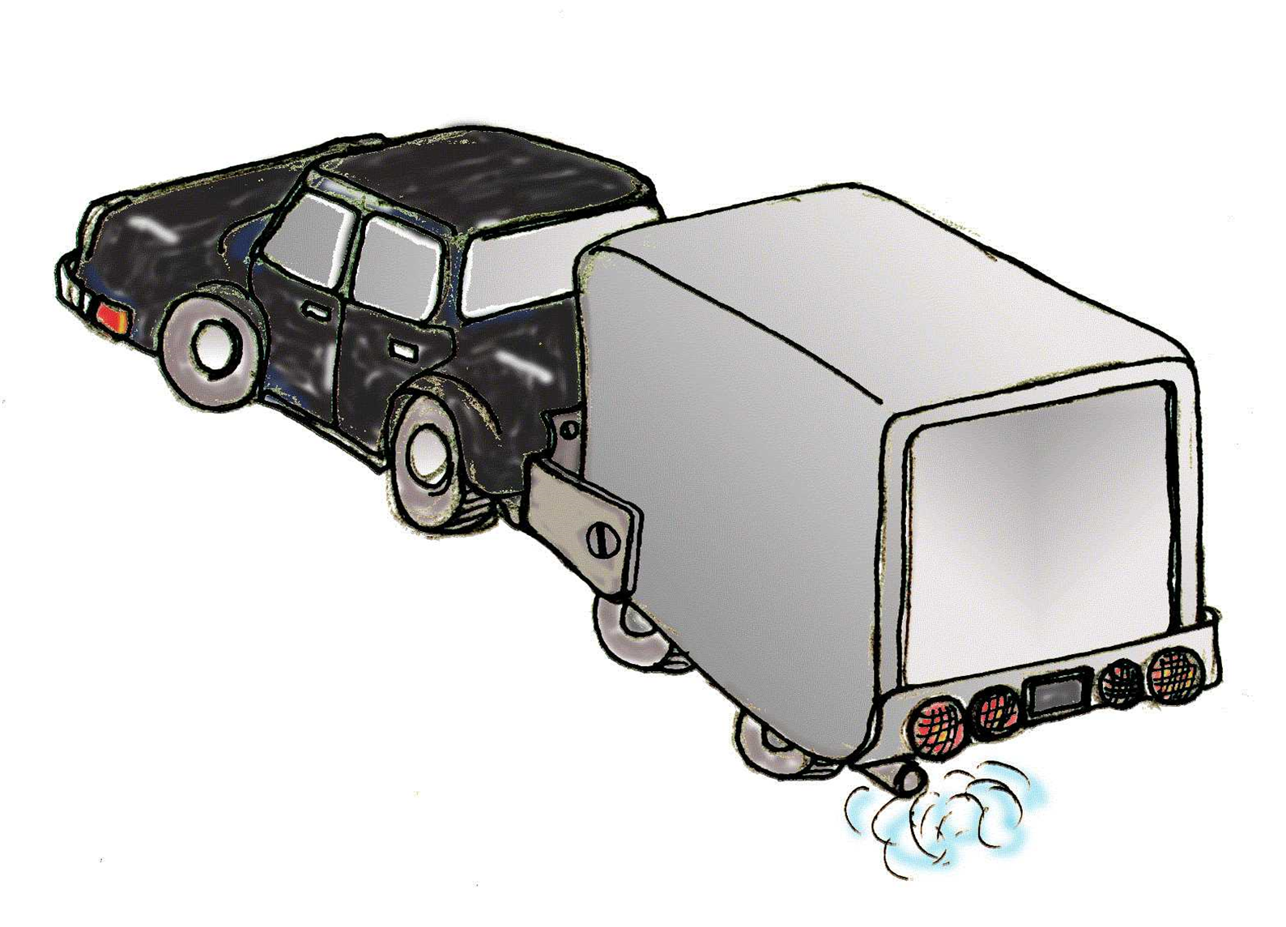
Why SRP?
Single Responsibility = increased cohesion
Violation leads to needless dependencies:
More reasons for changes.
Also becomes harder to reuse:
Rigidity, Immobility

Slide 32
Single Responsibility: First Example
Student
name
address
grades
feePayable
calculateGPA
calculateFee
student name
student address
grades
Semester fee payable
Why might this class definition change?
Notes:
Two answers: Student definition changes – or – we decide to store the student in a different way (DB? Network? Somewhere else)
32

Slide 33
SRP: 2nd Example
public interface Worker {
public void eat();
public void work();
}
public class OfficeWorker implements Worker{
public void work() {// ....work 8 hrs}
public void eat() {// .... eat in lunch break}
}
How to add a robot?
public class RobotWorker implements Worker {
public void work() {
// Do work }
public void eat() {
throw new NotImplementedException();
}
}
Notes:
33

Slide 34
SRP – Fix!
public interface Worker {
public void work();
}
public interface Eater{
public void eat();
}
public class OfficeWorker implements Worker, Eater{ … }
public class RobotWorker implements Worker{ …}
Now each interface has only one purpose
Notes:
Got here 11/20/2008
34

Slide 35
SRP: 3rd Example
Rectangle has 2 responsibilities
Computation
Geometry
Algorithm
Rectangle
Draw()
Area()
Graphics
Application
Rectangle
Draw()
Area()
Dependency
GUI
Changes to Rectangle may be needed from two unrelated sources.
1. Computational Geometry Application: Need area function to return result of type double.
2. Graphics Application (GA).
Need draw() in Windows 10 in addition to X Windows.
A change from either source will cause both the applications to recompile.

Slide 36
SRP: Initial Solution
Geometric
Rectangle
Area()
Graphic
Rectangle
Draw()
Graphics
Application
Comp Geo
Algorithm
GUI
Dependency
CGA is no longer dependent on Graphic Rectangle
Any change caused by graphics application no longer requires CGA to be recompiled.
However, any changes from the CGA side may cause GA to be recompiled.

Slide 37
Now How to Break Dependency of Graphic Rectangle on Geometric Rectangle?
<<Interface>> Geometric
Rectangle
Area()
Comp Geo
Algorithm
Graphic
Rectangle
Draw()
Graphics
Application
Geometric
Rectangle
Area()
GUI
Dependency

Slide 38
SRP: 4th Example
Shape
Line
draw()
area()
Rectangle
draw()
area();

Slide 39
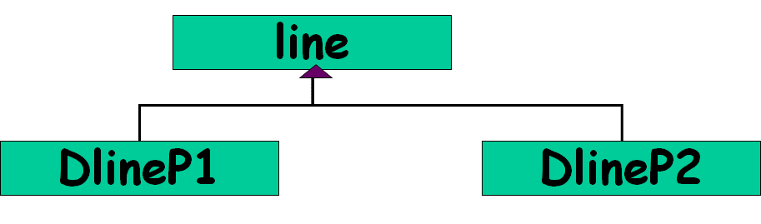
Now assume we need to support cheap low resolution displays as well as high resolution gaming displays… Drawing Line: 2 APIs Needed
Low resolution: dlineP1(x1, y1, x2, y2)
High resolution: dlineP2(x1, x2, y1, y2)
Similar for rectangle…
Rectangle
DRectP1
DRectP2

Slide 40
Obvious Solution…
line
DlineP1
DlineP2
Rectangle
DRectP1
DRectP2
Now need to support different types of drawings: dotted, dashed, dot and dash, etc.…

Slide 41
Obvious Solution…
line
lineDP1
lineDP2
Dotted
Dashed
Dotted
Dashed
Rectangle
RectDP1
RectDP2
Dotted
Dashed
Dotted
Dashed

Slide 42
Obvious Solution: Analysis
Advantages
Simple to implement
Simple to understand
Disadvantages
When number of shapes and drawing features increase:
Number of classes becomes LARGE (nXm)
Cohesion is low

Slide 43
Pattern Solution to the Problem: Bridge
defines the interface
shapes to draw
Shape
Drawer
Line
Triangle
Hi Res
Low Res
“adapters” for specific
drawing interfaces

Slide 44
Bridge Pattern
Shall discuss Details Little later…
Problem:
Decouple an abstraction from its implementation, so that the two can vary independently…
Also known as: Handle/Body pattern

Slide 45
SRP: A Reflection on Causes
Often inheritance is used to extend a class along unrelated dimensions:
Reduces method cohesion and violates SRP …
Student
UG
PG
PhD
resi
day
resi
day
rust
NR
rust
NR
rust
NR

Slide 46
SRP: A Reflection on Causes
Let’s say need arises to have different types of bank Accounts:
First, based on account type: Cash Account, Credit Account
Second, based on customer type: Individual Account, Institutional Account
These are two dimensions,
E.g. Individual Cash Account, Individual Credit Account, etc.
Often implemented as inheritance

Slide 47
Inheritance Diamond Problem
Do not inherit unrelated dimensions!
Account
Cash Account
Credit
Account
Individual Account
Institutional Account
Individual Cash Account
Two more classes here…
Individual Credit Account

Slide 48
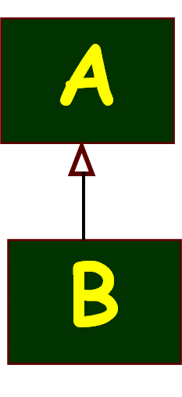
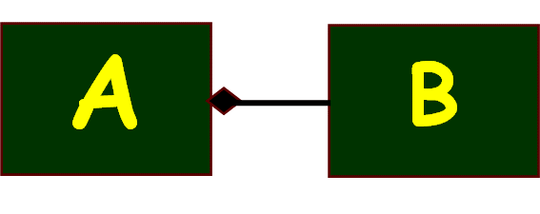
Inheritance versus Delegation
Two most common techniques for reuse
Class inheritance
white-box reuse: Add incremental functionality
Object Delegation
black-box reuse: New functionality is obtained by invoking the functionality of some object
Class inheritance: advantages
Easier implementation
Static: Easier understanding

Slide 49
Class inheritance: disadvantages
Inherited features can’t be changed at run time.
Even when you’re only trying to reuse the base class features in a subclass…
Bugs can appear in base class features.
Subclasses access Parent classes’ internal data:
breaks encapsulation

Slide 50
Delegation
Delegation can take place dynamically at run time:
Does not break encapsulation
A delegate object can be replaced at run time.
Helps to keep server class encapsulated and focused on one task.
Favor object delegation over class inheritance.

Slide 51
Favour Delegation over inheritance
inheritance
A
A
B
has a
isa
B
Delegation
BLACK box reuse
WHITE box reuse

Slide 52
Favor Delegation over inheritance
inheritance
Delegation
A
A
B
has a
isa
Caveat: sometimes inheritance is the right thing:
it gives us polymorphism
B
BLACK box reuse
WHITE box reuse

Slide 53
Dependency Inversion Principle
based on an article of that title by Robert Martin
Notes:
53

Slide 54
DIP: Statement
“Depend on Abstractions-- not on concretions”.
High level components should not depend upon low level components.
Abstractions should not depend upon details… Details should depend upon the abstractions…
Why?
High-level concepts are more stable than low-level implementations.
High Level
Low Level
Notes:
54

Slide 55
DIP
The goal is to limit dependence on the aspects of a design/implementation that may change.
There are times when dependency on concrete implementations is OK.
If the implementation is never going to change--- then no problem…
If going to change, then attempt to prevent dependencies on relatively lower level classes.

Slide 56
DIP: An Explanation
Whenever a certain functionality is implemented:
It can be divided into high level and low level parts.
The high level parts usually represent the concepts in the activity:
Whereas the low level parts implement the details of the high level activities.
Low level parts (code) more susceptible to change…
High Level
Low Level

Slide 57
Compute
Log to file
Any Problems?
High level concept depends on low level details!
What if we now require to write the log into database? --- Would require changes to Compute class… too bad…
Solution…
Compute
MessageLog Interface
How to know which is a high-level concept?
Gives orders to lower level concepts…
Log to file
Log to database

Slide 58
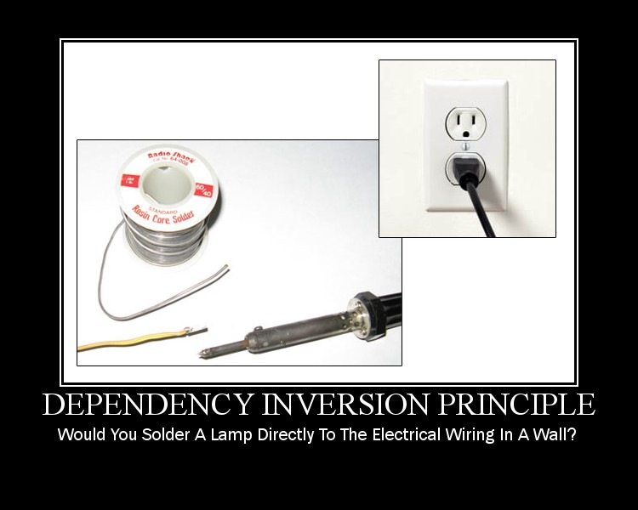
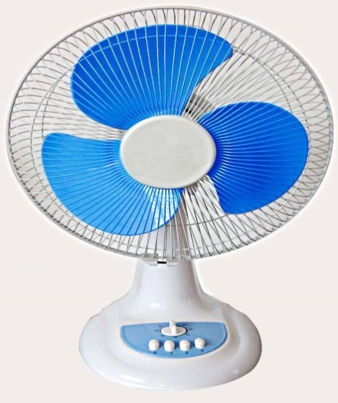
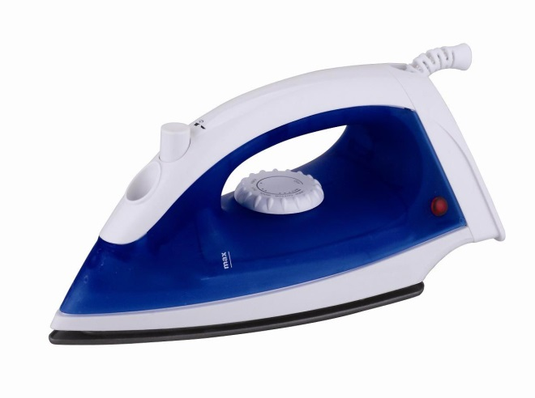
Solution: Use standard interfaces (sockets)

Slide 59
Dependency Inversion Principle
Higher level modules should not depend on the concrete lower level modules.
Should depend on abstractions
Interfaces or Abstract classes
Complex systems should be structured into layers.
But if that is not done carefully -- the top levels implicitly depend on the lower levels… Warranting unnecessary changes

Slide 60
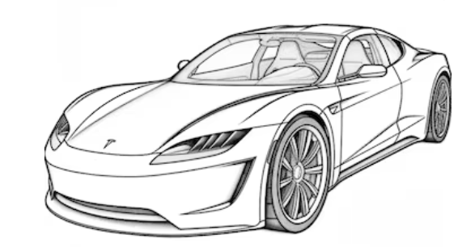
DIP: Another Example ...
Car
Petrol
Engine
For cost saving, you want to fit your Car with a CNG Engine:
Too bad if alterations needed to the car…
Should only change the engine…
How to achieve?
Car should be able to interface to any standard engine …

Slide 61
With DIP …
Car
<interface>>
Engine
Petrol
Engine
CNG
Engine
A higher level class must not depend on some lower level concrete class!
It must depend only on an interface ...

Slide 62
Removing Dependency
Dependency vanishes when changed from concrete to abstract ...
Client should not change due to changes to the implementation of the Server.
Server is open for extension through creation of new Server implementations…
Without AbsServer the Client is open to changes in Server.
Client
Client
- myServer : AbsServer
- myServer : Server
+doSomthing()
+doSomthing()
<<interface>>
AbsServer
+ serve() : Result
Server
+ serve() : Result
Server
+ serve() : Result

Slide 63
Summary of Requirement of DIP
No concrete class should directly refer to a class that is likely to change.

Slide 64
Depend On Abstractions
High-level modules should not depend on low-level modules.
Should depend on abstractions.
Abstractions should not depend on details.
Details should depend on abstractions.
Notes:
64

Slide 65
Is DIP Related to OCP?
For both: Depend on abstraction not implementation…
Or equivalently “design to interfaces”
OCP:
Use abstractions as an organizing principle.
Extensibility is then achieved by different realizations of the abstraction…
DIP:
Larger context: Partition solution to layers…
Rely on abstractions and not the concrete objects.

Slide 66
DIP Implications…
Layering
Interface based programming
Separated Interface:
Put interface in separate package than implementation
Dependency Injection

Slide 67
Plain old dependency creation
Example:
public class Foo {
private IBar bar;
private IBaz baz;
public Foo() {
bar = new SomeBar();
baz = new SomeBaz();
}
}
Cons
Class needs changes when any of it’s dependencies change.
Hard to change behavior without changing code
Hard to test as you must also test it with all that it depends. Cannot use mocks.
Pros
Easy to understand

Slide 68
First Solution: Service Locator
Example:
public class Foo {
private IBar bar;
private IServiceLocator locator;
public Foo(IServiceLocator locator_) {
locator = locator_;
bar = locator.Get();
}
}
Cons
The class depends upon the service locator
You must still get the locator to the class – either statically (yuk) or via… some sort of injection like mechanism
Pros
Easy to understand
Testable
Flexible
Extensible
Enforces separation of interface from implementation

Slide 69
Dependency Injection: Inversion of Control
Example:
public class Foo {
private IBar bar;
private IBaz baz;
public Foo(IBar bar_, IBaz baz_) {
bar = bar_;
baz = baz_;
}
}
Cons
You must create dependencies to pass along
Pros
Easy to understand
Testable
Flexible
Extensible
Enforces separation of interface from implementation
Code is simple and clear

Slide 70
What is Dependency Injection?
The ability to supply (inject) an external dependency into a software component as per requirement.
Types of Dependency Injection:
Constructor (Most popular)
Setter
Method

Slide 71
Dependency Injection
Description:
Allows injection of objects into a class, rather than relying on class to create the object
Responsibility for object creation and object linking is removed from the objects
Seeks to establish a level of abstraction via a public interface, and to remove dependency on components.
Martin Fowler described three main styles of dependency injection.
Constructor Injection: A constructor is used to decide how to inject ‘A’ implementation into the ‘B’ class. For this to work, B class needs to declare a constructor that includes everything it needs injected.
Setter Injection: define setter method that will accept the injection
Interface Injection: by defining an interface that performs the injection
Constructor Injection | Setter Injection | Interface Injection
public class MovieLister... public MovieLister(MovieFinder finder) { this.finder = finder; } | public class MovieLister... private MovieFinder finder; public void setFinder(MovieFinder finder) { this.finder = finder; } | public interface InjectFinder { void injectFinder(MovieFinder finder); } class MovieLister implements InjectFinder... public void injectFinder(MovieFinder finder) { this.finder = finder; }

Slide 72

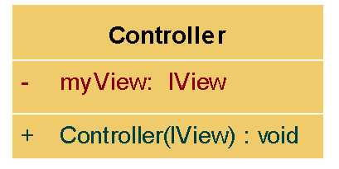
Constructor Injection
“Always” initialized
Better dependency visibility

Slide 73
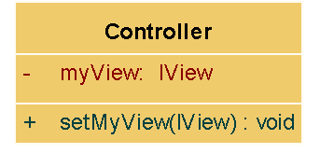
Setter Injection
The component is passive
Injects the dependency anytime

Slide 74
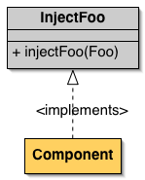
Interface Injection
Variation on setter injection

Slide 75
Setter Injection: Example
public class TextEditor {
private SpellChecker spellChecker;
public void setSpellChecker(SpellChecker spellChecker) {
this.spellChecker = spellChecker;
}
public SpellChecker getSpellChecker() {
return spellChecker;
}
public void spellCheck() {
spellChecker.checkSpelling();
}
}

Slide 76
Setter Variant: Method Injection
class AppPoolWatcher{
INofificationAction action = null;
public void Notify(INofificationAction concreteAction, string message){
this.action = concreteAction;
action.ActOnNotification(message);
}
}
Skip
Inject the dependency into only the method that uses it.

Slide 77
Dependency Injection Pros & Cons
Pros:
Loosely Coupled
Increases Testability
Inversion of Control
Cons:
Increases code complexity
Fresh Developers find it difficult to understand at First
Complicates understanding the control flow

Slide 78
Spring Framework
Skip
The Spring Framework is an application framework and inversion of control container for the Java platform. The framework's core features can be used by any Java application, but there are extensions for building web applications on top of the Java EE platform…
Central to the Spring Framework is its inversion of control (IoC) container (dependency injection)
Wiki

Slide 79
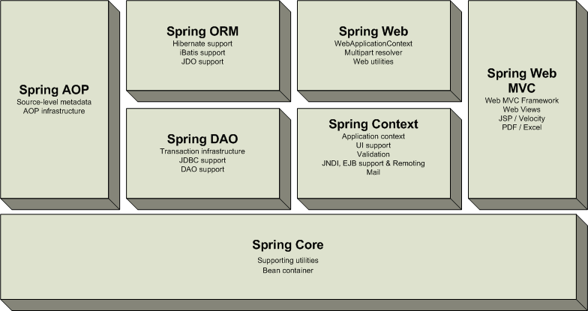
Spring for Java
Digression

Slide 80
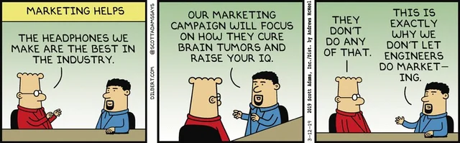

Slide 81
Why DIP?...
Reduces dependency:
Abstract interfaces don't change
If Concrete classes implement interfaces
Concrete classes can be easily replaced
Increases isolation:
Decreases rigidity (Increases mobility)
Increases testability
Increases maintainability

Slide 82
Recall Procedural Design…

Slide 83
DIP Compliant Design

Slide 84
Procedural vs. OO Design
main
Procedural
Design
mid 1
mid 2
mid 3
Detail
Detail
Detail
Detail
High Level Policy
Abstract/
Interface
Abstract/
Interface
Abstract/ Interface
Object-Oriented
Design
Detailed
Implementation
Detailed
Implementation
Detailed
Implementation

Slide 85
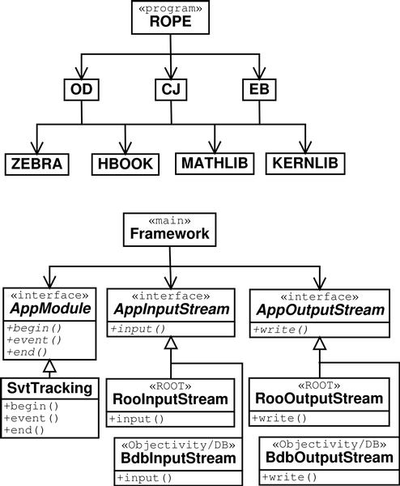
DIP and Procedural Design
Procedural:
Call many concrete routines
Dependence on concrete modules
The Framework class depends on interfaces
Can change data input /output without disturbing Framework classes

Slide 86
Deficient Design: Dependencies Exist at Different Levels
User Interface
Depends on
Business Logic Layer
Depends On
Data Access Layer
Depends On
Database
Needs Improvements

Slide 87
A Naïve Layered Architecture
Policy Layer
High-level modules make calls to low-level modules.
Mechanism Layer
The upper-level layer is dependent upon lower-level layers.
Utility Layer
Notes:
87

Slide 88
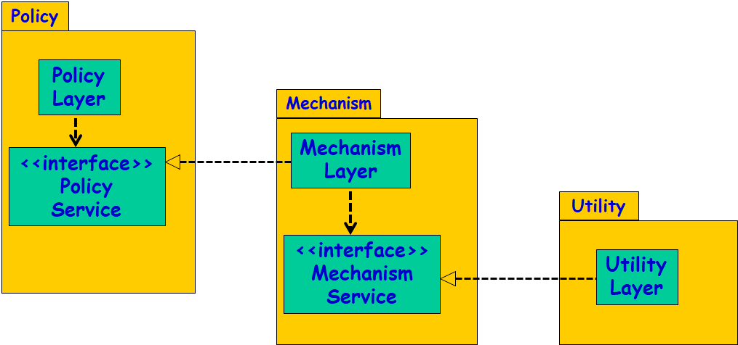
Need to Use Abstract Layers
Each layer should be separated by an abstract interface.
Policy should depend:
Not on the mechanism class, but on its abstract interface.
Mechanism should depend:
Only on the interface defined by utility
Utility should depend:
Only on its published interface
Notes:
88

Slide 89
Using Abstract Layers
Policy is unaffected by any changes to mechanism and utility:
Mechanism is unaffected by changes to utility.
The three components become reusable and robust.

Slide 90
Dependency Inversion Principle
Lower-level layers should depend upon upper-level layers.
Policy
Policy Layer
Mechanism
Mechanism Layer
<<interface>>
Policy
Service
Utility
<<interface>>
Mechanism
Service
Utility
Layer
Ownership Inversion: The client (upper-level layer) owns the interface, not the lower-level layers
Notes:
90

Slide 91
Layering Using DIP
Policy Layer
Mechanism Interface
Mechanism Layer
Utility Interface
Utility Layer

