Slide 1
Dependency Inversion Principle
based on an article of that title by Robert Martin
Lect 17
12-09-2023
Notes:
1

Slide 2
DIP: Statement
“Depend on Abstractions-- not on concretions”.
High level components should not depend upon low level components.
Abstractions should not depend upon details… Details should depend upon the abstractions…
Why?
High-level concepts are more stable than low-level implementations.
High Level
Low Level
Notes:
2

Slide 3
Button and Lamp - Example
Use Case Name: Turn lamp on and off
Actors: ButtonPusher
Description: When the button is pushed, the lamp goes on if it was off, and goes off if it was already on.
:Button
:Lamp
Push()
[state=OFF]TurnOn()
[state=ON]TurnOff()

Slide 4
Analyze the Code Obtained Directly from the Model…
:Button
:Lamp
Problems:
Any change to Lamp will require a corresponding change to (or at least a recompilation of) Button
It is very difficult to reuse either component alone, for example a button to start a motor and not to turn on a lamp…
Turn on()
Turn off()
Which statement is the culprit?

Slide 5
A better solution
Lamp
<<interface>>
Button
Lamp
Implementation

Slide 6
Why is it better?
Button knows nothing about concrete Lamp:
Resistant to change
Also, easily reused elsewhere

Slide 7
Dependency Inversion Example: 2
Application
Application
✗
<<abstract>>
GUI
Windows
GUI
Linux GUI
Windows
GUI
Linux GUI

Slide 8
Summary
Dependency Inversion Principle -- statement:
Components that implement high level policy should not depend on components that implement details.
Instead, should depend on abstractions…
Notes:
8

Slide 9
Interface Segregation Principle
based on an article of that title by Robert Martin
Notes:
9

Slide 10
Interface Segregation Principle
“The dependency of one class on another should depend on the smallest possible interface.”
Or, In simple words…
“Many client specific interfaces are better than one general purpose interface.”
C1
C2
C3
C1
C2
C3

Slide 11
ISP: Background
Rather than implementing new interfaces:
A programmer often changes an interface of a class to extend its capability.
Objects progressively sport fat interfaces…
However, clients use just those methods that they require…
Interfaces become fatter and fatter

Slide 12
ISP Overview ...
C1
General purpose servers:
Methods fall into different groups
Not all clients use all methods
Can lead to unwanted dependencies
Clients using one aspect of a class also depend indirectly on the dependencies of the other aspects
ISP helps to solve the problem:
Use several client-specific interfaces!
C2
C3
C1
C2
C3

Slide 13
Case for ISP
It is much better to have separate interfaces for multiple components:
One appropriate for each client.
Otherwise, when we change an interface we affect even those clients that do not use the features we change.
C1
C2
C3
C1
C2
C3

Slide 14
Intent of ISP
We should try to have interfaces immutable as far as possible.
However, when interfaces change:
It is important to keep the impact of changing an interface localized…
C1
C1
C2
C2
C3
C3
Notes:
14

Slide 15
ISP: Statement of Principle
Clients should not be forced to retain interfaces they do not use.
Create interfaces to satisfy the exact needs of clients.
A common pitfall of programmers’ is that when a component has several different clients --- they are tempted to provide a large interface that satisfies the needs of all clients.
Notes:
15

Slide 16
Fat Interface
Is it also violating any other principle that we have already discussed?
Client A
Service
✗
<<Client A Methods>>
+…
<<Client B Methods>>
+…
<<Client C Methods>>
+…
Client B
Client C
One should not certainly use this design…

Slide 17
OCP Compliant, but not exactly a good design…
Client A
Service
✗
<<Client A Methods>>
+…
<<Client B Methods>>
+…
<<Client C Methods>>
+…
Client B
Service interface
Client C

Slide 18
Segregated Interfaces
<<interface>>
Service A
✓
Client A
<<Client A Methods>>
+…
Service
<<Client A Methods>>
+…
<<Client B Methods>>
+…
<<Client C Methods>>
+…
<<interface>>
Service B
Client B
<<Client B Methods>>
+…
<<interface>>
Service C
Client C
<<Client C Methods>>
+…

Slide 19
Interface segregation principle
Suggested alternative to “fat” interfaces:
Define multiple “skinny” interfaces each with a small group of methods
Each appropriate to different classes of clients.
Interfaces should be cohesive:
That is, focused on one thing.
Clients should not be forced to implement portions of an interface they don’t use.
C1
C2
C3

Slide 20
ISP Violation Smells
Unimplemented interface methods:
public resetPassword( string username)
{
throw new NotImplementedException();
}
Observe LSP violation!

Slide 21
Interface Separation: Example 1
Admin
Client
Admin
Client
Admin
Interface
Game
Server
Game
Server
Game
Interface
Observer
Client
Game
Client
Observer
Interface
Game
Client
Observer
Client
Need to provide special interface to expert gamers…
Suggest a better design…

Slide 22
Interface Separation: Example 1
Admin
Client
Admin
Client
Admin
Interface
Admin
Interface
Game
Server
Game
Server
Game
Client
Game Interface
Game
Interface
Game
Client
Expert
Game
Client
Expert
Game
Interface
Observer
Interface
Observer
Client
Observer
Client
Observer
Interface
Need to provide special interface to expert gamers…
Suggest a better design…

Slide 23
Example Use of ISP
Java has two interfaces for mouse events:
One for common mouse events (MouseListener) and
One for motion events (MouseMotionListener).
Grouping all events into one interface would have violated ISP.
interface MouseListener { void mouseClicked(MouseEvent e); void mousePressed(MouseEvent e); void mouseReleased(MouseEvent e); void mouseEntered(MouseEvent e); void mouseExited(MouseEvent e); }
interface MouseMotionListener { void mouseDragged(MouseEvent e); void mouseMoved(MouseEvent e); }

Slide 24
Example 2
In a secure building:
Many types of electronically secured doors are required
Need to extend the base door class to provide support for:
Timed doors, Key code doors, and Remote control doors.
Notes:
24

Slide 25
Door OK… Made Door an interface keeping future requirements in mind...
<<Interface>>
Door
+lock()
+Unlock
+isOpen()
And, we need a timed door… A timed door closes by itself if it has been left open too long…
Notes:
25

Slide 26
Need to use Timer Class
<<Interface>>
Timer Client
Timer
+register()
+timeout()
Notes:
26

Slide 27
What are the problems?
First Cut Solution
<<Interface>>
Timer Client
Timer
+register()
+timeout()
<<Interface>>
Door
The interface Door has been polluted with a method that many clients do not need,
Results in low cohesion…
+lock()
+Unlock
+isOpen()
TimedDoor
Notes:
27

Slide 28
Fat Interface Example
Timer
Timer
Client
<<interface>>
timeOut
set
Door
<<interface>>
Later…
Key code door
timed door
Remote control door

Slide 29
Problems
Not all varieties of Door need timing.
Violation of LSP.
The interface of Door has been unnecessarily saddled with a method that many clients do not require.
Fat Interface.
ISP violation:
Clients should not be forced to retain methods that they do not use.

Slide 30
Door Example
What problems would be faced?
Any change in one behavior will cause recompilation of all derived classes.
Example: Suppose we change timer interface.
Every client will have to be recompiled.

Slide 31
Segregating Interfaces
The fat door interface can be slimmed down by implementing multiple interfaces:
The door base class would only provide behavior common to all doors.
Each of the specialized activity is segregated into its own base class:
key code base and remote control base.
Notes:
31

Slide 32
Implementation of Multiple Interfaces
<<Interface>>
Timer Client
Timer
<<Interface>>
Door
+register()
timeOut
+lock()
+Unlock
+isOpen()
+timeout()
set
TimedDoor

Slide 33
Putting Door Interface on a Diet…
Timer
Timer
client
Remote control
door
door
timeOut
set
timed door
Remote control door

Slide 34
Analysis: Door Example
Now the door class provides only the behavior for doors:
Doesn’t need to provide any unnecessary behaviors.
When a specific interface changes,
Only the clients that use that interface will need to be recompiled.

Slide 35
Another Example: Many client-specific interfaces are better than one general purpose interface…
<<Interface>>
SecurityFloorPlan
placeDevice()
showDevice()
groupDevice()
removeDevice()
FloorPlan
<< Implements>>
attributes
placeDevice()
showDevice()
groupDevice()
removeDevice()
showFOV()
showDeviceID()
<<Interface>>
SurveillanceFloorPlan
showDevice()
groupDevice()
removeDevice()
showFOV()
showDeviceID()
<< Implements>>

Slide 36
Example 3
<<interface>>
DAO
+insert ():void
+delete () :void
+update () :void
+read() :void
<<interface>>
DB Access
+insert ():void
+update () :void
+delete () :void
+next() :void
+previous() :void
<<interface>>
File Access
+write ():void
+read() :void
+append () :void
+rotate () :void
Database DAO
File DAO
Database DAO
File DAO
Initial Design
ISP compliant

Slide 37
Summary
When a class (Server) needs to serve various types of clients
Leads to a fat interface unless care is taken
The Interface Segregation Principle states that:
Fat interfaces lead to inadvertent couplings between clients that ought to be isolated.
Fat interfaces can be segregated:
One way: Use abstract base classes into multiple inheritance hierarchy to break unwanted coupling between components.
Clients can use the appropriate interfaces.
Notes:
37

Slide 38
Design Patterns

Slide 39
Design Patterns
Patterns are used as “building blocks” in software design.
Help designers to make important design decisions correctly.
If you can master a few important patterns:
You can easily spot them in your next application design problem and use pattern solutions.

Slide 40





Origin of Patterns
Roots in the architecture field:
Made prominent by Christopher Alexander (1977)

Slide 41

Christopher Alexander, A Pattern Language, 1977
Each pattern:
Describes a problem which occurs over and over again…
Describes the core of the solution to that problem, in such a way that you can use this solution a million times over, without ever doing it in the same way twice.

Slide 42

… use this solution a million times over, without ever doing it the same way twice... Christopher Alexander

Slide 43
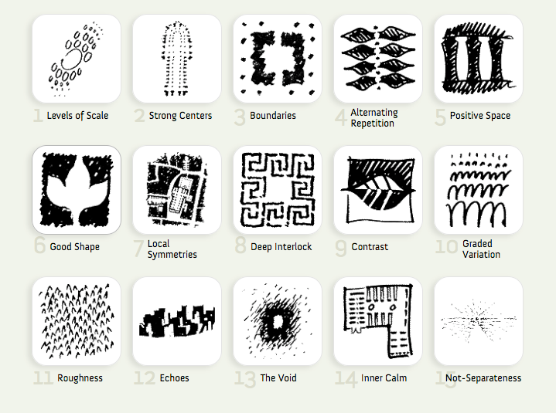
Christopher Alexander, A Pattern Language, 1977
253 patterns together formed the vocabulary of the language.
Each pattern describes a problem:
and then offers a solution.
They give ordinary people as well as professionals:
A way to design a house, improve a town or neighborhood, etc…

Slide 44
Patterns in Engineering
How do other engineering fields find and use patterns?
Mature engineering disciplines have handbooks describing successful solutions to known problems
Automobile designers don't design cars from scratch.
Instead, they reuse standard designs with successful track records.
Should software engineers make use of patterns?
Developing software from scratch is expensive
Patterns support reuse of past knowledge mainly in the form of software architecture and design.

Slide 45
Patterns in Software Design
Architectural Patterns: MVC, Layers etc.
GoF Design Patterns: Singleton, Observer etc
GUI Design Patterns: Window per task, Disabled irrelevant things, Explorable interface etc
Database Patterns: decoupling patterns, resource patterns, cache patterns etc.
Concurrency Patterns: Double buffering, Lock object, Producer-consumer,Asynchronous processing etc.
Enterprise (J2EE) Patterns: Data Access Object, Transfer Objects etc.
GRASP (General Responsibility Assignment Patterns): Low coupling/high cohesion, Controller, Law of Demeter (don’t talk to strangers), Expert, Creator etc.
Anti-patterns (Bad solutions deceptively appear good): God class,Singletonitis, Basebean, Golden hammer, etc.

Slide 46




History of Design Patterns
The concept of a "pattern“:
First expressed in Christopher Alexander's work A Pattern Language in 1977
A solution to a common design problem in a certain context.
In 1990:
Gang of Four or "GoF" (Gamma, Helm, Johnson, Vlissides) compiled a catalog of design patterns
Now assimilated into programming languages:
Example: Decorator, Composite, Iterator pattern Defines an interface that declares methods for sequentially accessing the objects in a collection.

Slide 47

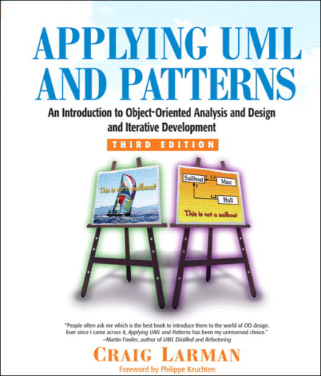
“Gang of four” (GoF) and GRASP Patterns
Erich Gamma, Richard Helm, Ralph Johnson & John Vlissides (Addison-Wesley, 1995)
Design Patterns book catalogs 23 different patterns
Larman
GRASP (General Responsibility Assignment Software Patterns) pattern
Several other types of patterns are also popular.

Slide 48
Elements of Design Patterns
Design patterns have 4 essential elements:
Pattern name: Forms designers’ vocabulary
Problem: intent, context, when to apply
Solution: UML model, skeletal code
Consequences: results and tradeoffs

Slide 49
Goals of Design Patterns
Codify good design
Distill & generalize experience
Aid to novices & experts alike
Give design structures explicit names
Common vocabulary
Save design iterations
Improve documentation
Improve understandability
Facilitate restructuring/refactoring

