Slide 1
Review of Domain Modelling
Lect 18
3-10-2023

Slide 2
Identification of Entity Objects: Some Hints
Usually:
Appear as data stores in DFD
Occur as aggregate objects
The aggregator corresponds to registers in physical world
CustomerRegister
*
CustomerRecord

Slide 3
7. Restaurant Automation Software
A Resturant sells certain food items. The computer should maintain the prices of all the items:
Also support changing the prices by the manager.
Whenever any item is sold:
The sales clerk would enter the item code and the quantity sold.
The computer should generate bills and register the payments.
Whenever ingredients are issued for preparation of food items, the data is to be entered into the computer.
Purchase orders are generated on a daily basis, for all ingredients whose stock falls below a threshold value.
The threshold value for each item is computed based on the average consumption for the past three days and assuming that two days stock must be maintained.
Whenever the ordered ingredients arrive, the invoice data regarding the quantity and price is entered.
If sufficient cash balance is available, the computer should print cheques against invoice.
Monthly sales receipt and expenses data should be generated whenever the manger would request to see them.

Slide 4
Design Patterns

Slide 5
Design Patterns
Patterns are used as “building blocks” in software design.
Help designers to make important design decisions correctly.
If you can master a few important patterns:
You can easily spot them in your next application design problem and use pattern solutions.

Slide 6
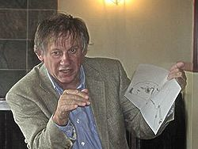




Origin of Patterns
Roots in the architecture field:
Made prominent by Christopher Alexander (1977)

Slide 7
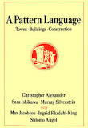
Christopher Alexander, A Pattern Language, 1977
Each pattern:
Describes a problem which occurs over and over again…
Describes the core of the solution to that problem, in such a way that you can use this solution a million times over, without ever doing it in the same way twice.

Slide 8
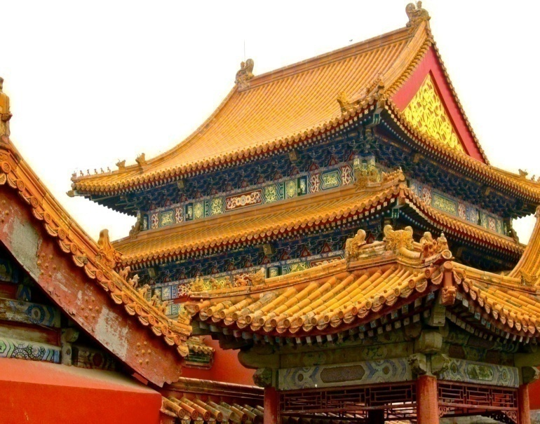
… use this solution a million times over, without ever doing it the same way twice... Christopher Alexander

Slide 9
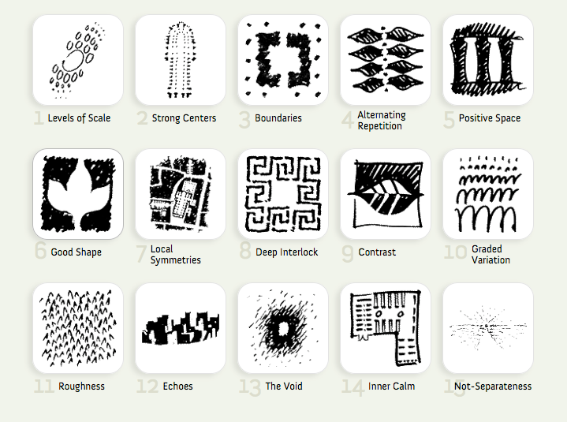
Christopher Alexander, A Pattern Language, 1977
253 patterns together formed the vocabulary of the language.
Each pattern describes a problem:
and then offers a solution to it.
They give ordinary people as well as professionals:
A way to design a house, improve a town or neighborhood, etc…

Slide 10
Patterns in Engineering
How do other engineering fields find and use patterns?
Mature engineering disciplines have handbooks describing successful solutions to known problems
Automobile designers don't design cars from scratch.
Instead, they reuse standard designs with successful track records.
Should software engineers make use of patterns?
Developing software from scratch is expensive
Patterns support reuse of past knowledge mainly in the form of software architecture and design.

Slide 11
Patterns in Software Design
Architectural Patterns: MVC, Layers etc.
GoF Design Patterns: Singleton, Observer etc
GUI Design Patterns: Window per task, Disabled irrelevant things, Explorable interface etc
Database Patterns: decoupling patterns, resource patterns, cache patterns etc.
Concurrency Patterns: Double buffering, Lock object, Producer-consumer,Asynchronous processing etc.
Enterprise (J2EE) Patterns: Data Access Object, Transfer Objects etc.
GRASP (General Responsibility Assignment Patterns): Low coupling/high cohesion, Controller, Law of Demeter (don’t talk to strangers), Expert, Creator etc.
Anti-patterns (Bad solutions deceptively appear good): God class,Singletonitis, Basebean, Golden hammer, etc.

Slide 12




History of Design Patterns
The concept of a "pattern“:
First expressed in Christopher Alexander's work A Pattern Language in 1977
A solution to a common design problem in a certain context.
In 1990:
Gang of Four or "GoF" (Gamma, Helm, Johnson, Vlissides) compiled a catalog of design patterns
Now assimilated into programming languages:
Example: Decorator, Composite, Iterator pattern Defines an interface that declares methods for sequentially accessing the objects in a collection.

Slide 13
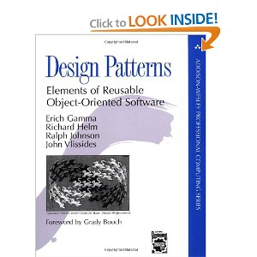
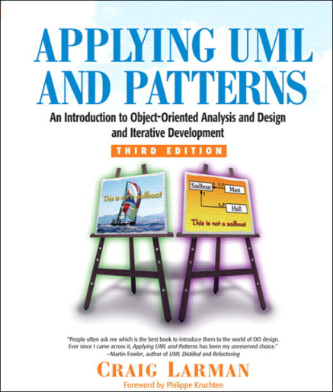
“Gang of four” (GoF) and GRASP Patterns
Erich Gamma, Richard Helm, Ralph Johnson & John Vlissides (Addison-Wesley, 1995)
Design Patterns book catalogs 23 different patterns
Larman
GRASP (General Responsibility Assignment Software Patterns) pattern
Several other types of patterns are also popular.

Slide 14
Elements of Design Patterns
Design patterns have 4 essential elements:
Pattern name: Forms designers’ vocabulary
Problem: intent, context, when to apply
Solution: UML model, skeletal code
Consequences: results and tradeoffs

Slide 15
Goals of Design Patterns
Codify good design
Distill & generalize experience
Aid to novices & experts alike
Give design structures explicit names
Common vocabulary
Save design iterations
Improve documentation
Improve understandability
Facilitate restructuring/refactoring

Slide 16
Types of Patterns
Architectural patterns
Design patterns
Code patterns (Idioms)‏

Slide 17
Architectural Patterns
Architectural designs concern the overall structure of software systems.
Architectural designs cannot directly be programmed.
Form a basis for more detailed design.
Architectural patterns:
Provide solutions to issues relevant to architectural design of large problems.

Slide 18
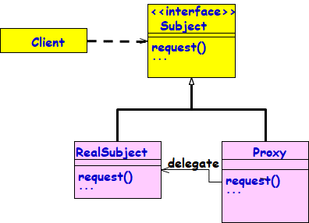
Design Patterns
A design pattern:
Suggests a scheme for structuring the classes in a design solution.
Also, defines the interactions required among those classes.
Design pattern solutions are described in terms of:
Classes, their instances, their roles and collaborations.

Slide 19
Idioms
Idioms are low-level patterns:
Programming language-specific.
Describe how to implement a solution to a particular problem in a given programming language.

Slide 20
Idioms
What is an Idiom in English language?
A group of words that has meaning different from a simple juxtaposition of the meanings of the individual words.
Example: “Raining cats and dogs”
A C idiom:
for(i=0;i<1000;i++){
}

Slide 21
Patterns versus Idioms
A pattern:
Describes a recurring problem
Describes a core solution
Used for generating many distinct designs
An Idiom though describes solution to a recurring problem, is rather restricted:
Provides only a specific solution, with fewer variations.
Applies only in a narrow context
e.g., C++ or Java language

Slide 22
Antipattern
If each pattern represents a best practice:
An antipattern represents lessons learned from a bad design.
Antipatterns help to recognise deceptive solutions:
They appear attractive at first, but turn out to be a liability later…
Not enough to use patterns in a solution --–must consciously avoid antipatterns.

Slide 23
Patterns versus Algorithms
Are patterns and algorithms identical concepts?
After all, both target to provide reusable solutions to problems!
Algorithms primarily focus on solving problems with reduced space and/or time requirements:
Patterns focus on understandability and maintainability of design and easier development.

Slide 24
Pros of Design Patterns
Help capture and disseminate expert knowledge.
Promotes reuse and helps avoid mistakes.
Provide a common vocabulary:
Help improve communication among the developers.
“The hardest part of programming is coming up with good variable and function names.”

Slide 25
Pros of Design Patterns cont…
Reduces the number of design iterations:
Helps improve the design quality and designer productivity.

Slide 26
Patterns put you on the shoulders of Giants
Isaac Newton famously remarked in a letter to Robert Hooke, in 1676:
"If I have seen a little further, it is by standing on the shoulders of Giants.”
When Hamming received the Turing award in 1968. He remarked:
“While Newton may have stood on the shoulders of Giants; in software development, sadly we stand on each other’s feet.”

Slide 27
Pros of Design Patterns
Patterns exempify solutions to software problems making use of:
Abstraction,
Encapsulation
SRP, OCP, LSP, ISP, DIP
Separation of concerns
Coupling and cohesion
Divide and conquer

Slide 28
Cons of Design Patterns
Design patterns do not directly lead to code reuse.
How to select the right design pattern at the right point during a design exercise?
At present no systematic methodology exists.

Slide 29
Why Learn Design Patterns?
Your own designs will improve:
Learn to borrow from well-tested ideas
Learn from pattern descriptions that usually contain some analysis of tradeoffs
You will be able to describe complex design ideas to others:
Assuming that they also know the same patterns
You can use patterns to “refactor” existing code:
Improve the structure of existing code without adding new functionality
You can understand why some aspects of Java language are that way.

Slide 30
Thought for the day…
Why are there no design patterns for procedural designs? ….

Slide 31
Why No Patterns for Procedural Development?
For patterns to be defined, procedural languages need to support:
Inheritance
Abstract classes and Interfaces
Polymorphism
Encapsulation

Slide 32
Design Patterns
These are standard solutions to commonly recurring problems.
Provide good solutions based on common sense
Pattern has four important parts:
The problem
The context
The solution
The context in which it works or does not work

Slide 33
Pattern Problem
The problem statement describes the problem and its context.
Also explainss when to apply the pattern.
It might describe situations where it works and does not work.
It can include a list of conditions that must be met before it makes sense to apply the pattern.

Slide 34
Pattern Solution
Abstract description of design problem:
how the pattern solves it
Describes the elements that make up:
Class design,
Class relationships,
Class responsibilities and
Class collaborations
Only skeletal implementation may be available.

Slide 35
Design Patterns are NOT…
NOT designs that can be plugged in and reused as it is:
Unlike code for linked lists, hash tables
NOT complex domain-specific designs:
For an entire application or subsystem.
Patterns are actually:
“Descriptions of communicating objects and classes that are customized to solve a general design problem in a particular context.”

Slide 36
GRASP Patterns

Slide 37
GRASP Patterns
GRASP: Generalized Responsibility Assignment Software Patterns:
Larman, “Applying UML and Patterns”
GRASP patterns can more accurately be described as best practices:
If used judiciously, will lead to maintainable, reusable, understandable, and easy to develop software

Slide 38
GRASP Patterns
GRASP patterns essentially describe how to assign responsibilities to classes:
Warning: Some Grasps tend to be vague and need to be seen as guidelines rather than solutions.
What is a responsibility?
A contract or obligation of a class
Responsibilities can include behaviour, data storage, object creation, etc.
Usually fall into two categories:
Doing
Knowing

Slide 39
Responsibility-Driven Design (RDD)
Advocates carrying out OOD by assigning:
Responsibilities
Roles
Collaborations
Common responsibility categories:
Doing:
Creating an object or doing a calculation
Initiating action in other objects
Knowing:
Knowing about private data
Knowing about related objects

Slide 40
Responsibilities
Responsibilities are implemented by methods:
Some methods act alone and do a job
Some collaborate with other objects
Example: SaleTransaction class has Total()
Total() collaborates with subtotal() method of SaleLineItem object
1:total
:SaleTransaction
2: subTotal
:SaleLineItem
3: price
:ItemSpecification

Slide 41
GRASP Patterns
Creator
Who creates an object?
Information Expert
Which class should be responsible?
Low Coupling
Support low dependency and increase reuse
Controller
Who handles a system event?
High Cohesion
How to keep complexity manageable?
Polymorphism
How to handle behavior that varies by type?
Pure Fabrication
How to handle a situation, when you do not want to violate High Cohesion and Low Coupling?
Indirection
How to avoid direct coupling?
Law of Demeter (Don’t talk to strangers)
How to avoid knowing about unassociated objects?

Slide 42
Grasp Patterns
11/15/2023

Slide 43
Expert Pattern
Problem: Which class should be responsible for doing a certain thing?
Solution:
Assign responsibility to the expert (class that has all/most information necessary to fulfil the required responsibility).

Slide 44
Which class is information expert for computing total price of a sales transaction?
SaleTrans
date
get-total-price()
*
SalesLineItem
Product Specification
quantity
description
price
Warranty

Slide 45
Example 1: Expert
SaleTransaction
1
*
SaleLineItem
1
1
ItemSpecification
Class Diagram
1:total
2: subTotal
3: price
:SaleTransaction
:SaleLineItem
:ItemSpecification
Collaboration Diagram

Slide 46
Sale
date
getTotal
SalesLineItem
Product
quantity
description
price
itemID
getSubTotal
getPrice

Slide 47
Example 2:Tic-Tac Toe
Board
Initial domain model
PlayMoveBoundary
PlayMoveController
Board
Refined domain model
Which class should check game result after a move?
Which class should play the computer’s move?

Slide 48
Example 2: Sequence Diagram
:playMove
Boundary
:playMove
Controller
:board
acceptMove
checkMoveValidity
move
[invalidMove]
[invalidMove]
announceInvalidMove
announceInvalidMove
checkWinner
[game over]
[game over]
announceResult
announceResult
playMove
checkWinner
[game over]
[game over]
announceResult
announceResult
displayBoardPositions
getBoardPositions
[game not over]
promptNextMove
Sequence Diagram for the play move use case

Slide 49
Expert Pattern: An Analysis
Expert improves cohesion.
Cohesion: the degree to which the information and responsibilities of a class are related to each other
How cohesion is improved?
The information needed for a responsibility is in the same class as the responsibility itself.

Slide 50
Creator Pattern: Background
Every object must be created somewhere.
Consider making a class responsible for creating an object if:
It is an inventory of objects of that type.
It has the information needed to initialize the object.
It will be the primary client of the object.
In a Library software, who creates a Member?

Slide 51
Creator Pattern
Problem: Which class should be responsible for creating a new instance of some class?
Solution: Assign a class C1 the responsibility to create objects of class C2 if
C1 object aggregates objects of type C2
C1 object contains object of type C2
C1 objects closely use C2 objects
C1 object has the initializing data for C2 objects

Slide 52
Example 2: Use Case Model
Supermarket
Prize scheme
register
customer
Customer
Clerk
register
sales
Sales Clerk
select
winners
Manager

Slide 53
Example 2: Initial Domain Model
SalesHistory
CustomerRegister
1
1
*
*
SalesRecords
CustomerRecord

Slide 54
Example 2: Refined Domain Model
SalesHistory
CustomerRegister
1
1
*
*
SalesRecords
CustomerRecord
RegisterCustomerBoundary
RegisterCustomerController
RegisterSalesBoundary
RegisterSalesController
SelectWinnersBoundary
SelectWinnersControllers

Slide 55
Example 2: Sequence Diagram for the Register Customer Use Case
:RegisterCustomer
Boundary
:RegisterCustomer
Controller
:Customer
Register
:Customer
Record
register
register
checkDuplicate
*match
[duplicate]
showError
generateCIN
create
:Customer
Record
register
displayCIN

Slide 56
Example 2: Sequence Diagram for the Register Sales Use Case
:Register
Sales
Boundary
:Register
Sales
Controller
:Sales
History
RegisterSales
registerSales
registerSales
:Sales
Record
create
confirm
confirm

Slide 57
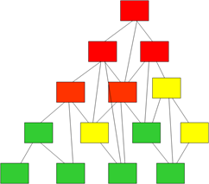
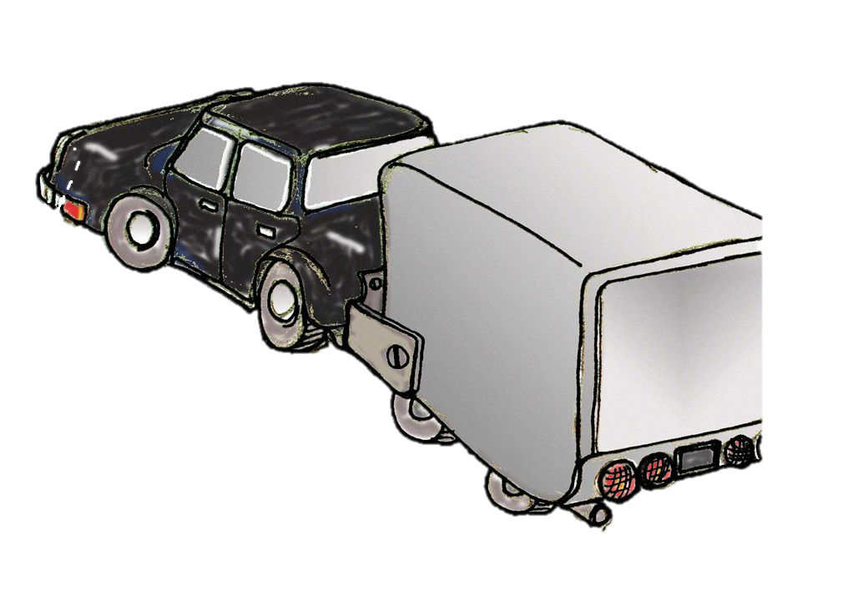
Low Coupling Pattern
Problem: How to reduce coupling in a design?
Why is classes having high coupling bad?
Developer is forced to change all classes frequently because of changes to related classes…
Hard to understand in isolation, debug, test…
Hard to re-use
Because it requires presence of classes that it depends on
Solution: Assign responsibilities so that coupling remains low.
Use this principle to evaluate alternatives

Slide 58
Two alternative responses to “Who creates Payment?”
makePayment()
:Controller
1: create()
p:Payment
2: addPayment(p)
:Sale
makePayment()
:Controller
1: makePayment()
:Sale
The second alternative leads to less coupling
Avoids an association between Controller and Payment
Sale and Payment already related
1.1: create()
:Payment

Slide 59
High Cohesion
Problem: How to increase cohesion?
Problems when a class has low cohesion:
Hard to comprehend
Hard to reuse
Hard to maintain
Frequent changes required

Slide 60
Example: Controller has Diverse Responsibilities
:Controller
:Sale
makePayment()
create()
p:Payment
addPayment(p)

Slide 61
Better design: Controller delegates, has higher cohesion
:Controller
:Sale
makePayment()
makePayment()
create()
:Payment

Slide 62
Pure Fabrication: Background
But how???
High Cohesion
Problem: To keep complexity manageable. Classes implement a set of cohesive tasks.
Solution: Assign focused and related responsibilities to classes.
Low Coupling
Problem: To support low dependency and increased reuse.
Solution: Assign responsibilities so that coupling remains low.
But how???

Slide 63
Pure Fabrication – Background
Suppose a class has responsibilities unrelated to its main task.
It is a bad design --- low cohesion and high coupling.
But, how to improve the design?

Slide 64
Pure Fabrication
Problem:
How to improve a design when a class has very high coupling and low cohesion?
Solution:
Assign a highly cohesive set of responsibilities to an artificial class
May not represent anything in the problem domain...
Created only to support high cohesion, low coupling, and reuse...

Slide 65
Pure Fabrication: Explanation
Pure Fabrication
Class having High Cohesion
Class having Poor Cohesion
Invented Class
Takes care of a
similar set of functions
Fabrication step: Assign a highly cohesive set of responsibilities to an artificial class.

Slide 66
Pure Fabrication Example
Suppose we need to save instances of SaleTrans in a relational database.
To which class would you assign this responsibility?
SaleTrans has all the information, so SaleTrans is suggested by Expert pattern.
To manage data transfer to and from a relational database will require a large number of operations … insert, delete, update, select, rollback, commit, buffer management, …
Cohesion of SaleTrans class reduces…
SaleTrans

Slide 67
Pure Fabrication
Create a new class for the database access related responsibilities:
SalesStorage
SalesStorage class is made up from imagination; it is not present in the Domain Model
insert()
delete()
update()
...
SaleTrans is now well-designed - high cohesion, low coupling
SalesStorage class is cohesive: Its sole purpose is to store/retrieve objects to/from a relational database

Slide 68
Pure Fabrication: Java Snippet
class SaleTrans {
// Process and record the sale for each line item
// Use SaleStorage class for persistent storage
}
class SalesLineItem {
//Process items of similar type and return subtotal
// Use SaleStorage class for persistent storage
}
class SaleStorage{
// Form JDBCDatabase objects to store data to the database
}

Slide 69
Pure Fabrication: An Analysis
Many GoF object-oriented patterns are examples of Pure Fabrication.:
Examples: Facade, Adapter, Mediator, command, strategy,…
Pure Fabrication may contraindicate the Expert pattern.
An informed decision is needed.
Increases Cohesion and reusability

Slide 70
Pure Fabrication: Final Analysis
Objects can be divided into two groups:
Representational:
Related to representation of entities and their components, such as Sale, Vehicle, Document, …
These are generally identifiable in the problem description.
Behavioural:
Often concocted, also may represent an algorithm.
Examples includes controller classes for use cases, Command class, Strategy class, etc
These are generally not in the problem domain model, and are mostly pure fabrication.

Slide 71
Pure Fabrication Final Analysis: Delegate Unrelated Responsibility
Delegator
Delegatee
Uses
1
1
User
Usee

Slide 72
Indirection Pattern
Problem:
How to avoid direct coupling between classes?
How to decouple objects so that low coupling is achieved and changes become easy?
Solution:
Depend on an interface class,
So that objects are not directly coupled.

Slide 73
Indirection: Example
Modem
dial()
receiver()
send()
✗
authorize(payment)
CreditAuthorizationService
1:dial(phoneNum)
Modem
Notes:
Assume that :
A point-of-sale terminal application needs to manipulate a modem in order to transmit credit payment request
The operating system provides a low-level function call API for doing so.
A class called CreditAuthorizationService is responsible for talking to the modem
If CreditAuthorizationService invokes the low –level API function calls directly, it is highly coupled to the API of the particular operating system. If the class needs to be ported to another operating system, then it will requiure modification.
Add an intermediate Modem class between the CreditAuthorizationService and the modem API. It is responsible for translating abstract modem requests to the API and creating an Indirection between the CreditAuthorizationService and the modem.

Slide 74
1
1
<<interface>>
+indirectionIF
Client
Uses
What is the name of this OO principle?
+service1
+service2
Hint:
Program to an interface…

Slide 75
Indirection : Example
Modem Interface
dial()
receiver()
send()
authorize(payment)
CreditAuthorizationService
1:dial(phoneNum)
Modem
<<Interface>>
Modem1
Modem2
Notes:
Assume that :
A point-of-sale terminal application needs to manipulate a modem in order to transmit credit payment request
The operating system provides a low-level function call API for doing so.
A class called CreditAuthorizationService is responsible for talking to the modem
If CreditAuthorizationService invokes the low –level API function calls directly, it is highly coupled to the API of the particular operating system. If the class needs to be ported to another operating system, then it will requiure modification.
Add an intermediate Modem class between the CreditAuthorizationService and the modem API. It is responsible for translating abstract modem requests to the API and creating an Indirection between the CreditAuthorizationService and the modem.

Slide 76
Indirection Advantages
Low coupling
Promotes reusability

