Slide 1
Remaining parts of Composite Pattern and then Adapter and Bridge Patterns
Lect 22--23
16-10-2023

Slide 2
Composite Pattern: Class Diagram
Client
Component
<Abstract>>
*
operation()
Leaf
Composite
operation()
operation()
other()
Each node of the Component structure can respond to some common operation(s).
The client can call operation of the Component and the structure responds “appropriately”.
Notes:
2

Slide 3
Composite: Object Diagram
top : Composite
a : Leaf
b : Leaf
top : Composite
c : Leaf
top : Composite
e : Leaf
d : Leaf
e : Leaf

Slide 4
Consequences
Makes it possible to define recursive compositions of primitive and composite objects.
Makes the client simple.
They don’t need to know whether they are dealing with leaves or composites.
Makes it easier to add new kinds of components.

Slide 5
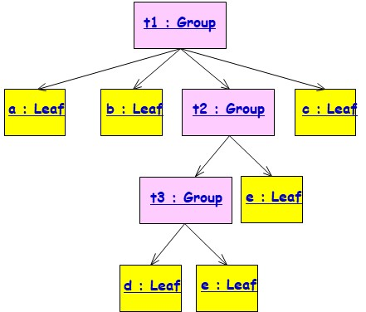
Applicability
Use the Composite pattern when:
You need to represent part-whole hierarchies of objects
You want clients to ignore the differences between parts and wholes
Especially use, if the parts are created dynamically – at run time:
Example: to build a complex system from primitive components and previously defined subsystems.
Composite is clearly applicable when the construction process will use primitive objects, as well reuse subsystems defined earlier.

Slide 6

Use Composite Pattern to only model dynamic aggregates
Fixed Structure:
Car
*
*
Doors
Wheels
Battery
Engine
Organization Chart (variable aggregate):
University
*
School
*
Department
Dynamic (recursive) aggregate:
Program
*
*
Block
Compound
Simple
Statement
Statement
Notes:
What you are seeing on this slide are what I would like to call patterns for analysis.
A pattern is a recurring theme, something once you get used to see something this way, allows you to very fast understand a situation.
It is well known, that if you show a set of chess positions of middle games tochess masters and non chess players, that chess masters are able to reconstruct these games without any effort.
However, if you give them random chess configurations, chess masters are about as bad as non-chess players in reconstructing the boards.
This tells you about the value of patterns. I would like you to learn about these aggregation patterns. In fact, I challenge you to see for your team and subsystem, if any of the analysis problems you face, can be cast in terms of one of the 3 patterns above.

Slide 7
Composite: Object Diagram
top : Composite
a : Leaf
b : Leaf
top : Composite
c : Leaf
top : Composite
e : Leaf
d : Leaf
e : Leaf

Slide 8
// "Component" abstract class Component {protected string name; // Constructor public Component(string name) {this.name = name;} public abstract void Add(Component c); public abstract void Remove(Component c); public abstract void Display(); }

Slide 9
// "Composite" class Composite extends Component {private ArrayList children = new ArrayList(); // Constructor public Composite(string name) {super(name); } public void Add(Component component) {children.Add(component);} public void Remove(Component component) {children.Remove(component);} public void Display(int depth) //override {System.out.println(new String('-', depth) + name); // Recursively display child nodes for(Component component : children) component.Display() } }

Slide 10
// "Leaf" class Leaf extends Component {// Constructor public Leaf(string name) {super(name);} public void Add(Component c) // override {System.out.println("Cannot add to a leaf");} public void Remove(Component c) //override {System.out.println("Cannot remove from a leaf");} public void Display(int depth) //override {System.out.println(new String('-', depth) + name);} } }

Slide 11
class MainApp { static void Main(){ // Create a tree structure Composite root = new Composite("root"); root.Add(new Leaf("Leaf A")); root.Add(new Leaf("Leaf B")); Composite comp = new Composite("Composite X"); comp.Add(new Leaf("Leaf XA")); comp.Add(new Leaf("Leaf XB")); root.Add(comp); root.Add(new Leaf("Leaf C")); // Add and remove a leaf Leaf leaf = new Leaf("Leaf D"); root.Add(leaf); root.Remove(leaf); // Recursively display tree root.Display(); } }
-root ---Leaf A ---Leaf B ---Composite X -----Leaf XA -----Leaf XB ---Leaf C

Slide 12
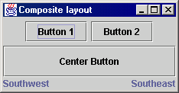
Composite example: Jpanel
Container north = new JPanel(new FlowLayout());
north.add(new JButton("Button 1"));
north.add(new JButton("Button 2"));
Container south = new JPanel(new BorderLayout());
south.add(new JLabel("Southwest"), BorderLayout.WEST);
south.add(new JLabel("Southeast"), BorderLayout.EAST);
// overall panel contains the smaller panels (composite)
JPanel overall = new JPanel(new BorderLayout());
overall.add(north, BorderLayout.NORTH);
overall.add(new JButton("Center Button"), BorderLayout.CENTER);
overall.add(south, BorderLayout.SOUTH);
frame.add(overall);
JPanel, a part of Java Swing package. It is a container that can store a group of components. The main task of JPanel is to organize components

Slide 13
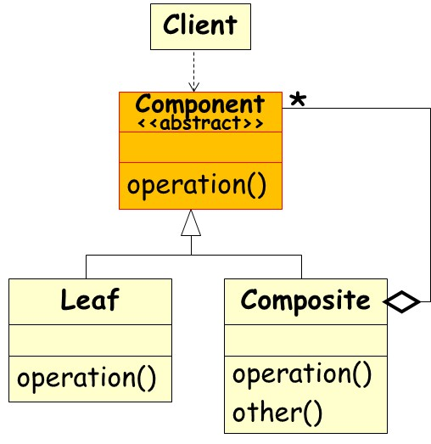
Some Insights
Why do you declare the methods to handle children in the abstract class?
Only the composite class has any use for them?
Is it not poor programming practice to have these methods inherited by primitive classes, which have no use for them?
There is a tradeoff here between safety and elegance…

Slide 14
Elegance Issue
If the child management methods are moved from the abstract class to the composite one,
The client can never call these methods on primitive objects, improving elegance.
However, this gives primitive and composite objects different interfaces:
Which is what the design pattern is to avoid

Slide 15
Composite Pattern: Example 1
MenuComponent
add()
remove()
print()…
*
Manager
MenuItem
Menu
add()
remove()
print()…
print()
How to print a menu?

Slide 16
Example 1
Menu
menuComponents: ArrayList
add()
remove()
print()…
Menu to MenuComponents association implemented with an ArrayList data type.
Let us examine what is the implementation of print() in Menu and in MenuItem…

Slide 17
Example 1
Class Menu implements MenuComponent{… … …
public void print() {
System.out.print("\n" + getName());
System.out.println(", " + getDescription());
System.out.println("----------------");
Iterator iterator= menuComponents.iterator();
while (iterator.hasNext()) {
MenuComponent menuComponents =
(MenuComponent)iterator.next();
menuComponents.print();
}
}

Slide 18
class MenuItem implements MenuComponent{ … …
public void print() {
System.out.print(" " + getName());
if (isVegetarian()) System.out.print("(v)");
System.out.println(", " + getPrice());
System.out.println("--" + getDescription());
}

Slide 19
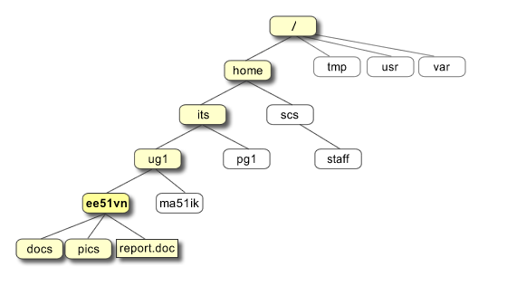
Exercise 1
Design a class structure to model a Unix file hierarchy…

Slide 20
Exercise 1: Solution
Folder
<<Interface>>
*
children
delete()
print()
File
Directory
For all children c:
c.delete();
Delete directory
delete()
print()
delete()
print()
add(Source)

Slide 21
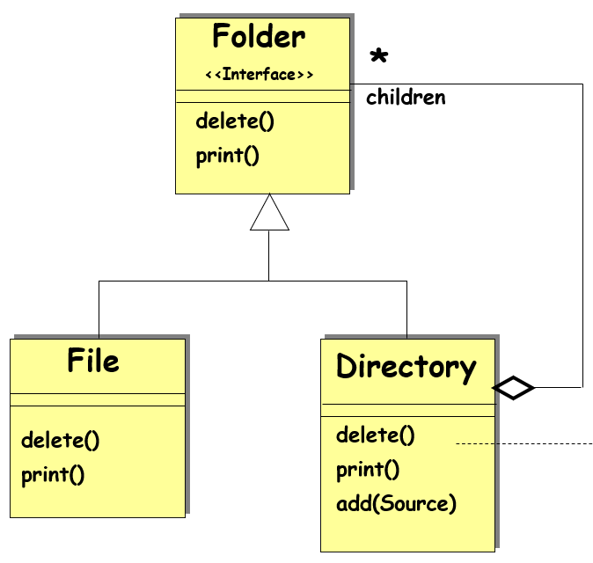
Component _{A}
Now Suppose file types are text, image, Video…
How to accommodate?
setName();
getName();
getAllFiles(List theList);
getContents(List theList);_{A}
*
Directory
TextFile
ImageFile
VideoFile
setName();
getName();
getAllFiles(List theList);
getContents(List theList);
setName();
getName();
getAllFiles(List theList);
getContents(List theList);
setName();
getName();
getAllFiles(List theList);
getContents(List theList);
setName();
getName();
getAllFiles(List theList);
getContents(List theList);
This is the Composite
These objects are the leaves

Slide 22
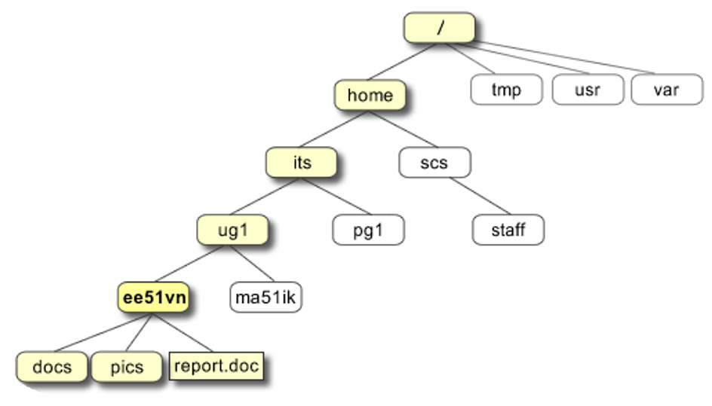
Object Diagram
Composite
Leaf
Composite
Composite
Leaf
Composite
Leaf
Leaf
Composite
Leaf
Etc…

Slide 23
Exercise 3: Programming
A program block can contain simple statements or other program blocks…
Item
*
Statement
execute()
Leaf
Composite
SimpleStatement
Block
children
execute()
execute()

Slide 24
Exercise 4
Develop class design of components to be handled by a Graphics editor:
Should let users group simple components into larger components.
Which in turn can be grouped to form still larger components.
Larger components should behave similarly w.r.t. select, copy, paste, move,delete, resize, ...

Slide 25
Composite Pattern: Solution
<<Component>>
Graphic
*
contains
*
contains
Resize()
Operation()
<<Leaf>>
<<Composite>>
Rectangle
Circle
Picture
Operation()
Operation()
AddComponent()
RemoveComponent()
GetChild()
Resize()
Resize()
Resize()
AddComp()
RemoveComp()
GetChild()
General Idea
Applied to the drawing example
Notes:
25
Aggregation is useful for ruling out invalid cyclic object structures.

Slide 26
Object Structure?
aPicture
aPicture
aLine
aRect
aText
aLine
aRect

Slide 27
Solution Note
The key to the Composite pattern:
An abstract class that represents both primitives and their containers.
The abstract class Graphic declares operations like Copy, Move, Delete, resize, etc. that are specific to graphical objects.
It also declares operations that only the composite objects need, such as
Operations for accessing and managing its children, like Add, UnGroup.

Slide 28
Alternatives…
Component does not know what it is part of:
Component can be in many composites
Component can be accessed only through composite
Component knows what it is a part of
Component can be in only one composite
Component can be accessed directly

Slide 29
Composite: Issues with Part-of
Rules when component knows its single composite
A is a part of B if and only if B is the composite of A
However, duplicating information is dangerous!
Problem: How to ensure that references of components to composite and composite to components are consistent?
B1
B2
A
A

Slide 30
Composite Implementation: Alternatives
Component does not know what it is a part of:
Component can be in many composites
Component can be accessed only through composite
Component knows what it is a part of
Component can be in only one composite
Component can be accessed directly

Slide 31
Composite: Issues with Part-of
Rules when component knows its single composite:
A is a part of B if and only if B is the composite of A
However, duplicating information is dangerous!
Problem: How to ensure that references of components to composite and composite to components are consistent?
B1
B2
A
A

Slide 32
Ensuring consistency
The public operations on components and composites are:
Composite can enumerate components
Component can name its container
Add/remove a component to/from the composite
The operation to add a component to a composite updates the container of the component

Slide 33
addChild() in Composite
public void addChild(Component child) {
ensureCapacity();
childArray.add(child);
child.setParent(this);
}

Slide 34
Exercise 4: Composing GUI
Q: How can we add any widget to another, for example panels to an applet?

Slide 35
Solution: Composing GUI
public class MyApplet extends java.applet.Applet {
public MyApplet() {
add(new Label(“My label”));
add(new Button(“My button”));
Panel myPanel = new Panel();
myPanel.add(new Label(“Sublabel”));
myPanel.add(new Button(“Subbutton”));
add(myPanel);
}
}

Slide 36
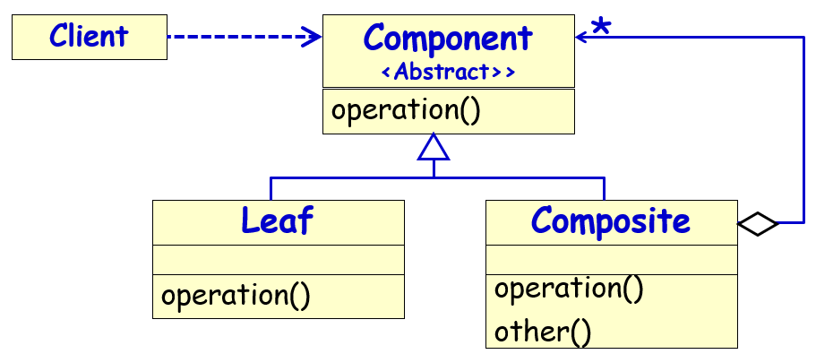
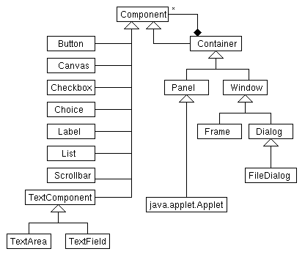
AWT Components

Slide 37
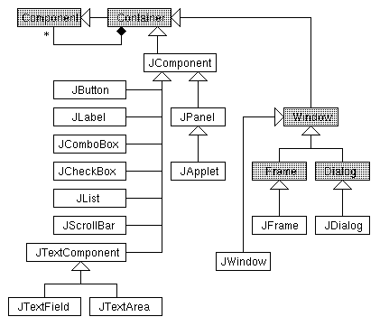
Swing Components
Every widget is a container!
Every Container is a Component!

Slide 38
Composite: Consequences
Benefits:
Makes it easy to add new kinds of components
Makes clients simpler, since they do not have to know if they are dealing with a leaf or a composite component
Liabilities:
Makes it harder to restrict the type of components of a composite

Slide 39
Adapter Pattern

Slide 40



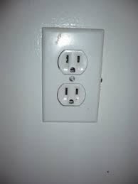

Adapter --a Wrapper Pattern
Intent
Convert the interface of a class to the interface expected by the users of the class.
Allows classes to work together even when they have incompatible interfaces.
Example (non-software)
You went to U.S.-- found
Had an Indian electrical appliance…
How can you use it in U.S.?
Use Adapters!
Also universal adapters?

Slide 41
Adapter Pattern
Wrapper
It is a wrapper pattern
“Convert the interface of a class into one that a client expects.”
Lets two classes work together --- that couldn’t otherwise --- because of incompatible interfaces
Used to provide a new interface to existing legacy components.
Two main adapter variants:
Class adapter:
Uses interface implementation and inheritance
Object adapter:
Uses delegation to adapt one interface to another
Object adapters are much more common.
Client
Server

Slide 42
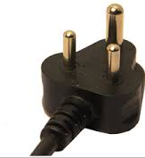
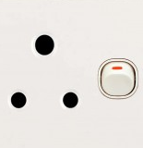



Essential Idea Behind Adapter Pattern
Target
Adaptee
Old interface
Old package
New package
Client
Old interface
New interface
Client
Adapter
New package

Slide 43
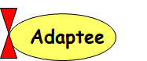
Adapter Pattern: Basics
Adapter
Helps two incompatible types to communicate.
A class expects an interface ---but that is not supported by a server class,
The adapter acts as a translator between the two types.
3 essential classes involved:
Target – Interface that client uses.
Adapter - class that wraps the operations of the Adaptee in interface familiar to client.
Adaptee - class with operations that the client class desires to use.
Target
Adaptee
Target
Adapter
Adaptee

Slide 44

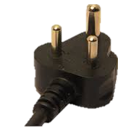
Lets Get Familiar With The Terminology
Target
Adapter
Adaptee

Slide 45
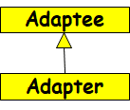

Class and Object Adapters
An adaptee may be given a new interface by an adapter in two ways:
Inheritance
The adapter sub-classes the adaptee;
This is the Class Adapter pattern
Delegation
The adapter holds a reference to the adaptee and delegates work to it;
This is the Object Adapter pattern

Slide 46
Example 1 – Sets
There are many ways to implement a set
Assume:
Your existing set implementation has poor performance.
You got hold of a more efficient set class,
BUT: The new set has a different interface.
Do not want to change voluminous client code
Solution: Design a class setAdapter:
Same interface as the existing set..
Simply translates to the new set’s interface.
Application
Set
NewSet
Adapter
Notes:
Of the many ways to implement a set, we have the one we’re using (OldSet) and the one we’ve acquired (NewSet). They have equivalent
functionality, but incompatible interfaces.

Slide 47
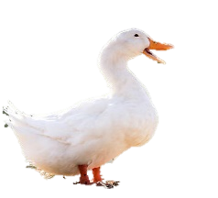
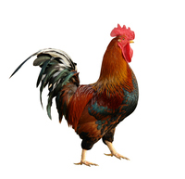
Class Adapter: Main Idea
Target
quack();
Adaptee
Cock-a-Doodle();
Client
Adapter
quack();

Slide 48
Object Adapter: Main Idea
Target
quack();
Adaptee
Cock-a-Doodle();
Client
Adapter
quack();

Slide 49
Example: Solution
Client
OldSet
Existing
add(Object e)
del(Object e)
int cardinality()
contains(Object e)
Got hold of Newset…
Target
NewSet
?
insert(Object e)
remove(Object e)
int size()
contains(Object e)
But, do not want to change Client code…
Adaptee
Notes:
This shows the current system, where clients use the interface given by OldSet, and we want to substitute in objects of type NewSet.

Slide 50
Object Adapter Pattern
Object Adapter: main idea -- delegation
The Adapter internally holds an instance of the Adaptee or a reference to it…
Uses it to call Adaptee operations from within the operations required by the Target.
Target
Adaptee
add()
insert()
Adapter
Client
add()
insert();

Slide 51
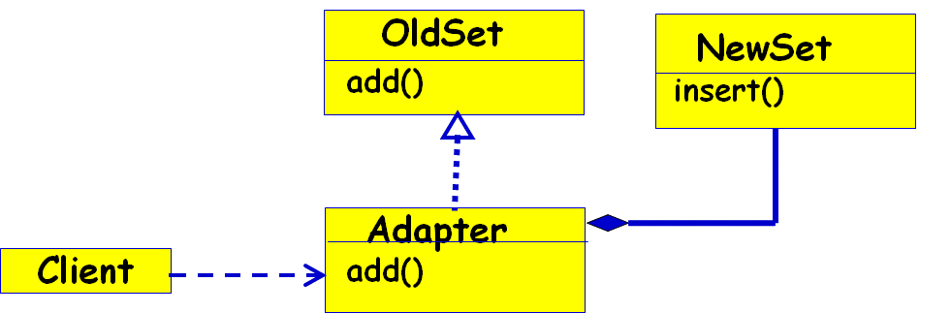
Object Adapter - Code
Client Code:
NewSet a =new NewSet(); OldSet t = new Adapter(a);
public void test() { t.add(); }
Target Code:
interface OldSet {
public void add(){}
}
Adaptee Code:
class NewSet {
public void insert(){}
}
Adapter Code:
class Adapter implements OldSet {
private NewSet nset;
public Adapter(NewSet a) { nset = a;}
public void add() { nset.insert();}
}

Slide 52
Class Adaptation
<<interface>>
OldSet
Adapter set makes NewSet appear as OldSet
OldSet is an interface, not a class
NewSet
add(Object e)
del(Object e)
int cardinality()
contains(Object e)
insert(Object e)
remove(Object e)
int size()
contains(Object e)
Adapter
add(Object e)
del(Object e)
int cardinality()
contains(Object e)
insert(e) ;
Client
Notes:
Class adaptation (not possible as such in Java, but common in C++). Use multiple inheritance to create an AdaptedSet. While it has the
interface OldSet expected in the system, it does simple forwarding to the relevant methods in NewSet.

Slide 53
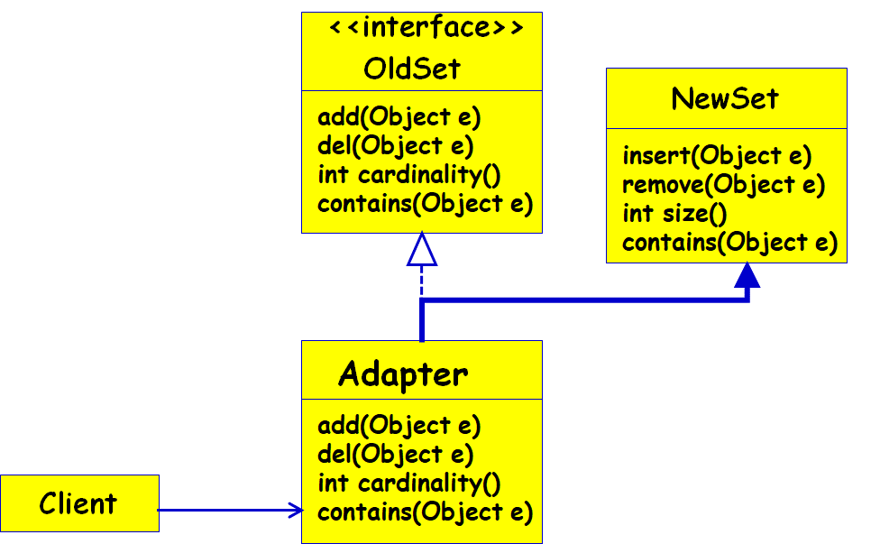
Class Adapter - Code
Client Code:
OldSet t = new Adapter();
public void test() { t.add(); }
Target Code:
interface OldSet {
public void add(){}
}
Adaptee Code:
class NewSet {
public void insert(){}
}
Adapter Code:
class Adapter extends NewSet implements OldSet {
public void add() { insert();}
}

Slide 54
Example: Restaurant Application
A restaurant application uses geo-coded address for customer delivery (Longitude, Latitude).
However, the customer application uses traditional address (House #, Street # etc).
Both are working software:
You do not want to change either.

Slide 55
Object Adapter Pattern
Example 2: Restaurant Adaptation
Solution: Object Adapter
Target
Customer
getAddressGL()
getAddress()
RestrantAdapter
Restaurant
Application
getAddressGL()
getAddress ;

Slide 56
Example Code: Object Adapter
class Customer{
Address getAddress(String address, String city, String state, String zip){
// do some calculation
}
} –Adaptee
interface Target{
void getAdressGL(String lat, String lng);
} - Restaurant application uses geocoded addresses.
class CustomerAdapter implements Target{
private Customer customer = new Customer();
public void getAddressGL(String lat, String lng){
// calculate latitude and longitude
// return address, city, state, zip
Adress=customer.getAddress();
GLAddress=conv(Address);
}
}

Slide 57
Adapter design pattern for comparing Objects
Client
Comparator
Student
int compare()
int score()
adaptee
StudComparator
int compare()
This idea has been used in implementing
“Comparable” in Java

Slide 58
Java Comparator: Example
class Student{
int rollno;
String name, address;
}
ArrayList <Student> al=new ArrayList<Student>();
Collections.sort(al,new SortByName());
Collections.sort(al,new SortByRoll());

Slide 59
Example: StudentComparator
public class SortByName implements Comparator<Student> {
public int compare(Student s1,
Student s2){
return s1.name.CompareTo(s2.name);}
}

Slide 60
Example: StudentComparator
public class SortByRoll implements Comparator<Student> {
public int compare(Student s1,
Student s2){
return s1.score() – s2.score();}
}

Slide 61
Variant: Universal Adapter--Adapt Multiple Versions of NewSet
(Object only) Several subclasses to adapt:
Too expensive to adapt each subclass.
Create single adapter to superclass interface.
Configure the AdaptedSet with the specific NewSet at run-time.
Client
OldSet
AdaptedSet
adaptee
NewSet
NewHashSet
NewBitSet
Notes:
Using an object adapter we can adapt any set that corresponds to the NewSet interface – including any subclasses that have variant implementation.

Slide 62
public class IPhoneCharger1 { public void iPhoneCharge(){ System.out.println("The iPhone is charging ..."); } }
public interface ChargAdapter{ public void phoneCharge(); }
public class UniversalCharger extends IPhoneCharger1 implements ChargAdapter{
public void phoneCharge() {
super.iPhoneCharge(); } }
✗
Class adapter:
Adapter object can have at most two faces.
public class UniversalCharger implements ChargeAdapter{
IPhoneCharger iphoneCharger;
public UniversalCharger(IPhoneCharger iphoneCharger1){
this.iphoneCharger = iphoneCharger; }
public void phoneCharge() {
iphoneCharger.iPhoneCharge(); }
Adapter
iPhoneCharger
iPhoneCharge1
iPhoneCharge2
Object adapter

Slide 63

Consequences - Class Adapters
Creates concrete adapter for a specific Adaptee (e.g., NewSet):
Not really a wrapper pattern…
- Cannot adapt a class and all its subclasses…
+ Can override Adaptee (e.g., NewSet) behavior:
After all, Adapter is a subclass of Adaptee
Obj

Slide 64
Consequences - Object Adapters
Single Adapter can handle many Adaptees (Universal adaptor):
Can adapt the Adaptee class and all its subclasses.
The biggest benefit of Object Adapter compared to Class Adapter ( and thus Inheritance ):
Loose coupling of client and adaptee.
Hard to override Adaptee behavior
Because the Adapter uses but does not inherit from Adaptee interface.

Slide 65
Other Issues
How much adapting does adapter do?
Simple forwarding of requests (renaming)?
Different set of operations and semantics?
At some point do the Adaptee and Adapter interfaces and functionality diverge so much that “adaption” is no longer the correct term…

Slide 66
Advantages of Adapter Pattern
Can help change behavior of existing software:
Without changing its source code.
Can help use legacy software:
Without making any modifications to old source code

Slide 67
Bridge Pattern

Slide 68
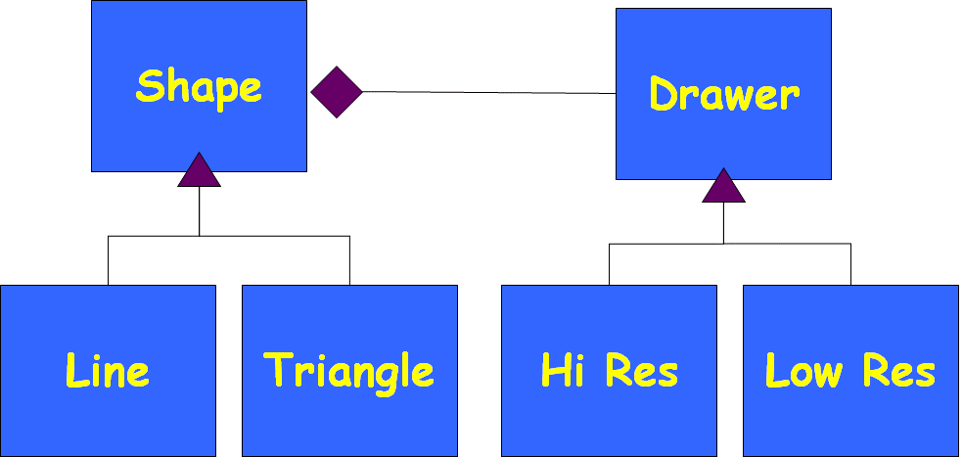
Bridge Pattern: Introduction
Helps decouple an abstraction hierarchy from its implementation:
Lets implementations and abstractions to vary independently.
Allows using one of several implementations of an interface to be decided upon dynamically.

Slide 69
Bridge Pattern
Also known as a Handle/Body pattern.
Split a class design into two class hierarchies.
One represents the concepts (called the handle).
The other embodies the implementation, and is called the body.
Handle forwards any invocations to the body.

Slide 70
Motivation: Novice Conference Participant Class Design
Conference
Participant
Organiser
Special
Guest
Registrant
Tutorial
Presenter
Paper
Presenter
Organiser
Tutorial
Presenter
Student
Paper
Presenter
Industrial
Academic
Student

Slide 71
Solution: Delegate to Roles
For the discussed example, multiple inheritance is not a good solution.
Delegation to required roles is a much better solution --- makes the solution more flexible.
Conference
Member
performs
1..*
Conference
Role
Organiser
Special
Guest
Registrant
Tutorial
Presenter
Paper
Presenter
Industrial
Academic
Student

Slide 72
Motivating Example 2
You designed a graphics package…
shape
Circle
draw()
area();
Line
draw()
area()
Rectangle
draw()
area();

Slide 73
Motivating Example cont…
Things worked fine:
Until you had to support mobile phones that can draw only low precision shapes.
You extended your design….
shape
Line
Rectangle
LineLow
LineHigh
RectLow
RectHigh

Slide 74
Motivating Example cont…
You soon had to support a different way of drawing for efficient transient views for animation…
You extended your design again ….
shape
Line
Rectangle
LineLow
LineHigh
RectLow
RectHigh
LineLowN
LineLowT
RecHighN
RecHighT

Slide 75
You soon needed a different way of drawing on Smartphones…
Things were becoming pretty complicated …
until you decided to use bridge design pattern…
defines the interface
shapes to draw
Shape
Drawer
Line
Triangle
Hi Res
Low Res
Bridge Design Pattern
“adapters” for specific
drawing interfaces

Slide 76
Separate the abstraction from implementation
defines the interface
shapes to draw
Abstraction
Implementation
Shape
Drawer
Line
Triangle
Hi Res
Low Res
Bridge Design Pattern
“adapters” for specific
drawing interfaces

Slide 77
Exercise 1
Consider thread scheduling :
Thread Scheduler
Preemptive Thread Scheduler
Time sliced Thread Scheduler
Unix PTS
Windows PTS
Unix TSTS
Windows TSTS

Slide 78
Exercise 1
We need to now support Java platform also…
Explosive Class Hierarchy!
Thread Scheduler
Give bridge solution!
Preemptive Thread Scheduler
Time sliced Thread Scheduler
Unix PTS
Windows PTS
Unix TSTS
Windows TSTS
JVM PTS
JVM TSTS

Slide 79
Solution with Bridge Pattern
Refactor into two orthogonal hierarchies:
Platform-independent abstractions and platform dependent implementations
Thread Scheduler
ThreadSched-Impl
Unix
Windows
Preemptive Thread Scheduler
Time sliced Thread Scheduler
JVM

Slide 80
Few Observations…
Suppose an abstraction has several implementations:
Inheritance is commonly used to accommodate these!!!
But inheritance binds an implementation to the abstraction permanently:
It becomes difficult to modify and reuse abstraction and implementations independently.
Inheritance without a Bridge:.
Leads to violation of single responsibilty principle

Slide 81
Overusing of inheritance…
“As a beginning object-oriented analyst, I had a tendency to solve every kind of problem by using special cases, taking advantage of inheritance. I loved the idea of inheritance because it seemed new and powerful. I used it whenever I could. This usually seems to be normal to many beginning analysts, but it is naive: “given a new hammer, everything seems like a nail.”

Slide 82
Bridge: Applicability
Use bridge Pattern when:
You want to avoid a permanent binding between an abstraction and its implementation.
Implementation may be selected or switched at run time.
Both the abstraction and their implementation should be extensible by subclassing without impacting the clients:
Even client code would not need recompiling.

Slide 83
Bridge: Structure
Client
<<abstract>>
Abstraction
+ Operation()
<<interface>>
Implementor
+ Implementation()
RefinedAbstraction1
+ Operation()
RefinedAbstraction2
+ Operation()
ConcreteImplementorA
+ Implementation()
ConcreteImplementorB
+ Implementation()

Slide 84
Why the Name Bridge?
Shape
Drawer
Line
Triangle
Hi Res
Low Res
Taxonomy in
Application Domain
Taxonomy in
Solution Domain

Slide 85
Provides A Bridge Between the Application and Solution domains…
Shape
Drawer
Line
Triangle
Hi Res
Low Res
Taxonomy in
Application Domain
Taxonomy in
Solution Domain

Slide 86
Bridge Pattern: Exercise 2
How to improve this design?
Vehicle
Ford
Toyota
Sporty
Truck
SUV
SportyFord
ToyotaTruck
FordTruck
SportyToyota
FordSUV
Existing design…

Slide 87
Exercise 1: Solution…
Use Bridge when you might otherwise be tempted to use multiple inheritance...
Car
CarManufacturer
Sporty
Truck
Ford
Toyota

Slide 88
When should we apply Bridge Pattern?
We want run-time binding with any required implementation.
We need to overcome a proliferation of classes:
Resulted from a coupled interface and numerous implementations
We need to map these into orthogonal class hierarchies…

Slide 89
Benefits
Decoupling abstraction from implementation
Reduction in number of sub-classes
Reduction of program complexity and executable code size.
Interface and Implementation can be varied independently.
Improved extensibility:
Abstraction and Implementation can be extended independently…

Slide 90
Drawbacks?
Runtime inefficiency
Increased Complexity due to double Indirection :
Abstraction→ Implementor →ConcreteImplementor

Slide 91
Final Analysis
Application of the time tested principle:
“Find what varies and encapsulate it” and
“Favor object composition over class inheritance”

Slide 92
Decorator Pattern

Slide 93
Decorator Pattern: Another wrapper pattern!
Intent:
Attach additional responsibilities to an object dynamically.
Provides a flexible alternative to subclassing.
Motivation:
Add responsibilities to individual objects as and when required and not to an entire class
Should conform to the interface of the object being decorated.

Slide 94
Decorator: In Simple Words
You have an object:
You wrap it with another object.
They both support the same interface.
Later possibly wrap with more objects..
The ones on outside are "decorators"
Clients use the one on the outermost.
Each decorator either masks, changes, or passes on method calls to one inside it…
Obj

Slide 95
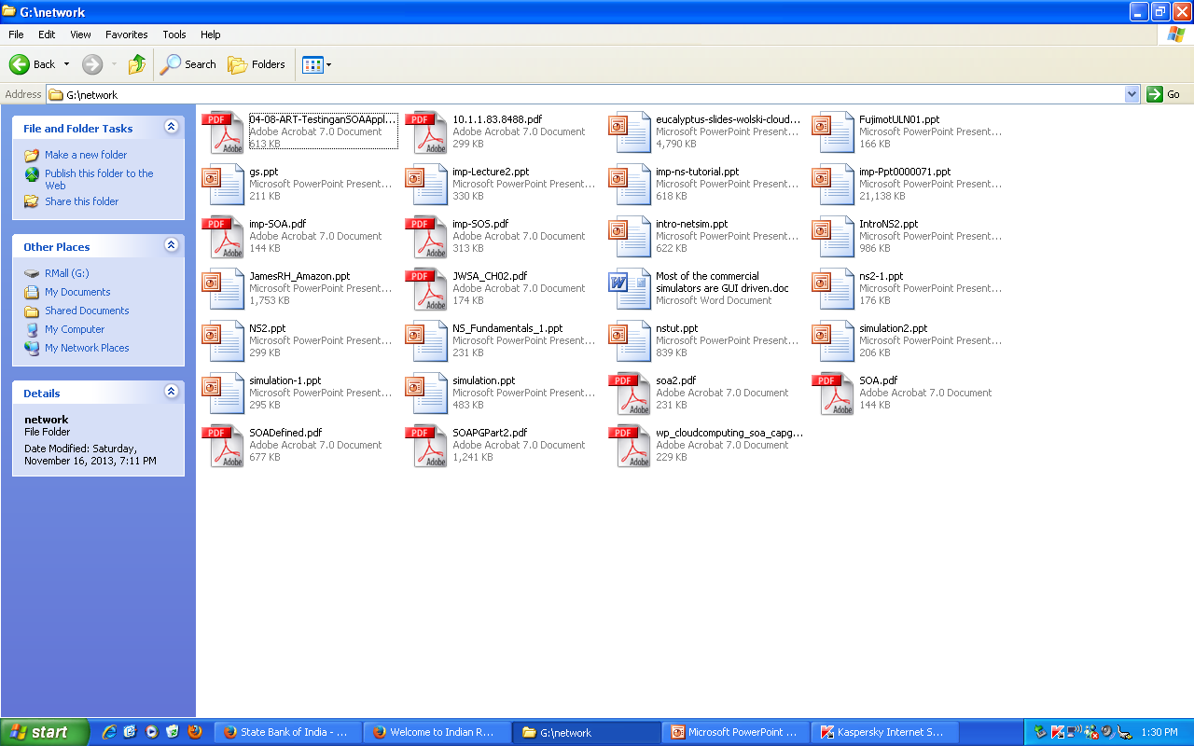
You were working with a directory listing window… then you decided to resize it…

Slide 96
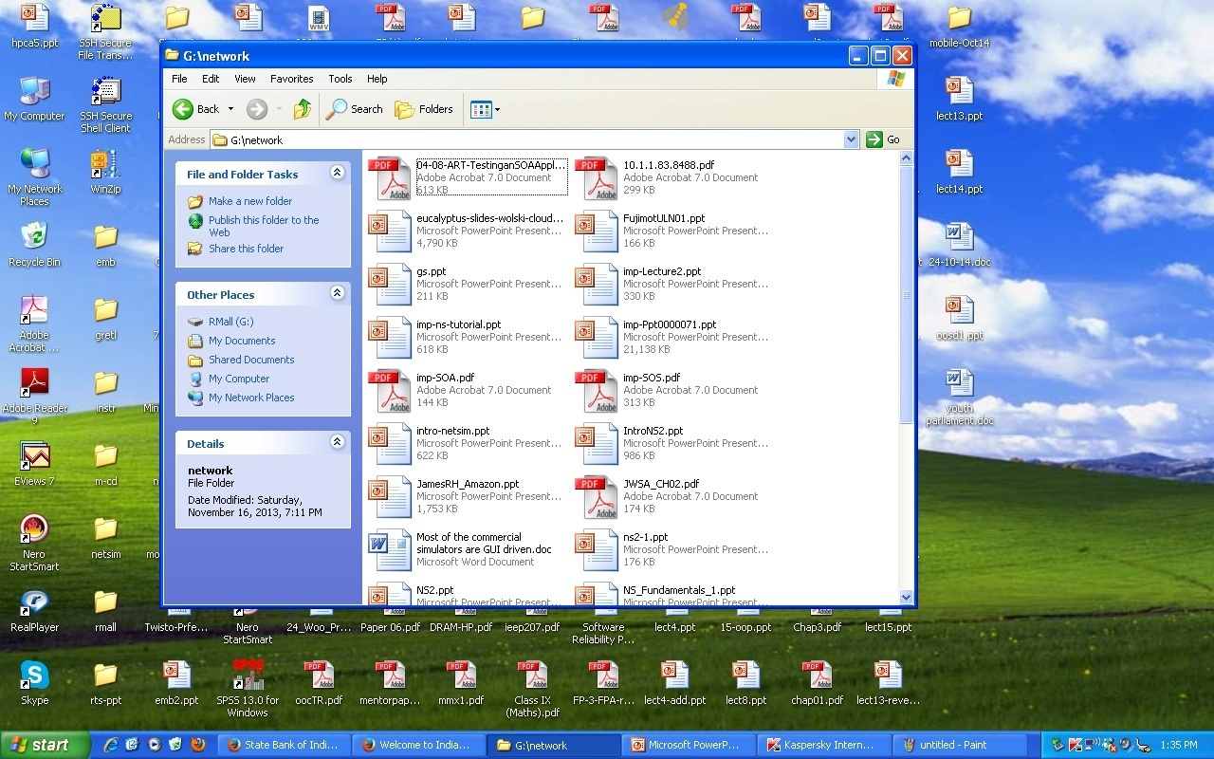
Mysteriously a scroll bar has appeared!!!
How can a window change?

Slide 97
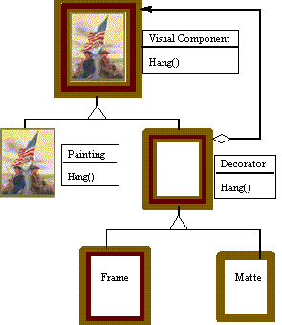

A Non-Software Example
Frames are often added to pictures.
Prior to hanging, the paintings may be matted
Matte

Slide 98

Matte Painting? --Digression
Helps create the illusion of an environment that is nonexistent or is too expensive or impossible to build or use.
The government warehouse in Raiders of the Lost Ark (1981) was painted on glass by Michael Pangrazio at Industrial Light & Magic, and combined with live-action footage of a government worker, pushing his cargo up the center aisle.

Slide 99

A Matte Painting

Slide 100



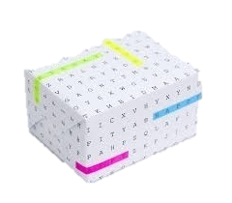
Decorator: Non-software example 2
Suppose you would like to give a gift to someone:.
- First you select the gift…
- Next you wrap the gift…
The gift can be wrapped in several ways…

Slide 101
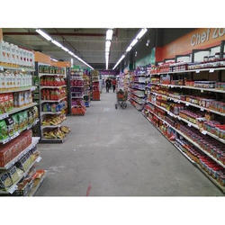
Gift-Wrap Options
Various options for wrapping gift:
box wrapped with gift-paper
box wrapped with gift-paper-with-crepe-paper
box wrapped with gift-paper-with-bow-without-crepe-paper
box wrapped with gift-paper-with-bow and crepe-paper
box wrapped with gift-paper with bow and crepe-paper and card
box wrapped with gift-paper with bow and crepe-paper without card
box wrapped with gift-paper without bow with crepe-paper and card
box wrapped with gift-paper without bow with crepe-paper without card
And so on…
Gift Paper
Kraft Paper
Crepe Paper
Bow
Card
Bow
Bow
Card
Card
Card
Card
Gift-wraps

Slide 102
Solution
To overcome the problem, manufacturers sell the following materials separately:
Boxes
Gift Papers
Cards
Bows
Crepe-paper
Clients select any number of materials and ask them to be put in any order required!

Slide 103
Decorator Pattern: Some Examples…
Add borders or scrollbars to a GUI component
Add headers and footers to an advertisement
Add functionality to a stream :
Reading input line by line or word by word; or compress a file before sending it over.

Slide 104
Decorator: Some General Concepts
A Decorator adds responsibilities to individual objects (not to all objects of a class!) dynamically:
In situations where a large number of independent extensions required…
An explosion of subclasses would occur if every combination to be supported.
Difficult to understand, remember and apply…

Slide 105
Decorator: Recounting the Ideas
A Decorator is an object that has an interface identical to an object that it contains.
Used for adding additional functionality to a particular object at run time as opposed to adding to a class.
Any call that the decorator gets, it relays to the object that it contains, and adds its own functionality along the way, either before or after the call.
Obj

Slide 106
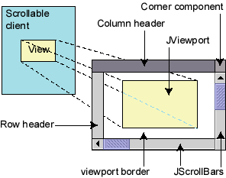
Decorator example: GUI
Normal GUI components don't have scroll bars
JScrollPane is a container with scroll bars to which you can add any component to make it scrollable
// JScrollPane decorates GUI components
JTextArea area = new JTextArea(20, 30);
JScrollPane scrollPane =
new JScrollPane(area);
contentPane.add(scrollPane);

Slide 107
Decorator: Programming Example
We have a text object and …
We want to add a border
Sometimes we want to also add a scrollbar.
Border decorator
Scrollbar decorator
For example, we may have
a text object and we want
to sometimes add a
vertical scrollbar and
Sometimes we want to add a
horizontal scrollbar.
For example, we may have
a text object and we want
to sometimes add a
vertical scrollbar and
Sometimes we want to add a
horizontal scrollbar.
Original text object

Slide 108
Decorator: Object Diagram
Border
Scrollbar
text
decorated
decorators
The objects refer each other like a linked list or chain of objects.
The last in the list is the decorated object.

Slide 109
Widget and Stream Examples
Suppose you have a user interface toolkit and you wish to provide a choice of border or scrolling to clients.
The client "attaches" the border or scrolling to only those objects requiring these capabilities.
Widget aWidget = new BorderDecorator( new ScrollDecorator(new TextView(), 1); aWidget.draw();
Stream Example
Cascading responsibilities to an output stream
Stream aStream = new CompressingStream( new ASCII7Stream(new FileStream( "fileName.dat" )));
aStream.putString( "Hello world" );

Slide 110
Example: Decorator Class Structure
VisualComponent
Draw()
TextView
Decorator
Draw()
Draw()
ScrollDecorator
BorderDecorator
Draw()
ScrollTo()
Draw()
DrawBorder()
ScrollPosition
BorderWidth

Slide 111
Decorator Structure
Client
component
1
component
operation()
Concrete component
decorator
operation()
operation()
Concrete decoratorA
Concrete decoratorB
operation()
operation()

Slide 112
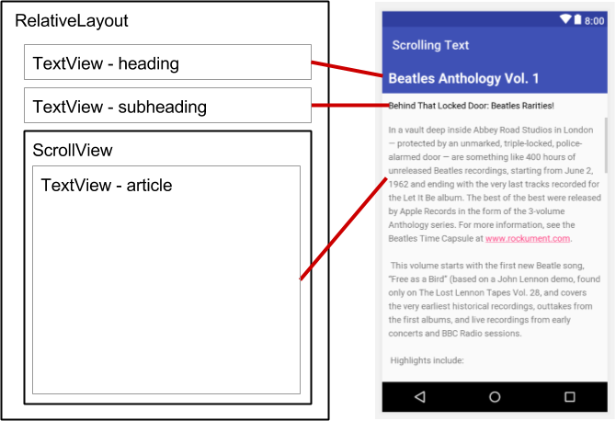
An Example Application
Consider a TextView GUI component:
You want to add different kinds of borders and/or scrollbars to it.
You can add 3 types of borders:
Plain, 3D, or Fancy
Also scrollbars:
Horizontal or Vertical
An inheritance solution would require 15 classes!

Slide 113
That’s a lot of classes!
TextView_Plain
TextView_Fancy
TextView_3D
TextView_Horizontal
TextView_Vertical
TextView_Horizontal_Vertical
TextView_Plain_Horizontal
TextView_Plain_Vertical
TextView_Plain_Horizontal_Vertical
TextView_3D_Horizontal
TextView_3D_Vertical
TextView_3D_Horizontal_Vertical
TextView_Fancy_Horizontal
TextView_Fancy_Vertical
TextView_Fancy_Horizontal_Vertical

Slide 114
A Simpler Solution
The component is contained in another object (decorator) that adds the border.
The decorator conforms to the interface of the component:
So its presence is transparent to clients
The decorator forwards requests to the component:
May perform additional actions before or after forwarding.

Slide 115
VisualComponent
draw()
resize()
1
TextView
draw()
resize()
StreamedVideoView
draw()
resize()
Decorator
draw()
resize()
1
Decorator contains a visual component
An imagined example
Border
draw()
resize()
ScrollBar
draw()
resize()
Plain
draw()
resize()
3D
draw()
resize()
Fancy
draw()
resize()
Horiz
draw()
resize()
Vert
draw()
resize()

Slide 116
Disadvantages of Inheritance
Use of inheritance leads to an explosion of classes …
With another type of border added:
Many more classes would be needed with this design.
If another view were added such as StreamedVideoView:
Double the number of Borders/Scrollbar classes
Use the Decorator Pattern instead!

Slide 117

Decorator Disadvantages
When tempted to add many decorators:
A package may become hard to understand…
Like Java I/O streams!!!
Solutions become complex:
A factory class may help
F-117

Slide 118
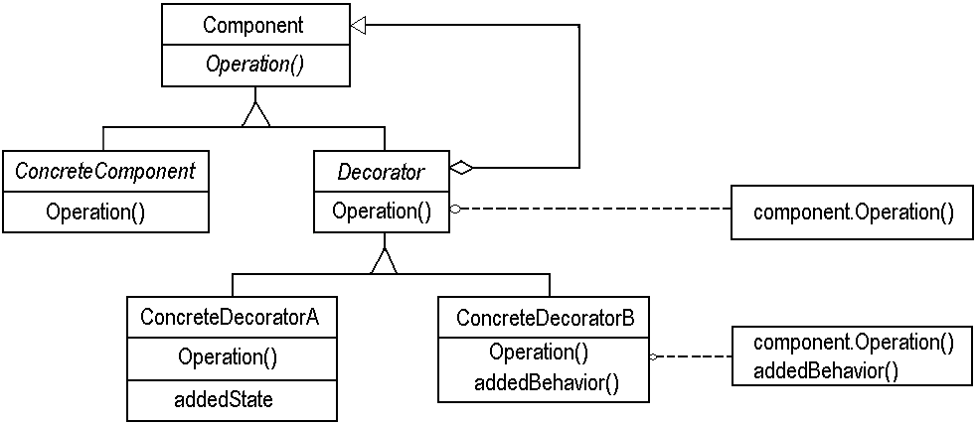
Decorator: Review
Interface for objects that can have responsibilities added to them dynamically
An object to which additional responsibilities can be attached.

Slide 119
Decorator Example: Object Diagram
aBorderDecorator
component
aScrollDecorator
component
aTextView

Slide 120
Java Borders
Any JComponent can have 1 or more borders
Borders are useful objects that, while not themselves components:
Know how to draw the edges of Swing components…
Borders are useful not only for drawing lines and fancy edges:
But also for providing titles and empty space around components

Slide 121
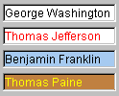

JTextField, JTextArea
An input control for typing text values (field = single line; area = multi-line)
public JTextField(int columns) public JTextArea(int lines, int columns) Creates a new field, the given number of letters wide.
public String getText() Returns the text currently in the field.
public void setText(String text) Sets field's text to be the given string.
What if the text area is too big to fit in the window?

Slide 122
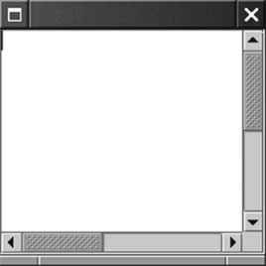
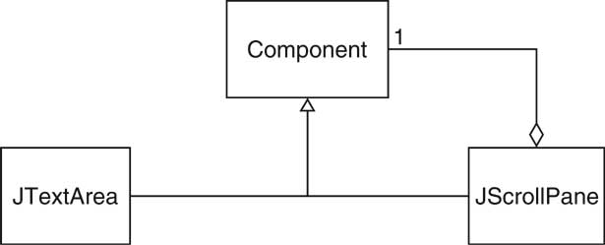
Example: Scroll Bars
Scroll bars can be attached to components
Approach #1: Component class can turn on scroll bars
Approach #2: Scroll bars can surround component JScrollPane pane = new JScrollPane(component);
Swing uses approach #2
JScrollPane is again a component

Slide 123
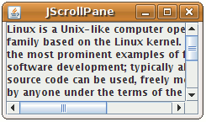
JScrollPane
A container that adds scrollbars around any other component
public JScrollPane(Component comp) Wraps the given component with scrollbars.
After constructing the scroll pane, you must add the scroll pane, to the onscreen container:
myContainer.add(new JScrollPane(textarea), BorderLayout.CENTER);

Slide 124
Quiz
An ice cream can be made with any of the following types of toppings in any combination and order:
Nutty
Honey
Fruity
Chocolate
Vanilla
Draw class diagram
Write Java Code

Slide 125
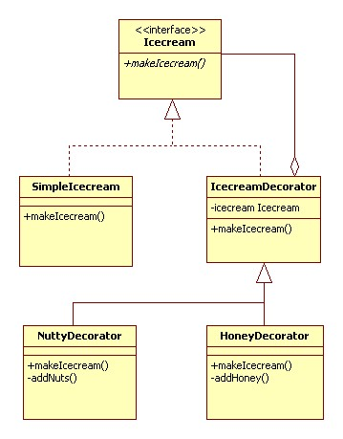
Quiz: Solution

Slide 126
Quiz: Java Code
public interface Icecream {
public String makeIcecream();
}
public class SimpleIcecream implements Icecream {
public String makeIcecream() {
return "Base Icecream";
}
abstract class IcecreamDecorator implements Icecream {
protected Icecream specialIcecream;
public IcecreamDecorator(Icecream specialIcecream) {
this.specialIcecream = specialIcecream;}
public String makeIcecream() {
return specialIcecream.makeIcecream();}
}

Slide 127
public class NuttyDecorator extends IcecreamDecorator {
public NuttyDecorator(Icecream specialIcecream) {
super(specialIcecream); }
public String makeIcecream() {
return specialIcecream.makeIcecream() + addNuts(); }
private String addNuts() {
return " + crunchy nuts“;}
}
public class HoneyDecorator extends IcecreamDecorator {
public HoneyDecorator(Icecream specialIcecream) {
super(specialIcecream); }
public String makeIcecream() {
return specialIcecream.makeIcecream() + addHoney(); }
private String addHoney() {
return " + sweet honey";}
}

Slide 128
Making Sense of Stream Classes…
Info
What are System.in.read() , System.out.print(), etc… ?
System class contains a variable called in -- an object created from a subclass of InputStream.
The period character after in states that read() belongs to in
In other words:
read() is a method that belongs to an object called in, which in turn belongs to a class called System.
public final class System extends Object;

Slide 129
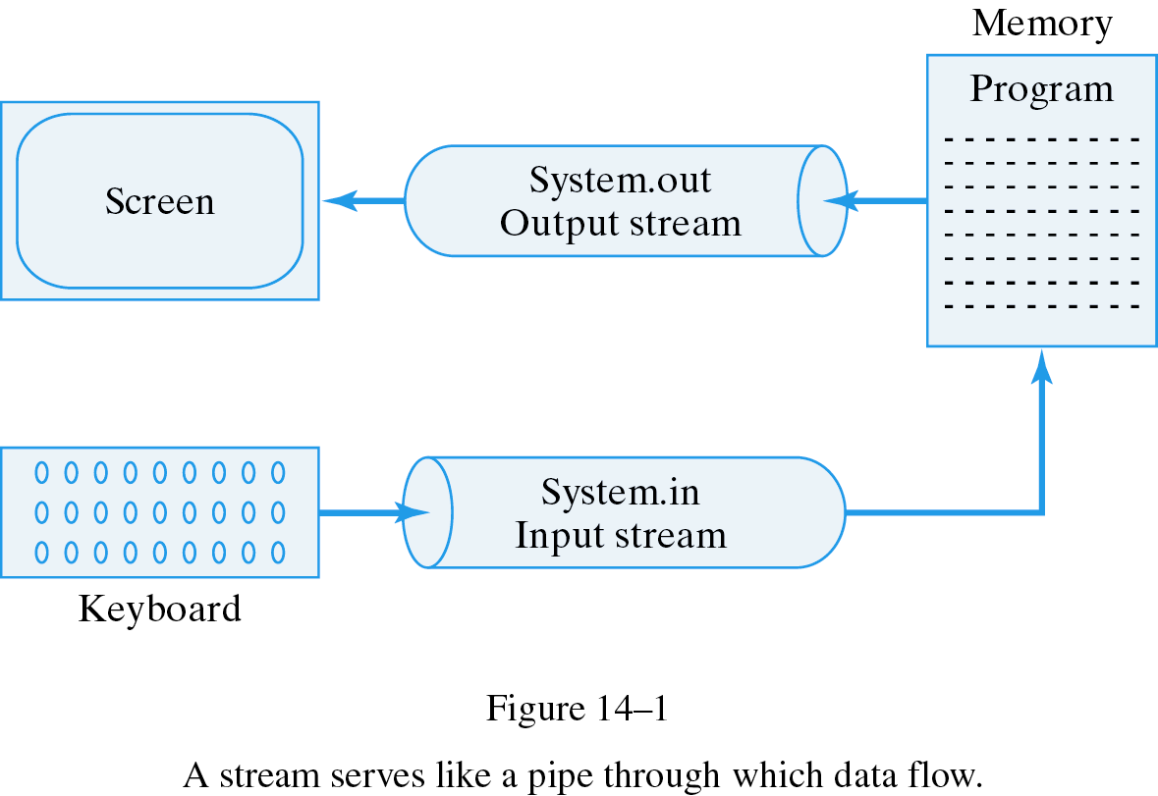
Info
System.out
System.in

Slide 130
What are Streams?
The I/O System in Java is based on Streams
Input Streams are data sources
Programmers read data from input streams
Output Streams are data sinks
Programmers write data to output streams
Java has two main types of Streams
Byte Oriented
Each datum is a byte
uses InputStream class hierarchy & OutputStream class hierarchy
Character-based I/O streams
each datum is a Unicode character
uses Reader & Writer class hierarchy
Info

Slide 131
Byte-Oriented Input Stream Classes
Info
InputStream
ByteArrayInputStream
FileInputStream
SequenceInputStream
ObjectInputStream
PipedInputStream
FilterInputStream
BufferedInputStream
DataInputStream
PushbackInputStream
Decorators
ZipInputStream
ZipInputStream is defined in: java.util.zip

Slide 132
Character-Oriented Stream Classes
Object
Info
InputStream
Reader
OutputStream
Writer
<<abstract>>
Reader
<<abstract>>
Writer
FileReader
BufferedReader
FileWriter
BufferedWriter

Slide 133
Creating an InputStream
InputStream is an abstract class
Programmers can only instantiate subclasses.
ByteArrayInputStream:
Constructor is provided with a byte array.
This byte array contains all the bytes provided by this stream
FileInputStream:
Constructor takes a filename or a FileDescriptor Object.
Opens a stream to a file.
FilterInputStream:
Provides a basis for filtered input streams
Our focus…
Info

Slide 134
Creating an InputStream
ObjectInputStream
Created from another input stream (such as FileInputStream)
Reads bytes from the stream (which represent serialized Objects) and converts them back into Objects
PipedInputStream:
Connects to an Instance of PipedOutputStream
A pipe represents a one-way stream through which 2 threads may communicate
Thread1 writes to a PipedOutputStream
Thread2 reads from the PipedInputStream
SequenceInputStream:
Constructor takes multiple InputStreams
Allows reading. When one stream ends, it continues reading from next stream in the list
Info

Slide 135
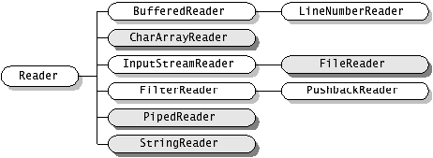
Info

Slide 136
Decorator Pattern in Java
System.in is associated with keyboard input stream
... InputStreamReader: Reads bytes and translates them into characters using the specified character encoding.
BufferedReader
Read text from a character-input stream, buffering characters so as to provide for efficient reading of characters, arrays, and lines.
Example:
BufferedReader keyboard = new BufferedReader(new InputStreamReader(System.in));
Info

Slide 137
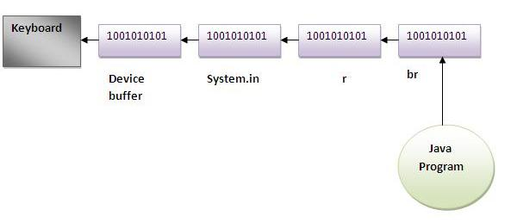
import java.io.*;
class Test{
public static void main(String args[])throws Exception{
InputStreamReader r=new
InputStreamReader(System.in);
BufferedReader br=new BufferedReader(r);
System.out.println("Enter your name");
String name=br.readLine();
System.out.println("Welcome "+name);
}
}
Info

Slide 138
Example of decorator pattern use
BufferedReader decorates InputStreamReader
BufferedReader
readLine()
Info
InputStreamReader
read() close()

Slide 139
I/O Explanation
Normal InputStream class has only public int read() method to read one letter at a time
Decorators such as BufferedReader add functionality to read the stream more easily
// InputStreamReader/BufferedReader decorate InputStream
InputStream in = new FileInputStream("hardcode.txt");
InputStreamReader isr = new InputStreamReader(in);
BufferedReader br = new BufferedReader(isr);
// Thanks to decorator streams, can read an
// entire line from the file in one call else would read characters
// (InputStream only provides public int read() )
String wholeLine = br.readLine();
Info

Slide 140
Filter Output Streams - Example
import java.io.*;
public class MyClass{
public void test() {
try {
FileOutputStream out = new FileOutputStream("Test");
OutputStreamWriter oswOut = new OutputStreamWriter(out);
BufferedWriter bufOut = new BufferedWriter(oswOut);
// programmer now uses bufOut…
}
catch (IOException x){
}
}
}
Info
bufOut
oswOut
out
Programmer
Writes
Data
BufferedWriter
OutputStreamWriter
FileOutputStream
File
named
"Test"
Data Buffered in
BufferedWriter
Character Data converted
to byte data
Byte Data written to file

Slide 141
Another Decorator Example
We can decorate a FileInputStream with an ObjectInputStream :
So you can read objects that implement Serializable Interface

Slide 142
Java streams
With > 60 stream decorators in Java, you can create a wide variety of input and output streams:
This provides flexibility -- good
It also adds complexity -- bad

Slide 143
Decorator: Pros
More flexible than static inheritance:
Responsibilities can be added and removed at run-time
Decorators also make it easy to add a property twice. For example, to give a TextView a double border, simply attach two BorderDecorators. Inheriting from a Border class twice is error.
Avoids inheriting from feature-laden classes.
An application needn't pay for features it doesn't use.
It's also easy to define new kinds of Decorators independently from the classes of objects they extend.

Slide 144

Decorator: Cons
Lots of little objects:
The objects differ only in the way they are interconnected, not in their class or in the value of their variables.
Although these are easy to customize by those who understand them, they can be hard to learn and debug.

Slide 145
Aggregation vs. inheritance
Both are ways to re-use functionality
Inheritance:
Re-use functionality of parent class
Statically decided
Weakens encapsulation
Aggregation:
Re-use functionality of objects at run-time
Invoked through the base interface
Dynamic: multiple types with same interface
Black-box re-use

Slide 146
Aggregation vs. Inheritance cont…
Inheritance is a quick and easy way to design new components:
These are variants of existing ones
However, indiscriminate use of inheritance creates bloated hierarchies
Code is more difficult to maintain
Unnecessary baggage for many classes
Aggregation drawback: it is harder to understand the behavior of a program by looking only at its source code…
Semantics of interaction are decided at run-time

Slide 147
Decorator: Consequences:
Responsibilities can be added/removed at run-time
Avoids subclass explosion
Recursive nesting allows attachment of multiple responsibilities
Implementation Issues:
Use lightweight classes as Decorators
Heavyweight classes make Strategy pattern more attractive

Slide 148
Decorator: Final Comments
The Decorator pattern gives you flexibility:
You can change a decorator at runtime, as opposed to having responsibility bound statically and determined at compile time by subclassing.
Since a Decorator complies with the interface of the object that it contains:
The Decorator is indistinguishable from the object that it contains and from any other concrete instances, including other decorated objects.
This is powerful and can be used to great advantage:
You can recursively nest decorators without any other objects being able to tell the difference, allowing significant customization.

