Slide 1
1. Regress: Modularity 2. Proxy Pattern
Lect 24
17-10-2023

Slide 2
Modularity
Modularity is a fundamental attributes of any good design.
Defined in terms of cohesion and coupling.
Normally covered in First level Software Engineering subject
We are revisiting the concepts based on requests from many of you.

Slide 3
Modularity
Modularity is a fundamental attributes of any good design.
Measures how effectively a design has been decomposed into a set of modules:
Modules should be almost independent of each other
Based on divide and conquer principle.

Slide 4
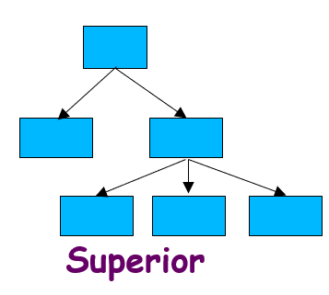
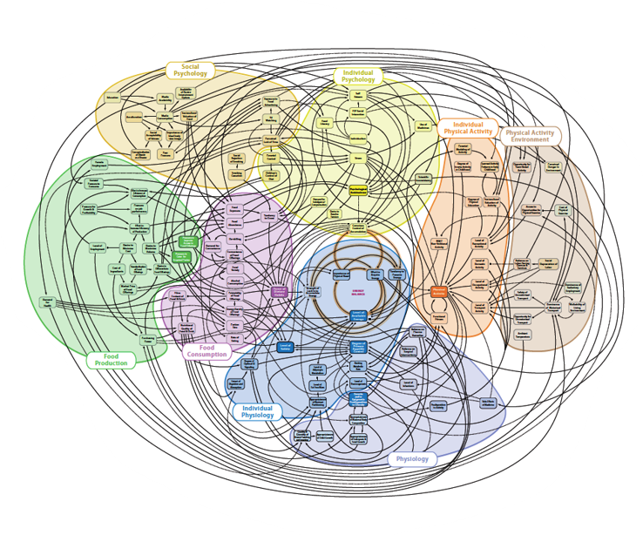

Modularity: Intuitive Explanation
If modules are independent:
Each module can be understood separately,
reduces complexity greatly.

Slide 5
Modularity
In technical terms, modules in a design have:
high cohesion
low coupling.
We next discuss:
cohesion and coupling.

Slide 6
Modularity
Arrangement of modules in a hierarchy ensures:
Low fan-out
Abstraction

Slide 7
Coupling: Degree of dependence among components
High coupling makes modifying parts of the system difficult, e.g., modifying a component affects all the components to which the component is connected.
No dependencies
Loosely coupled-some dependencies
Source:
Pfleeger, S., Software Engineering Theory and Practice. Prentice Hall, 2001.
Highly coupled-many dependencies
Notes:
7

Slide 8
Cohesion and Coupling
Cohesion is a measure of:
functional strength of a module.
A cohesive module performs a single task or function.
Coupling between two modules:
A measure of the degree of interdependence or interaction between the two modules.

Slide 9
Cohesion and Coupling
A module having high cohesion and low coupling:
Called functionally independent of other modules:
A functionally independent module:
Needs very little help from other modules during execution and therefore has minimal interaction with other modules.

Slide 10
Advantages of Functional Independence
Better understandability
Complexity of design is reduced,
Different modules easily understood in isolation:
Modules are independent
Also: Reuse of modules is possible.
No dependencies
Highly coupled-many dependencies

Slide 11
Measuring Functional Independence
Unfortunately, there are no ways available:
To quantitatively measure the degree of cohesion and coupling:
At present classification of different kinds of cohesion and coupling:
If we can classify a module with respect to its cohesion and coupling:
It will give us some rough idea regarding the degree of cohesiveness of a module.

Slide 12
Classification of Cohesiveness
Classification usually has scope for ambiguity and incorrectness:
yet gives us some rough idea about cohesiveness of a module.
By examining the type of cohesion exhibited by a module:
we can roughly tell whether it displays high cohesion or low cohesion.

Slide 13
Classification of Cohesiveness
functional
sequential
communicational
procedural
Degree of cohesion
temporal
logical
coincidental

Slide 14
Coincidental cohesion
The module performs a set of tasks:
which relate to each other very loosely, if at all.
That is, the module contains a random collection of functions.
functions have been put in the module out of pure coincidence without any thought or design.

Slide 15
Coincidental Cohesion - example
Module AAA{
Print-inventory();
Register-Student();
Issue-Book();
};

Slide 16
Logical cohesion
All elements of the module perform similar operations:
e.g. error handling, data input, data output, etc.
An example of logical cohesion:
a set of print functions to generate an output report arranged into a single module.

Slide 17
Logical Cohesion
module print{
void print-grades(student-file){ …}
void print-certificates(student-file){…}
void print-salary(teacher-file){…}
}

Slide 18
Temporal cohesion
The module contains functions so that:
all the functions must be executed in the same time span.
Example:
The set of functions responsible for
initialization,
start-up, shut-down of some process, etc.

Slide 19
init() {
Check-memory();
Check-Hard-disk();
Initialize-Ports();
Display-Login-Screen();
}
Temporal Cohesion – Example

Slide 20
Procedural cohesion
The set of functions of the module:
all part of a procedure (algorithm)
certain sequence of steps have to be carried out in a certain order for achieving an objective,
e.g. the algorithm for decoding a message.

Slide 21
Communicational cohesion
All functions of the module:
Reference or update the same data structure.
Example:
The set of functions defined on an array or a stack.

Slide 22
Communicational Cohesion
handle-Student- Data() {
Static Struct Student-data[10000];
Store-student-data();
Search-Student-data();
Print-all-students();
};
Function A
Function B
Function C
Communicational
Access same data

Slide 23
Sequential cohesion
Elements of a module form different parts of a sequence,
output from one element of the sequence is input to the next.
Example:
sort
search
display

Slide 24
Functional cohesion
Different elements of a module cooperate:
to achieve a single function,
e.g. managing an employee's pay-roll.
When a module displays functional cohesion,
we can describe the function using a single sentence.

Slide 25
Determining Cohesiveness
Write down a sentence to describe the function of the module
If the sentence is compound,
it has a sequential or communicational cohesion.
If it has words like “first”, “next”, “after”, “then”, etc.
it has sequential or temporal cohesion.
If it has words like initialize,
it probably has temporal cohesion.

Slide 26
Coupling
Coupling indicates:
How closely two modules interact or how interdependent they are.
The degree of coupling between two modules depends on their interface complexity.

Slide 27
Coupling
There are no ways to precisely measure coupling between two modules:
classification of different types of coupling will help us to approximately estimate the degree of coupling between two modules.
Five types of coupling can exist between any two modules.

Slide 28
Classes of coupling
data
stamp
control
Degree of coupling
common
content

Slide 29
Data coupling
Two modules are data coupled,
if they communicate via a parameter:
that is an elementary data item,
e.g an integer, a float, a character variable.
The data item should be problem related:
not used for control purpose.

Slide 30
Stamp coupling
Two modules are stamp coupled,
if they communicate via a composite data item
or an array or structure in C.

Slide 31
Control coupling
Data from one module is used to direct
order of instruction execution in another.
Example of control coupling:
a flag set in one module and tested in another module.

Slide 32
Common Coupling
Two modules are common coupled,
if they share some global data.

Slide 33
Content coupling
Content coupling exists between two modules:
if they share code,
e.g, branching from one module into another module.
The degree of coupling increases
from data coupling to content coupling.

Slide 34
Proxy Pattern

Slide 35
Proxy (Surrogate) Pattern
Problem: How should a client invoke the services of a server when access to the server should be managed in some way?
Solution: A proxy object should be created at the client side.
Explanation: Manage service
Authenticate
Hide details of network operations.
Determine server address,
Communicate with the server, obtain server response and seamlessly pass that to the client, etc.
c
c
S
c
c
c

Slide 36
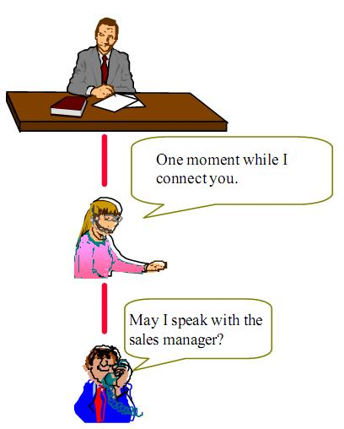
Proxy: Non-software example 1
To control access to an object:
Provide a surrogate for the object
May I know who is speaking?
May I speak to the manager?

Slide 37
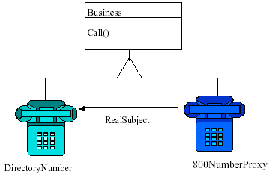
Proxy: Non-software example 2
Toll-free numbers
Client dials the “800” std code just like any other number
Proxy records billing information and connects to the nearest call center.

Slide 38
Non-software Example 3: Payment By Cheque
Problem:
A person has cash in his bank account but does not carry cash with him as it is cumbersome. Wants to make purchase…
Solution:
Proxy.

Slide 39
Payment by Cheque Example
The cheque acts as a proxy for the fund in the account.
The fund is the real subject.
The client asks for payment through a Cheque.
The proxy (cheque) behaves:
As if it was actual fund.

Slide 40
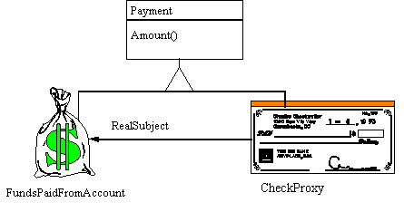
Proxy Design Pattern

Slide 41
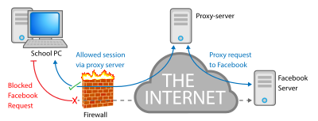
Digression: Network Proxy Server
What is the role of a network proxy server?
To keep machines behind it anonymous, mainly for security.
To speed up access to resources using caching.
To prevent downloading the same content multiple times and save bandwidth.
To log / audit usage, e.g. to provide company employee Internet usage reporting.
Firewall and filtering: Scan for malware

Slide 42
Encryption / SSL acceleration: Secure Sockets Layer (SSL) encryption is often not done by the web browser itself, but by proxy that is equipped with SSL acceleration hardware.
Load balancing: can distribute the load to several web servers, each web server serving its own application area.
Compression: proxy server can optimize and compress the content to speed up the load time.
Spoon feeding: reduces resource usage caused by slow clients by caching the content the web server sent and slowly "spoon feeding" it to the client.

Slide 43

Proxy: Some Insights
Use Proxy pattern whenever the services provided by a supplier need to be managed in some way without disturbing the supplier.
Example: You require some additional conditions to be satisfied before the actual object is accessed:
Consider loading an image from disk only when it is actually needed.

Slide 44
Proxy Pattern
The proxy object has the same interface as the target object:
Proxy stores a reference to the target object…
Forwards (delegates) requests to it.
Often more sophistication needed than just a simple method call to an object:
That is, we want to wrap code around the references to an object
<<interface>>
Subject
Client
request()
...
RealSubject
delegate
Proxy
request()
request()
...
...
Notes:
44

Slide 45
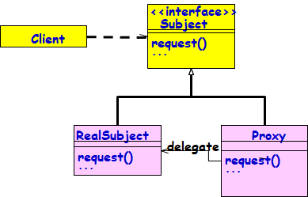
Proxy: Another Wrapper Pattern
A Structural Pattern:
Provides surrogate for some object,
Controls access to real target object.
Real target may not always be instantiated immediately:
Due to performance, location, or access restrictions.
Notes:
45

Slide 46
Proxy Solution
Create a Proxy object that implements the same interface as the real object
The Proxy object contains a reference to the real object
Clients are given a reference to the Proxy:
Not the real object
All clients invoke operations on the Proxy:
Allows the Proxy to perform additional processing
<<interface>>
Subject
Client
request()
...
RealSubject
delegate
Proxy
request()
request()
...
...
Client
Proxy
Real Object

Slide 47
Proxy Structure
Class Diagram
<<abstract>>
Subject
Client
request()
{
...
request()
...
realSubject.request()
...
}
RealSubject
Proxy
delegate
request()
request()
...
...

Slide 48
Proxy: Class Structure
Three Classes: Subject, RealSubject, and Proxy.
Interface Subject:
Implemented both by RealSubject, and Proxy.
Proxy:
Delegates any calls to RealSubject.
Client:
Always uses Proxy.
Notes:
48

Slide 49
Proxy Usage 1: Helps Save Expensive Steps
What is expensive?
Heavy weight object Creation
Object Initialization
Helps defer object creation and initialization to the time we actually need the object.
Proxy pattern:
Helps reduce the cost of accessing objects
The proxy object acts as a stand-in for the real object
The proxy creates the real object only if the user asks for it…

Slide 50
Example
Subject
<<interface>>
f();
p();
g();
Proxy
f();
p();
g();
RealSubject
f();
p();
g();
delegate

Slide 51
Proxy Code
Client Code: Proxy p = new Proxy();
public void test() { p.f(); p.g(); p.h(); }
interface Subject { void f(); void g(); void h();}
class Proxy implements Subject {
private Subject implementation;
public Proxy() { implementation = new RealSubject(); }
public void f() {implementation.f();} public void g() {implementation.g();} public void h() {implementation.h();}
}
class RealSubject implements Subject {
public void f() {System.out.println("Implementation.f()");}
public void g() {System.out.println("Implementation.g()");}
public void h() {System.out.println("Implementation.h()");}
}

Slide 52
Proxy Design Pattern
Client
<<abstract>>
Subject
expensiveMethod()
anotherMethod()
Instantiate with
Proxy object
Proxy
expensiveMethod()
anotherMethod()
RealSubject
expensiveMethod()
realActiveObject
. . . // Check if it is really needed:
if ( realActiveObject == null ) // never referenced
{ realActiveObject = getRealActiveObject();
realActiveObject.expensiveMethod();
}
else // try to avoid calling the real expensiveMethod()

Slide 53
Sequence Diagram for Proxy
:Client
:Proxy
:RealSubject
expensiveMethod()
[if needed]
realExpensiveMethod()
Proxy forwards requests to RealSubject when appropriate.

Slide 54
Kinds of proxies
Virtual proxy:
Delays the creation or loading of large or computationally expensive objects (lazy construction)
Proxy is a standin --- postpones accessing the real subject.
Remote proxy:
Use a local representative for a remote object (different address space)
Hides the fact that an object is not local
Encodes and sends the request to the real subject in a different address space.

Slide 55
Kinds of Proxies cont…
Synchronization Proxy
Controls access to a target object when multiple objects access it.
Cache Proxy
Hold results temporarily
Saves data for clients to share so data is only fetched or calculated once
Caching of information: Helpful if information does not change too often.
Copy-on-write:
Postpones creation of a copy of an object until it is necessary (if at all, changed from the original).
Notes:
55

Slide 56
Kinds of Proxies: Few Details
Protection Proxy:
Performs additional housekeeping chores when subject is accessed.
Checks access permission to the real object
Ensures that only authorized clients access a supplier in legitimate ways
Useful when different objects should have different access and viewing rights for the same document.
Example: Grade information shared by administrators, teachers and students.

Slide 57
Proxy Pattern
Client
«interface»
Subject
Proxy
RealSubject
delegate
Notes:
57

Slide 58
Virtual Proxy: Why Stand-in?
1. The image is expensive to load
2. The complete image is not always necessary
lightweight
2MB 2KB
Notes:
58

Slide 59
Virtual Proxy: Object Diagram
aTextDocument
image
anImageProxy
fileName
anImage
data
in memory
on disk
Notes:
59

Slide 60
Virtual Proxy example
Image
boundingBox()
draw()
ProxyImage
boundingBox()
draw()
RealImage
boundingBox()
draw()
realSubject
Images are stored and loaded separately from text
If a RealImage is not loaded a ProxyImage displays a grey rectangle in place of the image
The client cannot know that it is dealing with a ProxyImage instead of a RealImage

Slide 61
Virtual Proxy
DocumentEditor
Graphic
draw()
getExtent()
store()
load()
if (image==0) {
image = loadImage(fileName);
}
image®draw()
Image
ImageProxy
imageImp
extent
image
fileName
extent
if (image==0) {
return extent;
} else {
return image®getExtent();
}
draw()
getExtent()
store()
load()
draw()
getExtent()
store()
load()

Slide 62
Example Application: Picture Viewer
A picture viewer has many high quality images.
Opening the viewer should be fast:
Not so if all images must be loaded.
No need to load all:
Not all will be viewable in the Window.
Load images on demand !
Notes:
62

Slide 63
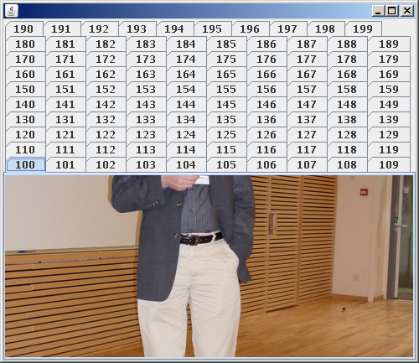
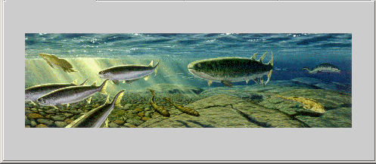

Slide 64
Example 1: Image Proxy
package proxyPattern;
public interface Image {
public void displayImage();
}
Client
«interface»
Image
ProxyImage
RealImage
delegate
Notes:
64

Slide 65
Example 2: Lazy Loading in A Word Processor
Suppose a document contains lots of multimedia objects:
Yet should load fast…
Create proxies to represent large images, movies, etc.:
Only load these objects on demand as they become visible on the screen (Afterall, only a small part of the document is visible at a time)

Slide 66
Lazy Loading cont…
Rather than instantiating an expensive object right away:
Create a proxy instead, and give the proxy to the client
The proxy creates the object on demand when the client first uses it:
If the client never uses the object, the expense of creating it is never incurred…

Slide 67
Lazy Loading cont…
A hybrid approach can be used:
The proxy implements some operations itself.
Create the real object only if the client invokes one of the operations it cannot perform…
A proxy stores necessary information to create the object on-the-fly:
file name, network address, etc.

Slide 68
Graphic
Draw()
GetExtent()
Store()
Load()
Document Editor
Image
imageImp
extent
Draw()
GetExtent()
Store()
Load()
ImageProxy
fileName
extent
Draw()
GetExtent()
Store()
Load()
if(image==0)
image=LoadImage(fileName);
Image.Draw();
if(image==0)
return(extent);
else
return(image.GetExtent();
Notes:
68

Slide 69
Image Proxy Example 1
interface Image {
public void displayImage();
public void loadImage();
}
class RealImage implements Image {
private String filename;
public RealImage(String filename) {
this.filename = filename;
System.out.println("Loading "+filename);
}
public void displayImage() {
System.out.println("Displaying "+filename); }
}
Notes:
69

Slide 70
Proxy Pattern Example 1
public class ProxyImage implements Image {
private String filename;
private Image image;
public ProxyImage(String filename){
this.filename = filename;
}
public void displayImage() {
if (image == null) {
image = new RealImage(filename);
//load only on demand
}
image.displayImage();
}
}
delegate request
to real subject
Notes:
70
Lazy evaluation

Slide 71
Proxy Example 1 - the Client
public class ProxyExample {
public static void main(String[] args) {
ArrayList<Image> images = new ArrayList<Image>();
images.add(new ProxyImage("HiRes_10MB_Photo1"));
images.add(new ProxyImage("HiRes_10MB_Photo2"));
images.add(new ProxyImage("HiRes_10MB_Photo3"));
images.get(0).displayImage();
images.get(1).displayImage();
images.get(0).loadImage();
}
}
Notes:
71

Slide 72
Before Proxy…

Slide 73
After Proxy…

Slide 74
Remote Proxy
The proxy object:
Assembles data into a network message
Sends it to the remote object
A remote receiver:
Receives data,
Turns it into a local message that is sent to the remote object

Slide 75
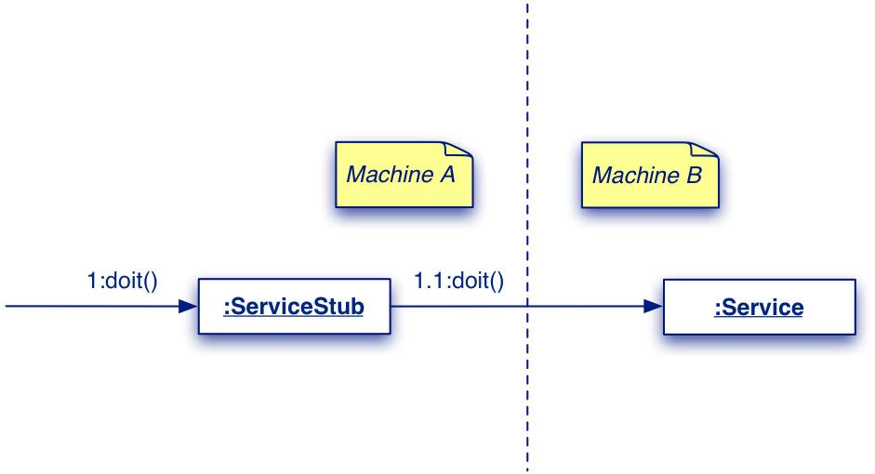
Proxy remote access example
Notes:
75

Slide 76
Remote Proxy
Stand-in for an object often needed because it is:
Not locally available;
Instantiation and access are complex
Needs protected access for security.
The stand-in must:
Have the same interface as the real object;
Handle as many messages as it can;
Delegate messages to the real object when necessary.

Slide 77
Remote Proxy Pattern Structure
Supplier
<<interface>>
request()
Client
ProxySupplier
RealSupplier

Slide 78
Proxy Pattern Behavior
request0()

Slide 79
Proxy: An Analysis
Consequences:
A Proxy decouples clients from servers. A Proxy introduces a level of indirection.
Proxy some what similar to object adapter but differs from it in that it does not change the object’s interface.
Notes:
79

Slide 80
Proxy Usage: Another Example
Enterprise JavaBeans and RMI provide examples of proxy usage:
A client for RMI or EJBs gets a proxy version of an object (called stub)
The proxy communicates (over the network) with the actual object
The proxy object makes remote communication appear (almost) identical to a local connection.

Slide 81
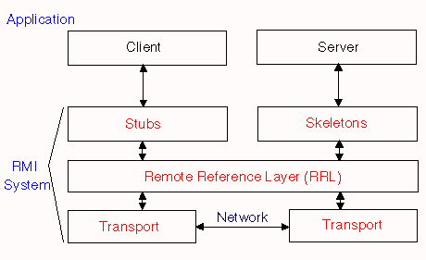
Java API Usage
java.rmi library --- “Remote Method Invocation”
Allows objects in separate virtual machines to be used as if local
Uses “stub and skeleton” to handle communication
Digression

Slide 82
Known Uses: Broker Objects
The Client and Real Subject are in different processes or on different machines:
So a direct method call will not work
The Proxy's job is to pass the method call across process or machine boundaries:
Return the result to the client (with Broker's help)
Digression

Slide 83
CORBA example
Digression
Interface
Repository
client application
ORB (server)
Stub objects have full
public interface, but no data.
They just push a message
over to the server.
CORBA
IDL stubs
IDL skeletons
Object
Implementations
network
Generated
by a tool
Developers
fill in details
requests
responses

Slide 84
Uses #3 and #4: Java Collections
Read-only Collections:
Wrap collection object in a proxy that only allows read-only operations to be invoked on the collection
All other operations throw exceptions
List unmodifiableList=Collections.unmodifiableList(List list);
Returns read-only List proxy
Synchronized Collections
Wrap collection object in a proxy that ensures only one thread at a time is allowed to access the collection
Proxy acquires lock before calling a method, and releases lock after the method completes
List Collections.synchronizedList(List list);
Returns a synchronized List proxy

Slide 85
Proxy Uses #5: Secure Objects
Different clients have different levels of access privileges to an object
Clients access the object through a proxy
The proxy either allows or rejects a method call:
Depending on what method is being called and who is calling it (i.e., the client's identity)

Slide 86
Proxy Use #6: Copy-on-Write
Multiple clients share the same object:
as long as nobody tries to change it
When a client attempts to change the object:
They get their own private copy of the object
Read-only clients continue to share the original object:
while writers get their own copies
Maximize resource sharing, while making it look like everyone has own object.

Slide 87
Use #6: Copy-on-Write
Highly optimized String classes often use this approach.
To make this work:
Clients are given proxies rather than direct references to the object.
When a write operation occurs:
A proxy makes a private copy of the object on-the-fly to insulate other clients from the changes …

Slide 88
Proxy Known Uses: Copy-on-Write
Before any Write
Client A
Proxy A
Client B
Proxy B
Real Subject
Client C
Proxy C
After Write by C
Client A
Proxy A
Client B
Proxy B
Real Subject
Client C
Proxy C
Real Subject Copy

Slide 89
Uses #7: Reference Counting
Client A
Proxy A
Client B
Proxy B
: Real Subject
RefCount : int
Client C
Proxy C
Proxies maintain the reference count inside the object
The last proxy to go away is responsible for deleting the object:
That is, when the reference count goes to 0, delete the object.

Slide 90
Proxy: Related Patterns
Adapter:
Provides a different interface to an object.
Decorator:
Somewhat similar structure as proxy, but different purpose.
Decorator adds responsibilities whereas proxy controls access.

Slide 91
Proxy vs. Decorator
Both patterns create a “wrapper” around another object.
But an adapter has a different interface than the wrapped object.
While a Decorator adds additional responsibilities to an object, a Proxy “controls access” to an object.
Not only that Proxy does not add any responsibilities, it might actually prevent access to some functionalities.
E.g. Read-only collections, Secure objects

