Slide 1
Iterator Pattern
Lect 25 --26
30-10-2023

Slide 2
Iterator Pattern: Intent
Provides a way to access the elements of an aggregate object sequentially:
Without exposing the programmer to the complexity of underlying representation.
Moves the responsibility for access and traversal:
From the aggregate object to an iterator object.

Slide 3
Background
Traversing through elements in an aggregation is a very common problem in programming:
Iterators provide a uniform way of doing this …
Using an iterator, we don’t need to know:
How the collection is implemented!
Concurrent access and Synchronization
Different methods for iterating

Slide 4
Iterator Pattern: Pros
Supports the same interface for all aggregates.
Supports multiple types of traversals of aggregate objects.
Supports multiple iterators…

Slide 5
Iterator: Essential Idea
The elements of a collection:
Accessed in some sequential order that may be independent of their position in the collection.
For example:
Level order: Access each object of a tree from left to right at each tree level
Inorder, post order, preorder, etc

Slide 6
The Iterator Pattern: Context
It might be necessary to have more than one type of traversal on the same aggregate object.
Also, not all types of traversals can be anticipated a priori.
One should not bloat the interface of an aggregate object with all possible traversals.

Slide 7
Iterator: Basic Methods
Reset:
Move to the beginning of the range of elements
next:
Advance to the next element
Get:
Return the value referred to
hasNext:
Interrogate it to see if it is at the end of the range

Slide 8
Iterator: Two Most Common Methods
public boolean hasNext()
Returns true if the Iterator object has more elements (objects) that have not yet been returned by next()
public Object next()
Returns the next element (object) from the iteration and advances to next element.

Slide 9
Additional Methods
Remove: Current element is removed, as in Java List.
Add: Add an element at the current position.
Count: Return the number of elements in the aggregate.
First: Reset

Slide 10
next() in Java: Issues
Theoretically, when an iterator returns an element of the collection:
It might return a clone of the element, or it might return a reference to the element
Iterators for Java collection classes ArrayList<T> and HashSet<T>:
Actually return references
Therefore, modifying the returned value will modify the element in the collection

Slide 11
Iterator Pattern: Main Idea
List
ListIterator
Count()
Append(Element)
Remove(Element)
…
First()
Next()
hasNext()
get()
index

Slide 12
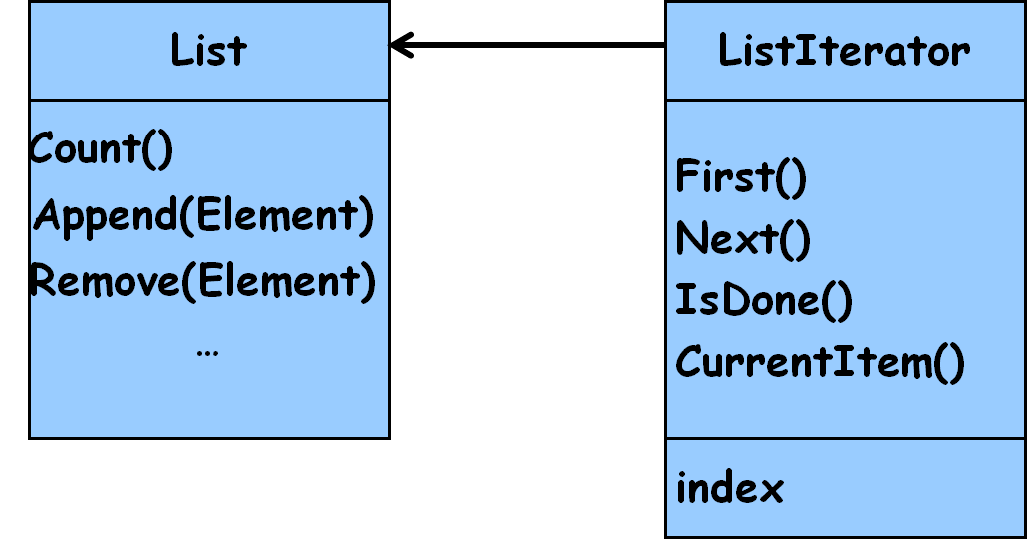
Iterator Pattern: Solution
The responsibility for accessing and traversing an aggregation object:
Placed in a separate iterator object and not in the aggregate object.
An iterator object should:
Provide the same interface for accessing and traversing elements,
Regardless of the class of the aggregate object and the kind of traversal performed

Slide 13
Structure of Iterator Pattern
Aggregate
Iterator
CreateIterator()
first()
next()
hasNext()
get()
ConcreteAggregate
ConcreteIterator
CreateIterator()
return new ConcreteIterator()
A ConcreteIterator object holds a reference to the ConcreteAggregate object that created it.

Slide 14
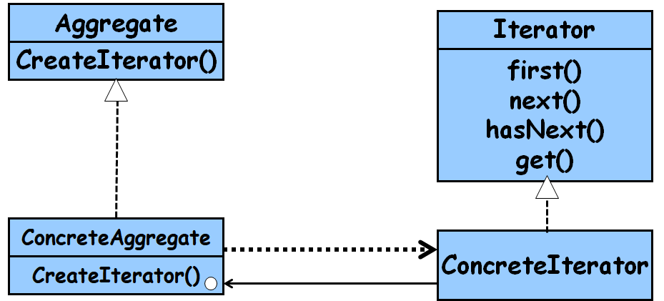
Iterator: Participants
Iterator
Defines an interface for accessing and traversing elements
ConcreteIterator
Implements the Iterator interface.
Keeps track of current position in the aggregate.
Aggregate
Defines an interface for creating an Iterator object
ConcreteAggregate
Creates and returns an instance of the ConcreteIterator

Slide 15
Iterator Design: Example
Iterator
{abstract}
first() : Item
next() : Item
hasNext() : Bool
ArrayIterator
LinkListIterator
first() : Item
next() : Item
hasNext() : Bool
first() : Item
next() : Item
hasNext() : Bool
Item
Array
LinkList
*
*

Slide 16
Iterator: Example
public String first() {
index = 0;
return data[0];
}
public String next() {
index++;
return data[index];
}
public boolean hasNext() {
if (index >= data.length)
return false;
return true;
}
}
public class ArrayIterator implements Iterator {
private String[] data;
private int index;
public ArrayIterator (String[] data) {
this.data = data;
this.index = 0;
}

Slide 17
Iterator Design: Example
public class LinkListIterator implements Iterator {
private LinkListElement first;
private LinkListElement current;
public LinkListIterator (LinkListElement first){
this.first = first;
this.current = first;
}
public String first() {
return first.value();
}
public String next() {
current = current.getNext();
return current.value();
}
public boolean moreElements() {
if (current.getNext() == null)
return false;
return true;
}
}

Slide 18
Iterating Through A Vector: without Iterator
import java.util.*;
public class IterationExample1{
public static void main(String args[]) {
Vector v = new Vector();
// Put some Complex number objects in the vector.
v.addElement(new Complex(3.2, 1.7));
Continued…

Slide 19
Iterating Through A Vector
v.addElement(new Complex(7.6));
v.addElement(new Complex());
v.addElement(new Complex(-4.9, 8.3));
for (int i = 0; i < v.size(); i++) {
Complex c = (Complex)v.elementAt(i);
System.out.println(c);}
}
}

Slide 20
Iterating Through A Vector
For vectors this approach does not appear too bad:
Because the elements of a vector can be retrieved by specifying their position:
v.elementAt(i);

Slide 21
Iterating Through a Vector: Using Iterator
Iterator i = v.iterator();
while (i.hasNext()) {
Complex c= (Complex)i.next();
System.out.println(c);
}

Slide 22
Iterator for Java Collection
Iterator
hasNext()
next()
Collection
iterator()
ConcreteCollection
iterator()
ConcreteIterator
hasNext()
next()
<<create>>
return new ConcreteIterator()

Slide 23
Iterator in Java
When we look through the documentation for the Java:
Support for the iterator pattern provided in the Java SDK is based on Iterator interface:
Not abstract class (why?)
public interface Iterator {
public boolean hasNext();
public Object next();
public void remove();
}

Slide 24
GOF Iterator Pattern in Java
An Iterator object is an instance of a class that implements the Iterator interface:
Java Iterator interface defines the hasNext(), next(), and remove() methods…

Slide 25
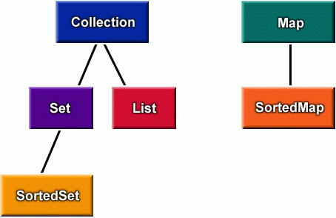
Java Collections

Slide 26
Java Collections
Collection
Map
Set
List
SortedMap
SortedSet
Hashtable
Hashtable is an old (pre-Collections) class
Hashtable has been retrofitted to implement the Map interface

Slide 27
«interface»
Collection
«interface»
Map
«interface»
Set
«interface»
Queue
«interface»
SortedMap
«interface»
List
HashSet
«interface»
SortedSet
Vector
ArrayList
LinkedList
TreeMap
HashMap
Linked HashSet
TreeSet

Slide 28
Iterating Through a Hashtable
Hashtable does not implement Collection:
Therefore does not have any method to return an Iterator object for the keys and values in the table
Instead:
entrySet() returns the Set of entries
keySet() returns a Set of the keys in the table
values() returns a Collection of values in the table
iterator() can be invoked on these collection objects

Slide 29
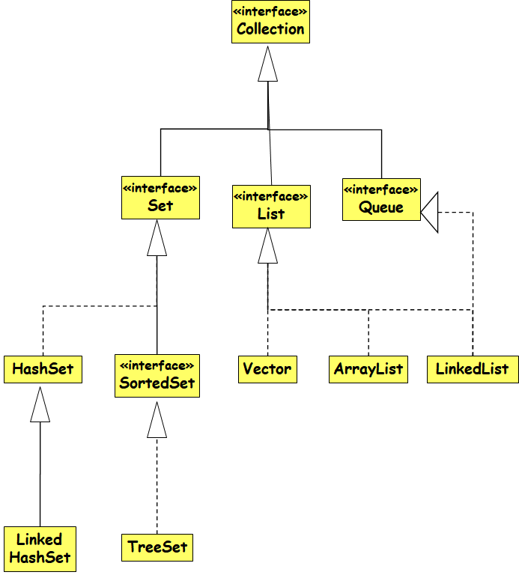
Iterator interface in Java
public interface java.util.Iterator {
public boolean hasNext();
public Object next();
public void remove();
}
public interface java.util.Collection {
... // List, Set extend Collection
public Iterator iterator();
}
public interface java.util.Map {
...
public Set keySet(); // keys,values are Collections
public Collection values(); // (can call iterator() on them)
}

Slide 30
The List Interface
java.util.List interface:
public interface List extends Collection {
Object get(int index);
Object set(int index, Object element);
void add(int index, Object element);
Object remove(int index);
boolean addAll(int index, Collection c);
int indexOf(Object o);
int lastIndexOf(Object);
ListIterator listIterator();
ListIterator listIterator(int index);
List subList(int from, int to);
}
Skip

Slide 31
The ListIterator Interface
java.util.ListIterator interface:
public interface ListIterator extends Iterator {
boolean hasNext();
Object next();
boolean hasPrevious();
Object previous();
int nextIndex();
int previousIndex();
void remove();
void set(Object o);
void add(Object o);
}
Skip

Slide 32
Iterators in Java
All Java collections have a method iterator that returns an iterator for the elements of the collection
List list = new ArrayList();
... add some elements ...
for (Iterator itr = list.iterator(); itr.hasNext()) {
BankAccount ba = (BankAccount)itr.next();
System.out.println(ba);
}
set.iterator()
map.keySet().iterator()
map.values().iterator()

Slide 33
Adding your Own Iterators
When implementing your own data structures, it can be very convenient to use Iterators
public class PlayerList {
public int getNumPlayers() { ... }
public boolean empty() { ... }
public Player getPlayer(int n) { ... }
}
public class PlayerList {
public Iterator iterator() { ... }
public int size() { ... }
public boolean isEmpty() { ... }
}
Discouraged Nonstandard interface.
Preferred

Slide 34
Implementing an Iterator
Three main approaches to create an Iterator for an aggregate class A:
Use a separate class
Use an inner class within A
Use an anonymous inner class within A

Slide 35
Inner Iterator Class
Java allows one class to be nested inside another
Inner class has full access to private data of main class
data is still kept as a private field

Slide 36
class LinkList {
private Node head;
// put all the usual stuff here
public class LLIterator implements Iterator {
private Node nextObject;
public LLIterator() {
nextObject = head;
}
}
public Iterator iterator() {
return new LLIterator();
}
}

Slide 37
A Few Issues
Who controls the iteration?
External:
Client explicitly calls all necessary operations for traversal, e.g. client must explicitly request next() on each node
Internal:
Client asks the internal iterator an operation to perform, and the iterator applies that operation to every element…

Slide 38
An external iterator is active, an internal is passive. When the client (i.e. the programmer) controls the iteration, the iterator is called external iterator. When the iterator controls it, it is called an internal iterator. ... Internal iteration is less error prone and more readable.
But,…

Slide 39
Pros and Cons
External Iterator:
More flexible than Internal.
Can compare 2 collections easily
Internal Iterator:
Easier to use, as they define the iteration logic for you. Makes portability easier.

Slide 40
Iterator Pattern: Variations
Who defines the traversal algorithm?
The iterator is not the only place where the traversal algorithm can be defined.
The aggregate might define the traversal algorithm and use the iterator to store just the state of the iteration. (does not break encapsulation)
This is called a cursor approach
A client will invoke the next operation on the aggregate with the cursor as an argument:
The next operation will change the state of the cursor.

Slide 41
Multiple Traversal Algorithms
Complex aggregates may be traversed in many ways.
For example, construction of parse tree may require inorder traversal
Semantic checking may involve traversing parse tree pre-order or post-order.
Code generation may traverse the parse tree post-order.
Iterators make it easy to change the traversal algorithm: Just replace the iterator instance with a different one

Slide 42
Traversal Issues
If the iterator is responsible for the traversal algorithm:
It becomes easy to use different iteration algorithms on the same aggregate
It is easy to reuse the same algorithm on different aggregates.
But, the traversal algorithm might need to access private data of the aggregate.:
Putting the traversal algorithm in the iterator violates the encapsulation of the aggregate.

Slide 43
Implementation Issues
How robust is the iterator?
It can become dangerous to modify an aggregate (elements are added or deleted ) while you're traversing it.
Why not just make a copy?
A robust iterator ensures that insertions and removals won't interfere with traversal, and it does it without copying the aggregate.

Slide 44
Implementation Issues
There are many ways to implement robust iterators.
Most rely on registering the iterator with the aggregate.
On insertion or removal:
The aggregate either adjusts the internal state of iterators it has produced,
Or it maintains information internally to ensure proper traversal.

Slide 45
Iterator: Final Analysis
Programmer gets a consistent interface to traverse any collection…
It is easy to have multiple iterators traversing the same collection.
Flexibility: An iterator can give access to a filtered view of the items in a collection…

Slide 46
Exercise: Design and Write Code for CircularList Iterator
CircularListIterator
implements the
Iterator interface
Iterator
CircularList
CircularList
Iterator
A CircularListIterator object holds a reference to the CircularList object that created it.

Slide 47
Using the CircularList Iterator …
CircularList l = new CircularList();
...
//store integers in the list
...
Iterator i = l.iterator();
while (i.hasNext()) {
System.out.println(i.next());
}

Slide 48
Solution: Class Structure
List
Iterator
CreateIterator()
First()
Next()
IsDone()
CurrentItem()
CircularList
ConcreteIterator
CreateIterator()
return new ConcreteIterator()
A ConcreteIterator object holds a reference to the CircularList object that created it.

Slide 49
Solution: Class CircularListIterator
class CircularListIterator implements Iterator {
public boolean hasNext() {}
public Object next() {}
public void remove() {}
}

Slide 50
Class CircularListIterator
class CircularListIterator implements Iterator{
private CircularList myList;
public CircularListIterator(CircularList
theList) { myList = theList; }
public Object next() {}
public boolean hasNext() {}
public void remove() {}
}
// Constructor: Pass a reference to the CircularList object to CircularListIterator’s constructor

Slide 51
Class CircularListIterator
class CircularListIterator implements Iterator {
private CircularList myList;
// constructor not shown…
private int pos = 0;
public Object next() {
Object o = myList.get(pos);
// Update pos to indicate the position of the element that
// will be returned the next time this method is invoked.
pos++;
return o;
}

Slide 52
Class CircularListIterator
public boolean hasNext() {
return(pos < myList.count()); }
public void remove() {
if (pos > 0) {
myList.remove(pos-1);
// This method should throw an // IllegalStateException if next() has not
// yet been invoked, or if remove() has
// already been invoked after the last
// invocation of next().
}

Slide 53
Modifying Class CircularList
All that remains now:
Define a method in CircularList to create and return a CircularListIterator object
In order to be consistent with other Java collection classes:
We'll call the method iterator()

Slide 54
Modifying Class CircularList
class CircularList{
public Iterator iterator() {
// Create a CircularListIterator object,passing
// it a reference to this CircularList object.
return new CircularListIterator(this);
}
}

Slide 55
Exercise: Polymorphic Iterators
Assume that we have an AbstractList class.
Based on this, we have List and SkipList implementations.
Design Iterators for these different implementations of the AbstractList.

Slide 56
AbstractList
CreatIterator()
Count()
Append(Item)
Remove(Item)
…
Client
Iterator
First()
Next()
IsDone()
CurrentItem()
List
ListIterator
SkipList
SkipListIterator

Slide 57
List list = new List();
SkipList skipList = new SkipList();
Iterator listIterator = list.CreateIterator();
Iterator skipListIterator = skipList.CreateIterator();
handleList(listIterator);
handleList(skipListIterator);
…
public void handleList(Iterator iterator) {
iterator.First();
while (!iterator.IsDone()) {
Object item = iterator.CurrentItem();
// Code here to process item.
iterator.Next();
}
}

Slide 58
Mediator Pattern

Slide 59
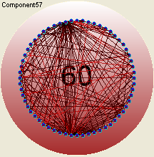
Mutual Dependencies among Objects - Mozilla 1.4.1
Object Oriented Design encourages distribution of behavior among objects.
Delegation can result in an object structure with many connections between objects.
In the worst case, every object ends up knowing about every other.

Slide 60
Quote from A Mozilla Developer…
“Even though some of us used to work on Mozilla, we have to admit that the Mozilla code is a gigantic, bloated mess, not to mention slow, and with an internal API so flamboyantly baroque that frankly we can't even comprehend where to begin…”

Slide 61
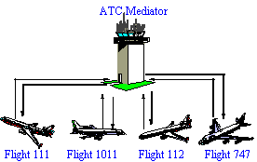

A non-Software Example: ATC

Slide 62

Another Non software example
Master distributes work to identical slaves:
Computes a final result from the results that the slaves return.

Slide 63
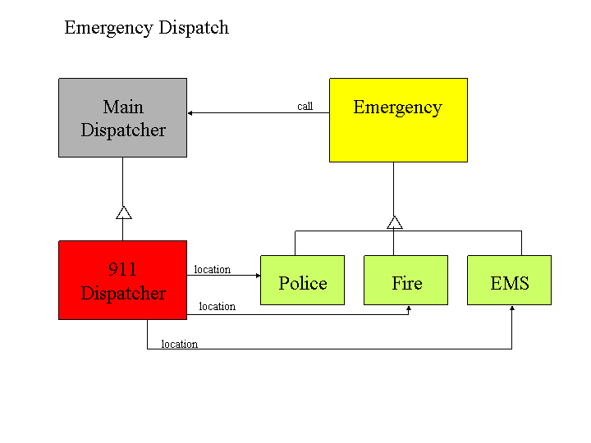
Yet Another Example

Slide 64
Motivation
Object-oriented design leads to distribution of behavior among objects.
Leads to many connections between objects.
Lots of interconnections make it less likely that an object can work without the support of others.
Sometimes the interactions between objects becomes so intense, that every object in the system ends up knowing about every other object.

Slide 65
Case for a Mediator!
Unmediated
Collaboration
collaboratorB
1: op1()
2.1: op2()
2: op2()
collaboratorA
collaboratorC
3: op4()
2.2: op3()
collaboratorD
Mediated
Collaboration
collaboratorB
1.1: op1()
1.5: op2()
1: op()
1.2: op2()
collaboratorA
mediator
collaboratorC
1.3: op3()
1.4: op4()
collaboratorD

Slide 66
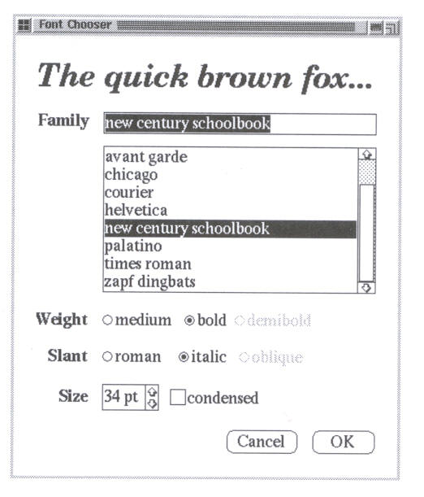
Example- User Interface
The quick brown fox

Slide 67
Font Editing: Mediator Pattern
Client
director
ListBox
director
FormDialog
Director
list
Button
button
field
Entry
Field
director
director

Slide 68
Contrast: Example Coupling Among Classes Without Mediator
Special
ListBox
list
list
button
field
Special
Button
Special
Entry Field
button
field

Slide 69
Font Editing: Mediator Pattern
FormDialogDirector acts as the mediator between the widgets in the dialog box.
It knows the widgets in a dialog and coordinates their interaction.
It acts as a hub of communications for widgets.

Slide 70
Mediator Sequence Diagram
aFormDialog
Director
aClient
anEntry
Field
ShowDialog()
aListBox
aButton
Widget
Changed()
Get
Selection()
SetText()
EnableButton()

Slide 71
Font Editing: Mediator Structure
DialogDirector
ShowDialog()
CreateWidgets()
WidgetChanged(w)
director
Widget
Changed()
Director.
WidgetChanged(this)
ListBox
GetSelection()
FormDialogDirector
CreateWidgets()
WidgetChanged(w)
list
EntryField
SetText()
field

Slide 72
Font Editing: Mediator Pattern
DialogDirector:
An abstract class that defines the overall behavior of a dialog.
Clients call the ShowDialog operation to display the dialog on the screen.
CreateWidgets:
An abstract operation for creating the widgets of a dialog.
WidgetChanged:
Another abstract operation, widgets call it to inform their director that they have changed.
DialogDirector subclasses:
Override CreateWidgets to create the proper widgets, and they override WidgetChanged to handle the changes.

Slide 73
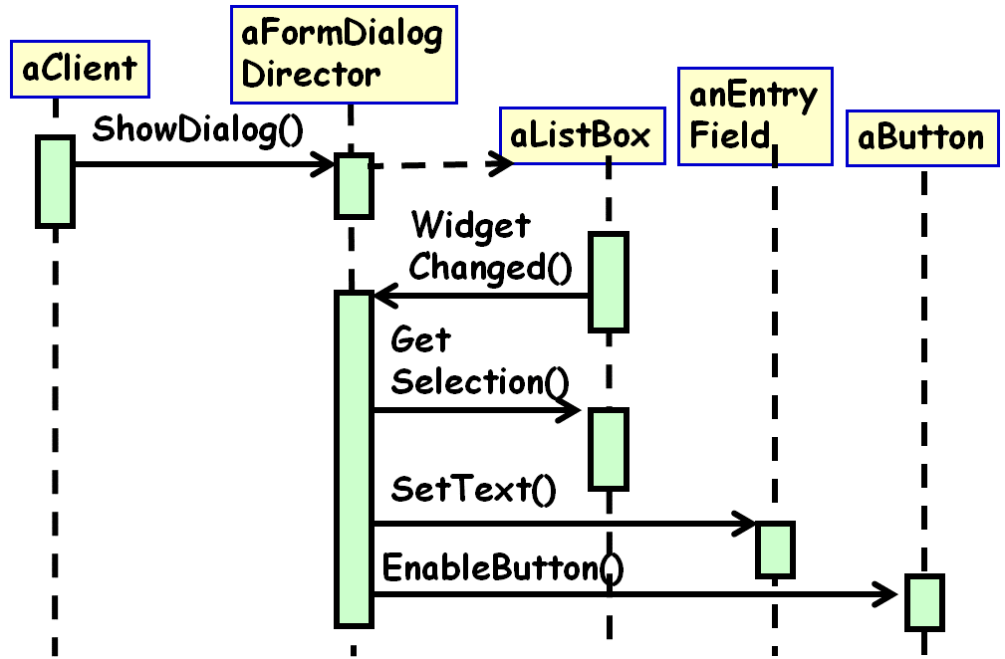
Font Editing Example -Steps
List box informs its director that it’s changed.
Director gets the selection from the list box.
Director passes the selection to the entry field.
Selected font is displayed.

Slide 74
Font Editing Example: Relationship
DialogDirector is an abstract class:
Defines the overall behavior of a dialog.
Clients call ShowDialog()
CreateWidgets():
Abstract operation for creating widgets.

Slide 75
Sample Java Code
class FontDialogBox extends Mediator{
private Button ok; private List fontList; private TextField fontName;
private CheckBox latino; private CheckBox latin2; //...more
public FontDialogBox(){
fontList = new ListBox(this);
fontName = new TextField(this);
//...
}
public void display(){
fontList.display();
fontName.display(); //...
}
public void colleagueChanged(Colleague c){
if( c==fontList)
//font_list …
else if(c==fontName)
//fontName...
else if……
}
}
}

Slide 76
Mediator
Encapsulates how a set of objects communicate:
Defines an interface for communicating with Colleague objects
Mediator encapsulates the communication.
Mediator promotes loose coupling:
The objects only know the Mediator
Keeps objects from referring to each other explicitly.

Slide 77
Mediator Pattern: General Structure
Mediator
mediator
Colleague
Concrete
Mediator
Concrete
ColleagueA
Concrete
ColleagueB

Slide 78
Mediator Pattern Participants
Mediator
defines an interface for communicating with Colleague objects.
ConcreteMediator
Implements cooperative behavior by coordinating Colleague objects.
Colleague classes
Each colleague knows its mediator
Each colleague communicates with its Mediator only, it would have otherwise communicated with another colleague

Slide 79
Mediator Pattern Collaborations
Colleagues send and receive requests from a Mediator object.
The Mediator facilitates cooperative behavior:
Routes requests between the appropriate colleagues
Implements a set of rules for message communication.

Slide 80
Mediator: Collaboration
Colleague
OurMediator
Mediator
Colleague
OurMediator
Colleague
OurMediator
Provides a common connection point, centralized behavior management, all with a common interface

Slide 81
Good Points about the Mediator
Centralizes control
Less chance of miscommunication.
Simplifies object protocols
Replaces many-to-many interactions with one-to-many interactions between mediator and colleagues
simple to understand, maintain and extend.
Abstracts how objects cooperate
Makes it easier to understand the objects in the system, how they interact and how they are structured.
Loose coupling between colleagues promotes Reusability…

Slide 82
Good Points
Limits effects of changes
Localizes behavior that would be otherwise distributed among many objects
Changes in behavior require changing only the Mediator class
Decouples colleagues
Colleagues become more reusable.

Slide 83
Bad Points about the Mediator
Overloaded Mediator:
Numerous subclasses of the Mediator and subclasses of those Mediator subclasses... It's just a horrible cycle from this point on…
Inefficiency:
If there are a relatively small group of objects, it may waste more time as compared to speaking to each other directly.
Might not be a good idea for a relatively small group of objects.

Slide 84
Bad Points cont…
Centralizes control:
Mediator can become very complex
With complex interactions, extensibility and maintainability may suffer.

Slide 85
Generic Example: Multiple Mediators
<<Interface>>
IMediator
<<Interface>>
IColleague
+ ColleagueList: List<IColleague>
-mediator
+ RecieveMessage()
+ SendMessage(IMediator)
+ DistributeMessage(IColleague)
+ Register(IColleague)
ConcreteMediator
ConcreteColleague
+ DistributeMessage(IColleague)
for each c in ColleagueList
if c is not parameter Colleague
//don’t send message to the sender
c.RecieveMessage
+ Register(IColleague)
colleagueListAdd(Colleague)
+ RecieveMessage()
+ SendMessage(IMediator)
mediator.DistributeMessage(this)

Slide 86
class MediatorApplicationProgram{
static void main(string[] args) {
//list of participants
IColleague colleagueA = new ConcreteColleague("ColleagueA");
IColleague colleagueB = new ConcreteColleague("ColleagueB");
IColleague colleagueC = new ConcreteColleague("ColleagueC");
IColleague colleagueD = new ConcreteColleague("ColleagueD");
//first mediator
IMediator mediator1 = new ConcreteMediator();
//participants registers to the mediator
mediator1.Register(colleagueA);
mediator1.Register(colleagueB);
mediator1.Register(colleagueC);
//participantA sends out a message
colleagueA.SendMessage(mediator1, "MessageX from ColleagueA");
Cont…

Slide 87
//second mediator
IMediator mediator2=new ConcreteMediator();
//participants registers to the mediator
mediator2.Register(colleagueB);
mediator2.Register(colleagueD);
//participantB sends out a message
colleagueB.SendMessage(mediator2, "MessageY from ColleagueB");
}
}

Slide 88
public interface IColleague{
void SendMessage(IMediator mediator, String message);
void ReceiveMessage(String message);
}
public class ConcreteColleague implements IColleague{
private string name;
public ConcreteColleague(string name) {
this.name = name; }
void SendMessage(IMediator mediator, String message) {
mediator.DistributeMessage(this, message); }
void ReceiveMessage(String message) {
Console.WriteLine(this.name + " received " + message);
}
}

Slide 89
public interface IMediator{
void DistributeMessage(IColleague sender, String message);
void Register(IColleague colleague);
}

Slide 90
public class ConcreteMediator implements IMediator{
private List<icolleague> colleagueList = new List<icolleague>();
void Register(IColleague<t> colleague) {
colleagueList.Add(colleague);
}
void DistributeMessage(IColleague sender, String message){
foreach (IColleague c in colleagueList)
if (c != sender)
//don't need to send message to sender
c.ReceiveMessage(message);
}
}

Slide 91
Related Patterns
Façade
Mediator defines bi-directional interaction but not façade.
Facade objects make requests to the subsystem classes but not vice versa.

Slide 92
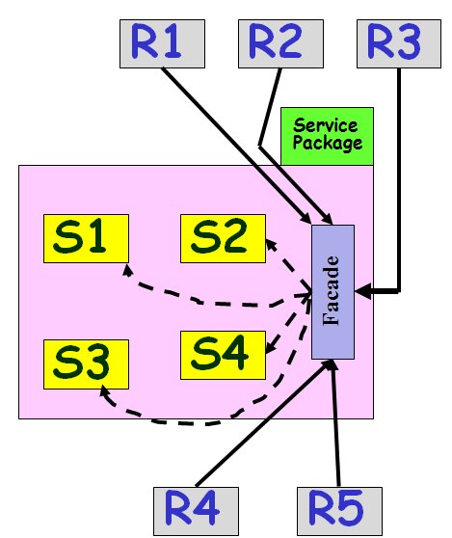
Façade Pattern

Slide 93
Factory Patterns

Slide 94
Pattern Taxonomy
Pattern
Creational
Pattern
Structural
Pattern
Behavioral
Pattern
Factory
Factory
Singleton
Command
Mediator
Observer
Strategy
Strategy
Adapter
Bridge
Facade
Proxy

Slide 95
Factory Patterns
Creational patterns:
Make it easier to construct complex objects
Hide complexity of creation and eliminate repetitive code.
Easy to extend (Open for extension)
Class creational pattern:
Makes use of inheritance to decide the object to be instantiated
Factory method pattern
Object creational pattern:
Concerns delegation of object instantiation to another object
Abstract factory

Slide 96
“New” is Closed for Modification
Use of new operator to directly instantiate a concrete class:
Makes the program closed for modification
That may be fine when things are simple, but . . .
Notes:
96

Slide 97
Factory Rationale
Why use a Factory?
Create new objects without explicitly using the new operator.
Can facilitate instantiation of other newly-derived classes.
Can initialize and configure the created object.
Factories are singletons:
An application typically needs only one instance of a ConcreteFactory per product family.

Slide 98
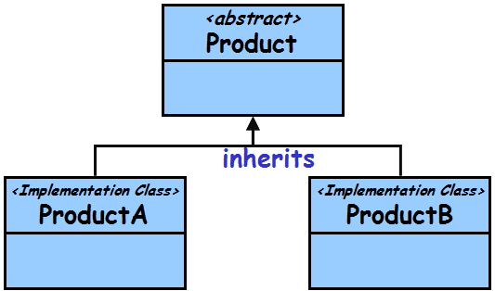
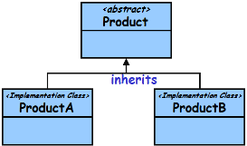
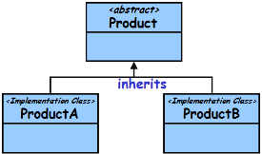

Factory Variations
Three main Variants:
Simple Factory:
Returns an object of a class from a class hierarchy
Factory Method pattern:
Produces objects of one type
Uses an overridable method to create its objects
Subclassed to make new kinds of factories
Abstract Factory pattern:
Produces objects of many different types (families)

Slide 99
Simple Factory Pattern
Factory:
A class whose sole job is to easily create and return instances of other classes
Instead of calling a constructor:
Use a static method in a "factory" class
Saves clutter and complexity and improves flexibility
Examples in Java:
Borders: BorderFactory,
key strokes: KeyStroke,
network connections: SocketFactory

Slide 100

How does Simple Factory Work?
<abstract>
Product
<static>
ProductFactory
createProduct(param) : Product
inherits
<Implementation Class>
ProductA
<Implementation Class>
ProductB
Produces different subclasses of Product according to parameters

Slide 101
Pizza orderPizza() {
Pizza pizza = new Pizza(); //Base
pizza.garnish();
pizza.bake();
pizza.cut();
pizza.box();
return pizza;
}
Motivation for Simple Factory
Notes:
101

Slide 102
Pizza orderPizza(String type) {
Pizza pizza;
if (type.equals(“cheese”)) {
pizza = new CheesePizza();
} else if (type.equals(“greek”)) {
pizza = new GreekPizza();
} else if (type.equals(“pepperoni”)){
pizza =new PepperoniPizza(); }
pizza.garnish();
pizza.bake();
pizza.cut();
pizza.box();
return pizza;
}
Notes:
102

Slide 103
Pizza orderPizza(String type) {
Pizza pizza;
if (type.equals(“cheese”)) {
pizza = new CheesePizza();
} else if (type.equals(“greek”)) {
pizza = new GreekPizza();
} else if (type.equals(“pepperoni”)) {
pizza = new PepperoniPizza();
} else if (type.equals(“sausage”)) {
pizza = new SausagePizza();
} else if (type.equals(“veggie”)) {
pizza = new VeggiePizza();
}
pizza.prepare();
pizza.bake();
pizza.cut();
pizza.box();
return pizza;
}
Closed for changes!
Encapsulate
Want to introduce new base pizzas…
Notes:
103

Slide 104
public class SimplePizzaFactory {
public static Pizza createPizza(String type) {
Pizza pizza;
if (type.equals(“cheese”)) {
pizza = new CheesePizza();
} else if (type.equals(“pepperoni”)) {
pizza = new PepperoniPizza();
} else if (type.equals(“sausage”)) {
pizza = new SausagePizza();
} else if (type.equals(“veggie”)) {
pizza = new VeggiePizza(); }
return pizza;
}
}
Motivation for Simple Factory
Now orderPizza() would be tidy
Notes:
104

Slide 105
public class PizzaStore {
SimplePizzaFactory factory;
public Pizza orderPizza(String type) {
Pizza pizza;
pizza = factory.createPizza(type);
pizza.garnish();
pizza.bake();
pizza.cut();
pizza.box();
return pizza;
}
}
No new operator
Notes:
105

Slide 106
Pizza Factory Class Diagram
PizzaStore
PizzaFactory
Pizza
Pepperoni
Veggie
Cheese
A Simple Factory:
Not quite the Factory pattern, later we discuss Factory method abstract PizzaFactory class.
Notes:
106

Slide 107
Simple Factory: An Explanation
Pull out the code that builds the instances, and put it into a separate factory class:
Principle: Identify the aspects of your application that vary and separate them from what stays the same…
Notes:
107

Slide 108
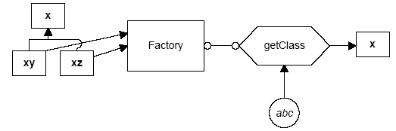
Simple Factory Pattern: Explanation
The simple Factory returns an instance of one of several possible classes depending on the data provided to it.
create
xz
Here, x is a base class:
Classes xy and xz are derived from it.
The Factory class decides which of these subclasses to return depending on the arguments you give it.
The create() method gets value xz, and returns an instance of the class xz.
Which one it returns doesn't matter to the programmer since they are all of type X, but different implementations.

Slide 109
Simple Factory Pattern
Client
orderProduct()
SimpleFactory
createProduct()
<<abstract>>
Product
productMethod()
ConcreteProductA
ConcreteProductB
ConcreteProductC
Notes:
109

Slide 110
Why Would We do This?
Two main reasons:
Ensure consistent object initialization when multiple clients need the same types of objects.
Open for modification
Notes:
110

Slide 111
Case for Simple Factory: 2 Examples
Code to construct many GUI components:
homestarItem = new JMenuItem("Homestar Runner");
homestarItem.addActionListener(this);
viewMenu.add(homestarItem);
crapItem = new JMenuItem("Crappy");
crapItem.addActionListener(this);
viewMenu.add(crapItem);
Another example (with buttons):
button1 = new JButton();
button1.addActionListener(this);
button1.setBorderPainted(false);
button2 = new JButton();
button2.addActionListener(this);
button2.setBorderPainted(false);

Slide 112
Factory Example 1
public class ButtonFactory {
private ButtonFactory() {}
public static JButton createButton( String text, ActionListener listener, Container panel){
JButton button = new JButton(text);
button.setMnemonic(text.charAt(0));
button.addActionListener(listener);
panel.add(button);
return button;
}
}

Slide 113
Simple Factory Advantages…
Creation of buttons etc. by an application object:
Avoids significant duplication of code.
Makes the client class work at a suitable level of abstraction as these may not be part of the composing object's concerns.

Slide 114
public class SimplePizzaFactory {
public static Pizza createPizza(String type) {
Pizza pizza;
if (type.equals(“cheese”)) {
pizza = new CheesePizza();
} else if (type.equals(“pepperoni”)) {
pizza = new PepperoniPizza();
} else if (type.equals(“sausage”)) {
pizza = new SausagePizza();
} else if (type.equals(“veggie”)) {
pizza = new VeggiePizza(); }
return pizza;
}
}
Draw Class Diagram for Simple Factory
Notes:
114

Slide 115
Simple Factory
Shortcomings?
Step 1
Child
Class A
Step 2
<<create>>
Client
Simple Factory
Child
Class B
Parent class --
Interface
<<create>>
<<create>>
Child
Class C
Step 3

